Slide 1



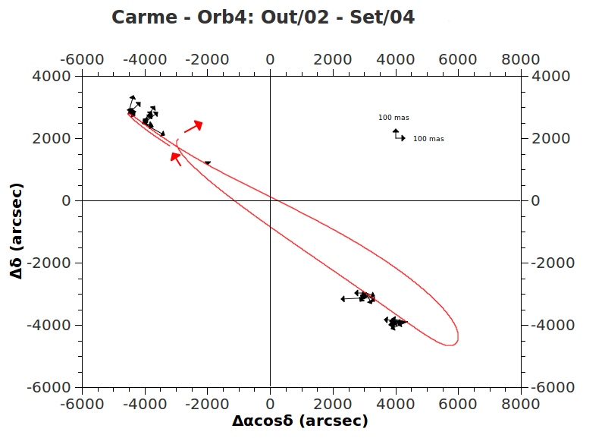




Astrometric positions for the irregular satellites
of the Giant Planets
Altair Ramos Gomes Júnior¹, Marcelo Assafin¹, Roberto Vieira Martins², Júlio I. B. Camargo², Gustavo B. Rossi², Alex Dias Oliveira², Felipe Braga-Ribas²
1-OV/UFRJ; 2-ON/MCT; 3-UEZO
The irregular satellites of the giant planets, mainly from Jupiter and Saturn, are much smaller than the regular ones. They have irregular shapes and their orbits are more eccentric with larger semi-major axes. Some of them have retrograde orbits. Explaining their existence is an interesting study in orbital dynamics. It's generally accepted that, due to their orbital configuration, they were captured by their planets. Stellar occultations are a method that would allow us to know better their physical features (size, shape, density) since they are not visited, at the moment, by any spacecraft. But their orbits are known with little precision, which is bad to obtain a good prediction for an occultation.
Irregular Satellites of Jupiter e Saturn
Distance to the Planet (Millions of km)
Distance to the Planet (Millions of km)
In this work, we aimed at organizing and reducing CCD images of the Jovian and Saturnian Irregular Satellites observed at the Observatório do Pico dos Dias (1.60 and 0.6m telescopes), at the Observatoire Haute-Provence (1.2m telescope) and at ESO (2.2m telescope). The observational data from these three observatories comprise more than 100,000 images. The reduction of this considerable amount of images with the necessary accuracy in position was only possible with the use of PRAIA. First, we eliminate discrepant positions night by night using a sigma-clip procedure. Then, we analyze the differences between the observed and ephemeris positions of the satellites to better constrain the origin of systematic differences and properly provide corrections to the orbits of the satellites. The projection of the orbits on the sky, along with vectors representing systematic effects on positions (see graphic below), clearly shows how this work contribute to a better determination of the orbits of the satellites .
Database: comparison between OPD, OHP and ESO
PRAIA - Package for the Reduction of Astronomical Images Automatically
 | OHP | OPD |  |  |  | ESO
Telescope | 1.2m | 1.6m | IAG (0,6m) | Zeiss (0,6m) | Total | 2.2m
Images | 27.963 | 30.380 | 50.240 | 7.979 | 88.599 | 1528
Nights | 354 | 196 | 254 | 30 | 480 | 24
Filters | Clear | Clear, Methane, B, V, R, I |  |  |  | I
Period | 1997 - 2008 | 1992-2012 |  |  |  | 2007-2009
Object detection
on field
Measuring (x,y)
centroids
Parameters’
configuration
Automatic reference star
identification
PRAIA
(α,δ) Reductions with
UCAC4 and 2MASS
PSF photometry
Statistics by satellite/observatory
Header
extraction
of fits files
 | Mag | OPD | OHP | ESO | OPD+OHP+ESO | Horizons*
Ananke | 18.8 | 70 | 156 | 70 | 296 | 600
Callirrhoe | 20.6 | 9 | 4 | 20 | 33 | 95
Carme | 17.8 | 106 | 222 | 37 | 365 | 973
Elara | 16.6 | 486 | 203 | 52 | 741 | 1115
Himalia | 14.6 | 900 | 401 | 25 | 1326 | 1757
Leda | 20.1 | 15 | 54 | 55 | 124 | 178
Lysithea | 18.3 | 80 | 91 | 106 | 277 | 431
Megaclite | 21.7 |  |  | 11 | 11 | 100
Pasiphae | 16.8 | 329 | 258 | 75 | 662 | 1629
Praxidike | 21.2 |  |  | 3 | 3 | 118
Sinope | 18.2 | 55 | 189 | 11 | 255 | 854
Themisto | 21 |  |  | 20 | 20 | 110
Albiorix | 20.5 |  | 4 | 57 | 61 | 137
Paaliaq | 21.1 |  |  | 14 | 14 | 82
Phoebe | 16.3 | 1365 | 590 | 35 | 1990 | 3479
Siarnaq | 19.9 |  | 29 | 59 | 88 | 239
Sycorax | 20.8 |  |  | 48 | 48 | 474
Nereida | 18.7 | 847 |  | 119 | 966 | 1432
Automatic
Target identification
List of
Targets
Results
* Jacobson, R. A. et al, 2012, The Astronomical Journal
Acknowledgement

