Slide 1
The stellar occultation by Triton in October 5, 2017
Altair Ramos Gomes Júnior
(Observatório do Valongo –
Rio de Janeiro - Brazil)

Slide 2
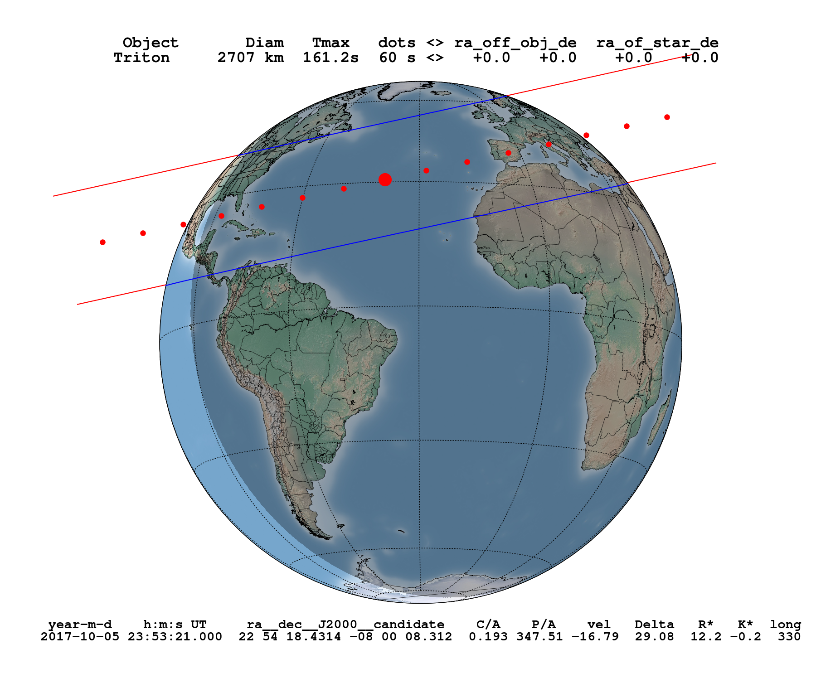

Slide 3
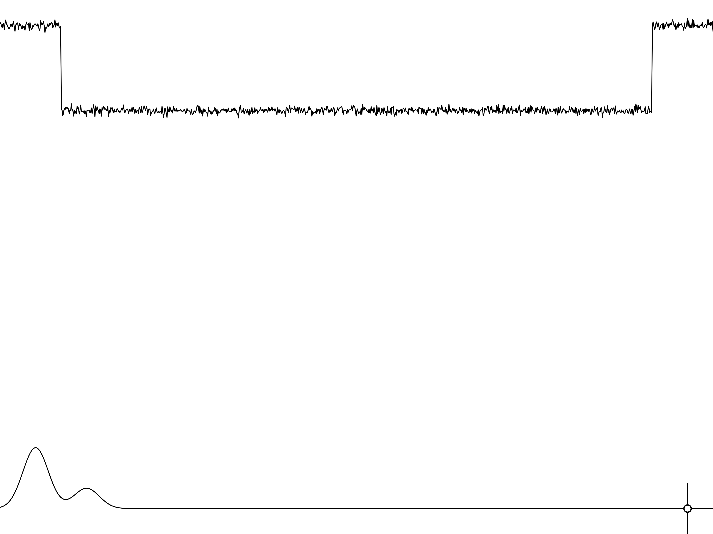
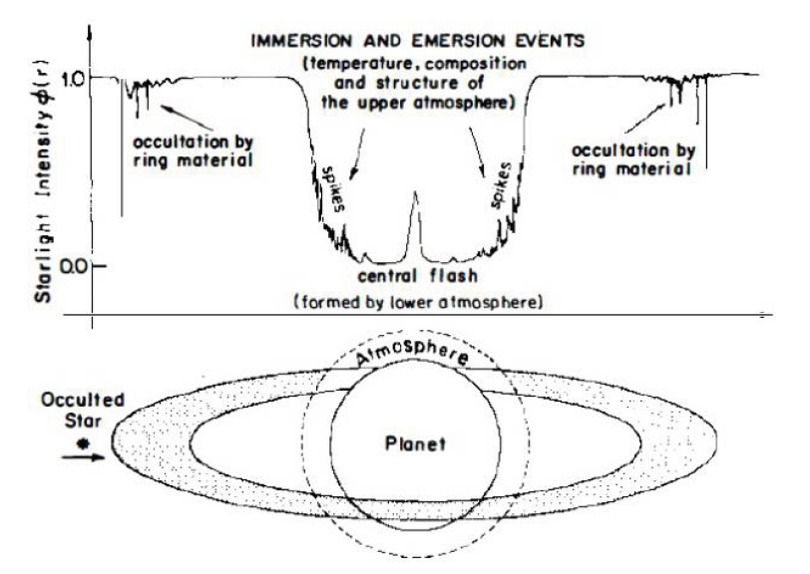
Stellar Occultation
Elliot et al, 1979
Notes:
Anéis
Atmosfera (refração)
Pico central
Caso não haja atmosfera

Slide 4
Stellar Occultation Prediction
Star: GAIA;
Ephemeris:
  NEP081, Emelyanov (2015).
  New numerical integration using new positions;
    Reduction of more than 5000 observations from Itajubá – Brazil.

Slide 5
ASTROMETRY

Slide 6
Reduction
More than 5000 observations in the Observatório do Pico dos Dias – Itajubá – BR.
~4000 with Neptune on the same field.
June, 1995 to September, 2016.
Reduction Process:
  PRAIA
  UCAC4, GAIA and UCAC5

Slide 7
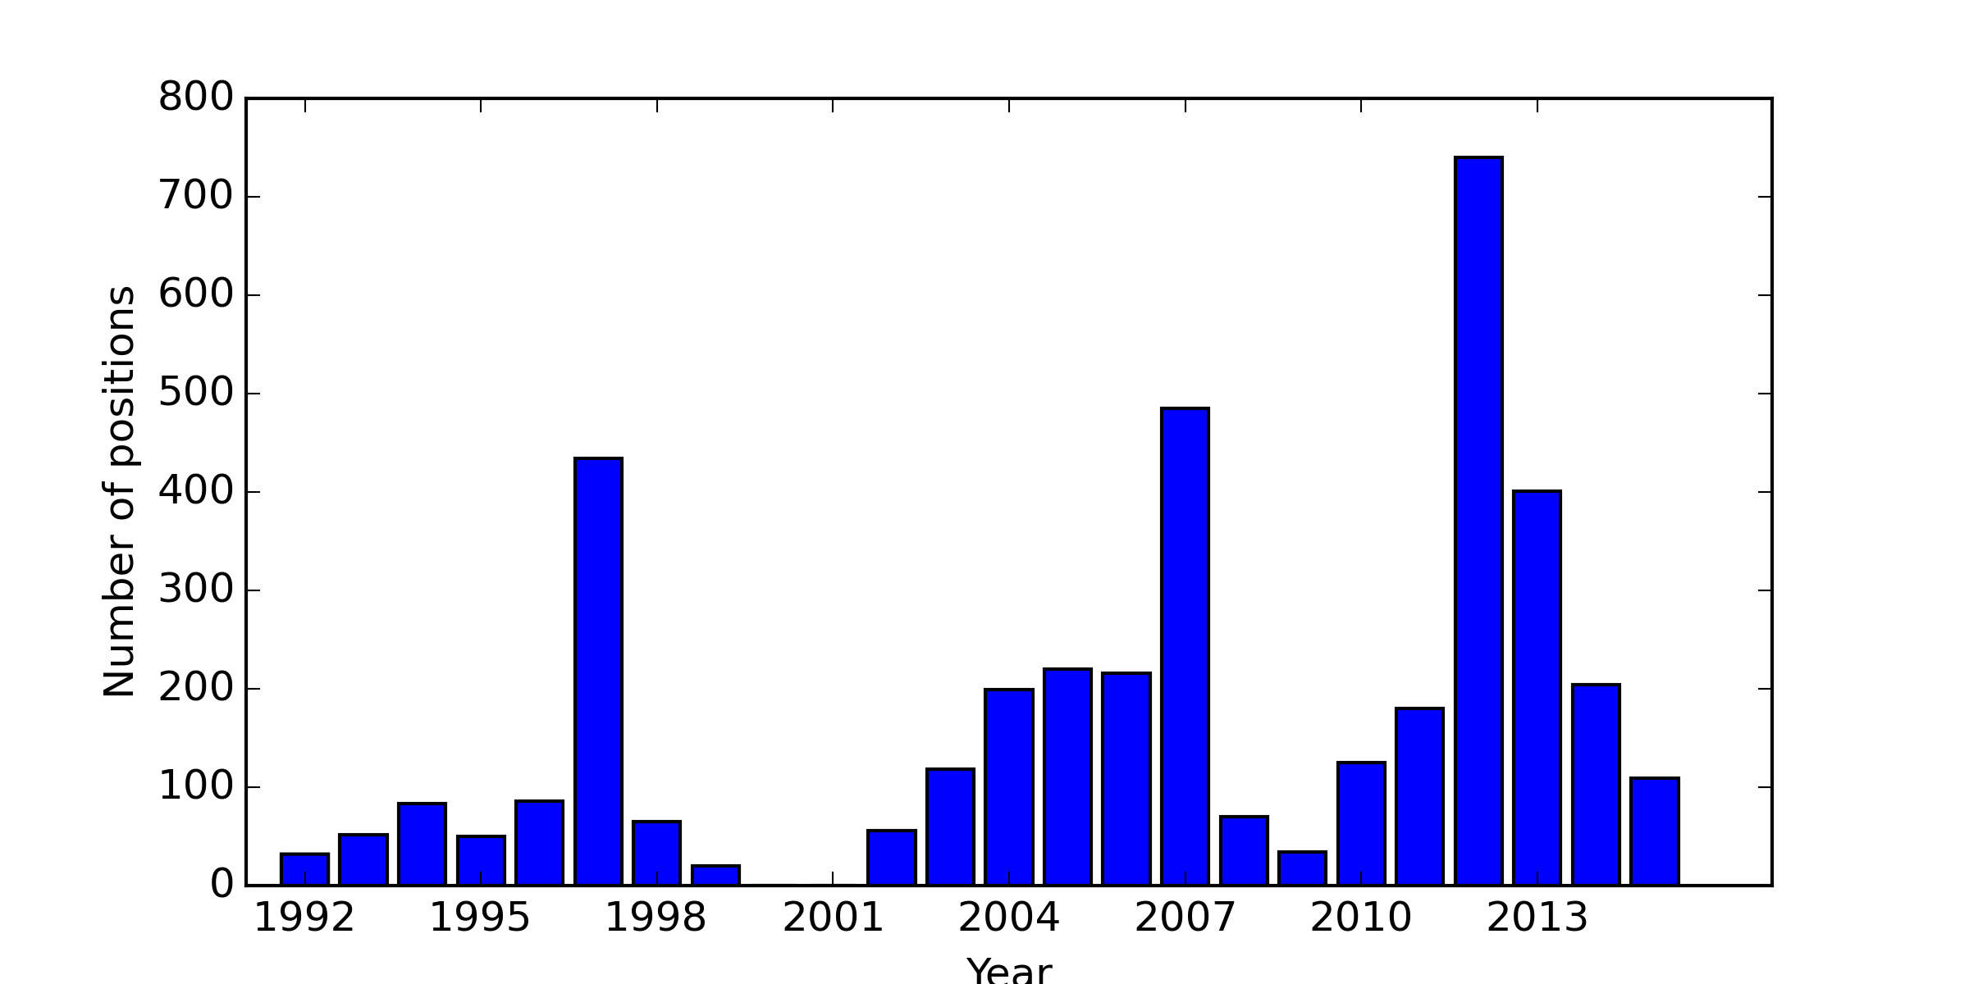
Distribution of positions by time: Triton

Slide 8
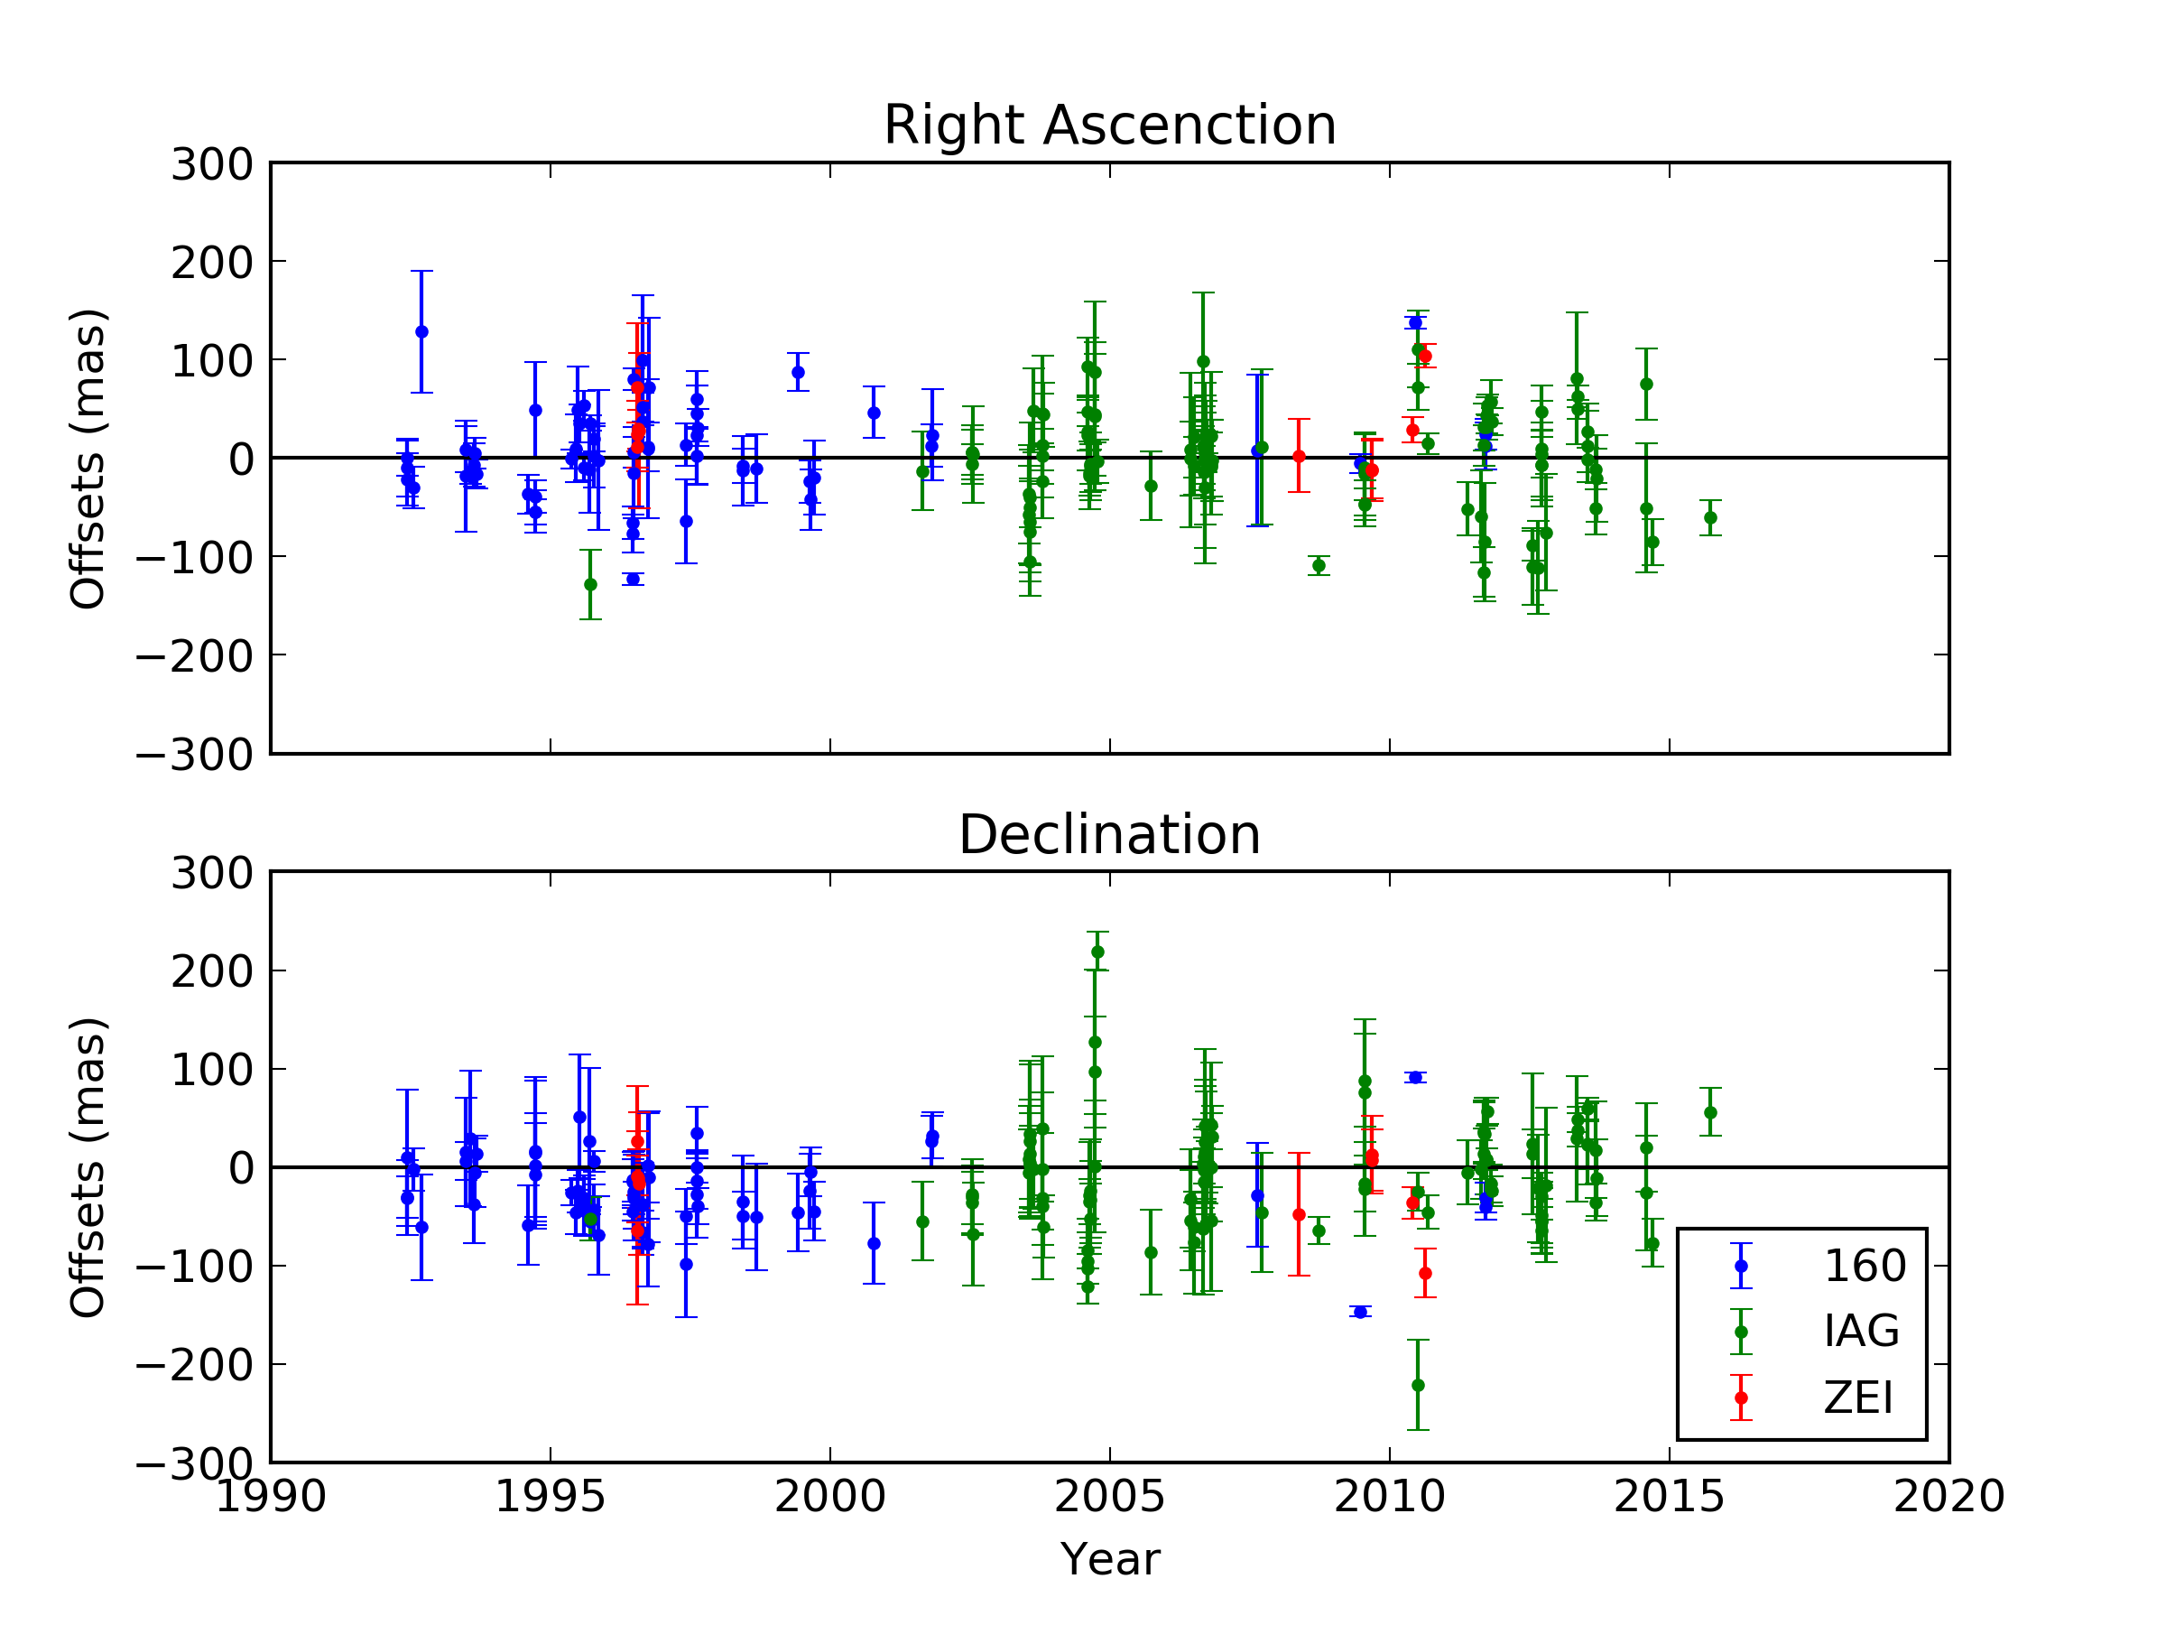
Triton

Slide 9
Astrometry of Neptune
Color: Bluer than field stars;
  Higher Chromatic Refraction
Size: Wider than the seeing (2.1”);
  Would an usual Gaussian PSF be adequate?
  Should the phase angle be considered in the PSF calculation?

Slide 10
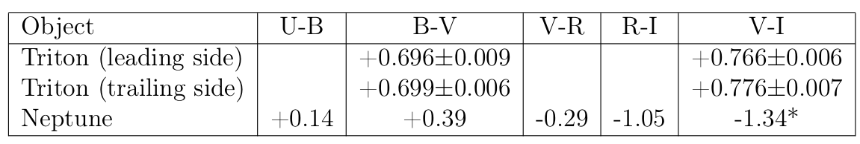
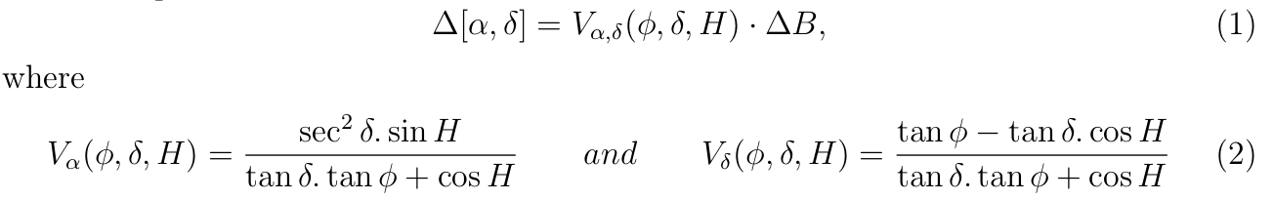
Chromatic Refraction
Schmude et al (2016)
Benedetti-Rossi et al (2016)

Slide 11
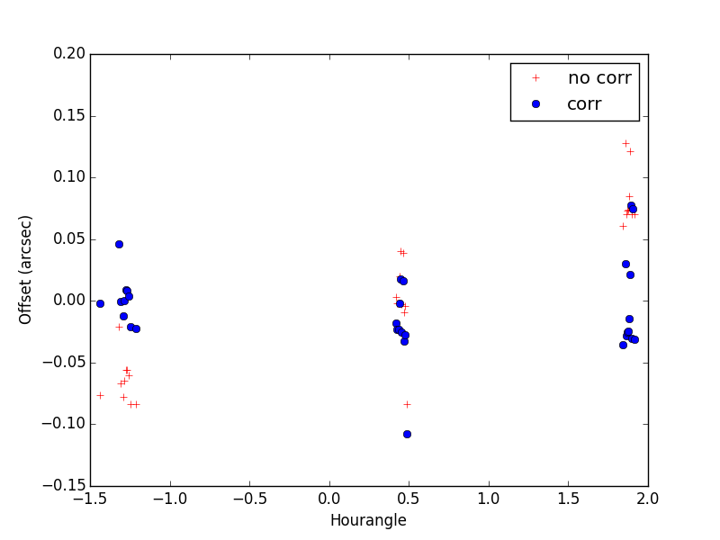
Chromatic Refraction

Slide 12
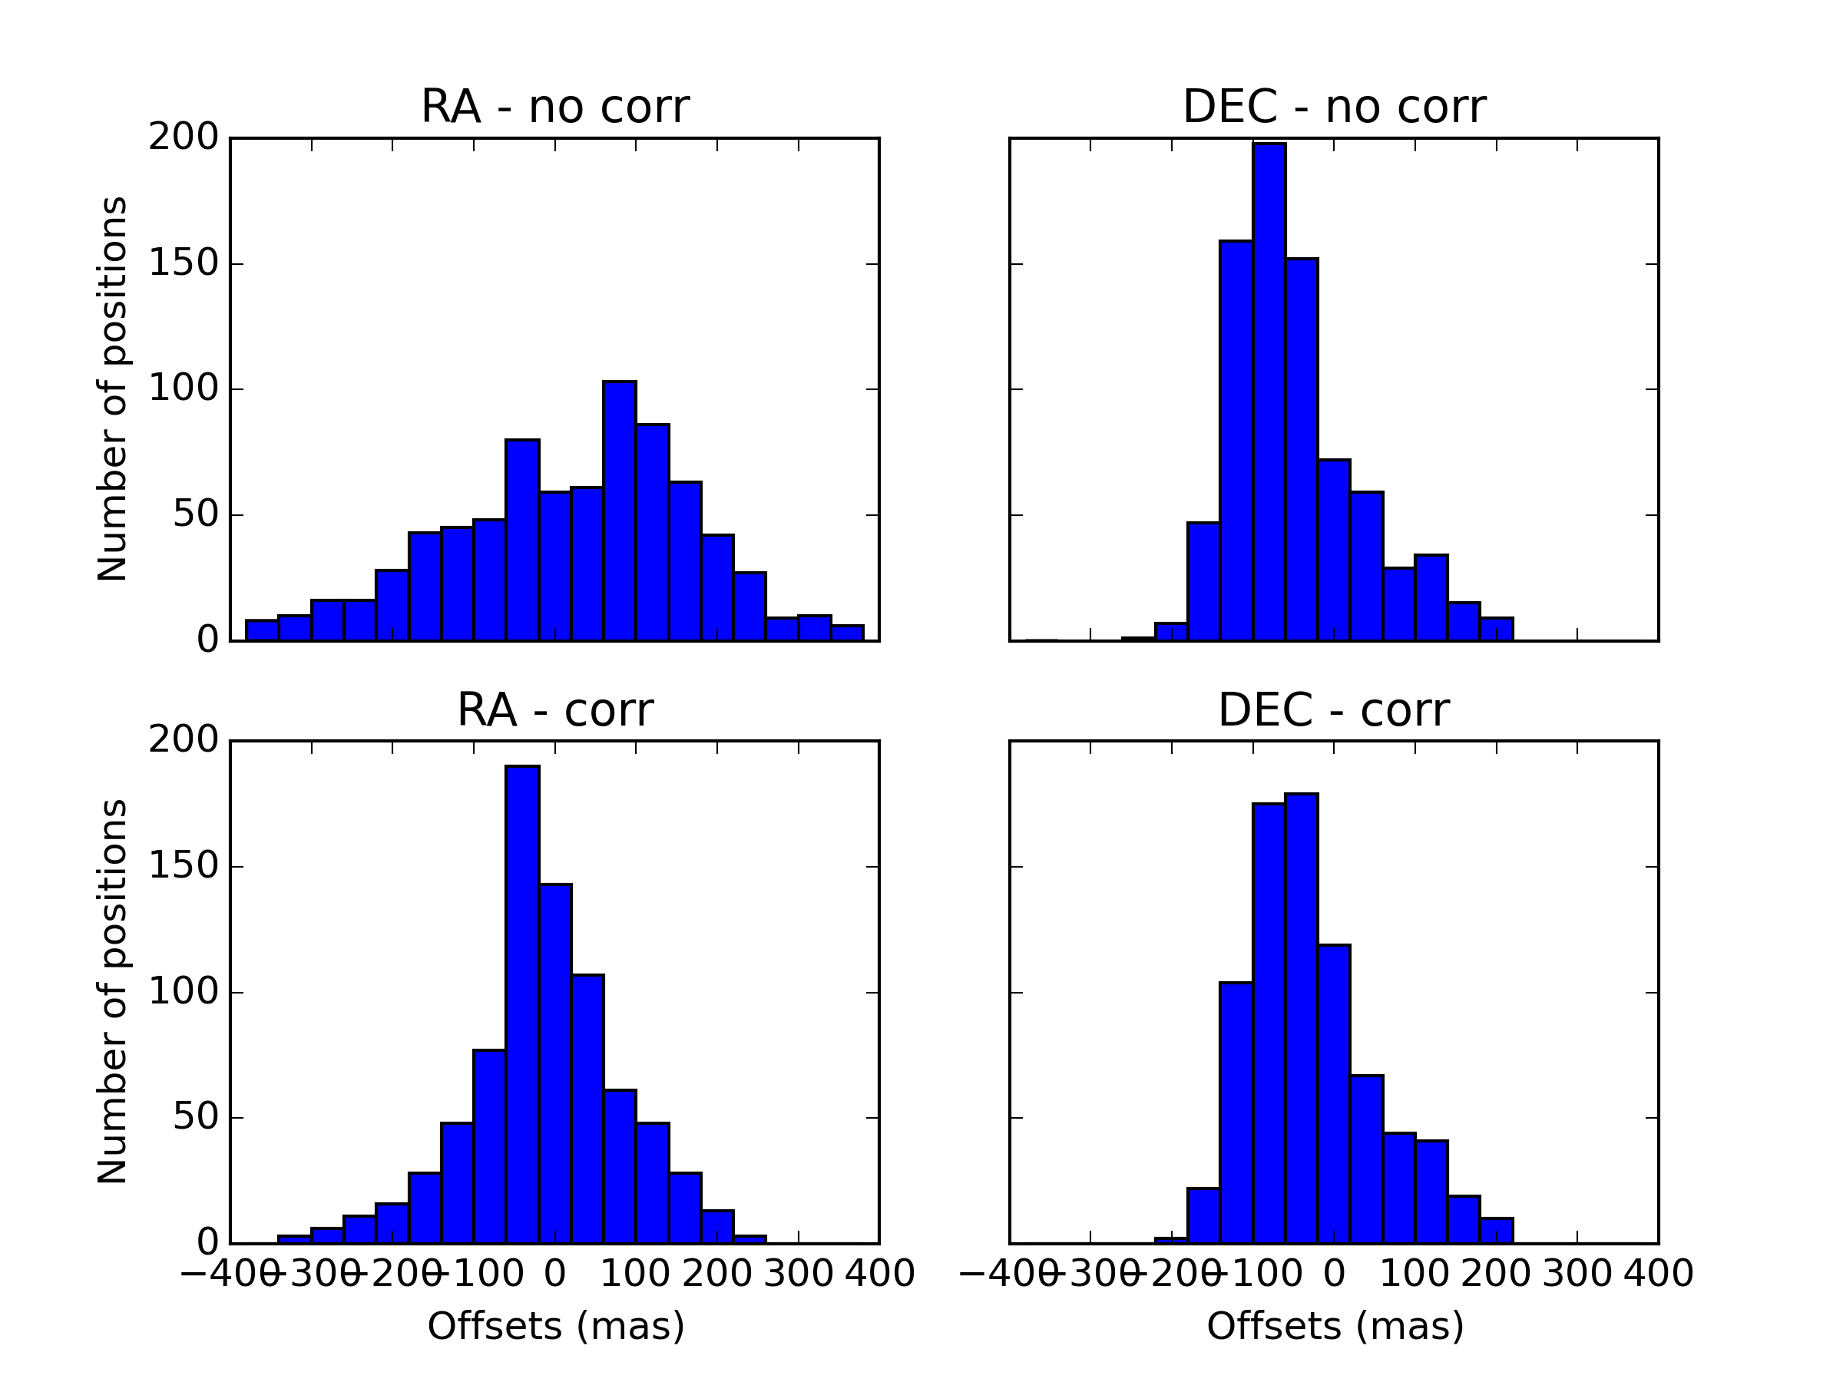
Chromatic Refraction

Slide 13
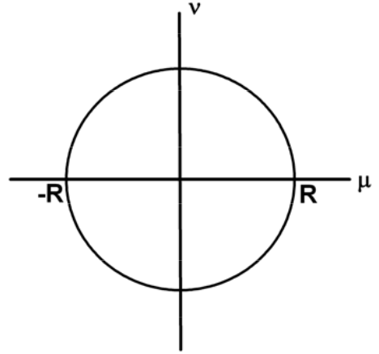
Numerical PSF

Slide 14
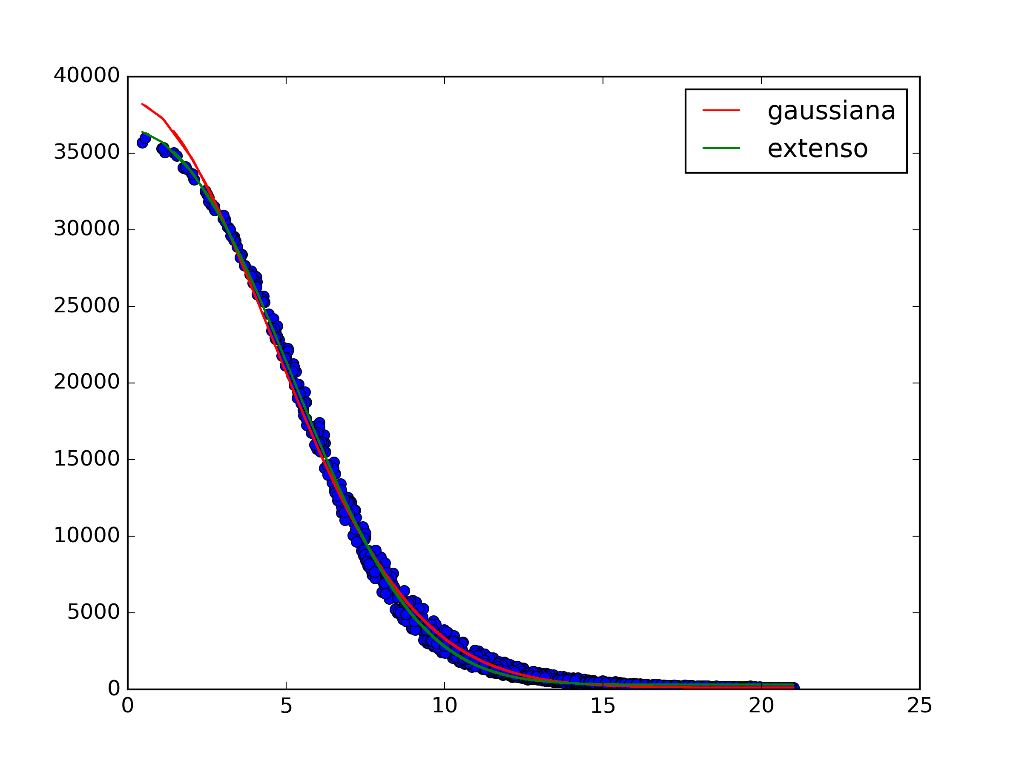
Numerical PSF

Slide 15
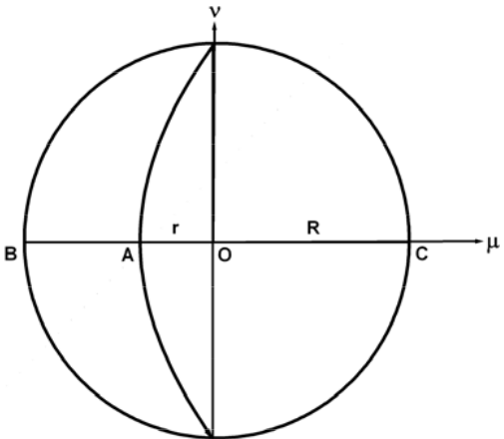
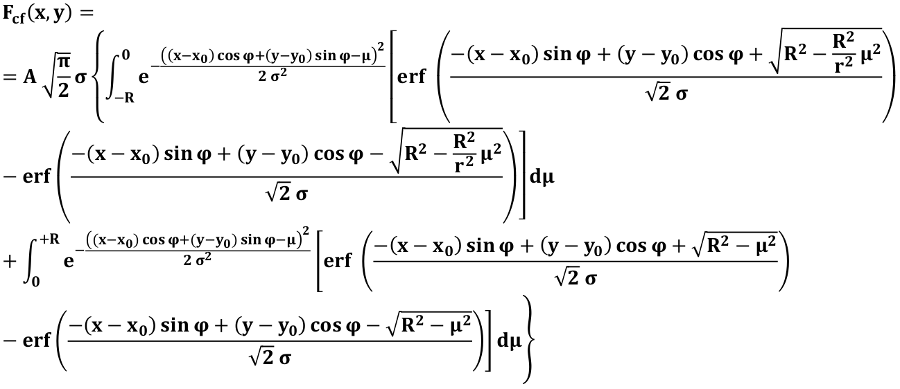
Numerical PSF – Next Step

Slide 16
Next Steps
Re-reduce with GAIA and UCAC5;
Implement the Numerical PSF with phase angle;
Integrate the orbit of Triton using our positions;
Test the prediction of the occultation by predicting an approximation of Triton on a GAIA star.

Slide 17
Thank You

