Slide 1

Predictions of Stellar Occultations by Irregular Satellites up to 2020
Altair Ramos Gomes Júnior
(Observatório do Valongo –
Rio de Janeiro - Brazil)
Phoebe
Source: Cassini

Slide 2

Irregular Satellites
Burns (1986): Satellites are irregular when their orbital planes precess primarily under the influence of torques from the Sun.
Their orbits are eccentric, usually highly inclined and distant from their planets. The direction of their movements can be prograde or retrograde.

Slide 3
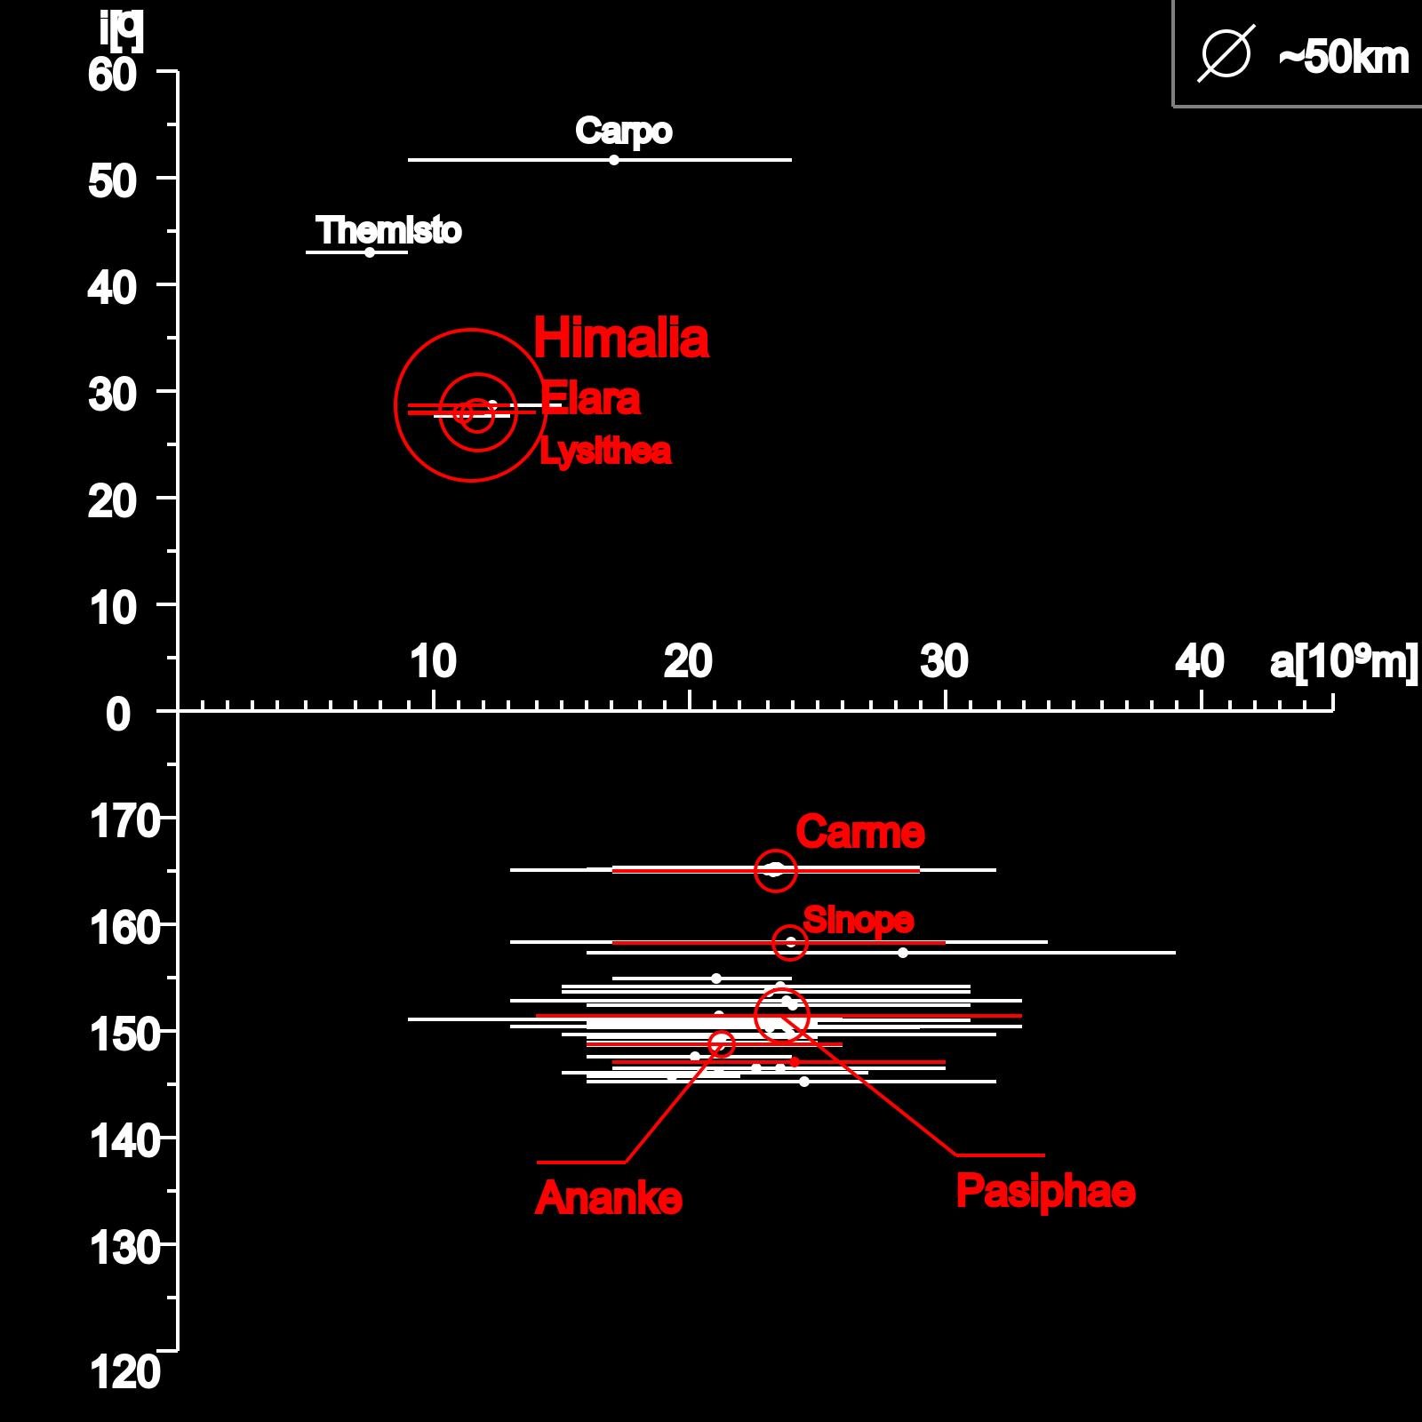
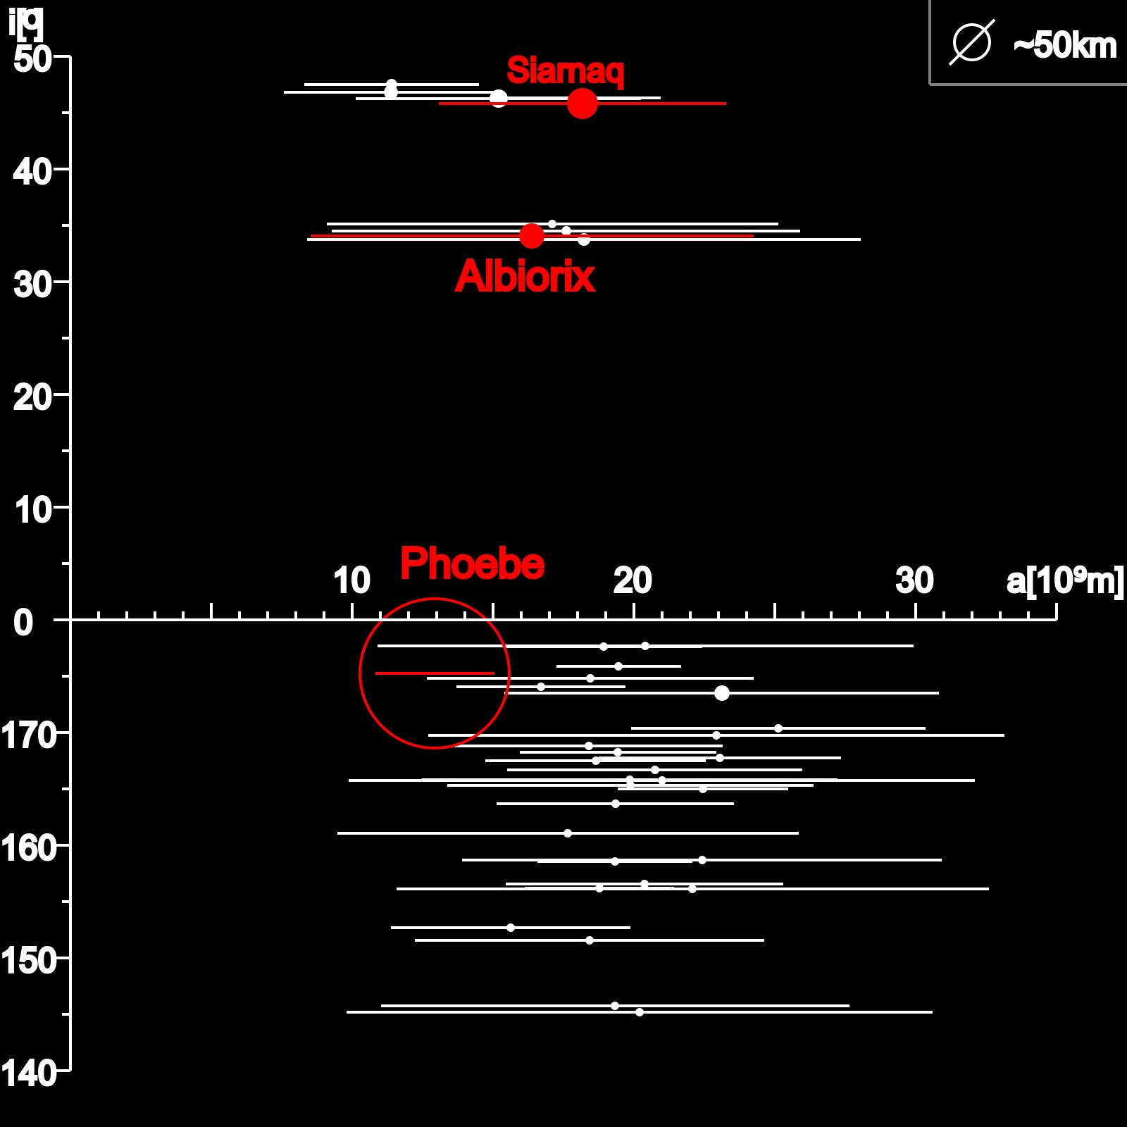
Irregular Satellites
Satellites of Jupiter
Satellites of Saturn

Slide 4
Irregular Satellites
Capture:
  Gas Drag (Cuk & Burns, 2003);
  3-body interation (Nesvorný et al., 2007);
  Collision (Sheppard, 2006).
Orbital Evolution:
  Origin of the orbital family of satellites (Nesvorný et al., 2004);

Slide 5
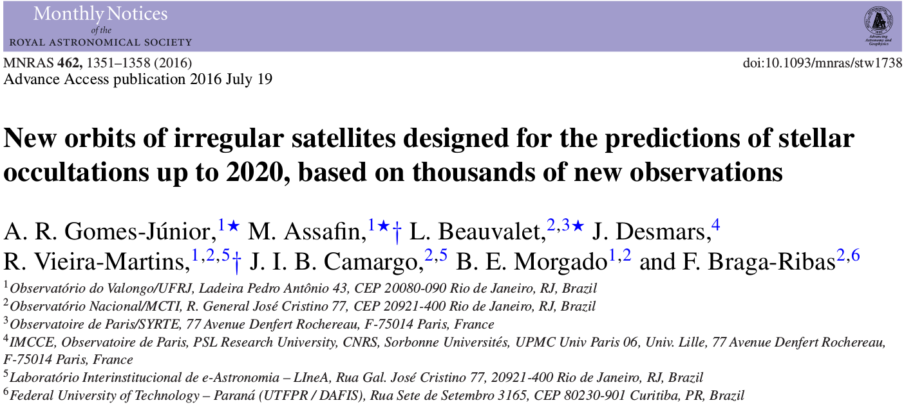
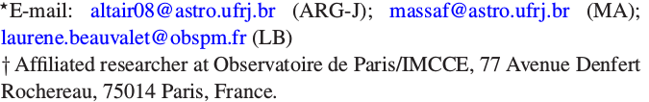
Stellar Occultations of Irregular Satellites

Slide 6
Goal
Predict stellar occultation by irregular satellites to determine:
  Size;
  Shape;
  Albedo;
  Density, if mass known;
  Characterize family of satellites.

Slide 7

Stellar Occultation
Elliot et al, 1979
Notes:
Anéis
Atmosfera (refração)
Pico central
Caso não haja atmosfera

Slide 8

Example: Ceres (2010)
Gomes-Júnior et al. (2015, MNRAS)

Slide 9
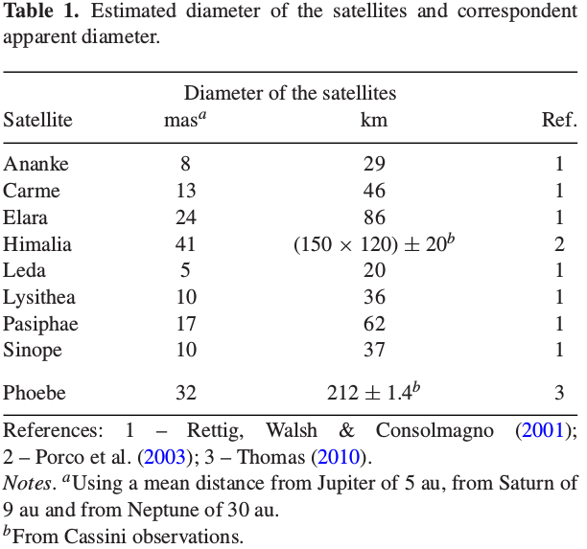
Irregular Satellites
Gomes-Júnior et al. (2016)

Slide 10
Opportunity for Irregular Satellites
Successful experience in stellar occultations by TNOs/Centaurs with Rio team;
Saturn and Jupiter will cross the central side of the Galactic Plane in 2018 and 2019-2020, respectivelly;
Release of the Gaia catalogue (DR1 in September 2016);
Improvement of ephemeris using our positions (Gomes-Júnior, 2015).

Slide 11
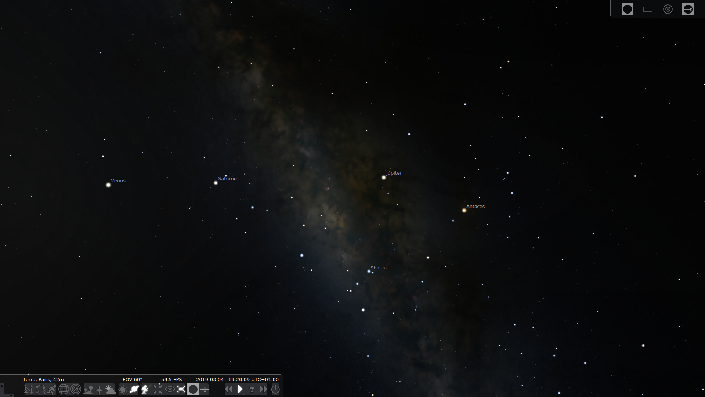
Galactic Plane
The next time that Jupiter will cross the central side of the galactic plane will be in 2031 and Saturn in 2046–2047.

Slide 12
Special Tailored Ephemeris
Ephemeris for the 8 major irregular satellites of Jupiter;
Only using the positions of Gomes-Júnior et al. (2015, A&A);

Slide 13
Ephemeris of Phoebe
Update the ephemeris of Desmars et al. (2013) using the position of Gomes-Júnior et al. (2015, A&A), +75% in the number of obs.

Slide 14
Prediction
Code: PRAIA;
Ephemeris: STE and Phoebe ephemeris;
Star Catalogue: UCAC4;
Number of occultations: 5442 from January 1st, 2016 up to December 31, 2020;
10% with stars brighter than R=14. Potentially observable by amateurs.
25% with stars brighter than R=15.

Slide 15
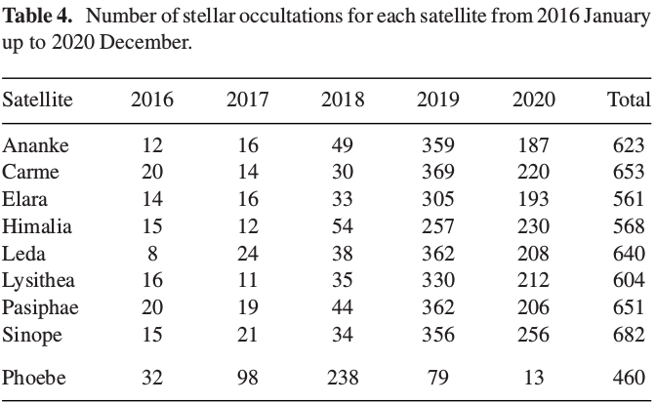
Occultations

Slide 16
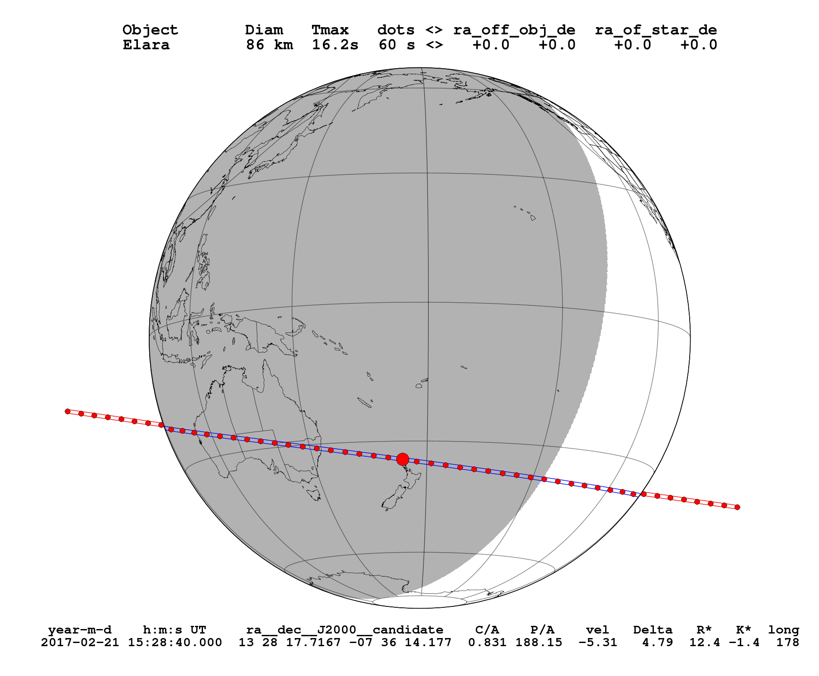
Elara – February 02, 2017

Slide 17
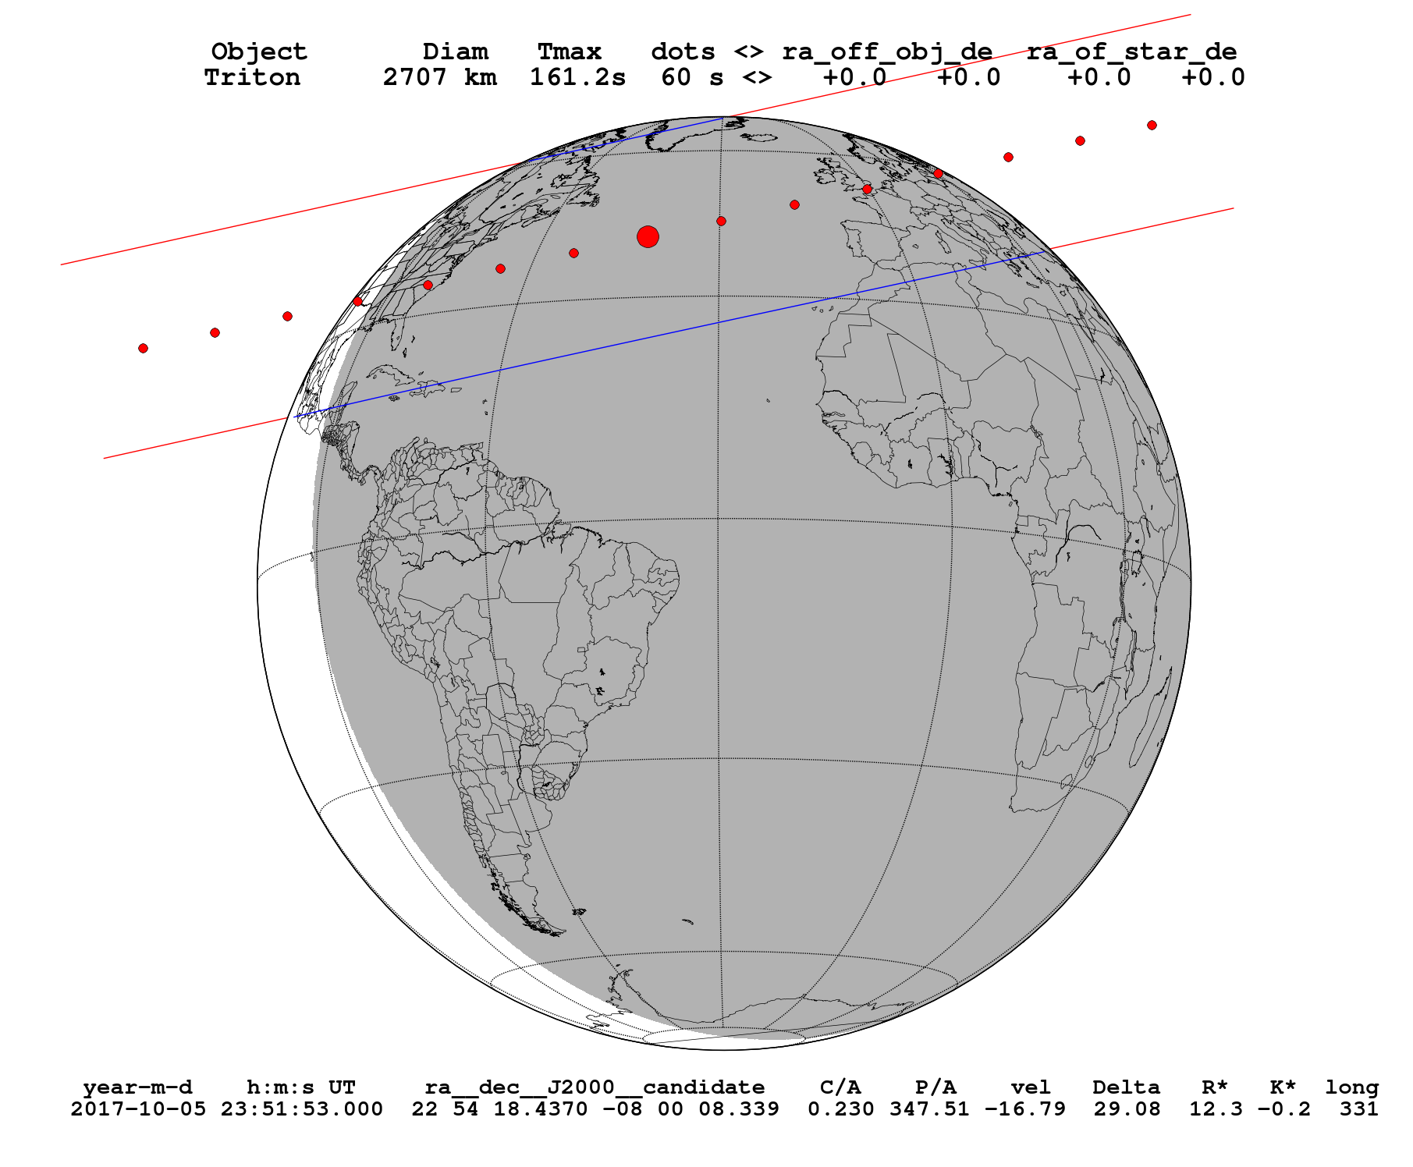
Triton – October 05, 2017

Slide 18
Next Steps
Re-reduce the observations with GAIA catalogue;
Numerical Integration of the orbits of the Irregular Satellites using all positions available;
Update occultation predictions using GAIA;
Observe stellar occultations by these objects.

Slide 19
Thank You

