Slide 1



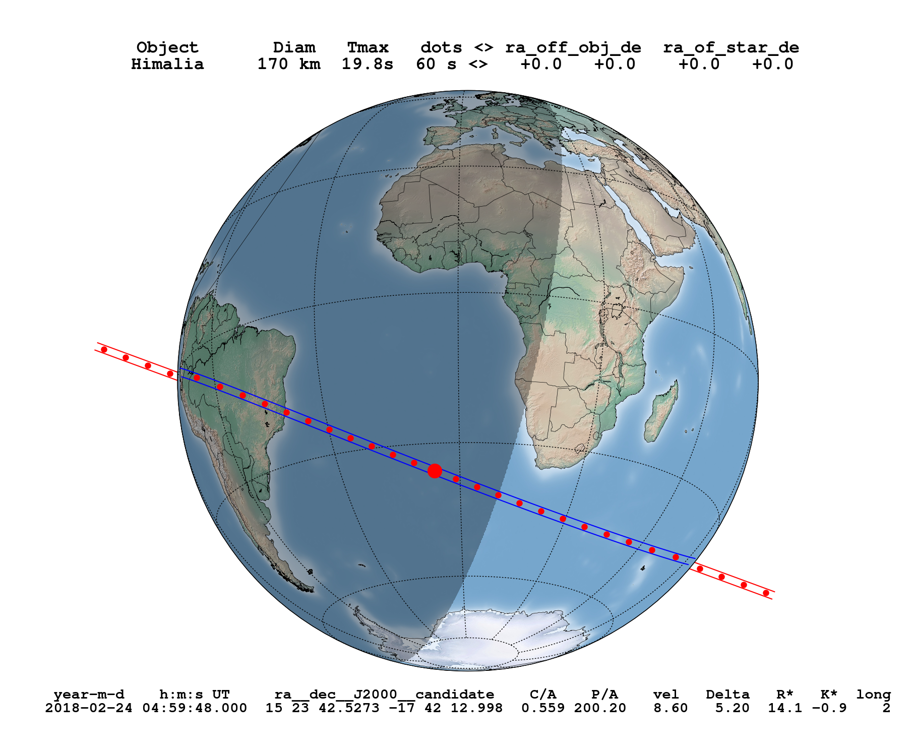
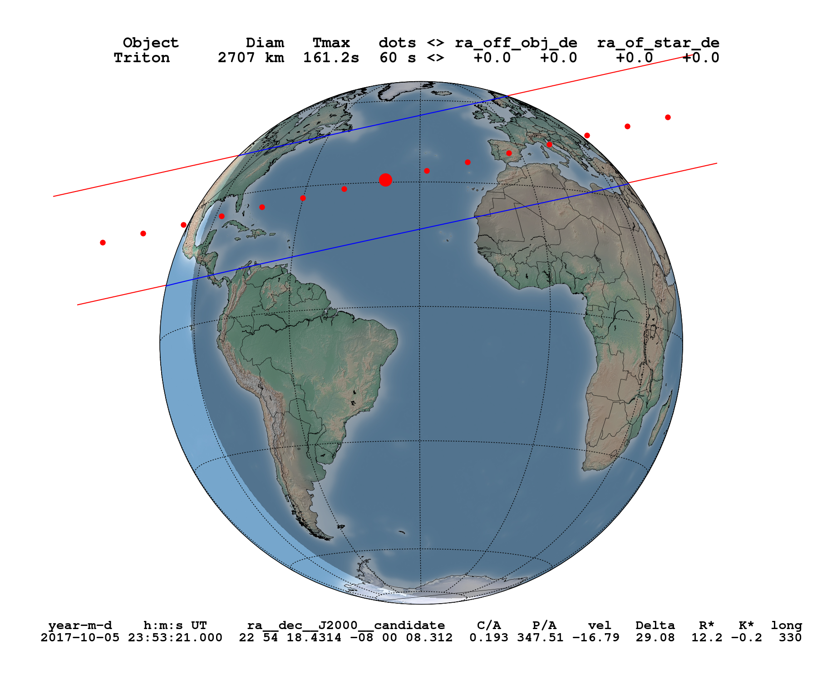




Predictions of Stellar Occultations by Irregular Satellites up to 2020
Altair Ramos Gomes Júnior¹, Marcelo Assafin¹, Laurene Beauvalet^{2,3}, Josselin Desmars³,
Roberto Vieira Martins², Júlio I. B. Camargo², Felipe Braga-Ribas²
1-OV/UFRJ; 2-ON/MCT; 3-OBSPM
The irregular satellites of the giant planets, mainly from Jupiter and Saturn, are much smaller than the regular ones. They have irregular shapes and their orbits are more eccentric with larger semi-major axes. Some of them have retrograde orbits. Explaining their existence is an interesting study in orbital dynamics. It's generally accepted that, due to their orbital configuration, they were captured by their planets. Stellar occultations are a method that would allow us to know better their physical features (size, shape, density) since they are not visited, at the moment, by any spacecraft. But their orbits are known with little precision, which is bad to obtain a good prediction for an occultation.
Irregular Satellites of Jupiter e Saturn
Distance to the Planet (Millions of km)
Distance to the Planet (Millions of km)
In this work, we predicted stellar occultation by the 8 largest irregular satellites of Jupiter (Himalia, Elara, Pasiphae, Carme, Lysithea, Leda, Sinope and Ananke) and the largest irregular satellite of Saturn (Phoebe) up to 2020. In 2019-2020, Jupiter will pass in front of the central side of the Galactic Plane creating the best opportunity to observe stellar occultations due to the large number of stars in the region. The same goes for Saturn in 2018. With the release of Gaia Catalogue, the positions of the stars will have high accuracy and the only source of error in the prediction will be caused by the ephemeris. In order to improve the ephemeris of these 9 satellites, we updated the ephemeris of Desmars et al. (2013) for Phoebe and created a new numerical fit for the Jovian satellites, called STE. The latter was created using only the positions published by Gomes-Júnior et al. (2015) in order to eliminate systematic errors from former ephemeris as shown by the authors. We didn’t use all the positions available in the literature because we don’t need ephemeris for a long time, only up to 2020, and the recovery of all the positions was not worth it.
Number of Occultations predicted (G < 16.5)
Exemple: Occultation by Himalia (Feb 24, 2018)
Satellite | 2017 | 2018 | 2019 | 2020 | Total
Ananke | 16 | 44 | 359 | 187 | 606
Carme | 16 | 33 | 369 | 235 | 653
Elara | 17 | 39 | 305 | 193 | 554
Himalia | 13 | 55 | 380 | 222 | 670
Leda | 24 | 51 | 536 | 207 | 818
Lysithea | 10 | 35 | 414 | 221 | 680
Pasiphae | 20 | 44 | 522 | 226 | 812
Sinope | 21 | 45 | 491 | 279 | 836
Phoebe | 234 | 274 | 78 | 15 | 601
Exemple: Occultation by Triton (Oct 10, 2017)
Acknowledgement

