Slide 1

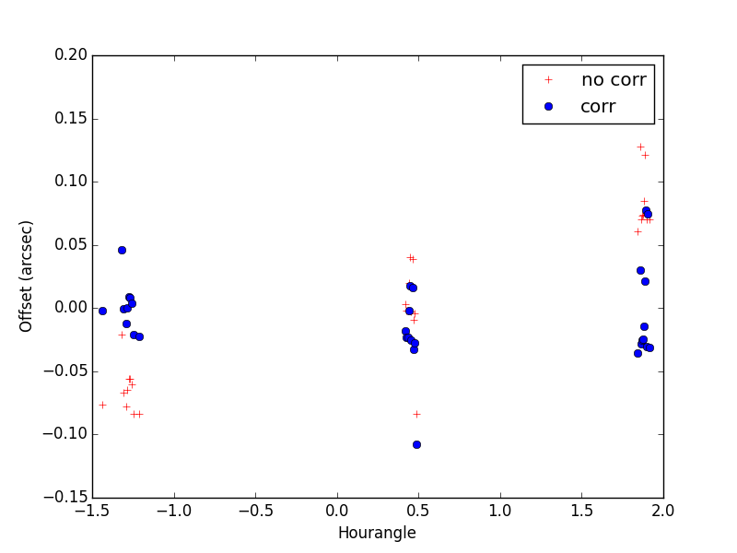
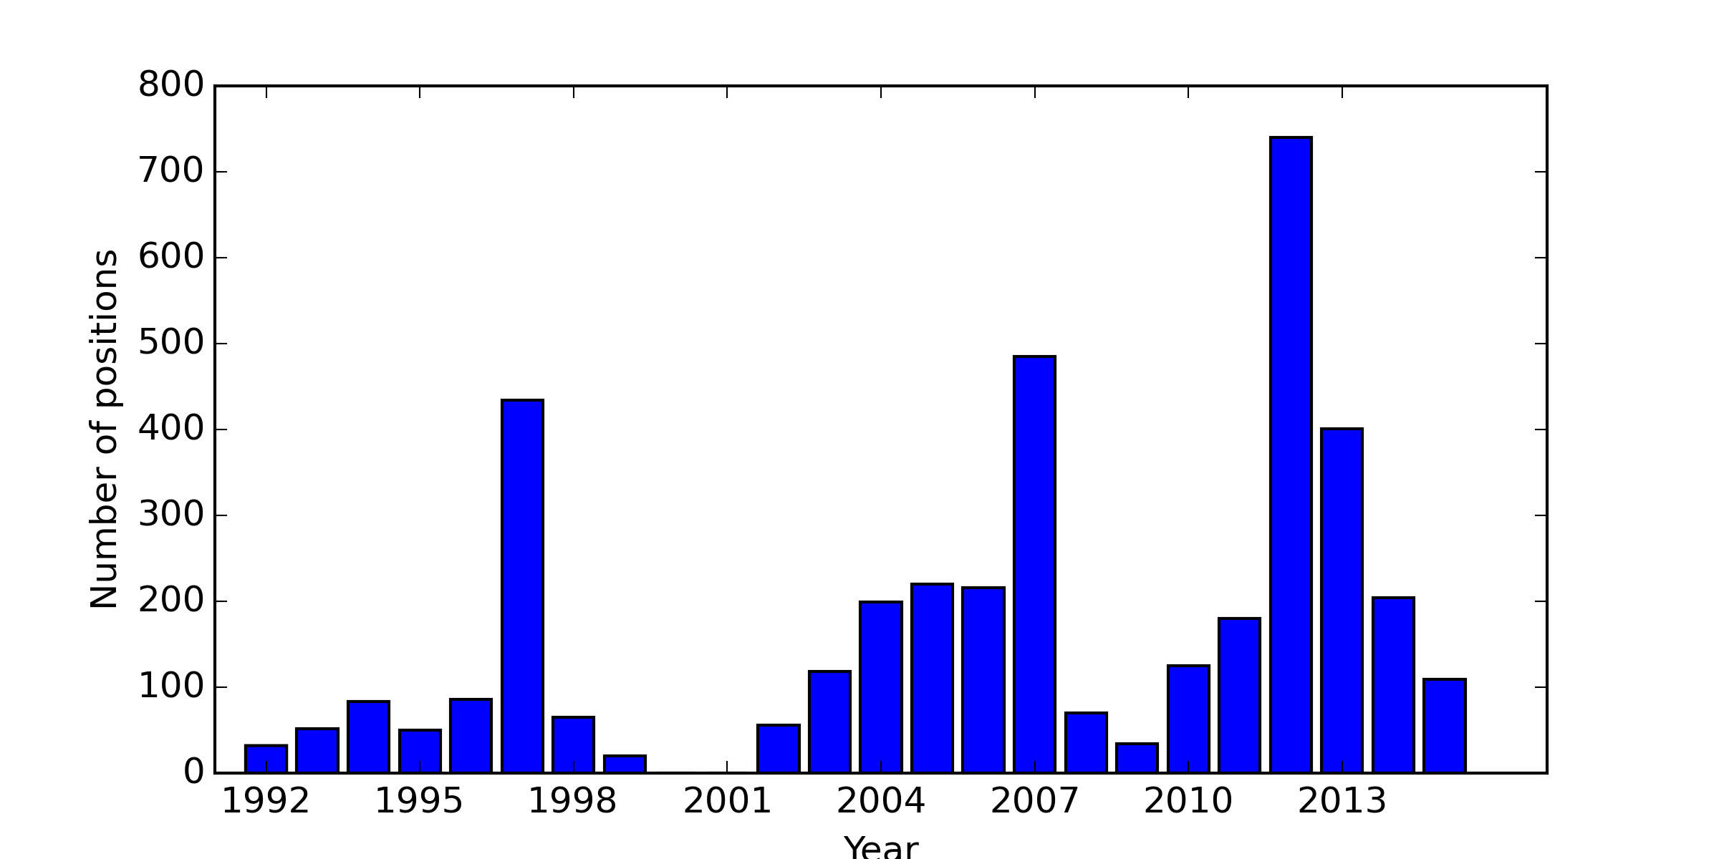
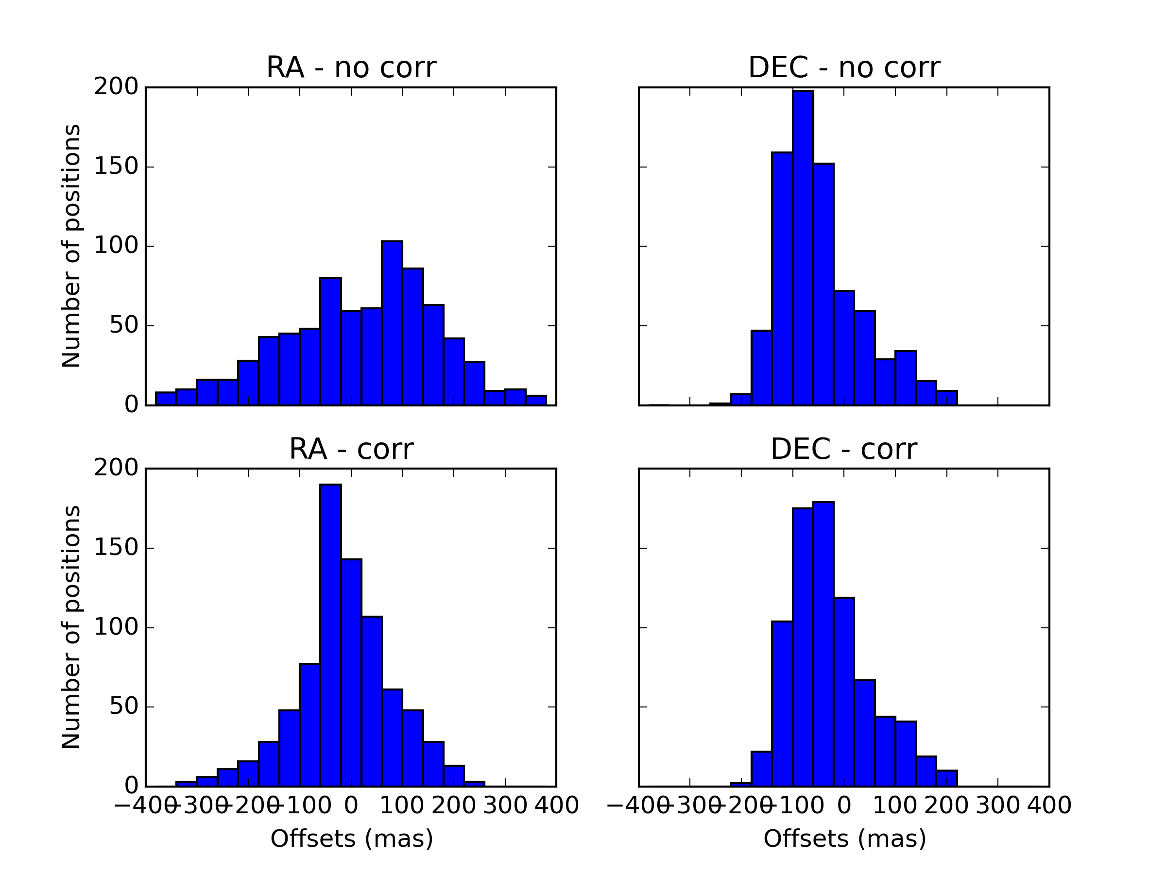
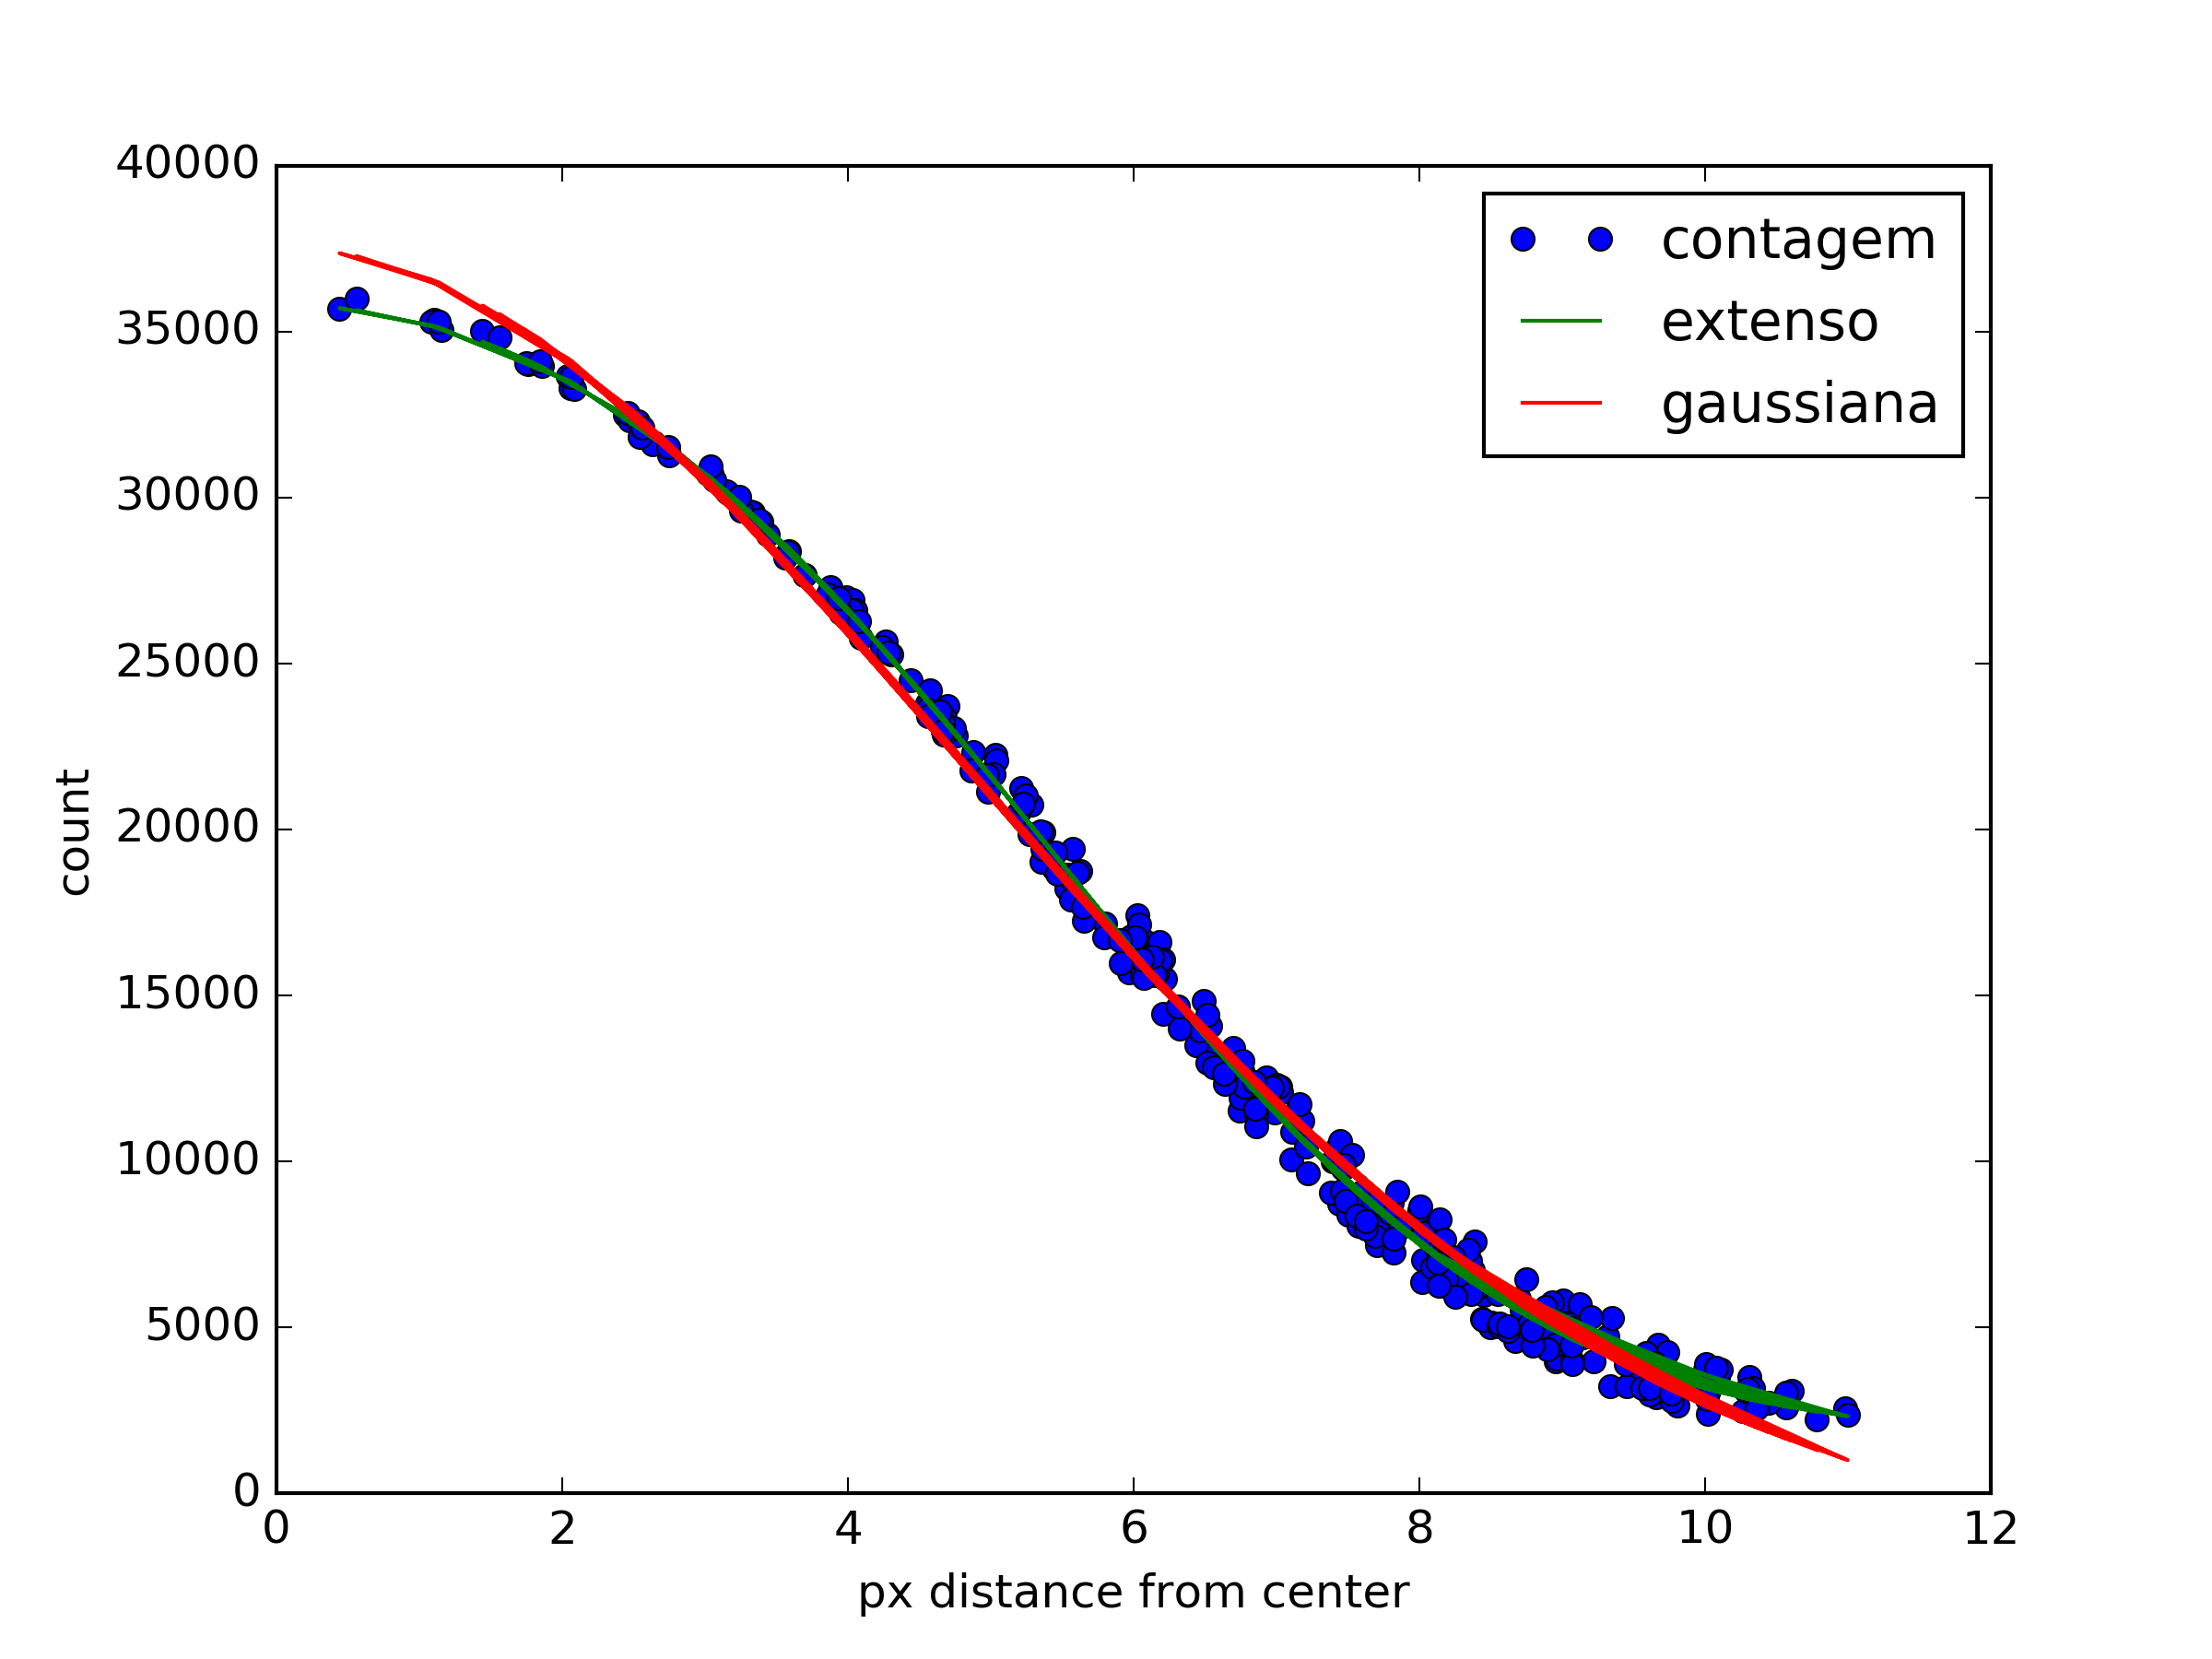
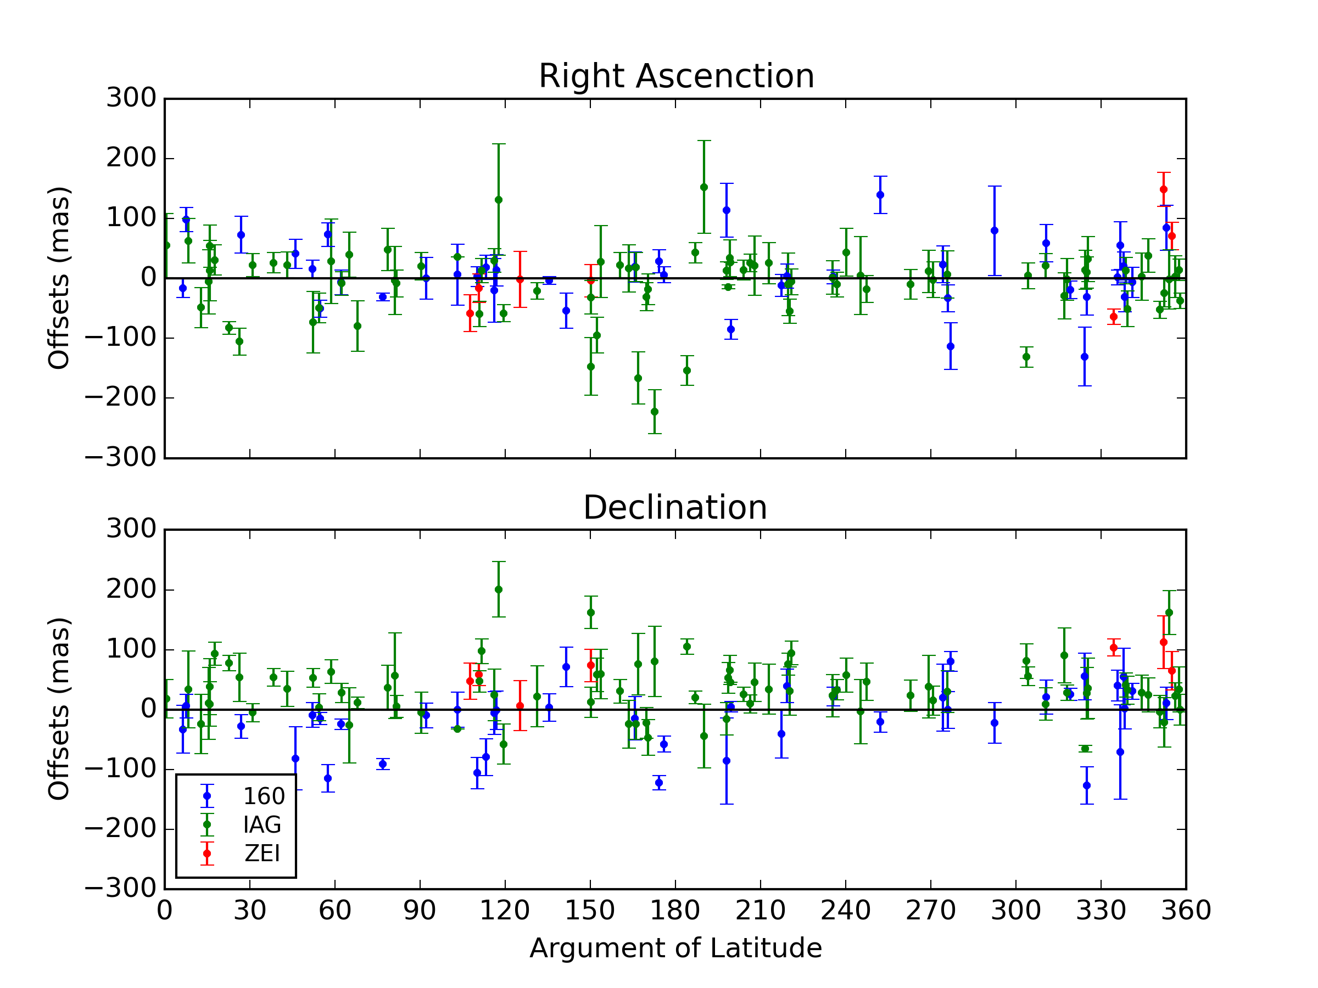
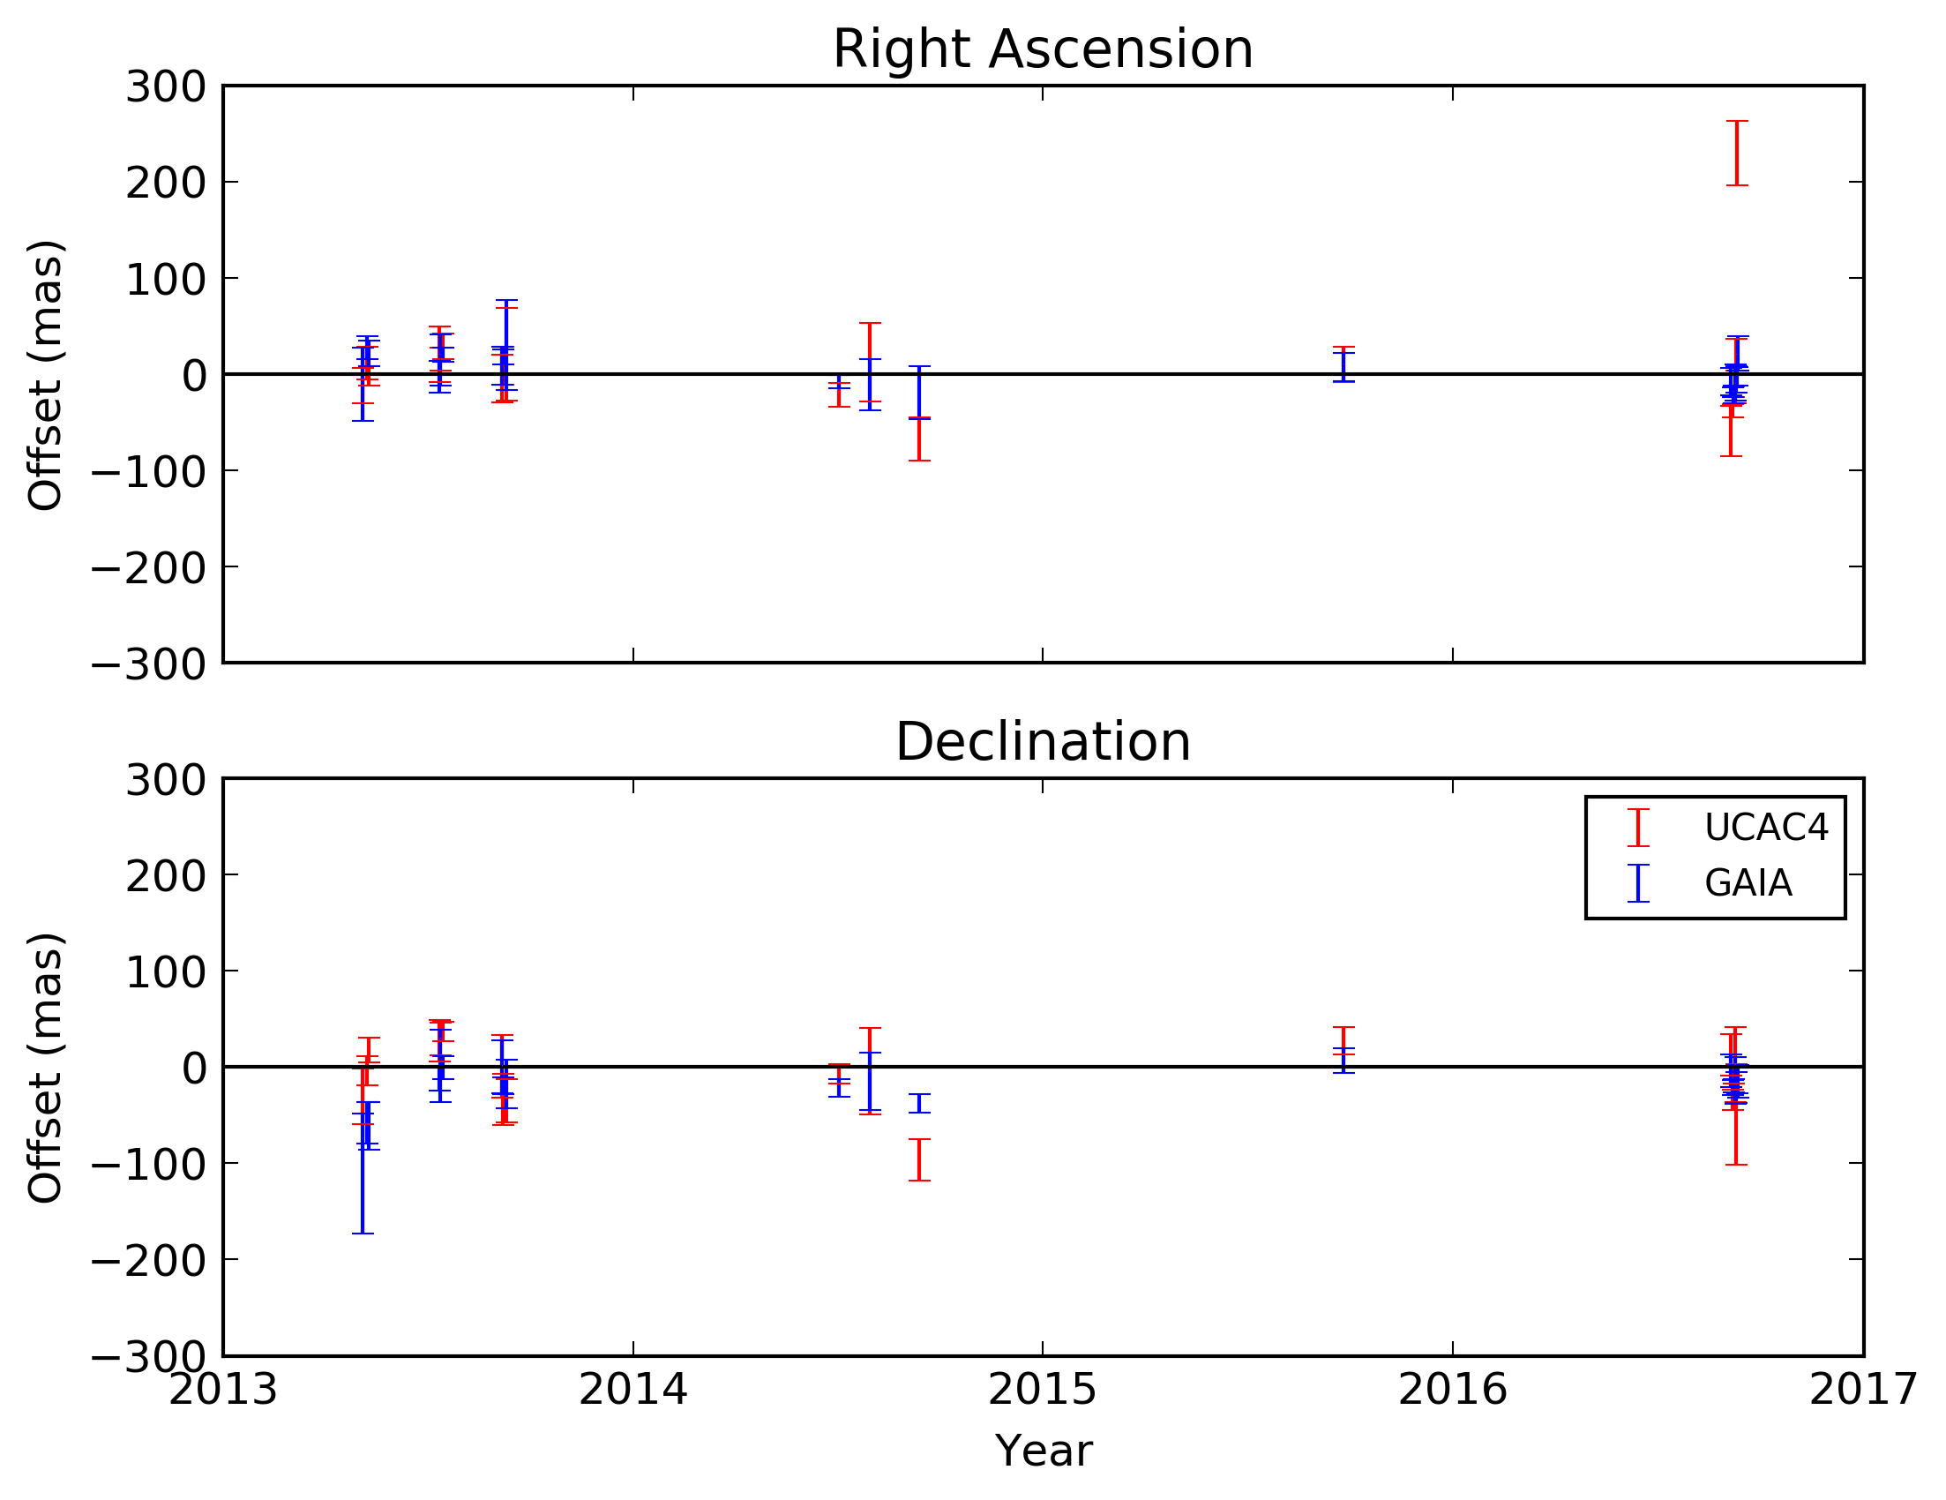







Astrometry of the Neptune-Triton System from OPD observations
A. R. Gomes-Júnior (1), M. Assafin (1), R Vieira-Martins (1,2,3), J. I. B. Camargo (2,3), G. Benedetti-Rossi (2)
(1) Observatório do Valongo, (2) Observatório Nacional, (3) Laboratório Interinstitucional de e-Astronomia
Triton is the main satellite of Neptune. Differently of the other regular ones, it has a retrograde, circular and high inclined orbit. Due to its orbital configuration, it’s believed Triton was captured by Neptune [1]. Triton is one of the few objects in the Solar System that have an atmosphere. The extreme variation in the subsolar latitude in Triton causes strong variations in the distribution of frozen N2 on its surface. This way, the polar cap of Triton can almost reach its equator [2].
Neptune and Triton were observed by Voyager II spacecraft in 1989 [3], but it was only a close approach. The monitoring of their orbits and the study of Triton’s atmosphere must be made from ground-based observations. The latter using the stellar occultation technique.
Our group has observed the Neptune-Triton system along time producing a large database with more than 5000 CCD observations since 1992 (Tab. 1, Tab. 2 and Fig. 1). More than 3000 of these observations have positions for both objects from the same image, which is important to improve the satellite’s ephemeris. As comparison, [4] produced new ephemeris for Triton from 10254 observations from 1847-2012.
Neptune is much brighter and demands short exposure time, but Triton ends underexposed with a low number of reference stars. With Triton well-exposed, Neptune ends saturated in the image. The reduction of Neptune’s position still finds 2 difficulties: the differential Chromatic Refraction and its apparent size of 2.3”, in the order of the seeing.
To correct the chromatic refraction (CR), we used a technique from [5] where the CR is modeled from the ephemeris offsets of the object. This technique was effective improving the offsets dispersion in Right Ascension in the majority of the cases (Figs. 2 and 3). For Triton, due to its redder color, the technique was not effective.
Because of the size of Neptune, a numerical PSF is being tested so its photocenter can be improved. Fig. 4 shows an improvement in the fit using a numerical PSF for Neptune. A numerical PSF which takes into account the phase angle is being implemented.
Preliminary ephemeris offsets of the difference between Triton’s and Neptune’s offsets over the Argument of Latitude are found in Fig. 5.
Fig. 6 shows the offsets for Triton using UCAC4 (red) and GAIA-DR1 (blue) as reference catalogue from 2013-2016 observations. We can see an improvement using GAIA-DR1 for observations close to mean epoch of the catalogue with smaller dispersions.
[1] McKinnon, W. and Kirk, R. (2007). Triton, chapter 26, page 483–502. Elsevier
[2] Hansen, C. J. and Paige, D. A. (1992). A thermal model for the seasonal nitrogen cycle on Triton. Icarus, 99(2):273–288
[3] Smith, B. A., Soderblom, L. A., Banfield, D., et al. (1989). Voyager 2 at Neptune: Imaging Science Results. Science, 246(4936):1422–1449
[4] Emelyanov, N. V. and Samorodov, M. Y. (2015). Analytical theory of motion and new ephemeris of triton from observations. Mon. Not. R. Astron. Soc., 454(2):2205–2215
[5] Benedetti-Rossi, G., Vieira Martins, R., Camargo, J. I. B., et al. (2014). Pluto: improved astrometry from 19 years of observations. Astronomy and Astrophysics, 570:A86
Telescope | Neptune | Triton | Matches
160 | 735 | 1251 | 682
IAG | 2795 | 3341 | 2459
Zeiss | 292 | 463 | 280
Total | 3822 | 5055 | 3421
Telescope | Clear | B | V | R | I | Metano
160 | 569 | 4 | 5 | 5 | 86 | 13
IAG | 919 | 21 | 126 | 243 | 1032 | 118
Zeiss | 218 | - | - | - | 62 | -
Distance to the Planet (Millions of km)
Table 2: Number of positions with Neptune and Triton in the same image by filter for each telescope.
Table 1: Number of positions identified of non-saturated-Neptune and Triton by telescope. Matches: Number of positions where non-saturaded-Neptune and Triton were identified in the same image.
Figure 1: Distribution of positions with Neptune and Triton in the same image (short-exposure observations) by year.
Figure 2: Offsets in right ascension before (red) and after (blue) CR correction for the night of August 20, 1993 observed with the Perkin-Elmer telescope.
Figure 3: distributions of the offsets in RA and DEC before (no corr) and after (corr) the elimination of chromatic refraction for Neptune observed with the 160 telescope.
Figure 4: Profile of the PSF of Neptune with a Gaussian fit (red) and with a numerical fit (green).
Figure 5: Difference between the offsets of Triton and Neptune by Argument of Latitude. It shows the variation in the position of Triton around Neptune along its orbit.
Figure 6: Offsets of Triton from 2013-2016 observations using UCAC4 (red) and GAIA-DR1 (blue).

