Slide 1

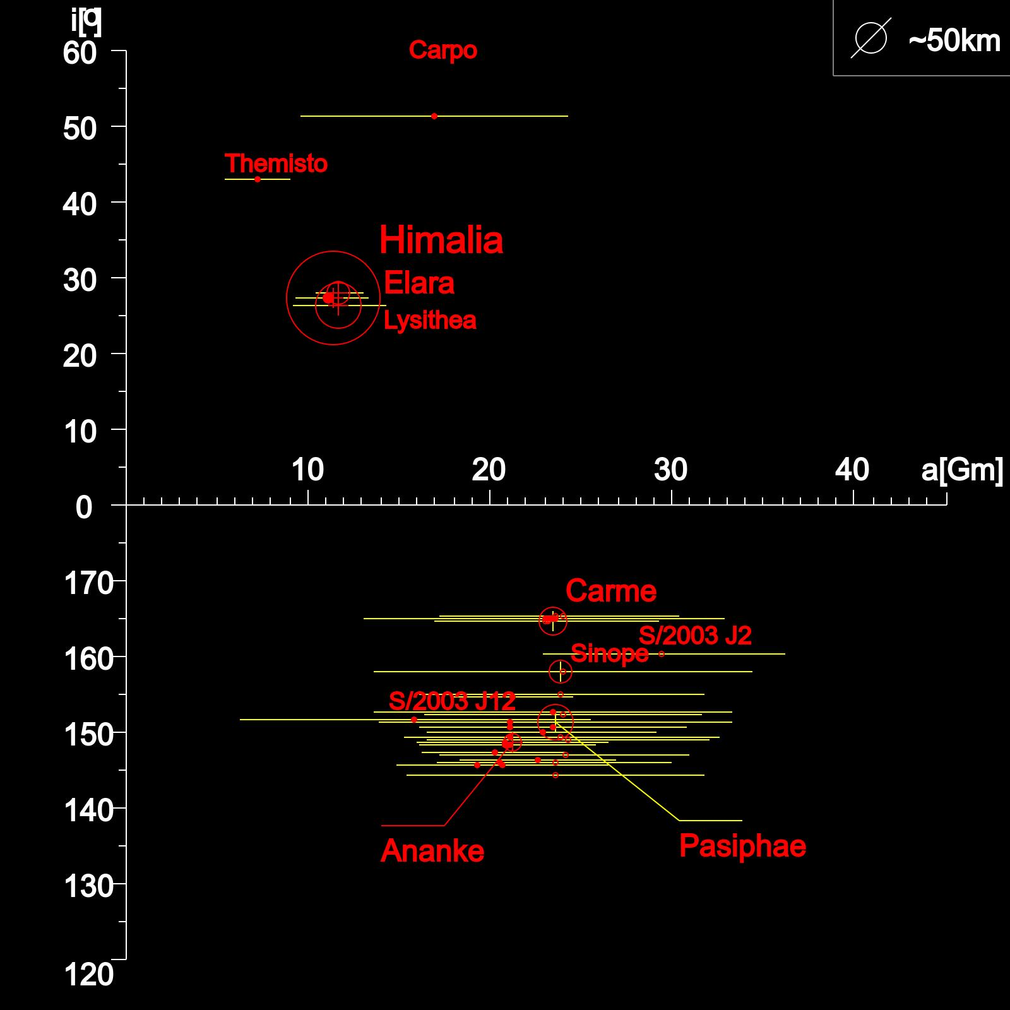
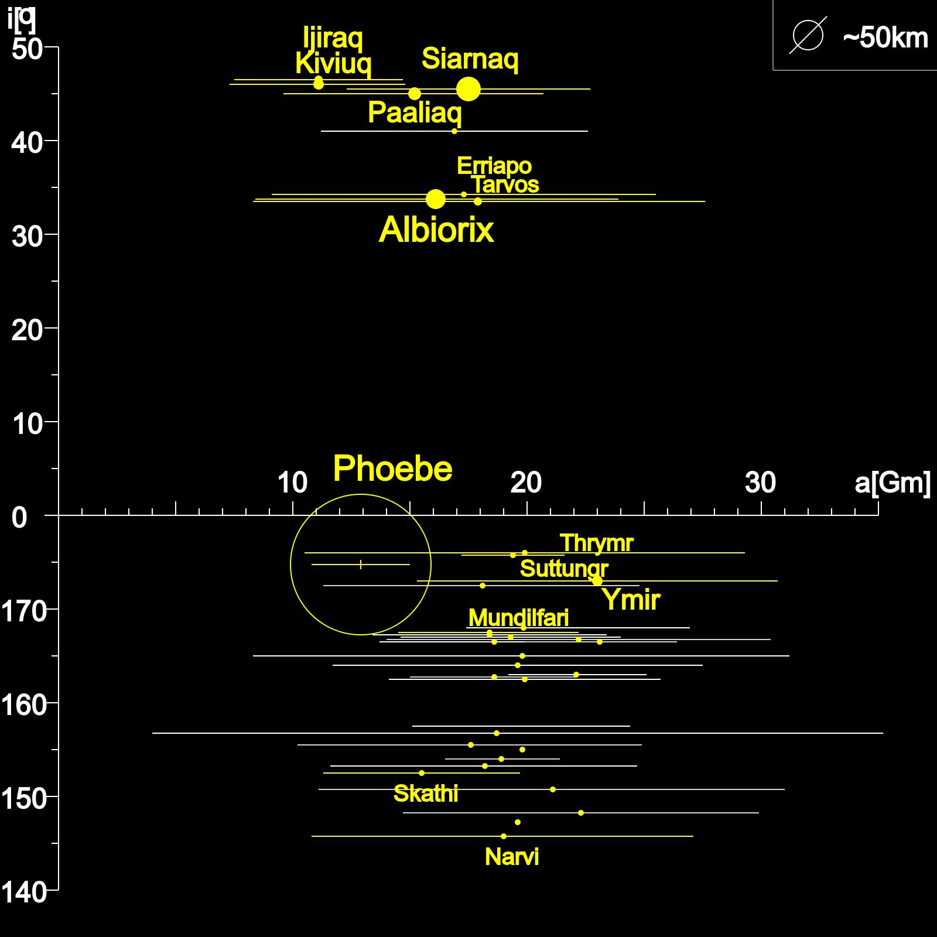
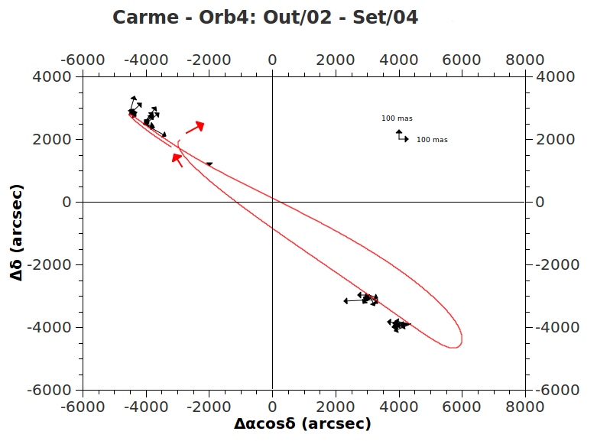




Astrometric positions for the irregular satellites of Jupiter and Saturn
Altair Ramos Gomes Júnior¹, Marcelo Assafin¹, Roberto Vieira Martins², Júlio I. B. Camargo², Alexandre H. Andrei², Dario Nepomuceno da Silva Neto³, Gustavo B. Rossi², Alex Dias Oliveira², Felipe Braga-Ribas²
1-OV/UFRJ; 2-ON/MCT; 3-UEZO
The irregular satellites of the giant planets, mainly from Jupiter and Saturn, are much smaller than the regular ones. They have irregular shapes and their orbits are more eccentric with larger semi-major axes. Some of them have retrograde orbits. Explaining their existence is an interesting study in orbital dynamics. It's generally accepted that, due to their orbital configuration, they were captured by their planets. Stellar occultations are a method that would allow us to know better their physical features (size, shape, density) since they are not visited, at the moment, by any spacecraft. But their orbits are known with little precision, which is bad to obtain a good prediction for a occultation.
Irregular Satellites of Jupiter e Saturn
Distance to the Planet (Millions of km)
Distance to the Planet (Millions of km)
In this work, we aimed at organizing and reducing CCD images of the Jovian and Saturnian Irregular Satellites observed at the Observatório do Pico dos Dias (1,60 and 0,6m telescopes) and at the Observatoire Haute-Provence (1,2m telescope). The observational data from these two observatories comprise more than 100.000 images. The reduction of this considerable amount of images with the necessary accuracy in position was only possible with the use of PRAIA. First, we eliminate discrepant positions night by night using a sigma-clip procedure. Then, we analyze the differences between the observed and ephemeris positions of the satellites to better constrain the origin of systematic differences and properly provide corrections to the orbits of the satellites. The projection of the orbits on the sky, along with vectors representing systematic effects on positions (see graphic below), clearly shows how this work contribute to a better determination of the orbits of the satellites .
Object detection
on field
Measuring (x,y)
centroids
Database: comparison between LNA and OHP
 | OHP | LNA
Telescope | 1.2m | 1.6m | IAG (0,6m) | Zeiss (0,6m) | Total
Images | 27.963 | 30.380 | 50.240 | 7.979 | 88.599
Nights | 354 | 196 | 254 | 30 | 480
Filters | Clear | Clear, Methane, B, V, R, I
Period | 1997 - 2008 | 1992-2012
Automatic reference star
identification
Parameters’
configuration
PRAIA
(α,δ) Reductions with
UCAC4 and 2MASS
PSF photometry
Header
extraction
of fits files
Statistics by satellite/observatory
List of
Targets
Automatic
Target identification
 | OHP |  |  |  |  | 160 |  |  |  |  | IAG
 | NI | o RA | σ RA | o DE | σ DE | NI | o RA | σ RA | o DE | σ DE | NI | o RA | σ RA | o DE | σ DE
Ananke | 156 | 29 | 99 | -8 | 76 | 71 | 39 | 201 | -67 | 182
Carme | 222 | -2 | 88 | -52 | 85 | 35 | 11 | 149 | -33 | 102 | 23 | 56 | 96 | 3 | 67
Elara | 203 | -9 | 71 | -26 | 75 | 101 | -67 | 180 | -39 | 122 | 290 | 35 | 118 | -61 | 77
Himalia | 401 | -4 | 61 | 5 | 71 | 213 | -30 | 232 | -22 | 97 | 542 | 0 | 115 | -3 | 146
Leda | 54 | 3 | 129 | 152 | 83 | 12 | 289 | 291 | 51 | 91
Lysithea | 91 | 6 | 67 | -46 | 61 | 65 | 49 | 108 | -55 | 105 | 7 | -30 | 121 | 23 | 53
Pasiphae | 258 | -49 | 86 | -63 | 88 | 59 | 40 | 195 | -76 | 107 | 172 | -62 | 112 | -32 | 80
Sinope | 189 | -67 | 199 | -21 | 92 | 47 | 204 | 207 | -81 | 132 | 7 | 285 | 146 | -43 | 68
Phoebe | 590 | -4 | 44 | 5 | 44 | 61 | -12 | 66 | -48 | 46 | 540 | 6 | 92 | -45 | 78
Results
Mean and standard deviation of the offsets in Right Ascension and Declination; NI: Number of Images
Agradecimentos

