Slide 1
Astrometric and Photometric Applications to Study the Outer Solar System Bodies”
Altair Ramos Gomes Júnior
Advisor: Marcelo Assafin

Slide 2

Summary
Introduction
Stellar Occultation by Ceres
Irregular Satellites
Neptune and Triton
Other Works
Perspectives

Slide 3
Introduction
Objects of the Outer Solar System:
  Icy Giant Planets;
  Dwarf-Planets (Pluto, Eris, …);
  Centaurs and TNOs;
  Comets
Peculiar Objetcs;
  Ceres
  Irregular Satellites.
Remants of the Early Solar System.
Notes:
Cometas dessa região do Sistema Solar
Remanescentes: distância, colisão, baixa temperatura;

Slide 4
Introduction
Few spacecrafts sent to the Outer Solar System;
Use of ground-based observations:
  Astrometric positions to correct ephemeris;
  Prediction and observation of stellar occultations.
Notes:
Ou telescópios espaciais
Dentre as diversas técnicas como espectroscopia, fotometria...

Slide 5
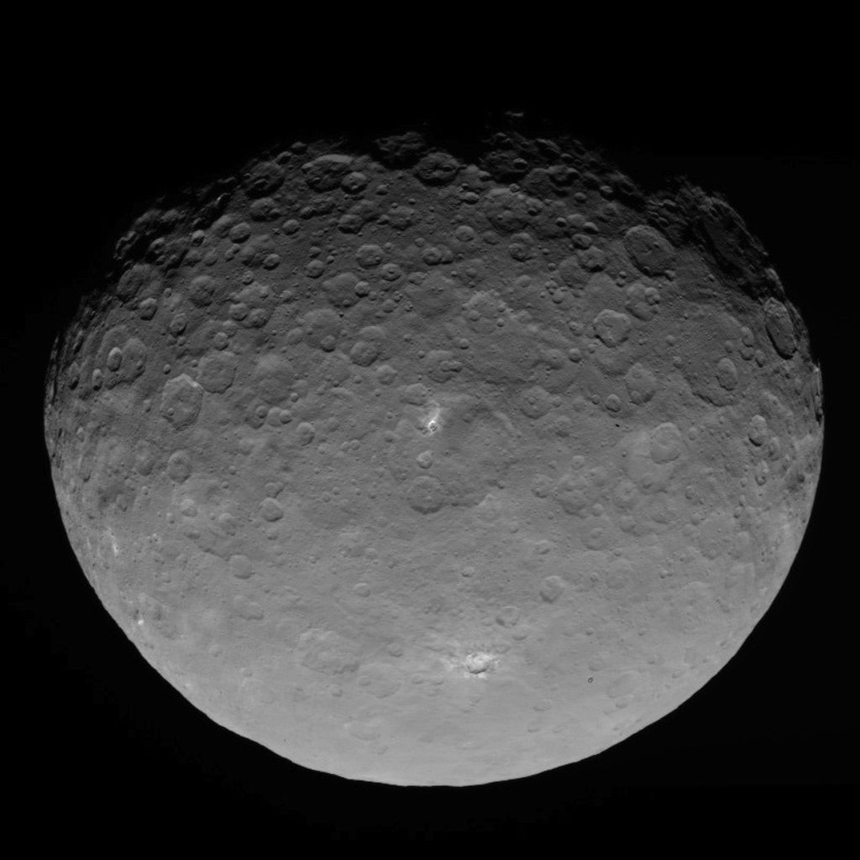
Stellar Occultations by Ceres
Source: Dawn

Slide 6
Ceres
It is a dwarf planet;
It may have a common origin with the TNOs population (McKinnon, 2012);
Contains one fifth of the whole mass of the Main Belt of Asteroids;
5 stellar occultations by Ceres were observed (1984, 1994, 2 em 2010 e 2013).

Slide 7

Stellar Occultation
Differential Aperture Photometry with PRAIA;
Elliot et al, 1979
Notes:
Anéis
Atmosfera (refração)
Pico central
Caso não haja atmosfera

Slide 8
2010 Occultation
August 17, 2010
Notes:
Detalhar mapa
Corda negativa também é importante

Slide 9

2010 Occultation

Slide 10
2013 Occultation
Outober 25, 2013

Slide 11
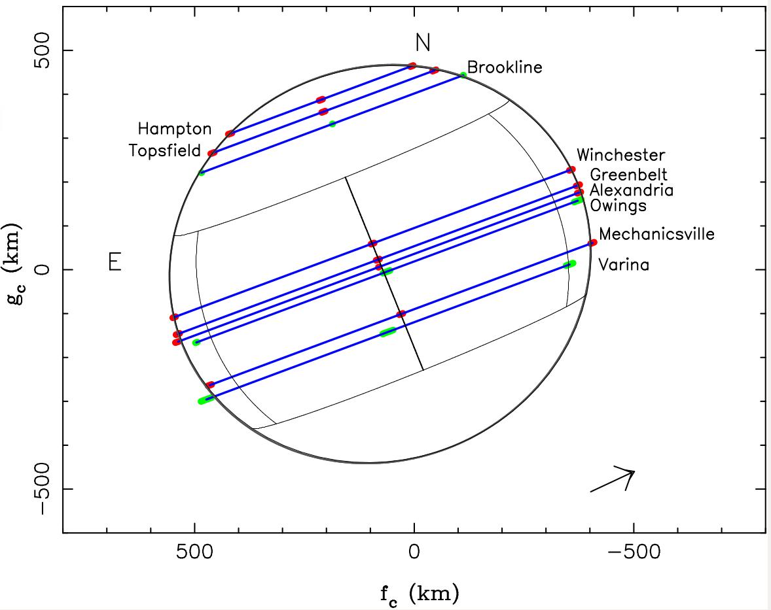
2013 Occultation

Slide 12
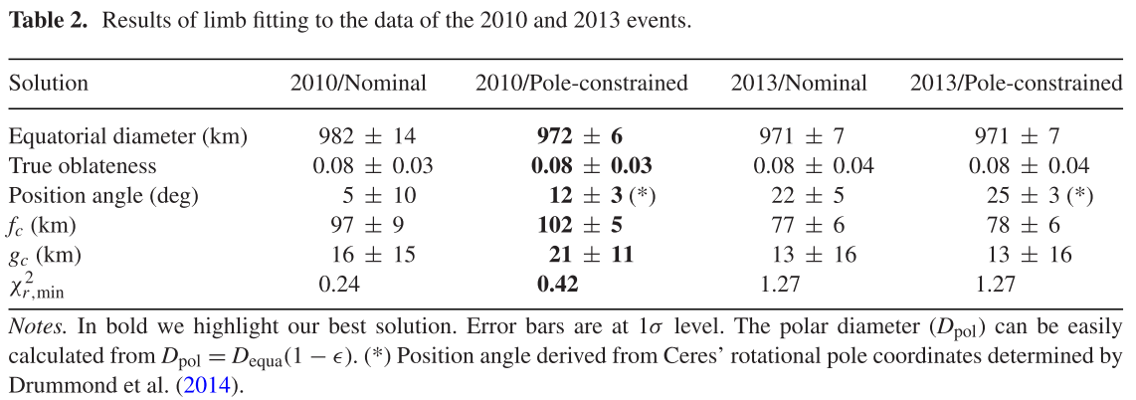
Ceres - Results
Gomes-Júnior et al., 2015a

Slide 13
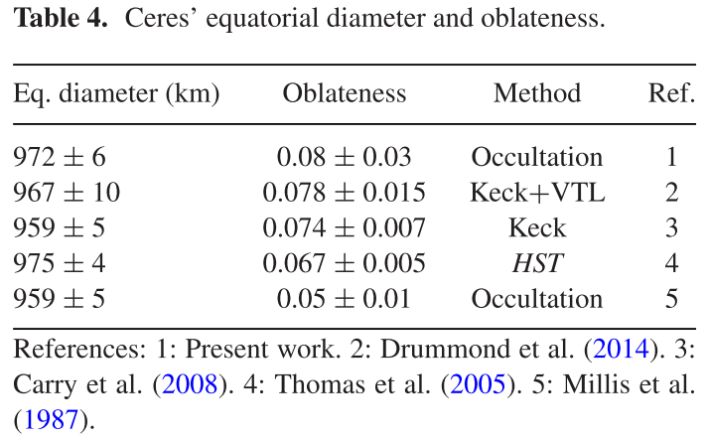
Ceres - Results
Dawn spacecraft is orbiting Ceres.
Gomes-Júnior et al., 2015a
Notes:
Dawn pode elucidar sobre a origem de Ceres

Slide 14
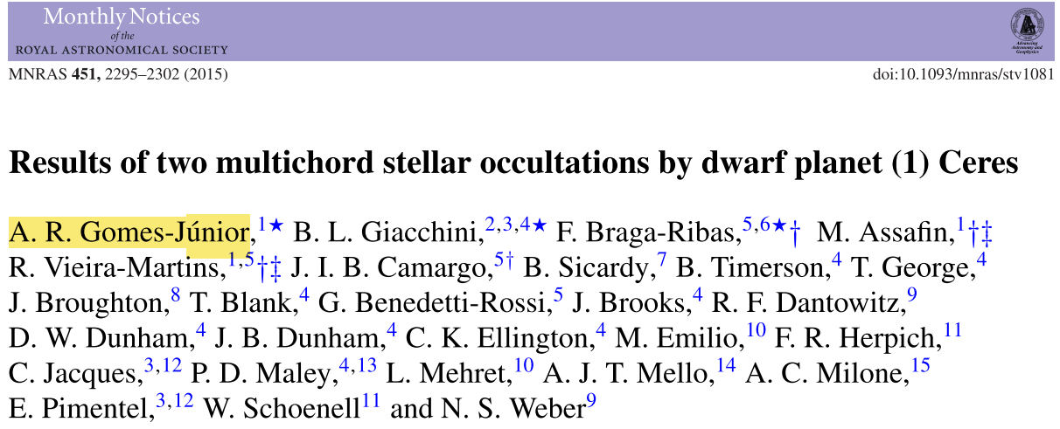
Ceres

Slide 15

Irregular Satellites
Phoebe
Source: Cassini

Slide 16
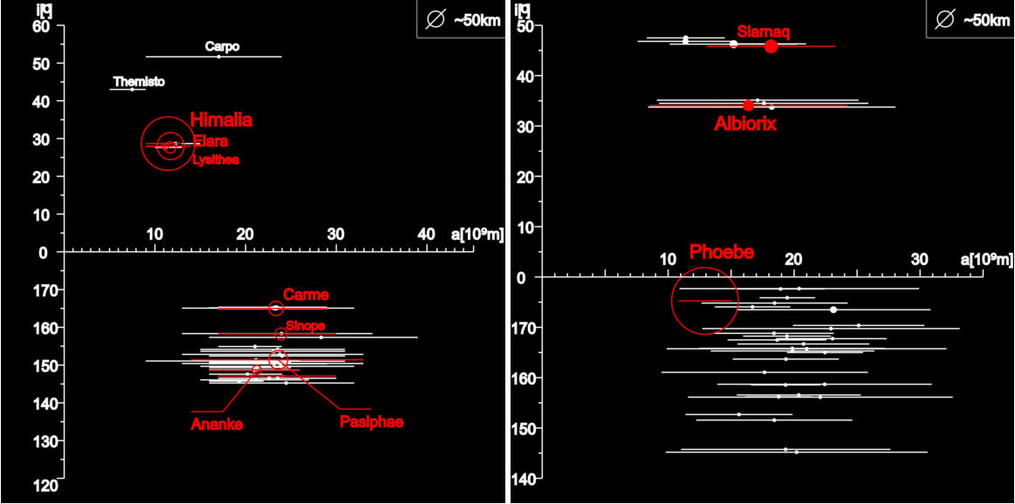
Irregular Satellites
Satellites of Jupiter
Satellites of Saturn
Notes:
Descrever eixos
Distantes
Excentricidade alta
Inclinação alta
Tamanhos estimados pequenos
Retrógrados
Grupos orbitais
Comparação com os regulares

Slide 17
Irregular Satellites
Probably captured by the Giant Planets;
They may have common origin with TNOs (Jewitt et al., 2007);
Only Himalia, Phoebe and Nereid were observed by spacecrafts;
Studies show that the irregular satellites have similar colors to the C-, P- and D-type asteroids or to the Centaurs and TNOs.
Notes:
Nesse contexto pretendiamos apenas melhorar as efemérides, agora queremos fazer ocultações

Slide 18
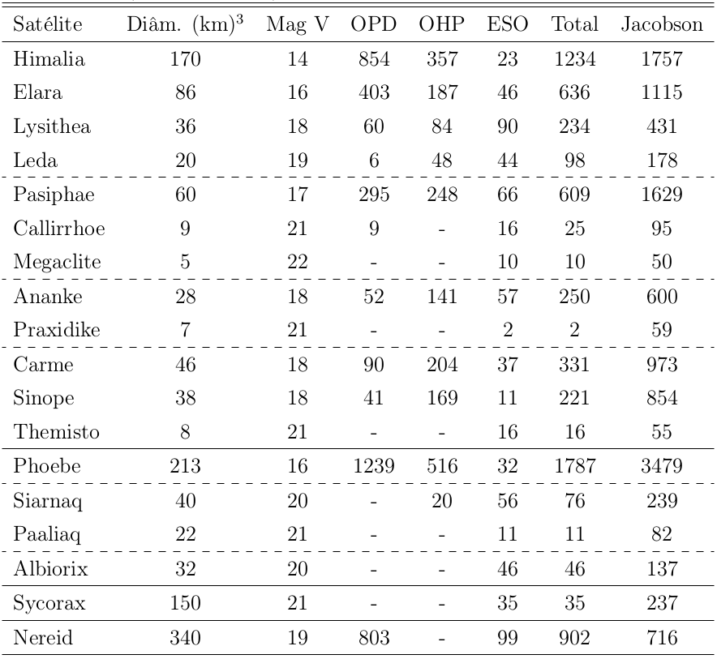
Astrometry

Slide 19
Astrometry
Gomes-Júnior et al., 2015b
Notes:
Descrever gráfico

Slide 20
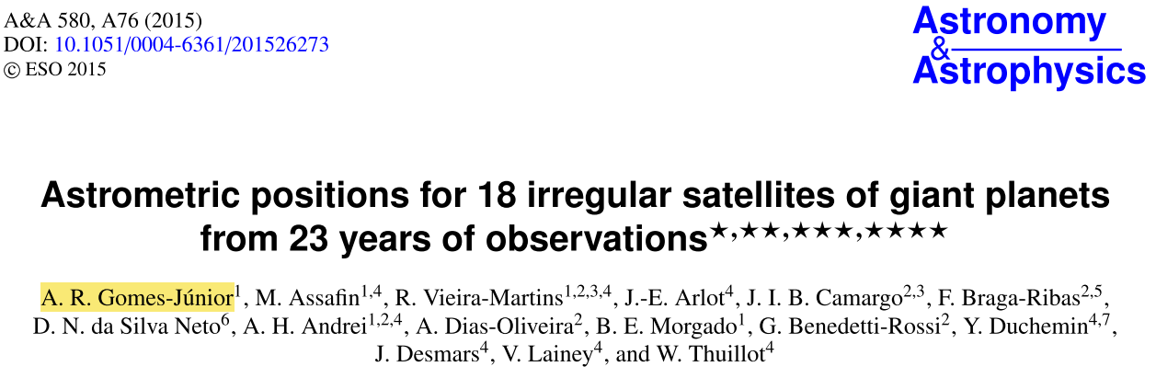
Astrometry

Slide 21
Occultations
Prediction of occultations for 8 satellites of Jupiter (Himalia, Elara, Pasiphae, Sinope, Lysithea, Carme, Ananke, Leda), Phoebe and Nereid;
UCAC4 stars and JPL ephemeris;
634 events identified between January, 2015 and December, 2017.
Notes:
Para Nereida foi utilizado o catálogo WFI
Após meados de 2016 teremos o catálogo GAIA

Slide 22
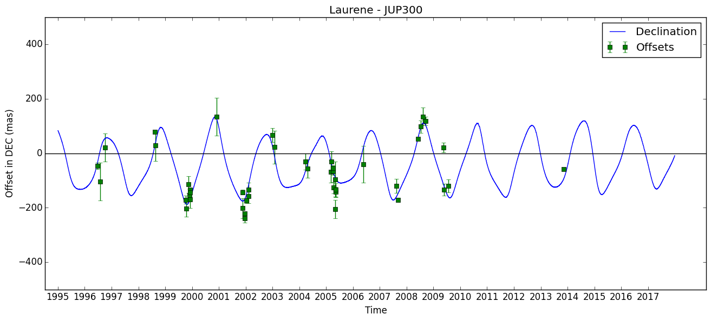
Numerical Integration

Slide 23
Nominal prediction
Numerical integration
Obs. February 22, 2015
Obs. March 03, 2015

Slide 24
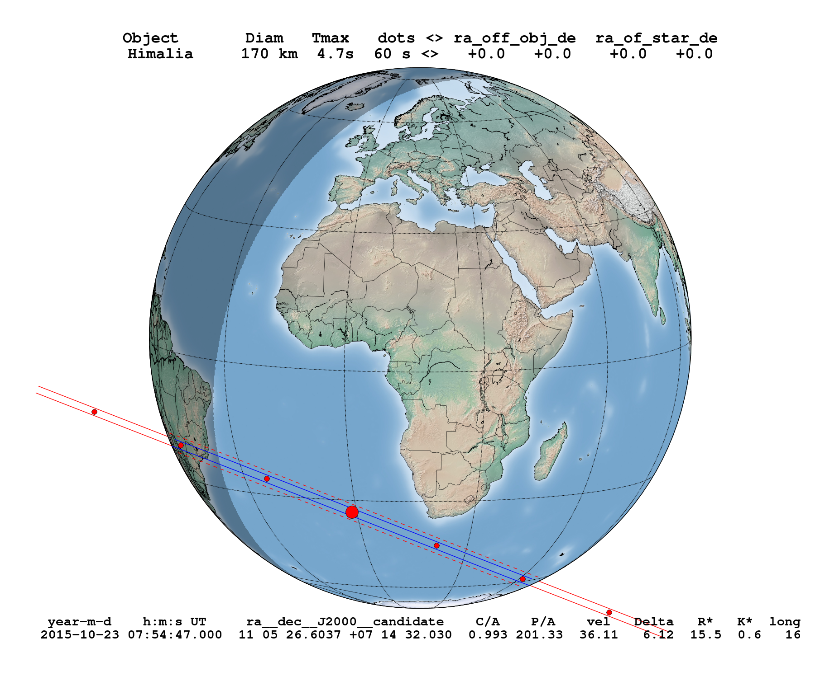
Himalia Occultation

Slide 25
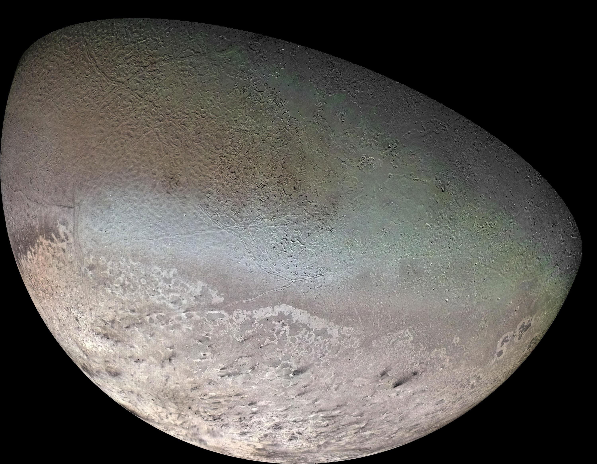
Triton
Source:
Voyager 2
Notes:
É um estudo novo para mim

Slide 26
Triton
Retrograd orbit, circular and highly inclined;
Probably captured by dissociation of a binary system;
One of the few objects in the Solar System to maintain an atmosphere;
It has a great seasonal variation.
Notes:
Várias observações com a motivação de melhorar as efemérides

Slide 27
Astrometry
Astrometry of more than 7000 observations of Neptune-Triton obtained at OPD;
Numerical PSF to obtain the fotocenter of Neptune (ang. diam. ~ 2 arcsec);
Positions of spacecraft telemetry among the ESPaCE project (joint-PhD);
Study the dissipative effects of energy by tidal effects to improve ephemeris.
Notes:
Redeterminar órbita usando NOE

Slide 28
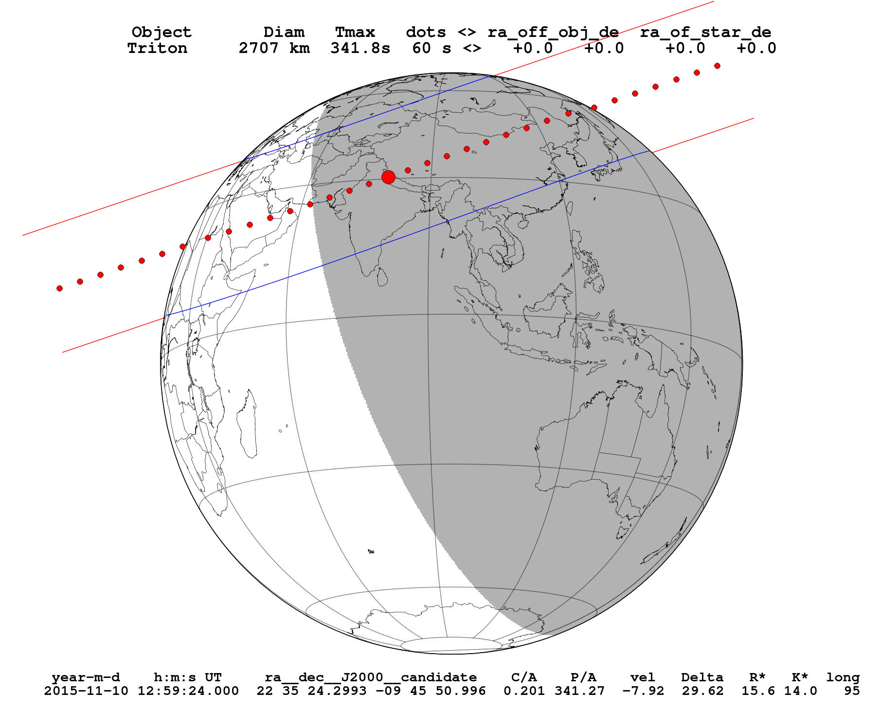
Occultation November 10, 2015

Slide 29
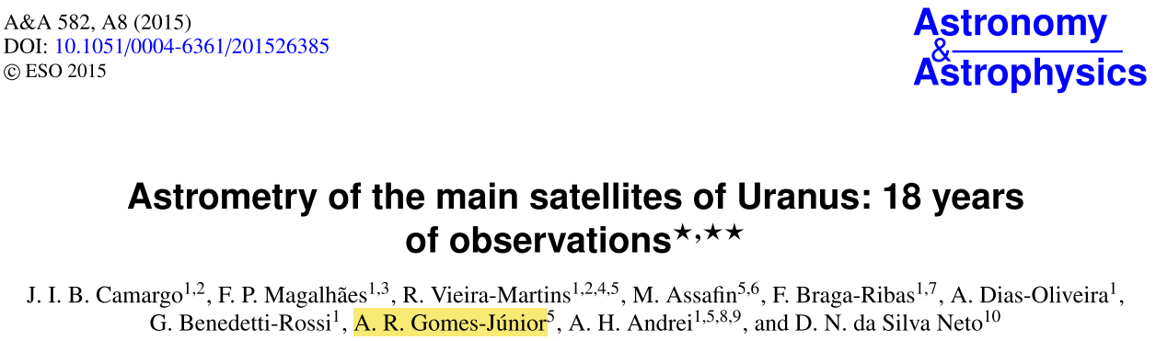
Other Works

Slide 30
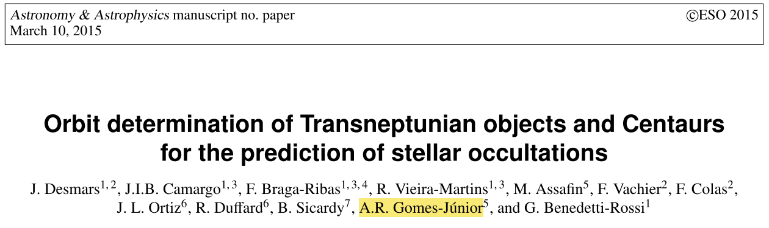
Other Works
Notes:
NIMA

Slide 31
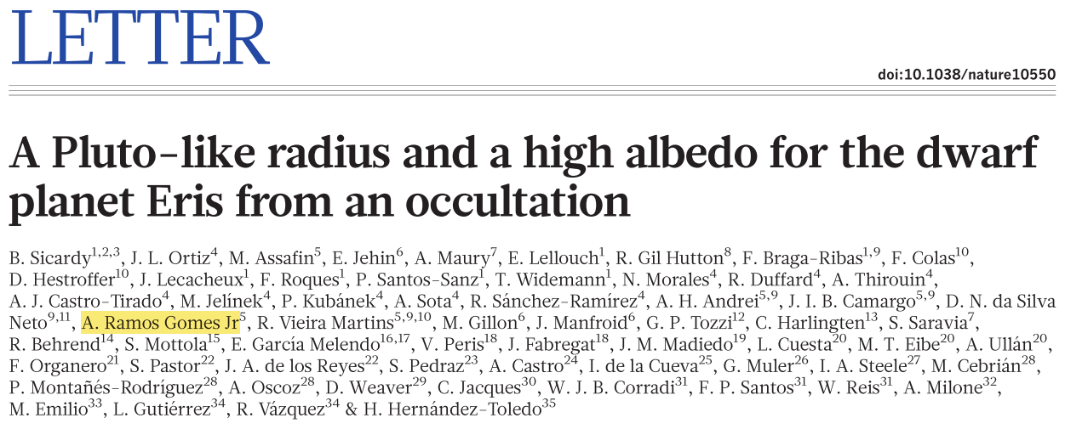
Occultation - Eris

Slide 32
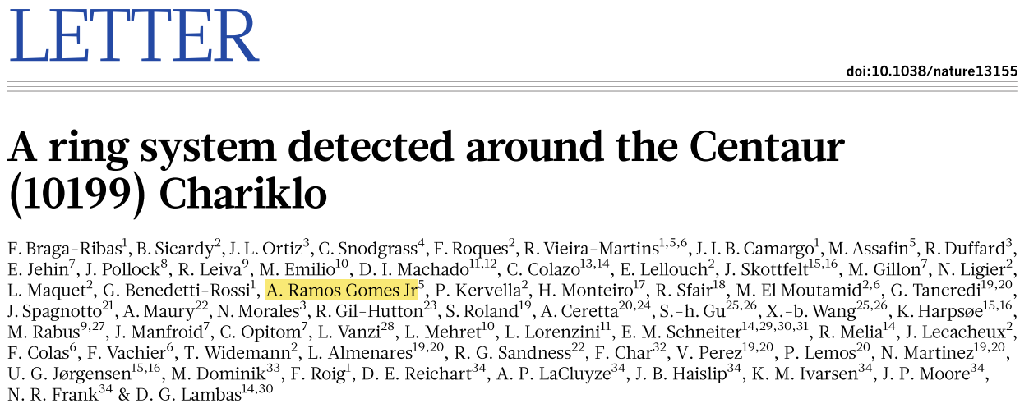
Occultation - Chariklo

Slide 33
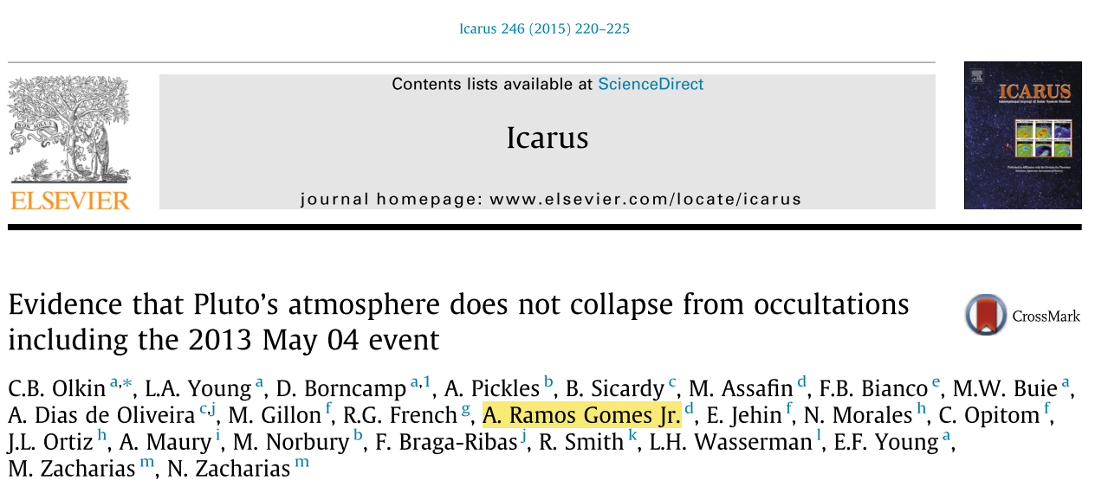
Occultation - Pluto

Slide 34
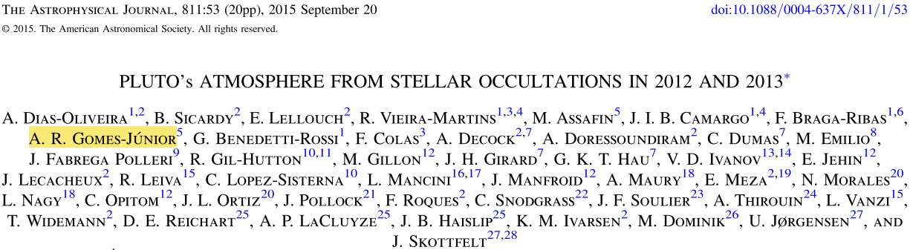
Occultation - Pluto
Other unpublished occultations: Chariklo observed in Africa, Pluto in New Zealand and 2003VS2 at OPD.

Slide 35
Perspectives
Publish the predictions of occultations by irregular satellites;
Observe occultation by Triton on November 10, 2015;
Use GAIA to make better predictions.
Joint-PhD under supervision of Dr. Valéry Lainey working on Triton.

Slide 36
Thank You

