Slide 1




Astrometric Positions of Irregular Satellites of Giant Planets from 23 Years of Observations
Altair Ramos Gomes Júnior
Marcelo Assafin
Roberto Vieira Martins
Júlio Ignácio Bueno de Camargo
Felipe Braga Ribas
Bruno Eduardo Morgado
Alex Dias Oliveira
Gustavo Benedetti Rossi

Slide 2
Goal
Organize e reduce three database with images of the irregular satellites of the giant planets observed between 1992 e 2014 at OPD, OHP e ESO.
Obtain precise positions from these observations which can be used to:
  New numerical integrations of the orbits of these satellites.
  Predict and observe stellar occultations by these objects.

Slide 3


Irregular Satellites
Satellites of Jupiter
Satellites of Saturn

Slide 4
Irregular Satellites
Capture:
  Gas Drag (Cuk & Burns, 2003);
  3-body interation (Nesvorný et al., 2007);
  Colision (Sheppard, 2006).
Evolução orbital:
  Origin of the orbital family of satellites (Nesvorný et al., 2004);

Slide 5
Observations
Telescope | Diameter | Number of CCDs | Filters | Number of Images | Time Span
OHP | 1.2 m | 1 | Clear | 24000 | 1998-2008
ESO | 2.2 m | 1 | I | 1500 | 2007-2009
OPD (PE) | 1.6 m | 9 | Clear, U, B, V, R, I, Metano | 42000 | 1992-2014
OPD (B&C) | 0.6 m | 11 | Clear, U, B, V, R, I, Metano | 72000 | 1995-2014
OPD (Zeiss) | 0.6 m | 9 | Clear, B, V, R, I, Metano | 20000 | 1996-2014

Slide 6
Reduction Process
Bias and flat-field calibration.
PRAIA:
  Extract data of the header of the images;
  Detect objects in the image (x, y);
  Identify catalogue reference stars;
    UCAC4
  Obtain (α,δ) from gnomonic projection;
  Identify targets in the images.
    JPL ephemeris.

Slide 7
RESULTS

Slide 8
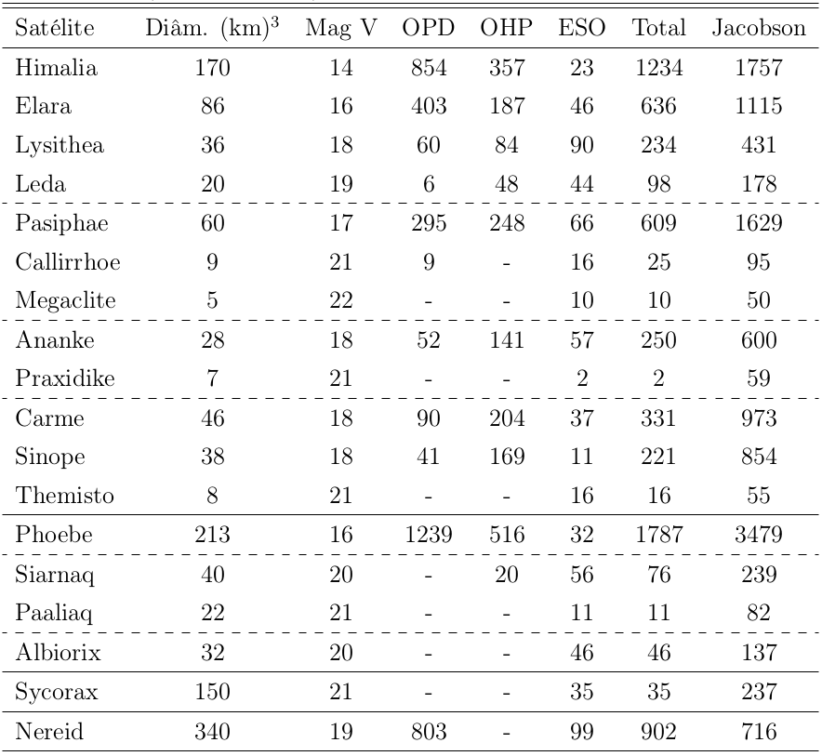
Results
*
* Jacobson, R. A. et al, 2012, The Astronomical Journal

Slide 9
Results - Carme

Slide 12
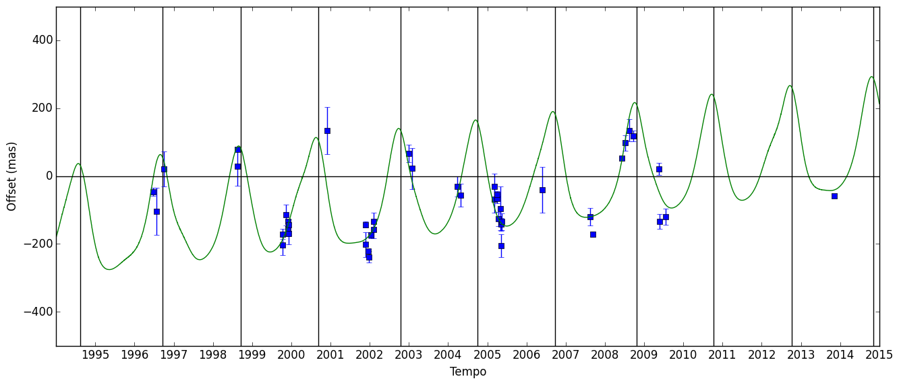
Results - Carme
Carme - Declination
Notes:
Descrever gráfico

Slide 13
Conclusion
We identified 8466 observations of irregular satellites, from which we obtained 6523 suitable astrometric positions.
Position errors estimated of about 60-80 mas depending on brightness.
All positions are available at the CDS

Slide 14
Next Steps
Numerical Integration of the orbits of the Irregular Satellites.
Predict and observe stellar occultations by these objects.
Re-reduce the observations with GAIA catalogue.

Slide 15
Thank You

