Slide 1

Astrometric Positions for 18 Irregular Satellites of Giant Planets from 23 Years of Observations
Altair Ramos Gomes Júnior
(Observatório do Valongo)
Phoebe
Source: Cassini

Slide 2
Irregular Satellites
Burns (1986): Satellites are irregular when their orbital planes precess primarily under the influence of torques from the Sun.
Their orbits are eccentric, usually highly inclined and distant from their planets. The direction of their movements can be prograde or retrograde.

Slide 3
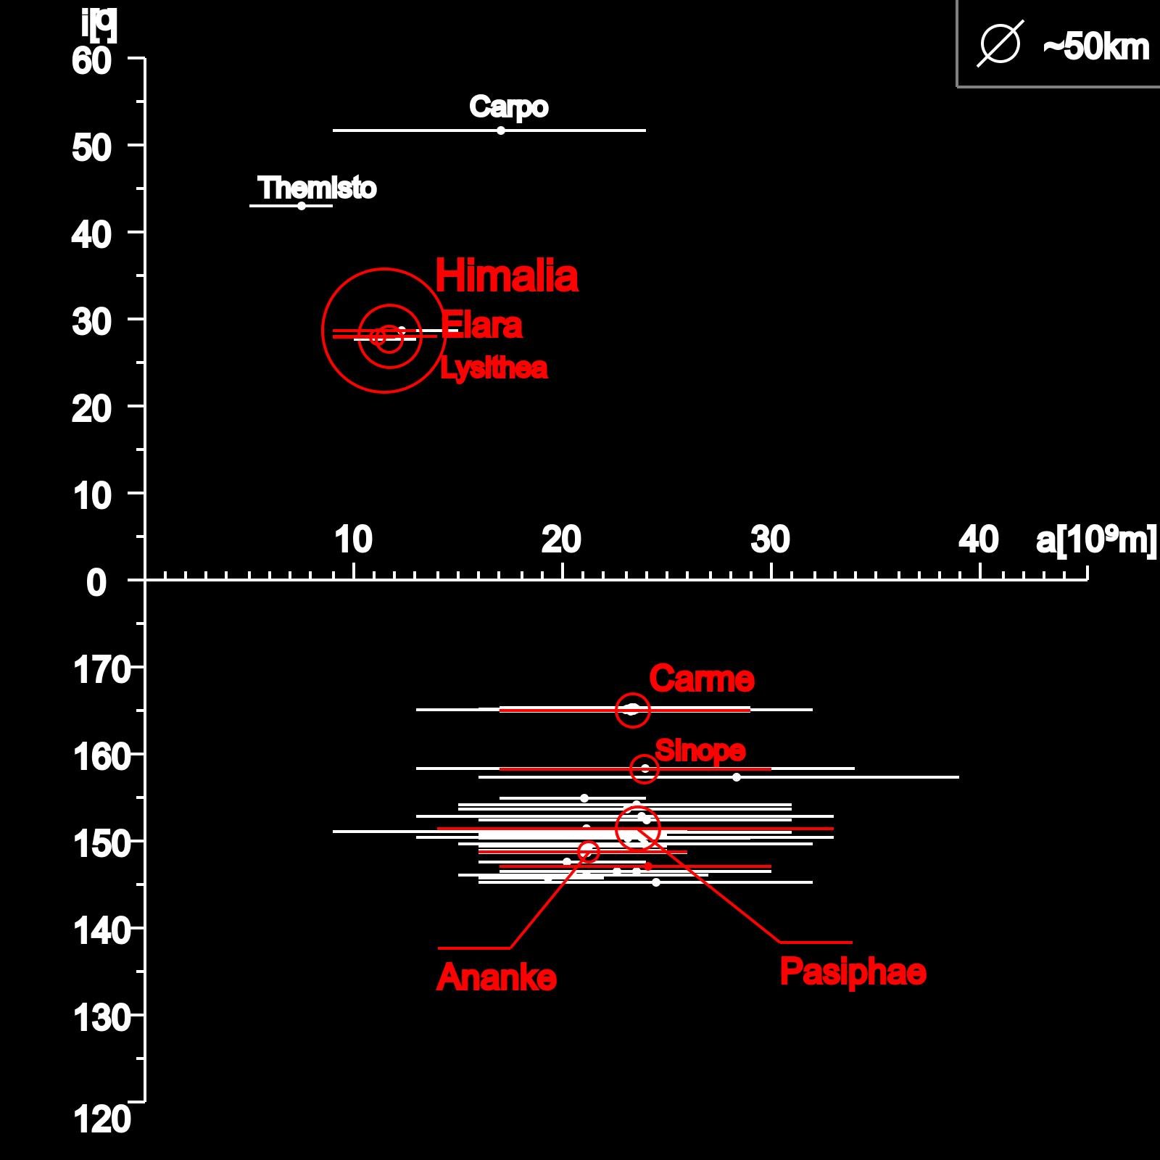
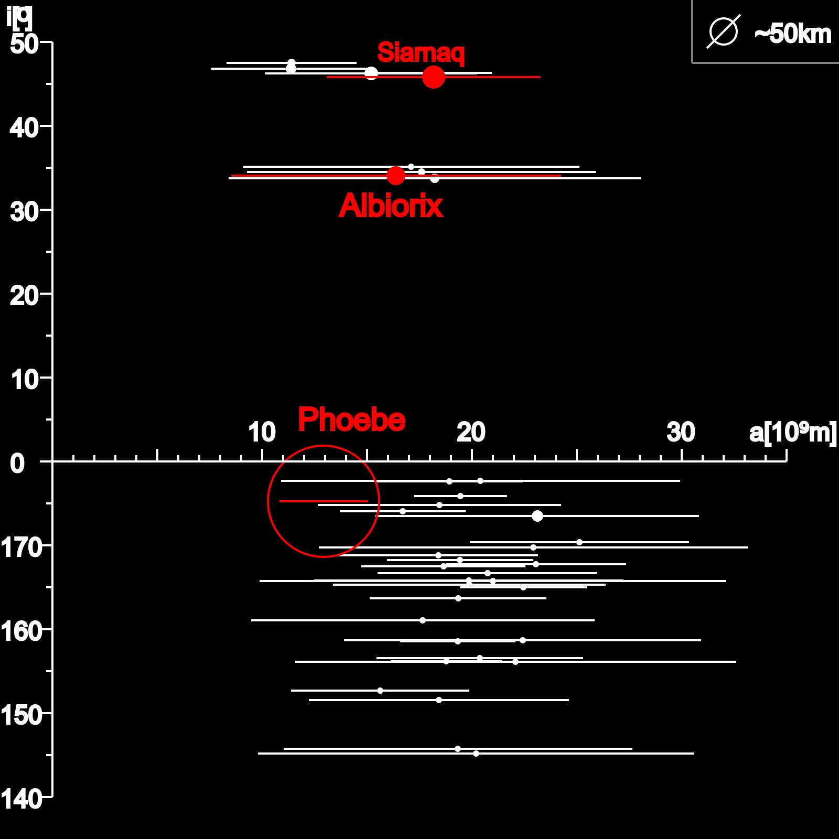
Irregular Satellites
Satellites of Jupiter
Satellites of Saturn

Slide 4
Irregular Satellites
Capture:
  Gas Drag (Cuk & Burns, 2003);
  3-body interation (Nesvorný et al., 2007);
  Collision (Sheppard, 2006).
Orbital Evolution:
  Origin of the orbital family of satellites (Nesvorný et al., 2004);

Slide 5
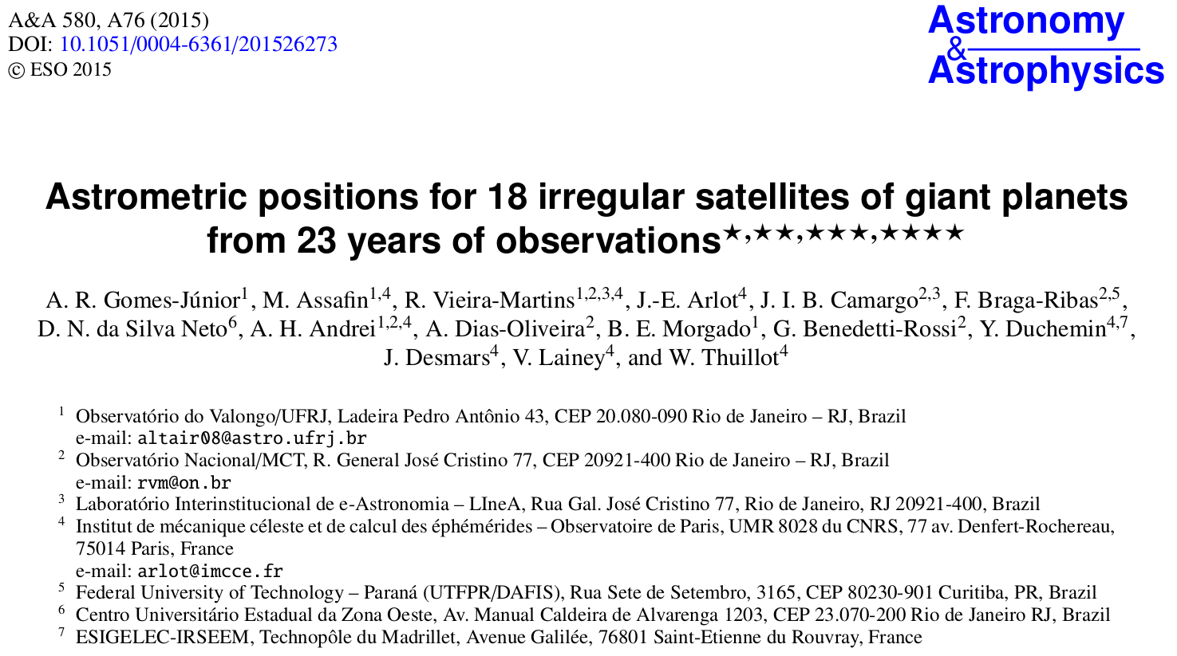
Astrometry

Slide 6
Goal
Organize and reduce three database with images of the irregular satellites of the giant planets observed between 1992 e 2014 at OPD, OHP e ESO.
Obtain precise positions from these observations which can be used to:
  New numerical integrations of the orbits of these satellites.
  Predict and observe stellar occultations by these objects.

Slide 7
Observations

Slide 8
OPD (Itajubá) Telescopes
3 Telescopes: Perkin-Elmer (1.6m), Boller&Chivens (0.6m) and Zeiss (0.6m);
11 Detectors used;
FOV: 5'x5' – 13'x13';
Pixel Scale: 0.176'' – 0.702'';
Filters used: Clear, U, B, V, R, I;
5248 observations (1992-2014).

Slide 9
OHP Telescope
Aperture of 1.2m;
CCD 1024x1024 pixel;
Pixel scale of 0.69'';
FOV of 12'x12';
Filters used: V, R, I;
2408 observations (1998-2008).

Slide 10
ESO Telescope
2.2m Max-Planck Telescope;
Wide Field Imager Detector with 8 CCDs;
The size of each CCD is 2k x 4k pixel with a pixel scale of 0.238”;
Each CCD has a FOV of 7.5'x15';
The filter used was a broad-band R filter (ESO#844) with λc = 651.725 nm and ∆λ = 162.184 nm;
810 observations (2007-2009).

Slide 11
Reduction Process
Bias and flat-field calibration.
PRAIA (Assafin et al., 2011):
  Extract data of the header of the images;
  Detect objects in the image (x, y);
  Identify catalogue reference stars;
    UCAC4
  Obtain (α,δ) from gnomonic projection;
  Global Reduction (Assafin et al., 2012) for the mosaic CCDs;
  Identify targets in the images.
    JPL ephemeris.

Slide 12
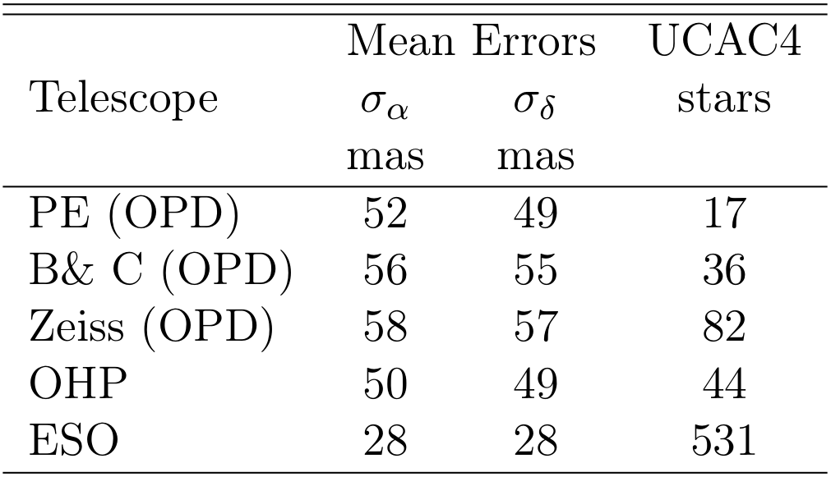
Astrometry
Mean errors are the standard deviations in the (O−C) residuals from (α, δ) reductions with the UCAC4 catalog.

Slide 13
RESULTS

Slide 14
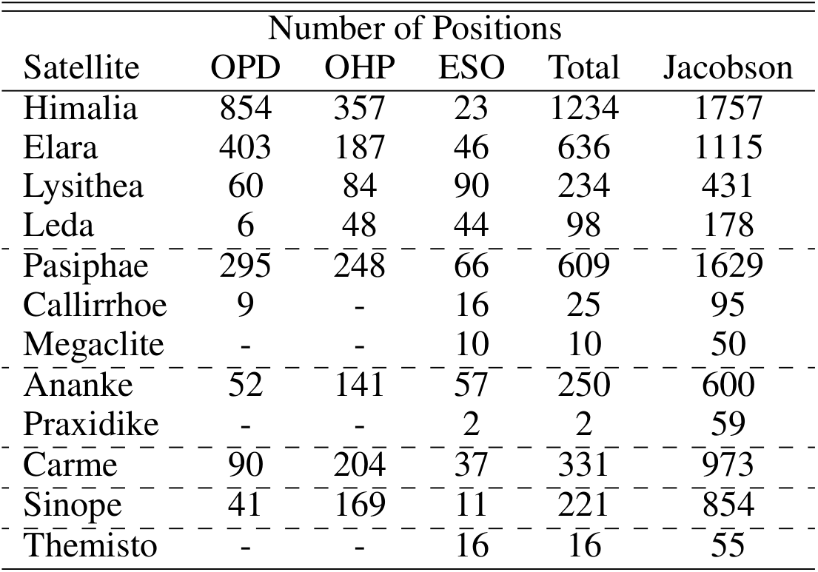
Results
*
* Jacobson, R. A. et al, 2012, The Astronomical Journal

Slide 15

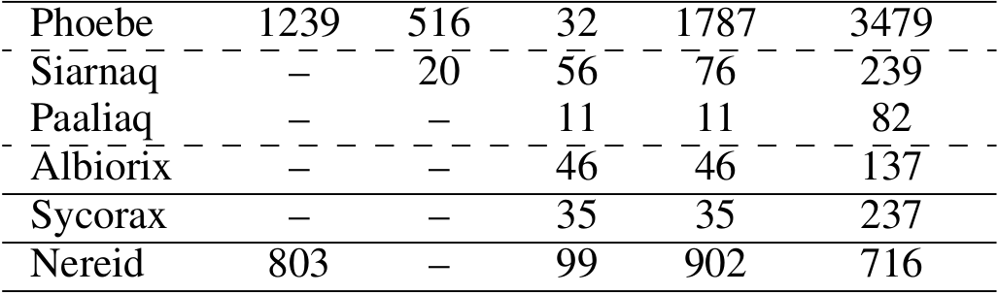
Results
*
* Jacobson, R. A. et al, 2012, The Astronomical Journal

Slide 16
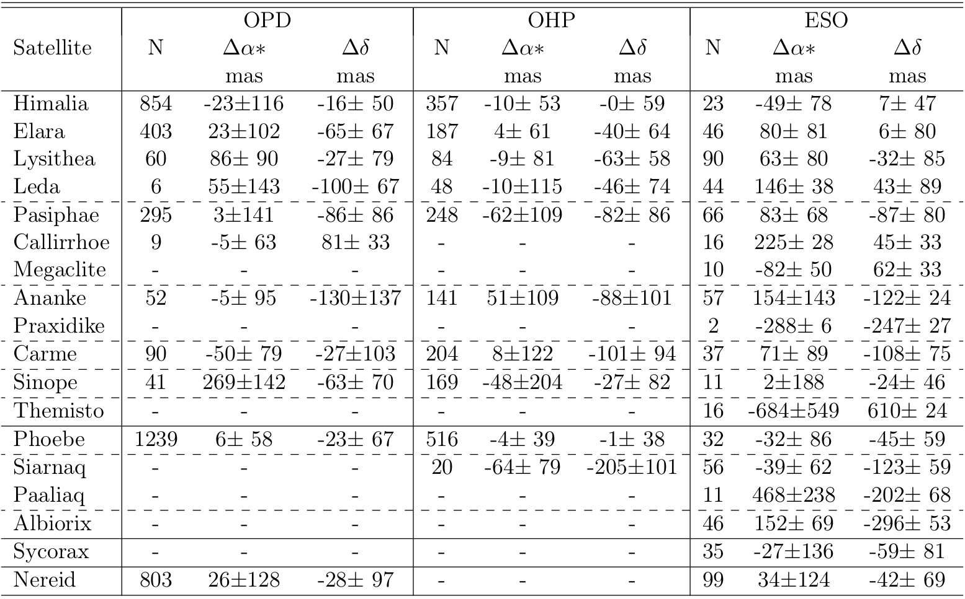
Results - Offsets
N: Number of positions
Δα* = Δα cosδ

Slide 17
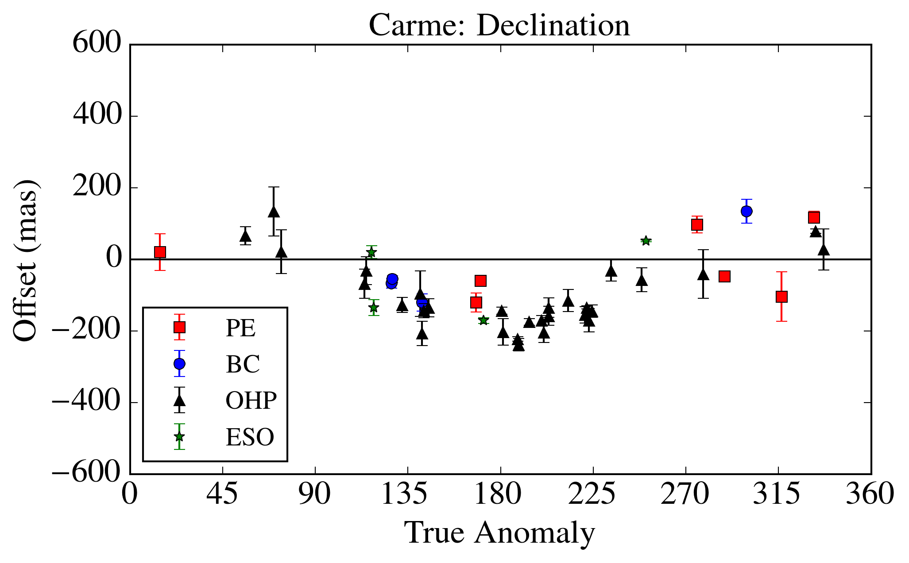
Results - Carme
*
* Relative to JPL jup300+DE421 ephemeris

Slide 18
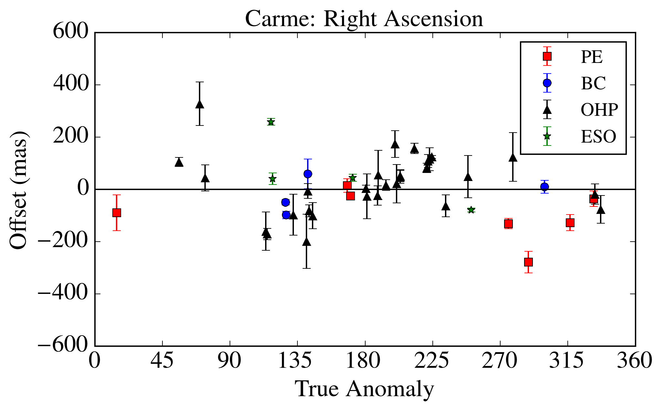
Results - Carme
*
* Relative to JPL jup300+DE421 ephemeris

Slide 19
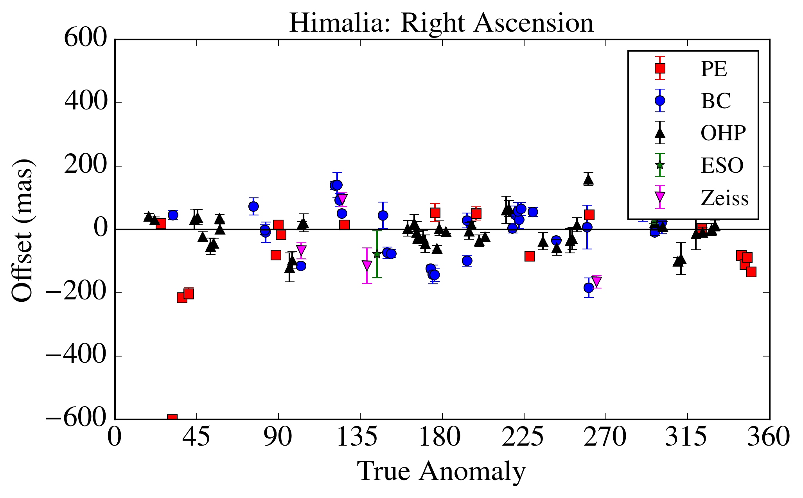
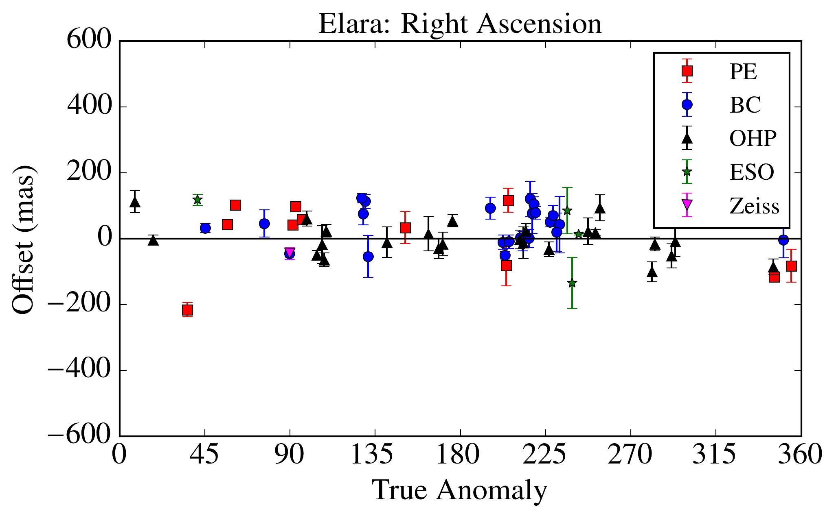
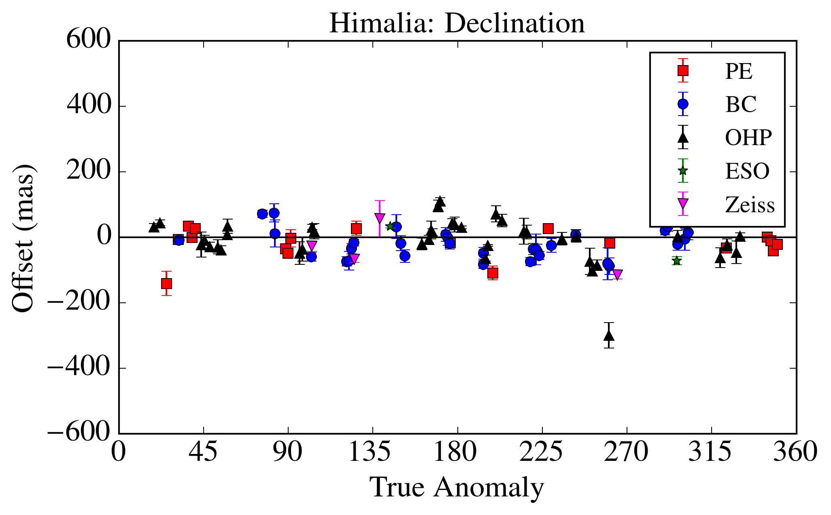
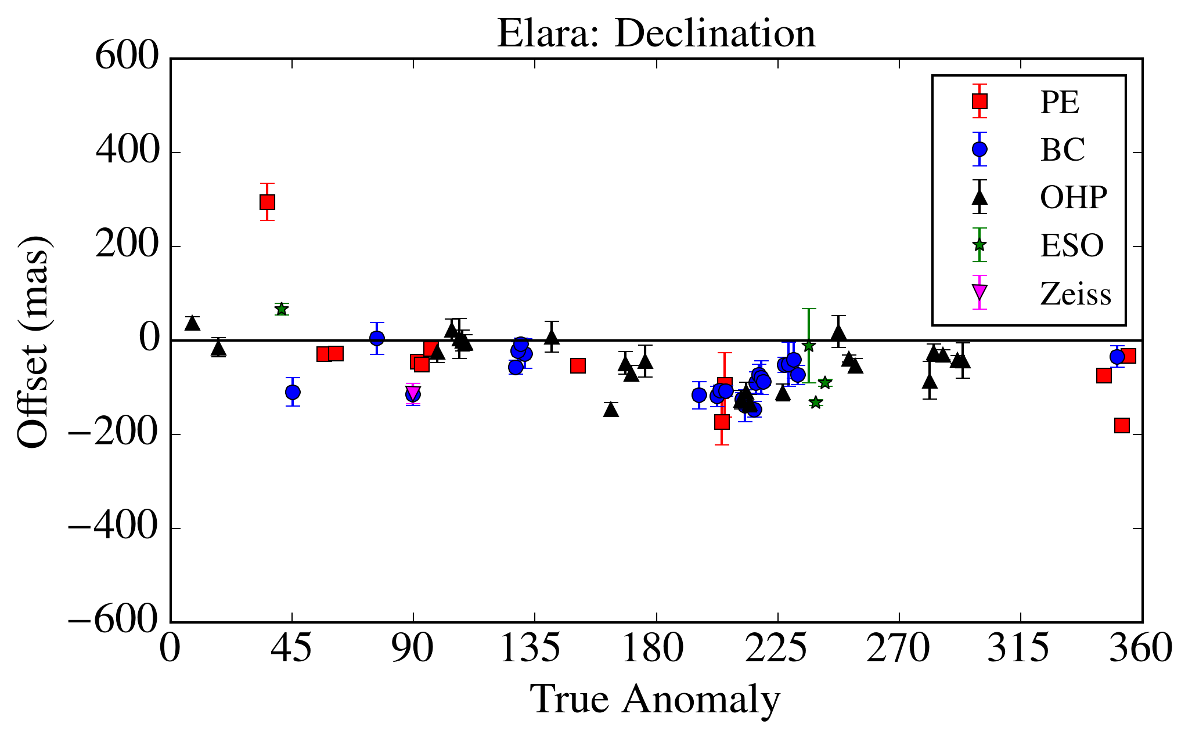
Results – Himalia and Elara

Slide 20
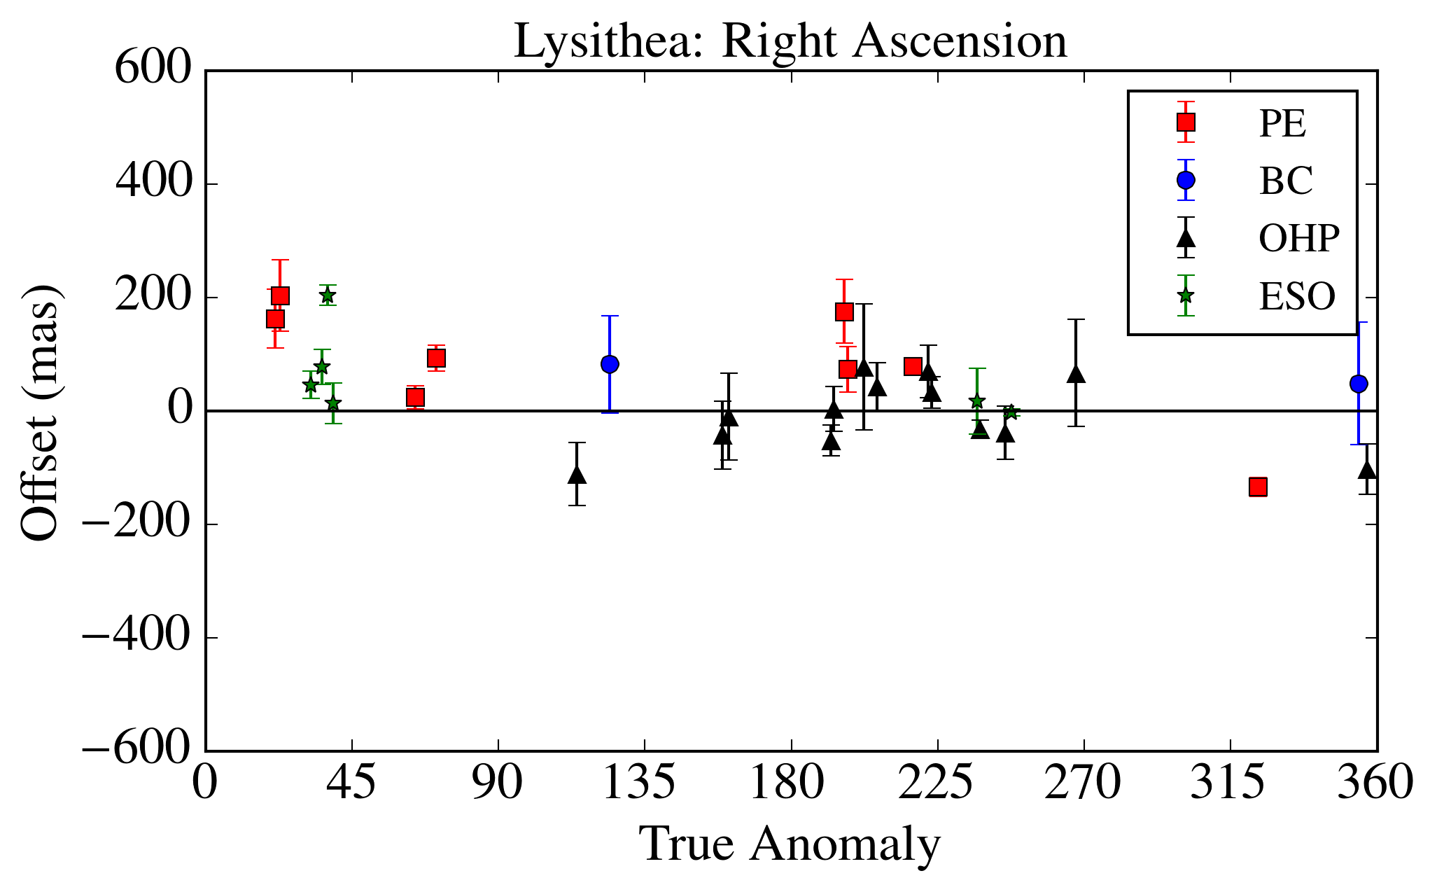
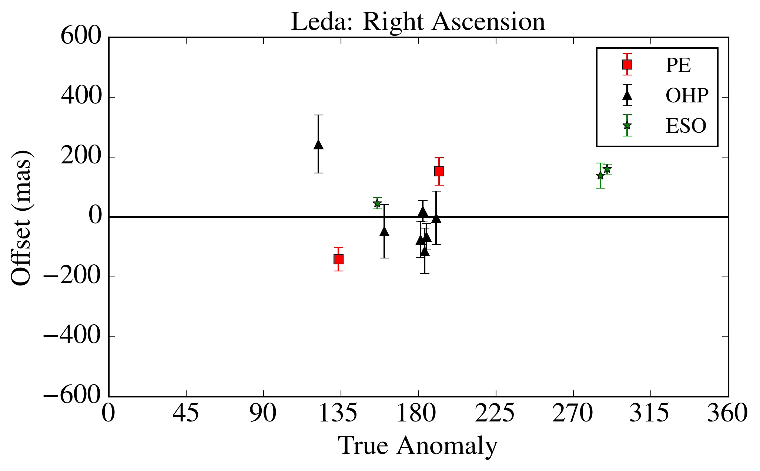
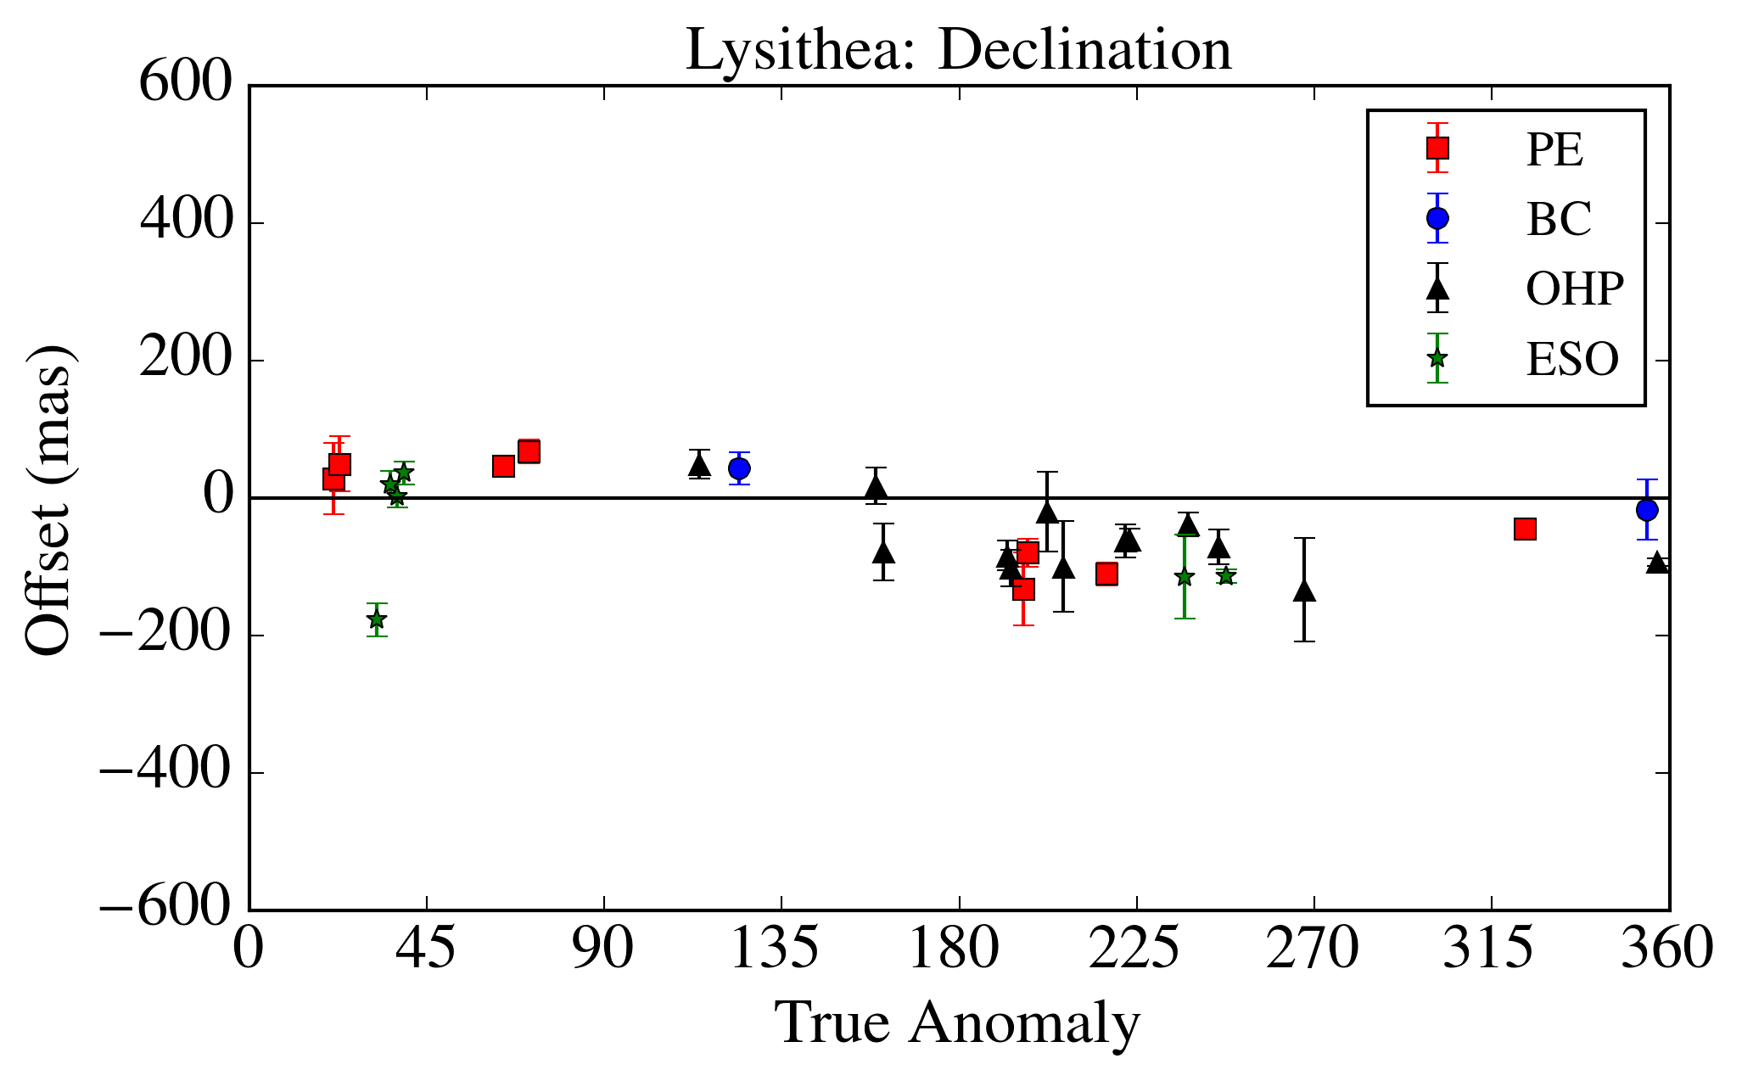
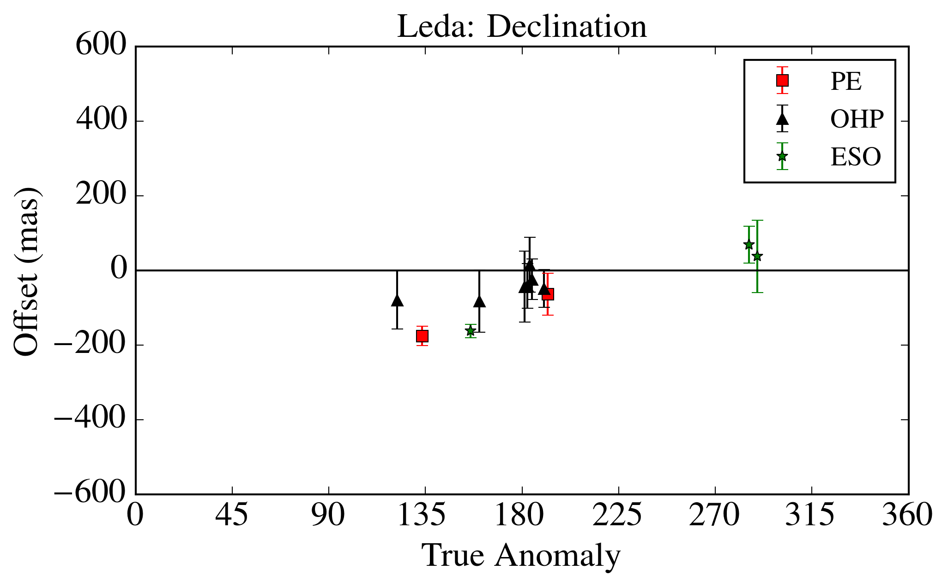
Results – Lysithea and Leda

Slide 21
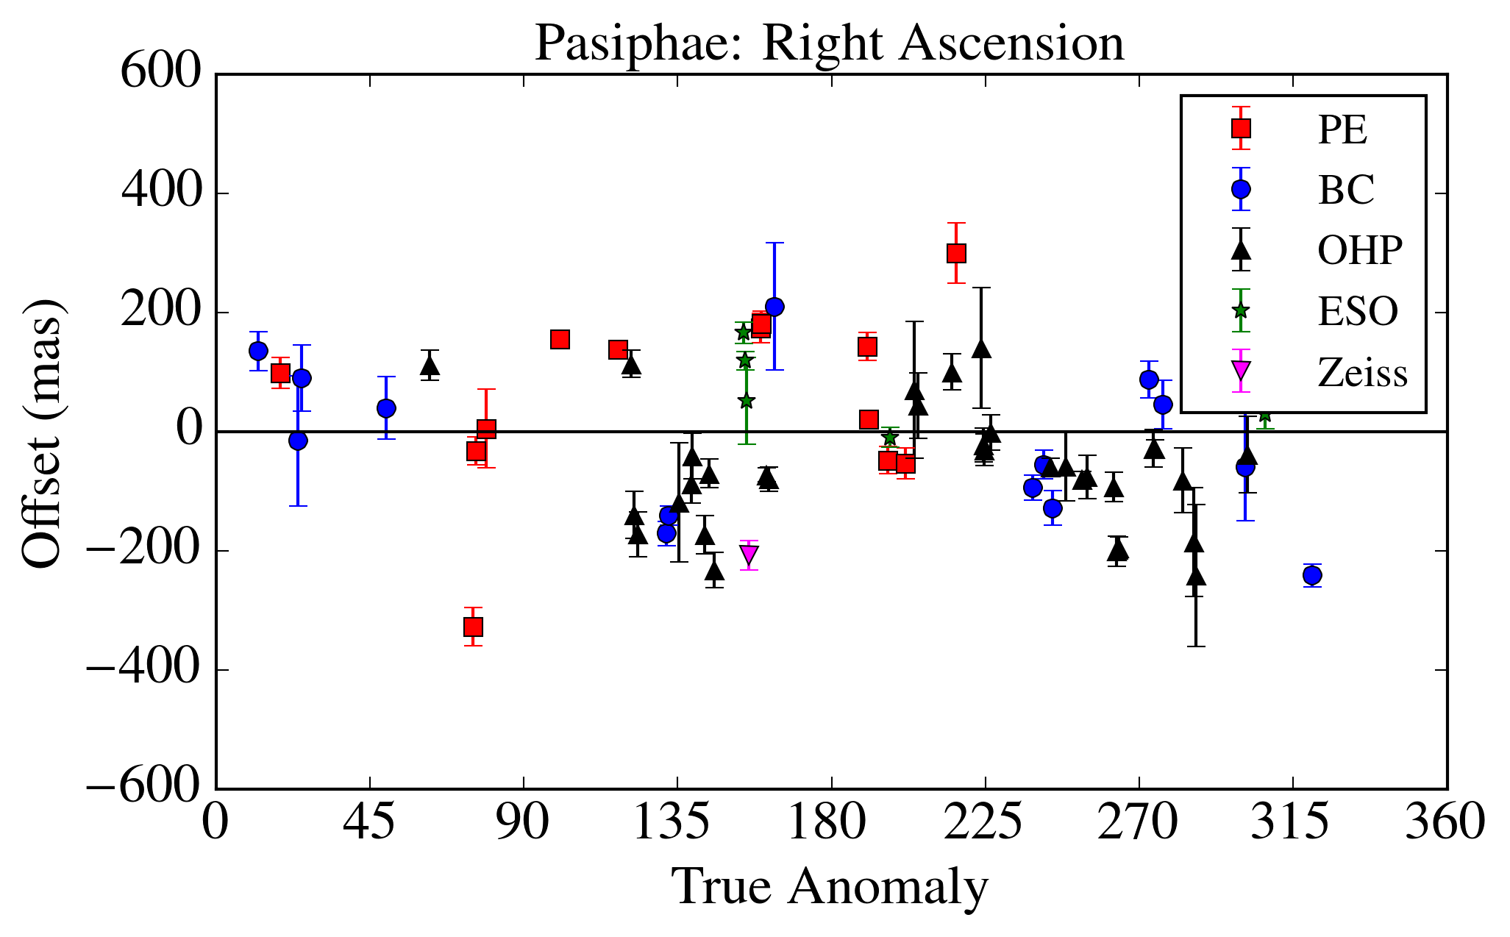
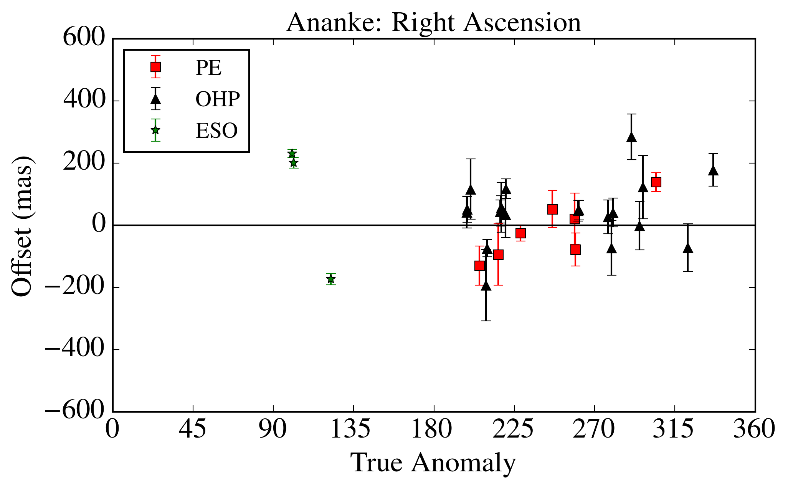
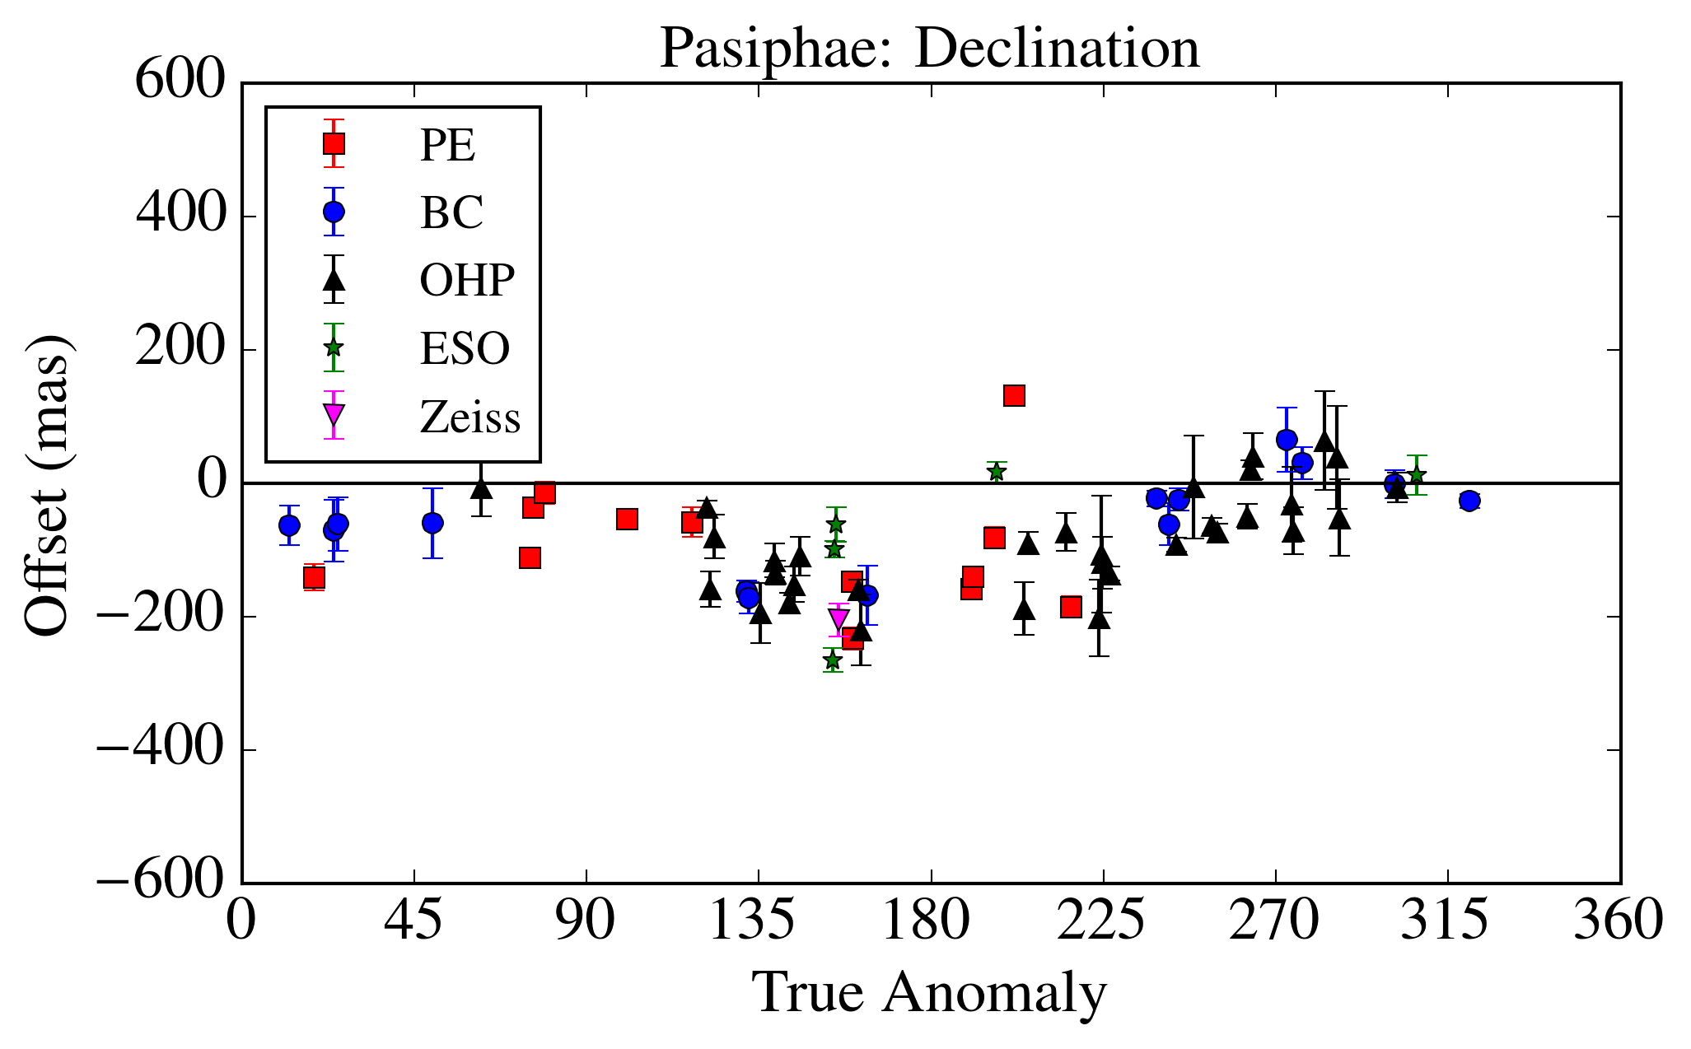
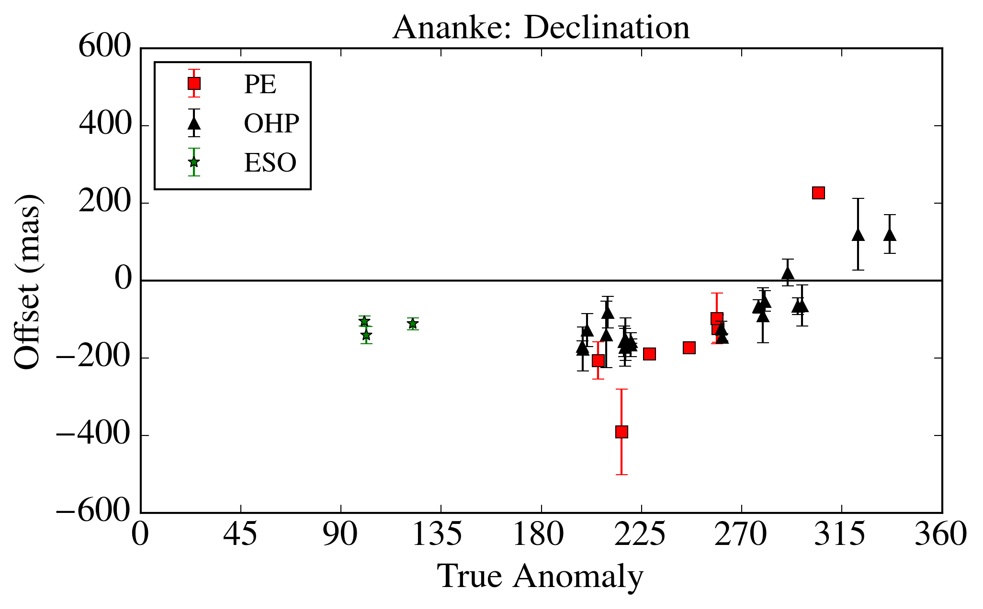
Results – Pasiphae and Ananke

Slide 22
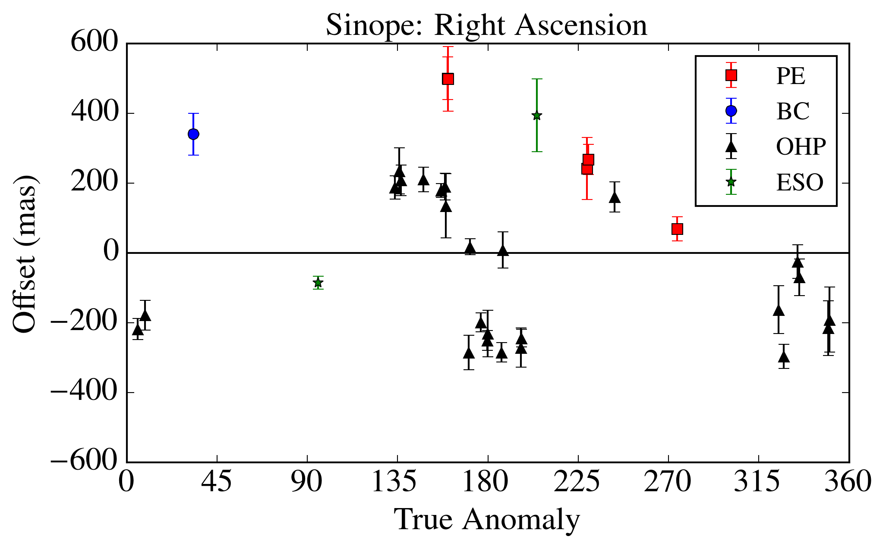
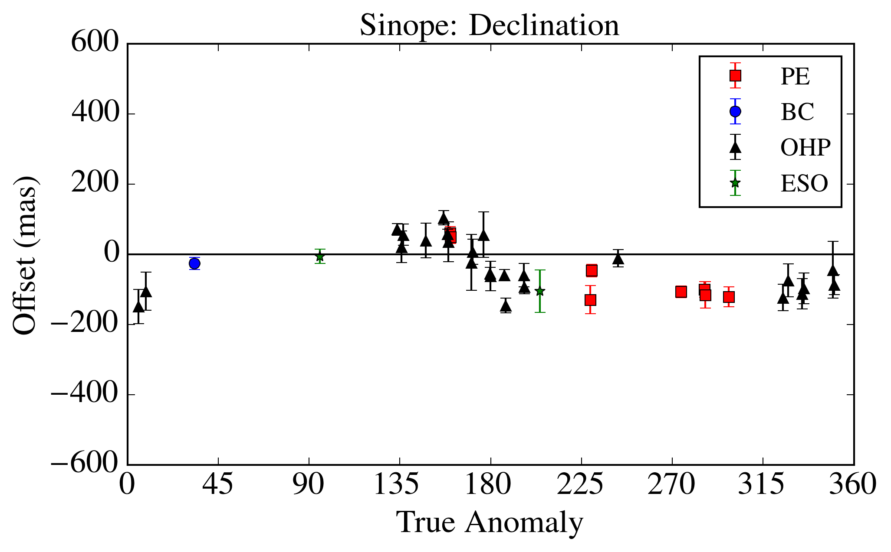
Results -Sinope

Slide 23
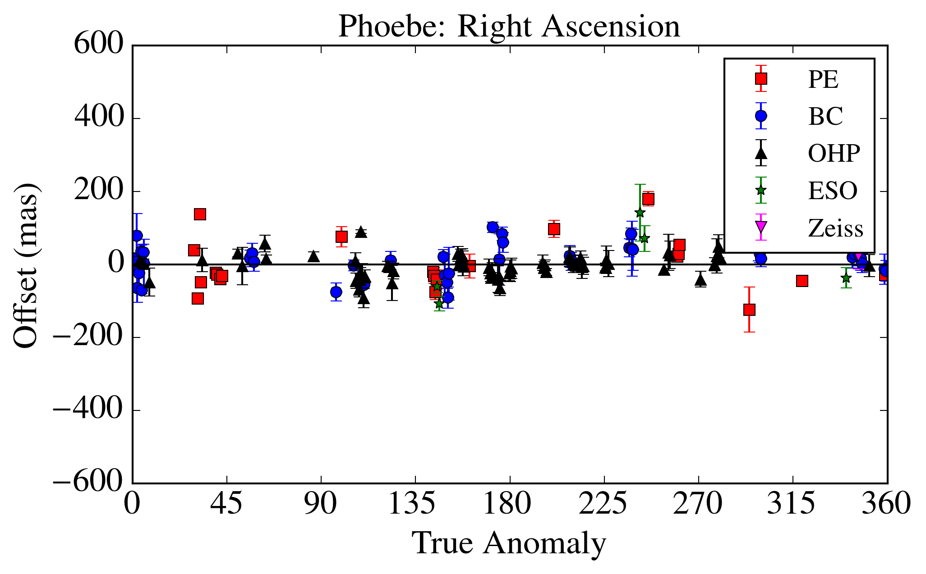
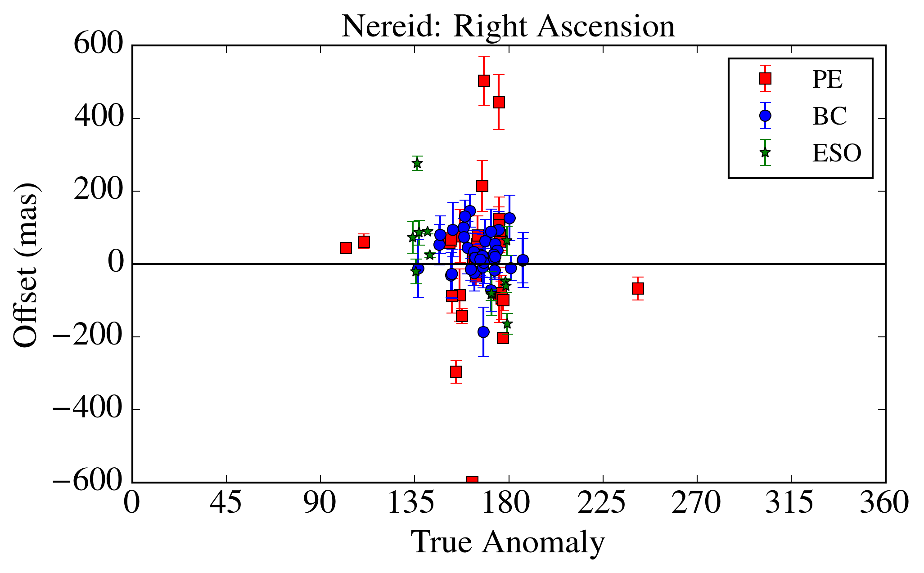
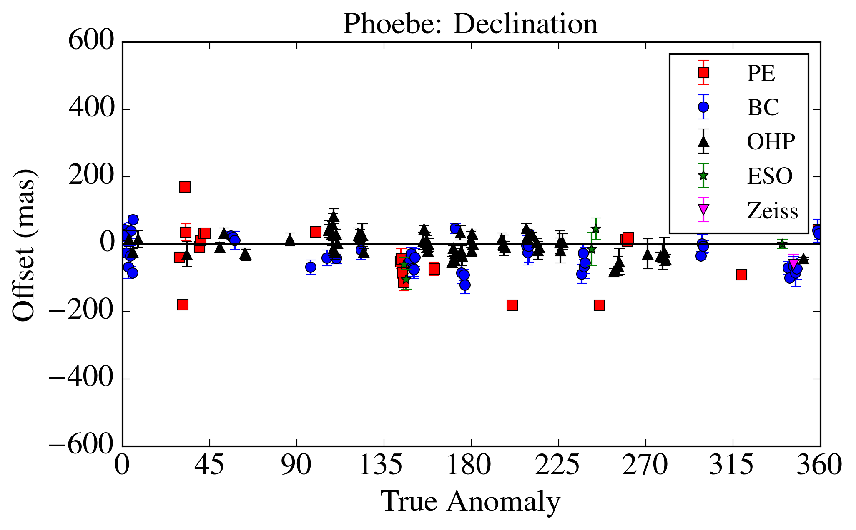
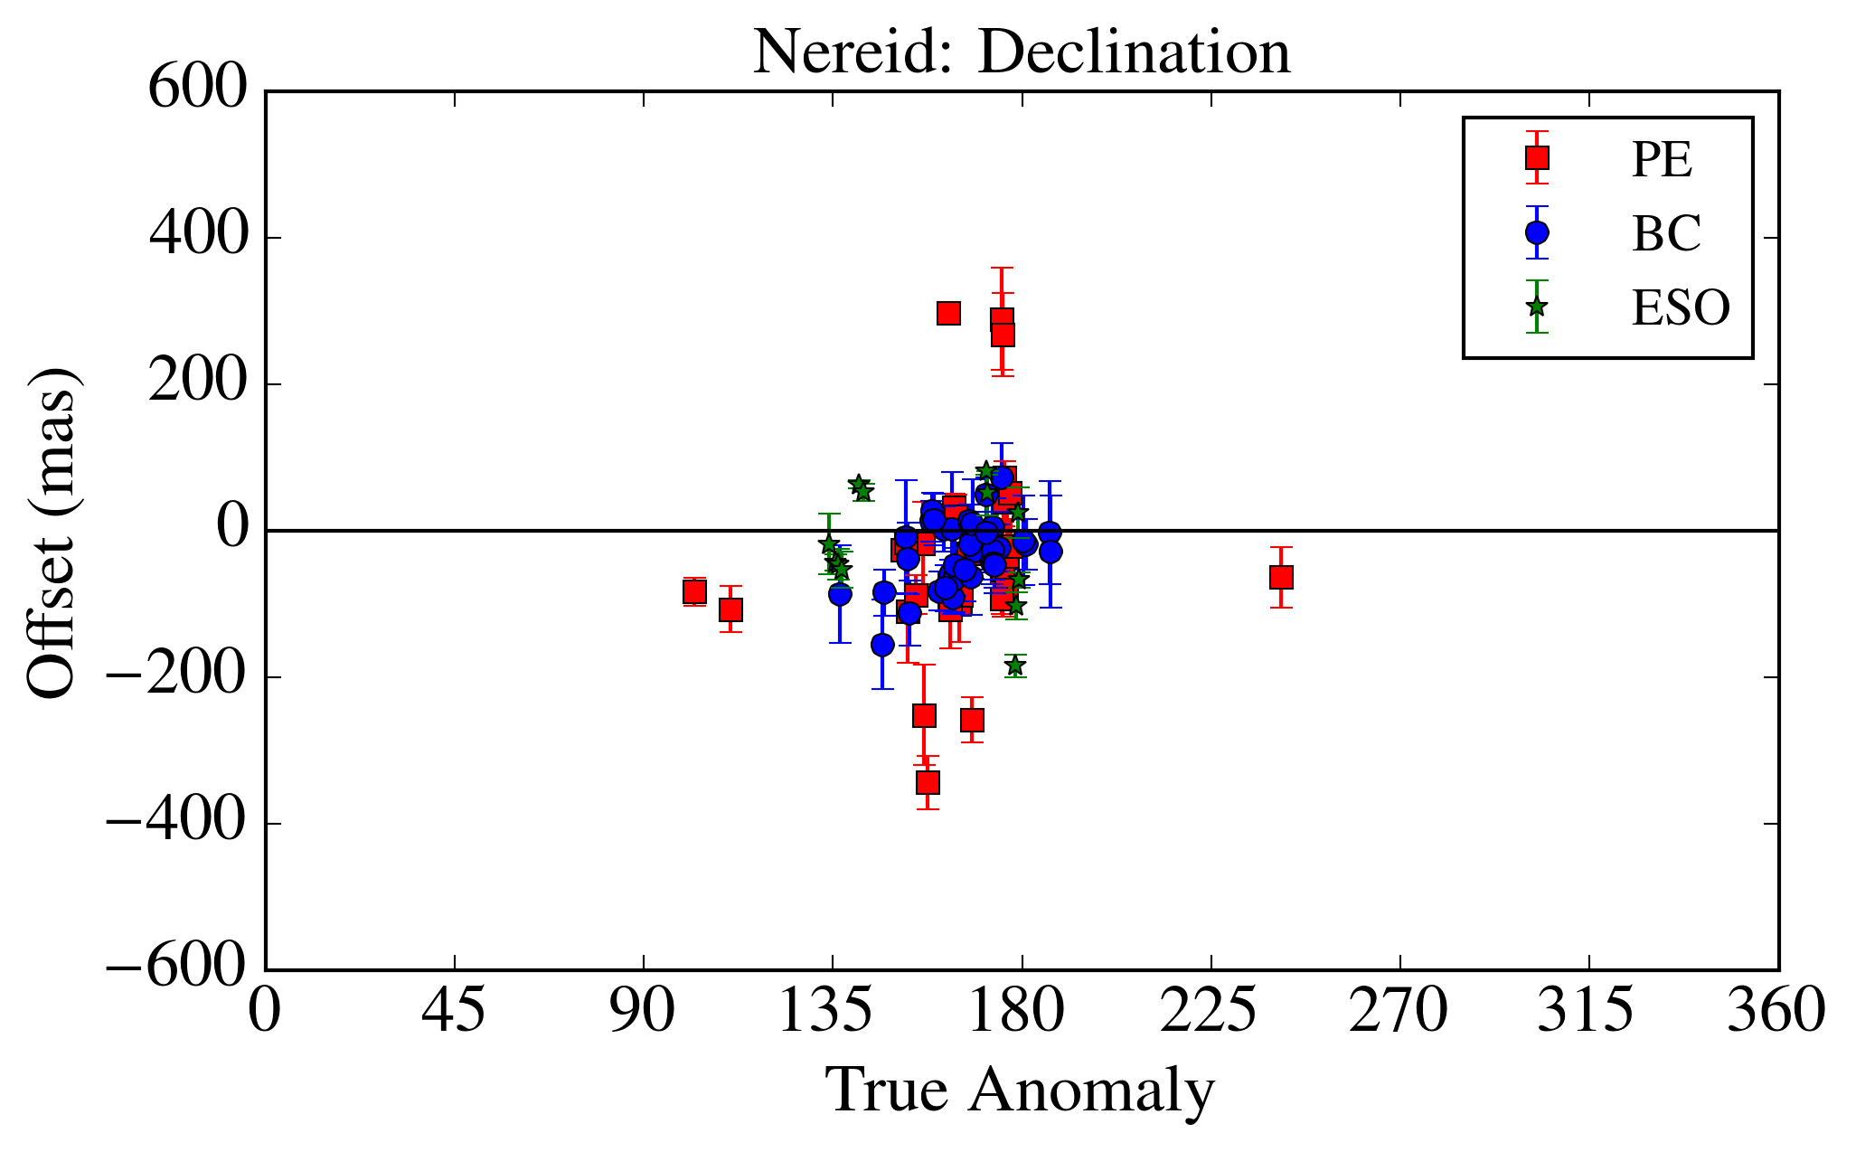
Results – Phoebe and Nereid

Slide 24
Conclusion
We identified 8466 observations of irregular satellites, from which we obtained 6523 suitable astrometric positions.
Position errors estimated of about 60-80 mas depending on brightness.
All positions are available at the CDS

Slide 25

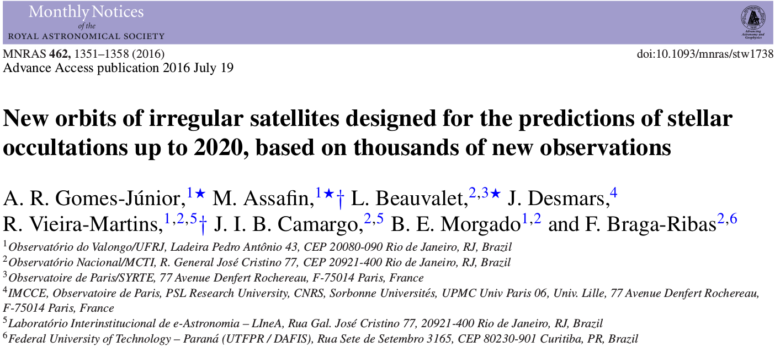
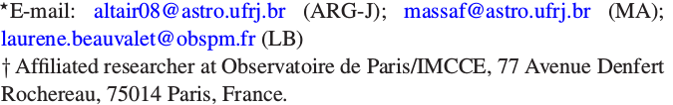
Stellar Occultations of Irregular Satellites

Slide 26
Goal
Predict stellar occultation for irregular satellites to determine:
  Size;
  Shape;
  Albedo;
  Density, if mass known;
  Characterize family of satellites.

Slide 27

Stellar Occultation
Elliot et al, 1979
Notes:
Anéis
Atmosfera (refração)
Pico central
Caso não haja atmosfera

Slide 28

Example: Ceres (2010)
Gomes-Júnior et al. (2015, MNRAS)

Slide 29
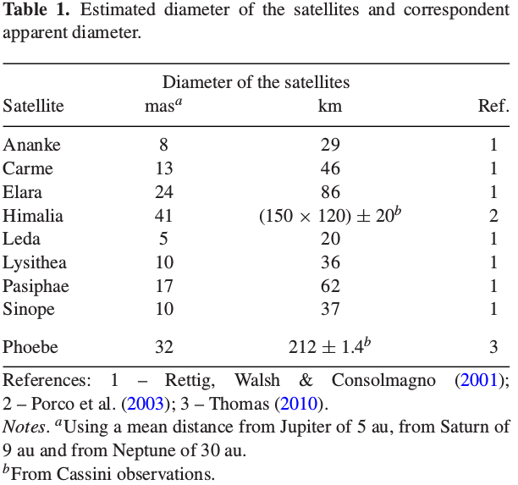
Irregular Satellites
Gomes-Júnior et al. (2016)

Slide 30
Opportunity for Irregular Satellites
Successful experience in stellar occultations by TNOs/Centaurs with Rio team;
Jupiter and Saturn will cross the central side of the Galactic Plane in 2018 and 2019-2020, respectivelly;
Release of the Gaia catalogue (DR1 last week);
Improvement of ephemeris using our positions.

Slide 31
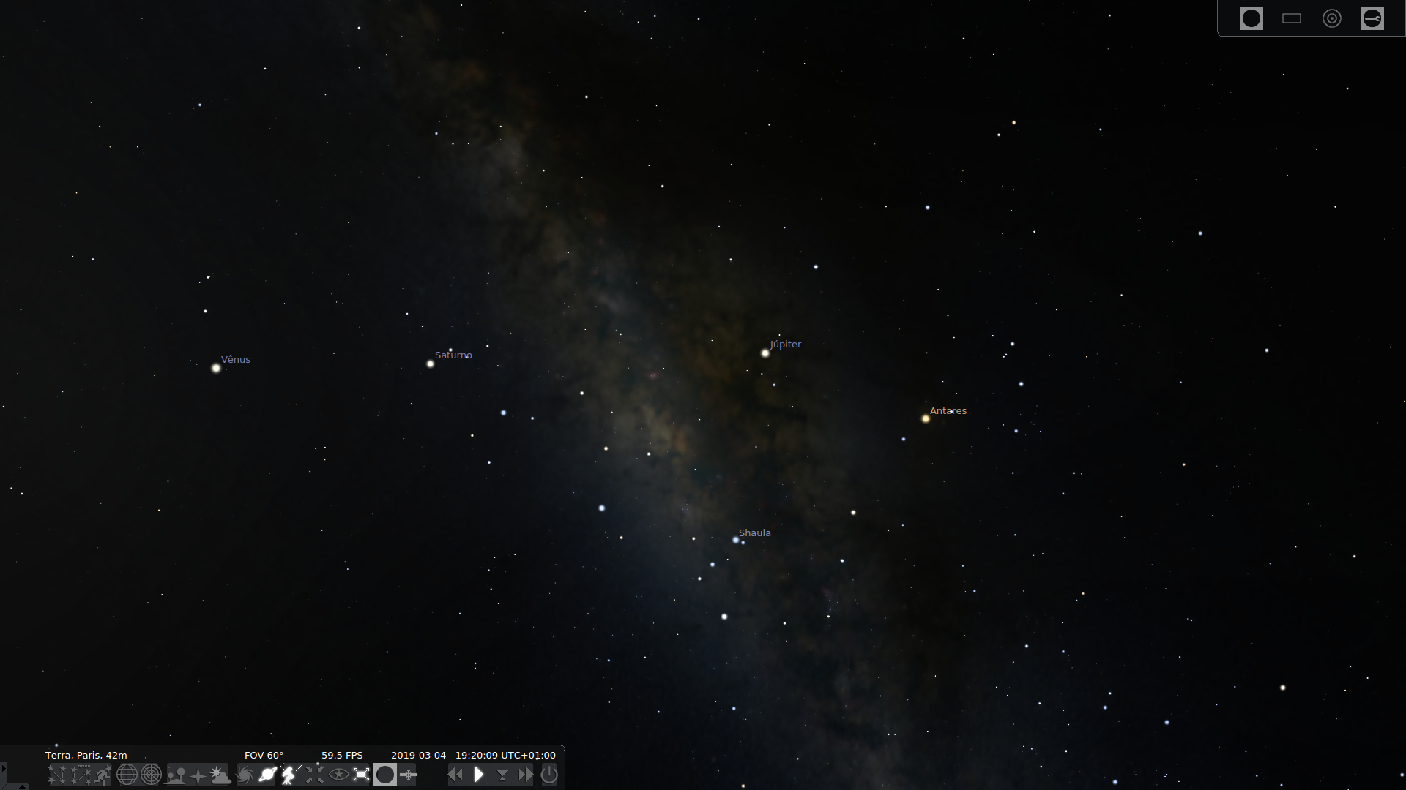
Galactic Plane
The next time that Jupiter will cross the central side of the galactic plane will be in 2031 and Saturn in 2046–2047.

Slide 32
Special Tailored Ephemeris
Ephemeris for the 8 major irregular satellites of Jupiter;
Only using the positions of Gomes-Júnior et al. (2015, A&A);

Slide 33
Ephemeris of Phoebe
Update the ephemeris of Desmars et al. (2013) using the position of Gomes-Júnior et al. (2015, A&A), +75% in the number of obs.

Slide 34
Prediction
Code: PRAIA;
Ephemeris: STE and Phoebe ephemeris;
Star Catalogue: UCAC4;
Number of occultations: 5442 from January 1st, 2016 up to December 31, 2020;
10% with a star brighter than R=14. Potentially observable by amateurs.
25% with a star brighter than R=15.

Slide 35
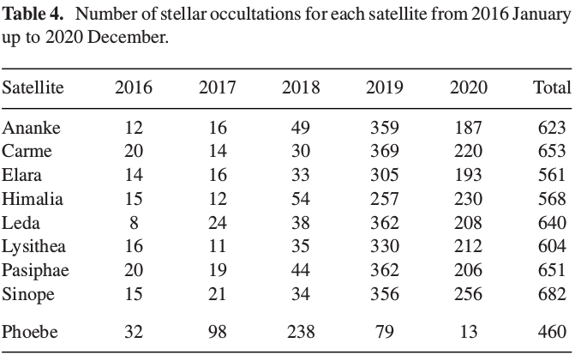
Occultations

Slide 36
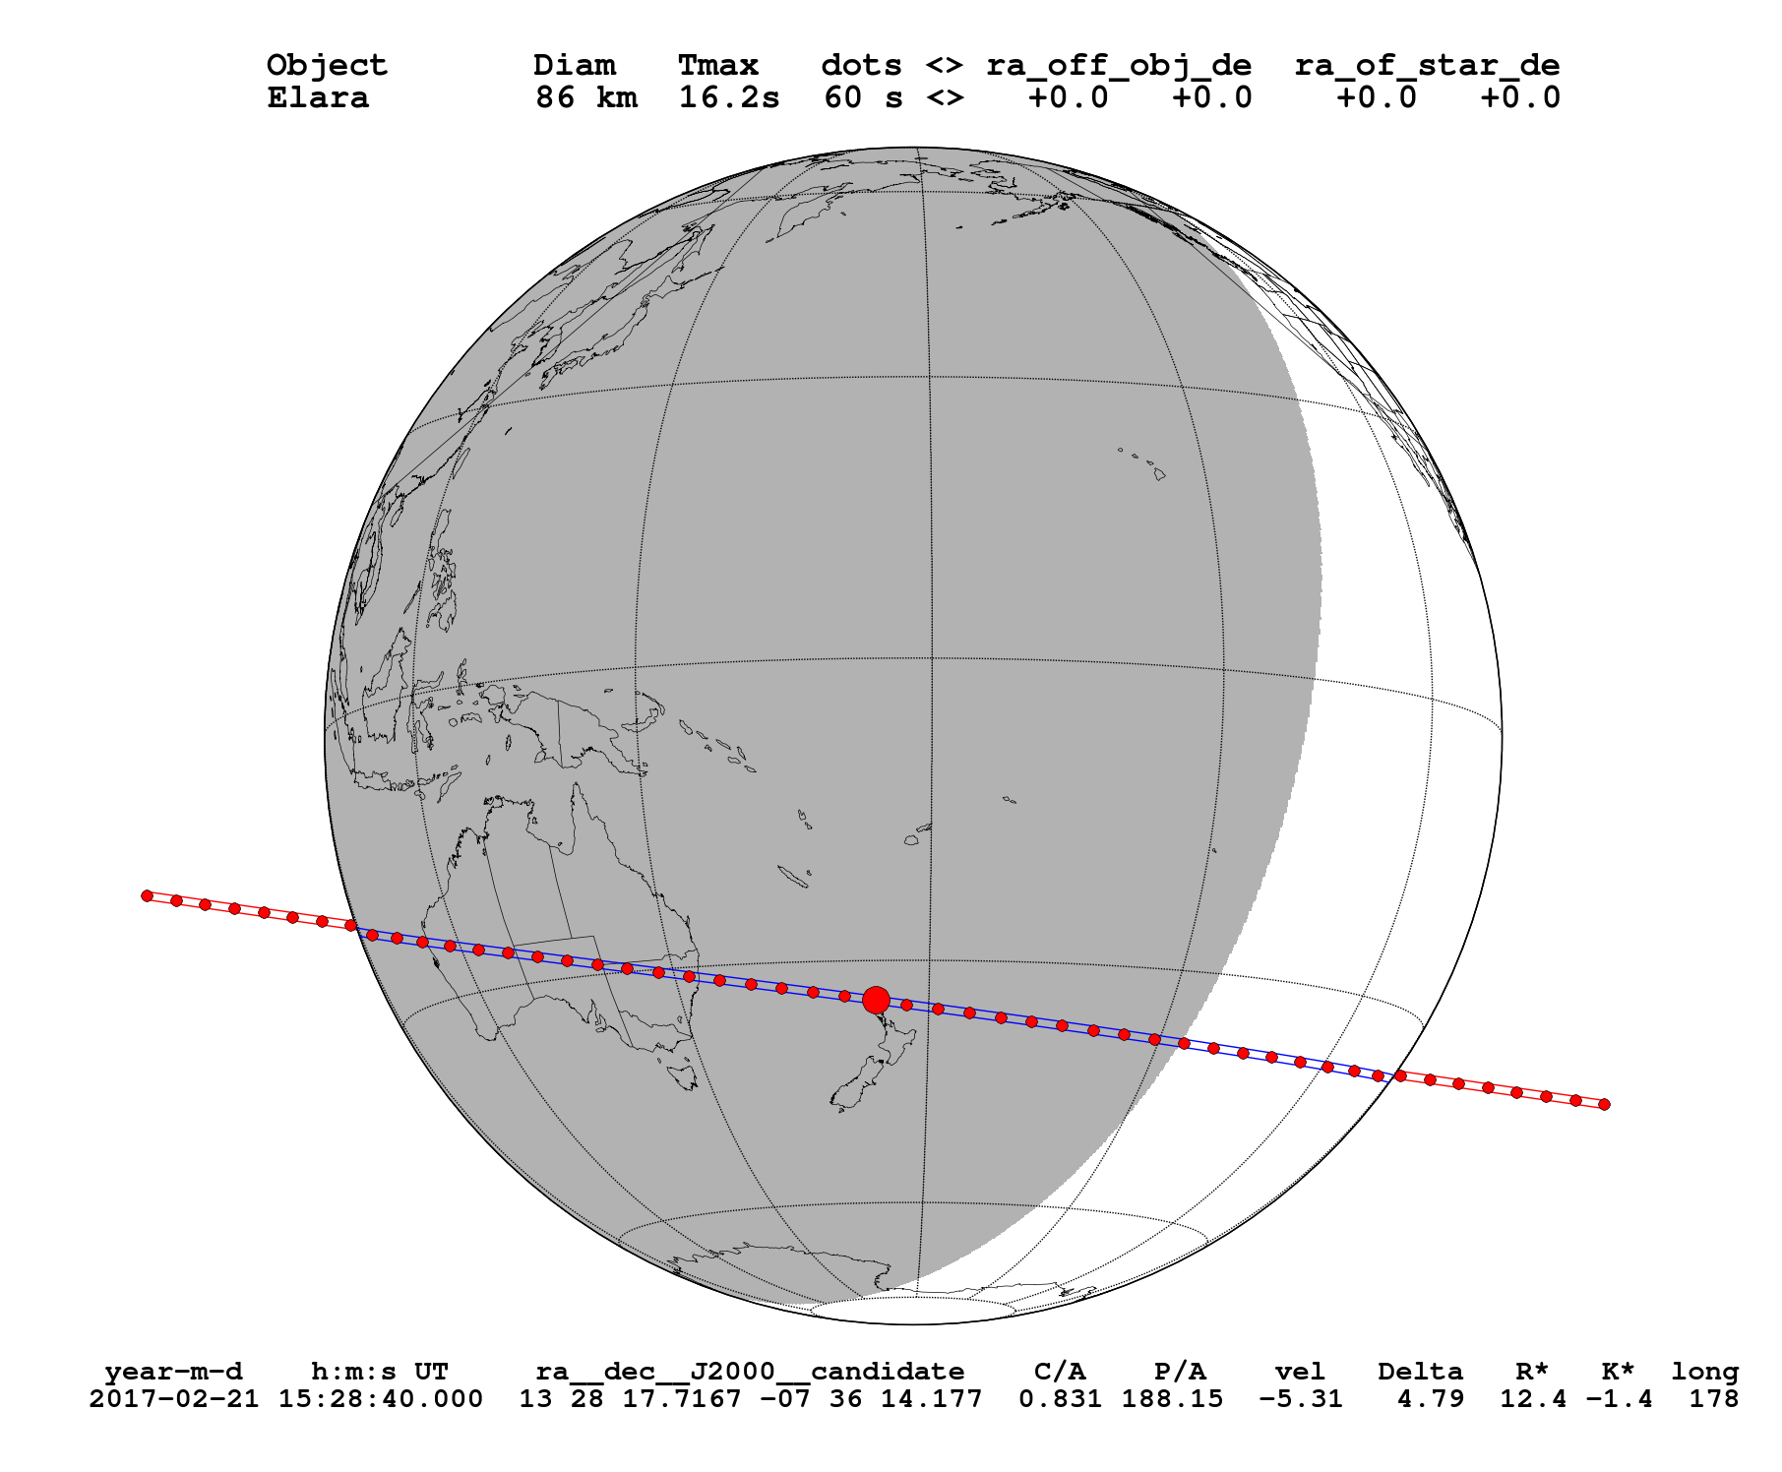
Elara – February 02, 2017

Slide 37
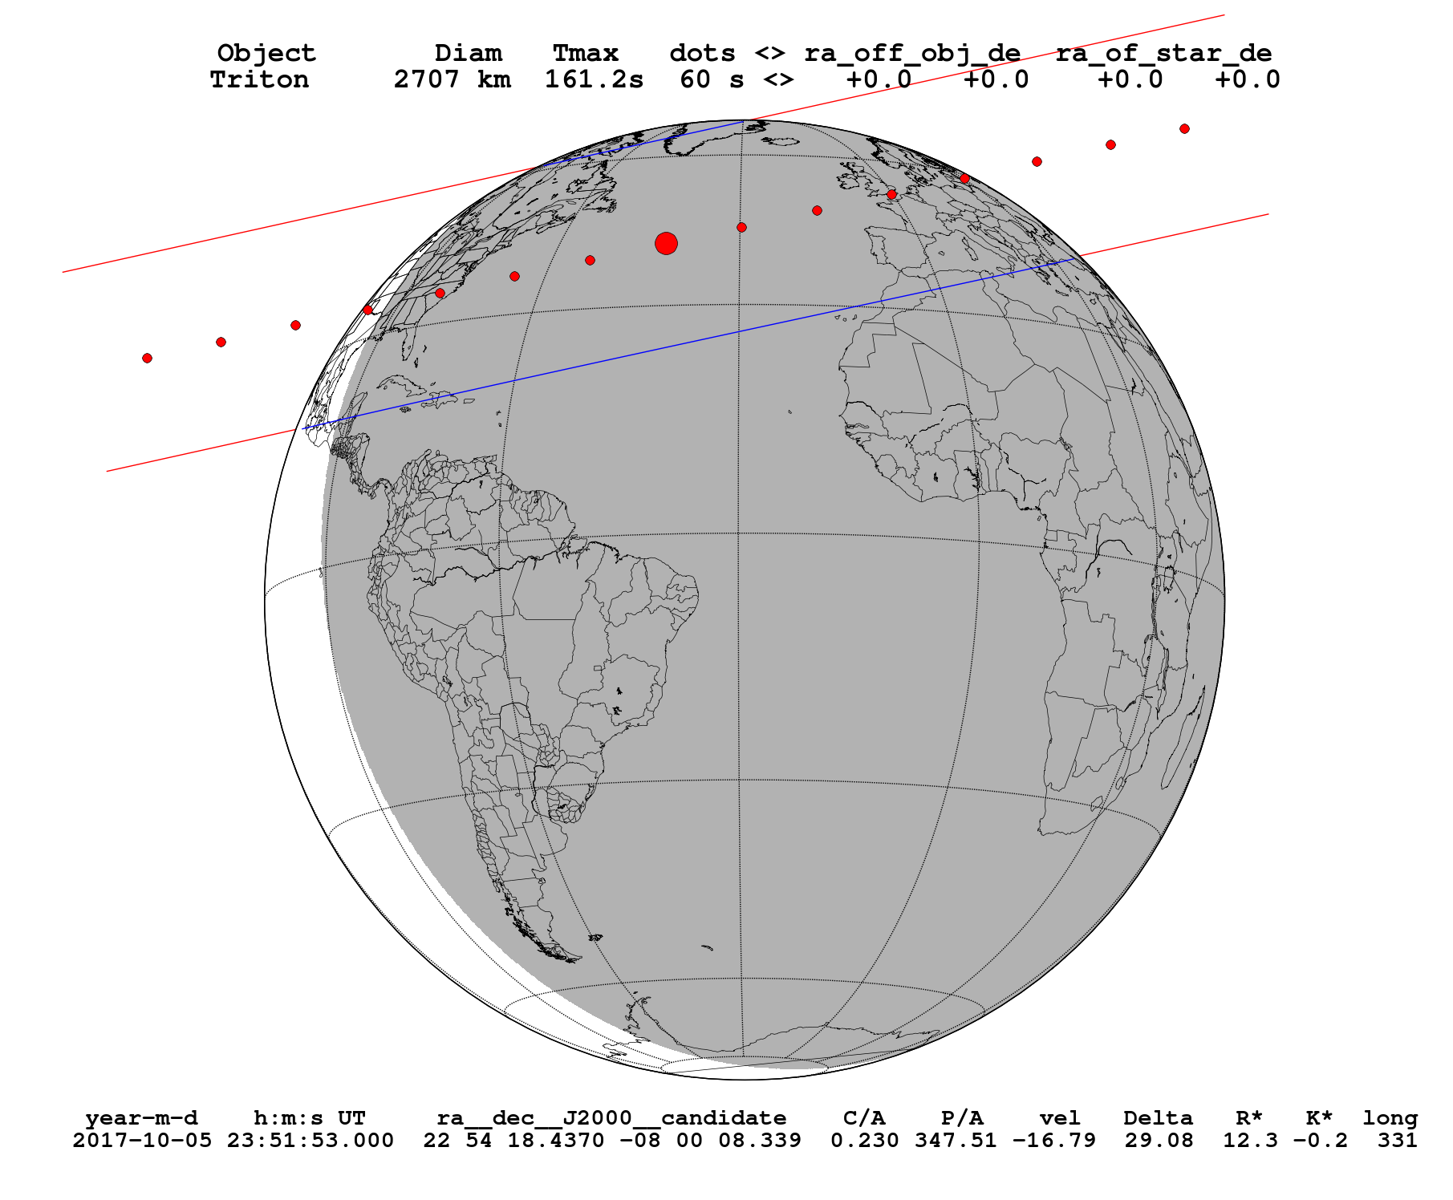
Triton – October 05, 2017

Slide 38
Next Steps
Re-reduce the observations with GAIA catalogue;
Numerical Integration of the orbits of the Irregular Satellites using all positions available;
Update occultation predictions using GAIA;
Observe stellar occultations by these objects.

Slide 39
Thank You

