Slide 1
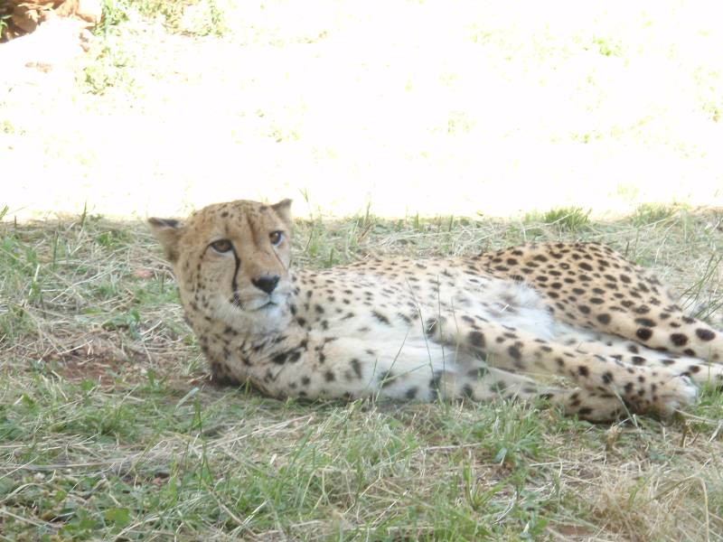
The Triton stellar occultation of 21 May 2008
Bruno Sicardy, Y. Boissel, F. Colas, A. Doressoundiram, J. Lecacheux, T. Widemann, M. Castets, E. Frappa, G. Blanchard, T. Payet, J.-P. Teng, K.-L. Bath, W. Beisker, H.-J. Bode, G. Roy, B. Thome, C. de Witt, P. Shönau, D. Buckley, N. Loaring, O. Bernard, M. Assafin, J. Camargo, D. da Silva Neto, F. B. Ribas, A. Andrei, R. Vieira Martins, R. Behrend

Slide 2
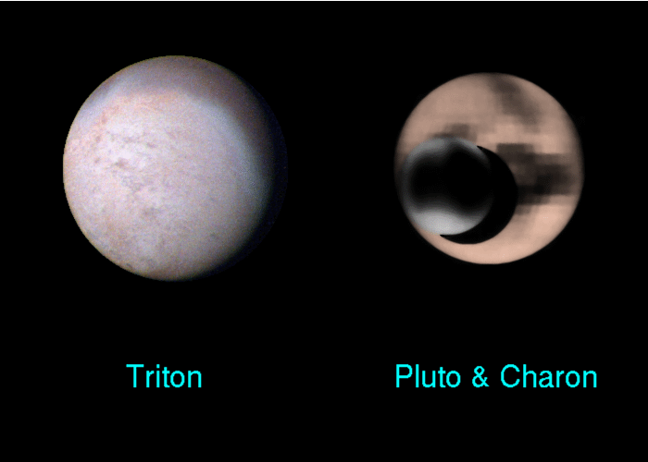

Slide 3
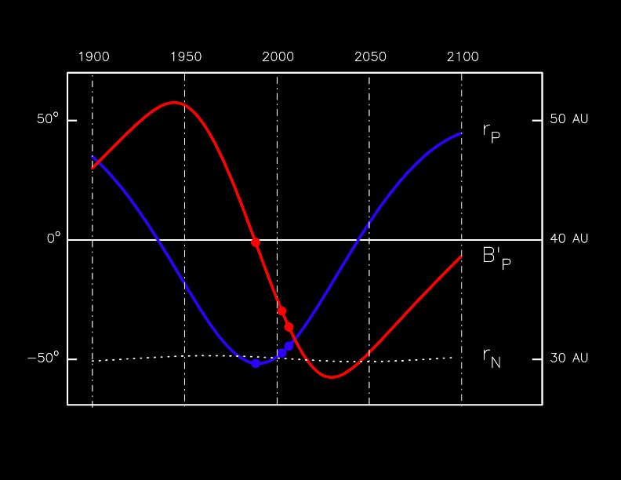
r_{P}
1988
B'_{P}
2002
2006
r_{N}
Pluto's seasons
Time

Slide 4
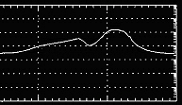
C.J Hansen & D.A. Paige
Icarus, 120, 247-265 (1996)

10 μbar

1 μbar
0.1 μbar
1900
2000
2100

Slide 5
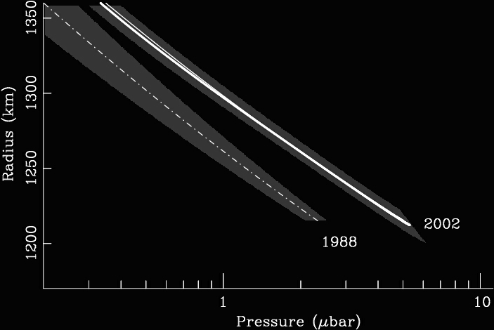
Sicardy et al.
« Large changes in Pluto’s atmosphere as revealed by recent stellar occultations »
Nature, 10 July 2003

Slide 6
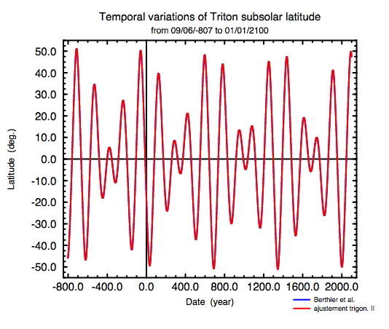
latitude sub-solaire de Triton:
le solstice "extrême" de 2000
650 ans!
from www.imcce.fr/fr/observateur/support/Triton/

Slide 7
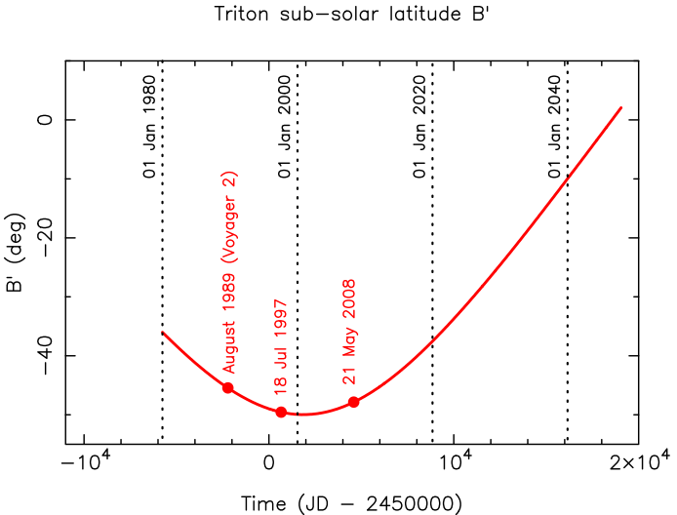
le solstice "extrême" Triton de 2000

Slide 8
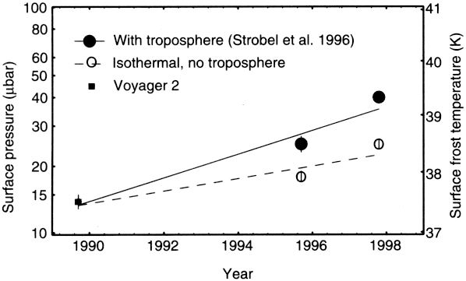
"Global warming on Triton" (?)
Elliot et al., Nature 393, 765 (1998)

Slide 9
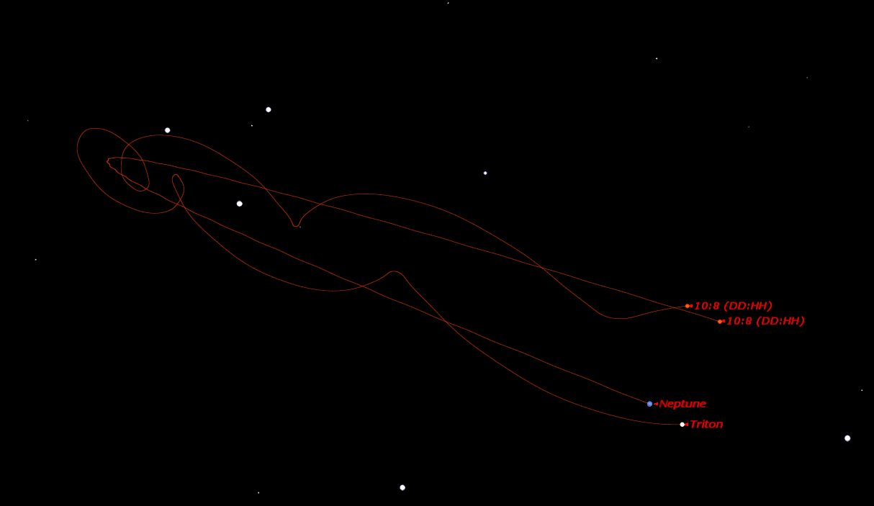
N
occulted star
1 arcmin
Neptune 21 May
Triton motion
Neptune 26 May
Neptune motion
10 May 2008
E
11 June 2008

Slide 10
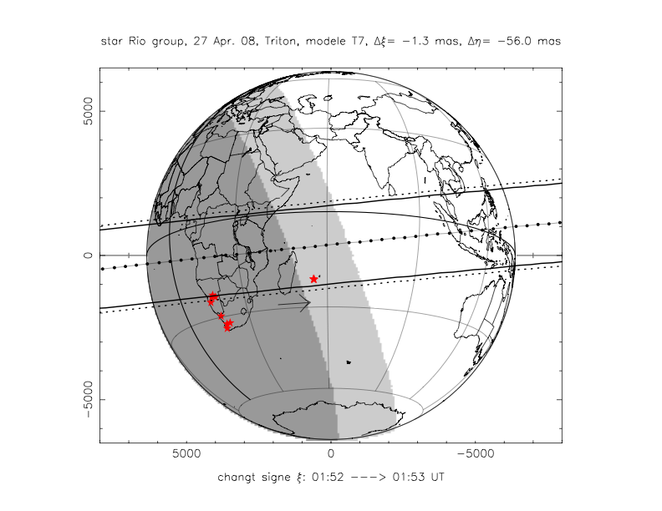

Slide 11
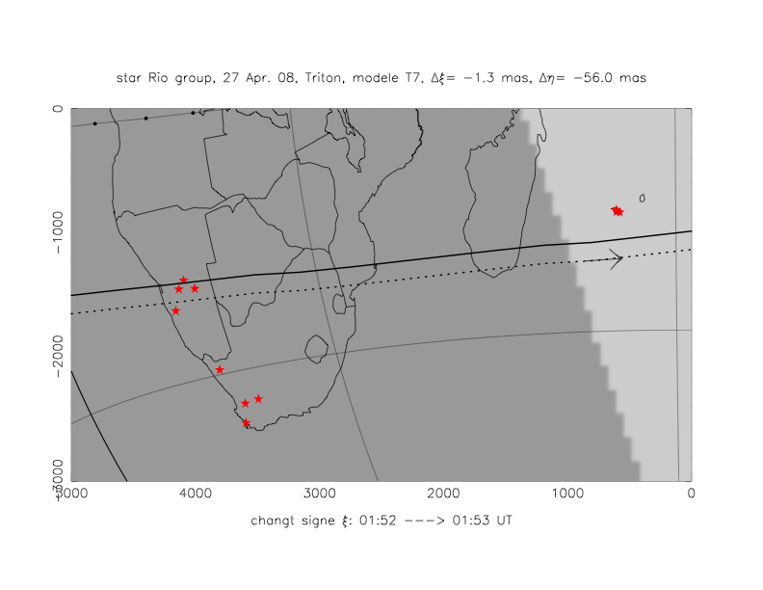
-Windhoek
-Hakos
-Tivoli
-Makes
-Maïdo
-Fournaise
-Le Cap
-Cederberg
-Springbok
-désert
Sutherland
-10m (SALT)
-1.9m
-1m

Slide 12
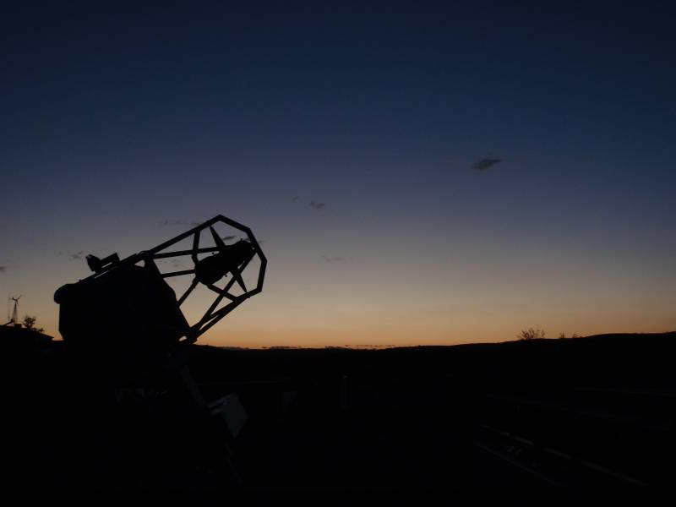
Namibia

Slide 13
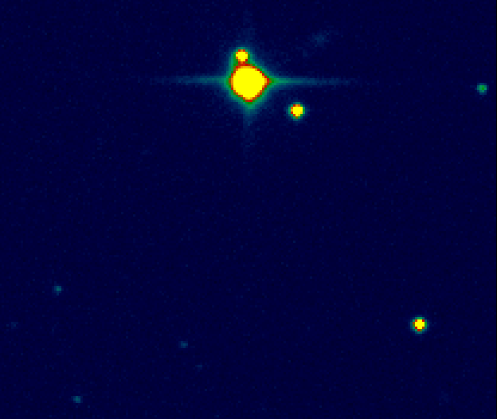
N
galaxy
occulted star + Triton
Neptune
reference star
E
Merlin
Raptorphotonics
camera
1 arcmin

Slide 14
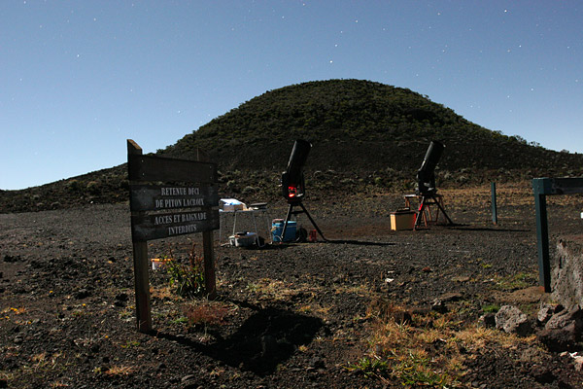
La Réunion

Slide 15
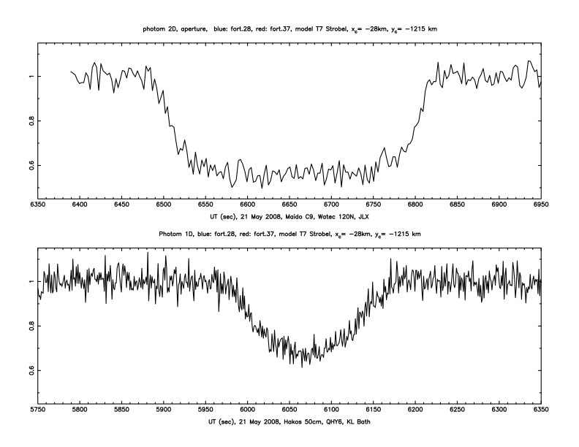
La Réunion, Maïdo
Watec 120N, T23cm
1 mn
Namibia, Hakos/IAS
QHY6, T50cm

Slide 16
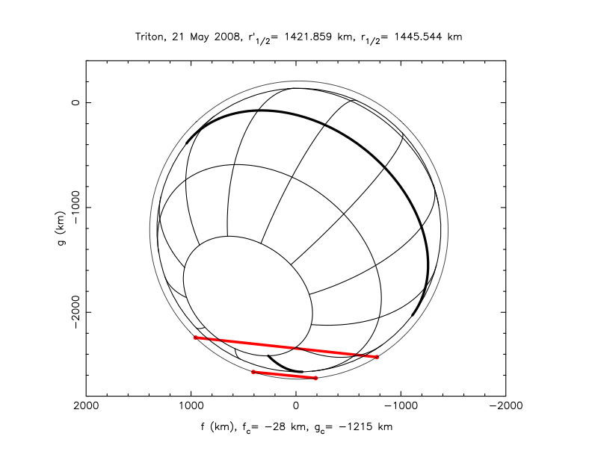
S
La Réunion, Maïdo
Namibia, Hakos/IAS

Slide 17
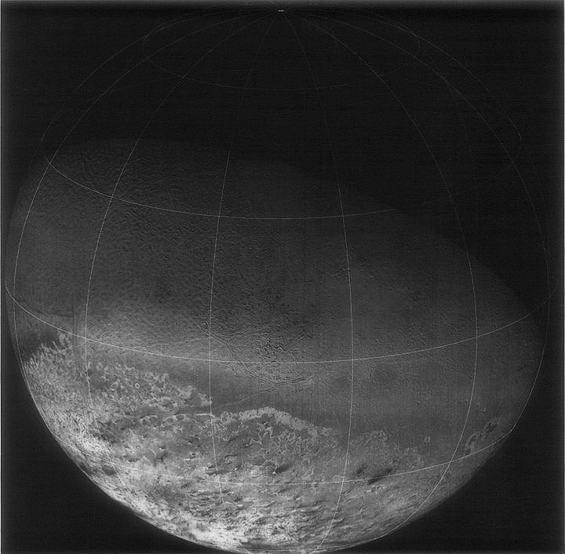
fig. 1 Hansen & Paige, Icarus 99, 273 (1992)

Slide 18
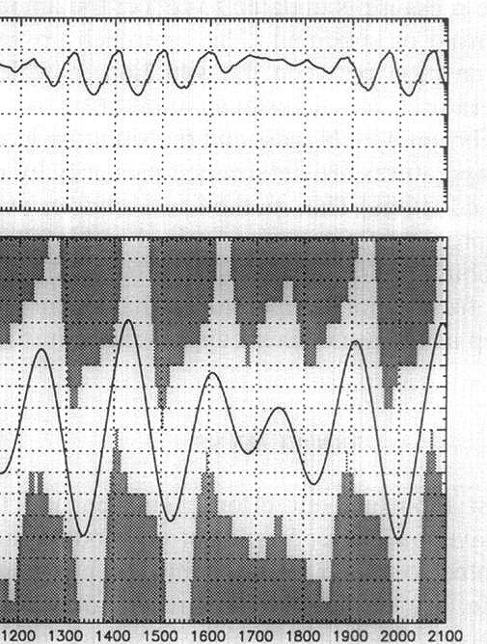
100 µbar
10 µbar
1 µbar
fig. 3 Hansen & Paige
Icarus 99, 273 (1992)
50° N
0° N
50° S

Slide 19
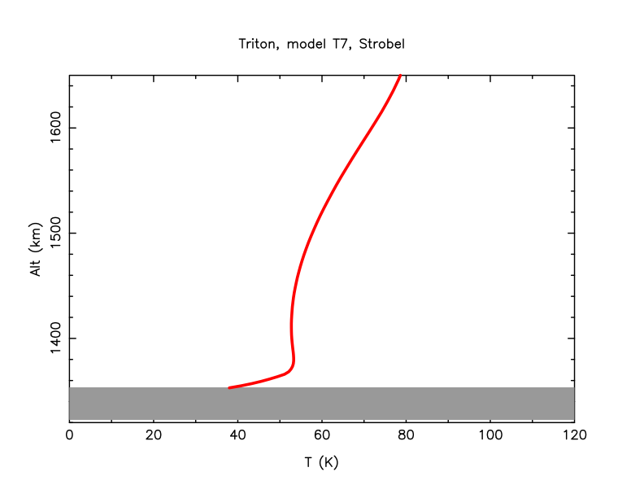
N₂ atmosphere
highest rays (1% drop)
reference radius
deepest rays (Maïdo)
14 µbar

Slide 20
pressure correction
offtrack correction

Slide 22
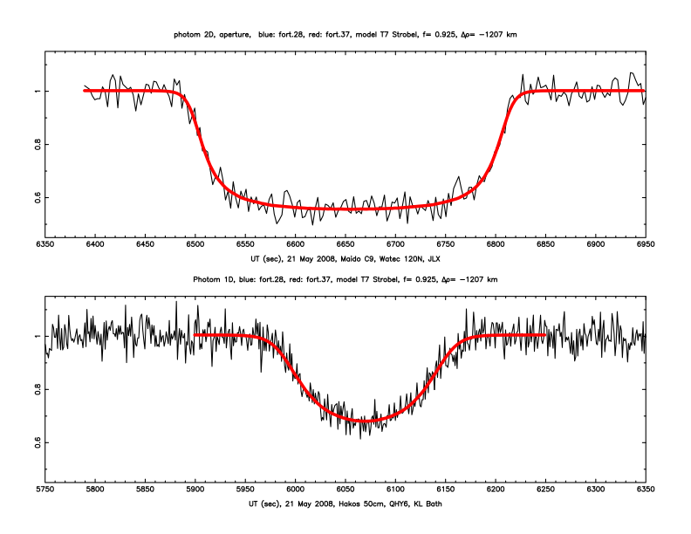

Slide 23
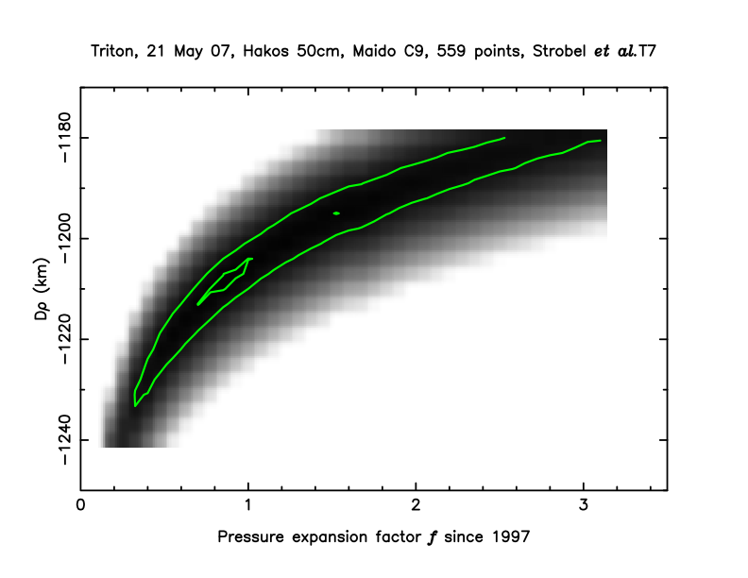
offtrack correction to Triton motion
3-σ level
(99.7 % confidence level)
1-σ level
(68.3 % confidence level)
Pressure expansion factor wrt T7 Strobel et al.

Slide 24
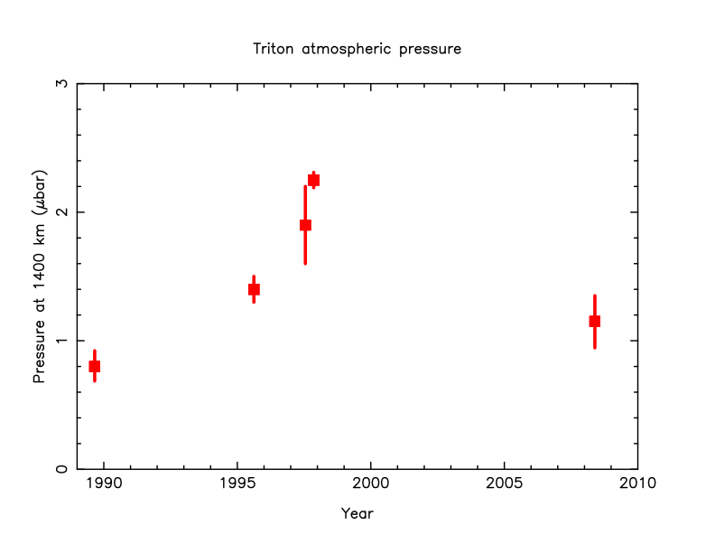
Elliot et al., 2000
1-σ
Sicardy et al., 1998
Olkin et al., 1997
this work
Gurola, 1995
Notes:
Gurrola, Interpretation of radar data from the icy galilean satellites and Triton, thesis, Stanford, 1995
Olkin et al. Icarus 129, 178, 1997
Elliot et al. Nature 393, 765, 1998
Sicardy et al. BAAS 30, 1107, 1998

Slide 25
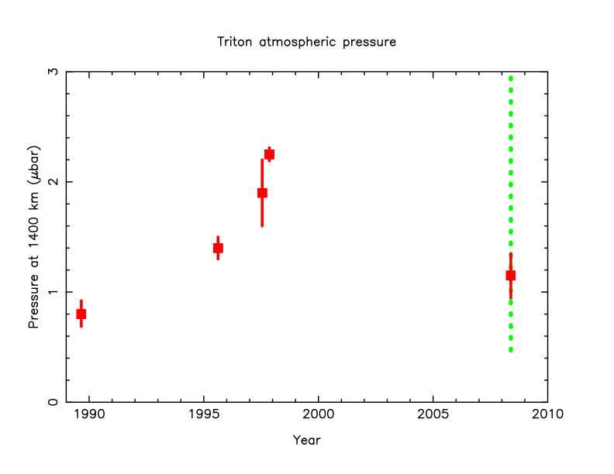
3-σ !

Slide 27


Slide 28
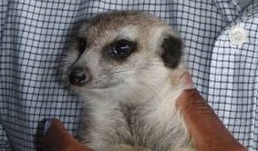
conclusions
- 21 May 2008: first stellar occultation by Triton since 1997
- back to 1995 situation at 1-σ level
- large error bars, however, due to grazing geometry. Better results with + light curves and improves zero stellar flux calibration
- Triton offset wrt DE405: -1 ± 30 mas in α and -56 ± 30 in δ
we
we'll be
back…

