Slide 1
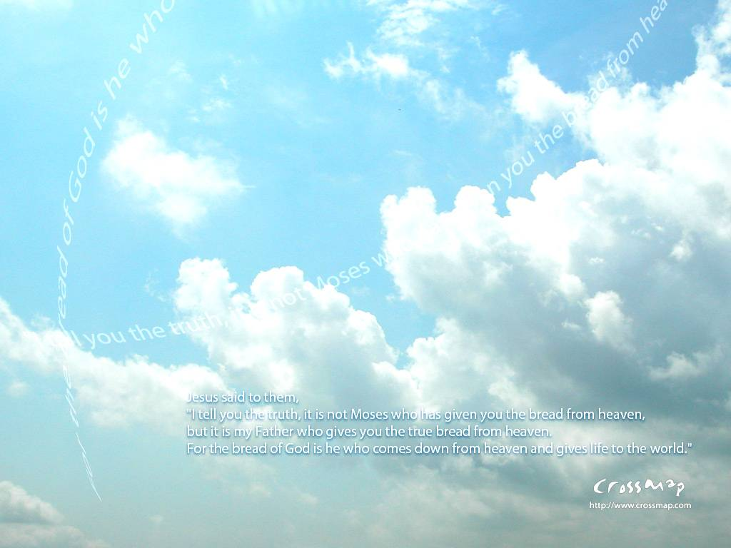
你是神配得讚美
You are God and we praise you
All Creation worship you

Slide 2
你是主我們歡呼
You are Lord we acclaim you
All Creation worship you

Slide 3
你是永在的天父
You are eternal father

Slide 4
凡受造的都敬拜
All creation worship you

Slide 5
凡受造的都敬拜
All creation worship you

Slide 6
凡受造的都敬拜
All creation worship you
Amen

