Slide 1
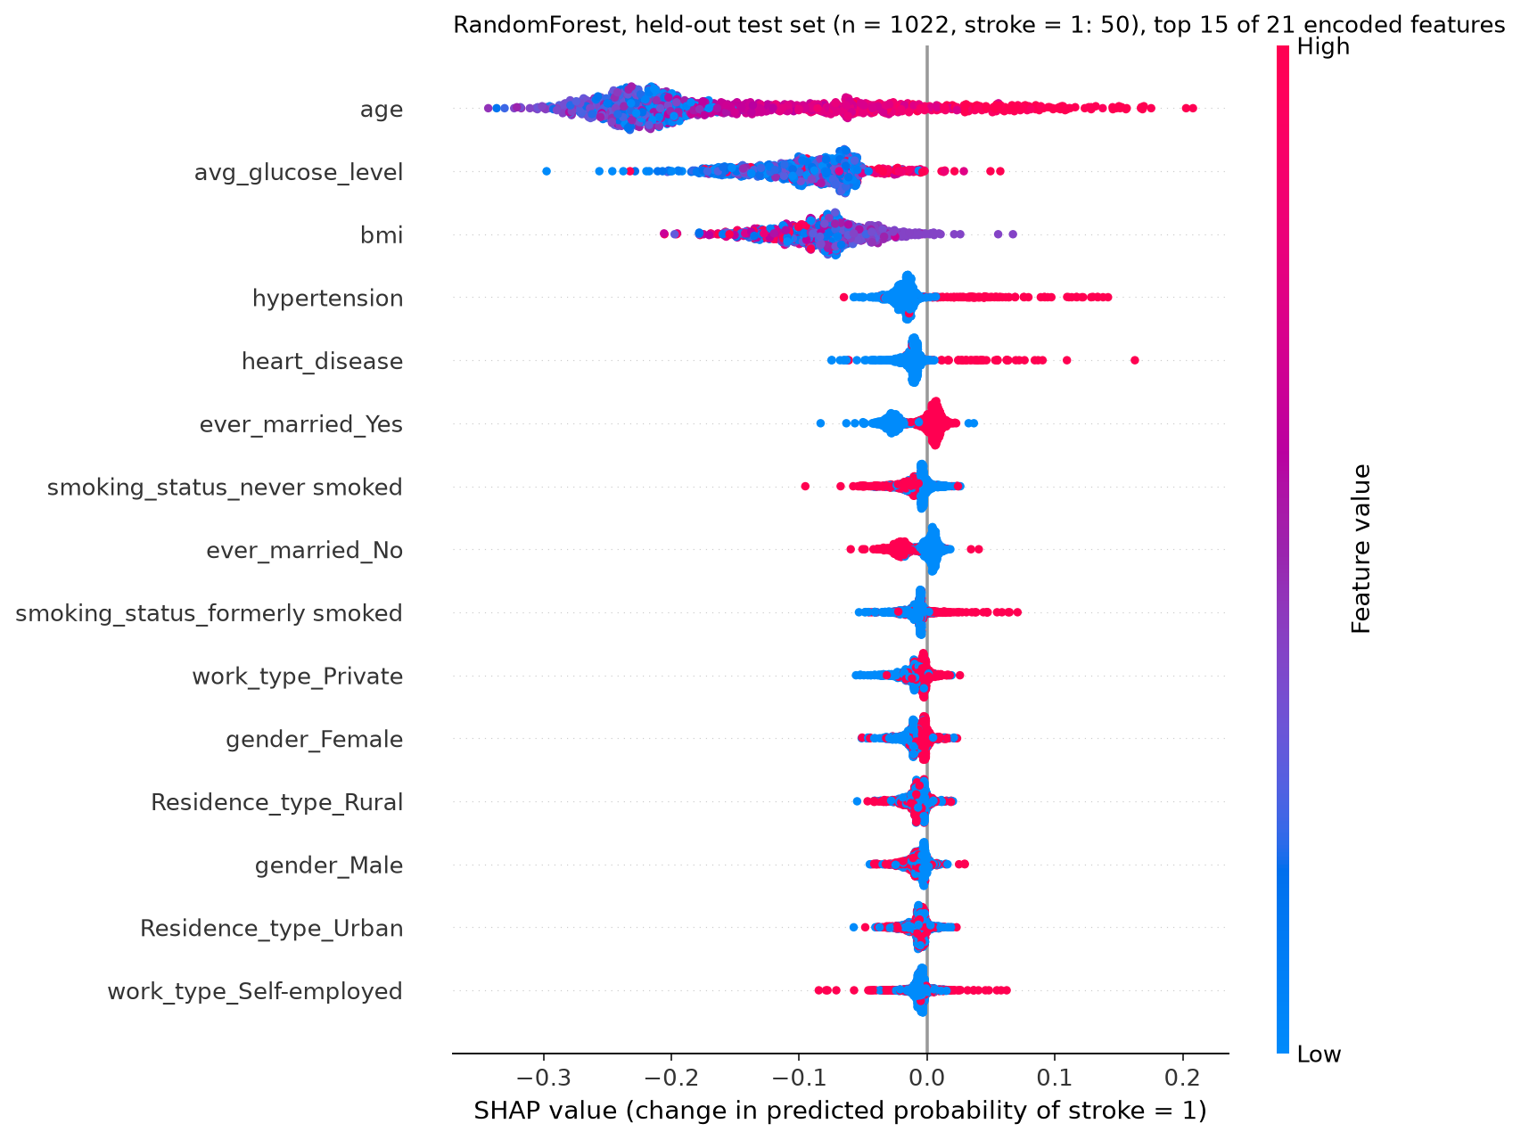
Model performance and explanation of stroke classification
RandomForest, 80/20 stratified split, only the train set oversampled. Positive class is stroke = 1
Test set: ROC AUC 0.827, AP 0.145, recall 0.760, precision 0.141 (threshold 0.09, picked on training folds)
Top features are age, avg_glucose_level and bmi
TreeExplainer, tree path dependent, so no background data. Output is P(stroke = 1)
Limitation: trained on balanced data, so scores are not calibrated (base value 0.50, test prevalence 4.89%)
Dataset: Kaggle stroke prediction, fedesoriano. Student project, not a clinical tool.

Slide 2
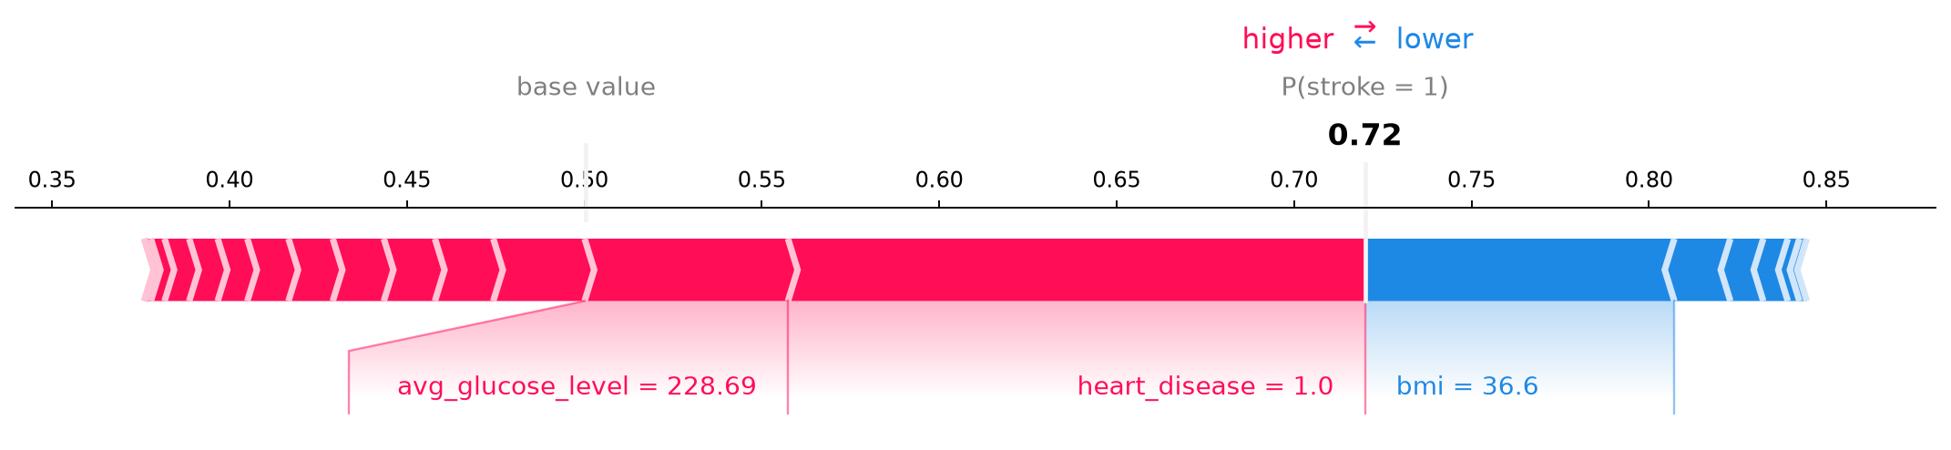
Interpreting one patient prediction in clinical context
Predicted probability of stroke = 1 is 0.72, from a base value of 0.50. Actual class was 1
Heart disease and high average glucose push it up. BMI of 36.6 pushes it down
At threshold 0.09 the model still missed 12 of 50 recorded strokes and flagged 232 people without one
Calibration was not checked and there is no external validation yet
SHAP explains how the model behaves. It is not a diagnosis
Dataset: Kaggle stroke prediction, fedesoriano. Student project, not a clinical tool.

Slide 3
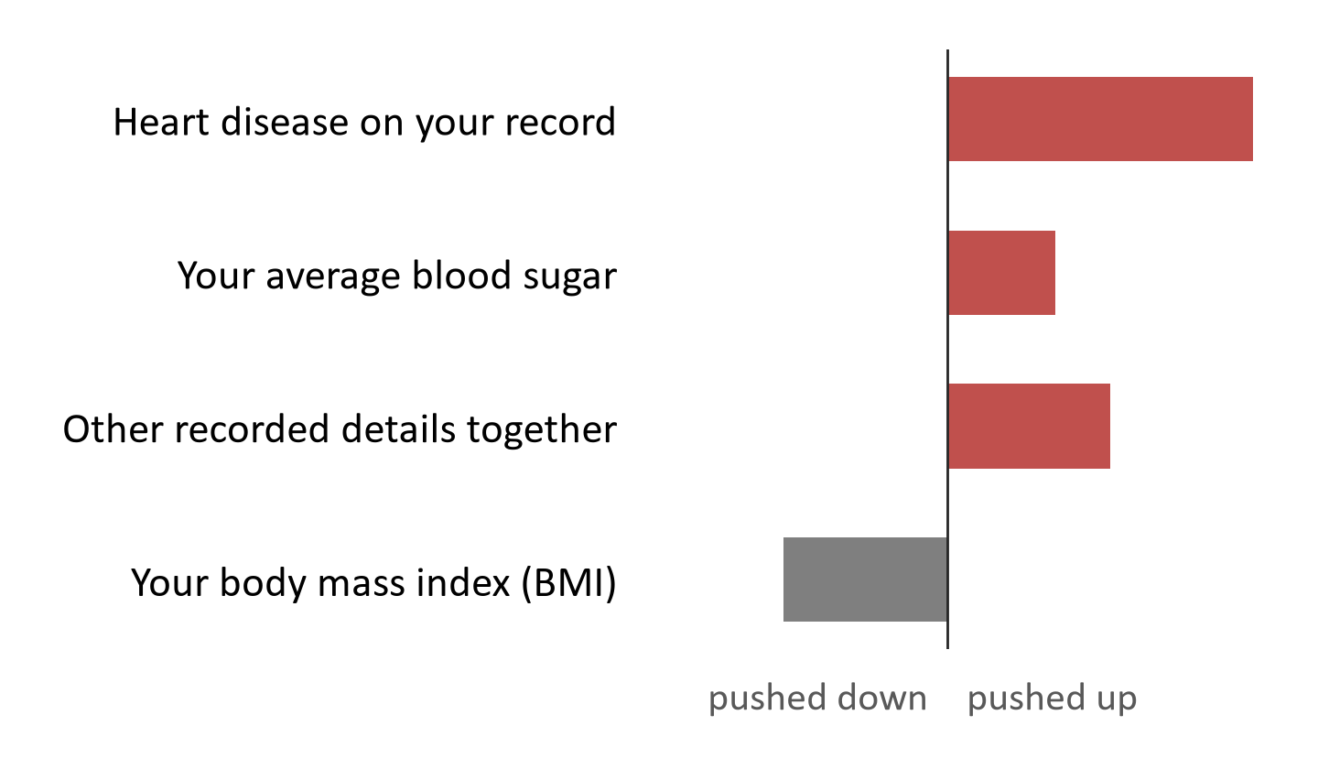
What the computer prediction means for this example
The computer looked at recorded details such as your age, health conditions, blood sugar, BMI and smoking status
In this example, heart disease and your blood sugar pushed the result up. Your BMI pushed it down
This only shows how the computer worked. It does not show what caused anything, and it is not health advice
The prediction can be wrong. It learned from old records, it misses some people who had a stroke and flags many who did not
A clinician reads this together with your other information
Dataset: Kaggle stroke prediction, fedesoriano. Student project, not a clinical tool.

