Slide 1
Bat 2: external architecture overview

Slide 2
The target
Create a real polyglot environment

Slide 3
Global overview
Model
API
Implementation

Slide 4



Model

Slide 5
Model variant 1: Bayesian tree
TODO

Slide 6
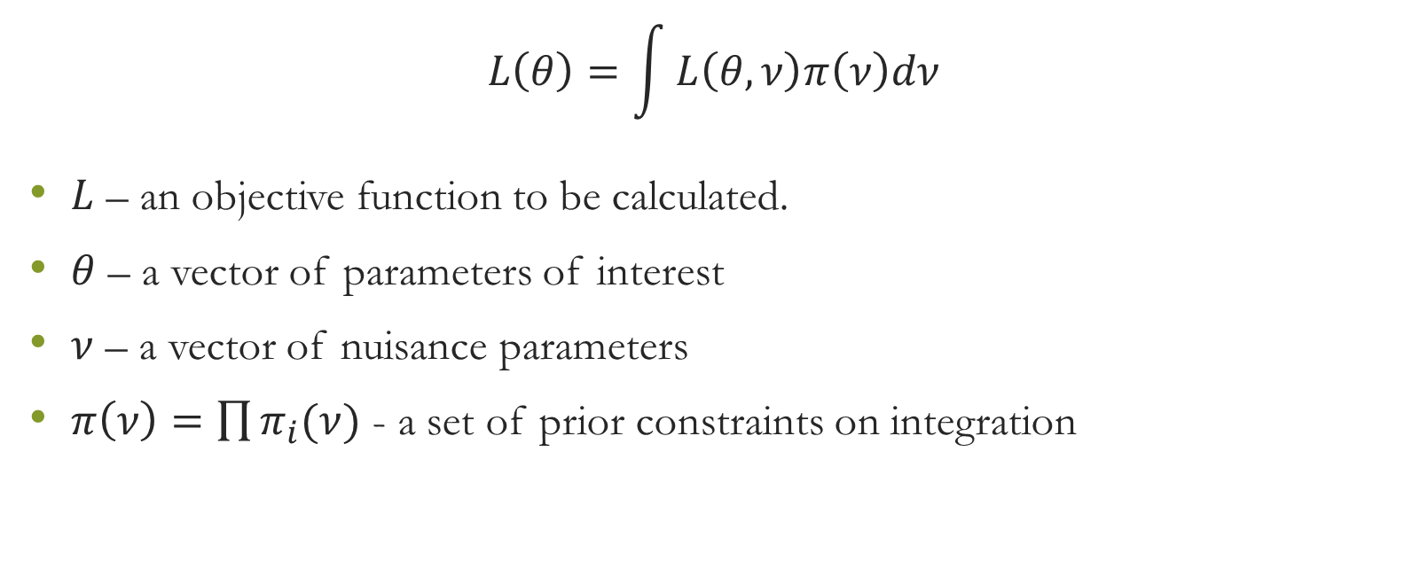
Model variant 1: Integration
$$L\left(θ\right)=\int{L\left(θ,ν\right)π\left(ν\right)dν}$$
$L$ – an objective function to be calculated.
$θ$ – a vector of parameters of interest
$ν$ – a vector of nuisance parameters
$π\left(ν\right)=\prod{π_{i}(ν)}$ - a set of prior constraints on integration

Slide 7
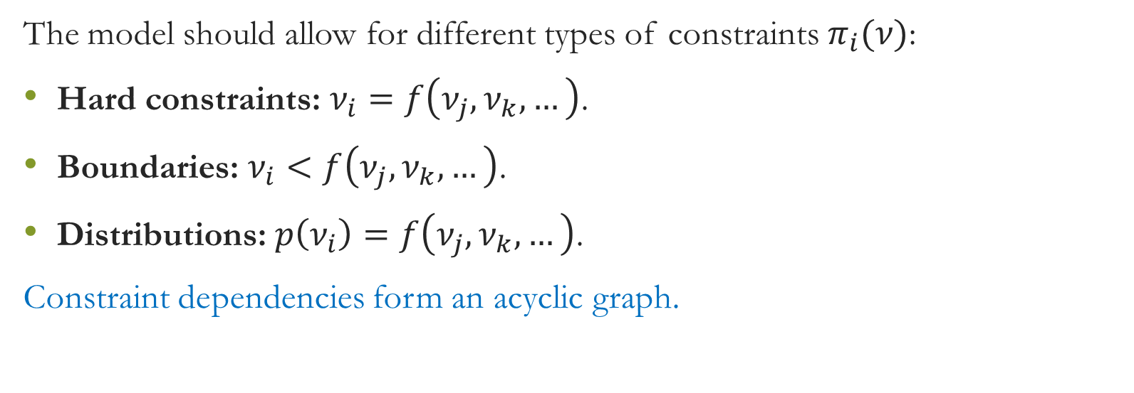
Integration: constraints
The model should allow for different types of constraints $π_{i}(ν)$:
Hard constraints: $ν_{i}=f\left(ν_{j},ν_{k},…\right)$.
Boundaries: $ν_{i}<f\left(ν_{j},ν_{k},…\right)$.
Distributions: $p\left(ν_{i}\right)=f\left(ν_{j},ν_{k},…\right)$.
Constraint dependencies form an acyclic graph.

Slide 8
Model comparison
Tree
Integration

Slide 9
API

Slide 10
API: General ideas
The application consists of client and server side. Client generates the model and passes it to server. Server performs actual computation and returns result to the client.
Client and server could be written in different languages and could run on different machines.
Client uses declarative way to define model. The information in the model could be redundant. In this case server uses its best judgment.
The model is described using limited number of primitive types.

Slide 11
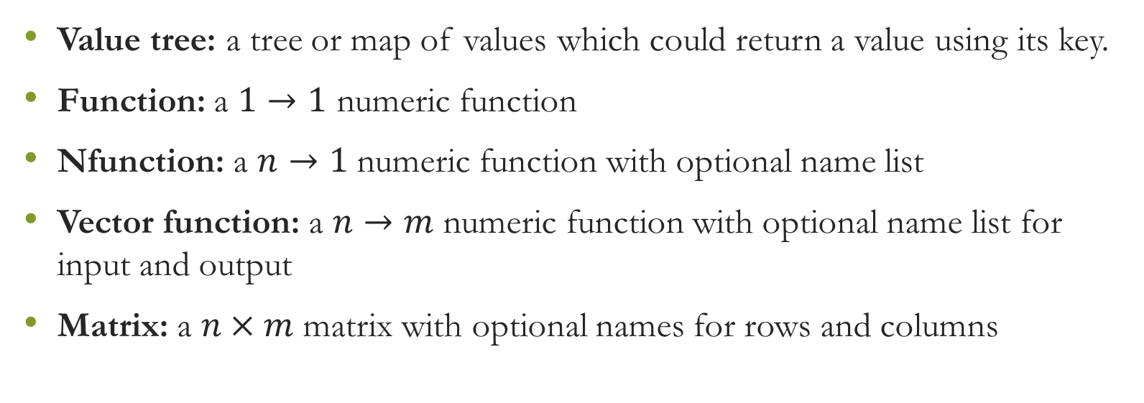
API Primitives
Value tree: a tree or map of values which could return a value using its key.
Function: a $1→1$ numeric function
Nfunction: a $n→1$ numeric function with optional name list
Vector function: a $n→m$ numeric function with optional name list for input and output
Matrix: a $n×m$ matrix with optional names for rows and columns

Slide 13
Implementation

