Slide 1






PYTHON BEGINNER COURSE
2024
2024
PYTHON
BEGINNER COURSE
Lesson 2
SHALEV LAU
/in/shalevl
/mushroomhater07

Slide 2
Lesson 2 - Content
1.What is Control Flow?
2.IF Statements
3.Assignment vs. Equality vs. Identity
4.Lecture 2 Mini-Project: Odd or Even
5.Other comparison operators
6.Boolean Operators
7.Boolean Algebra
8.Short Circuiting
9.Lecture 2 Mini-Project 2:FizzBuzz!
10.Ternary Operators (In-Line If)
11.Lecture 2 Mini-Project 3: Days of The Week
12.Structural Pattern Matching (Switch Statements)
13.Lecture 2 Project: Love Calculator 🥰

Slide 3
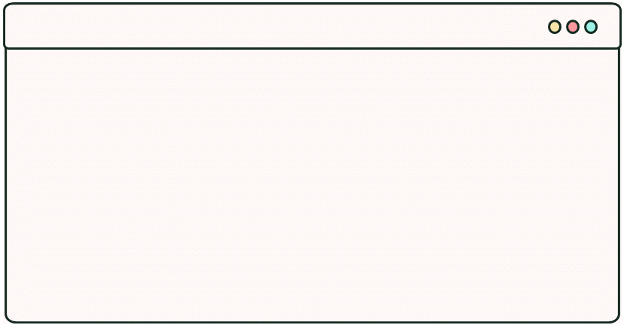
Relative Operations
used in Boolean expressions (expressions which evaluate to either true or false) when we want to test things in our programs.
Description | In Python
Equal to | ==
Less than | <
Greater than | >
Not equal to | !=
Less than or equal to | <=
Greater than or equal to | >=

Slide 4
Boolean Operations
NOT, AND, OR can also be used in Boolean expressions.
Not (Number < 30) | Number is not less than 30
Number > 5 And Number < 30 | Number is greater than 5 and less than 30
Number < 5 Or Number > 30 | Number is less than 5 or Number is greater than 30

Slide 5
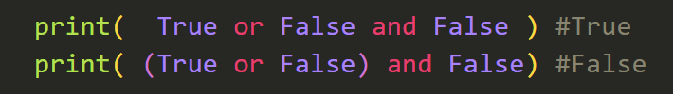
Association
The same evaluation gives the same value irrespective of the grouping of variables.
A = True
B = False
print(A or B or (A or B) == (A or B) or A or B) # True
Like if you do 1 + (2 + 3), it doesn't matter if you do the 2 + 3 first.
Real-life analogy: "Nedjm and his homies, Shalev and Haris are coming to the crib" is the same as "Shalev and Haris and their homie Nedjm are coming to the crib" and also the same as "Nedjm, Shalev and Haris are coming to the crib"
Operator Precedence: Sometimes you must use brackets to get the result you intended as although we tend to read the first part of an expression first, without brackets python uses its own order
Python’s order = not then and then or

Slide 6
Ternary Operator(IN-LINE IF)
Are conditional expressions which behave like if statements but evaluate to some value (here it's "nice.") based on some value being true (i.e. she is_nice) otherwise it must evaluate to some other value (she is "not nice." 😡).
is_nice = True
description = "nice." if is_nice else "not nice.") # value_if_true if condition else value_if_false
print("Alexandra is " + description)
You cannot omit the alternate condition (i.e. else "not nice.") otherwise you get a SyntaxError: invalid syntax. The name "ternary" means "composed of 3 parts", so you can not miss one part of the operator – they're all important.
THIS IS NOT A REPLACEMENT FOR IF STATEMENTS, JUST A SHORT AND DIRTY ALTERNATIVE.
Before Python 2.5, this wasn't a native feature. You may (rarely) see them written as a tuple or list accessed by using a boolean index (which evaluates to 0 for False and 1 for True). You'll understand lists, tuples and why this works in Lecture 3.
It's not recommended you write ternary operators this way because the code's purpose isn't very clear so it isn't "Pythonic" – conforming to the PEP8 style guide for writing clean code.
is_nice = True
print("Alexandra is " + ("not nice.", "nice.")[is_nice])
# (value_if_false, value_if_true)[condition]

Slide 7



Branch with IF…..
allows you to specify conditions under which some lines of your code will be run;
the idea is that you compare a value to some criteria
score = int(input("input your score"))
if score < 60:
score += 10
print(score)

Slide 8
Else
The all the condition in if statement (including else if) doesn’t match ➔ run else OR;
Else run only if the previous if doesn’t match
score = int(input("input your score"))
if score < 60:
score += 10
else:
score -= 10
print(score)

Slide 9
Elif (else if)
The all the condition in if statement (including else if) doesn’t match ➔ run else OR;
Else run only if the previous if doesn’t match
score = int(input("input your score"))
if score < 60:
score += 10
elif score > 60:
score -= 10
print(score)

Slide 10
Else + Elif (else if)
The all the condition in if statement (including else if) doesn’t match ➔ run else OR;
Else run only if the previous if doesn’t match
score = int(input("input your score"))
if score < 60:
score += 10
elif score > 50:
score -= 10
else:
score +=20
print(score)

Slide 11
Nested IF…..
The block part of an If statement can itself contain another If statement, i.e. ‘If inside an If’ => nested if
If score >= 55 Then If score >= 75 Then grade = "A" ElseIf score >= 65 Then grade = "B" Else grade = "C" End If Else grade = "U" End If

Slide 12
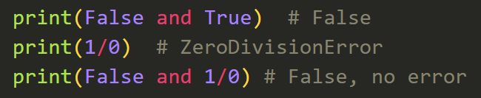
Fun to know, Error avoiding
"False and " statement immediately give out false, why?
Left.. AND | Right…. | Result
True | True | True
True | False | False
False | True | False
False | False | False

Slide 13






Few point to mention
Must be 4 spacebar
(some IDE automatically turn TAB into 4 spaces but not gurantee)
score = int(input("input your score"))
if score < 60:
score += 10
else:
score -= 10
print(score)
Colon after condition OR else
Escape if with no indentation

Slide 14
Switch Case
Now a native feature in Python 3.10, you can write this:
day = input("Enter a day of the week: ").lower()
match day:
case 'monday' | 'tuesday' | 'wednesday' | 'thursday' | 'friday':
print(f"{day.title()} is a weekday.")
case 'saturday' | 'sunday': # Equivalent to if day == 'saturday' or day == 'sunday'
print(f"{day.title()} is a weekend.")
case _: # Default case where none of the days are matched.
print(
"""
%s isn't a day of the week,
you silly goose.
"""
% day.title())

Slide 15
Lecture 2 MINI-Project 1: ODD OR EVEN
An even number is defined as divisible by 2 with no remainders. Odd numbers are just numbers that aren't even.
Given that you know the modulus operator (%) gives the remainder, make a program to determine whether any real number is odd or even.
Worked solutions will be posted in 5 minutes.

Slide 16
Quadratic Equation

Slide 17
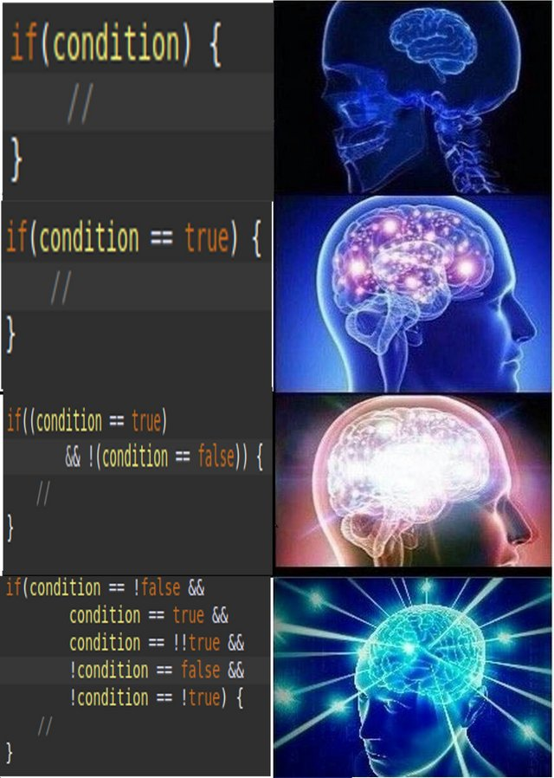
MEME OF THE DAY

