Slide 1




Big Data Intro Day 1: Storage and Azure

Slide 2

Your Lecturer
Claudio Paterniti
Data Consultant - A.B.S. – Altea Federation
https://github.com/ClaudioPaterniti/
Lectures Repository
https://github.com/altea-abs/big-data-azure-intro

Slide 3
Course Content
Day 1: Big Data Foundations, Azure and Storage
Day 2: Data Ingestion and Modelling
Day 3: Apache Spark and Databricks

Slide 4









Full Lab Architecture
Day 1
Day 2
Day 3
data flow
logic flow
SQL Server
EventHub
streaming
Config
Data Lake
Data Factory
Databricks
Power BI
batch

Slide 5

Day Program
01
History of Data Analytics
02
Big Data Concepts
03
Hadoop Ecosystem
04
Azure Data Services
05
Lab
Image generated with DALL-E
Notes:
7.5

Slide 6
Chapter History of Data Analytics

Slide 7
Classical RDBMS
Transactional
Based on ACID properties
Optimized for writing latency
Seek for specific row
Update that row
Normalized

Slide 8
Classical RDBMS ACID properties
Atomicity
Consistency
Isolation
Durability

Slide 9
Classical RDBMS Normalization
Customer
Id | Name | Address
1 | HSR | Milan
2 | ABS | Milan
Date | Customer | Customer Address | Product | Product Category | Total
2024 | HSR | Milan | Big Data | Course | 100
2024 | ABS | Milan | AI | Lab | 200
2023 | HSR | Milan | AI | Lab | 100
Normalization
Date | Customer Id | Product Id | Total
2024 | 1 | 1 | 100
2024 | 2 | 2 | 200
2023 | 1 | 2 | 100
Denormalization
Product
Id | Name | Category
1 | Big Data | Course
2 | AI | Lab

Slide 10



Analytics on Transactional DB
Write
Analytics
. .
.
User
User
Transactional DB
Views and Queries

Slide 11
OLAP VS OLTP
Batch Read and no writes
No writes => atomicity and isolation don’t matter
Optimized for query latency and aggregation
Denormalized
Different indexes

Slide 12

Data Warehouse
Write
Read
Write
Analytics
User
OLTP DB
Data Warehouse
OLAP DB
User
ETL

Slide 13
Data Warehouse
Decouple transactional and analytics databases
Reduce the impact of analytics on transactional performance
ETL: Extract -> Transform -> Load
Batch extraction from the transactional database
Transform data to improve analytics performance
Write to the Data Warehouse

Slide 14
Data Warehouse Modelling
Granularity
Normalization Level
Optimize for query performance

Slide 15
Star Schema
1
Dim Table:
Calendar
1
*
*
Dim Table:
Customer
*
Fact Table:
Orders
1
Dim Table:
Product
Notes:
32

Slide 16
Data Warehouse Vs Data Lake
Warehouses are still relational
Only contains refined and curated data
Relatively expensive to build
Not very ML and DS friendly

Slide 17




Data Lake
Procurement DB
ETL
Data Warehouse
. .
.
Unstructured data
Data Lake
Machine Learning
Sales DB

Slide 18
Data Lake
Decoupling Storage and Compute
Structured and Unstructured Data
Raw and refined data
Data discovery and data governance
Notes:
40

Slide 19
Data Lakehouse
Data Lakes with warehouse like enhancements
Apply some structure to unstructured or semi structured data
SQL or SQL-like queries
Data Catalogs

Slide 20
Data Lakehouse Example: Delta Lake
Delta file format (based on Apache Parquet)
Allows updates, delete and merge
Allows versioning and time travel
Catalog like Unity Catalog or Apache Hive Metastore
Query Delta files with SQL through spark

Slide 21
Data Mesh
Organizational concept
Data Products
Data Lake as a service at organization level
Distributed data ownership
Notes:
45

Slide 22
Q&A

Slide 23
Chapter Big Data Concepts

Slide 24
Big Data: a definition
What is big data?
How big to be big data?
Structured vs Unstructured

Slide 25
Distributed Systems
Vertical vs horizontal scaling
Cluster computing
Explicit communication
Potentially infinite horizontal scaling
Notes:
6.5

Slide 26
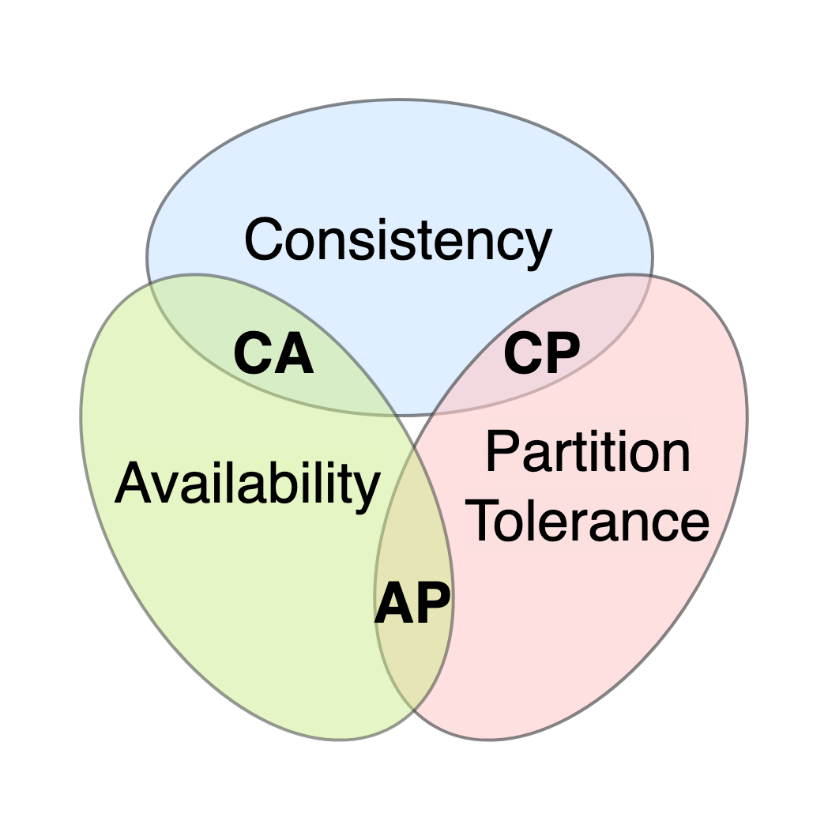
Distributed Systems CAP theorem
Consistency
Availability
Partition Tolerance
CAP theorem
Notes:
6.5

Slide 27
Distributed Systems Architectures
Master-Slave
Peer-to-peer
Most systems, ex: Hadoop, Spark
Ex: Cassandra

Slide 28
Distributed Systems Partitioning
Vertical vs Horizontal
Round robin, range, hash
Skewness and balancing
Horizontal Partitioning
Vertical Partitioning

Slide 29
Distributed Systems Partitioning - Skewness
A
B
C, D, E, F

Slide 30

Distributed Systems Fault Tolerance
Faults scale exponentially
Points of failure
MTBF and MTTR

Slide 31
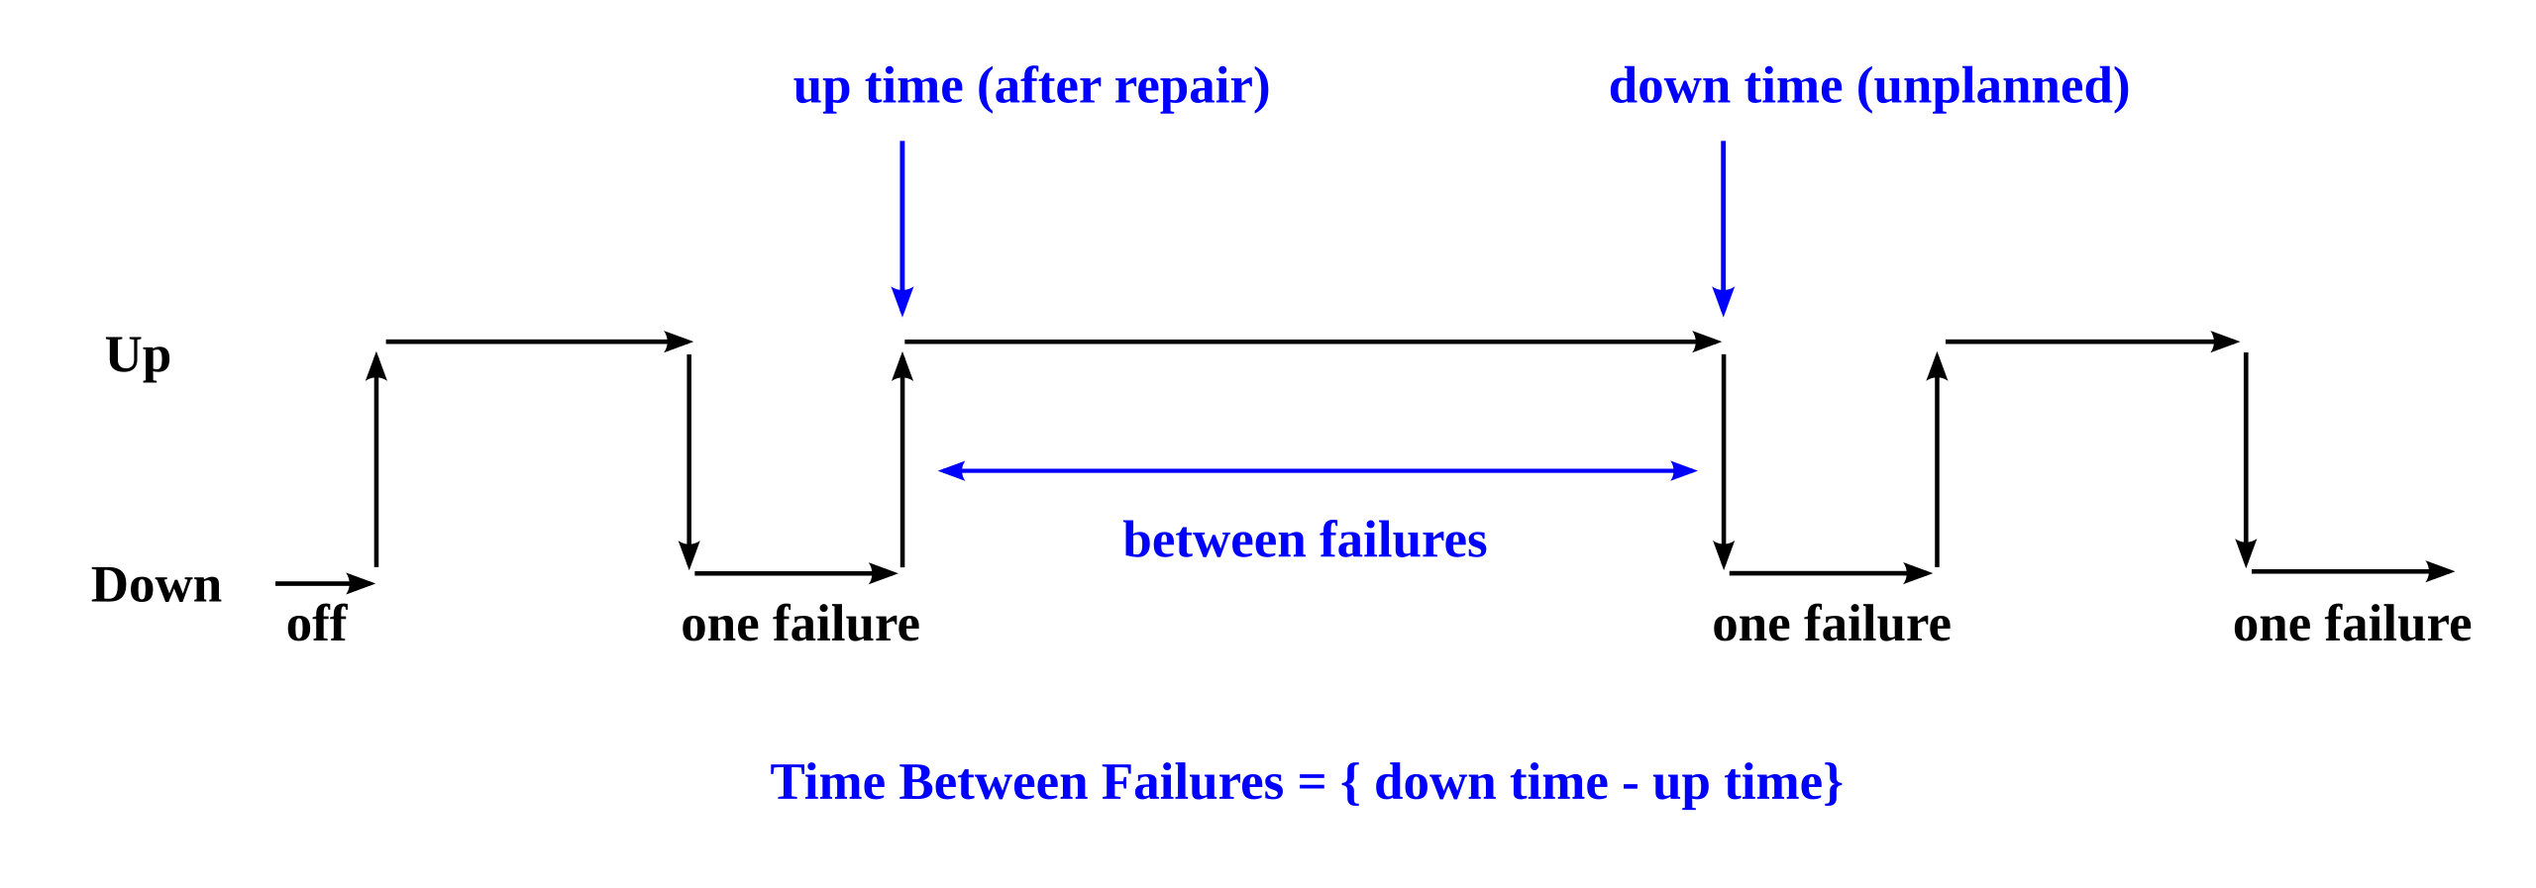
Distributed Systems Fault Tolerance – MTBF and MTTR

Slide 32
Distributed Systems Replication
Consequence of fault tolerance
Replication for efficiency
Eventual Consistency

Slide 33
Distributed Systems Replication – Fault tolerance
User
Ask C
User
Ask C
Replication
A
B
C
D
A, C
B, A
C, A, B
D, B

Slide 34
Distributed Systems Replication - Efficiency
Ask C
Ask C
Ask C
Ask C
Replication
A
B
C
D
A, C
B, A
C, A, B
D, B

Slide 35
Distributed Systems Replication - Consistency
Update C
Read C
A, C
B, A
C, A, B
D, B
Notes:
27

Slide 36
Chapter Hadoop Ecosystem

Slide 37

Hadoop Ecosystem
Hadoop Common
Hadoop Distributed File System
Hadoop YARN
Hadoop MapReduce

Slide 38
Hadoop Distributed File System
Hardware failure is the norm
High throughput of data access over low latency of data access
Write once read many
Moving computation instead of data

Slide 39
Hadoop Distributed File System
Written in Java
Runs on commodity hardware
NameNode and DataNode deamons
Replication factor per file
Each block has the same size except the last

Slide 40

Hadoop Distributed File System

Slide 41
Hadoop Distributed File System NameNode
Keeps the file system metadata in a local file FsImage
Keep a transaction log EditLog
FsImage is kept loaded in memory
High Availability: option to have multiple backup NameNodes

Slide 42
Hadoop Distributed File System DataNode
Store HDFS blocks as files in the local file system
Has no knowledge of HDFS files
At start time send a Blockreport with the list of blocks to the NameNode

Slide 43
Hadoop Distributed File System
Rack Awareness Replication
Heartbeats and Re-Replication
Cluster Rebalancing
Data Integrity

Slide 44
Hadoop MapReduce
Hadoop original computation model
Based on MapReduce (Google 2004)
On disk input and output
Key-value input and output

Slide 45
MapReduce Computation Model
input
output
<key, value>
<key, value>
key-1 value-1
value-2
value-3
…
<key-1, value-1>
<key, value>
<key, value>
<key-2, value-2>
map
partition
reduce
. .
.
. .
.
. .
.
. .
.
key-n value-1
value-2
value-3
…
<key, value>
<key, value>
<key-n, value-n>

Slide 46

MapReduce Execution
Hadoop Cluster (HDFS)
Client
mapper,
combiner,
reducer
/path/input,
/path/output
local: /path/input
local: /path/input
local: /path/input
. . .
mapper
mapper
mapper
Application master
combiner
combiner
shuffle
combiner
reducer
reducer
. . .
reducer
local: /path/output
local: /path/output
local: /path/output

Slide 47
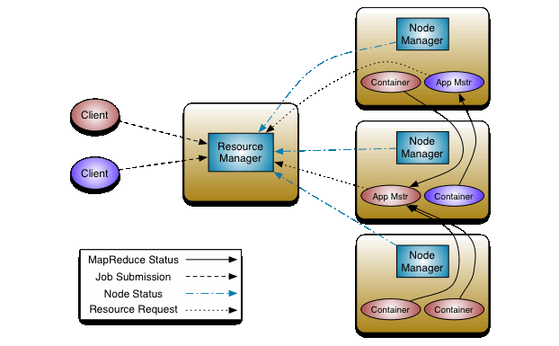
Hadoop YARN Yet Another Resource Negotiator
Do more than MapReduce on Hadoop cluster
Decouple resource manager and job scheduling
Multiple concurrent application

Slide 48
Chapter Azure Data Services

Slide 49
Azure Data Services
Azure Data Lake Storage Gen2
Azure Data Factory
Azure EventHub
Azure Synapse Analytics
Azure Databricks
Azure Data Explorer
Power BI

Slide 50

Azure Storage Account
Blob, files, queues, tables
Datalake Gen 2
Tiers

Slide 51
Azure Data Factory
Ochestrator
Pipelines
Triggers
Integration

Slide 52
Azure Event Hub
Streaming
Namespaces, Hubs
Consumer Groups

Slide 53
Azure SQL Server
Relational Databases
T-SQL
Managed

Slide 54

Azure Synapse Analytics
Data Warehouse
Spark
Notebooks

Slide 55
Azure Databricks
Spark
Notebooks
Unity Catalog
Api

Slide 56

Azure Data Explorer
Log Analytics
Kusto language

Slide 57
Power BI
Power BI Desktop
Power BI Services
Connectors
DAX

Slide 58

Microsoft Fabric
Integrate Power Bi and Synapse
Direct Lake
Spark
Data Factory

Slide 59
Q&A

Slide 60
Chapter Lab Session

Slide 61
Azure Fundamentals Microsoft Entra ID
Tenant
Subscription
Administration Group

Slide 62
Azure Fundamentals Identity
User
Groups
Service Principal
Managed Identity

Slide 63
Azure Fundamentals Resource Groups
Unique within subscription
Every resource must be in a single resource group
Tags
RBAC

Slide 64
Azure Storage Account Services
Blob storage
Queues
Files
Tables

Slide 65
Blob Storage Replication
Locally Redundant (LRS)
Zone Redundant (ZRS)
Geo Redundant (GRS)
Geo-zone-redundant (GZRS)

Slide 66
Blob Storage Access Tiers
Hot
Cool (min 30 days)
Cold (min 90 days)
Archive (min 180 days)

Slide 67
Blob Storage Access Methods
Account Key
Microsoft Entra (OAuth)
Shared Access Signature (SAS)
SAS policies

Slide 68
Lab: Azure Storage
Storage Account Creation
Settings
Access Methods
Policies and Acl
Storage Explorer
Python API and Auth

