Slide 1
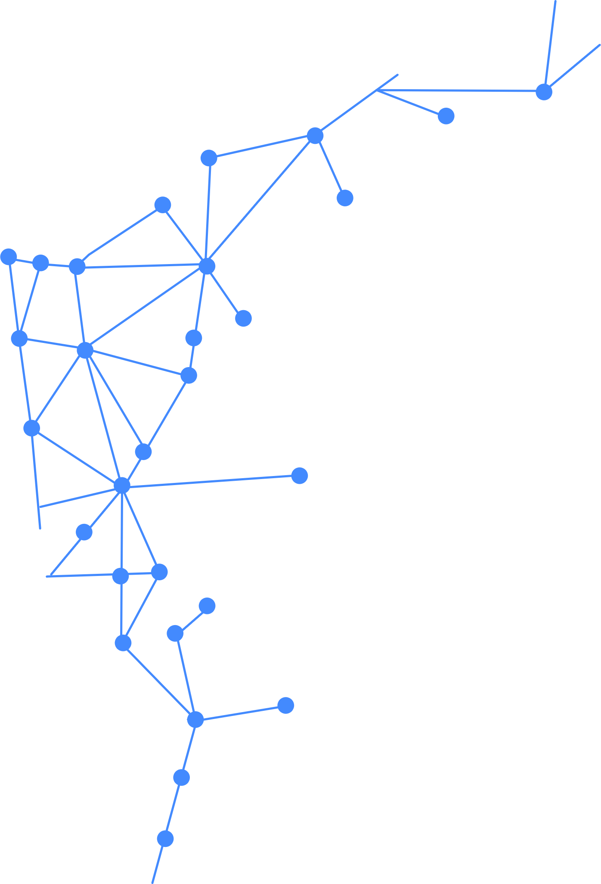



Big Data Intro Day 2: Ingestion and Governance

Slide 2

Your Lecturer
Claudio Paterniti
Data Consultant - A.B.S. – Altea Federation
https://github.com/ClaudioPaterniti/
Lectures Repository
https://github.com/altea-abs/big-data-azure-intro

Slide 3
Course Content
Day 1: Big Data Foundations, Azure and Storage
Day 2: Data Ingestion and Governance
Day 3: Apache Spark and Databricks

Slide 4









Full Lab Architecture
Day 1
Day 2
Day 3
data flow
logic flow
SQL Server
EventHub
streaming
Config
Data Lake
Data Factory
Databricks
Power BI
batch

Slide 5

Day Program
01
Batch Processing
02
Streaming Processing
03
Apache Kafka
04
Data Governance
05
Lab
Image generated with DALL-E

Slide 6
Chapter Batch Processing

Slide 7


Batch Processing
Data processed periodically in large chunks
Input and output are generally files or tables
Throughput over latency

Slide 8
Row vs Column Oriented
Controls how data is physically stored
Impacts read and write performance
OLTP vs OLAP
c1 c2 c3 c4 c5
. . . . .
. . . . .
. . . . .
. . . . .
. . . . .
c1 c2 c3 c4 c5
. . . . .
. . . . .
. . . . .
. . . . .
. . . . .

Slide 9
Column vs Row Oriented OLAP
SELECT SUM(Total) FROM Orders WHERE Product = ‘course’
Id | Date | Customer | Product | Total
1 | 2020 | HSR | course | 100
2 | 2020 | ABS | course | 150
3 | 2021 | Efficiento | ai | 100
4 | 2022 | ABS | lab | 200
5 | 2024 | HSR | lab | 150
6 | 2024 | HSR | course | 100
Id | 1 | 2 | 3 | 4 | 5 | 6
Date | 2020 | 2020 | 2021 | 2022 | 2024 | 2024
Customer | HSR | ABS | Efficiento | ABS | HSR | HSR
Product | course | course | ai | lab | lab | course
Total | 100 | 150 | 100 | 200 | 150 | 100
Row Oriented
Column Oriented
…
= read

Slide 10
Column vs Row Oriented OLTP
PAGE 10
INSERT Orders (Id, Date, Customer, Product, Total)
VALUES (6, 2024, ‘HSR’, ‘course’, 100)
Id | Date | Customer | Product | Total
1 | 2020 | HSR | course | 100
2 | 2020 | ABS | course | 150
3 | 2021 | Efficiento | ai | 100
4 | 2022 | ABS | lab | 200
5 | 2024 | HSR | lab | 150
6 | 2024 | HSR | course | 100
Id | 1 | 2 | 3 | 4 | 5 | 6
Date | 2020 | 2020 | 2021 | 2022 | 2024 | 2024
Customer | HSR | ABS | Efficiento | ABS | HSR | HSR
Product | course | course | ai | lab | lab | course
Total | 100 | 150 | 100 | 200 | 150 | 100
Row Oriented
Column Oriented
…
= write

Slide 11

Apache Parquet
Open-source columnar format
Originally developed at Twitter
Main structured file format for Spark
Very efficient data compression

Slide 12
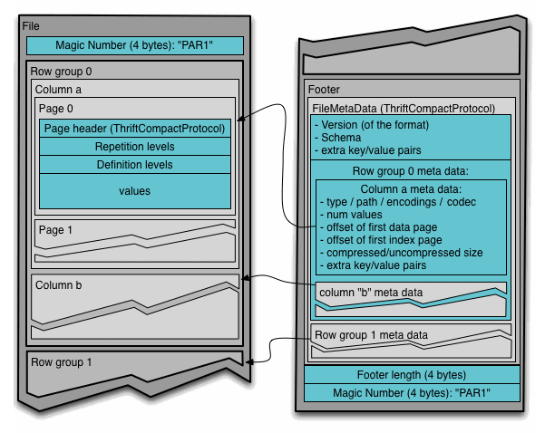
Apache Parquet File Format
Row groups
Column Chunk
Data Page
File metadata

Slide 13
Apache Parquet Nested Structures
Parquet allows structured columns of type Map or List
Structured columns can be nested
They are encoded using Dremel encoding

Slide 14
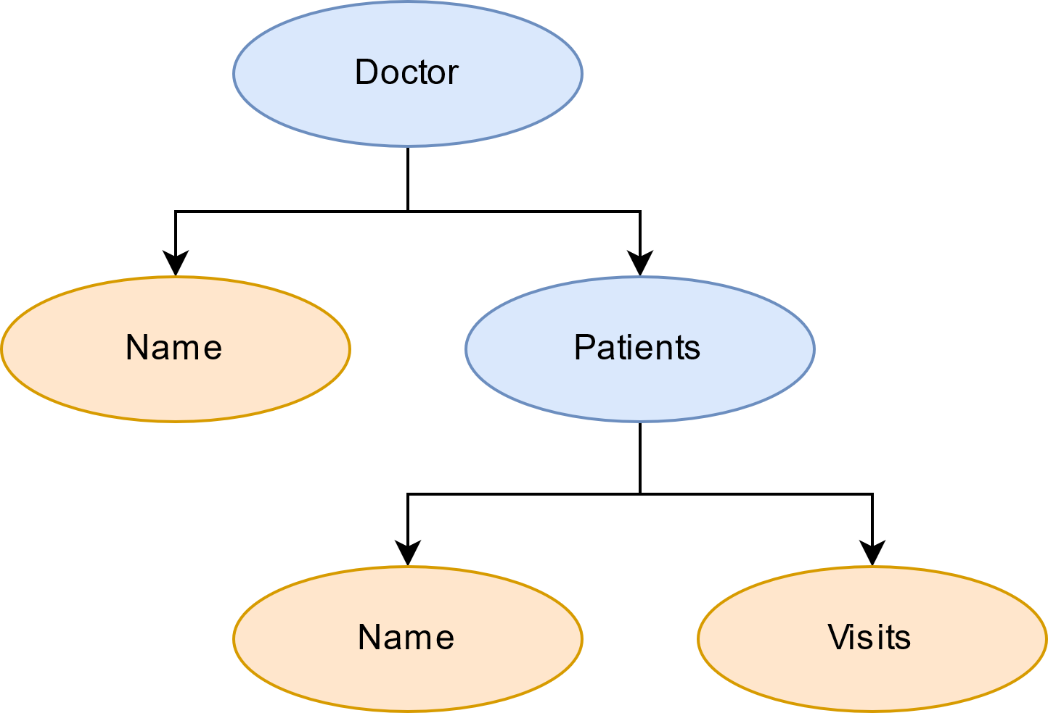
Apache Parquet Dremel: primitive columns
Doctor: Map
Name: str
Patients: List[Map]
Name: str
Visits: List[Date]

Slide 15
Apache Parquet Dremel: definition and repetition levels
Each column is encoded with three sequences:
Definition levels
Repetition levels
Values
Definition Level: nesting level of the value
Repetition Level: level of nested lists

Slide 16
Apache Parquet Dremel: Doctor.Patients.Visits example
Doctor
Patient
Visits: [
2021,
NULL,
2024
]
Patient: null
Patient
Visits: null
Doctor: null
Doctor
Patient
Visits: [
2024
]
Definition Levels
3
2
3
1
2
0
3
Repetition Levels
0
2
2
1
1
0
0
Values
2021
2024
2024

Slide 17
Apache Parquet Dictionary Encoding
Values are encoded through dictionary encoding
A dictionary of the possible values
Values are then encoded as pointers to dictionary entries

Slide 18
Apache Parquet Compression
Parquet compress data pages after dictionary encoding
Multiple (extensible) compression codecs:
snappy (default)
gzip
lzo

Slide 19
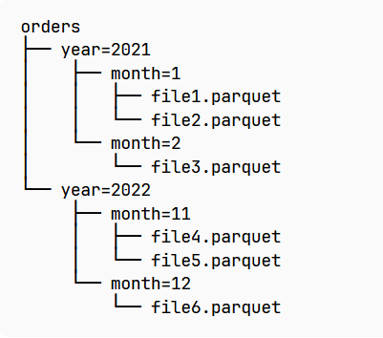
Partitioning
Partitioning based on file system structure
Allows to pushdown filters on a subset of files
Spark follows Hive partitioning schema

Slide 20
Q&A

Slide 21
Chapter Stream Processing

Slide 22
Stream Processing
Processing data continuously in real time
Async event-based processing
Latency over throughput
.
.
.
.
.
.
.
.
.
.
.
.

Slide 23
Stream Processing Use Cases
Near real time latency
Fraud Detection
Sensors and IoT data
Social networks data

Slide 24
Stream-Table Duality
(1, ABS, 100)
(2, HSR, 150)
(2, HSR, 200)
(3, ABS, 200)
(4, Efficiento, 50)
(5, Altea, 100)
(3, HSR, 150)
(6, HSR, 100)
(6, HSR, 50)
(7, ABS, 100)
Id | Customer | Total
1 | ABS | 100
2 | HSR | 200
3 | HSR | 150
4 | Efficiento | 50
5 | Altea | 100
6 | HSR | 50
7 | ABS | 100
Update
Change Log

Slide 25
Windowing
Running continuous moving aggregation on event windows
Produces a new stream with one event per window
Example: last 20 minutes average

Slide 26
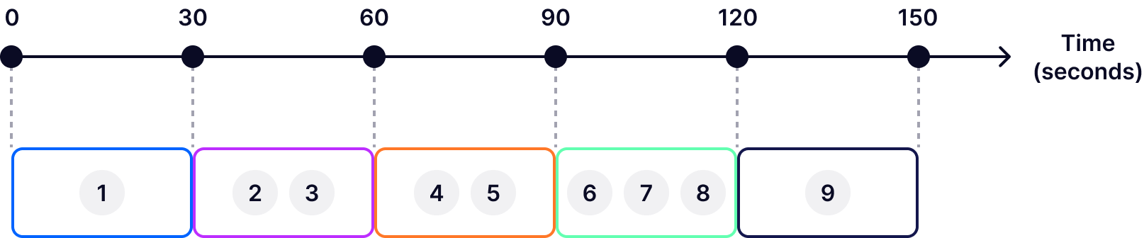
Tumbling Window

Slide 27
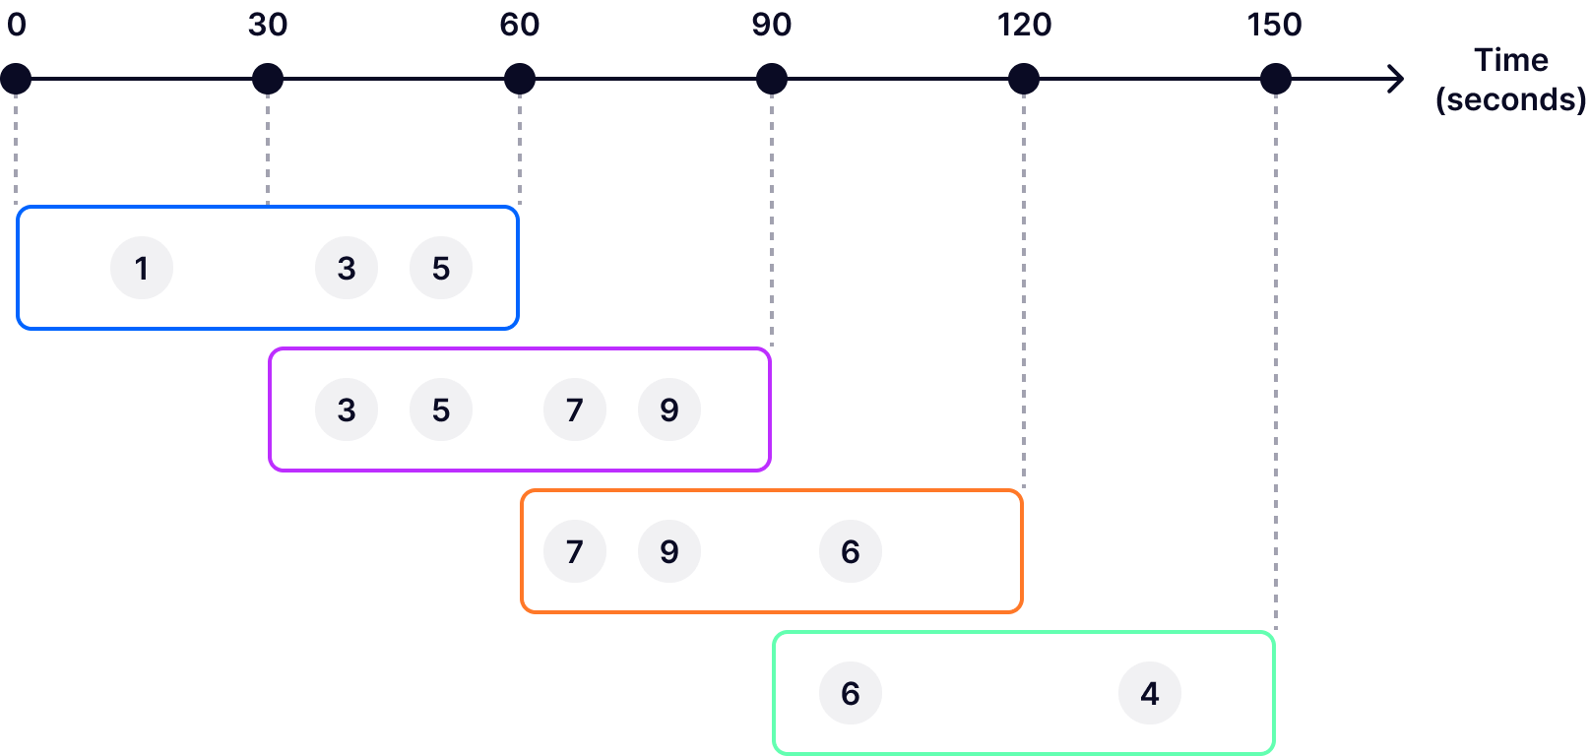
Hopping Window

Slide 28
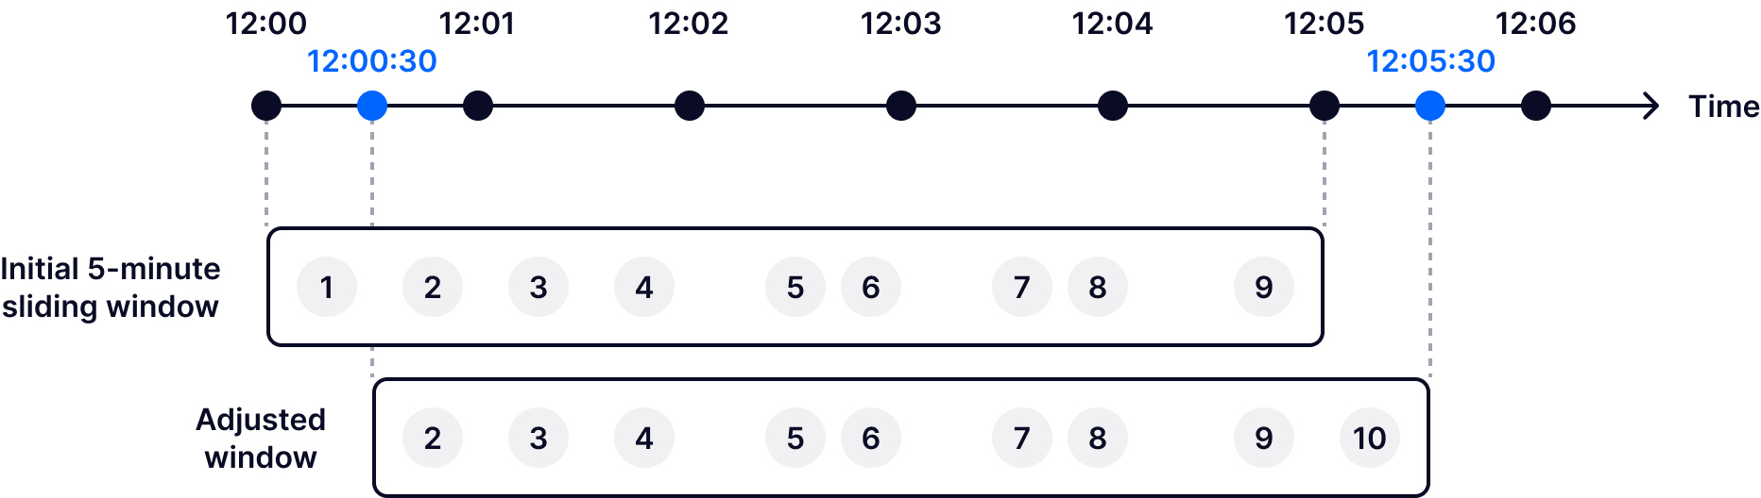
Sliding Window

Slide 29
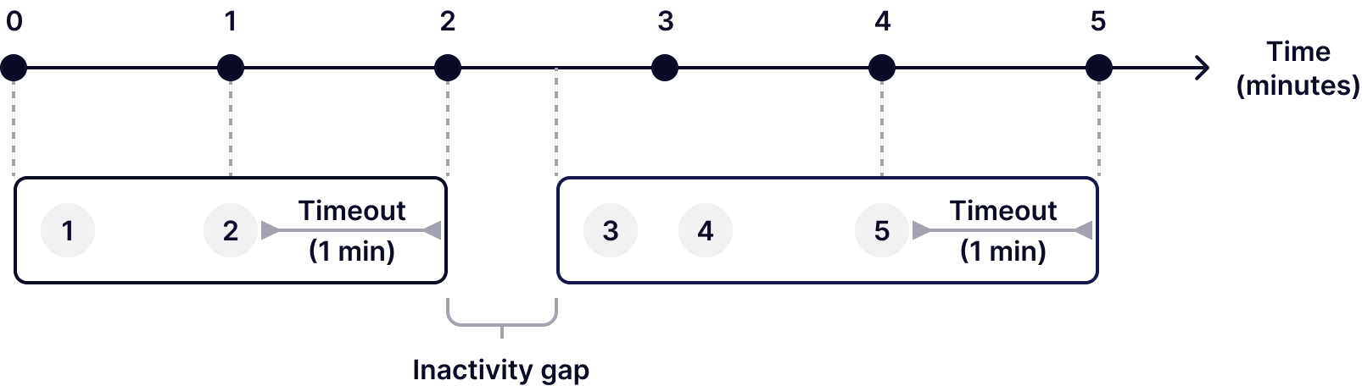
Session Window

Slide 30
Windowing Eviction
Count based: keep only a maximum amount of events per window
Time based: keep only the most recent events in a time delta
Priority based: mask certain events based on priority criteria

Slide 31
Processing vs Event Time
Difference between when the even happened and when it is processed
Event might be out of order based on event time
We usually want to group based on event time

Slide 32
Late Arrivals
Event can arrive after their window is closed
To update the window value we must recover the window state
We cannot wait indefinitely

Slide 33
Late Arrivals Grace period
We leave a window open for a fixed amount of extra time
If late arrivals arrived within the grace period we update the value
Later events are discarded

Slide 34
Late Arrivals: Watermarks
Estimation of new arrivals lower bound
We update our estimate based on new event
We close windows when watermark > start

Slide 35
State
Streams are intrinsically stateless
A notion of state must be kept during processing
State is necessary to avoid data loss and duplicates

Slide 36
Fault Tolerance Producer
Guarantee that events are not lost in case of faults
Guarantee that events are not duplicated
Guarantee that events are persistent once delivered

Slide 37
Fault Tolerance Consumer
Completeness: each event is read at least once
Consistency: each event is read only once
State recovery: how to recover state after a fault

Slide 38
Atomic Broadcast Problem

Slide 39
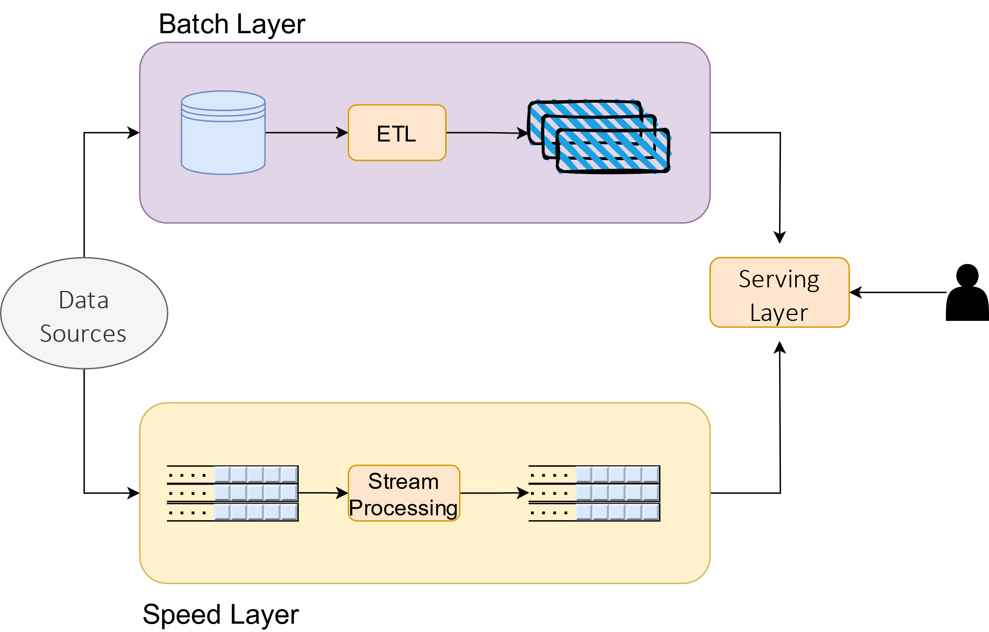
Lambda Architecture

Slide 40
Kappa Architecture
Full streaming solution
Events are fully persisted indefinitely
Recomputing means reading the full stream again

Slide 41
Q&A

Slide 42
Chapter Apache Kafka

Slide 43

Apache Kafka
Distributed event streaming platform
Originally developed ad LinkedIn
Write, store and read streams of events
Libraries for stream processing

Slide 44
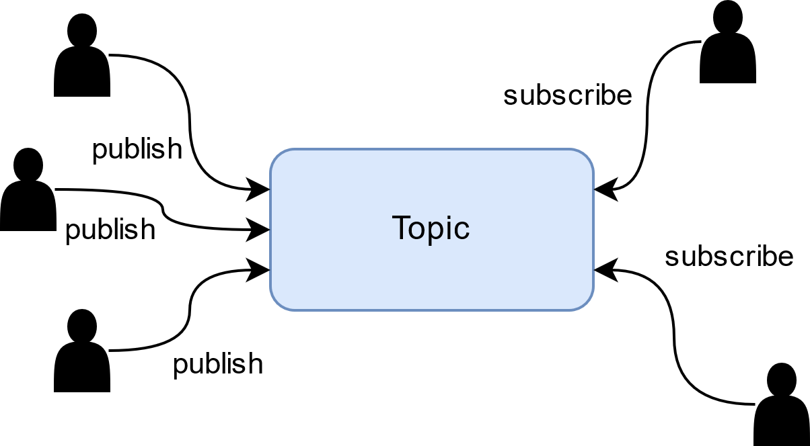
Pub/Sub
Write and read are asynchronous
Writers know nothing about readers
Readers know nothing about writers

Slide 45
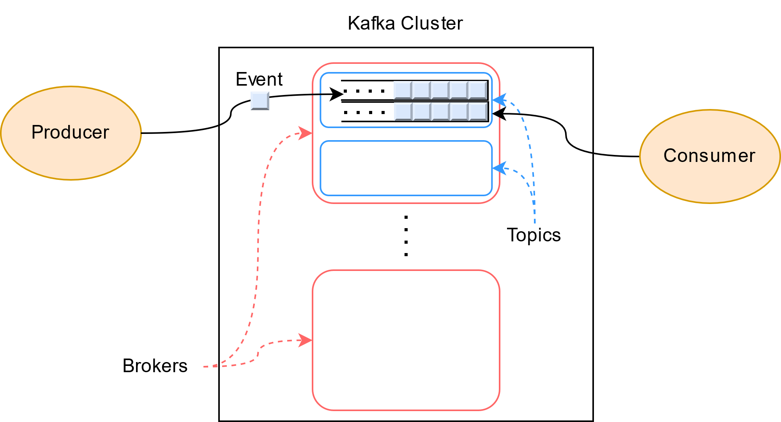
Apache Kafka Architecture

Slide 46
Events
Kafka events are key-value pairs, with optional headers
Key and Value are opaque byte arrays
Headers are a list of <string, byte[]>
All events are immutable once written

Slide 47
Topic
Logical organizational unit of events
Groups logically related events
Pub/sub at topic level
Most configuration is at topic level

Slide 48
Topic Partitions
Topic are divided into partitions
Partitions is what allows Kafka Topics to scale
Partitions can be distributed across Brokers
Event order is only defined on the same partition

Slide 49
Topic Partitions: methods
Key Hash (default)
Round robin (for events with no key)
Producer can use a custom partitioner

Slide 50
Topic Partitions: replication
Event replication factor at Topic level
Replication is performed at the partition level
Each partition has one leader and zero ore more follower brokers
Faults can promote followers to leader

Slide 51
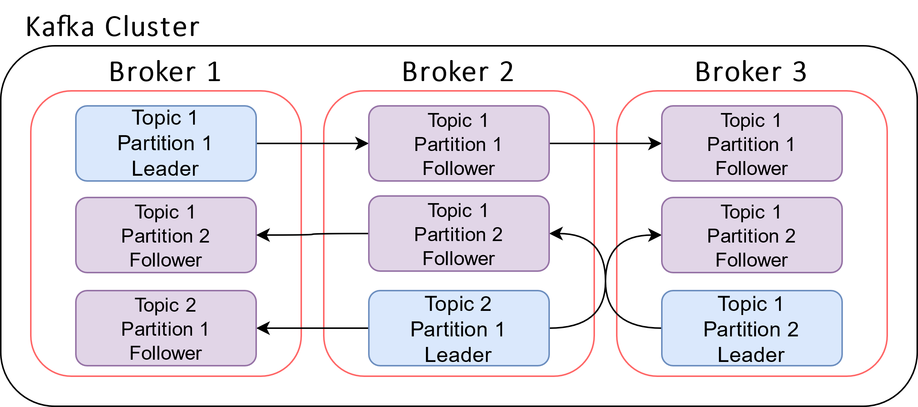
Topic Partitions: replication

Slide 52
Topic Partitions: sizing
Partition number vs Consumer number
Scaling vs Ordering

Slide 53
Topic Retention
Retention period controls how long events are stored
Eviction is performed at the segment level
Can be set to infinity to persist events indefinitely

Slide 54
Topic Delivery Guarantees
Three levels of committed messages guarantees:
At most once
At least once
Exactly once

Slide 55
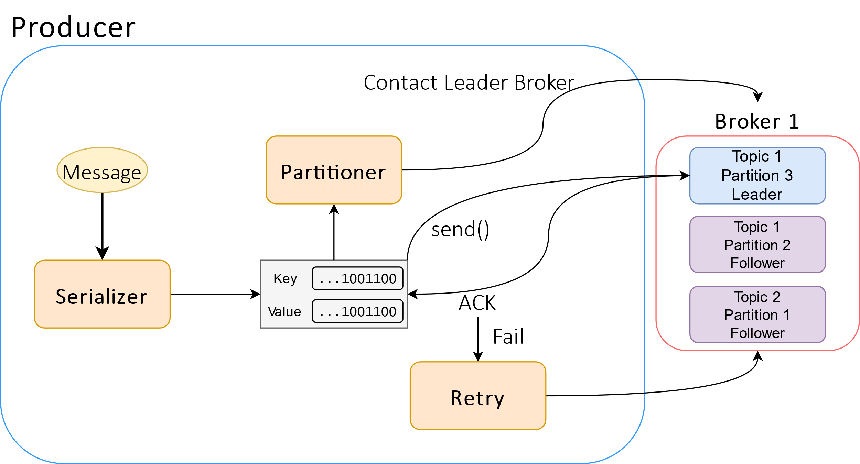
Producer

Slide 56
Producer acks configuration
acks = 0: producer does not wait for an ack
acks = 1: request ack only from leader
required for ‘at least once’ guarantee
acks = all: request ack from all replications
required for ‘exactly once’ guarantee

Slide 57
Broker
Written in Java, can run on commodity machines
All brokers are equal
A set of broker nodes constitutes the Kafka cluster
Save messages in local filesystem as files named segments

Slide 58
Consumer
Subscript to one or multiple topics
Poll the cluster for messages
Group.id property assigns the consumer group

Slide 59
Consumer Group
Allow consumers to scale
Brokers distribute topic partitions to consumers in a group
Must handle the failure and addition of new nodes

Slide 60
Consumer Group Rebalancing
Consumer failure, group resize, partition resize
Group coordinator and Group leader
Group leader can control partition assignment logic
Consumer groups are responsible of offset management

Slide 61
Schema Data contract
Serialization is handled by producer and consumers indipendently
No guaranteed coordination
Producers and Consumer must implicitly agree on the schema

Slide 62
Zookeeper
Broker coordinator
Brokers interact with Zookeeper to elect leaders
Zookeeper also keep track of all the brokers in the cluster
Kafka 4 will not need Zookeeper anymore

Slide 63
Kafka Streams
Client library to write Kafka applications
Simplify fault recovery and stateful consumers
Implements windowing, delivery guarantees and more
Stream processing topology model

Slide 64
ksqlDB
Built on top of Kafka Streams
Relational SQL like interface to stream processing
Materialized table views of stream events

Slide 65
Q&A

Slide 66
Chapter Data Governance

Slide 67
Data Governance
Data Quality
Data Security
Data Discovery
Data Compliance

Slide 68
Data Quality
Test as early as possible
Data quality policies and processes
Source of truth

Slide 69
Data Security
Least privilege principle
Object and Row level security
Logging

Slide 70
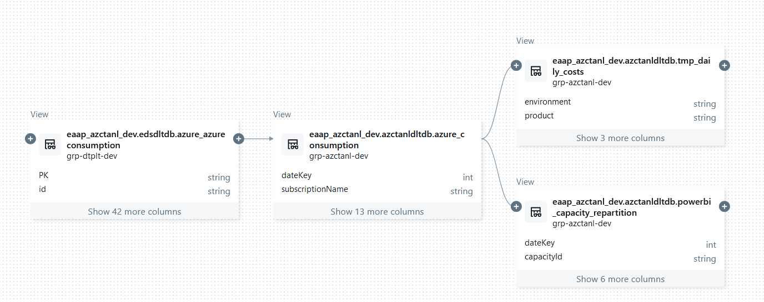
Lineage

Slide 71
Q&A

Slide 72
Chapter Lab Session

