Slide 1
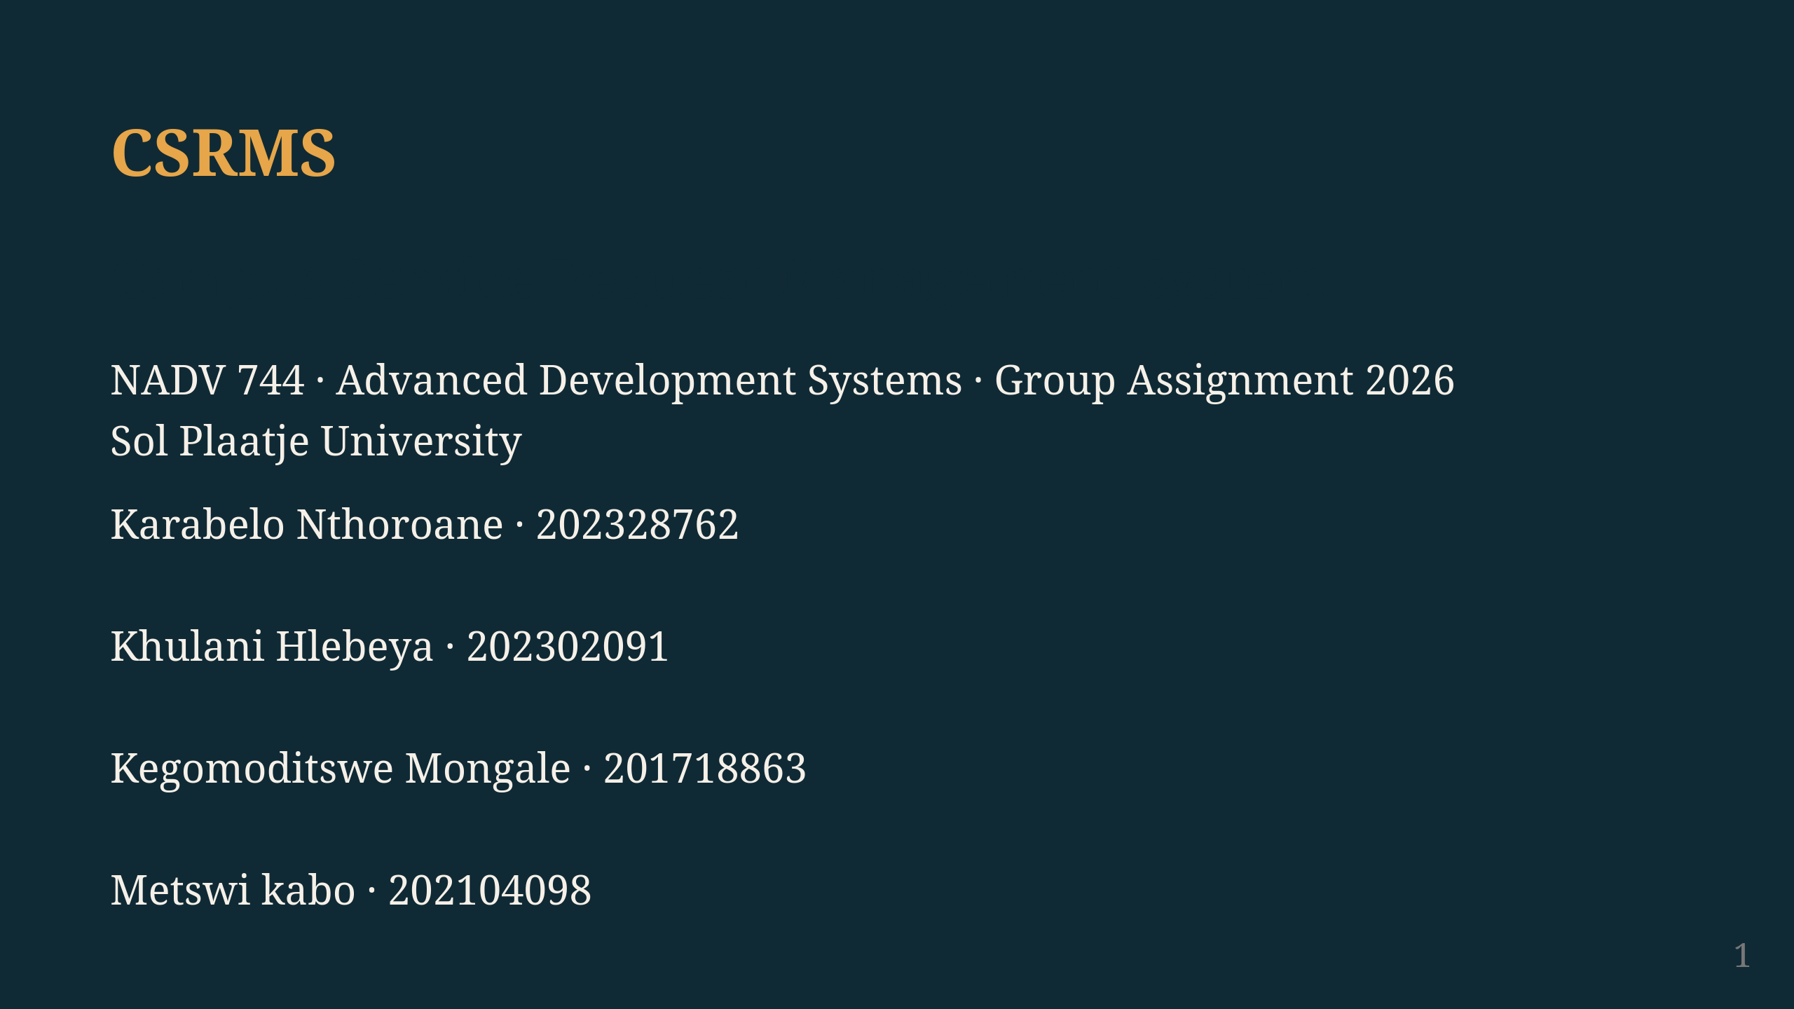
Notes:
Four of us built CSRMS for this module. The problem: campus maintenance runs on WhatsApp and people bumping into each other in hallways. Nothing gets logged, so requests slip through. And some things — a leaking pipe at 2am, a server room overheating — nobody is around to report. We wanted one system that handles both.

Slide 2
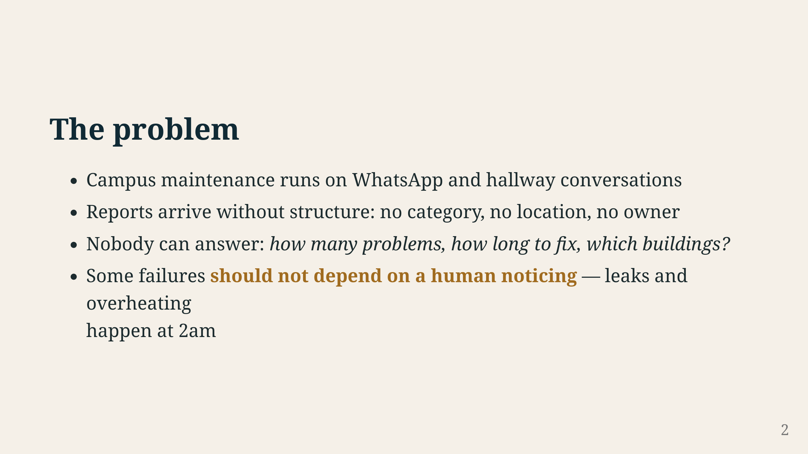
Notes:
Picture this: a geyser bursts in a residence at midnight. Nobody is there to report it. By morning the damage is done. Or IT finds out about a network outage from students tweeting about it. Right now there is no structure — a student tells a lecturer, the lecturer sends a WhatsApp, maybe it gets forgotten. We wanted to fix that: give students a place to log things, and give sensors a way to speak up when nobody is watching.

Slide 3
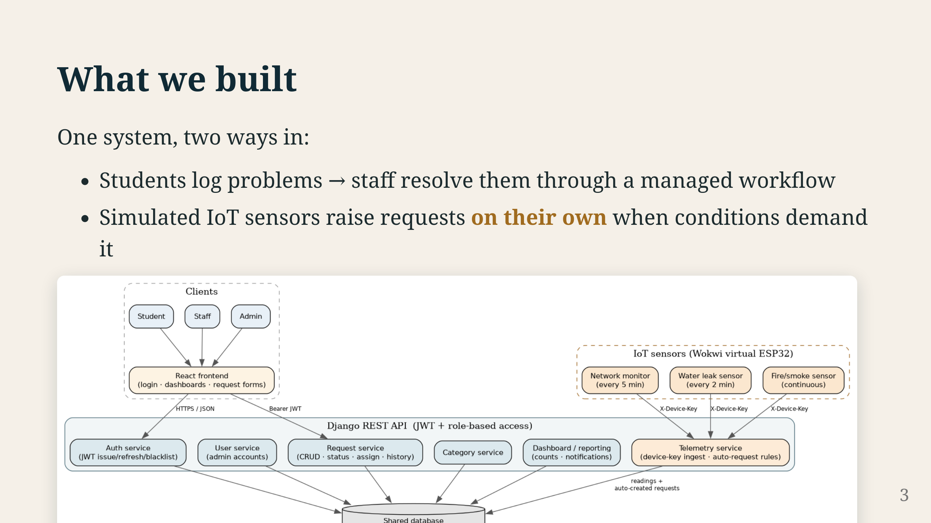
Notes:
Look at the diagram. Left side is the human flow — students log in, submit requests, staff pick them up and work through the workflow. Right side is the IoT flow — three sensors post readings to the same API. When a threshold trips, the backend creates a ticket in the same table staff already look at. The important thing: sensors are not a separate system. They are just another API client. A sensor ticket follows the exact same path as a student report.

Slide 4
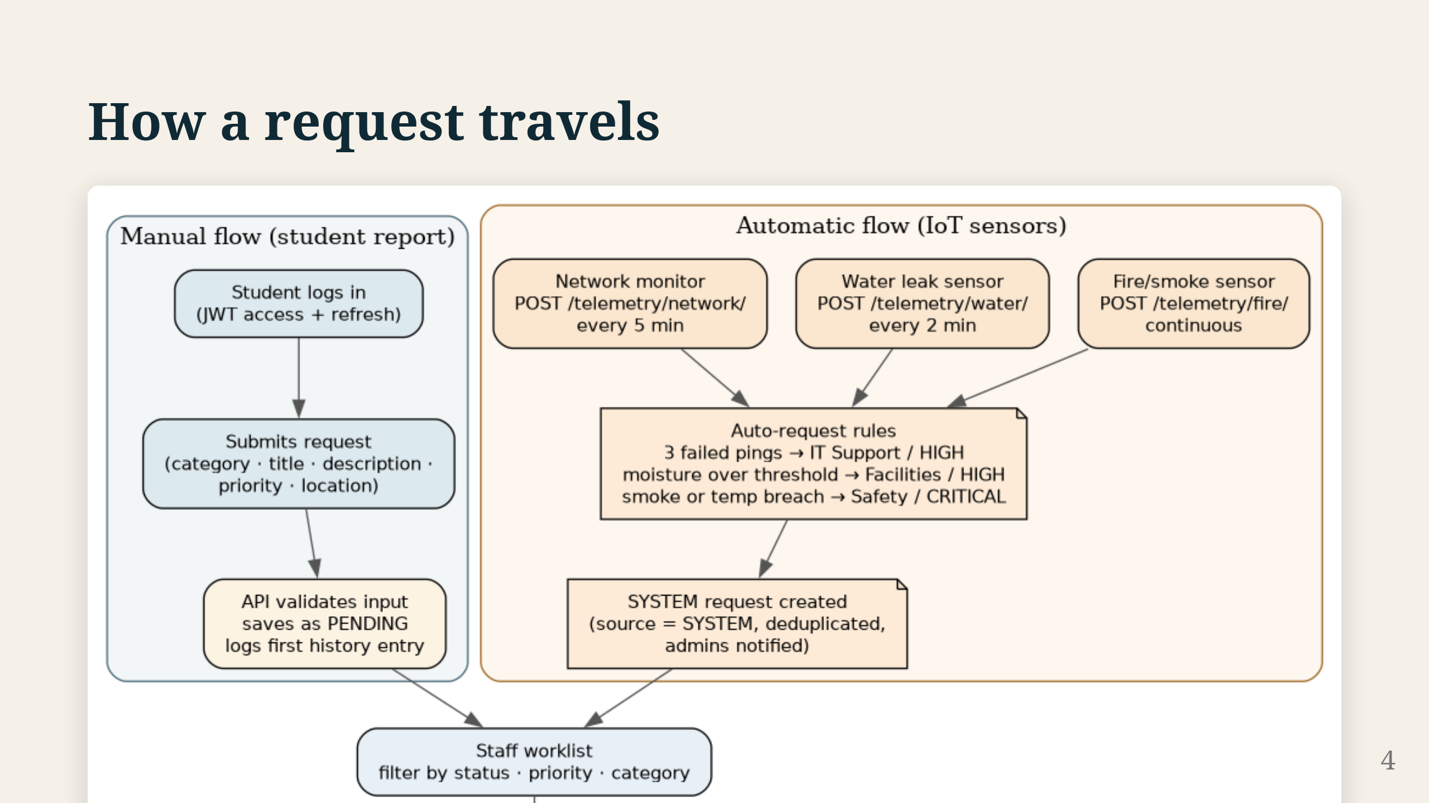
Notes:
Two ways in, same pipeline. Student logs in, gets a JWT, submits a request — API validates it, stamps it PENDING, writes the first history entry. Staff see it, assign it, work it, resolve it. Every change gets logged with a timestamp and a comment. Sensors do the same thing: post a reading with their device key, backend checks the rule, creates a SYSTEM request if the threshold is hit. From there, same workflow.

Slide 5
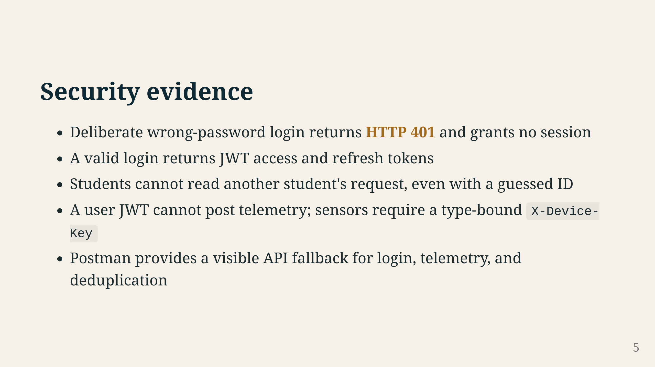
Notes:
We can back up every security claim. Wrong password? 401, no session. Students can't see each other's tickets — guess an ID, you get 404. A user JWT is useless for posting sensor data; that needs a device key. We will demo all of this. Postman is there as a backup if the browser misbehaves.

Slide 6
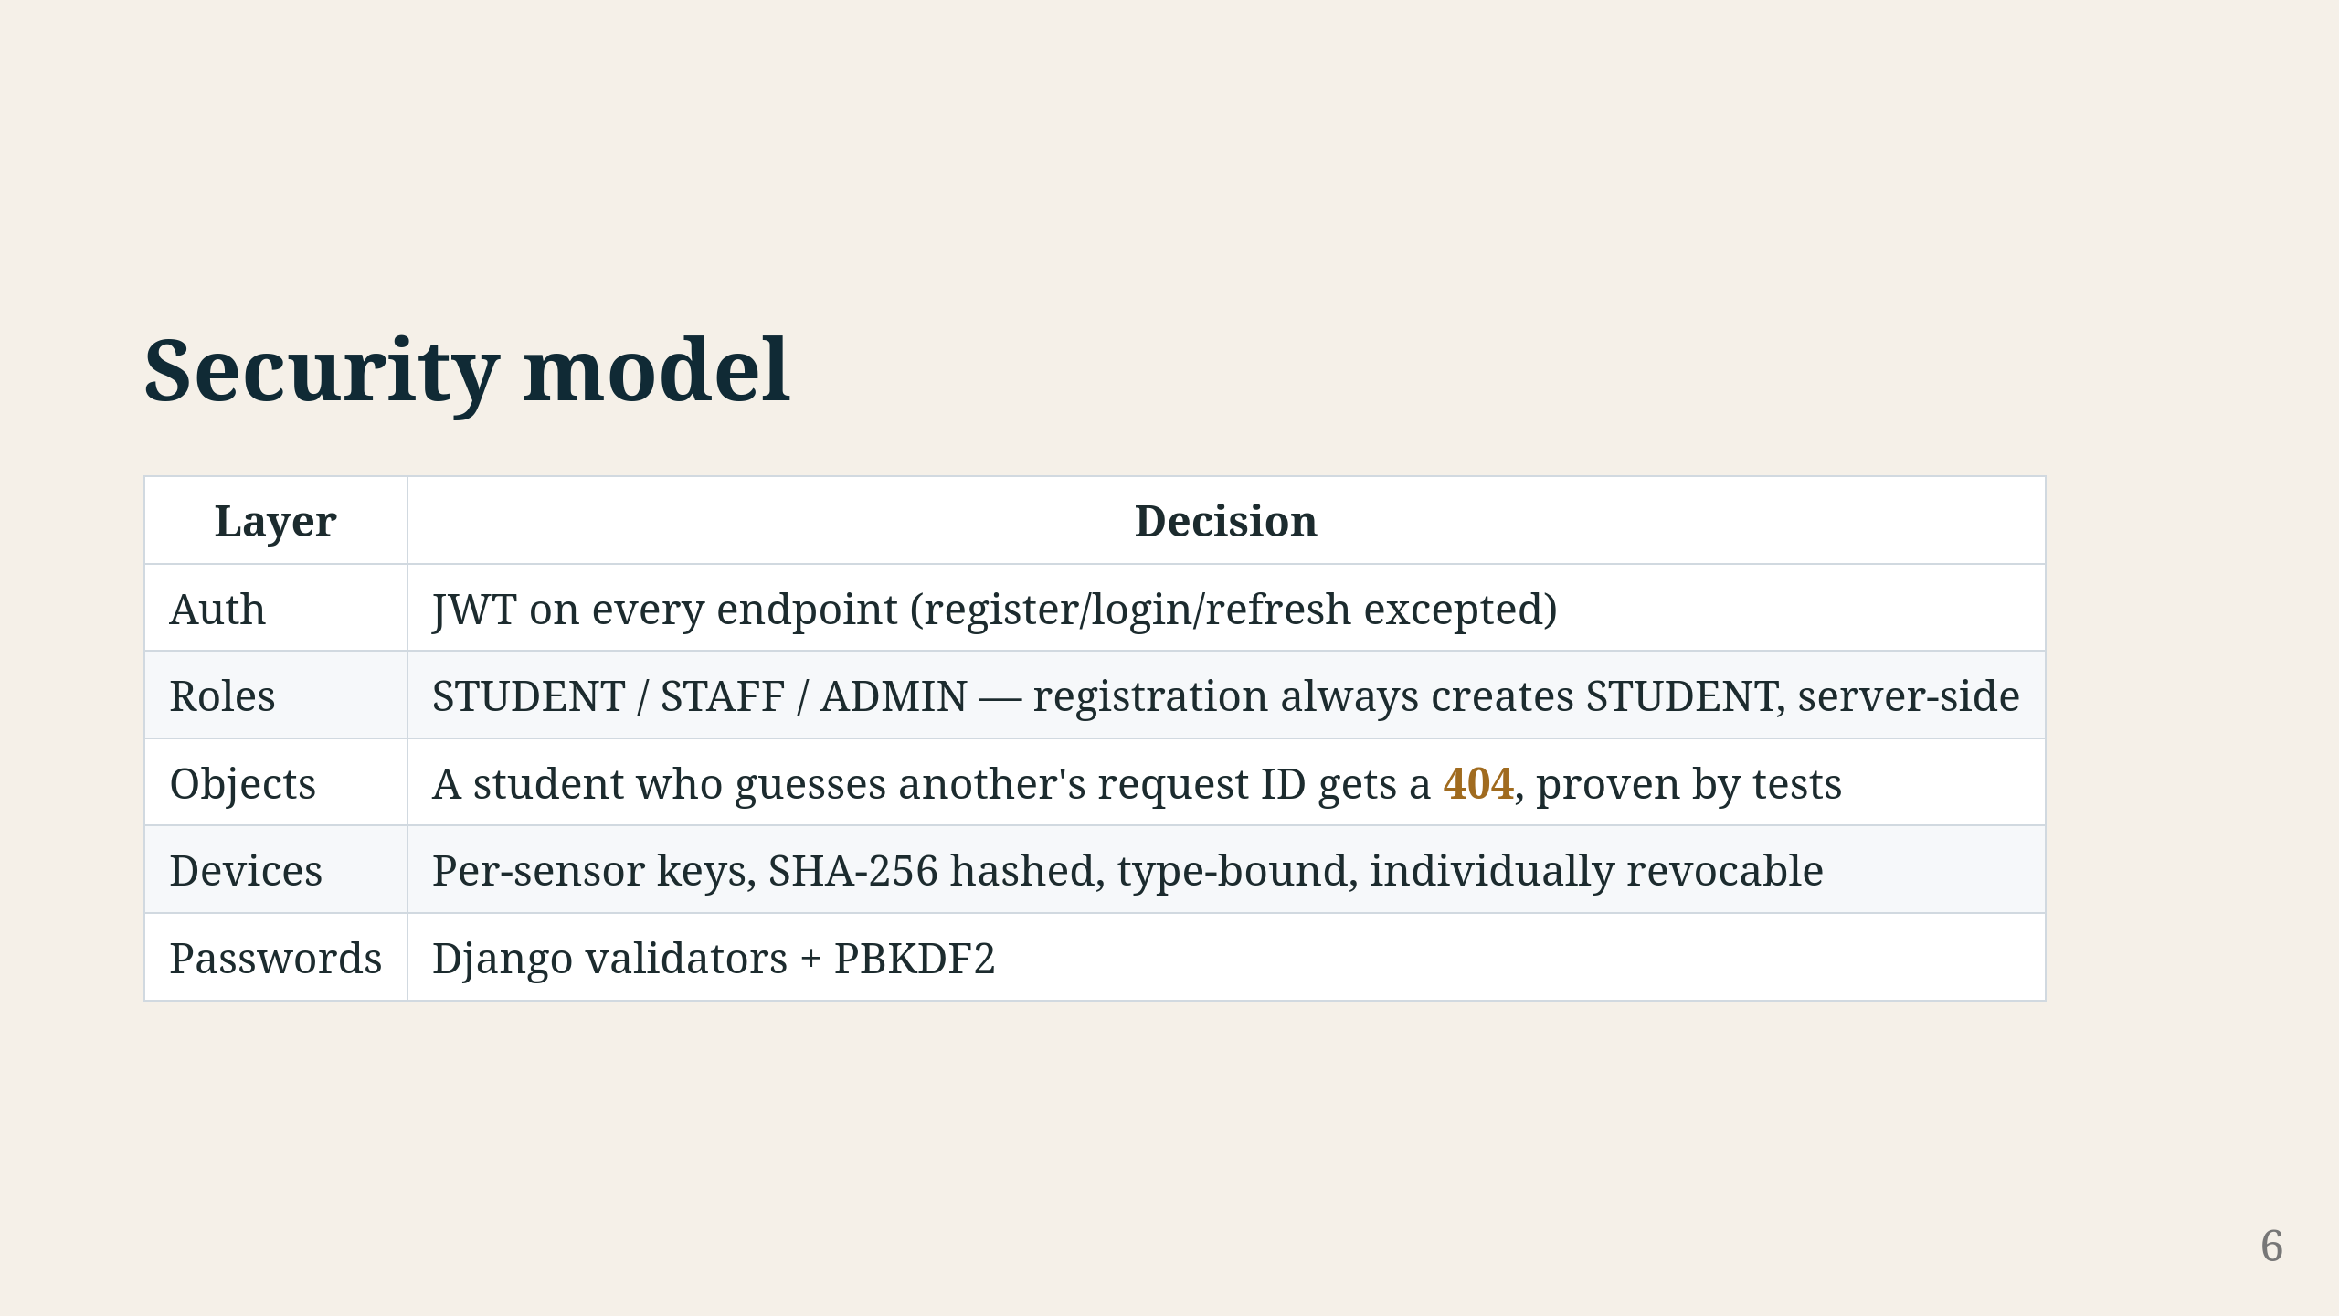
Notes:
Five layers. JWT on everything except register and login. Three roles — and registration always makes a STUDENT account, no matter what you submit. Object permissions mean a student guessing IDs gets nothing. Device keys are hashed, bound to one sensor type, and you can revoke any key individually. Passwords use Django's validators plus PBKDF2.

Slide 7
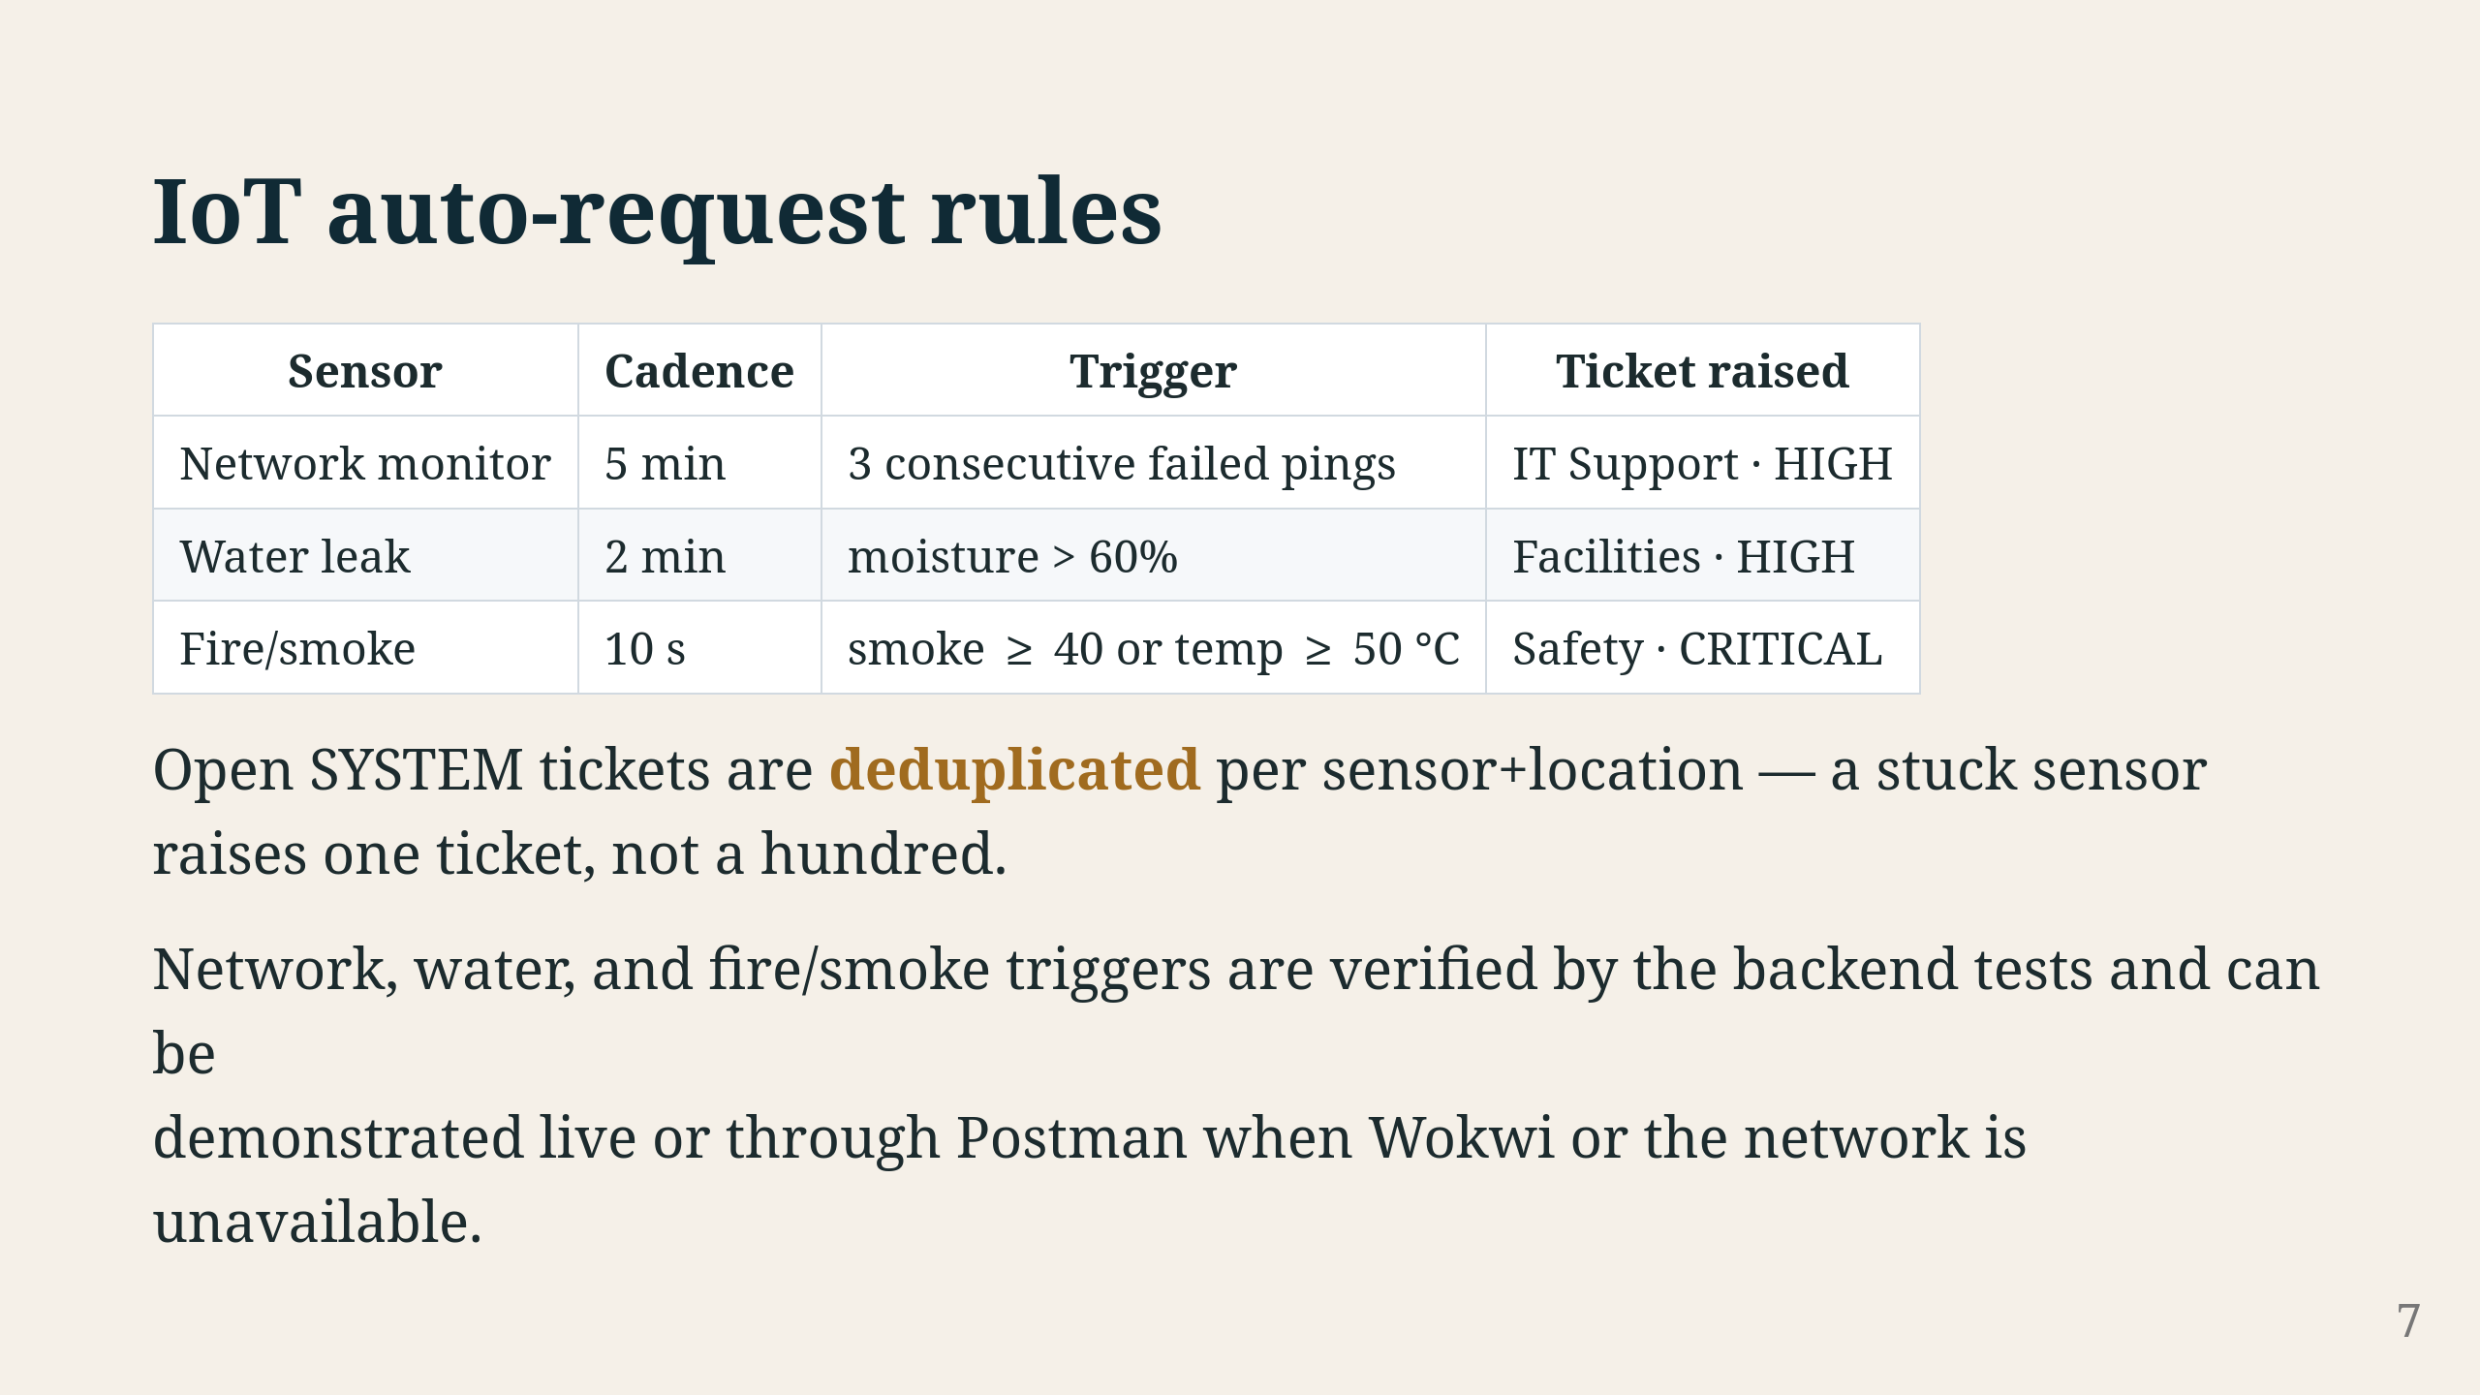
Notes:
Three sensors, three rules. Network monitor pings the gateway every 5 minutes — three fails in a row and it raises an IT Support ticket. Water leak checks moisture every 2 minutes — over 60% and Facilities gets a ticket. Fire sensor runs nonstop — smoke above 40 or temp above 50 Celsius, Safety ticket at CRITICAL. The trick is deduplication: if a sensor keeps tripping, you only get one open ticket, not a flood. A new one shows up only after the last one is resolved or cancelled. All thresholds come from environment variables, and the test suite covers all three rules.

Slide 8
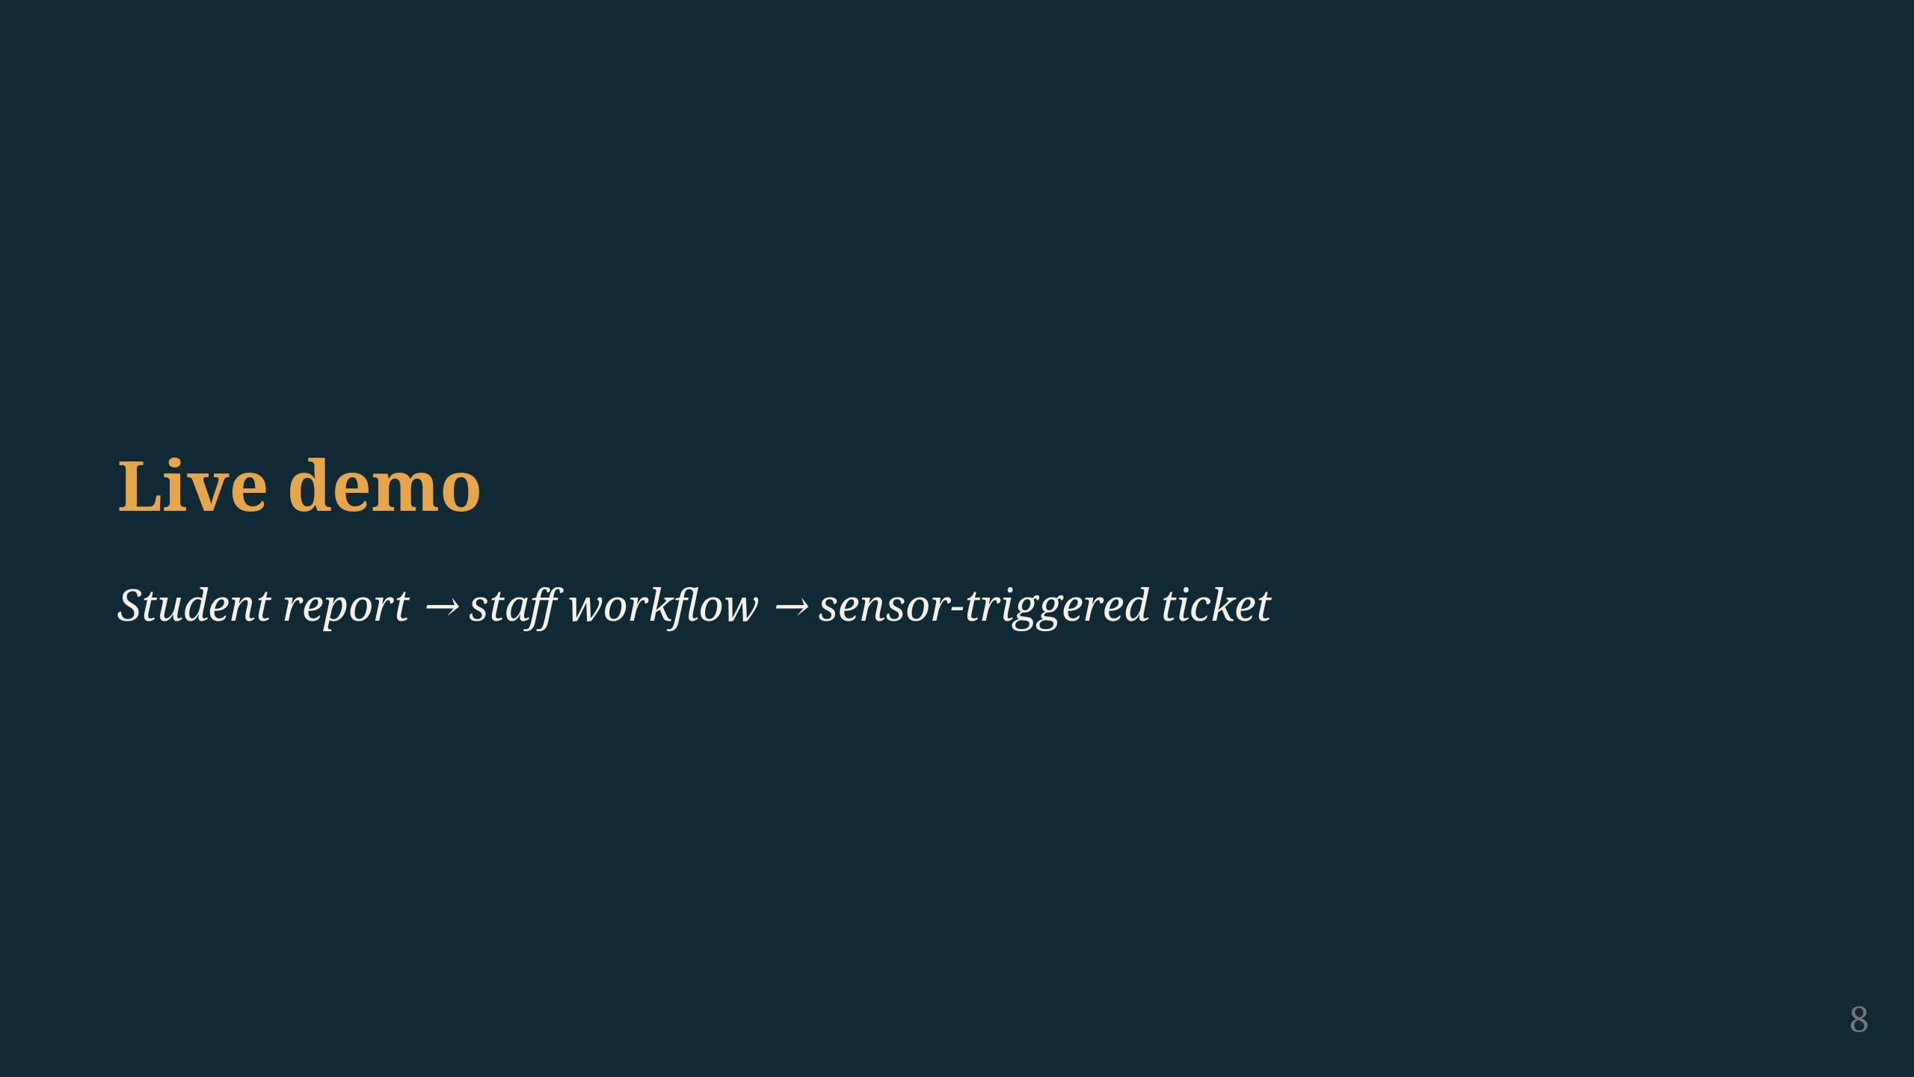
Notes:
Let's do the live demo. One story: student reports a problem, staff works through it, sensor trips and raises its own ticket. Same workflow both ways. Logins: naledi (student), lerato (staff), admin — password Campus#2026.

Slide 9
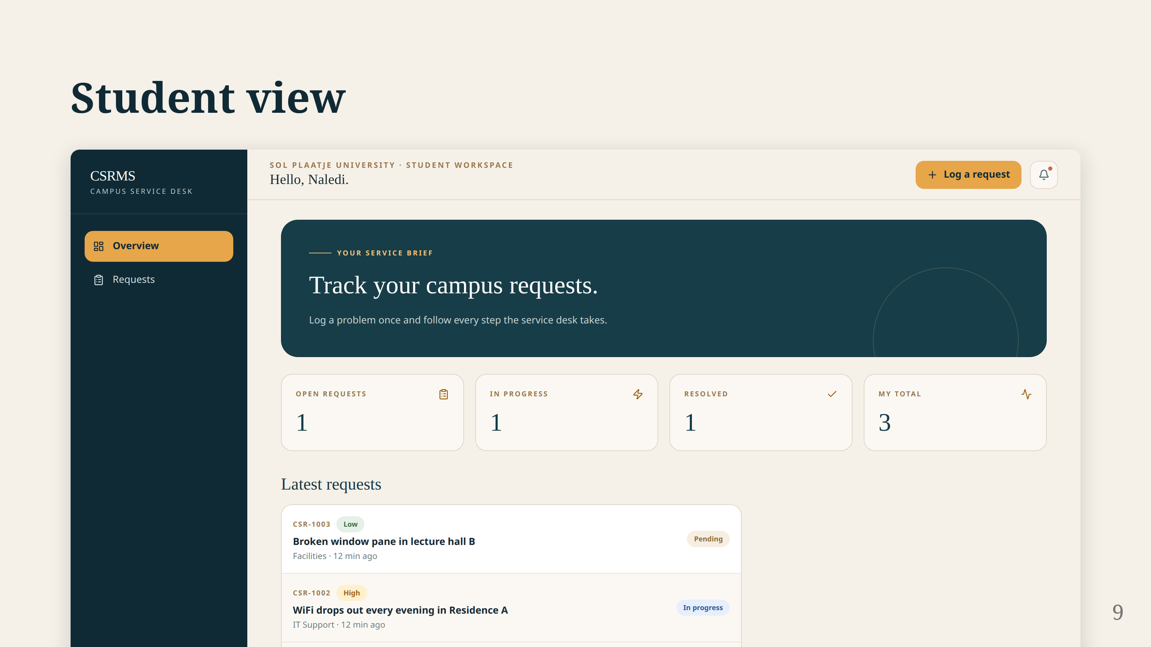
Notes:
Logged in as naledi. See the counters at the top — students only see their own stuff. They cannot see anyone else's requests. From here they can go to Requests, log a new one, or check notifications. Try guessing another student's request ID and you get a 404. There is a test that proves it.

Slide 10
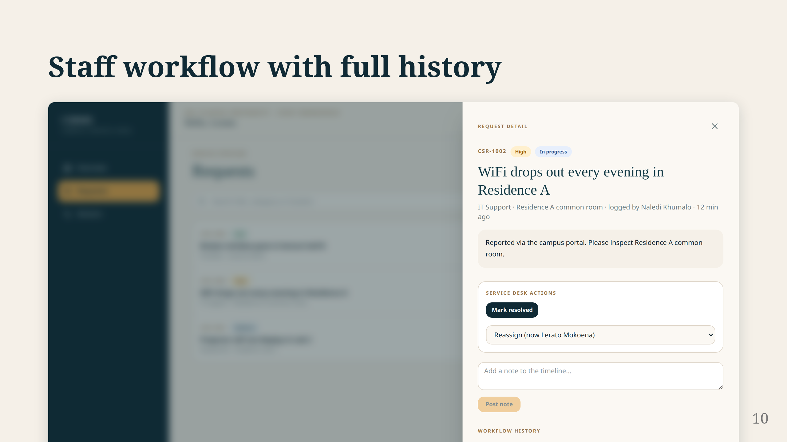
Notes:
Staff see everything. Open a request and you get the full picture: title, description, category, priority, location, status. The timeline at the bottom shows every change — who did what and when. Assign it, move it forward, resolve it. One thing: you cannot skip steps. PENDING straight to RESOLVED gets rejected. The same service layer backs the API, the seed command, and the IoT rules — no side door.

Slide 11
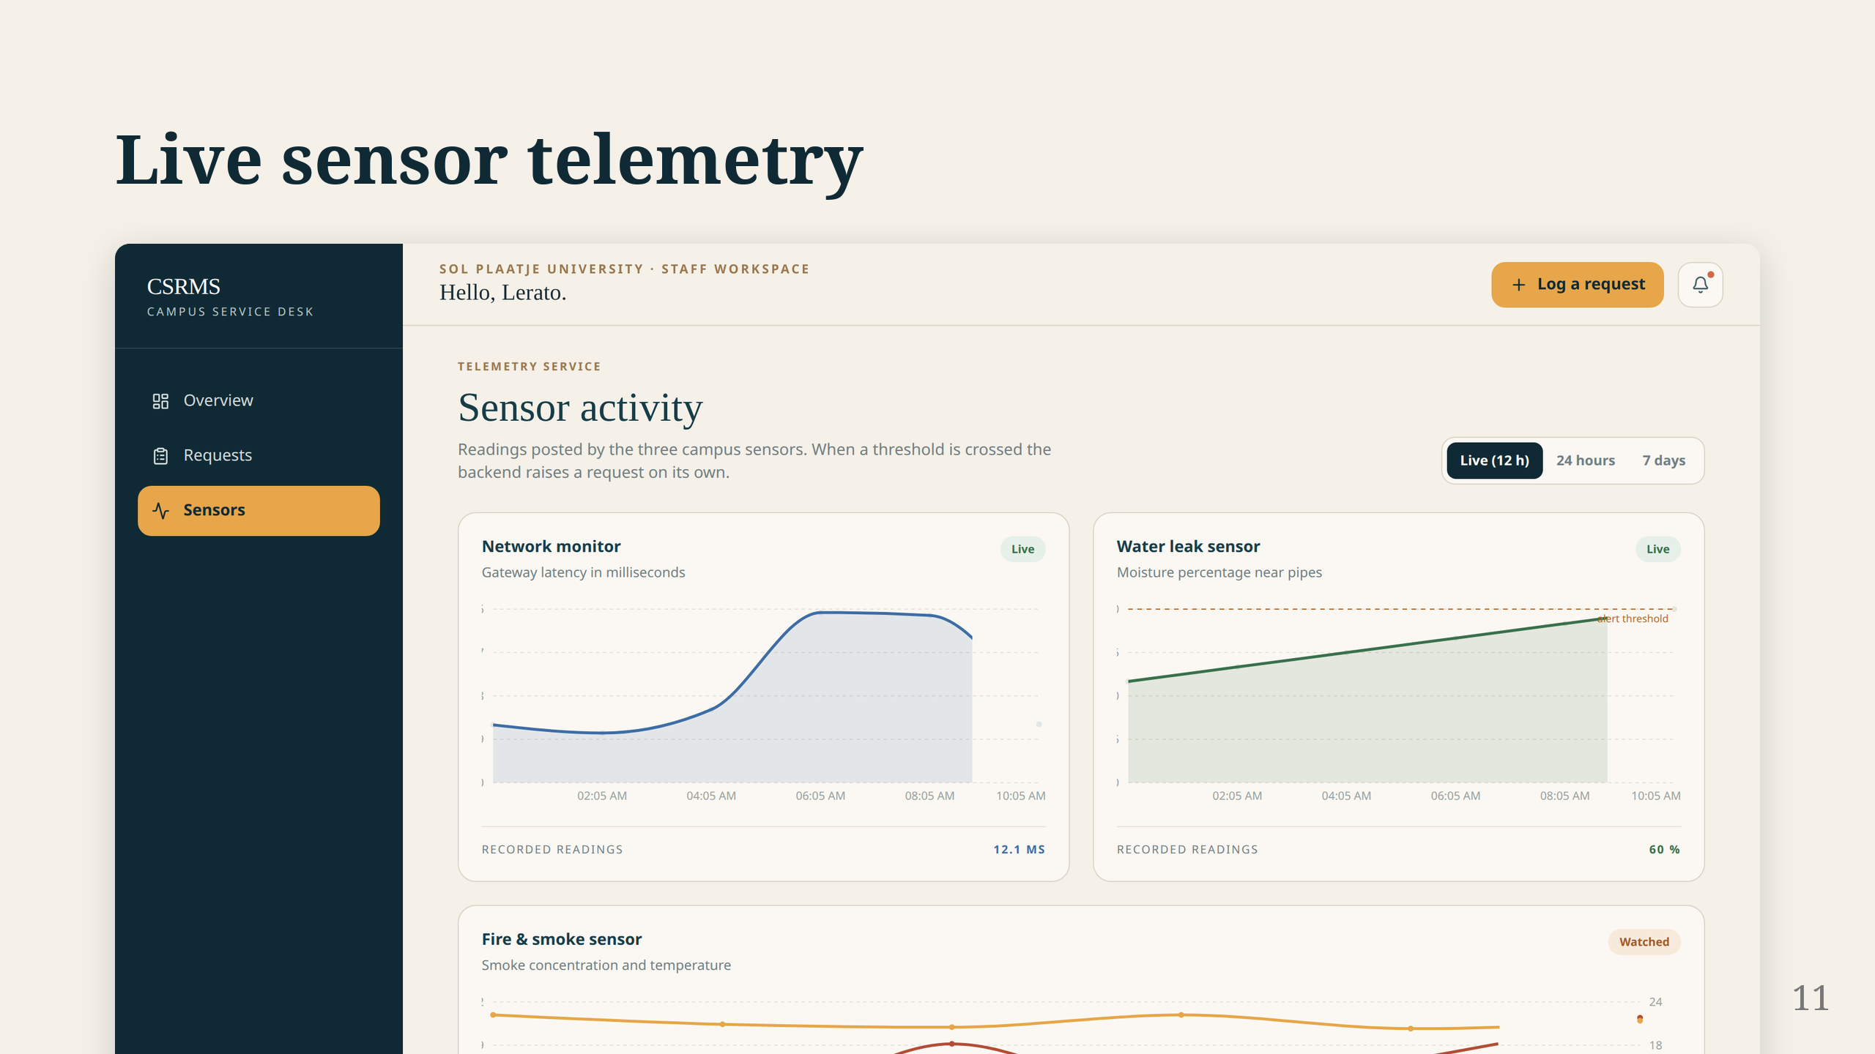
Notes:
Twelve hours of sensor history on one page — network, moisture, smoke and temperature. During the demo we flip to Wokwi, run the water sim, drag the potentiometer past 60%. You see HTTP 201 on the serial monitor. Back in CSRMS, a SYSTEM ticket appeared under Facilities. Post another high reading — no duplicate, dedupe key blocks it. If we have time, same thing with the fire sensor: push the DHT22 past 50 degrees, CRITICAL Safety ticket. Network monitor can be shown through Postman if Wokwi is not cooperating.

Slide 12
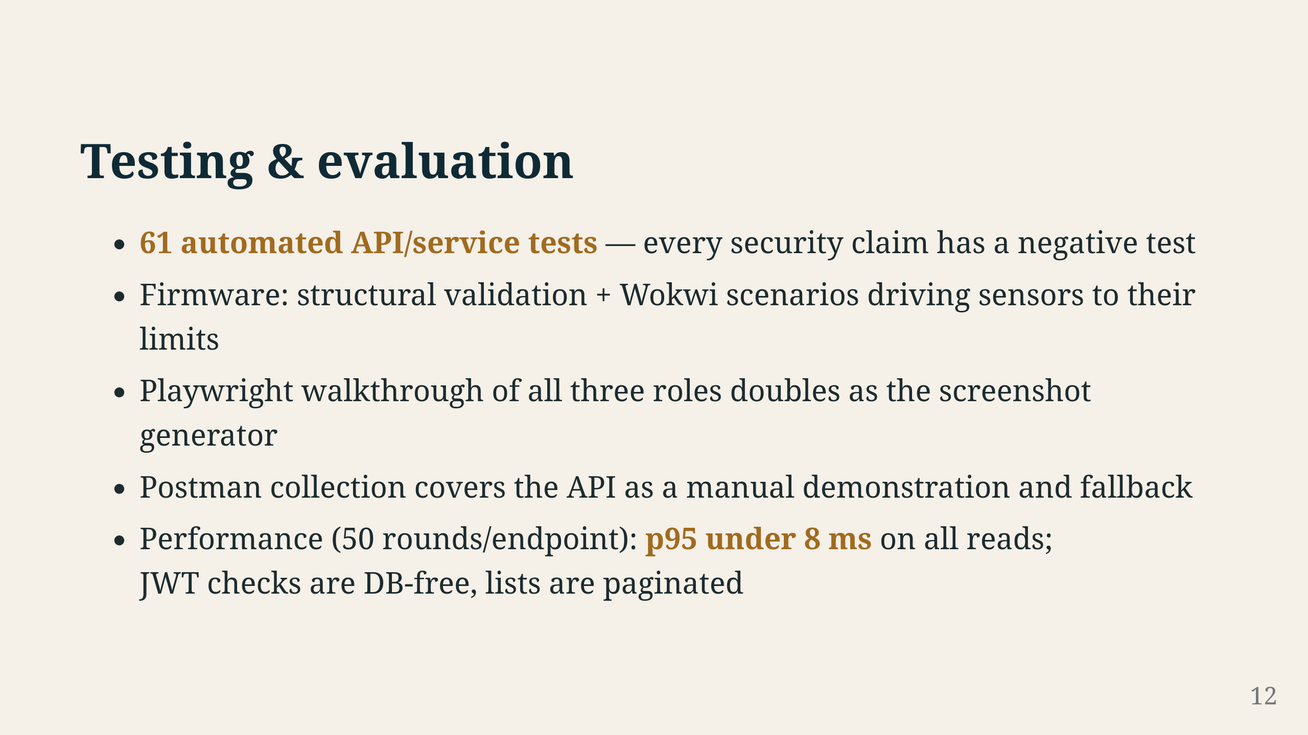
Notes:
61 tests in Django's test suite — wrong password, object visibility, device key separation, all three sensor rules, deduplication. Every claim we made has a test trying to break it. Firmware side: a Python script validates the sketch structure, and Wokwi scenarios push the sensors past their thresholds. Playwright walks through all three roles in the browser — that is where these screenshots came from. Postman covers the API by hand. On performance, we timed every read endpoint 50 times — p95 under 8 milliseconds across the board. JWT checks do not touch the database, lists are paginated.

Slide 13
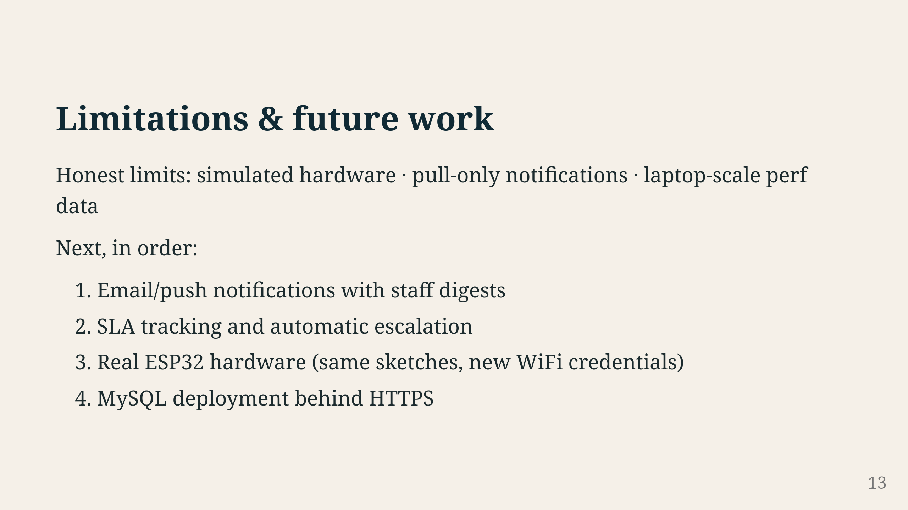
Notes:
What we did not do. Sensors are simulated — same code runs on real ESP32, we just did not have the hardware. Notifications only show up in the app, no email or push. Performance numbers are from a laptop, not a production server. If we had more time: push notifications so staff get alerted, SLA tracking to escalate stale tickets, real hardware, and MySQL behind HTTPS. The sketches need only WiFi credentials and an API URL to run on real boards.

Slide 14
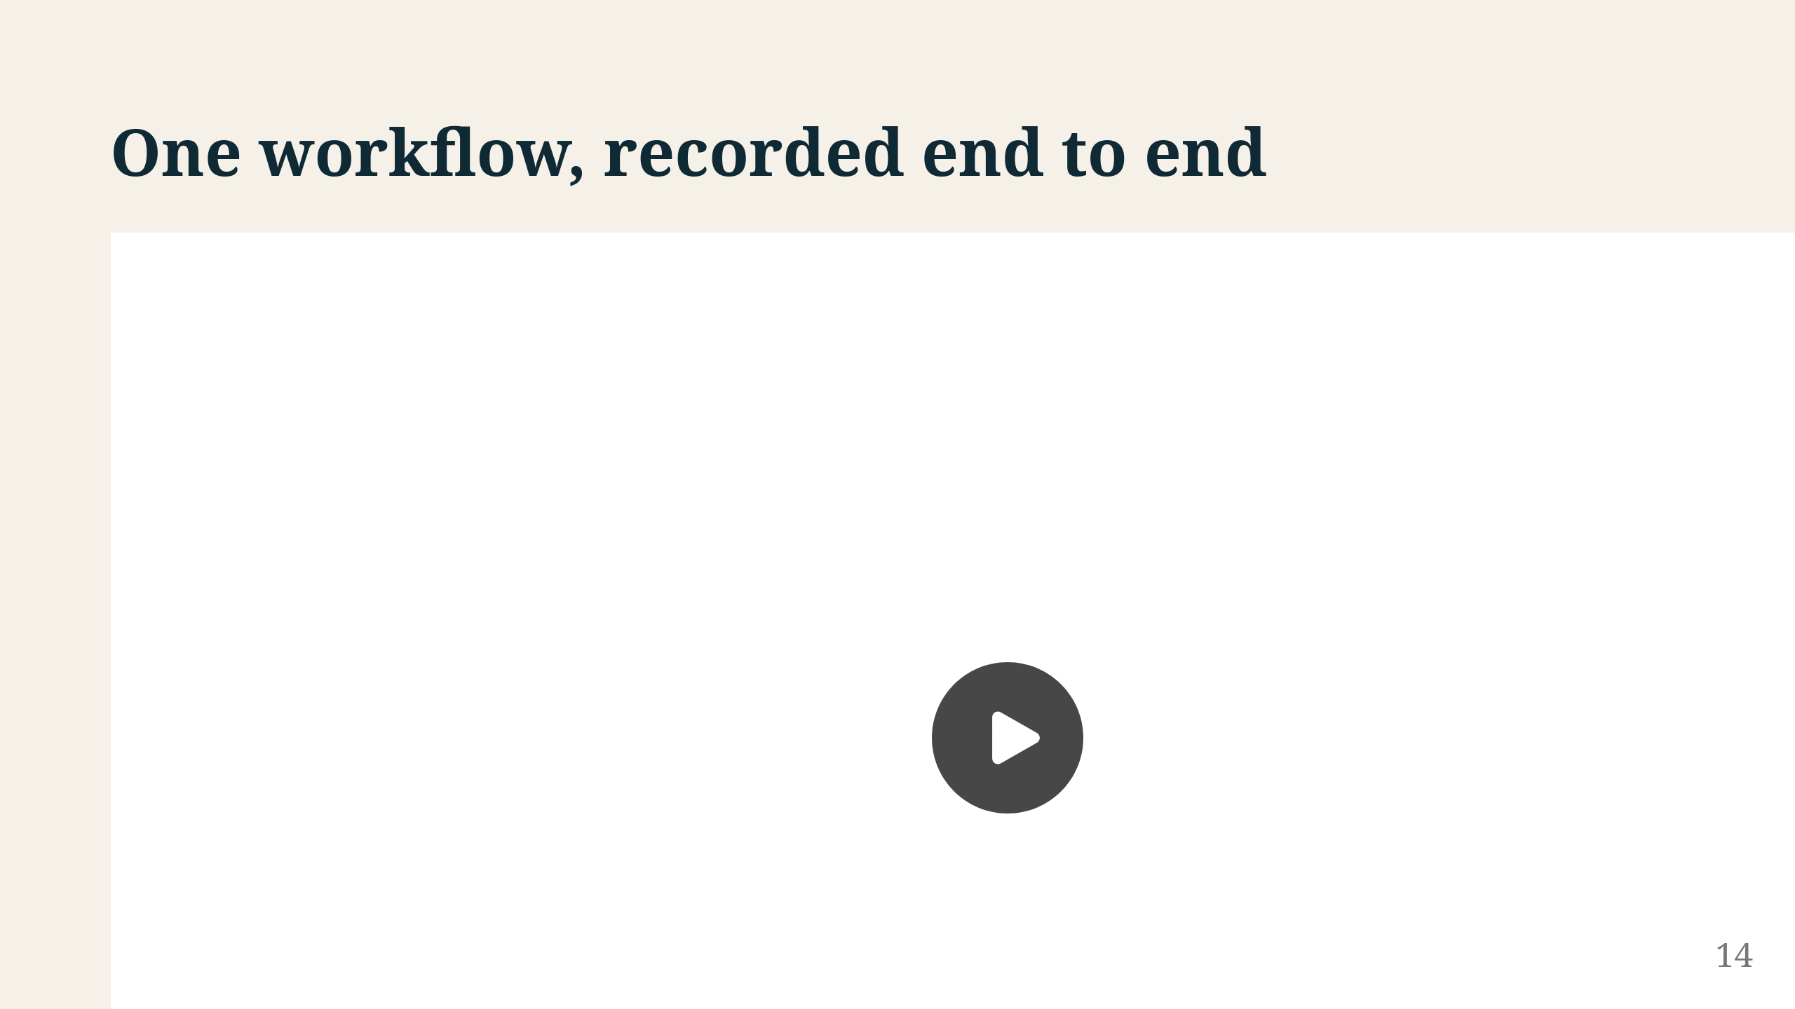
Notes:
Full recording of the workflow: student logs in and reports, staff picks it up and works through the statuses, sensors trip and SYSTEM tickets appear. One take, real time. File is at docs/demo/assets/csrms-demo.webm.

Slide 15
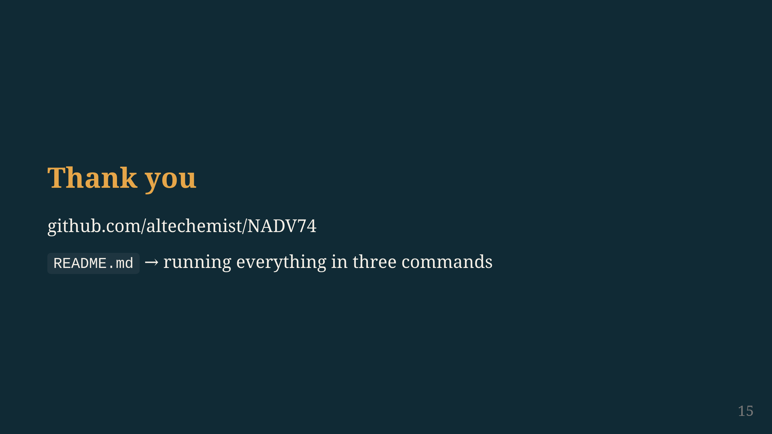
Notes:
Everything is on GitHub — code, tests, docs, this deck. README gets you running in three commands. Questions?

