Slide 1
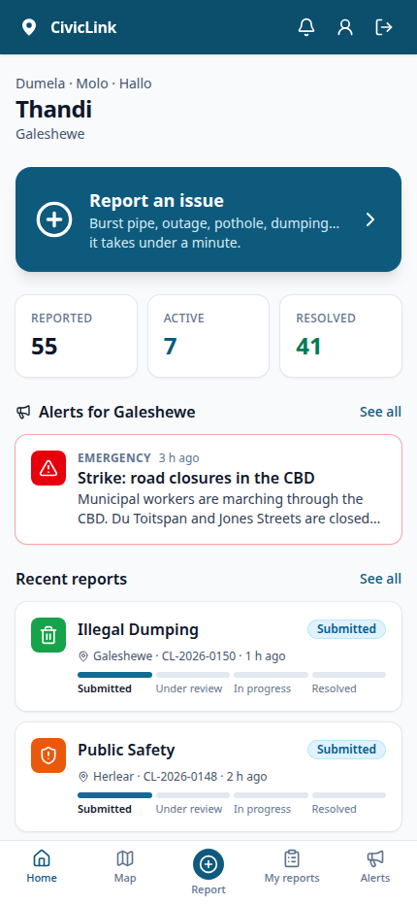
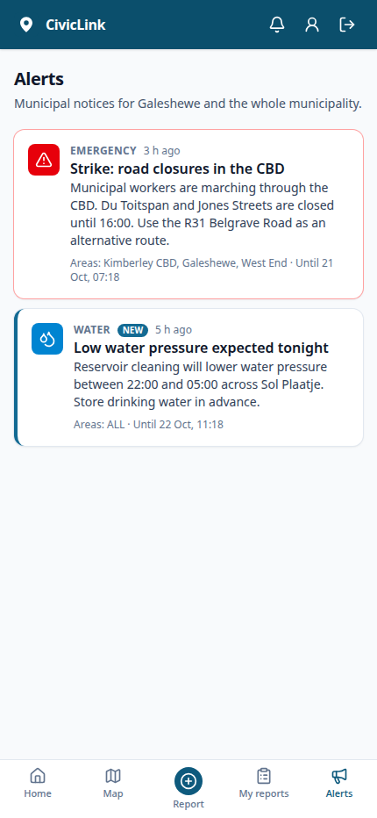
SOL PLAATJE LOCAL MUNICIPALITY · KIMBERLEY
CivicLink: municipal incident reporting and community alerts
The problem: reports by phone, walk-in and WhatsApp; no location or photos; duplicates; phone dispatch with no record; residents never hear back
31 March 2026: a workers' strike closed roads across Kimberley, with no official way to warn residents or commuters
The purpose: one accountable workflow from report to resolution, with targeted alerts and an audit trail
CivicLink · Nthoroane KP (202328762) · NPRJ740 2026

Slide 2
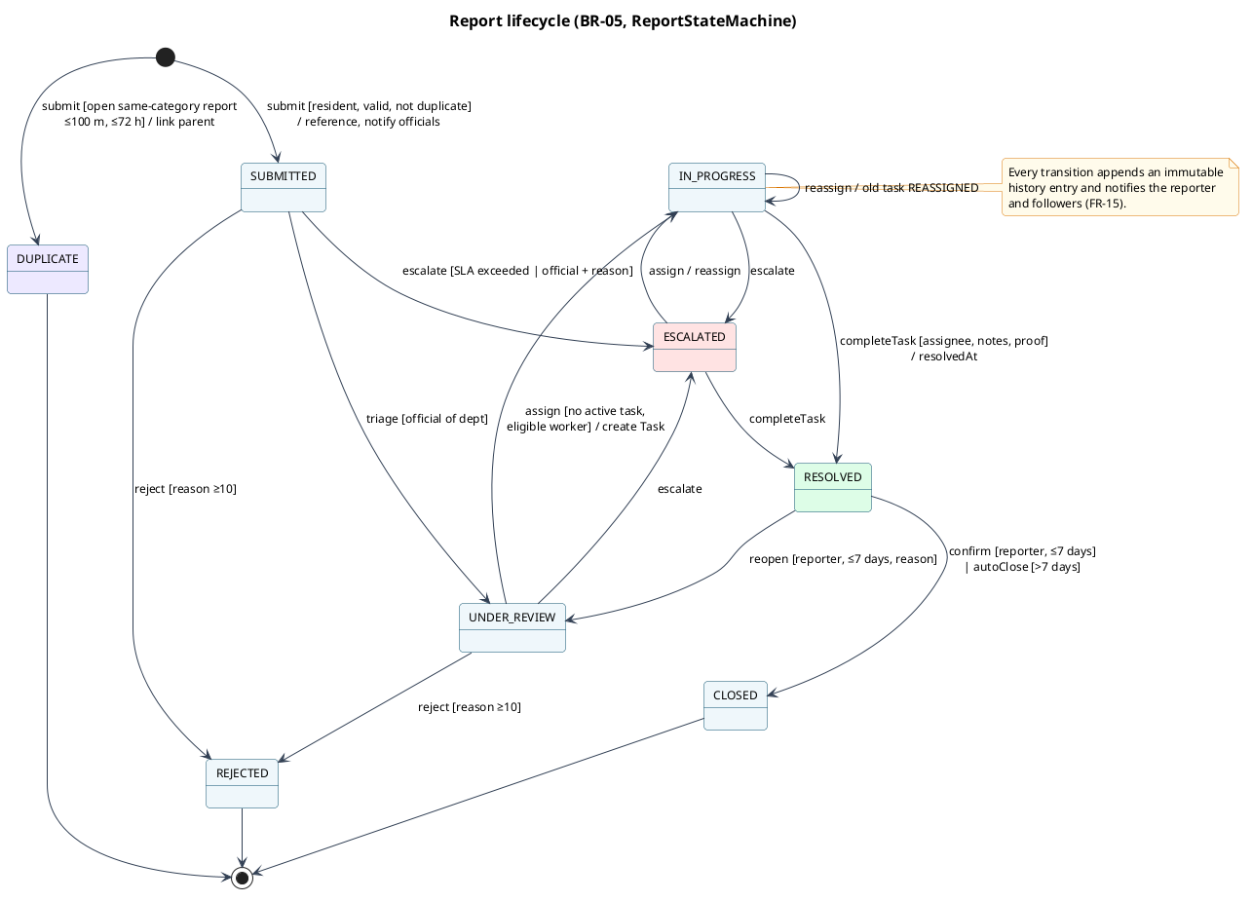
SOLUTION AND FINAL SCOPE
Four roles, one lifecycle: all 37 requirements delivered
Residents report in 3 steps (map pin, photos, severity), even offline; get a reference, follow it live, confirm with a rating or reopen
Officials department queue, triage, assign (one or many), escalate, suburb alerts now or scheduled, live analytics
Field workers accept, start and complete with notes and proof photos
Administrators staff accounts, roles, departments, SLA targets, system log
Accounts Google sign-in, password reset, profile, POPIA self-deletion with anonymised records
Reach web push, SMS for emergencies, "Me too" on the map, installable app that saves reports offline
Transparency a public page with time-to-fix, SLA compliance and satisfaction, served from the CDN
CivicLink · Nthoroane KP (202328762) · NPRJ740 2026

Slide 3
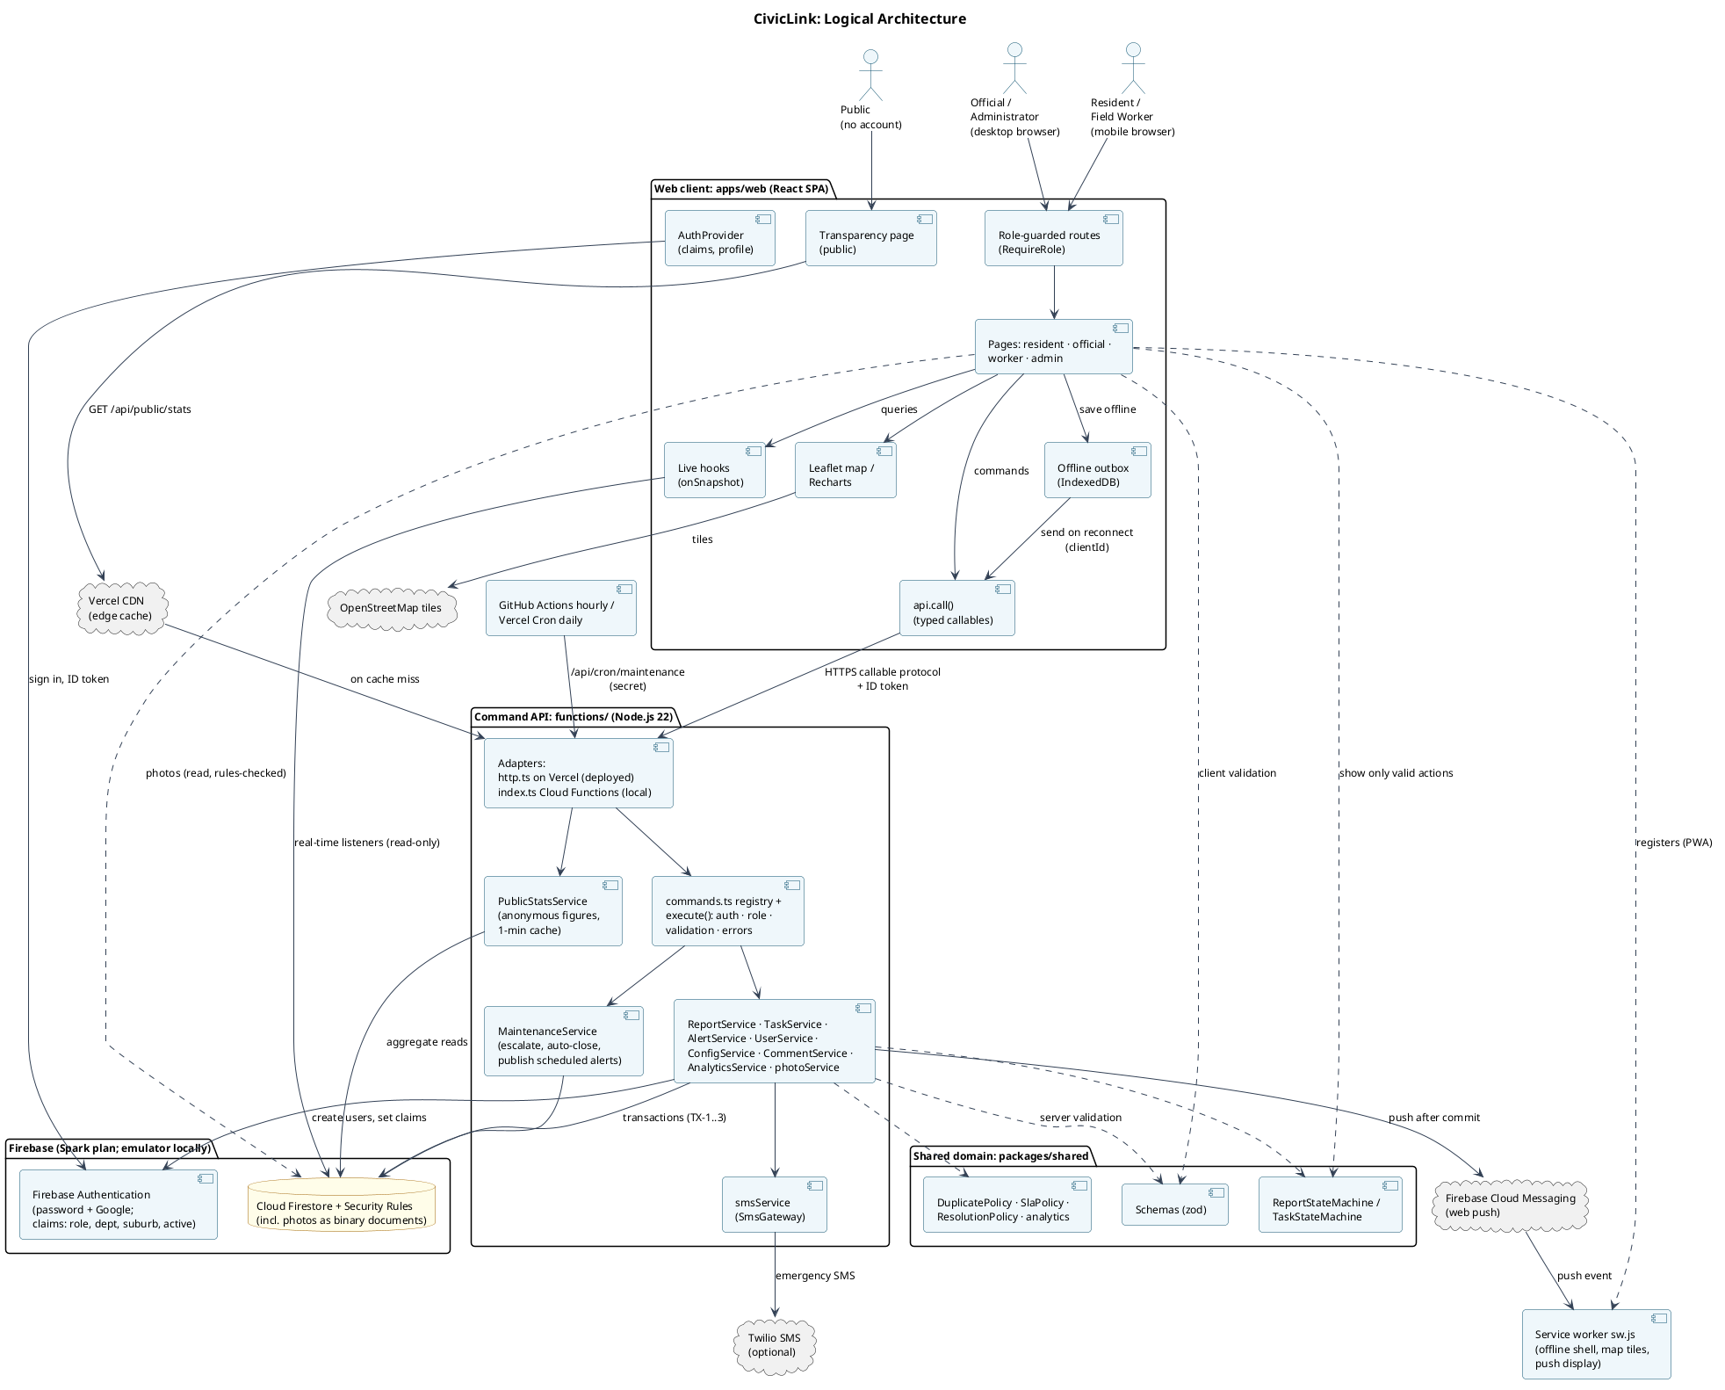
ARCHITECTURE
Commands on the server, real-time reads in the browser
React SPA reads Firestore through live listeners, under Security Rules
Node command API one registry of 31 commands: auth, roles, Zod validation, transactions; served by Vercel (deployed) or Cloud Functions (local)
Shared domain package state machines, duplicate/SLA policies, used on both sides
Free tier Vercel + Firebase Spark; photos stored in Firestore; emulator for offline demo and tests
CivicLink · Nthoroane KP (202328762) · NPRJ740 2026

Slide 4
ENGINEERING DECISIONS
Decisions that shaped the system
D1: Every state change is a server command in a transaction Rules alone cannot enforce "one active task", reference counters or the 100 m duplicate search. TX-1 submit, TX-2 assign, TX-3 complete are atomic; two simultaneous assignments → exactly one wins.
D3: Free-tier deployment without Cloud Functions Firebase Spark + a Node API on Vercel; photos compressed to ≤ 700 KB and stored in Firestore with real-type checks. One command registry, two adapters, and CI runs every E2E test through both.
D5: Offline reports through an outbox and idempotent commands Saved on the phone (IndexedDB) and sent on reconnect with a device-chosen id, so a resend is stored once. Works in every browser, unlike Background Sync.
Also: public figures from the CDN cache (D6); enforced CSP + HSTS; Leaflet + OpenStreetMap instead of Google Maps; React SPA instead of Next.js.
CivicLink · Nthoroane KP (202328762) · NPRJ740 2026

Slide 5
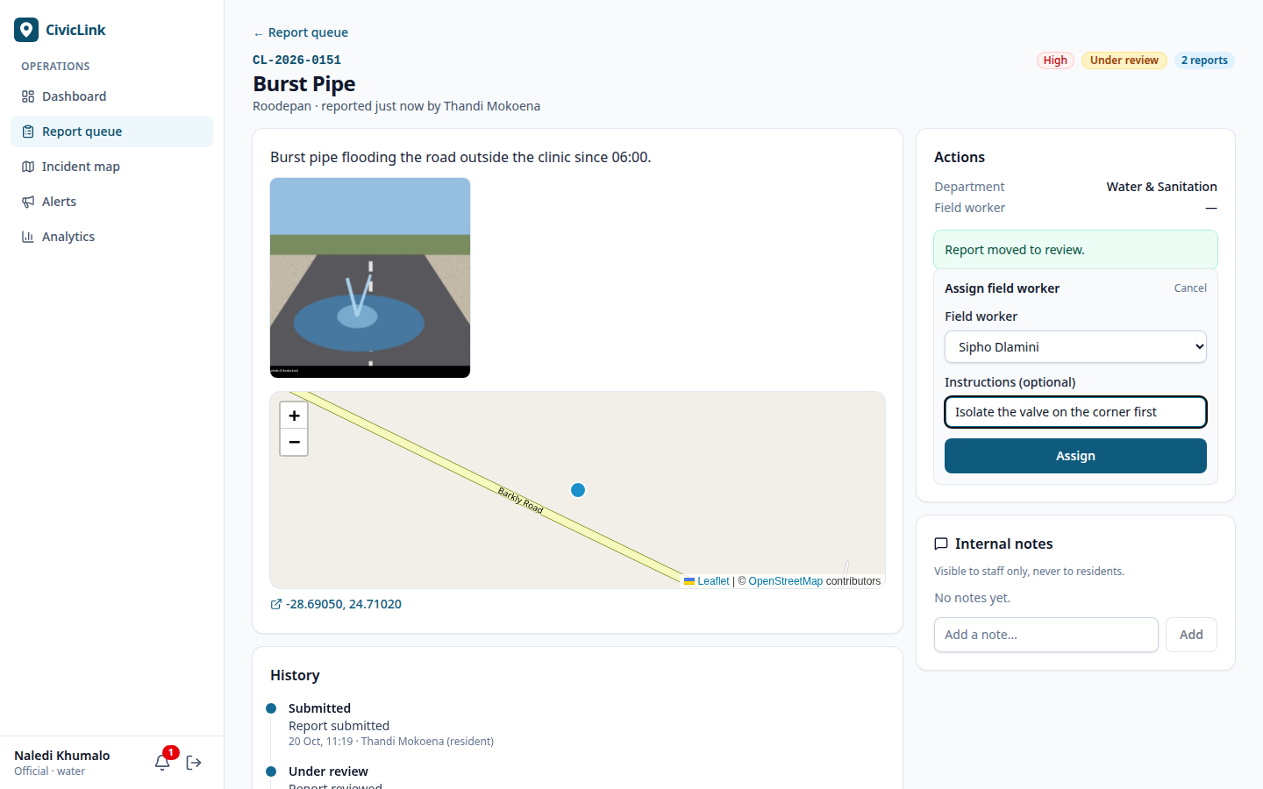
VERIFICATION
173 automated tests, all green
Unit (40) state machines, duplicate boundaries 99/100/101 m and 71/72/73 h, SLA, schedules, ratings, SMS text; 97.9% coverage
Security rules (21) every cell of the permission matrix, allow and deny
API integration (91) validation, authorisation, wrong-state and concurrency for every command; push and SMS with fake gateways
End-to-end, PWA, live site (21) full lifecycle across 3 browsers, offline drafts, scheduled alerts, bulk assign, transparency, access denied, Google sign-in; CDN and CSP on the live site
NFRs update reaches the resident in 2.5 s (target 5 s), screens < 1.1 s, p95 command 28 ms, 0 WCAG and 0 CSP violations
CivicLink · Nthoroane KP (202328762) · NPRJ740 2026

Slide 6
EVALUATION AND NEXT STEPS
All five success criteria achieved
SC-01 End-to-end lifecycle E2E-01 passes in Chromium and Firefox
SC-02 Server-side rules BR-03 to BR-11 tested through the API, bypassing the UI
SC-03 Access control 20 rule tests + authorisation tests + E2E-04
SC-04 Timely information 0.09 s to the official, 2.47 s to the resident
SC-05 Live visibility analytics verified against the dataset
Next a paid SMS gateway with a send queue; Cloud Scheduler for exact alert times; a pilot with one department
CivicLink · Nthoroane KP (202328762) · NPRJ740 2026

