Slide 1
Data Access
Entity Framework 6 with Code First Migrations

Slide 2
Why EF?
Fast to build all CRUD
Testability (compared to using stored procedures or other advanced database features)
But keep in mind that ORM:s in general does not perform well on complex queries and EF 6 in particular does not handle batch INSERT etc well.
Notes:
FNV hashes are designed to be fast while maintaining a low collision rate. The FNV speed allows one to quickly hash lots of data while maintaining a reasonable collision rate. The high dispersion of the FNV hashes makes them well suited for hashing nearly identical strings such as URLs, hostnames, filenames, text, IP addresses, etc.

Slide 3
Why Code First Migrations?
Database versioning!
(The main scenario for MS and EF 7)
Notes:
FNV hashes are designed to be fast while maintaining a low collision rate. The FNV speed allows one to quickly hash lots of data while maintaining a reasonable collision rate. The high dispersion of the FNV hashes makes them well suited for hashing nearly identical strings such as URLs, hostnames, filenames, text, IP addresses, etc.

Slide 4
DEMO – Set up EF Code First repository!
Notes:
FNV hashes are designed to be fast while maintaining a low collision rate. The FNV speed allows one to quickly hash lots of data while maintaining a reasonable collision rate. The high dispersion of the FNV hashes makes them well suited for hashing nearly identical strings such as URLs, hostnames, filenames, text, IP addresses, etc.

Slide 5
Performance
Nice LINQ, but a LOT of ugly SQL (compared to stored procedure calls)
Context.DetectChanges = false
Small changes in LINQ can have a major impact on performance…
Notes:
FNV hashes are designed to be fast while maintaining a low collision rate. The FNV speed allows one to quickly hash lots of data while maintaining a reasonable collision rate. The high dispersion of the FNV hashes makes them well suited for hashing nearly identical strings such as URLs, hostnames, filenames, text, IP addresses, etc.

Slide 6
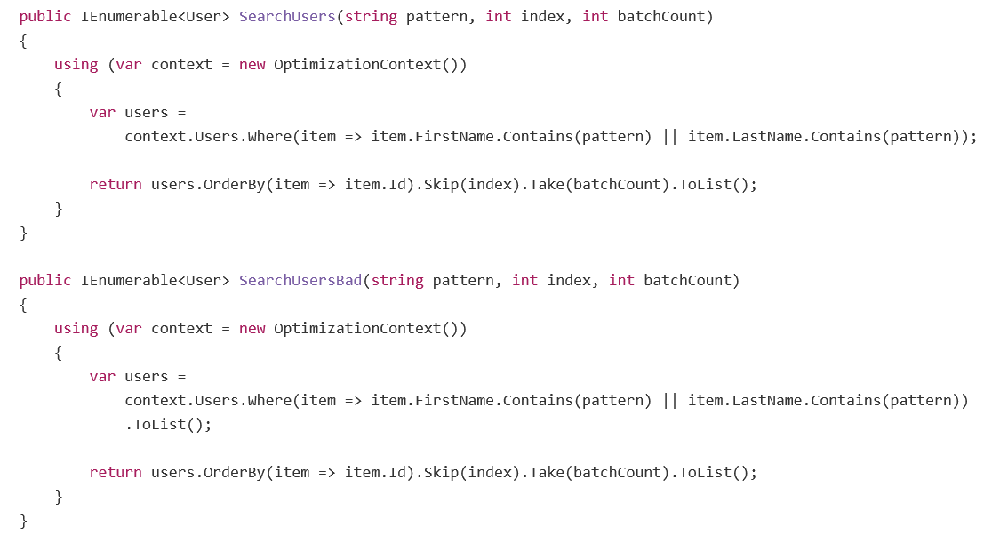
Why is one of these bad?
Notes:
FNV hashes are designed to be fast while maintaining a low collision rate. The FNV speed allows one to quickly hash lots of data while maintaining a reasonable collision rate. The high dispersion of the FNV hashes makes them well suited for hashing nearly identical strings such as URLs, hostnames, filenames, text, IP addresses, etc.

Slide 7
Summary
Rapid testable CRUD implementation, but unoptimized.
Optimize when needed.
Use load tests to identify when to optimize (to parameterized SQL).
Notes:
FNV hashes are designed to be fast while maintaining a low collision rate. The FNV speed allows one to quickly hash lots of data while maintaining a reasonable collision rate. The high dispersion of the FNV hashes makes them well suited for hashing nearly identical strings such as URLs, hostnames, filenames, text, IP addresses, etc.

