Slide 1
Security
How to authorize access to resources with OAuth 2

Slide 2
OAuth 2 – JWT and Claims based security
Bearer tokens, TLS required!
Claims, name:value pairs where value can be any JSON value. Typical example is email:tobias.ahnoff@omegapint.se or customerRead:[“1”, ”2”…]
JWT:s are transported in a HTTP header attribute, so keep it short!

Slide 3
OAuth 2 - Clients and grant types
Authorization Framework (not Authentication)
Authorization server, Client, User and Resource server.
Defines four basic grants (or flows) for authorization delegation.
Active vs Passive (redirects or not).
Confidential vs non-Confidential (can the client be trusted with the users credentials?).

Slide 4
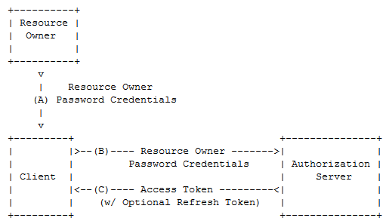
Resource Owner Password Credentials flow

Slide 5
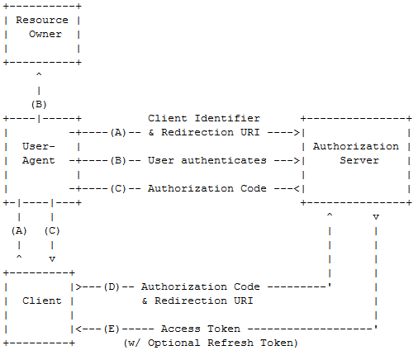
Authorization Code Grant

Slide 6
DEMO – Add authorization to the Resource Server
Add the Authorize-attribute

Slide 7
DEMO – Set up trust on the Resource server
Import the signing certificate to the CurrentUser->Personal store (and since self-signed also copy it to LocalComputer->TrustedPeople).
Make sure that correct issuer, audience and signing certificate identifier is set in web.config.
Install-Package Microsoft.Owin.Security.Jwt and add app.UseJwtBearerAuthentication() in Startup.cs

