Slide 1
CS162 Operating Systems and Systems Programming Lecture 12 Address Translation
March 5th, 2020
Prof. John Kubiatowicz
http://cs162.eecs.Berkeley.edu

Slide 2
Recall: Starvation vs Deadlock
Starvation: thread waits indefinitely
Example, low-priority thread waiting for resources constantly in use by high-priority threads
Deadlock: circular waiting for resources
Thread A owns Res 1 and is waiting for Res 2 Thread B owns Res 2 and is waiting for Res 1
Deadlock ⇒ Starvation but not vice versa
Starvation can end (but doesn’t have to)
Deadlock can’t end without external intervention
Thread
A
Wait
For
Owned
By
Res 1
Res 2
Owned
By
Wait
For
Thread
B
Notes:
Now let's look at some key problems we face when synchronizing or scheduling concurrent tasks.

Slide 3
Recall: Four requirements for Deadlock
Mutual exclusion
Only one thread at a time can use a resource.
Hold and wait
Thread holding at least one resource is waiting to acquire additional resources held by other threads
No preemption
Resources are released only voluntarily by the thread holding the resource, after thread is finished with it
Circular wait
There exists a set {T₁, …, T_{n}} of waiting threads
T₁ is waiting for a resource that is held by T₂
T₂ is waiting for a resource that is held by T₃
…
T_{n} is waiting for a resource that is held by T₁

Slide 4
Recall: Banker’s Algorithm
Banker’s algorithm assumptions:
Every thread pre-specifies is maximum need for resources
However, it doesn’t have to ask for the all at once… (key advantage)
Threads may now request and hold dynamically up to the maximum specified number of each resources
Simple use of the deadlock detection algorithm
For each request for resources from a thread:
Technique: pretend each request is granted, then run deadlock detection algorithm, and grant request if result is deadlock free (conservative!)
Keeps system in a “SAFE” state, i.e. there exists a sequence {T₁, T₂, … T_{n}} with T₁ requesting all remaining resources, finishing, then T₂ requesting all remaining resources, etc..
Banker’s algorithm prevents deadlocks involving threads and resources by stalling requests that would lead to deadlock
Can’t fix all issues – e.g. thread going into an infinite loop!

Slide 5
Revisit: Deadlock Avoidance using Banker’s Algorithm
Idea: When a thread requests a resource, OS checks if it would result in deadlock an unsafe state
If not, it grants the resource right away
If so, it waits for other threads to release resources
Example:
Thread A
x.Acquire();
y.Acquire();
…
y.Release();
x.Release();
Thread B
y.Acquire();
x.Acquire();
…
x.Release();
y.Release();
Thread B Waits until Thread A releases resources…

Slide 6
Recall: Does Priority Inversion Cause Deadlock?
Definition: Priority Inversion
A low priority task prevents a high-priority task from running
Does Priority Inversion cause Deadlock?
Consider typical case (requires 3 threads):
3 threads, T1, T2, T3 in priority order (T3 highest)
T1 grabs lock, T3 tries to acquire, then sleeps, T2 running
Will this make progress?
No, as long as T2 is running
But T2 could stop at any time and the problem would resolve itself…
So, this is not a deadlock (it is a livelock). But is could last a long time…
Why is this a priority inversion?
T3 is prevented from running by T2

Slide 7
Priority Donation as a remedy to Priority Inversion
What is priority donation?
When high priority Thread TB is about to sleep while waiting for a lock held by lower priority Thread TA, it may temporarily donate its priority to the holder of the lock if that lock holder has a lower priority
So, Priority(TB) => TA until lock is released
So, now, TA runs with high priority until it releases its lock, at which time its priority is restored to its original priority
How does priority donation help the priority inversion scenario? [ T1 has lock, T2 running, T3 blocked on lock ]
Briefly raise T1 to the same priority as T3⇒T1 can run and release lock, allowing T3 to run
Does priority donation involve taking lock away from T1?
NO! That would break semantics of the lock and potentially corrupt any information protected by lock!

Slide 8
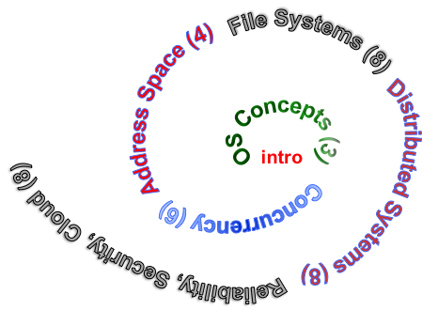
Next Objective
Dive deeper into the concepts and mechanisms of memory sharing and address translation
Enabler of many key aspects of operating systems
Protection
Multi-programming
Isolation
Memory resource management
I/O efficiency
Sharing
Inter-process communication
Debugging
Demand paging
Today: Translation

Slide 9
Recall: Four Fundamental OS Concepts
Thread: Execution Context
Fully describes program state
Program Counter, Registers, Execution Flags, Stack
Address space (with or w/o translation)
Set of memory addresses accessible to program (for read or write)
May be distinct from memory space of the physical machine (in which case programs operate in a virtual address space)
Process: an instance of a running program
Protected Address Space + One or more Threads
Dual mode operation / Protection
Only the “system” has the ability to access certain resources
Combined with translation, isolates programs from each other and the OS from programs

Slide 10
THE BASICS: Address/Address Space
Address Space:
2^{k} “things”
Address:
“Things” here usually means “bytes” (8 bits)
k bits
What is 2¹⁰ bytes (where a byte is appreviated as “B”)?
2¹⁰ B = 1024B = 1 KB (for memory, 1K = 1024, not 1000)
How many bits to address each byte of 4KB page?
4KB = 4×1KB = 4× 2¹⁰= 2¹²⇒ 12 bits
How much memory can be addressed with 20 bits? 32 bits? 64 bits?
Use 2^{k}

Slide 11
Address Space, Process Virtual Address Space
Definition: Set of accessible addresses and the state associated with them
2³² = ~4 billion bytes on a 32-bit machine
How many 32-bit numbers fit in this address space?
32-bits = 4 bytes, so 2³²/4 = 2³⁰=~1billion
What happens when processor reads or writes to an address?
Perhaps acts like regular memory
Perhaps causes I/O operation
(Memory-mapped I/O)
Causes program to abort (segfault)?
Communicate with another program
…
0x000…
code
Static Data
heap
stack
0xFFF…

Slide 12
Recall: Process Address Space: typical structure
0x000…
Code Segment
PC:
SP:
Static Data
heap
Processor
registers
sbrk syscall
Stack Segment
0xFFF…

Slide 13
Virtualizing Resources
Physical Reality: Different Processes/Threads share the same hardware
Need to multiplex CPU (Just finished: scheduling)
Need to multiplex use of Memory (starting today)
Need to multiplex disk and devices (later in term)
Why worry about memory sharing?
The complete working state of a process and/or kernel is defined by its data in memory (and registers)
Consequently, cannot just let different threads of control use the same memory
Physics: two different pieces of data cannot occupy the same locations in memory
Probably don’t want different threads to even have access to each other’s memory if in different processes (protection)
Notes:
Now we're going to talk about other ways we can virtualize resources.
Seen: virtualizing CPU by multiplexing many processes and threads onto it (scheduling)
Now: memory

Slide 14
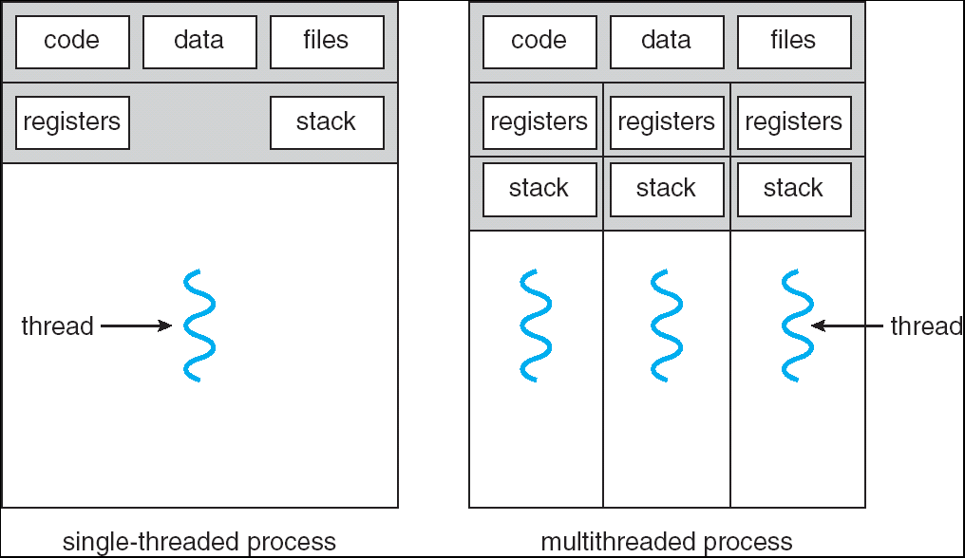
Recall: Single and Multithreaded Processes
Threads encapsulate concurrency
“Active” component of a process
Address spaces encapsulate protection
Keeps buggy program from trashing the system
“Passive” component of a process

Slide 15
Recall: Key OS Concept: Address Translation
Program operates in an address space that is distinct from the physical memory space of the machine
“physical address”
0x000…
“virtual address”
Processor
translator
Memory
Registers
0xFFF…

Slide 16
Important Aspects of Memory Multiplexing
Protection:
Prevent access to private memory of other processes
Different pages of memory can be given special behavior (Read Only, Invisible to user programs, etc).
Kernel data protected from User programs
Programs protected from themselves
Controlled overlap:
Separate state of threads should not collide in physical memory. Obviously, unexpected overlap causes chaos!
Conversely, would like the ability to overlap when desired (for communication)
Translation:
Ability to translate accesses from one address space (virtual) to a different one (physical)
When translation exists, processor uses virtual addresses, physical memory uses physical addresses
Side effects:
Can be used to avoid overlap
Can be used to give uniform view of memory to programs

Slide 17
Administrivia
Midterm 1
Regrade requests until next Monday
Solutions posted on Resources page (and in piazza)
Also due: Peer evaluations
These are a required mechanism for evaluating group dynamics
You get 20 points/partner to distribute as you want: Example—4 person group, you get 3 x 20 = 60 points
DO NOT GIVE YOURSELF POINTS!
You are NOT an unbiased evaluator of your group behavior
Project 2 has been released now
Sorry about delay

Slide 18
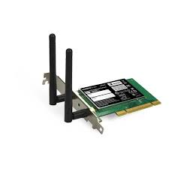
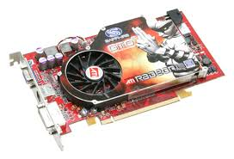


Recall: Loading
Threads
Address Spaces
Windows
Processes
Files
Sockets
Software
OS Hardware Virtualization
Hardware
ISA
Memory
Processor
Protection Boundary
OS
Ctrlr
storage
Networks
Displays
Inputs

Slide 19
Binding of Instructions and Data to Memory
Assume 4byte words
0x300 = 4 * 0x0C0
0x0C0 = 0000 1100 0000
0x300 = 0011 0000 0000
Process view of memory
Physical addresses
data1: dw 32
…
start: lw r1,0(data1)
jal checkit
loop: addi r1, r1, -1
bnz r1, loop …
checkit: …
0x0300 00000020
… …
0x0900 8C2000C0
0x0904 0C000280
0x0908 2021FFFF
0x090C 14200242
…
0x0A00

Slide 20
Binding of Instructions and Data to Memory
Physical
Memory
0x0000
0x0300
00000020
Process view of memory
Physical addresses
data1: dw 32
…
start: lw r1,0(data1)
jal checkit
loop: addi r1, r1, -1
bnz r1, loop …
checkit: …
0x0300 00000020
… …
0x0900 8C2000C0
0x0904 0C000280
0x0908 2021FFFF
0x090C 14200242
…
0x0A00
0x0900
8C2000C0
0C000340
2021FFFF
14200242
0xFFFF

Slide 21
Second copy of program from previous example
Physical
Memory
0x0000
0x0300
App X
Process view of memory
Physical addresses
data1: dw 32
…
start: lw r1,0(data1)
jal checkit
loop: addi r1, r1, -1
bnz r1, loop …
checkit: …
0x0300 00000020
… …
0x0900 8C2000C0
0x0904 0C000280
0x0908 2021FFFF
0x090C 14200242
…
0x0A00
0x0900
?
0xFFFF
Need address translation!

Slide 22
Second copy of program from previous example
Physical Memory
0x0000
0x0300
App X
Process view of memory
Physical addresses
data1: dw 32
…
start: lw r1,0(data1)
jal checkit
loop: addi r1, r1, -1
bnz r1, loop …
checkit: …
0x1300 00000020
… …
0x1900 8C2004C0
0x1904 0C000680
0x1908 2021FFFF
0x190C 14200642
…
0x1A00
0x0900
0x1300
00000020
0x1900
8C2004C0
0C000680
2021FFFF
14200642
One of many possible translations!
Where does translation take place?
Compile time, Link/Load time, or Execution time?
0xFFFF

Slide 23
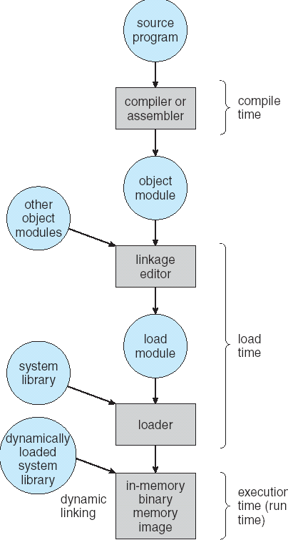
Multi-step Processing of a Program for Execution
Preparation of a program for execution involves components at:
Compile time (i.e., “gcc”)
Link/Load time (UNIX “ld” does link)
Execution time (e.g., dynamic libs)
Addresses can be bound to final values anywhere in this path
Depends on hardware support
Also depends on operating system
Dynamic Libraries
Linking postponed until execution
Small piece of code (i.e. the stub), locates appropriate memory-resident library routine
Stub replaces itself with the address of the routine, and executes routine

Slide 24

Recall: Uniprogramming
Uniprogramming (no Translation or Protection)
Application always runs at same place in physical memory since only one application at a time
Application can access any physical address
Application given illusion of dedicated machine by giving it reality of a dedicated machine
0xFFFFFFFF
Operating
System
Valid 32-bit
Addresses
Application
0x00000000

Slide 25
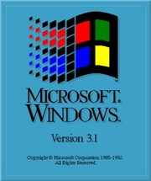
Multiprogramming (primitive stage)
Multiprogramming without Translation or Protection
Must somehow prevent address overlap between threads
Use Loader/Linker: Adjust addresses while program loaded into memory (loads, stores, jumps)
Everything adjusted to memory location of program
Translation done by a linker-loader (relocation)
Common in early days (… till Windows 3.x, 95?)
With this solution, no protection: bugs in any program can cause other programs to crash or even the OS
0xFFFFFFFF
Operating
System
Application2
0x00020000
Application1
0x00000000

Slide 26
Multiprogramming (Version with Protection)
Can we protect programs from each other without translation?
Yes: use two special registers BaseAddr and LimitAddr to prevent user from straying outside designated area
Cause error if user tries to access an illegal address
During switch, kernel loads new base/limit from PCB (Process Control Block)
User not allowed to change base/limit registers
0xFFFFFFFF
Operating
System
LimitAddr=0x10000
0x00020000
BaseAddr=0x20000
Application2
Application1
0x00000000

Slide 27
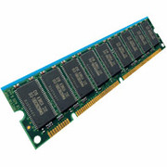
Recall: General Address translation
Virtual
Addresses
Physical
Addresses
CPU
MMU
Untranslated read or write
Recall: Address Space:
All the addresses and state a process can touch
Each process and kernel has different address space
Consequently, two views of memory:
View from the CPU (what program sees, virtual memory)
View from memory (physical memory)
Translation box (Memory Management Unit or MMU) converts between the two views
Translation ⇒ much easier to implement protection!
If task A cannot even gain access to task B’s data, no way for A to adversely affect B
With translation, every program can be linked/loaded into same region of user address space

Slide 28

Recall: Base and Bound (was from CRAY-1)
Base
Virtual
Address
CPU
+
DRAM
Physical
Address
Bound
(Limit)
<?
No: Error!
Could use base/bounds for dynamic address translation – translation happens at execution:
Alter address of every load/store by adding “base”
Generate error if address bigger than limit
Gives program the illusion that it is running on its own dedicated machine, with memory starting at 0
Program gets continuous region of memory
Addresses within program do not have to be relocated when program placed in different region of DRAM

Slide 29
Issues with Simple B&B Method
process 6
process 6
process 6
process 6
process 5
process 5
process 5
process 9
process 9
process 11
process 2
process 10
OS
OS
OS
OS
Fragmentation problem over time
Not every process is same size ⇒ memory becomes fragmented over time
Missing support for sparse address space
Would like to have multiple chunks/program (Code, Data, Stack, Heap, etc)
Hard to do inter-process sharing
Want to share code segments when possible
Want to share memory between processes
Helped by providing multiple segments per process

Slide 30
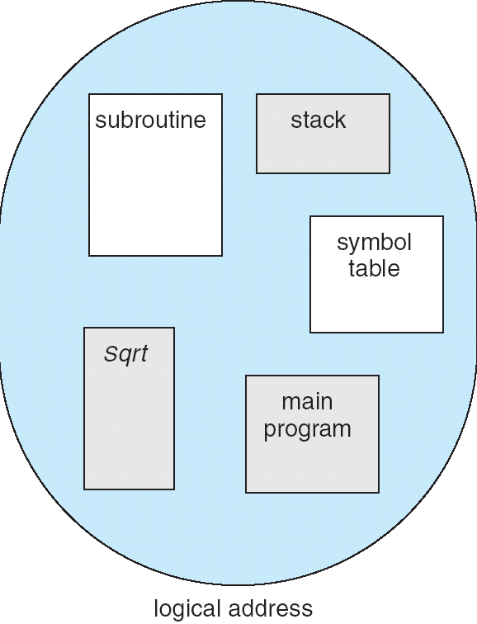
More Flexible Segmentation
1
1
1
4
2
3
2
2
4
3
user view of
memory space
physical
memory space
Logical View: multiple separate segments
Typical: Code, Data, Stack
Others: memory sharing, etc
Each segment is given region of contiguous memory
Has a base and limit
Can reside anywhere in physical memory

Slide 31
Implementation of Multi-Segment Model
Virtual
Address
offset
>
Error
Seg #
Offset
Base0
Limit0
V
Base1
Limit1
V
Base2
Limit2
V
Base2
Limit2
V
Physical
Address
Base3
Limit3
N
+
Base4
Limit4
V
Base5
Limit5
N
Base6
Limit6
N
Base7
Limit7
V
Check Valid
Segment map resides in processor
Segment number mapped into base/limit pair
Base added to offset to generate physical address
Error check catches offset out of range
As many chunks of physical memory as entries
Segment addressed by portion of virtual address
However, could be included in instruction instead:
x86 Example: mov [es:bx],ax.
What is “V/N” (valid / not valid)?
Can mark segments as invalid; requires check as well
Access
Error

Slide 32
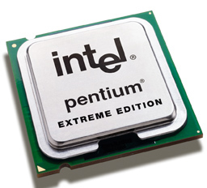
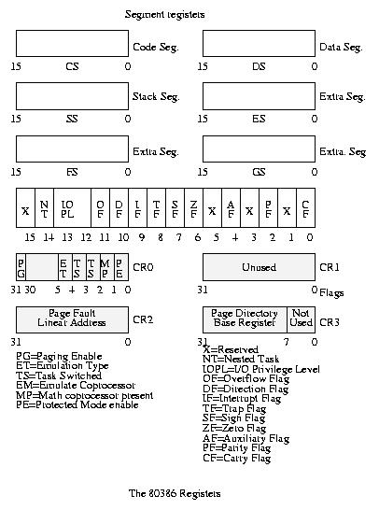
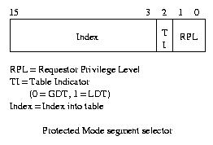
Intel x86 Special Registers
80386 Special Registers
Typical Segment Register
Current Priority is RPL
Of Code Segment (CS)

Slide 33
Example: Four Segments (16 bit addresses)
Seg ID # | Base | Limit
0 (code) | 0x4000 | 0x0800
1 (data) | 0x4800 | 0x1400
2 (shared) | 0xF000 | 0x1000
3 (stack) | 0x0000 | 0x3000
Seg
Offset
15
14
13
0
Virtual Address Format
0x0000
0x0000
0x4000
0x8000
0xC000
Virtual
Address Space
Physical
Address Space

Slide 34
Example: Four Segments (16 bit addresses)
Seg ID # | Base | Limit
0 (code) | 0x4000 | 0x0800
1 (data) | 0x4800 | 0x1400
2 (shared) | 0xF000 | 0x1000
3 (stack) | 0x0000 | 0x3000
Seg
Offset
15
14
13
0
Virtual Address Format
SegID = 0
0x0000
0x0000
0x4000
0x4000
0x4800
0x8000
0xC000
Virtual
Address Space
Physical
Address Space

Slide 35
Example: Four Segments (16 bit addresses)
Seg ID # | Base | Limit
0 (code) | 0x4000 | 0x0800
1 (data) | 0x4800 | 0x1400
2 (shared) | 0xF000 | 0x1000
3 (stack) | 0x0000 | 0x3000
Seg
Offset
15
14
13
0
Virtual Address Format
SegID = 0
0x0000
0x0000
SegID = 1
0x4000
Might
be shared
0x4000
0x4800
0x5C00
0x8000
Space for
Other Apps
0xC000
Shared with
Other Apps
Virtual
Address Space
Physical
Address Space

Slide 36
Example: Four Segments (16 bit addresses)
Seg ID # | Base | Limit
0 (code) | 0x4000 | 0x0800
1 (data) | 0x4800 | 0x1400
2 (shared) | 0xF000 | 0x1000
3 (stack) | 0x0000 | 0x3000
Seg
Offset
15
14
13
0
Virtual Address Format
SegID = 0
0x0000
0x0000
SegID = 1
0x4000
Might
be shared
0x4000
0x4800
0x5C00
0x8000
Space for
Other Apps
0xC000
0xF000
Shared with
Other Apps
Virtual
Address Space
Physical
Address Space

Slide 37
Example of Segment Translation (16bit address)
0x240 main: la $a0, varx 0x244 jal strlen
… …
0x360 strlen: li $v0, 0 ;count 0x364 loop: lb $t0, ($a0) 0x368 beq $r0,$t0, done
… …
0x4050 varx dw 0x314159
Seg ID # | Base | Limit
0 (code) | 0x4000 | 0x0800
1 (data) | 0x4800 | 0x1400
2 (shared) | 0xF000 | 0x1000
3 (stack) | 0x0000 | 0x3000
Let’s simulate a bit of this code to see what happens (PC=0x240):
Fetch 0x0240 (0000 0010 0100 0000). Virtual segment #? 0; Offset? 0x240
Physical address? Base=0x4000, so physical addr=0x4240
Fetch instruction at 0x4240. Get “la $a0, varx”
Move 0x4050 → $a0, Move PC+4→PC

Slide 38
Example of Segment Translation (16bit address)
0x240 main: la $a0, varx 0x244 jal strlen
… …
0x360 strlen: li $v0, 0 ;count 0x364 loop: lb $t0, ($a0) 0x368 beq $r0,$t0, done
… …
0x4050 varx dw 0x314159
Seg ID # | Base | Limit
0 (code) | 0x4000 | 0x0800
1 (data) | 0x4800 | 0x1400
2 (shared) | 0xF000 | 0x1000
3 (stack) | 0x0000 | 0x3000
Let’s simulate a bit of this code to see what happens (PC=0x240):
Fetch 0x0240 (0000 0010 0100 0000). Virtual segment #? 0; Offset? 0x240
Physical address? Base=0x4000, so physical addr=0x4240
Fetch instruction at 0x4240. Get “la $a0, varx”
Move 0x4050 → $a0, Move PC+4→PC
Fetch 0x244. Translated to Physical=0x4244. Get “jal strlen” Move 0x0248 → $ra (return address!), Move 0x0360 → PC

Slide 39
Example of Segment Translation (16bit address)
0x240 main: la $a0, varx 0x244 jal strlen
… …
0x360 strlen: li $v0, 0 ;count 0x364 loop: lb $t0, ($a0) 0x368 beq $r0,$t0, done
… …
0x4050 varx dw 0x314159
Seg ID # | Base | Limit
0 (code) | 0x4000 | 0x0800
1 (data) | 0x4800 | 0x1400
2 (shared) | 0xF000 | 0x1000
3 (stack) | 0x0000 | 0x3000
Let’s simulate a bit of this code to see what happens (PC=0x240):
Fetch 0x0240 (0000 0010 0100 0000). Virtual segment #? 0; Offset? 0x240
Physical address? Base=0x4000, so physical addr=0x4240
Fetch instruction at 0x4240. Get “la $a0, varx”
Move 0x4050 → $a0, Move PC+4→PC
Fetch 0x244. Translated to Physical=0x4244. Get “jal strlen” Move 0x0248 → $ra (return address!), Move 0x0360 → PC
Fetch 0x360. Translated to Physical=0x4360. Get “li $v0, 0” Move 0x0000 → $v0, Move PC+4→PC

Slide 40
Example of Segment Translation (16bit address)
0x0240 main: la $a0, varx 0x0244 jal strlen
… …
0x0360 strlen: li $v0, 0 ;count 0x0364 loop: lb $t0, ($a0) 0x0368 beq $r0,$t0, done
… …
0x4050 varx dw 0x314159
Seg ID # | Base | Limit
0 (code) | 0x4000 | 0x0800
1 (data) | 0x4800 | 0x1400
2 (shared) | 0xF000 | 0x1000
3 (stack) | 0x0000 | 0x3000
Let’s simulate a bit of this code to see what happens (PC=0x0240):
Fetch 0x0240 (0000 0010 0100 0000). Virtual segment #? 0; Offset? 0x240
Physical address? Base=0x4000, so physical addr=0x4240
Fetch instruction at 0x4240. Get “la $a0, varx”
Move 0x4050 → $a0, Move PC+4→PC
Fetch 0x0244. Translated to Physical=0x4244. Get “jal strlen” Move 0x0248 → $ra (return address!), Move 0x0360 → PC
Fetch 0x0360. Translated to Physical=0x4360. Get “li $v0, 0” Move 0x0000 → $v0, Move PC+4→PC
Fetch 0x0364. Translated to Physical=0x4364. Get “lb $t0, ($a0)” Since $a0 is 0x4050, try to load byte from 0x4050
Translate 0x4050 (0100 0000 0101 0000). Virtual segment #? 1; Offset? 0x50 Physical address? Base=0x4800, Physical addr = 0x4850,
Load Byte from 0x4850→$t0, Move PC+4→PC

Slide 41
Observations about Segmentation
Virtual address space has holes
Segmentation efficient for sparse address spaces
A correct program should never address gaps (except as mentioned in moment)
If it does, trap to kernel and dump core
When it is OK to address outside valid range?
This is how the stack and heap are allowed to grow
For instance, stack takes fault, system automatically increases size of stack
Need protection mode in segment table
For example, code segment would be read-only
Data and stack would be read-write (stores allowed)
Shared segment could be read-only or read-write
What must be saved/restored on context switch?
Segment table stored in CPU, not in memory (small)
Might store all of process’ memory onto disk when switched (called “swapping”)

Slide 42
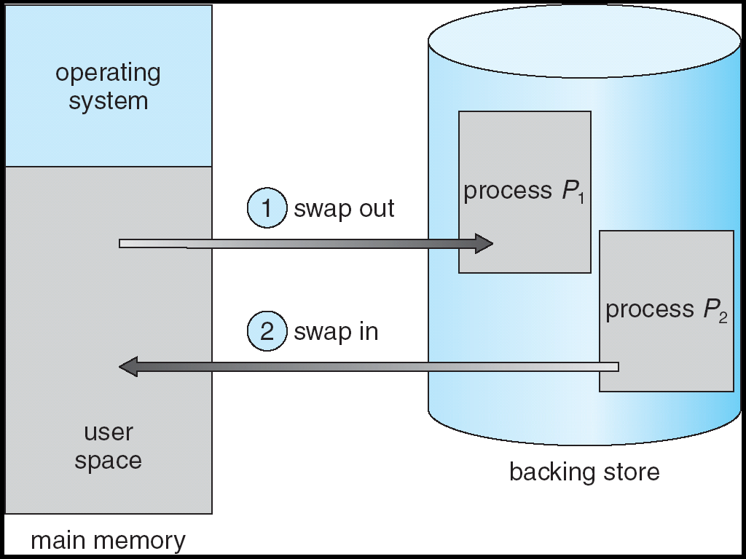
What if not all segments fit into memory?
Extreme form of Context Switch: Swapping
In order to make room for next process, some or all of the previous process is moved to disk
Likely need to send out complete segments
This greatly increases the cost of context-switching
What might be a desirable alternative?
Some way to keep only active portions of a process in memory at any one time
Need finer granularity control over physical memory

Slide 43
Problems with Segmentation
Must fit variable-sized chunks into physical memory
May move processes multiple times to fit everything
Limited options for swapping to disk
Fragmentation: wasted space
External: free gaps between allocated chunks
Internal: don’t need all memory within allocated chunks

Slide 44
Recall: General Address Translation
Code
Data
Heap
Stack
Data 2
Code
Data
Heap
Stack
Stack 1
Heap 1
Code 1
Stack 2
Prog 1
Virtual
Address
Space 1
Data 1
Prog 2
Virtual
Address
Space 2
Heap 2
Code 2
OS code
Translation Map 1
OS data
Translation Map 2
OS heap &
Stacks
Physical Address Space

Slide 45
Paging: Physical Memory in Fixed Size Chunks
Solution to fragmentation from segments?
Allocate physical memory in fixed size chunks (“pages”)
Every chunk of physical memory is equivalent
Can use simple vector of bits to handle allocation: 00110001110001101 … 110010
Each bit represents page of physical memory 1 ⇒ allocated, 0 ⇒ free
Should pages be as big as our previous segments?
No: Can lead to lots of internal fragmentation
Typically have small pages (1K-16K)
Consequently: need multiple pages/segment

Slide 46
How to Implement Simple Paging?
Virtual Address:
Virtual
Page #
Offset
PageTablePtr
page #0
V,R
Physical
Page #
Offset
page #1
V,R
page #1
V,R
page #2
V,R,W
Physical Address
PageTableSize
>
page #3
V,R,W
Check Perm
Access Error
page #4
N
page #5
V,R,W
Access
Error
Page Table (One per process)
Resides in physical memory
Contains physical page and permission for each virtual page
Permissions include: Valid bits, Read, Write, etc
Virtual address mapping
Offset from Virtual address copied to Physical Address
Example: 10 bit offset ⇒ 1024-byte pages
Virtual page # is all remaining bits
Example for 32-bits: 32-10 = 22 bits, i.e. 4 million entries
Physical page # copied from table into physical address
Check Page Table bounds and permissions

Slide 47
Simple Page Table Example
Example (4 byte pages)
0x00
0000 0000
0x00
a
b
c
d
0001 0000
0x04
0
4
i
j
k
l
0x04
0000 0100
1
0000 1100
0x05!
e
f
g
h
3
2
1
0000 0100
0x08
0x06?
0x08
0000 1000
Page
Table
0x0C
i
j
k
l
e
f
g
h
0x09?
0x0E!
0x10
Virtual
Memory
0000 0110
0000 1110
a
b
c
d
0000 1001
0000 0101
Physical
Memory
Notes:
What is virtual address 0x6? 1|10 = 3|2 = 0xE
What is virtual address 0x9? 10|01 = 1|1 = 0x5

Slide 48
What about Sharing?
Virtual Address
(Process A):
Virtual
Page #
Offset
PageTablePtrA
page #0
V,R
page #1
V,R
page #2
V,R,W
page #2
V,R,W
page #3
V,R,W
Shared
Page
page #4
N
page #5
V,R,W
PageTablePtrB
page #0
V,R
page #1
N
This physical page
appears in address
space of both processes
page #2
V,R,W
page #3
N
page #4
V,R
page #4
V,R
page #5
V,R,W
Virtual Address
(Process B):
Virtual
Page #
Offset

Slide 49
Where is page sharing used ?
The “kernel region” of every process has the same page table entries
The process cannot access it at user level
But on U->K switch, kernel code can access it AS WELL AS the region for THIS user
What does the kernel need to do to access other user processes?
Different processes running same binary!
Execute-only, but do not need to duplicate code segments
User-level system libraries (execute only)
Shared-memory segments between different processes
Can actually share objects directly between processes
Must map page into same place in address space!
This is a limited form of the sharing that threads have within a single process

Slide 50
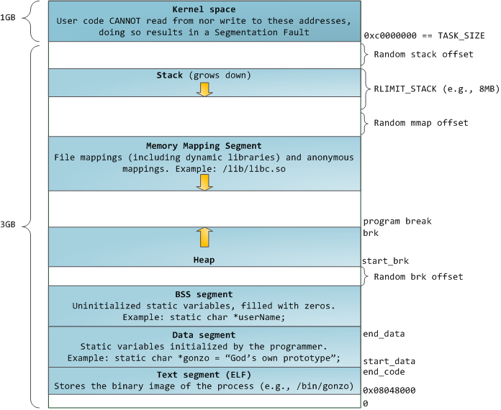
Example: Memory Layout for Linux 32-bit (Pre-Meltdown patch!)
http://static.duartes.org/img/blogPosts/linuxFlexibleAddressSpaceLayout.png

Slide 51
Some simple security measures
Address Space Randomization
Position-Independent Code => can place user code region anywhere in the address space
Random start address makes much harder for attacker to cause jump to code that it seeks to take over
Stack & Heap can start anywhere, so randomize placement
Kernel address space isolation
Don’t map whole kernel space into each process, switch to kernel page table
Meltdown⇒map none of kernel into user mode!

Slide 52
Summary: Paging
Virtual memory view
Page Table
11111 11101
11110 11100
11101 null
11100 null
11011 null
11010 null
11001 null
11000 null
10111 null
10110 null
10101 null
10100 null
10011 null
10010 10000
10001 01111
10000 01110
01111 null
01110 null
01101 null
01100 null
01011 01101
01010 01100
01001 01011
01000 01010
00111 null
00110 null
00101 null
00100 null
00011 00101
00010 00100
00001 00011
00000 00010
Physical memory view
1111 1111
1110 1111
1111 0000
stack
stack
1110 0000
1100 0000
heap
1000 0000
heap
0111 000
data
data
0101 000
0100 0000
code
code
0001 0000
0000 0000
0000 0000
page #
offset

Slide 53
Summary: Paging
Virtual memory view
Page Table
11111 11101
11110 11100
11101 null
11100 null
11011 null
11010 null
11001 null
11000 null
10111 null
10110 null
10101 null
10100 null
10011 null
10010 10000
10001 01111
10000 01110
01111 null
01110 null
01101 null
01100 null
01011 01101
01010 01100
01001 01011
01000 01010
00111 null
00110 null
00101 null
00100 null
00011 00101
00010 00100
00001 00011
00000 00010
Physical memory view
1111 1111
stack
1110 0000
stack
1110 0000
1100 0000
What happens if stack grows to 1110 0000?
heap
1000 0000
heap
0111 000
data
data
0101 000
0100 0000
code
code
0001 0000
0000 0000
0000 0000
page #
offset

Slide 54
Summary: Paging
Virtual memory view
Page Table
11111 11101
11110 11100
11101 10111
11100 10110
11011 null
11010 null
11001 null
11000 null
10111 null
10110 null
10101 null
10100 null
10011 null
10010 10000
10001 01111
10000 01110
01111 null
01110 null
01101 null
01100 null
01011 01101
01010 01100
01001 01011
01000 01010
00111 null
00110 null
00101 null
00100 null
00011 00101
00010 00100
00001 00011
00000 00010
Physical memory view
1111 1111
stack
1110 0000
stack
1110 0000
1100 0000
stack
Allocate new pages where room!
heap
1000 0000
heap
0111 000
data
Challenge: Table size equal to # of pages in virtual memory!
data
0101 000
0100 0000
code
code
0001 0000
0000 0000
0000 0000
page #
offset

Slide 55
How big do things get?
32-bit address space => 2³² bytes (4 GB)
Note: “b” = bit, and “B” = byte
And for memory:
“K”(kilo) = 2¹⁰ = 1024 ≈ 10³ (But not quite!)
“M”(mega) = 2²⁰ = (1024)² = 1,048,576 ≈ 10⁶ (But not quite!)
“G”(giga) = 2³⁰ = (1024)³= 1,073,741,824 ≈ 10⁹ (But not quite!)
Typical page size: 4 KB
how many bits of the address is that ? (remember 2¹⁰ = 1024)
Ans – 4KB = 4×2¹⁰ = 2¹² ⇒ 12 bits of the address
So how big is the simple page table for each process?
2³²/2¹² = 2²⁰ (that’s about a million entries) x 4 bytes each => 4 MB
When 32-bit machines got started (vax 11/780, intel 80386), 16 MB was a LOT of memory
How big is a simple page table on a 64-bit processor (x86_64)?
2⁶⁴/2¹² = 2⁵²(that’s 4.5×10¹⁵ or 4.5 exa-entries)×8 bytes each = 36×10¹⁵ bytes or 36 exa-bytes!!!! This is a ridiculous amount of memory!
This is really a lot of space – for only the page table!!!
Mostly, the address space is sparse, i.e. has holes in it that are not mapped to physical memory
So, most of this space is taken up by page tables mapped to nothing

Slide 56
Page Table Discussion
What needs to be switched on a context switch?
Page table pointer and limit
What provides protection here?
Translation (per process) and dual-mode!
Can’t let process alter its own page table!
Analysis
Pros
Simple memory allocation
Easy to share
Con: What if address space is sparse?
E.g., on UNIX, code starts at 0, stack starts at (2³¹-1)
With 1K pages, need 2 million page table entries!
Con: What if table really big?
Not all pages used all the time ⇒ would be nice to have working set of page table in memory
Simple Page table isway too big!
Does it all need to be in memory?
How about multi-level paging?
or combining paging and segmentation
Notes:
What if page size is very small? VAX had a 512-byte page size = lots of space for page table entries
What if page size is really big? Wastes space inside of page (internal fragmentation)

Slide 57
Fix for sparse address space: The two-level page table
Physical
Address:
Physical
Page #
Offset
10 bits
10 bits
12 bits
Virtual
Address:
Virtual
P1 index
Virtual
P2 index
Offset
4KB
PageTablePtr
4 bytes
Tree of Page Tables
Tables fixed size (1024 entries)
On context-switch: save single PageTablePtr register
Valid bits on Page Table Entries
Don’t need every 2nd-level table
Even when exist, 2nd-level tables can reside on disk if not in use
4 bytes

Slide 58
Summary: Two-Level Paging
Virtual memory view
Page Table
(level 1)
Page Tables
(level 2)
Physical memory view
1111 1111
stack
11 11101
10 11100
01 10111
00 10110
stack
1110 0000
1111 0000
1100 0000
stack
111
110 null
101 null
100
011 null
010
001 null
000
11 null
10 10000
01 01111
00 01110
heap
1000 0000
heap
0111 000
11 01101
10 01100
01 01011
00 01010
data
data
0101 000
0100 0000
11 00101
10 00100
01 00011
00 00010
code
page2 #
code
0001 0000
0000 0000
0000 0000
page1 #
offset

Slide 59
Summary: Two-Level Paging
Virtual memory view
Page Table
(level 1)
Page Tables
(level 2)
Physical memory view
stack
11 11101
10 11100
01 10111
00 10110
stack
1110 0000
stack
111
110 null
101 null
100
011 null
010
001 null
000
11 null
10 10000
01 01111
00 01110
1001 0000
(0x90)
heap
heap
1000 0000
(0x80)
In best case, total size of page tables ≈ number of pages used by program virtual memory. Requires two additional memory accesses!
11 01101
10 01100
01 01011
00 01010
data
data
11 00101
10 00100
01 00011
00 00010
code
code
0001 0000
0000 0000

Slide 60
Multi-level Translation: Segments + Pages
What about a tree of tables?
Lowest level page table ⇒ memory still allocated with bitmap
Higher levels often segmented
Could have any number of levels. Example (top segment):
What must be saved/restored on context switch?
Contents of top-level segment registers (for this example)
Pointer to top-level table (page table)
Virtual
Address:
Virtual
Seg #
Virtual
Page #
Offset
page #0
V,R
Base0
Limit0
V
page #1
V,R
Physical
Page #
Offset
page #2
V,R,W
Base1
Limit1
V
page #2
V,R,W
Physical Address
Base2
Limit2
V
page #3
V,R,W
Base2
Limit2
V
Base3
Limit3
N
page #4
N
Base4
Limit4
V
page #5
V,R,W
Check Permissions
Base5
Limit5
N
Base6
Limit6
N
Base7
Limit7
V
>
Access
Error
Access
Error

Slide 61
What about Sharing (Complete Segment)?
Process A:
Virtual
Seg #
Virtual
Page #
Offset
page #0
V,R
page #1
V,R
page #2
V,R,W
Base0
Limit0
V
page #3
V,R,W
Base1
Limit1
V
page #4
N
Base2
Limit2
V
Base2
Limit2
V
page #5
V,R,W
Base3
Limit3
N
Base4
Limit4
V
Shared Segment
Base5
Limit5
N
Base6
Limit6
N
Base0
Limit0
V
Base7
Limit7
V
Base1
Limit1
V
Base2
Base2
Limit2
Limit2
V
V
Base3
Limit3
N
Base4
Limit4
V
Base5
Limit5
N
Base6
Limit6
N
Base7
Limit7
V
Process B:
Virtual
Seg #
Virtual
Page #
Offset

Slide 62
Multi-level Translation Analysis
Pros:
Only need to allocate as many page table entries as we need for application
In other wards, sparse address spaces are easy
Easy memory allocation
Easy Sharing
Share at segment or page level (need additional reference counting)
Cons:
One pointer per page (typically 4K – 16K pages today)
Page tables need to be contiguous
However, previous example keeps tables to exactly one page in size
Two (or more, if >2 levels) lookups per reference
Seems very expensive!

Slide 63
Summary
Segment Mapping
Segment registers within processor
Segment ID associated with each access
Often comes from portion of virtual address
Can come from bits in instruction instead (x86)
Each segment contains base and limit information
Offset (rest of address) adjusted by adding base
Page Tables
Memory divided into fixed-sized chunks of memory
Virtual page number from virtual address mapped through page table to physical page number
Offset of virtual address same as physical address
Large page tables can be placed into virtual memory
Multi-Level Tables
Virtual address mapped to series of tables
Permit sparse population of address space

