Slide 1
CS162 Operating Systems and Systems Programming Lecture 18 Queueing Theory, Disk scheduling & File Systems
April 2nd, 2020
Prof. John Kubiatowicz
http://cs162.eecs.Berkeley.edu

Slide 2
Review: Magnetic Disks
Track
Cylinders: all the tracks under the head at a given point on all surface
Read/write data is a three-stage process:
Seek time: position the head/arm over the proper track
Rotational latency: wait for desired sector to rotate under r/w head
Transfer time: transfer a block of bits (sector) under r/w head
Sector
Head
Cylinder
Platter
Disk Latency = Queueing Time + Controller time +
Seek Time + Rotation Time + Xfer Time
Software
Queue
(Device Driver)
Hardware
Controller
Media Time
(Seek+Rot+Xfer)
Request
Result

Slide 3
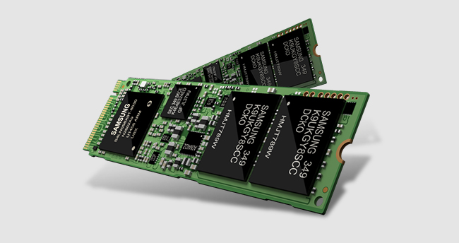
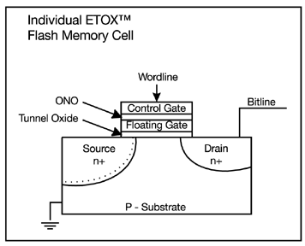
FLASH Memory
Samsung 2015:
512GB, NAND Flash
Like a normal transistor but:
Has a floating gate that can hold charge
To write: raise or lower wordline high enough to cause charges to tunnel
To read: turn on wordline as if normal transistor
presence of charge changes threshold and thus measured current
Two varieties:
NAND: denser, must be read and written in blocks
NOR: much less dense, fast to read and write
V-NAND: 3D stacking (Samsung claims 1TB possible in 1 chip)

Slide 4
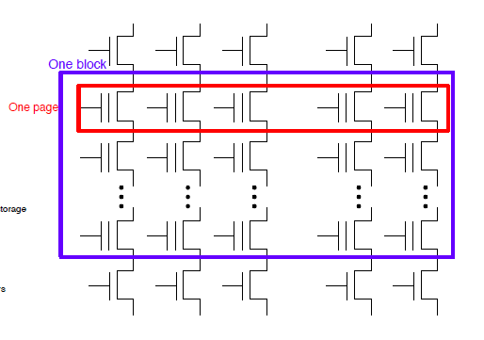
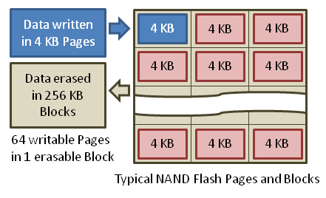
Flash Memory (Con’t)
Data read and written in page-sized chunks (e.g. 4K)
Cannot be addressed at byte level
Random access at block level for reads (no locality advantage)
Writing of new blocks handled in order (kinda like a log)
Before writing, must be erased (256K block at a time)
Requires free-list management
CANNOT write over existing block (Copy-on-Write is normal case)

Slide 5
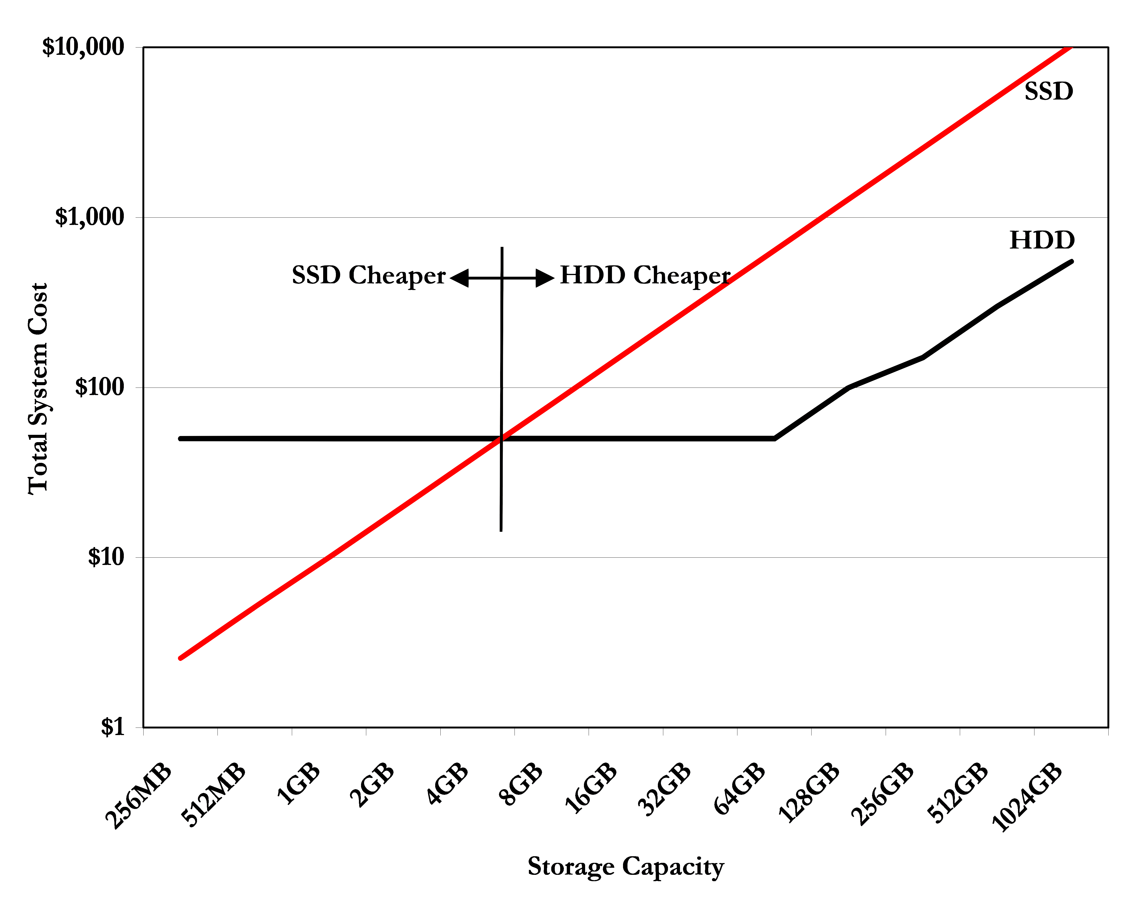
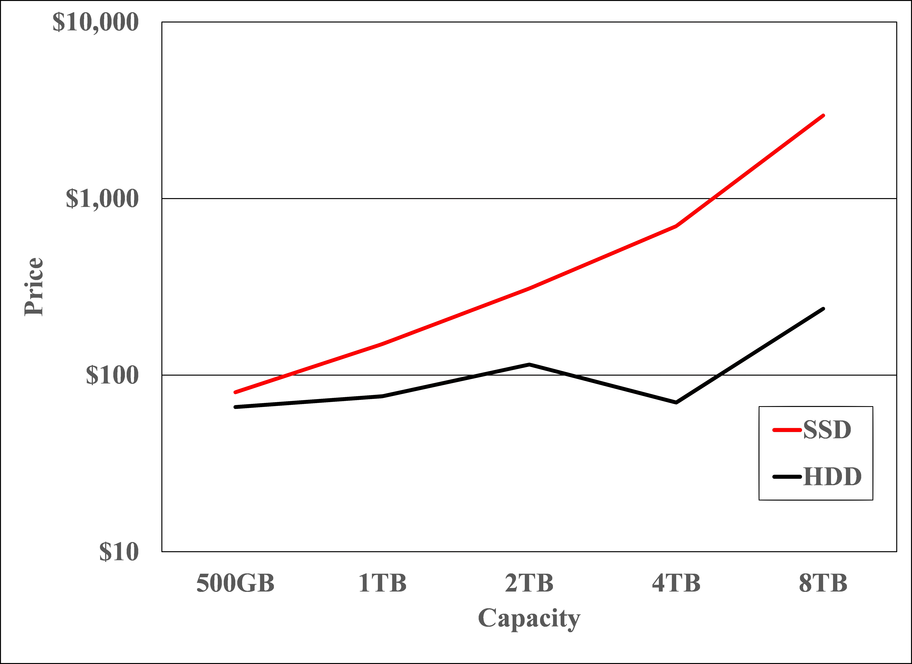
Recall: SSD Summary
Pros (vs. hard disk drives):
Low latency, high throughput (eliminate seek/rotational delay)
No moving parts:
Very light weight, low power, silent, very shock insensitive
Read at memory speeds (limited by controller and I/O bus)
Cons
Small storage (0.1-0.5x disk), expensive (3-20x disk)
Hybrid alternative: combine small SSD with large HDD
Wear-out happens because of writing
2007 perspective (Storage Newsletter)
2019 perspective

Slide 6
Recall: I/O Performance
300
Response
Time (ms)
Controller
User
Thread
I/O
device
200
Queue
[OS Paths]
100
Response Time = Queue + I/O device service time
0
Performance of I/O subsystem
Metrics: Response Time, Throughput
Effective BW per op = transfer size / response time
EffBW(n) = n / (S + n/B) = B / (1 + SB/n )
Contributing factors to latency:
Software paths (can be loosely modeled by a queue)
Hardware controller
I/O device service time
Queuing behavior:
Can lead to big increases of latency as utilization increases
Solutions?
0%
100%
Throughput (Utilization)
(% total BW)

Slide 7
A Simple Deterministic World
arrivals
Queue
Server
departures
T_{Q}
T_{S}
T_{A}
T_{A}
T_{A}
T_{q}
T_{S}
Assume requests arrive at regular intervals, take a fixed time to process, with plenty of time between …
Service rate (μ = 1/T_{S}) - operations per second
Arrival rate: (λ = 1/T_{A}) - requests per second
Utilization: U = λ/μ , where λ < μ
Average rate is the complete story

Slide 8
A Ideal Linear World
Saturation
1
1
Delivered Throughput
Delivered Throughput
Empty Queue
Unbounded
0
1
0
1
Offered Load (T_{S}/T_{A})
Offered Load (T_{S}/T_{A})
Queue delay
Queue delay
time
time
What does the queue wait time look like during overload?
Grows unbounded at a rate ~ (T_{S}/T_{A}) till request rate subsides

Slide 9
Reality: A Bursty World
arrivals
Queue
Server
departures
T_{Q}
T_{S}
Arrivals
Q depth
Server
Requests arrive in a burst, must queue up till served
Same average arrival time, but:
Almost all of the requests experience large queue delays
Even though average utilization is low!

Slide 10
So how do we model the burstiness of arrival?
Elegant mathematical framework if you start with exponential distribution
Probability density function of a continuous random variable with a mean of 1/λ
f(x) = λe^{-λx}
“Memoryless”
Likelihood of an event occurring is independent of how long we’ve been waiting
mean arrival interval (1/λ)
Lots of short arrival intervals (i.e., high instantaneous rate)
Few long gaps (i.e., low instantaneous rate)
x (λ)

Slide 11
Background: General Use of Random Distributions
Mean
(m)
Server spends variable time (T) with customers
Mean (Average) m = Σp(T)×T
Variance (stddev²) σ² = Σp(T)×(T-m)² = Σp(T)×T²-m²
Squared coefficient of variance: C = σ²/m² Aggregate description of the distribution
Important values of C:
No variance or deterministic ⇒ C=0
“Memoryless” or exponential ⇒ C=1
Past tells nothing about future
Poisson process – purely or completely random process
Many complex systems (or aggregates) are well described as memoryless
Disk response times C ≈ 1.5 (majority seeks < average)
σ
Distribution
of service times
mean
Memoryless

Slide 12
Introduction to Queuing Theory
Controller
Arrivals
Disk
Departures
Queue
Queuing System
What about queuing time??
Let’s apply some queuing theory
Queuing Theory applies to long term, steady state behavior ⇒ Arrival rate = Departure rate
Arrivals characterized by some probabilistic distribution
Departures characterized by some probabilistic distribution
Notes:
Old and New Testament by Kleirock
Regret skipping as grad student

Slide 13
Little’s Law
N
arrivals
departures
λ
L
In any stable system
Average arrival rate = Average departure rate
The average number of jobs/tasks in the system (N) is equal to arrival time / throughput (λ) times the response time (L)
N (jobs) = λ (jobs/s) x L (s)
Regardless of structure, bursts of requests, variation in service
Instantaneous variations, but it washes out in the average
Overall, requests match departures

Slide 14
Example
L = 5
λ = 1
L = 5
N = 5 jobs
Jobs
0
1
2
3
4
5
6
7
8
9
10
11
12
13
14
15
16
time
A: N = λ x L
E.g., N = λ x L = 5

Slide 15
Little’s Theorem: Proof Sketch
N
arrivals
departures
λ
Job i
L(i) = response time of job i
N(t) = number of jobs in system
at time t
L
N(t)
time
L(1)
T

Slide 16
Little’s Theorem: Proof Sketch
N
arrivals
departures
λ
Job i
L(i) = response time of job i
N(t) = number of jobs in system
at time t
L
N(t)
time
T
What is the system occupancy, i.e., average
number of jobs in the system?

Slide 17
Little’s Theorem: Proof Sketch
N
arrivals
departures
λ
Job i
L(i) = response time of job i
N(t) = number of jobs in system
at time t
S(i) = L(i) * 1 = L(i)
L
S(k)
N(t)
S(2)
S(1)
time
T
S = S(1) + S(2) + … + S(k) = L(1) + L(2) + … + L(k)

Slide 18
Little’s Theorem: Proof Sketch
N
arrivals
departures
λ
Job i
L(i) = response time of job i
N(t) = number of jobs in system
at time t
S(i) = L(i) * 1 = L(i)
L
N(t)
S= area
time
T
Average occupancy (N_{avg}) = S/T

Slide 19
Little’s Theorem: Proof Sketch
N
arrivals
departures
λ
Job i
L(i) = response time of job i
N(t) = number of jobs in system
at time t
S(i) = L(i) * 1 = L(i)
L
S(k)
N(t)
S(2)
S(1)
time
T
Navg = S/T = (L(1) + … + L(k))/T

Slide 20
Little’s Theorem: Proof Sketch
N
arrivals
departures
λ
Job i
L(i) = response time of job i
N(t) = number of jobs in system
at time t
S(i) = L(i) * 1 = L(i)
L
S(k)
N(t)
S(2)
S(1)
time
T
N_{avg} = (L(1) + … + L(k))/T = (N_{total}/T)*(L(1) + … + L(k))/N_{total}

Slide 21
Little’s Theorem: Proof Sketch
N
arrivals
departures
λ
Job i
L(i) = response time of job i
N(t) = number of jobs in system
at time t
S(i) = L(i) * 1 = L(i)
L
S(k)
N(t)
S(2)
S(1)
time
T
N_{avg} = (N_{total}/T)*(L(1) + … + L(k))/N_{total} = λ_{avg} × L_{avg}

Slide 22
Little’s Theorem: Proof Sketch
N
arrivals
departures
λ
Job i
L(i) = response time of job i
N(t) = number of jobs in system
at time t
S(i) = L(i) * 1 = L(i)
L
S(k)
N(t)
S(2)
S(1)
time
T
N_{avg} = λ_{avg} × L_{avg}

Slide 23
Administrivia (Rough Cut!)
MT2 has been moved to next Thursday (4/9)
Lectures 10-17
It will be 5-7PM in Pacific Daylight Time
Make sure to register conflicts in the google doc posted by Alex
Basic Mechanism:
We will release an answer book early so that you can print it on a printer
We will start the exam on time and send out exams to you
When time is up, we will give you time to scan your exam by taking pictures of the pages, then submitting your result
We anticipate that people will do well on this exam
We are not going to grade on a curve and will likely reduce the overall value of MT2 and MT3 relative to MT1
However, we are invoking the honor code that you will not ask others for help
And, there will be many different versions of the exam

Slide 24
A Little Queuing Theory: Some Results
Assumptions:
System in equilibrium; No limit to the queue
Time between successive arrivals is random and memoryless
Parameters that describe our system:
λ: mean number of arriving customers/second
T_{ser}: mean time to service a customer (“m1”)
C: squared coefficient of variance = σ²/m1²
μ: service rate = 1/T_{ser}
u: server utilization (0≤u≤1): u = λ/μ = λ × T_{ser}
Parameters we wish to compute:
T_{q}: Time spent in queue
L_{q}: Length of queue = λ × T_{q} (by Little’s law)
Results:
Memoryless service distribution (C = 1): (an “M/M/1 queue”):
T_{q} = T_{ser} x u/(1 – u)
General service distribution (no restrictions), 1 server (an “M/G/1 queue”):
T_{q} = T_{ser} x ½(1+C) x u/(1 – u)
Why does response/queueing delay grow unboundedly even though the utilization is < 1 ?
Queue
Server
Arrival Rate
λ
Service Rate
μ=1/T_{ser}
Response
Time (ms)
300
200
100
0
0%
100%
Throughput (Utilization)
(% total BW)

Slide 25
Why unbounded response time?
Assume deterministic arrival process and service time
Possible to sustain utilization = 1 with bounded response time!
time
arrival time
service time

Slide 26
Why unbounded response time?
300
Response
Time (ms)
Assume stochastic arrival process (and service time)
No longer possible to achieve utilization = 1
200
100
This wasted time can never be reclaimed! So cannot achieve u = 1!
0
0%
100%
Throughput (Utilization)
(% total BW)
time

Slide 27
A Little Queuing Theory: An Example
Example Usage Statistics:
User requests 10 x 8KB disk I/Os per second
Requests & service exponentially distributed (C=1.0)
Avg. service = 20 ms (From controller+seek+rot+trans)
Questions:
How utilized is the disk?
Ans: server utilization, u = λT_{ser}
What is the average time spent in the queue?
Ans: T_{q}
What is the number of requests in the queue?
Ans: L_{q}
What is the avg response time for disk request?
Ans: T_{sys} = T_{q} + T_{ser}
Computation:
λ (avg # arriving customers/s) = 10/s
T_{ser} (avg time to service customer) = 20 ms (0.02s)
u (server utilization) = λ x T_{ser}= 10/s x .02s = 0.2
T_{q} (avg time/customer in queue) = T_{ser} x u/(1 – u) = 20 x 0.2/(1-0.2) = 20 x 0.25 = 5 ms (0 .005s)
L_{q} (avg length of queue) = λ x T_{q}=10/s x .005s = 0.05
T_{sys} (avg time/customer in system) =T_{q} + T_{ser}= 25 ms

Slide 28
Queuing Theory Resources
Resources page contains Queueing Theory Resources (under Readings):
Scanned pages from Patterson and Hennessy book that gives further discussion and simple proof for general equation: https://cs162.eecs.berkeley.edu/static/readings/patterson_queue.pdf
A complete website full of resources: http://web2.uwindsor.ca/math/hlynka/qonline.html
Some previous midterms with queueing theory questions
Assume that Queueing Theory is fair game for Midterm III!

Slide 29
Optimize I/O Performance
Controller
300
Response
Time (ms)
User
Thread
I/O
device
200
Queue
[OS Paths]
100
Response Time = Queue + I/O device service time
0
0%
100%
How to improve performance?
Make everything faster ☺
More Decoupled (Parallelism) systems
multiple independent buses or controllers
Optimize the bottleneck to increase service rate
Use the queue to optimize the service
Do other useful work while waiting
Queues absorb bursts and smooth the flow
Admissions control (finite queues)
Limits delays, but may introduce unfairness and livelock
Throughput (Utilization)
(% total BW)

Slide 30
I/O Scheduling Discussion
What happens when two processes are accessing storage in different regions of the disk ?
What can the driver do?
How can buffering help?
What about non-blocking I/O?
Or threads with blocking I/O?
What limits how much reordering the OS can do?

Slide 31
When is Disk Performance Highest?
When there are big sequential reads, or
When there is so much work to do that they can be piggy backed (reordering queues—one moment)
OK to be inefficient when things are mostly idle
Bursts are both a threat and an opportunity
<your idea for optimization goes here>
Waste space for speed?
Other techniques:
Reduce overhead through user level drivers
Reduce the impact of I/O delays by doing other useful work in the meantime

Slide 32
Disk Scheduling (1/2)
Disk can do only one request at a time; What order do you choose to do queued requests?
FIFO Order
Fair among requesters, but order of arrival may be to random spots on the disk ⇒ Very long seeks
SSTF: Shortest seek time first
Pick the request that’s closest on the disk
Although called SSTF, today must include rotational delay in calculation, since rotation can be as long as seek
Con: SSTF good at reducing seeks, but may lead to starvation
User
Requests
2,2
5,2
7,2
3,10
2,1
2,3
Head
3
Disk Head
2
1
4

Slide 33
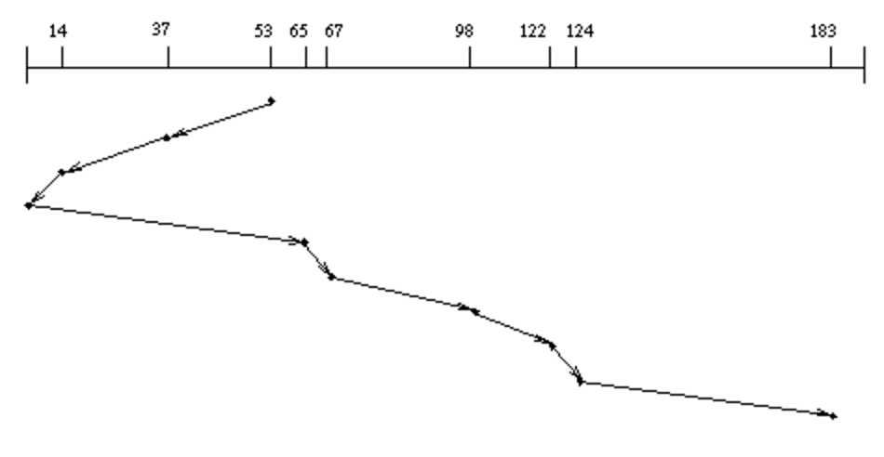
Disk Scheduling (2/2)
Disk can do only one request at a time; What order do you choose to do queued requests?
SCAN: Implements an Elevator Algorithm: take the closest request in the direction of travel
No starvation, but retains flavor of SSTF
User
Requests
2,2
5,2
7,2
3,10
2,1
2,3
Head

Slide 34
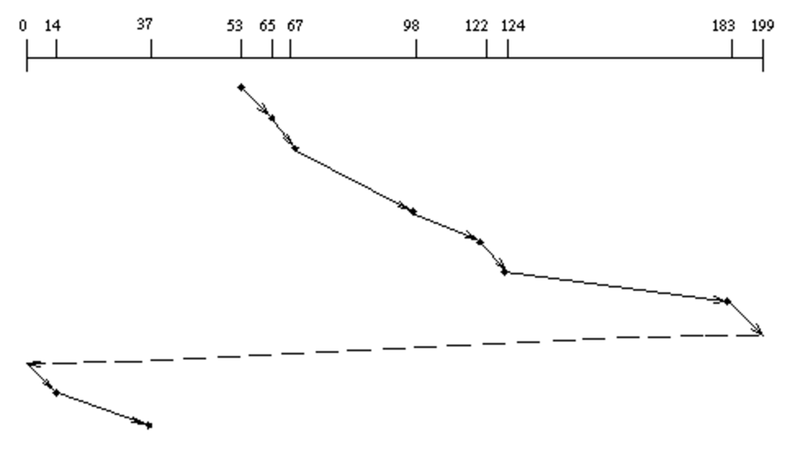
Disk Scheduling (2/2)
Disk can do only one request at a time; What order do you choose to do queued requests?
C-SCAN: Circular-Scan: only goes in one direction
Skips any requests on the way back
Fairer than SCAN, not biased towards pages in middle
User
Requests
2,2
5,2
7,2
3,10
2,1
2,3
Head

Slide 35
Recall: How do we Hide I/O Latency?
Blocking Interface: “Wait”
When request data (e.g., read() system call), put process to sleep until data is ready
When write data (e.g., write() system call), put process to sleep until device is ready for data
Non-blocking Interface: “Don’t Wait”
Returns quickly from read or write request with count of bytes successfully transferred to kernel
Read may return nothing, write may write nothing
Asynchronous Interface: “Tell Me Later”
When requesting data, take pointer to user’s buffer, return immediately; later kernel fills buffer and notifies user
When sending data, take pointer to user’s buffer, return immediately; later kernel takes data and notifies user

Slide 36
From Storage to File Systems
I/O API and
syscalls
Variable-Size Buffer
Memory Address
Logical Index, Typically 4 KB
File System
Block
Hardware Devices
Flash Trans. Layer
Sector(s)
Sector(s)
Sector(s)
Phys. Block
Phys Index., 4KB
Physical Index,
512B or 4KB
Erasure Page
HDD
SSD

Slide 37
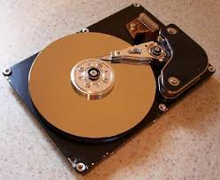
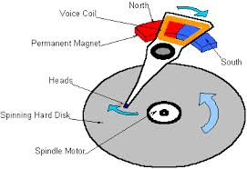
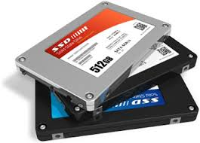

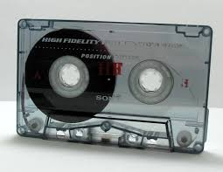
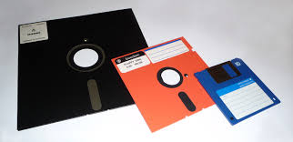
I/O & Storage Layers
Operations, Entities and Interface
Application / Service
streams
High Level I/O
Low Level I/O
handles
Syscall
registers
file_open, file_read, … on struct file * & void *
File System
descriptors
we are here …
I/O Driver
Commands and Data Transfers
Disks, Flash, Controllers, DMA

Slide 38
Recall: C Low level I/O
Operations on File Descriptors – as OS object representing the state of a file
User has a “handle” on the descriptor
#include <fcntl.h>
#include <unistd.h>
#include <sys/types.h>
int open (const char *filename, int flags [, mode_t mode])
int create (const char *filename, mode_t mode)
int close (int filedes)
Bit vector of:
Access modes (Rd, Wr, …)
Open Flags (Create, …)
Operating modes (Appends, …)
Bit vector of Permission Bits:
User|Group|Other X R|W|X
http://www.gnu.org/software/libc/manual/html_node/Opening-and-Closing-Files.html

Slide 39
Recall: C Low Level Operations
ssize_t read (int filedes, void *buffer, size_t maxsize)
- returns bytes read, 0 => EOF, -1 => error
ssize_t write (int filedes, const void *buffer, size_t size)
- returns bytes written
off_t lseek (int filedes, off_t offset, int whence)
- set the file offset
* if whence == SEEK_SET: set file offset to “offset”
* if whence == SEEK_CRT: set file offset to crt location + “offset”
* if whence == SEEK_END: set file offset to file size + “offset”
int fsync (int fildes)
– wait for i/o of filedes to finish and commit to disk
void sync (void) – wait for ALL to finish and commit to disk
When write returns, data is on its way to disk and can be read, but it may not actually be permanent!

Slide 40
Building a File System
File System: Layer of OS that transforms block interface of disks (or other block devices) into Files, Directories, etc.
File System Components
Naming: Interface to find files by name, not by blocks
Disk Management: collecting disk blocks into files
Protection: Layers to keep data secure
Reliability/Durability: Keeping of files durable despite crashes, media failures, attacks, etc.

Slide 41
Recall: User vs. System View of a File
User’s view:
Durable Data Structures
System’s view (system call interface):
Collection of Bytes (UNIX)
Doesn’t matter to system what kind of data structures you want to store on disk!
System’s view (inside OS):
Collection of blocks (a block is a logical transfer unit, while a sector is the physical transfer unit)
Block size ≥ sector size; in UNIX, block size is 4KB

Slide 42

Translating from User to Systems View
File (Bytes)
File
System
What happens if user says: "give me bytes 2 – 12?"
Fetch block corresponding to those bytes
Return just the correct portion of the block
What about writing bytes 2 – 12?
Fetch block, modify relevant portion, write out block
Everything inside file system in terms of whole-size blocks
Actual disk I/O happens in blocks
read/write smaller than block size needs to translate and buffer

Slide 43
Disk Management Policies
Basic entities on a disk:
File: user-visible group of blocks arranged sequentially in logical space
Directory: user-visible index mapping names to files
Access disk as linear array of sectors. Two Options:
Identify sectors as vectors [cylinder, surface, sector], sort in cylinder-major order, not used anymore
Logical Block Addressing (LBA): Every sector has integer address from zero up to max number of sectors
Controller translates from address ⇒ physical position
First case: OS/BIOS must deal with bad sectors
Second case: hardware shields OS from structure of disk

Slide 44
What does the file system need?
Track free disk blocks
Need to know where to put newly written data
Track which blocks contain data for which files
Need to know where to read a file from
Track files in a directory
Find list of file's blocks given its name
Where do we maintain all of this?
Somewhere on disk

Slide 45
Data Structures on Disk
Different than data structures in memory
Access a block at a time
Can't efficiently read/write a single word
Have to read/write full block containing it
Ideally want sequential access patterns
Durability
Ideally, file system is in meaningful state upon shutdown
This obviously isn't always the case…

Slide 46
Designing a File System …
What factors are critical to the design choices?
Durable data store => it’s all on disk
(Hard) Disks Performance !!!
Maximize sequential access, minimize seeks
Open before Read/Write
Can perform protection checks and look up where the actual file resource are, in advance
Size is determined as they are used !!!
Can write (or read zeros) to expand the file
Start small and grow, need to make room
Organized into directories
What data structure (on disk) for that?
Need to allocate / free blocks
Such that access remains efficient

Slide 47
Components of a File System
File path
Directory
Structure
File Index
Structure
One Block = multiple sectors
Ex: 512 sector, 4K block
File number
“inumber”
Data blocks
“inode”
…

Slide 48
Components of a file system
file name
offset
file number
offset
Index structure
Storage block
directory
Open performs Name Resolution
Translates pathname into a “file number”
Used as an “index” to locate the blocks
Creates a file descriptor in PCB within kernel
Returns a “handle” (another integer) to user process
Read, Write, Seek, and Sync operate on handle
Mapped to file descriptor and to blocks

Slide 49
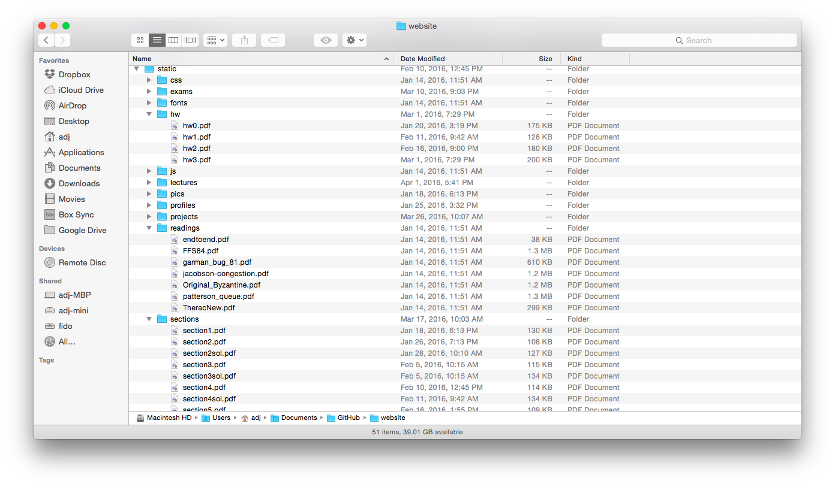
Directories

Slide 50
Directory
Basically a hierarchical structure
Each directory entry is a collection of
Files
Directories
A link to another entries
Each has a name and attributes
Files have data
Links (hard links) make it a DAG, not just a tree
Softlinks (aliases) are another name for an entry

Slide 51
I/O & Storage Layers
Application / Service
streams
High Level I/O
handles
#4 - handle
Low Level I/O
registers
Syscall
descriptors
File System
Commands and Data Transfers
Data blocks
I/O Driver
Disks, Flash, Controllers, DMA
…
Directory Structure

Slide 52
File
Named permanent storage
Contains
Data
Blocks on disk somewhere
Metadata (Attributes)
Owner, size, last opened, …
Access rights
R, W, X
Owner, Group, Other (in Unix systems)
Access control list in Windows system
Data blocks
…

Slide 53
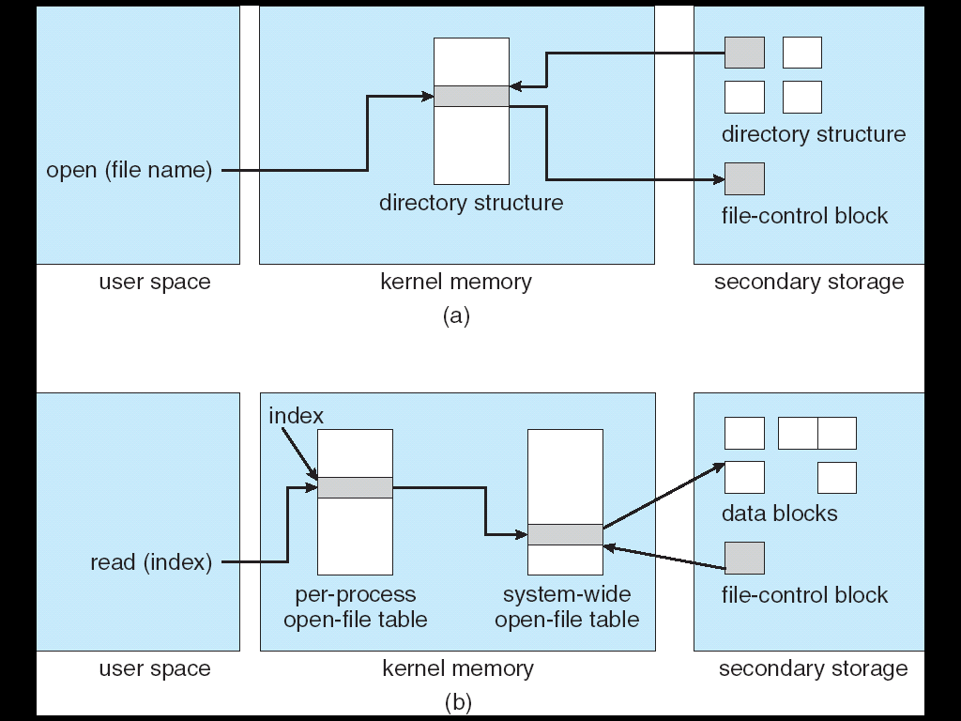
In-Memory File System Structures
Open system call:
Resolves file name, finds file control block (inode)
Makes entries in per-process and system-wide tables
Returns index (called “file handle”) in open-file table

Slide 54
In-Memory File System Structures
Read/write system calls:
Use file handle to locate inode
Perform appropriate reads or writes

Slide 55
Our first filesystem: FAT (File Allocation Table)
The most commonly used filesystem in the world!
Assume (for now) we have a way to translate a path to a “file number”
i.e., a directory structure
Disk Storage is a collection of Blocks
Just hold file data (offset o = < B, x >)
Example: file_read 31, < 2, x >
Index into FAT with file number
Follow linked list to block
Read the block from disk into memory
FAT
Disk Blocks
0:
0:
File number
31:
File 31, Block 0
File 31, Block 1
File 31, Block 2
N-1:
N-1:
memory

Slide 56
FAT Properties
File is collection of disk blocks
FAT is linked list 1-1 with blocks
File Number is index of root of block list for the file
File offset (o = < B, x >)
Follow list to get block #
Unused blocks ⬄ Marked free (no ordering, must scan to find)
FAT
Disk Blocks
0:
0:
File number
31:
File 31, Block 0
File 31, Block 1
free
File 31, Block 2
N-1:
N-1:
memory

Slide 57
FAT Properties
File is collection of disk blocks
FAT is linked list 1-1 with blocks
File Number is index of root of block list for the file
File offset (o = < B, x > )
Follow list to get block #
Unused blocks ⬄ Marked free (no ordering, must scan to find)
Ex: file_write(31, < 3, y >)
Grab free block
Linking them into file
FAT
Disk Blocks
0:
0:
File number
31:
31:
File 31, Block 0
File 31, Block 1
File 31, Block 3
free
File 31, Block 2
N-1:
N-1:
memory

Slide 58
FAT Properties
File is collection of disk blocks
FAT is linked list 1-1 with blocks
File Number is index of root of block list for the file
Grow file by allocating free blocks and linking them in
Ex: Create file, write, write
FAT
Disk Blocks
0:
0:
File 1 number
31:
File 31, Block 0
free
File 31, Block 1
File 63, Block 1
File 31, Block 3
63:
File 63, Block 0
File 2 number
File 31, Block 2
N-1:
N-1:
memory

Slide 59
FAT Assessment
FAT32 (32 instead of 12 bits) used in Windows, USB drives, SD cards, …
Where is FAT stored?
On Disk, on boot cache in memory, second (backup) copy on disk
What happens when you format a disk?
Zero the blocks, Mark FAT entries “free”
What happens when you quick format a disk?
Mark all entries in FAT as free
Simple
Can implement in device firmware
FAT
Disk Blocks
0:
0:
File 1 number
31:
File 31, Block 0
File 31, Block 1
File 63, Block 1
File 31, Block 3
63:
File 63, Block 0
File 2 number
File 31, Block 2
N-1:
N-1:
memory

Slide 60
FAT Assessment – Issues
Time to find block (large files) ??
Block layout for file ???
Sequential Access ???
Random Access ???
Fragmentation ???
MSDOS defrag tool
Small files ???
Big files ???
FAT
Disk Blocks
0:
0:
File 1 number
31:
File 31, Block 0
File 31, Block 1
File 63, Block 1
File 31, Block 3
63:
File 63, Block 0
File 2 number
File 31, Block 2
N-1:
N-1:
memory

Slide 61
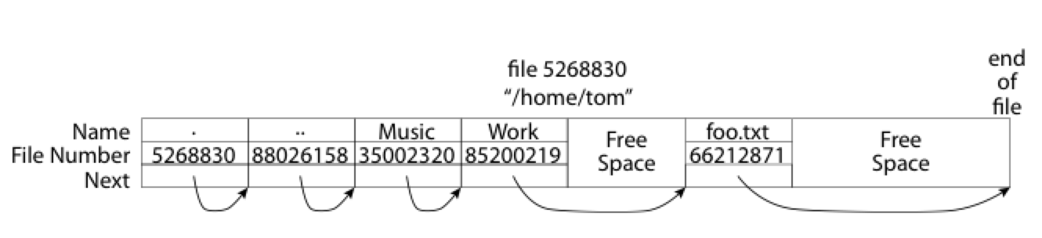
What about the Directory?
Essentially a file containing <file_name: file_number> mappings
Free space for new entries
In FAT: file attributes are kept in directory (!!!)
Each directory a linked list of entries
Where do you find root directory ( “/” )?

Slide 62
Directory Structure (cont’d)
How many disk accesses to resolve “/my/book/count”?
Read in file header for root (fixed spot on disk)
Read in first data block for root
Table of file name/index pairs. Search linearly – ok since directories typically very small
Read in file header for “my”
Read in first data block for “my”; search for “book”
Read in file header for “book”
Read in first data block for “book”; search for “count”
Read in file header for “count”
Current working directory: Per-address-space pointer to a directory (inode) used for resolving file names
Allows user to specify relative filename instead of absolute path (say CWD=“/my/book” can resolve “count”)

Slide 63
Many Huge FAT Security Holes!
FAT has no access rights
FAT has no header in the file blocks
Just gives an index into the FAT
(file number = block number)

Slide 64
Summary
Bursts & High Utilization introduce queuing delays
Queuing Latency:
M/M/1 and M/G/1 queues: simplest to analyze
As utilization approaches 100%, latency → ∞ T_{q} = T_{ser} × ½(1+C) × u/(1 – u))
File System:
Transforms blocks into Files and Directories
Optimize for access and usage patterns
Maximize sequential access, allow efficient random access
File (and directory) defined by header, called “inode”
File Allocation Table (FAT) Scheme
Linked-list approach
Very widely used: Cameras, USB drives, SD cards
Simple to implement, but poor performance and no security
Look at actual file access patterns – many small files, but large files take up all the space!

