Slide 1
CS162
Operating Systems and
Systems Programming
Lecture 19
File Systems (Con’t),
MMAP, Buffer Cache
April 7th, 2020
Prof. John Kubiatowicz
http://cs162.eecs.Berkeley.edu

Slide 2
Recall: A Little Queuing Theory: Some Results
Assumptions:
  System in equilibrium; No limit to the queue
  Time between successive arrivals is random and memoryless
Parameters that describe our system:
  λ: mean number of arriving customers/second
  T_{ser}: mean time to service a customer (“m1”)
  C: squared coefficient of variance = σ²/m1²
  μ: service rate = 1/T_{ser}
  u: server utilization (0≤u≤1): u = λ/μ = λ × T_{ser}
Parameters we wish to compute:
  T_{q}: Time spent in queue
  L_{q}: Length of queue = λ × T_{q} (by Little’s law)
Results:
  Memoryless service distribution (C = 1): (an “M/M/1 queue”):
    T_{q} = T_{ser} x u/(1 – u)
  General service distribution (no restrictions), 1 server (an “M/G/1 queue”):
    T_{q} = T_{ser} x ½(1+C) x u/(1 – u)
Queue
Server
Arrival Rate
λ
Service Rate
μ=1/T_{ser}

Slide 3
Recall: A Little Queuing Theory: Some Results
Assumptions:
  System in equilibrium; No limit to the queue
  Time between successive arrivals is random and memoryless
Parameters that describe our system:
  λ: mean number of arriving customers/second
  T_{ser}: mean time to service a customer (“m1”)
  C: squared coefficient of variance = σ²/m1²
  μ: service rate = 1/T_{ser}
  u: server utilization (0≤u≤1): u = λ/μ = λ × T_{ser}
Parameters we wish to compute:
  T_{q}: Time spent in queue
  L_{q}: Length of queue = λ × T_{q} (by Little’s law)
Results:
  Memoryless service distribution (C = 1): (an “M/M/1 queue”):
    T_{q} = T_{ser} x u/(1 – u)
  General service distribution (no restrictions), 1 server (an “M/G/1 queue”):
    T_{q} = T_{ser} x ½(1+C) x u/(1 – u)
Why does response/queueing delay grow unboundedly even though the utilization is < 1 ?
Queue
Server
Arrival Rate
λ
Service Rate
μ=1/T_{ser}
Response
Time (ms)
300
200
100
0
0%
100%
Throughput (Utilization)
(% total BW)

Slide 4
Components of a File System
File path
One file system block
usually = multiple sectors
Ex: 512 sector, 4K block
Directory
Structure
File Index
Structure
File number
“inumber”
Data blocks
“inode”
…
Note: we have an unfortunate conflicting terminology for FLASH:
  Block ⇒ 256KB group of pages
  Page ⇒ 4KB chunk inside block
A FLASH page corresponds to a disk sector (minimum addressable unit) and block (file system unit), i.e. sector=block

Slide 5
Components of a file system
file name
offset
file number
offset
Index
structure
Storage block
directory
Open performs Name Resolution
  Translates pathname into a “file number”
    Used as an “index” to locate the blocks
  Creates a file descriptor in PCB within kernel
  Returns a “handle” (another integer) to user process
Read, Write, Seek, and Sync operate on handle
  Mapped to file descriptor and to blocks

Slide 6
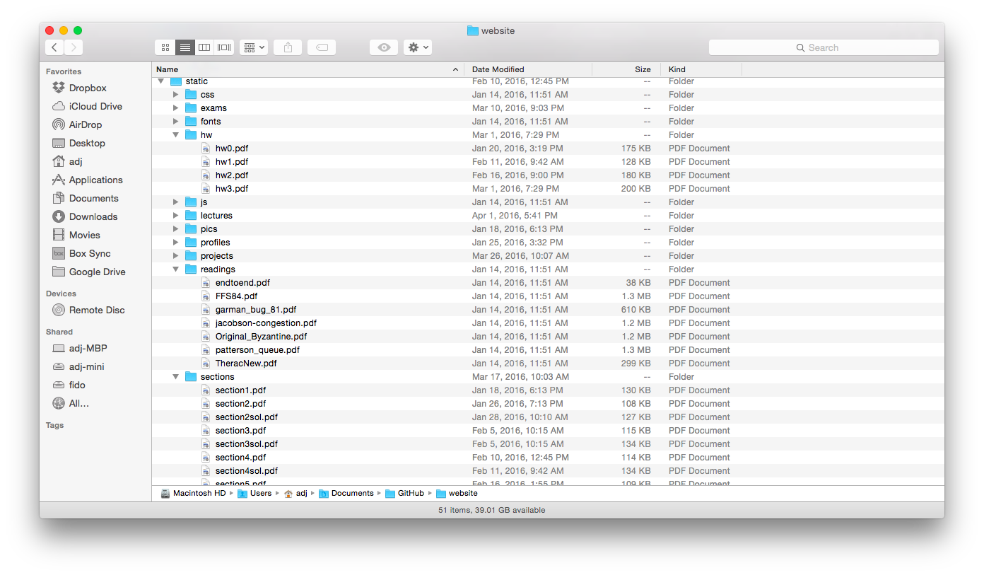
Directories

Slide 7
Directory
Basically a hierarchical structure
Each directory entry is a collection of
  Files
  Directories
    A link to another entries
Each has a name and attributes
  Files have data
Links (hard links) make it a DAG, not just a tree
  Softlinks (aliases) are another name for an entry

Slide 8
Directory Structure
How many disk accesses to resolve “/my/book/count”?
  Read in file header for root (fixed spot on disk)
  Read in first data block for root
    Table of file name/index pairs. Search linearly – ok since directories typically very small
  Read in file header for “my”
  Read in first data block for “my”; search for “book”
  Read in file header for “book”
  Read in first data block for “book”; search for “count”
  Read in file header for “count”
Current working directory: Per-address-space pointer to a directory (inode) used for resolving file names
  Allows user to specify relative filename instead of absolute path (say CWD=“/my/book” can resolve “count”)

Slide 9
File
Named permanent storage
Contains
  Data
    Blocks on disk somewhere
  Metadata (Attributes)
    Owner, size, last opened, …
    Access rights
      R, W, X
      Owner, Group, Other (in Unix systems)
      Access control list in Windows system
Data blocks
…

Slide 10
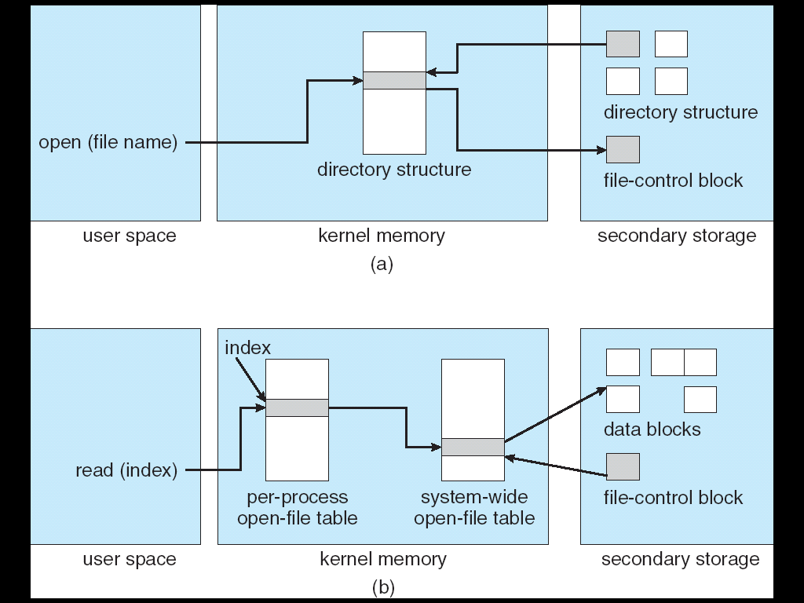
In-Memory File System Structures
Open system call:
  Resolves file name, finds file control block (inode)
  Makes entries in per-process and system-wide tables
  Returns index (called “file handle”) in open-file table

Slide 11
In-Memory File System Structures
Read/write system calls:
  Use file handle to locate inode
  Perform appropriate reads or writes

Slide 12
Our first filesystem: FAT (File Allocation Table)
The most commonly used filesystem in the world!
Assume (for now) we have a
way to translate a path to
a “file number”
  i.e., a directory structure
Disk Storage is a collection of Blocks
  Just hold file data (offset o = < B, x >)
Example: file_read 31, < 2, x >
  Index into FAT with file number
  Follow linked list to block
  Read the block from disk
  into memory
FAT
Disk Blocks
0:
0:
File number
31:
File 31, Block 0
File 31, Block 1
File 31, Block 2
N-1:
N-1:
memory

Slide 13
FAT Properties
File is collection of disk blocks
FAT is linked list 1-1 with blocks
File Number is index of root
of block list for the file
File offset (o = < B, x >)
Follow list to get block #
Unused blocks ⬄ Marked free (no ordering, must scan to find)
FAT
Disk Blocks
0:
0:
File number
31:
File 31, Block 0
File 31, Block 1
free
File 31, Block 2
N-1:
N-1:
memory

Slide 14
FAT Properties
File is collection of disk blocks
FAT is linked list 1-1 with blocks
File Number is index of root
of block list for the file
File offset (o = < B, x > )
Follow list to get block #
Unused blocks ⬄ Marked free (no ordering, must scan to find)
Ex: file_write(31, < 3, y >)
  Grab free block
  Linking them into file
FAT
Disk Blocks
0:
0:
File number
31:
31:
File 31, Block 0
File 31, Block 1
File 31, Block 3
free
File 31, Block 2
N-1:
N-1:
memory

Slide 15
FAT Properties
File is collection of disk blocks
FAT is linked list 1-1 with blocks
File Number is index of root
of block list for the file
Grow file by allocating free blocks
and linking them in
Ex: Create file, write, write
FAT
Disk Blocks
0:
0:
File 1 number
31:
File 31, Block 0
free
File 31, Block 1
File 63, Block 1
File 31, Block 3
63:
File 63, Block 0
File 2 number
File 31, Block 2
N-1:
N-1:
memory

Slide 16
FAT Assessment
FAT32 (32 instead of 12 bits) used in Windows, USB drives,
SD cards, …
Where is FAT stored?
  On Disk, on boot cache in memory,
  second (backup) copy on disk
What happens when you format a disk?
  Zero the blocks, Mark FAT entries “free”
What happens when you
quick format a disk?
  Mark all entries in FAT as free
Simple
  Can implement in
  device firmware
FAT
Disk Blocks
0:
0:
File 1 number
31:
File 31, Block 0
File 31, Block 1
File 63, Block 1
File 31, Block 3
63:
File 63, Block 0
File 2 number
File 31, Block 2
N-1:
N-1:
memory

Slide 17
FAT Assessment – Issues
Time to find block (large files) ??
Block layout for file ???
Sequential Access ???
Random Access ???
Fragmentation ???
  MSDOS defrag tool
Small files ???
Big files ???
FAT
Disk Blocks
0:
0:
File #1
31:
File 31, Block 0
File 31, Block 1
File 63, Block 1
File 31, Block 3
63:
File 63, Block 0
File #2
File 31, Block 2
N-1:
N-1:

Slide 18
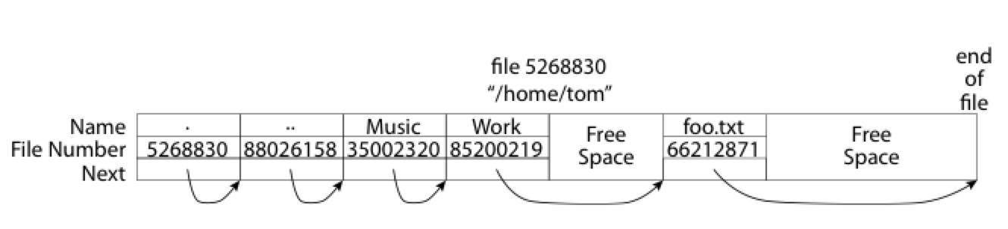
What about FAT directories?
Directory is a file containing <file_name: file_number> mappings
  Free space for new/deleted entries
  In FAT: file attributes are kept in directory (!!!)
  Each directory is a linked list of entries
Where do you find root directory ( “/” )?
  At well-defined place on disk
  For FAT, this is at block 2 (there are no blocks 0 or 1)
  Remaining directories are accessed via their file_number

Slide 19
Many Huge FAT Security Holes!
FAT has no access rights
  No way, even in principle, to track ownership of data
FAT has no header in the file blocks
  No way to enforce control over data, since all processes have access of FAT table
  Just follow pointer to disk blocks
Just gives an index into the FAT to read data
  (file number = block number)
  Could start in middle of file or access deleted data

Slide 20
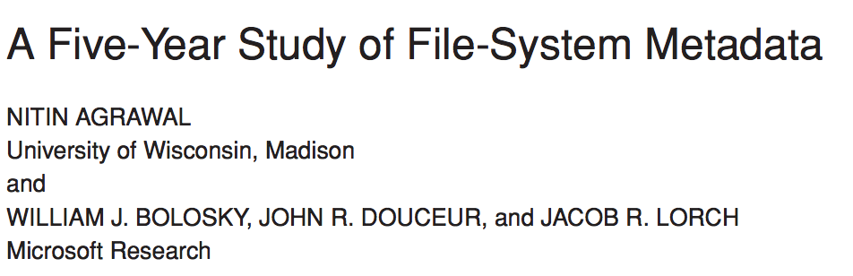
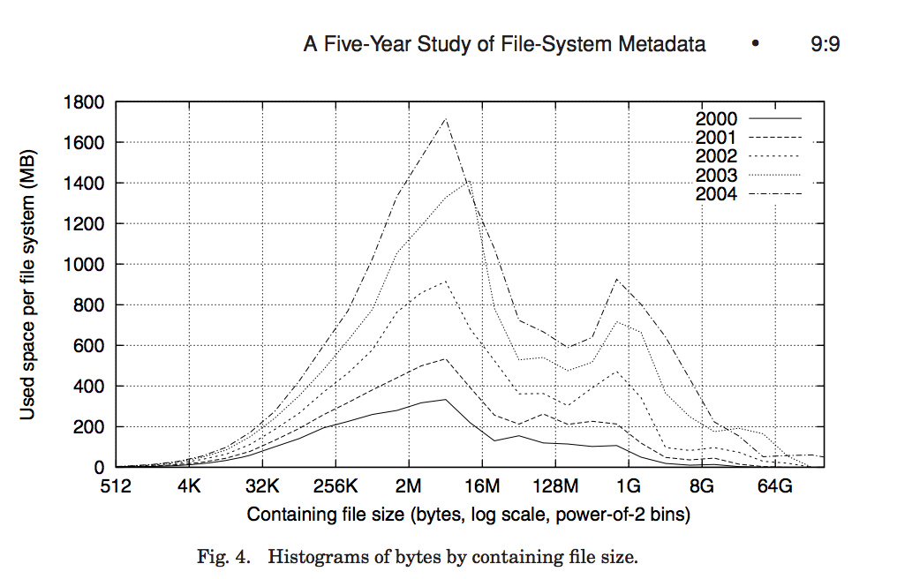
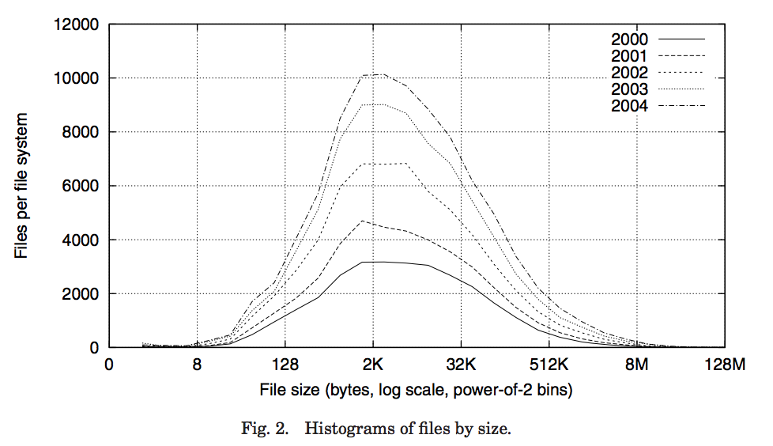
Characteristics of Files
Notes:
FAST’07 paper
Data from >10K PCs at MS
May be skewed by corporate distros

Slide 21
Characteristics of Files
Most files are small, growing numbers of files over time
Notes:
From 30k to 90k files

Slide 22
Characteristics of Files
Most of the space is occupied by the rare big ones
Notes:
15% file size growth/year
New peaks are DB, video, and blob (email) files
Median capacity from 5 to 40GB

Slide 23
Unix File System (1/2)
Original inode format appeared in BSD 4.1
  Berkeley Standard Distribution Unix
  Part of your heritage!
  Similar structure for Linux Ext2/3
File Number is index into inode arrays
Multi-level index structure
  Great for little and large files
  Asymmetric tree with fixed sized blocks

Slide 24
Unix File System (2/2)
Metadata associated with the file
  Rather than in the directory that points to it
UNIX Fast File System (FFS) BSD 4.2 Locality Heuristics:
  Block group placement
  Reserve space
Scalable directory structure

Slide 25
Inode Structure
inode metadata

Slide 26
File Attributes
inode metadata
User
Group
9 basic access control bits
- UGO x RWX
Setuid bit
- execute at owner permissions
rather than user
Setgid bit
- execute at group’s permissions

Slide 27
Data Storage
Small files: 12 pointers direct to data blocks
Direct pointers
4kB blocks ⇒ sufficient for files up to 48KB

Slide 28
Data Storage
Large files: 1,2,3 level indirect pointers
Indirect pointers
- point to a disk block
containing only pointers
- 4 kB blocks => 1024 ptrs
=> 4 MB @ level 2
=> 4 GB @ level 3
=> 4 TB @ level 4
48 KB
+4 MB
+4 GB
+4 TB

Slide 29
UNIX BSD 4.2 (1984) (1/2)
Same as BSD 4.1 (same file header and triply indirect blocks), except incorporated ideas from Cray Operating System:
  Uses bitmap allocation in place of freelist
  Attempt to allocate files contiguously
  10% reserved disk space
  Skip-sector positioning (mentioned later)

Slide 30
UNIX BSD 4.2 (1984) (2/2)
Problem: When create a file, don’t know how big it will become (in UNIX, most writes are by appending)
  How much contiguous space do you allocate for a file?
  In BSD 4.2, just find some range of free blocks
    Put each new file at the front of different range
    To expand a file, you first try successive blocks in bitmap, then choose new range of blocks
  Also in BSD 4.2: store files from same directory near each other
Fast File System (FFS)
  Allocation and placement policies for BSD 4.2

Slide 31
Attack of the Rotational Delay
Problem 2: Missing blocks due to rotational delay
  Issue: Read one block, do processing, and read next block. In meantime, disk has continued turning: missed next block! Need 1 revolution/block!
  Solution1: Skip sector positioning (“interleaving”)
    Place the blocks from one file on every other block of a track: give time for processing to overlap rotation
    Can be done by OS or in modern drives by the disk controller
  Solution 2: Read ahead: read next block right after first, even if application hasn’t asked for it yet
    This can be done either by OS (read ahead)
    By disk itself (track buffers) - many disk controllers have internal RAM that allows them to read a complete track
Modern disks + controllers do many things “under the covers”
  Track buffers, elevator algorithms, bad block filtering
Skip Sector
Track Buffer
(Holds complete track)

Slide 32
Where are inodes Stored?
In early UNIX and DOS/Windows’ FAT file system, headers stored in special array in outermost cylinders
Header not stored anywhere near the data blocks
  To read a small file, seek to get header, seek back to data
Fixed size, set when disk is formatted
  At formatting time, a fixed number of inodes are created
  Each is given a unique number, called an “inumber”

Slide 33
Where are inodes Stored?
Later versions of UNIX moved the header information to be
closer to the data blocks
  Often, inode for file stored in same “cylinder group” as parent directory of the file (makes an ls of that directory run fast)
Pros:
  UNIX BSD 4.2 puts bits of file header array on many cylinders
  For small directories, can fit all data, file headers, etc. in same cylinder ⇒ no seeks!
  File headers much smaller than whole block (a few hundred bytes), so multiple headers fetched from disk at same time
  Reliability: whatever happens to the disk, you can find many of the files (even if directories disconnected)
Part of the Fast File System (FFS)
  General optimization to avoid seeks

Slide 34
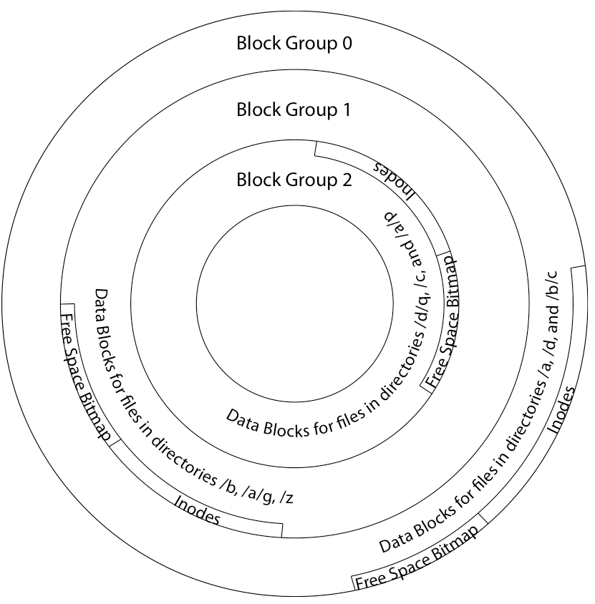
4.2 BSD Locality: Block Groups
File system volume is divided into a set of block groups
  Close set of tracks
Data blocks, metadata, and free
space interleaved within block group
  Avoid huge seeks between
  user data and system structure
Put directory and its files in
common block group

Slide 35
4.2 BSD Locality: Block Groups
First-Free allocation of new file blocks
  To expand file, first try successive
  blocks in bitmap, then
  choose new range of blocks
  Few little holes at start, big
  sequential runs at end of group
  Avoids fragmentation
  Sequential layout for big files
Important: keep 10% or more free!
  Reserve space in the Block Group

Slide 36
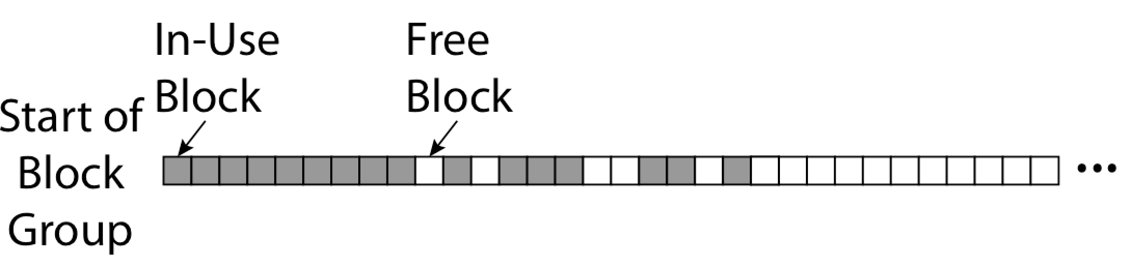
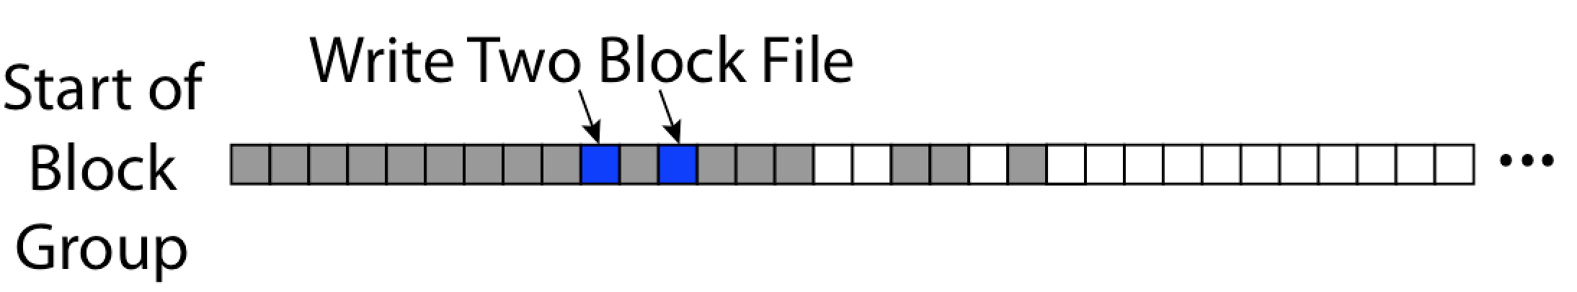
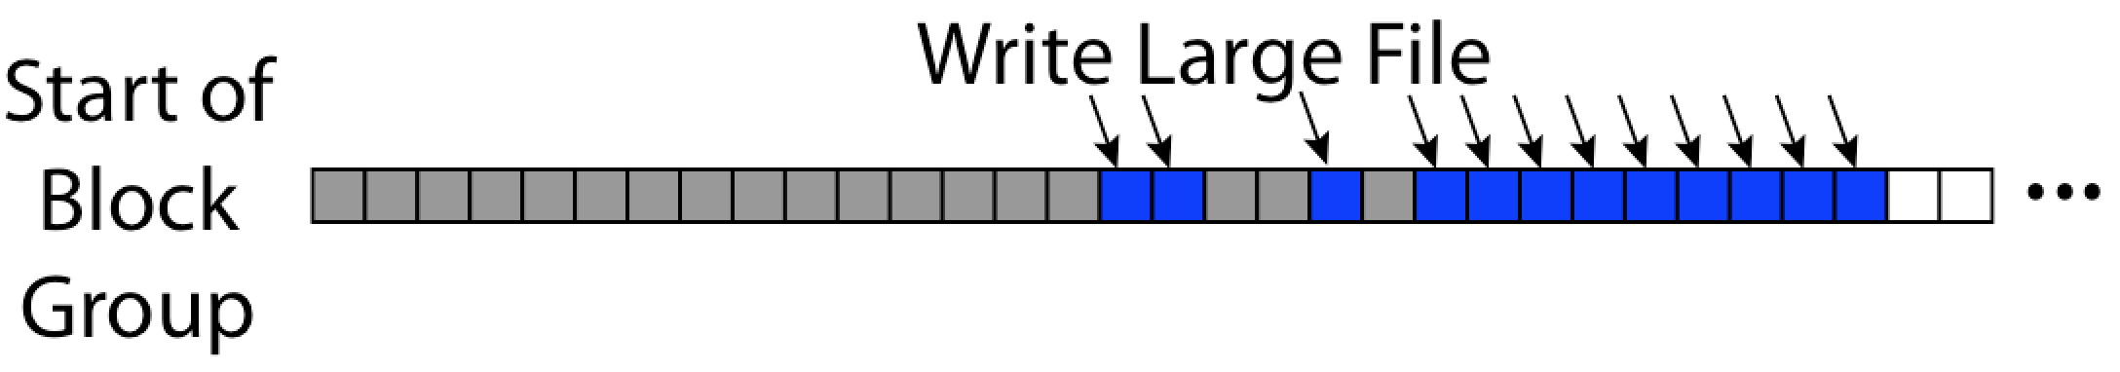
UNIX 4.2 BSD FFS First Fit Block Allocation
Fills in the small holes at the start of block group
Avoids fragmentation, leaves contiguous free space at end

Slide 37
UNIX 4.2 BSD FFS
Pros
  Efficient storage for both small and large files
  Locality for both small and large files
  Locality for metadata and data
  No defragmentation necessary!
Cons
  Inefficient for tiny files (a 1 byte file requires both an inode and a data block)
  Inefficient encoding when file is mostly contiguous on disk
  Need to reserve 10-20% of free space to prevent fragmentation

Slide 38
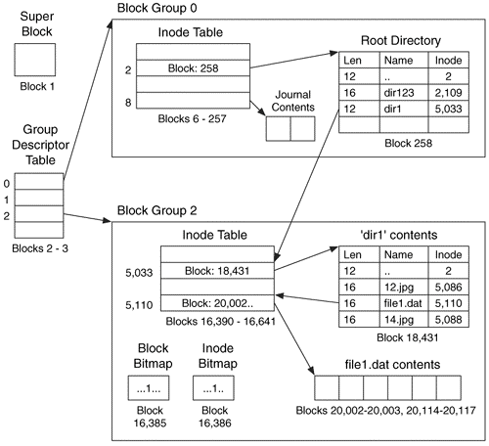
Linux Example: Ext2/3 Disk Layout
Disk divided into block groups
  Provides locality
  Each group has two block-sized bitmaps (free blocks/inodes)
  Block sizes settable
  at format time:
  1K, 2K, 4K, 8K…
Actual inode structure similar to 4.2 BSD
  with 12 direct pointers
Ext3: Ext2 with Journaling
  Several degrees of protection with comparable overhead
Example: create a file1.dat
under /dir1/ in Ext3

Slide 39
A bit more on directories
Stored in files, can be read, but typically don’t
  System calls to access directories
  open / creat traverse the structure
  mkdir /rmdir add/remove entries
  link / unlink (rm)
    Link existing file to a directory
      Not in FAT !
    Forms a DAG
When can file be deleted?
  Maintain ref-count of links to the file
  Delete after the last reference is gone
libc support
  DIR * opendir (const char *dirname)
  struct dirent * readdir (DIR *dirstream)
  int readdir_r (DIR *dirstream, struct dirent *entry,
  struct dirent **result)
/usr
/usr/lib
/usr/lib4.3
/usr/lib/foo
/usr/lib4.3/foo

Slide 40
Links
Hard link
  Sets another directory entry to contain the file number for the file
  Creates another name (path) for the file
  Each is “first class”
Soft link or Symbolic Link or Shortcut
  Directory entry contains the path and name of the file
  Map one name to another name

Slide 41
Large Directories: B-Trees (dirhash)
in FreeBSD, NetBSD, OpenBSD

Slide 42
NTFS
New Technology File System (NTFS)
  Default on Microsoft Windows systems
Variable length extents
  Rather than fixed blocks
Everything (almost) is a sequence of <attribute:value> pairs
  Meta-data and data
Mix direct and indirect freely
Directories organized in B-tree structure by default

Slide 43
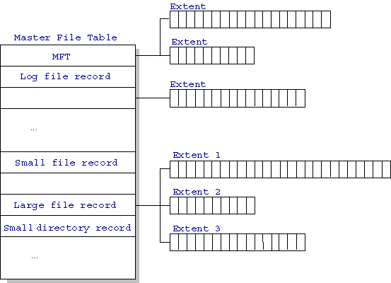
NTFS
Master File Table
  Database with Flexible 1KB entries for metadata/data
  Variable-sized attribute records (data or metadata)
  Extend with variable depth tree (non-resident)
Extents – variable length
contiguous regions
  Block pointers cover
  runs of blocks
  Similar approach in
  Linux (ext4)
  File create can provide
  hint as to size of file
Journaling for reliability
  Discussed later
http://ntfs.com/ntfs-mft.htm

Slide 44
NTFS Small File
Create time, modify time, access time,
Owner id, security specifier, flags (RO, hidden, sys)
data attribute
Attribute list

Slide 45
NTFS Medium File

Slide 46
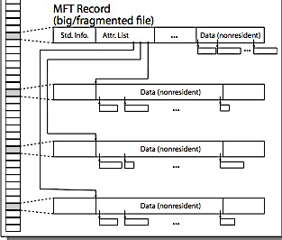
NTFS Multiple Indirect Blocks

Slide 48
Memory Mapped Files
Traditional I/O involves explicit transfers between buffers in process address space to/from regions of a file
  This involves multiple copies into caches in memory, plus system calls
What if we could “map” the file directly into an empty region of our address space
  Implicitly “page it in” when we read it
  Write it and “eventually” page it out
Executable files are treated this way when we exec the process!!

Slide 49
Recall: Who Does What, When?
Process
virtual address
physical address
MMU
page#
PT
instruction
frame#
retry
page fault
offset
exception
frame#
Operating System
offset
update PT entry
Page Fault Handler
load page from disk
scheduler

Slide 50
Using Paging to mmap() Files
Process
virtual address
physical address
MMU
page#
PT
instruction
frame#
offset
retry
page fault
exception
Read File contents
from memory!
Operating System
Create PT entries
for mapped region
as “backed” by file
Page Fault Handler
File
scheduler
mmap() file to region of VAS

Slide 51
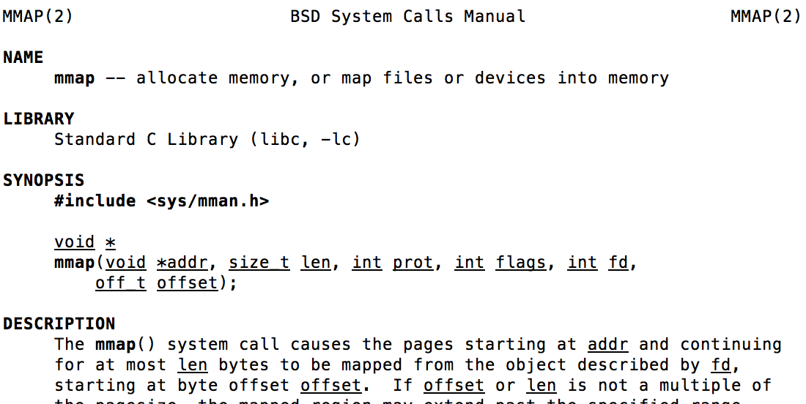
mmap() system call
May map a specific region or let the system find one for you
  Tricky to know where the holes are
Used both for manipulating files and for sharing between processes

Slide 52
An mmap() Example
#include <sys/mman.h> /* also stdio.h, stdlib.h, string.h, fcntl.h, unistd.h */
int something = 162;
int main (int argc, char *argv[]) {
int myfd;
char *mfile;
printf("Data at: %16lx\n", (long unsigned int) &something);
printf("Heap at : %16lx\n", (long unsigned int) malloc(1));
printf("Stack at: %16lx\n", (long unsigned int) &mfile);
/* Open the file */
myfd = open(argv[1], O_RDWR | O_CREAT);
if (myfd < 0) { perror("open failed!");exit(1); }
/* map the file */
mfile = mmap(0, 10000, PROT_READ|PROT_WRITE, MAP_FILE|MAP_SHARED, myfd, 0);
if (mfile == MAP_FAILED) {perror("mmap failed"); exit(1);}
printf("mmap at : %16lx\n", (long unsigned int) mfile);
puts(mfile);
strcpy(mfile+20,"Let's write over it");
close(myfd);
return 0;
}
$ cat test
This is line one
This is line two
This is line three
This is line four
$ ./mmap test
Data at: 105d63058
Heap at : 7f8a33c04b70
Stack at: 7fff59e9db10
mmap at : 105d97000
$ cat test
This is line one
ThiLet's write over its line three
This is line four

Slide 53
Sharing through Mapped Files
VAS 1
VAS 2
0x000…
0x000…
instructions
instructions
data
data
File
heap
heap
Memory
stack
stack
OS
OS
0xFFF…
0xFFF…
Also: anonymous memory between parents and children
  no file backing – just swap space

Slide 54
File System Caching
Key Idea: Exploit locality by caching data in memory
  Name translations: Mapping from paths→inodes
  Disk blocks: Mapping from block address→disk content
Buffer Cache: Memory used to cache kernel resources, including disk blocks and name translations
  Can contain “dirty” blocks (blocks yet on disk)
Replacement policy? LRU
  Can afford overhead of timestamps for each disk block
  Advantages:
    Works very well for name translation
    Works well in general as long as memory is big enough to accommodate a host’s working set of files.
  Disadvantages:
    Fails when some application scans through file system, thereby flushing the cache with data used only once
    Example: find . –exec grep foo {} \;
Other Replacement Policies?
  Some systems allow applications to request other policies
  Example, ‘Use Once’:
    File system can discard blocks as soon as they are used

Slide 55
File System Caching (con’t)
Cache Size: How much memory should the OS allocate to the buffer cache vs virtual memory?
  Too much memory to the file system cache ⇒ won’t be able to run many applications at once
  Too little memory to file system cache ⇒ many applications may run slowly (disk caching not effective)
  Solution: adjust boundary dynamically so that the disk access rates for paging and file access are balanced
Read Ahead Prefetching: fetch sequential blocks early
  Key Idea: exploit fact that most common file access is sequential by prefetching subsequent disk blocks ahead of current read request (if they are not already in memory)
  Elevator algorithm can efficiently interleave groups of prefetches from concurrent applications
  How much to prefetch?
    Too many imposes delays on requests by other applications
    Too few causes many seeks (and rotational delays) among concurrent file requests

Slide 56
File System Caching (con’t)
Delayed Writes: Writes to files not immediately sent out to disk
  Instead, write() copies data from user space buffer to kernel buffer (in cache)
    Enabled by presence of buffer cache: can leave written file blocks in cache for a while
    If some other application tries to read data before written to disk, file system will read from cache
  Flushed to disk periodically (e.g. in UNIX, every 30 sec)
  Advantages:
    Disk scheduler can efficiently order lots of requests
    Disk allocation algorithm can be run with correct size value for a file
    Some files need never get written to disk! (e..g temporary scratch files written /tmp often don’t exist for 30 sec)
  Disadvantages
    What if system crashes before file has been written out?
    Worse yet, what if system crashes before a directory file has been written out? (lose pointer to inode!)

Slide 57
Important “ilities”
Availability: the probability that the system can accept and process requests
  Often measured in “nines” of probability. So, a 99.9% probability is considered “3-nines of availability”
  Key idea here is independence of failures
Durability: the ability of a system to recover data despite faults
  This idea is fault tolerance applied to data
  Doesn’t necessarily imply availability: information on pyramids was very durable, but could not be accessed until discovery of Rosetta Stone
Reliability: the ability of a system or component to perform its required functions under stated conditions for a specified period of time (IEEE definition)
  Usually stronger than simply availability: means that the system is not only “up”, but also working correctly
  Includes availability, security, fault tolerance/durability
  Must make sure data survives system crashes, disk crashes, other problems

Slide 58
File System Summary (1/2)
File System:
  Transforms blocks into Files and Directories
  Optimize for size, access and usage patterns
  Maximize sequential access, allow efficient random access
  Projects the OS protection and security regime (UGO vs ACL)
File defined by header, called “inode”
Naming: translating from user-visible names to actual sys resources
  Directories used for naming for local file systems
  Linked or tree structure stored in files
Multilevel Indexed Scheme
  inode contains file info, direct pointers to blocks, indirect blocks, doubly indirect, etc..
  NTFS: variable extents not fixed blocks, tiny files data is in header

Slide 59
File System Summary (2/2)
4.2 BSD Multilevel index files
  Inode contains ptrs to actual blocks, indirect blocks, double indirect blocks, etc.
  Optimizations for sequential access: start new files in open ranges of free blocks, rotational optimization
File layout driven by freespace management
  Integrate freespace, inode table, file blocks and dirs into block group
Deep interactions between mem management, file system, sharing
  mmap(): map file or anonymous segment to memory
Buffer Cache: Memory used to cache kernel resources, including disk blocks and name translations
  Can contain “dirty” blocks (blocks yet on disk)

