Slide 1
CS162 Operating Systems and Systems Programming Lecture 20 Filesystems (Con’t) Reliability, Transactions
April 14th, 2020
Prof. John Kubiatowicz
http://cs162.eecs.Berkeley.edu

Slide 2
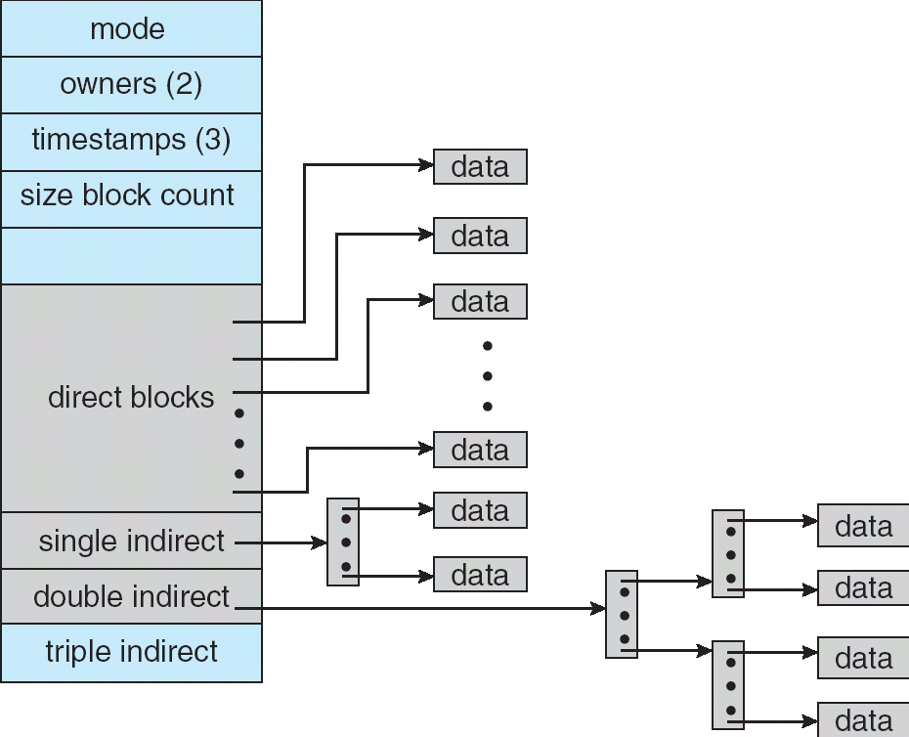
Recall: Multilevel Indexed Files (Original 4.1 BSD)
Sample file in multilevel indexed format:
10 direct ptrs, 1K blocks
How many accesses for block #23? (assume file header accessed on open)?
Two: One for indirect block, one for data
How about block #5?
One: One for data
Block #340?
Three: double indirect block, indirect block, and data
UNIX 4.1 Pros and cons
Pros: Simple (more or less) Files can easily expand (up to a point) Small files particularly cheap and easy
Cons: Lots of seeks (lead to 4.2 Fast File System Optimizations)
Ext2/3 (Linux):
12 direct ptrs, triply-indirect blocks, settable block size (4K is common)

Slide 3
Recall: Buffer Cache
Kernel must copy disk blocks to main memory to access their contents and write them back if modified
Could be data blocks, inodes, directory contents, etc.
Possibly dirty (modified and not written back)
Key Idea: Exploit locality by caching disk data in memory
Name translations: Mapping from paths→inodes
Disk blocks: Mapping from block address→disk content
Buffer Cache: Memory used to cache kernel resources, including disk blocks and name translations
Can contain “dirty” blocks (blocks yet on disk)

Slide 4
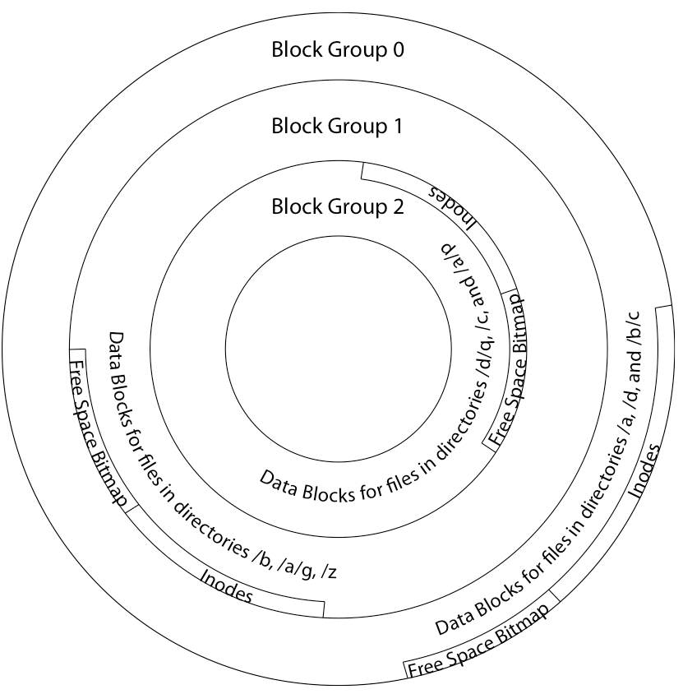
File System Buffer Cache
Data blocks
Disk
Reading
PCB
iNodes
file desc
Writing
Dir Data blocks
Free bitmap
Memory
Blocks
State
free
free
OS implements a cache of disk blocks for efficient access to data, directories, inodes, freemap

Slide 5
File System Buffer Cache: open
Data blocks
Disk
Reading
PCB
iNodes
file desc
Writing
Dir Data blocks
Free bitmap
Memory
Blocks
State
free
free
rd
dir
{load block of directory; search for map}+ ;

Slide 6
File System Buffer Cache: open
Data blocks
Disk
Reading
PCB
iNodes
file desc
Writing
Dir Data blocks
<name>:inumber
Free bitmap
Memory
Blocks
State
free
dir
inode
rd
{load block of directory; search for map}+ ; Load inode ;
Create reference via open file descriptor

Slide 7
File System Buffer Cache: Read?
Data blocks
Disk
Reading
PCB
iNodes
file desc
Writing
Dir Data blocks
<name>:inumber
Free bitmap
Memory
Blocks
State
free
dir
inode
From inode, traverse index structure to find data block; load data block; copy all or part to read data buffer

Slide 8
File System Buffer Cache: Write?
Data blocks
Disk
Reading
PCB
iNodes
file desc
Writing
Dir Data blocks
<name>:inumber
Free bitmap
Memory
Blocks
State
free
dir
inode
Process similar to read, but may allocate new blocks (update free map), blocks need to be written back to disk; inode?

Slide 9
File System Buffer Cache: Eviction?
Data blocks
Disk
Reading
PCB
iNodes
file desc
Writing
Dir Data blocks
<name>:inumber
Free bitmap
Memory
Blocks
State
free
dir
dirty
inode
Blocks being written back to disc go through a transient state

Slide 10
Buffer Cache Discussion
Implemented entirely in OS software
Unlike memory caches and TLB
Blocks go through transitional states between free and in-use
Being read from disk, being written to disk
Other processes can run, etc.
Blocks are used for a variety of purposes
inodes, data for dirs and files, freemap
OS maintains pointers into them
Termination – e.g., process exit – open, read, write
Replacement – what to do when it fills up?

Slide 11
File System Caching
Replacement policy? LRU
Can afford overhead full LRU implementation
Advantages:
Works very well for name translation
Works well in general as long as memory is big enough to accommodate a host’s working set of files.
Disadvantages:
Fails when some application scans through file system, thereby flushing the cache with data used only once
Example: find . –exec grep foo {} \;
Other Replacement Policies?
Some systems allow applications to request other policies
Example, ‘Use Once’:
File system can discard blocks as soon as they are used

Slide 12
File System Caching (con’t)
Cache Size: How much memory should the OS allocate to the buffer cache vs virtual memory?
Too much memory to the file system cache ⇒ won’t be able to run many applications at once
Too little memory to file system cache ⇒ many applications may run slowly (disk caching not effective)
Solution: adjust boundary dynamically so that the disk access rates for paging and file access are balanced
Read Ahead Prefetching: fetch sequential blocks early
Key Idea: exploit fact that most common file access is sequential by prefetching subsequent disk blocks ahead of current read request (if they are not already in memory)
Elevator algorithm can efficiently interleave groups of prefetches from concurrent applications
How much to prefetch?
Too many imposes delays on requests by other applications
Too few causes many seeks (and rotational delays) among concurrent file requests

Slide 13
Delayed Writes
Delayed Writes: Writes to files not immediately sent to disk
So, Buffer Cache is a write-back cache
write() copies data from user space buffer to kernel buffer
Enabled by presence of buffer cache: can leave written file blocks in cache for a while
Other apps read data from cache instead of disk
Cache is transparent to user programs
Flushed to disk periodically
In Linux: kernel threads flush buffer cache very 30 sec. in default setup
Disk scheduler can efficiently order lots of requests
Elevator Algorithm can rearrange writes to avoid random seeks

Slide 14
Delayed Writes
Delay block allocation: May be able to allocate multiple blocks at same time for file, keep them contiguous
Some files never actually make it all the way to disk
Many short-lived files
But what if system crashes before buffer cache block is flushed to disk?
And what if this was for a directory file?
Lose pointer to inode
file systems need recovery mechanisms

Slide 15
Important “ilities”
Availability: the probability that the system can accept and process requests
Often measured in “nines” of probability. So, a 99.9% probability is considered “3-nines of availability”
Key idea here is independence of failures
Durability: the ability of a system to recover data despite faults
This idea is fault tolerance applied to data
Doesn’t necessarily imply availability: information on pyramids was very durable, but could not be accessed until discovery of Rosetta Stone
Reliability: the ability of a system or component to perform its required functions under stated conditions for a specified period of time (IEEE definition)
Usually stronger than simply availability: means that the system is not only “up”, but also working correctly
Includes availability, security, fault tolerance/durability
Must make sure data survives system crashes, disk crashes, other problems

Slide 16
How to Make File System Durable?
Disk blocks contain Reed-Solomon error correcting codes (ECC) to deal with small defects in disk drive
Can allow recovery of data from small media defects
Make sure writes survive in short term
Either abandon delayed writes or
Use special, battery-backed RAM (called non-volatile RAM or NVRAM) for dirty blocks in buffer cache
Make sure that data survives in long term
Need to replicate! More than one copy of data!
Important element: independence of failure
Could put copies on one disk, but if disk head fails…
Could put copies on different disks, but if server fails…
Could put copies on different servers, but if building is struck by lightning….
Could put copies on servers in different continents…

Slide 17
RAID: Redundant Arrays of Inexpensive Disks
Classified by David Patterson, Garth A. Gibson, and Randy Katz here at UCB in 1987
Classic paper was first to evaluate multiple schemes
Data stored on multiple disks (redundancy)
Berkeley researchers were looking for alternatives to big expensive disks
Redundancy necessary because cheap disks were more error prone
Either in software or hardware
In hardware case, done by disk controller; file system may not even know that there is more than one disk in use
Initially, five levels of RAID (more now)

Slide 18
RAID 1: Disk Mirroring/Shadowing
recovery
group
Each disk is fully duplicated onto its “shadow”
For high I/O rate, high availability environments
Most expensive solution: 100% capacity overhead
Bandwidth sacrificed on write:
Logical write = two physical writes
Highest bandwidth when disk heads and rotation fully synchronized (hard to do exactly)
Reads may be optimized
Can have two independent reads to same data
Recovery:
Disk failure ⇒ replace disk and copy data to new disk
Hot Spare: idle disk already attached to system to be used for immediate replacement

Slide 19
RAID 5+: High I/O Rate Parity
Stripe
Unit
Data stripped across multiple disks
Successive blocks stored on successive (non-parity) disks
Increased bandwidth over single disk
Parity block (in green) constructed by XORing data bocks in stripe
P0=D0⊕D1⊕D2⊕D3
Can destroy any one disk and still reconstruct data
Suppose Disk 3 fails, then can reconstruct: D2=D0⊕D1⊕D3⊕P0
Can spread information widely across internet for durability
RAID algorithms work over geographic scale
D0
D1
D2
D3
P0
D4
D5
D6
P1
Increasing
Logical
Disk
Addresses
D7
D8
D9
P2
D10
D11
D12
P3
D13
D14
D15
P4
D16
D17
D18
D19
D20
D21
D22
D23
P5
Disk 1
Disk 2
Disk 3
Disk 4
Disk 5

Slide 20
Allow more disks to fail!
In general: RAIDX is an “erasure code”
Must have ability to know which disks are bad
Treat missing disk as an “Erasure”
Today, Disks so big that: RAID 5 not sufficient!
Time to repair disk sooooo long, another disk might fail in process!
“RAID 6” – allow 2 disks in replication stripe to fail
But – must do something more complex that just XORing together blocks!
Already used up the simple XOR operation across disks
Simple option: Check out EVENODD code in readings
Will generate one additional check disks to support RAID 6
More general option for general erasure code: Reed-Solomon codes
Based on polynomials in GF(2^{k}) (I.e. k-bit symbols)
Gailois Field is finite version of real numbers
Data as coefficients (a_{j}), code space as values of polynomial:
P(x)=a₀+a₁x¹+… a_{m-1}x^{m-1}
Coded: P(0),P(1),P(2)….,P(n-1)
Can recover polynomial (i.e. data) as long as get any m of n; allows n-m failures!

Slide 21
Allow more disks to fail! (Con’t)
How to use Reed-Solomon code in practice?
Each coefficient has a fixed (k) number of bits. So, must encode with symbols that size
Example: k=16 bit symbols, m=4, encoding 16x4 bits at a time
Take original data, split into 4 chunks. On each encoding step, grab 16 bits from each chunk to use as coefficients
Each data point yields a 16-bit symbol, which you distributed to final encoded chunks
(better version of Reed-Solomon code for erasure channels is the “Cauchy Reed-Solomon” code; it is isomorphic to the version here)
Examples (with k=16):
Suppose have 6 disks, want to tolerate 2 failures
Split data into 4 chunks, encode 16 bits from each chunk at a time, by generating 6 points (of 16 bits) on 3rd-degree polynomial
Distribute data from polynomial to 6 disks – each disk will ultimately hold data that is ¼ size of original data
Can handle 2 lost disks for 50% overhead
More interesting extreme for Internet-level replication:
Split data into 4 chunks, produce 16 chunks
Each chunk is ¼ total size of original data, Overhead = factor of 4
But – only need 4 of 16 fragments! REALLY DURABLE!

Slide 22
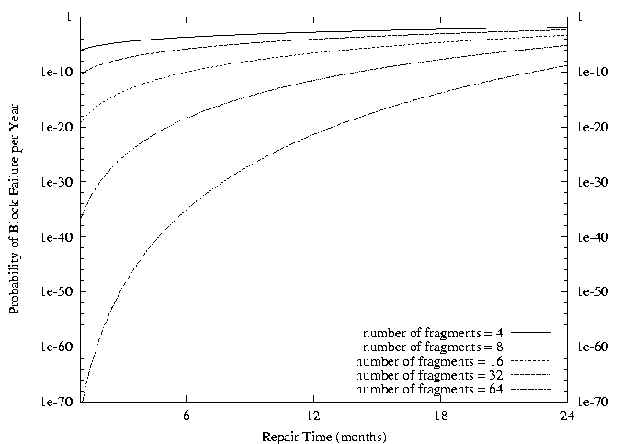
Use of Erasure Coding in general: High Durability/overhead ratio!
Fraction Blocks Lost
Per Year (FBLPY)
Exploit law of large numbers for durability!
6 month repair, FBLPY with 4x increase in total size of data:
Replication (4 copies): 0.03
Fragmentation (16 of 64 fragments needed): 10⁻³⁵

Slide 23
Higher Durability/Reliability through Geographic Replication
Highly durable – hard to destroy all copies
Highly available for reads
Simple replication: read any copy
Erasure coded: read m of n
Low availability for writes
Can’t write if any one replica is not up
Or – need relaxed consistency model
Reliability? – availability, security, durability, fault-tolerance
Replica/Frag #1
Replica/Frag #2
Replica/Frag #n

Slide 24
File System Reliability: (Difference from Block-level reliability)
What can happen if disk loses power or software crashes?
Some operations in progress may complete
Some operations in progress may be lost
Overwrite of a block may only partially complete
Having RAID doesn’t necessarily protect against all such failures
No protection against writing bad state
What if one disk of RAID group not written?
File system needs durability (as a minimum!)
Data previously stored can be retrieved (maybe after some recovery step), regardless of failure

Slide 25
Storage Reliability Problem
Single logical file operation can involve updates to multiple physical disk blocks
inode, indirect block, data block, bitmap, …
With sector remapping, single update to physical disk block can require multiple (even lower level) updates to sectors
At a physical level, operations complete one at a time
Want concurrent operations for performance
How do we guarantee consistency regardless of when crash occurs?

Slide 26
Threats to Reliability
Interrupted Operation
Crash or power failure in the middle of a series of related updates may leave stored data in an inconsistent state
Example: transfer funds from one bank account to another
What if transfer is interrupted after withdrawal and before deposit?
Loss of stored data
Failure of non-volatile storage media may cause previously stored data to disappear or be corrupted

Slide 27
Reliability Approach #1: Careful Ordering
Sequence operations in a specific order
Careful design to allow sequence to be interrupted safely
Post-crash recovery
Read data structures to see if there were any operations in progress
Clean up/finish as needed
Approach taken by
FAT and FFS (fsck) to protect filesystem structure/metadata
Many app-level recovery schemes (e.g., Word, emacs autosaves)

Slide 28
FFS: Create a File
Normal operation:
Allocate data block
Write data block
Allocate inode
Write inode block
Update bitmap of free blocks and inodes
Update directory with file name → inode number
Update modify time for directory
Recovery:
Scan inode table
If any unlinked files (not in any directory), delete or put in lost & found dir
Compare free block bitmap against inode trees
Scan directories for missing update/access times
Time proportional to disk size

Slide 29
Reliability Approach #2: Copy on Write File Layout
To update file system, write a new version of the file system containing the update
Never update in place
Reuse existing unchanged disk blocks
Seems expensive! But
Updates can be batched
Almost all disk writes can occur in parallel
Approach taken in network file server appliances
NetApp’s Write Anywhere File Layout (WAFL)
ZFS (Sun/Oracle) and OpenZFS

Slide 30
COW with Smaller-Radix Blocks
old version
new version
Write
If file represented as a tree of blocks, just need to update the leading fringe

Slide 31
ZFS and OpenZFS
Variable sized blocks: 512 B – 128 KB
Symmetric tree
Know if it is large or small when we make the copy
Store version number with pointers
Can create new version by adding blocks and new pointers
Buffers a collection of writes before creating a new version with them
Free space represented as tree of extents in each block group
Delay updates to freespace (in log) and do them all when block group is activated

Slide 32
More General Reliability Solutions
Use Transactions for atomic updates
Ensure that multiple related updates are performed atomically
i.e., if a crash occurs in the middle, the state of the systems reflects either all or none of the updates
Most modern file systems use transactions internally to update filesystem structures and metadata
Many applications implement their own transactions
Provide Redundancy for media failures
Redundant representation on media (Error Correcting Codes)
Replication across media (e.g., RAID disk array)

Slide 33
Transactions
Closely related to critical sections for manipulating shared data structures
They extend concept of atomic update from memory to stable storage
Atomically update multiple persistent data structures
Many ad-hoc approaches
FFS carefully ordered the sequence of updates so that if a crash occurred while manipulating directory or inodes the disk scan on reboot would detect and recover the error (fsck)
Applications use temporary files and rename

Slide 34
Key Concept: Transaction
An atomic sequence of actions (reads/writes) on a storage system (or database)
That takes it from one consistent state to another
transaction
consistent state 1
consistent state 2

Slide 35
Typical Structure
Begin a transaction – get transaction id
Do a bunch of updates
If any fail along the way, roll-back
Or, if any conflicts with other transactions, roll-back
Commit the transaction

Slide 36
“Classic” Example: Transaction
BEGIN; --BEGIN TRANSACTION
UPDATE accounts SET balance = balance - 100.00 WHERE name = 'Alice';
UPDATE branches SET balance = balance - 100.00 WHERE name = (SELECT branch_name FROM accounts WHERE name = 'Alice');
UPDATE accounts SET balance = balance + 100.00 WHERE name = 'Bob';
UPDATE branches SET balance = balance + 100.00 WHERE name = (SELECT branch_name FROM accounts WHERE name = 'Bob');
COMMIT; --COMMIT WORK
Transfer $100 from Alice’s account to Bob’s account

Slide 37
The ACID properties of Transactions
Atomicity: all actions in the transaction happen, or none happen
Consistency: transactions maintain data integrity, e.g.,
Balance cannot be negative
Cannot reschedule meeting on February 30
Isolation: execution of one transaction is isolated from that of all others; no problems from concurrency
Durability: if a transaction commits, its effects persist despite crashes

Slide 38
Concept of a log
One simple action is atomic – write/append a basic item
Use that to seal the commitment to a whole series of actions
Commit Tran N
Start Tran N
Get 10$ from account A
Get 7$ from account B
Get 13$ from account C
Put 15$ into account X
Put 15$ into account Y

Slide 39
Transactional File Systems
Better reliability through use of log
All changes are treated as transactions
A transaction is committed once it is written to the log
Data forced to disk for reliability
Process can be accelerated with NVRAM
Although File system may not be updated immediately, data preserved in the log
Difference between “Log Structured” and “Journaled”
In a Log Structured filesystem, data stays in log form
In a Journaled filesystem, Log used for recovery
Journaling File System
Applies updates to system metadata using transactions (using logs, etc.)
Updates to non-directory files (i.e., user stuff) can be done in place (without logs), full logging optional
Ex: NTFS, Apple HFS+, Linux XFS, JFS, ext3, ext4
Full Logging File System
All updates to disk are done in transactions

Slide 40
Journaling File Systems
Instead of modifying data structures on disk directly, write changes to a journal/log
Intention list: set of changes we intend to make
Log/Journal is append-only
Single commit record commits transaction
Once changes are in the log, it is safe to apply changes to data structures on disk
Recovery can read log to see what changes were intended
Can take our time making the changes
As long as new requests consult the log first
Once changes are copied, safe to remove log
But, …
If the last atomic action is not done … poof … all gone
Basic assumption:
Updates to sectors are atomic and ordered
Not necessarily true unless very careful, but key assumption

Slide 41
Example: Creating a File
Find free data block(s)
Find free inode entry
Find dirent insertion point
-----------------------------------------
Write map (i.e., mark used)
Write inode entry to point to block(s)
Write dirent to point to inode
Free space map
Data blocks
…
Inode table
Directory
entries

Slide 42
Ex: Creating a file (as a transaction)
Find free data block(s)
Find free inode entry
Find dirent insertion point
---------------------------------------------------------
[log] Write map (used)
[log] Write inode entry to point to block(s)
[log] Write dirent to point to inode
Free space map
Data blocks
…
Inode table
Directory
entries
tail
head
done
pending
start
commit
Log: in non-volatile storage (Flash or on Disk)

Slide 43
“Redo Log “ – Replay Transactions
After Commit
All access to file system first looks in log
Eventually copy changes to disk
Free space map
Data blocks
…
Inode table
Directory
entries
tail
tail
tail
tail
tail
head
done
start
commit
pending
Log: in non-volatile storage (Flash or Disk)

Slide 44
Crash During Logging – Recover
Upon recovery scan the log
Detect transaction start with no commit
Discard log entries
Disk remains unchanged
Free space map
Data blocks
…
Inode table
Directory
entries
tail
head
done
pending
start
Log: in non-volatile storage (Flash or on Disk)

Slide 45
Recovery After Commit
Scan log, find start
Find matching commit
Redo it as usual
Or just let it happen later
Free space map
Data blocks
…
Inode table
Directory
entries
tail
head
done
pending
start
commit
Log: in non-volatile storage (Flash or on Disk)

Slide 46
Journaling Summary
Why go through all this trouble?
Updates atomic, even if we crash:
Update either gets fully applied or discarded
All physical operations treated as a logical unit
Isn't this expensive?
Yes! We're now writing all data twice (once to log, once to actual data blocks in target file)
Modern filesystems offer an option to journal metadata updates only
Record modifications to file system data structures
But apply updates to a file's contents directly

Slide 47
Going Further – Log Structured File Systems
The log IS what is recorded on disk
File system operations logically replay log to get result
Create data structures to make this fast
On recovery, replay the log
Index (inodes) and directories are written into the log too
Large, important portion of the log is cached in memory
Do everything in bulk: log is collection of large segments
Each segment contains a summary of all the operations within the segment
Fast to determine if segment is relevant or not
Free space is approached as continual cleaning process of segments
Detect what is live or not within a segment
Copy live portion to new segment being formed (replay)
Garbage collection entire segment
No bit map

Slide 48
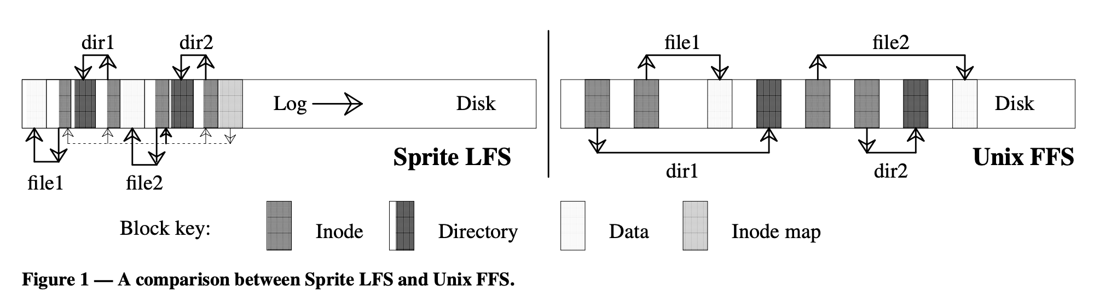
LFS Paper in Readings
LFS: write file1 block, write inode for file1, write directory page mapping “file1” in “dir1” to its inode, write inode for this directory page. Do the same for ”/dir2/file2”. Then write summary of the new inodes that got created in the segment
FFS: <left as exercise>
Reads are same in either case (pointer following)
Buffer cache likely to hold information in both cases
But disk IOs are very different – writes sequential, reads not!
Randomness of read layout assumed to be handled by cache

Slide 49
Example: F2FS: A Flash File System
File system used on many mobile devices
Including the Pixel 3 from Google
Latest version supports block-encryption for security
Has been “mainstream” in linux for several years now
Assumes standard SSD interface
With built-in Flash Translation Layer (FTL)
Random reads are as fast as sequential reads
Random writes are bad for flash storage
Forces FTL to keep moving/coalescing pages and erasing blocks
Sustained write performance degrades/lifetime reduced
Minimize Writes/updates and otherwise keep writes “sequential”
Start with Log-structured file systems/copy-on-write file systems
Keep writes as sequential as possible
Node Translation Table (NAT) for “logical” to “physical” translation
Independent of FTL
For more details, check out paper in Readings section of website
“F2FS: A New File System for Flash Storage” (from 2015)
Design of file system to leverage and optimize NAND flash solutions
Comparison with Ext4, Btrfs, Nilfs2, etc

Slide 50
Flash-friendly on-disk Layout
Main Area:
Divided into segments (basic unit of management in F2FS)
4KB Blocks. Each block typed to be node or data.
Node Address Table (NAT): Independent of FTL!
Block address table to locate all “node blocks” in Main Area
Updates to data sorted by predicted write frequency (Hot/Warm/Cold) to optimize FLASH management
Checkpoint (CP): Keeps the file system status
Bitmaps for valid NAT/SIT sets and Lists of orphan inodes
Stores a consistent F2FS status at a given point in time
Segment Information Table (SIT):
Per segment information such as number of valid blocks and the bitmap for the validity of all blocks in the “Main” area
Segments used for “garbage collection”
Segment Summary Area (SSA):
Summary representing the owner information of all blocks in the Main area

Slide 51
LFS Index Structure: Forces many updates when updating data

Slide 52
F2FS Index Structure: Indirection and Multi-head logs optimize updates

Slide 53
File System Summary (1/3)
File System:
Transforms blocks into Files and Directories
Optimize for size, access and usage patterns
Maximize sequential access, allow efficient random access
Projects the OS protection and security regime (UGO vs ACL)
File defined by header, called “inode”
Naming: translating from user-visible names to actual sys resources
Directories used for naming for local file systems
Linked or tree structure stored in files
Multilevel Indexed Scheme
inode contains file info, direct pointers to blocks, indirect blocks, doubly indirect, etc..
NTFS: variable extents not fixed blocks, tiny files data is in header

Slide 54
File System Summary (2/3)
File layout driven by freespace management
Optimizations for sequential access: start new files in open ranges of free blocks, rotational optimization
Integrate freespace, inode table, file blocks and dirs into block group
FLASH filesystems optimized for:
Fast random reads
Limiting Updates to data blocks
Buffer Cache: Memory used to cache kernel resources, including disk blocks and name translations
Can contain “dirty” blocks (blocks yet on disk)

Slide 55
File System Summary (3/3)
File system operations involve multiple distinct updates to blocks on disk
Need to have all or nothing semantics
Crash may occur in the midst of the sequence
Traditional file system perform check and recovery on boot
Along with careful ordering so partial operations result in loose fragments, rather than loss
Copy-on-write provides richer function (versions) with much simpler recovery
Little performance impact since sequential write to storage device is nearly free
Transactions over a log provide a general solution
Commit sequence to durable log, then update the disk
Log takes precedence over disk
Replay committed transactions, discard partials

