Slide 1
CS162 Operating Systems and Systems Programming Lecture 21 Filesystem Transactions (Con’t), End-to-End Argument, Distributed Decision Making
April 16th, 2020
Prof. John Kubiatowicz
http://cs162.eecs.Berkeley.edu

Slide 2
Recall: Allow more disks to fail!
More general option for general erasure code: Reed-Solomon codes
Based on polynomials in GF(2^{k}) (I.e. k-bit symbols)
Gailois Field is finite version of real numbers
Data as coefficients (a_{j}), code space as values of polynomial:
P(x)=a₀+a₁x¹+… a_{m-1}x^{m-1}
Coded: P(0),P(1),P(2)….,P(n-1)
Can recover polynomial (i.e. data) as long as get any m of n; allows n-m failures!
Examples (with k=16):
Suppose have 6 disks, want to tolerate 2 failures
Split data into 4 chunks, encode 16 bits from each chunk at a time, by generating 6 points (of 16 bits) on 3rd-degree polynomial
Distribute data from polynomial to 6 disks – each disk will ultimately hold data that is ¼ size of original data
Can handle 2 lost disks for 50% overhead
More interesting extreme for Internet-level replication:
Split data into 4 chunks, produce 16 chunks
Each chunk is ¼ total size of original data, Overhead = factor of 4
But – only need 4 of 16 fragments! REALLY DURABLE!

Slide 3
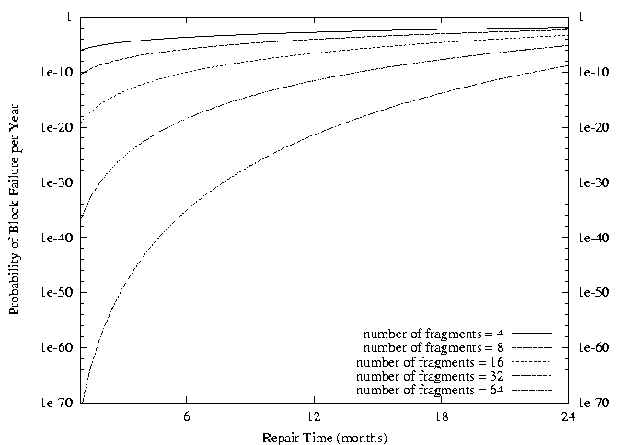
Recall: Use of Erasure Coding in general: High Durability/overhead ratio!
Fraction Blocks Lost
Per Year (FBLPY)
Exploit law of large numbers for durability!
6 month repair, FBLPY with 4x increase in total size of data:
Replication (4 copies): 0.03
Fragmentation (16 of 64 fragments needed): 10⁻³⁵

Slide 4
Recall: The ACID properties of Transactions
Atomicity: all actions in the transaction happen, or none happen
Consistency: transactions maintain data integrity, e.g.,
Balance cannot be negative
Cannot reschedule meeting on February 30
Isolation: execution of one transaction is isolated from that of all others; no problems from concurrency
Durability: if a transaction commits, its effects persist despite crashes

Slide 5
Concept of a log
One simple action is atomic – write/append a basic item
Use that to seal the commitment to a whole series of actions
Commit Tran N
Start Tran N
Get 10$ from account A
Get 7$ from account B
Get 13$ from account C
Put 15$ into account X
Put 15$ into account Y

Slide 6
Journaling File Systems
Instead of modifying data structures on disk directly, write changes to a journal/log
Intention list: set of changes we intend to make
Log/Journal is append-only
Single commit record commits transaction
Once changes are in the log, it is safe to apply changes to data structures on disk
Recovery can read log to see what changes were intended
Can take our time making the changes
As long as new requests consult the log first
Once changes are copied, safe to remove log
But, …
If the last atomic action is not done … poof … all gone
Basic assumption:
Updates to sectors are atomic and ordered
Not necessarily true unless very careful, but key assumption

Slide 7
Example: Creating a File
Find free data block(s)
Find free inode entry
Find dirent insertion point
-----------------------------------------
Write map (i.e., mark used)
Write inode entry to point to block(s)
Write dirent to point to inode
Free space map
Data blocks
…
Inode table
Directory
entries

Slide 8
Ex: Creating a file (as a transaction)
Find free data block(s)
Find free inode entry
Find dirent insertion point
---------------------------------------------------------
[log] Write map (used)
[log] Write inode entry to point to block(s)
[log] Write dirent to point to inode
Free space map
Data blocks
…
Inode table
Directory
entries
tail
head
done
pending
start
commit
Log: in non-volatile storage (Flash or on Disk)

Slide 9
“Redo Log “ – Replay Transactions
After Commit
All access to file system first looks in log
Eventually copy changes to disk
Free space map
Data blocks
…
Inode table
Directory
entries
tail
tail
tail
tail
tail
head
done
start
commit
pending
Log: in non-volatile storage (Flash or Disk)

Slide 10
Crash During Logging – Recover
Upon recovery scan the log
Detect transaction start with no commit
Discard log entries
Disk remains unchanged
Free space map
Data blocks
…
Inode table
Directory
entries
tail
head
done
pending
start
Log: in non-volatile storage (Flash or on Disk)

Slide 11
Recovery After Commit
Scan log, find start
Find matching commit
Redo it as usual
Or just let it happen later
Free space map
Data blocks
…
Inode table
Directory
entries
tail
head
done
pending
start
commit
Log: in non-volatile storage (Flash or on Disk)

Slide 12
Journaling Summary
Why go through all this trouble?
Updates atomic, even if we crash:
Update either gets fully applied or discarded
All physical operations treated as a logical unit
Isn't this expensive?
Yes! We're now writing all data twice (once to log, once to actual data blocks in target file)
Modern filesystems offer an option to journal metadata updates only
Record modifications to file system data structures
But apply updates to a file's contents directly

Slide 13
Going Further – Log Structured File Systems
The log IS what is recorded on disk
File system operations logically replay log to get result
Create data structures to make this fast
On recovery, replay the log
Index (inodes) and directories are written into the log too
Large, important portion of the log is cached in memory
Do everything in bulk: log is collection of large segments
Each segment contains a summary of all the operations within the segment
Fast to determine if segment is relevant or not
Free space is approached as continual cleaning process of segments
Detect what is live or not within a segment
Copy live portion to new segment being formed (replay)
Garbage collection entire segment
No bit map

Slide 14
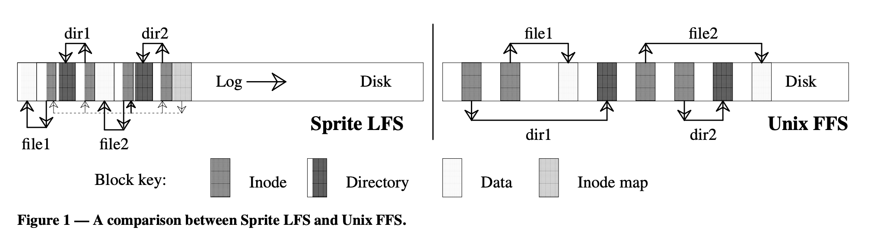
LFS Paper in Readings
LFS: write file1 block, write inode for file1, write directory page mapping “file1” in “dir1” to its inode, write inode for this directory page. Do the same for ”/dir2/file2”. Then write summary of the new inodes that got created in the segment
FFS: <left as exercise>
Read mechanism is same in either case (pointer following)
Buffer cache likely to hold information in both cases
But disk IOs are very different – writes sequential, reads not!
Randomness of read layout assumed to be handled by cache

Slide 15
Example Use of LFS: F2FS: A Flash File System
File system used on many mobile devices
Including the Pixel 3 from Google
Latest version supports block-encryption for security
Has been “mainstream” in linux for several years now
Assumes standard SSD interface
With built-in Flash Translation Layer (FTL)
Random reads are as fast as sequential reads
Random writes are bad for flash storage
Forces FTL to keep moving/coalescing pages and erasing blocks
Sustained write performance degrades/lifetime reduced
Minimize Writes/updates and otherwise keep writes “sequential”
Start with Log-structured file systems/copy-on-write file systems
Keep writes as sequential as possible
Node Translation Table (NAT) for “logical” to “physical” translation
Independent of FTL
For more details, check out paper in Readings section of website
“F2FS: A New File System for Flash Storage” (from 2015)
Design of file system to leverage and optimize NAND flash solutions
Comparison with Ext4, Btrfs, Nilfs2, etc

Slide 16
Flash-friendly on-disk Layout
Main Area:
Divided into segments (basic unit of management in F2FS)
4KB Blocks. Each block typed to be node or data.
Node Address Table (NAT): Independent of FTL!
Block address table to locate all “node blocks” in Main Area
Updates to data sorted by predicted write frequency (Hot/Warm/Cold) to optimize FLASH management
Checkpoint (CP): Keeps the file system status
Bitmaps for valid NAT/SIT sets and Lists of orphan inodes
Stores a consistent F2FS status at a given point in time
Segment Information Table (SIT):
Per segment information such as number of valid blocks and the bitmap for the validity of all blocks in the “Main” area
Segments used for “garbage collection”
Segment Summary Area (SSA):
Summary representing the owner information of all blocks in the Main area

Slide 17
LFS Index Structure: Forces many updates when updating data

Slide 18
F2FS Index Structure: Indirection and Multi-head logs optimize updates

Slide 19



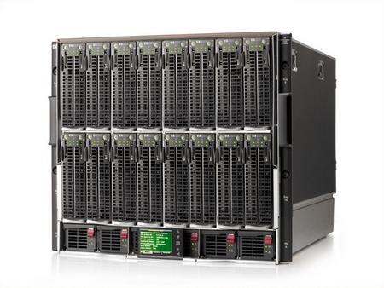


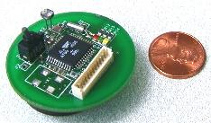



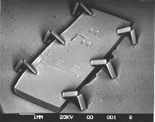

Societal Scale Information Systems
The world is a large distributed system
Microprocessors in everything
Vast infrastructure behind them
Internet Connectivity
Scalable, Reliable,
Secure Services
Databases
Information Collection
Remote Storage
Online Games
Commerce
…
MEMS for
Sensor Nets

Slide 20
Centralized vs Distributed Systems
Server
Client/Server Model
Peer-to-Peer Model
Centralized System: System in which major functions are performed by a single physical computer
Originally, everything on single computer
Later: client/server model
Distributed System: physically separate computers working together on some task
Early model: multiple servers working together
Probably in the same room or building
Often called a “cluster”
Later models: peer-to-peer/wide-spread collaboration

Slide 21
Distributed Systems: Motivation/Issues/Promise
Why do we want distributed systems?
Cheaper and easier to build lots of simple computers
Easier to add power incrementally
Users can have complete control over some components
Collaboration: much easier for users to collaborate through network resources (such as network file systems)
The promise of distributed systems:
Higher availability: one machine goes down, use another
Better durability: store data in multiple locations
More security: each piece easier to make secure

Slide 22
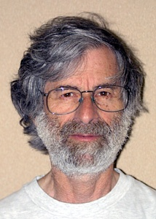
Distributed Systems: Reality
Reality has been disappointing
Worse availability: depend on every machine being up
Lamport: “A distributed system is one in which the failure of a computer you didn’t even know existed can render your own computer unusable.”
Worse reliability: can lose data if any machine crashes
Worse security: anyone in world can break into system
Coordination is more difficult
Must coordinate multiple copies of shared state information (using only a network)
What would be easy in a centralized system becomes a lot more difficult
Trust/Security/Privacy/Denial of Service
Many new variants of problems arise as a result of distribution
Can you trust the other members of a distributed application enough to even perform a protocol correctly?
Corollary of Lamport’s quote: “A distributed system is one where you can’t do work because some computer you didn’t even know existed is successfully coordinating an attack on my system!”
Leslie Lamport

Slide 23
Distributed Systems: Goals/Requirements
Transparency: the ability of the system to mask its complexity behind a simple interface
Possible transparencies:
Location: Can’t tell where resources are located
Migration: Resources may move without the user knowing
Replication: Can’t tell how many copies of resource exist
Concurrency: Can’t tell how many users there are
Parallelism: System may speed up large jobs by splitting them into smaller pieces
Fault Tolerance: System may hide various things that go wrong
Transparency and collaboration require some way for different processors to communicate with one another

Slide 24
How do entities communicate? A Protocol!
Protocol Exchange
C
D
C
D
E
E
B
B
A
A
Stable
Storage
Stable
Storage
A protocol is an agreement on how to communicate, including:
Syntax: how a communication is specified & structured
Format, order messages are sent and received
Semantics: what a communication means
Actions taken when transmitting, receiving, or when a timer expires
Described formally by a state machine
Often represented as a message transaction diagram
Can be a partitioned state machine: two parties synchronizing duplicate sub-state machines between them
Stability in the face of failures!

Slide 25
Examples of Protocols in Human Interactions
Telephone
(Pick up / open up the phone)
Listen for a dial tone / see that you have service
Dial
Should hear ringing …
Callee: “Hello?”
Caller: “Hi, it’s John….” Or: “Hi, it’s me” (← what’s that about?)
Caller: “Hey, do you think … blah blah blah …” pause
Callee: “Yeah, blah blah blah …” pause
Caller: Bye
Callee: Bye
Hang up

Slide 26
Global Communication: The Problem
Application
Skype
SSH
NFS
HTTP
Transmission
Media
Coaxial
cable
Fiber
optic
Packet
Radio
Many different applications
email, web, P2P, etc.
Many different network styles and technologies
Wireless vs. wired vs. optical, etc.
How do we organize this mess?
Re-implement every application for every technology?
No! But how does the Internet design avoid this?

Slide 27
Solution: Intermediate Layers
Application
Skype
SSH
NFS
HTTP
Intermediate
layers
“Narrow Waist”
Internet Protocol
Transmission
Media
Coaxial
cable
Fiber
optic
Packet
radio
Introduce intermediate layers that provide set of abstractions for various network functionality & technologies
A new app/media implemented only once
Variation on “add another level of indirection”
Goal: Reliable communication channels on which to build distributed applications

Slide 28
The Internet Hourglass
SMTP
HTTP
DNS
NTP
Applications
TCP
UDP
Transport
Waist
IP
Data Link
Ethernet
SONET
802.11
Physical
Copper
Fiber
Radio
The Hourglass Model
There is just one network-layer protocol, IP.
The “narrow waist” facilitates interoperability.

Slide 29
Implications of Hourglass
Single Internet-layer module (IP):
Allows arbitrary networks to interoperate
Any network technology that supports IP can exchange packets
Allows applications to function on all networks
Applications that can run on IP can use any network
Supports simultaneous innovations above and below IP
But changing IP itself, i.e., IPv6, very involved

Slide 30
Drawbacks of Layering
Layer N may duplicate layer N-1 functionality
E.g., error recovery to retransmit lost data
Layers may need same information
E.g., timestamps, maximum transmission unit size
Layering can hurt performance
E.g., hiding details about what is really going on
Some layers are not always cleanly separated
Inter-layer dependencies for performance reasons
Some dependencies in standards (header checksums)
Headers start to get really big
Sometimes header bytes >> actual content

Slide 31
End-To-End Argument
Hugely influential paper: “End-to-End Arguments in System Design” by Saltzer, Reed, and Clark (‘84)
“Sacred Text” of the Internet
Endless disputes about what it means
Everyone cites it as supporting their position
Simple Message: Some types of network functionality can only be correctly implemented end-to-end
Reliability, security, etc.
Because of this, end hosts:
Can satisfy the requirement without network’s help
Will/must do so, since can’t rely on network’s help
Therefore don’t go out of your way to implement them in the network
Notes:
This paper is about a basic observation

Slide 32
Example: Reliable File Transfer
Host A
Host B
Appl.
Appl.
OS
OS
OK
Solution 1: make each step reliable, and then concatenate them
Solution 2: end-to-end check and try again if necessary
Notes:
For example, imagine I want to reliably send a file from one host to another.

Slide 33
Discussion
Solution 1 is incomplete
What happens if memory is corrupted?
Receiver has to do the check anyway!
Solution 2 is complete
Full functionality can be entirely implemented at application layer with no need for reliability from lower layers
Is there any need to implement reliability at lower layers?
Well, it could be more efficient
Notes:
what do we observe about these two solutions?

Slide 34
End-to-End Principle
Implementing complex functionality in the network:
Doesn’t reduce host implementation complexity
Does increase network complexity
Probably imposes delay and overhead on all applications, even if they don’t need functionality
However, implementing in network can enhance performance in some cases
e.g., very lossy link

Slide 35
Conservative Interpretation of E2E
Don’t implement a function at the lower levels of the system unless it can be completely implemented at this level
Or: Unless you can relieve the burden from hosts, don’t bother

Slide 36
Moderate Interpretation
Think twice before implementing functionality in the network
If hosts can implement functionality correctly, implement it in a lower layer only as a performance enhancement
But do so only if it does not impose burden on applications that do not require that functionality
This is the interpretation we are using
Is this still valid?
What about Denial of Service?
What about Privacy against Intrusion?
Perhaps there are things that must be in the network???

Slide 37
Distributed Applications
How do you actually program a distributed application?
Need to synchronize multiple threads, running on different machines
No shared memory, so cannot use test&set
One Abstraction: send/receive messages
Already atomic: no receiver gets portion of a message and two receivers cannot get same message
Interface:
Mailbox (mbox): temporary holding area for messages
Includes both destination location and queue
Send(message,mbox)
Send message to remote mailbox identified by mbox
Receive(buffer,mbox)
Wait until mbox has message, copy into buffer, and return
If threads sleeping on this mbox, wake up one of them
Send
Network
Receive

Slide 38
Using Messages: Send/Receive behavior
When should send(message,mbox) return?
When receiver gets message? (i.e. ack received)
When message is safely buffered on destination?
Right away, if message is buffered on source node?
Actually two questions here:
When can the sender be sure that receiver actually received the message?
When can sender reuse the memory containing message?
Mailbox provides 1-way communication from T1→T2
T1→buffer→T2
Very similar to producer/consumer
Send = V, Receive = P
However, can’t tell if sender/receiver is local or not!

Slide 39
Messaging for Producer-Consumer Style
Using send/receive for producer-consumer style:
Producer: int msg1[1000]; while(1) { prepare message; send(msg1,mbox); }
Consumer: int buffer[1000]; while(1) { receive(buffer,mbox); process message; }
No need for producer/consumer to keep track of space in mailbox: handled by send/receive
Next time: will discuss fact that this is one of the roles the window in TCP: window is size of buffer on far end
Restricts sender to forward only what will fit in buffer
Send
Message
Receive
Message

Slide 40
Messaging for Request/Response communication
What about two-way communication?
Request/Response
Read a file stored on a remote machine
Request a web page from a remote web server
Also called: client-server
Client ≡ requester, Server ≡ responder
Server provides “service” (file storage) to the client
Example: File service
Client: (requesting the file) char response[1000]; send(“read rutabaga”, server_mbox); receive(response, client_mbox);
Server: (responding with the file) char command[1000], answer[1000]; receive(command, server_mbox); decode command; read file into answer; send(answer, client_mbox);
Request
File
Get Response
Receive
Request
Send
Response

Slide 41
Distributed Consensus Making
Consensus problem
All nodes propose a value
Some nodes might crash and stop responding
Eventually, all remaining nodes decide on the same value from set of proposed values
Distributed Decision Making
Choose between “true” and “false”
Or Choose between “commit” and “abort”
Equally important (but often forgotten!): make it durable!
How do we make sure that decisions cannot be forgotten?
This is the “D” of “ACID” in a regular database
In a global-scale system?
What about erasure coding or massive replication?
Like BlockChain applications!

Slide 42
General’s Paradox
General’s paradox:
Constraints of problem:
Two generals, on separate mountains
Can only communicate via messengers
Messengers can be captured
Problem: need to coordinate attack
If they attack at different times, they all die
If they attack at same time, they win
Named after Custer, who died at Little Big Horn because he arrived a couple of days too early

Slide 43
General’s Paradox (con’t)
Can messages over an unreliable network be used to guarantee two entities do something simultaneously?
Remarkably, “no”, even if all messages get through
No way to be sure last message gets through!
In real life, use radio for simultaneous (out of band) communication
So, clearly, we need something other than simultaneity!
11 am ok?
Yes, 11 works
So, 11 it is?
Yeah, but what if you
Don’t get this ack?

Slide 44
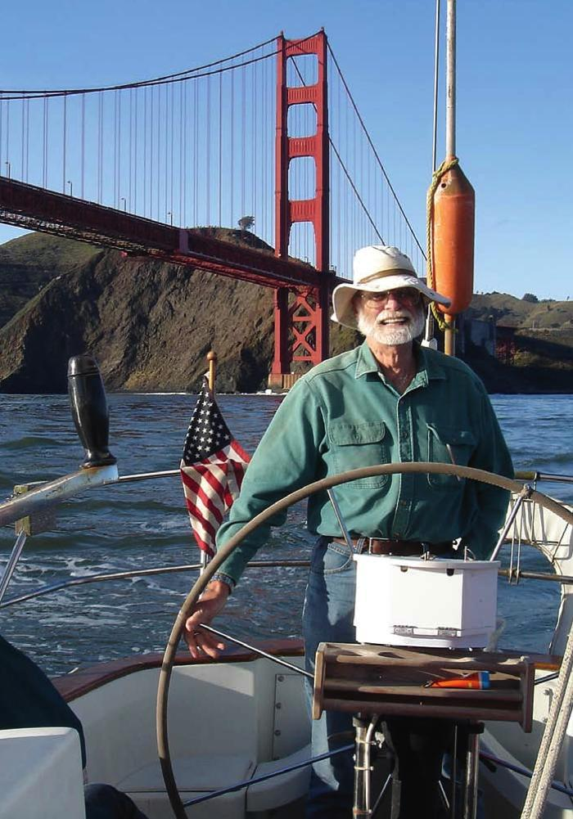
Two-Phase Commit
Since we can’t solve the General’s Paradox (i.e. simultaneous action), let’s solve a related problem
Distributed transaction: Two or more machines agree to do something, or not do it, atomically
No constraints on time, just that it will eventually happen!
Two-Phase Commit protocol: Developed by Turing award winner Jim Gray
(first Berkeley CS PhD, 1969)
Many important DataBase breakthroughs also from Jim Gray
Jim Gray

Slide 45
Two-Phase Commit Protocol
Persistent stable log on each machine: keep track of whether commit has happened
If a machine crashes, when it wakes up it first checks its log to recover state of world at time of crash
Prepare Phase:
The global coordinator requests that all participants will promise to commit or rollback the transaction
Participants record promise in log, then acknowledge
If anyone votes to abort, coordinator writes "Abort" in its log and tells everyone to abort; each records "Abort" in log
Commit Phase:
After all participants respond that they are prepared, then the coordinator writes "Commit" to its log
Then asks all nodes to commit; they respond with ACK
After receive ACKs, coordinator writes "Got Commit" to log
Log used to guarantee that all machines either commit or don’t

Slide 46
2PC Algorithm
One coordinator
N workers (replicas)
High level algorithm description:
Coordinator asks all workers if they can commit
If all workers reply “VOTE-COMMIT”, then coordinator broadcasts “GLOBAL-COMMIT”
Otherwise coordinator broadcasts “GLOBAL-ABORT”
Workers obey the GLOBAL messages
Use a persistent, stable log on each machine to keep track of what you are doing
If a machine crashes, when it wakes up it first checks its log to recover state of world at time of crash

Slide 47
Two-Phase Commit: Setup
One machine (coordinator) initiates the protocol
It asks every machine to vote on transaction
Two possible votes:
Commit
Abort
Commit transaction only if unanimous approval

Slide 48
Two-Phase Commit: Preparing
Agree to Commit
Machine has guaranteed that it will accept transaction
Must be recorded in log so machine will remember this decision if it fails and restarts
Agree to Abort
Machine has guaranteed that it will never accept this transaction
Must be recorded in log so machine will remember this decision if it fails and restarts

Slide 49
Two-Phase Commit: Finishing
Commit Transaction
Coordinator learns all machines have agreed to commit
Record decision to commit in local log
Apply transaction, inform voters
Abort Transaction
Coordinator learns at least on machine has voted to abort
Record decision to abort in local log
Do not apply transaction, inform voters

Slide 50
Two-Phase Commit: Finishing
Commit Transaction
Coordinator learns all machines have agreed to commit
Record decision to commit in local log
Apply transaction, inform voters
Abort Transaction
Coordinator learns at least on machine has voted to abort
Record decision to abort in local log
Do not apply transaction, inform voters
Because no machine can take back its decision, exactly one of these will happen

Slide 51
Detailed Algorithm
Coordinator Algorithm
Worker Algorithm
Coordinator sends VOTE-REQ to all workers
Wait for VOTE-REQ from coordinator
If ready, send VOTE-COMMIT to coordinator
If not ready, send VOTE-ABORT to coordinator
And immediately abort
If receive VOTE-COMMIT from all N workers, send GLOBAL-COMMIT to all workers
If doesn’t receive VOTE-COMMIT from all N workers, send GLOBAL-ABORT to all workers
If receive GLOBAL-COMMIT then commit
If receive GLOBAL-ABORT then abort

Slide 52
Failure Free Example Execution
coordinator
VOTE-REQ
GLOBAL-COMMIT
worker 1
worker 2
VOTE-COMMIT
worker 3
time

Slide 53
State Machine of Coordinator
Coordinator implements simple state machine:
INIT
Recv: START
Send: VOTE-REQ
WAIT
Recv: VOTE-ABORT
Send: GLOBAL-ABORT
Recv: all VOTE-COMMIT
Send: GLOBAL-COMMIT
ABORT
COMMIT

Slide 54
State Machine of Workers
INIT
Recv: VOTE-REQ
Send: VOTE-ABORT
Recv: VOTE-REQ
Send: VOTE-COMMIT
READY
Recv: GLOBAL-ABORT
Recv: GLOBAL-COMMIT
ABORT
COMMIT

Slide 55
Dealing with Worker Failures
INIT
Recv: START
Send: VOTE-REQ
WAIT
Recv: VOTE-ABORT
Send: GLOBAL-ABORT
Recv: VOTE-COMMIT
Send: GLOBAL-COMMIT
ABORT
COMMIT
Failure only affects states in which the coordinator is waiting for messages
Coordinator only waits for votes in “WAIT” state
In WAIT, if doesn’t receive N votes, it times out and sends GLOBAL-ABORT

Slide 56
Example of Worker Failure
INIT
WAIT
coordinator
ABORT
COMM
timeout
GLOBAL-ABORT
VOTE-REQ
worker 1
VOTE-COMMIT
worker 2
worker 3
time

Slide 57
Dealing with Coordinator Failure
INIT
Recv: VOTE-REQ
Send: VOTE-ABORT
Recv: VOTE-REQ
Send: VOTE-COMMIT
READY
Recv: GLOBAL-ABORT
Recv: GLOBAL-COMMIT
ABORT
COMMIT
Worker waits for VOTE-REQ in INIT
Worker can time out and abort (coordinator handles it)
Worker waits for GLOBAL-* message in READY
If coordinator fails, workers must BLOCK waiting for coordinator to recover and send GLOBAL_* message

Slide 58
Example of Coordinator Failure #1
INIT
READY
coordinator
ABORT
COMM
VOTE-REQ
timeout
worker 1
VOTE-ABORT
worker 2
timeout
timeout
worker 3

Slide 59
Example of Coordinator Failure #2
INIT
READY
ABORT
COMM
coordinator
restarted
VOTE-REQ
worker 1
VOTE-COMMIT
GLOBAL-ABORT
worker 2
block waiting for coordinator
worker 3

Slide 60
Durability
All nodes use stable storage to store current state
stable storage is non-volatile storage (e.g. backed by disk) that guarantees atomic writes.
E.g.: SSD, NVRAM
Upon recovery, it can restore state and resume:
Coordinator aborts in INIT, WAIT, or ABORT
Coordinator commits in COMMIT
Worker aborts in INIT, ABORT
Worker commits in COMMIT
Worker “asks” Coordinator in READY

Slide 61
Blocking for Coordinator to Recover
A worker waiting for global decision can ask fellow workers about their state
If another worker is in ABORT or COMMIT state then coordinator must have sent GLOBAL-*
Thus, worker can safely abort or commit, respectively
If another worker is still in INIT state then both workers can decide to abort
If all workers are in ready, need to BLOCK (don’t know if coordinator wanted to abort or commit)
INIT
Recv: VOTE-REQ
Send: VOTE-ABORT
Recv: VOTE-REQ
Send: VOTE-COMMIT
READY
Recv: GLOBAL-ABORT
Recv: GLOBAL-COMMIT
ABORT
COMMIT

Slide 62
Distributed Decision Making Discussion (1/2)
Why is distributed decision making desirable?
Fault Tolerance!
A group of machines can come to a decision even if one or more of them fail during the process
Simple failure mode called “failstop” (different modes later)
After decision made, result recorded in multiple places

Slide 63
Distributed Decision Making Discussion (2/2)
Undesirable feature of Two-Phase Commit: Blocking
One machine can be stalled until another site recovers:
Site B writes "prepared to commit" record to its log, sends a "yes" vote to the coordinator (site A) and crashes
Site A crashes
Site B wakes up, check its log, and realizes that it has voted "yes" on the update. It sends a message to site A asking what happened. At this point, B cannot decide to abort, because update may have committed
B is blocked until A comes back
A blocked site holds resources (locks on updated items, pages pinned in memory, etc) until learns fate of update

Slide 64
Alternatives to 2PC
Three-Phase Commit: One more phase, allows nodes to fail or block and still make progress.
PAXOS: An alternative used by Google and others that does not have 2PC blocking problem
Develop by Leslie Lamport (Turing Award Winner)
No fixed leader, can choose new leader on fly, deal with failure
Some think this is extremely complex!
RAFT: PAXOS alternative from John Osterhout (Stanford)
Simpler to describe complete protocol
What happens if one or more of the nodes is malicious?
Malicious: attempting to compromise the decision making

Slide 65
Byzantine General’s Problem
Lieutenant
Attack!
Attack!
Attack!
Attack!
Retreat!
Attack!
Attack!
Lieutenant
Retreat!
General
Attack!
Lieutenant
Malicious!
Byazantine General’s Problem (n players):
One General and n-1 Lieutenants
Some number of these (f) can be insane or malicious
The commanding general must send an order to his n-1 lieutenants such that the following Integrity Constraints apply:
IC1: All loyal lieutenants obey the same order
IC2: If the commanding general is loyal, then all loyal lieutenants obey the order he sends

Slide 66
Byzantine General’s Problem (con’t)
Impossibility Results:
Cannot solve Byzantine General’s Problem with n=3 because one malicious player can mess up things
With f faults, need n > 3f to solve problem
Various algorithms exist to solve problem
Original algorithm has #messages exponential in n
Newer algorithms have message complexity O(n2)
One from MIT, for instance (Castro and Liskov, 1999)
Use of BFT (Byzantine Fault Tolerance) algorithm
Allow multiple machines to make a coordinated decision even if some subset of them (< n/3 ) are malicious
General
General
Attack!
Attack!
Attack!
Retreat!
Lieutenant
Lieutenant
Lieutenant
Lieutenant
Retreat!
Retreat!
Request
Distributed
Decision

Slide 67
Is a BlockChain a Distributed Decision Making Algorithm?
Tentative Head #1
Root
Block
Tentative Head #2
Hash Ptr
The “Block Chain”
BlockChain: a chain of blocks connected by hashes to root block
The Hash Pointers are unforgeable (assumption)
The Chain has no branches except perhaps for heads
Blocks are considered “authentic” part of chain when they have authenticity info in them
How is the head chosen?
Some consensus algorithm
In many BlockChain algorithms (e.g. BitCoin, Ethereum), the head is chosen by solving hard problem
This is the job of “miners” who try to find “nonce” info that makes hash over block have specified number of zero bits in it
The result is a “Proof of Work” (POW)
Selected blocks above (green) have POW in them and can be included in chains
Longest chain wins

Slide 68
Is a Blockchain a Distributed Decision Making Algorithm? (Con’t)
Miner:
Tries to solve POW problem
Observer:
Tracks state of BlockChain
Miner:
Tries to solve POW problem
Observer:
Tracks state of BlockChain
Proposal
Observer:
Tracks state of BlockChain
Root
Block
Root
Block
Hash Ptr
Root
Block
Root
Block
Hash Ptr
Hash Ptr
Root
Block
Hash Ptr
Epidemic
Replication
Hash Ptr
Observer:
Tracks state of BlockChain
Observer:
Tracks state of BlockChain
Observer:
Tracks state of BlockChain
Observer:
Tracks state of BlockChain
Observer:
Tracks state of BlockChain
Miner:
Tries to solve POW problem
Observer:
Tracks state of BlockChain
Root
Block
Root
Block
Hash Ptr
Root
Block
Hash Ptr
Root
Block
Hash Ptr
Root
Block
Hash Ptr
Root
Block
Root
Block
Hash Ptr
Hash Ptr
Hash Ptr
Decision means: Proposal is locked into BlockChain
Could be Commit/Abort decision
Could be Choice of Value, State Transition, ….
NAK: Didn’t make it into the block chain (must retry!)
Anyone in world can verify the result of decision making!
Proposal

Slide 69
Summary (1/2)
Protocol: Agreement between two parties as to how information is to be transmitted
E2E argument encourages us to keep Internet communication simple
If higher layer can implement functionality correctly, implement it in a lower layer only if:
it improves the performance significantly for application that need that functionality, and
it does not impose burden on applications that do not require that functionality
Two-phase commit: distributed decision making
First, make sure everyone guarantees that they will commit if asked (prepare)
Next, ask everyone to commit

Slide 70
Summary (2/2)
Byzantine General’s Problem: distributed decision making with malicious failures
One general, n-1 lieutenants: some number of them may be malicious (often “f” of them)
All non-malicious lieutenants must come to same decision
If general not malicious, lieutenants must follow general
Only solvable if n ≥ 3f+1
BlockChain protocols
Could be used for distributed decision making

