Slide 1
CS162 Operating Systems and Systems Programming Lecture 24 Distributed Storage, Key Value Stores, Chord
April 28th, 2020
Prof. John Kubiatowicz
http://cs162.eecs.Berkeley.edu

Slide 2
Recall: TCP Congestion Avoidance
Congestion Avoidance algorithm:
Pick amount of outstanding data to avoid overloading network while still maximizing pipelining
Assumption: most data loss caused by overloading!
How does the sender’s window size get chosen?
Must be less than receiver’s advertised buffer size
Try to match the rate of sending packets with the rate that the slowest link can accommodate
Sender uses an adaptive algorithm to decide window size
Goal: fill network between sender and receiver
Basic technique: slowly increase size of window until acknowledgements start being delayed/lost
So, how much data do we want in the network baring congestion?
Round-trip latency × bandwidth of slowest link
Ack arrives just as we are about to send next packet
TCP solution: “slow start” (start sending slowly)
If no timeout, slowly increase window size (throughput) by 1 for each ACK received
Timeout ⇒ congestion, so cut window size in half
“Additive Increase, Multiplicative Decrease”
Notes:
2nd thing we use window-based acknowledgment protocol for:
Avoid overwhelming network

Slide 3

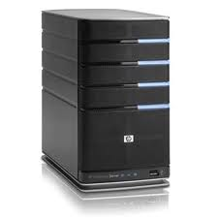
Recall: The CAP Theorem
Network
Consistency:
Changes appear to everyone in the same serial order
Availability:
Can get a result at any time
Partition-Tolerance
System continues to work even when network becomes partitioned
Consistency, Availability, Partition-Tolerance (CAP) Theorem: Cannot have all three at same time
Otherwise known as “Brewer’s Theorem”

Slide 4
Recall: NFS Cache consistency
NFS protocol: weak consistency
Client polls server periodically to check for changes
Polls server if data hasn’t been checked in last 3-30 seconds (exact timeout it tunable parameter).
Thus, when file is changed on one client, server is notified, but other clients use old version of file until timeout.
What if multiple clients write to same file?
In NFS, can get either version (or parts of both)
Completely arbitrary!
cache
F1 still ok?
F1:V2
F1:V1
No: (F1:V2)
Client
cache
Write (RPC)
Server
F1:V2
ACK
cache
F1:V2
Client

Slide 5
NFS: Sequential Ordering Constraints
What sort of cache coherence might we expect?
i.e. what if one CPU changes file, and before it’s done, another CPU reads file?
Example: Start with file contents = “A”
What would we actually want?
Assume we want distributed system to behave exactly the same as if all processes are running on single system
If read finishes before write starts, get old copy
If read starts after write finishes, get new copy
Otherwise, get either new or old copy
For NFS:
If read starts more than 30 seconds after write, get new copy; otherwise, could get partial update
Client 1:
Read: gets A
Write B
Read: parts of B or C
Client 2:
Read: gets A or B
Write C
Client 3:
Read: parts of B or C
Time

Slide 6
Andrew File System
Andrew File System (AFS, late 80’s) → DCE DFS (commercial product)
Callbacks: Server records who has copy of file
On changes, server immediately tells all with old copy
No polling bandwidth (continuous checking) needed
Write through on close
Changes not propagated to server until close()
Session semantics: updates visible to other clients only after the file is closed
As a result, do not get partial writes: all or nothing!
Although, for processes on local machine, updates visible immediately to other programs who have file open
In AFS, everyone who has file open sees old version
Don’t get newer versions until reopen file

Slide 7
Andrew File System (con’t)
Data cached on local disk of client as well as memory
On open with a cache miss (file not on local disk):
Get file from server, set up callback with server
On write followed by close:
Send copy to server; tells all clients with copies to fetch new version from server on next open (using callbacks)
What if server crashes? Lose all callback state!
Reconstruct callback information from client: go ask everyone “who has which files cached?”
AFS Pro: Relative to NFS, less server load:
Disk as cache ⇒ more files can be cached locally
Callbacks ⇒ server not involved if file is read-only
For both AFS and NFS: central server is bottleneck!
Performance: all writes→server, cache misses→server
Availability: Server is single point of failure
Cost: server machine’s high cost relative to workstation

Slide 8
Sharing Data, rather than Files ?
Key:Value stores are used everywhere
Native in many programming languages
Associative Arrays in Perl
Dictionaries in Python
Maps in Go
…
What about a collaborative key-value store rather than message passing or file sharing?
Can we make it scalable and reliable?

Slide 9
Key Value Storage
Simple interface
put(key, value); // Insert/write "value" associated with key
get(key); // Retrieve/read value associated with key

Slide 10
Why Key Value Storage?
Easy to Scale
Handle huge volumes of data (e.g., petabytes)
Uniform items: distribute easily and roughly equally across many machines
Simple consistency properties
Used as a simpler but more scalable "database"
Or as a building block for a more capable DB

Slide 11





Key Values: Examples
Amazon:
Key: customerID
Value: customer profile (e.g., buying history, credit card, ..)
Facebook, Twitter:
Key: UserID
Value: user profile (e.g., posting history, photos, friends, …)
iCloud/iTunes:
Key: Movie/song name
Value: Movie, Song

Slide 12
Key-value storage systems in real life
Amazon
DynamoDB: internal key value store used to power Amazon.com (shopping cart)
Simple Storage System (S3)
BigTable/HBase/Hypertable: distributed, scalable data storage
Cassandra: “distributed data management system” (developed by Facebook)
Memcached: in-memory key-value store for small chunks of arbitrary data (strings, objects)
eDonkey/eMule: peer-to-peer sharing system
…

Slide 13
Key Value Store
Also called Distributed Hash Tables (DHT)
Main idea: simplify storage interface (i.e. put/get), then partition set of key-values across many machines
key, value
…

Slide 14
Challenges
…
Scalability:
Need to scale to thousands of machines
Need to allow easy addition of new machines
Fault Tolerance: handle machine failures without losing data and without degradation in performance
Consistency: maintain data consistency in face of node failures and message losses
Heterogeneity (if deployed as peer-to-peer systems):
Latency: 1ms to 1000ms
Bandwidth: 32Kb/s to 100Mb/s

Slide 15
Important Questions
put(key, value):
where do you store a new (key, value) tuple?
get(key):
where is the value associated with a given “key” stored?
And, do the above while providing
Scalability
Fault Tolerance
Consistency

Slide 16
How to solve the “where?”
Hashing to map key space ⇒ location
But what if you don’t know who are all the nodes that are participating?
Perhaps they come and go …
What if some keys are really popular?
Lookup
Hmm, won’t this be a bottleneck and single point of failure?

Slide 17
Recursive Directory Architecture (put)
Have a node maintain the mapping between keys and the machines (nodes) that store the values associated with the keys
Master/Directory
put(K14, V14)
K5
N2
K14
N3
K105
N50
put(K14, V14)
K5
V5
K14
V14
K105
V105
…
N₁
N₂
N₃
N₅₀

Slide 18
Recursive Directory Architecture (get)
Have a node maintain the mapping between keys and the machines (nodes) that store the values associated with the keys
Master/Directory
get(K14)
K5
N2
V14
K14
N3
K105
N50
get(K14)
V14
K5
V5
K14
V14
K105
V105
…
N₁
N₂
N₃
N₅₀

Slide 19
Iterative Directory Architecture (put)
Having the master relay the requests → recursive query
Another method: iterative query (this slide)
Return node to requester and let requester contact node
Master/Directory
put(K14, V14)
K5
N2
N3
K14
N3
K105
N50
put(K14, V14)
K5
V5
K14
V14
K105
V105
…
N₁
N₂
N₃
N₅₀

Slide 20
Iterative Directory Architecture (get)
Having the master relay the requests → recursive query
Another method: iterative query (this slide)
Return node to requester and let requester contact node
Master/Directory
get(K14)
N3
K5
N2
K14
N3
V14
K105
N50
get(K14)
K5
V5
K14
V14
K105
V105
…
N₁
N₂
N₃
N₅₀

Slide 21
Iterative vs. Recursive Query
Master/Directory
Master/Directory
get(K14)
get(K14)
V14
K14
N3
N3
K14
N3
V14
get(K14)
get(K14)
V14
K14
V14
K14
V14
…
…
N1
N2
N3
N50
N1
N2
N3
N50
Recursive
Iterative
Faster, as directory server is typically close to storage nodes
Easier for consistency: directory can enforce an order for all puts and gets
Directory is a performance bottleneck
More scalable, clients do more work
Harder to enforce consistency

Slide 22
Scalability: Is it easy to make the system bigger?
Storage: Use more nodes
Number of Requests
Can serve requests from all nodes on which a value is stored in parallel
Master can replicate a popular item on more nodes
Master/Directory Scalability
Replicate It (multiple identical copies)
Partition it, so different keys are served by different directories
But how do we do this….?

Slide 23
Fault Tolerance
Replicate value on several nodes
Usually, place replicas on different racks in a datacenter to guard against rack failures
Master/Directory
put(K14, V14)
K5
N2
N1, N3
K14
N1,N3
K105
N50
put(K14, V14)
put(K14, V14), N1
K14
V14
K5
V5
K14
V14
K105
V105
…
N₁
N₂
N₃
N₅₀

Slide 24
Consistency
Need to make sure that a value is replicated correctly
How do you know a value has been replicated on every node?
Wait for acknowledgements from every node
What happens if a node fails during replication?
Pick another node and try again
What happens if a node is slow?
Slow down the entire put()? Pick another node?
In general, with multiple replicas
Slow puts and fast gets

Slide 25
Consistency (cont’d)
If concurrent updates (i.e., puts to same key) may need to make sure that updates happen in the same order
Master/Directory
put(K14, V14’)
K5
N2
put(K14, V14’’)
K14
N1,N3
K105
N50
put(K14, V14’’)
put(K14, V14’)
K14
K14
V14
V14’’
K5
V5
K14
K14
V14
V14’
K105
V105
…
N₁
N₂
N₃
N₅₀

Slide 26
Consistency (cont’d)
If concurrent updates (i.e., puts to same key) may need to make sure that updates happen in the same order
put(K14, V14’) and put(K14, V14’’) reach N1 & N3 in reverse order!
Master/Directory
put(K14, V14’)
K5
N2
put(K14, V14’’)
K14
N1,N3
K105
N50
put(K14, V14’’)
put(K14, V14’)
put(K14, V14’')
put(K14, V14’)
K14
K14
V14
V14’
K5
V5
K14
K14
V14
V14’’
K105
V105
…
N₁
N₂
N₃
N₅₀

Slide 27
Consistency (cont’d)
If concurrent updates (i.e., puts to same key) may need to make sure that updates happen in the same order
put(K14, V14’) and put(K14, V14’’) reach N1 & N3 in reverse order!
What does get(K14) return?
Undefined!
Master/Directory
put(K14, V14’)
K5
N2
put(K14, V14’’)
K14
N1,N3
K105
N50
put(K14, V14’’)
put(K14, V14’)
put(K14, V14’')
put(K14, V14’)
K14
K14
V14
V14’
K5
V5
K14
K14
V14
V14’’
K105
V105
…
N₁
N₂
N₃
N₅₀

Slide 28
Large Variety of Consistency Models
Atomic consistency (linearizability): reads/writes (gets/puts) to replicas appear as if there was a single underlying replica (single system image)
Think “one updated at a time”
Transactions
Eventual consistency: given enough time all updates will propagate through the system
One of the weakest form of consistency; used by many systems in practice
Must eventually converge on single value/key (coherence)
And many others: causal consistency, sequential consistency, strong consistency, …

Slide 29
Quorum Consensus
Improve put() and get() operation performance
In the presence of replication!
Define a replica set of size N
put() waits for acknowledgements from at least W replicas
Different updates need to be differentiated by something monotonically increasing like a timestamp
Allows us to replace old values with updated ones
get() waits for responses from at least R replicas
W+R > N
Why does it work?
There is at least one node that contains the update
Why might you use W+R > N+1?

Slide 30
Quorum Consensus Example
N=3, W=2, R=2
Replica set for K14: {N1, N2, N4}
Assume put() on N3 fails
put(K14, V14)
ACK
put(K14, V14)
put(K14, V14)
ACK
K14
V14
K14
V14
N₁
N₂
N₃
N₄

Slide 31
Quorum Consensus Example
Now, issuing get() to any two nodes out of three will return the answer
get(K14)
get(K14)
V14
nill
K14
V14
K14
V14
N₁
N₂
N₃
N₄

Slide 32
Scalability
Storage: use more nodes
Number of requests:
Can serve requests from all nodes on which a value is stored in parallel
Master can replicate a popular value on more nodes
Master/directory scalability:
Replicate it
Partition it, so different keys are served by different masters/directories
How do you partition?

Slide 33
Scalability: Load Balancing
Directory keeps track of the storage availability at each node
Preferentially insert new values on nodes with more storage available
What happens when a new node is added?
Cannot insert only new values on new node. Why?
Move values from the heavy loaded nodes to the new node
What happens when a node fails?
Need to replicate values from fail node to other nodes

Slide 34
Scaling Up Directory
Challenge:
Directory contains a number of entries equal to number of (key, value) tuples in the system
Can be tens or hundreds of billions of entries in the system!
Solution: Consistent Hashing
Provides mechanism to divide [key,value] pairs amongst a (potentially large!) set of machines (nodes) on network
Associate to each node a unique id in an uni-dimensional space 0..2^{m}-1 ⇒ Wraps around: Call this “the ring!”
Partition this space across n machines
Assume keys are in same uni-dimensional space
Each [Key, Value] is stored at the node with the smallest ID larger than Key

Slide 35
Key to Node Mapping Example
Paritioning example with m = 6 → ID space: 0..63
Node 8 maps keys [5,8]
Node 15 maps keys [9,15]
Node 20 maps keys [16, 20]
…
Node 4 maps keys [59, 4]
For this example, the mapping [14, V14] maps to node with ID=15
Node with smallest ID larger than 14 (the key)
In practice, m=256 or more!
Uses cryptographically secure hash such as SHA-256 to generate the node IDs
63
0
4
58
8
14
V14
“The Ring”
15
44
20
35
32

Slide 36
Chord: Distributed Lookup (Directory) Service
“Chord” is a Distributed Lookup Service
Designed at MIT and here at Berkeley (Ion Stoica among others)
Simplest and cleanest algorithm for distributed storage
Serves as comparison point for other optims
Import aspect of the design space:
Decouple correctness from efficiency
Combined Directory and Storage
Properties
Correctness:
Each node needs to know about neighbors on ring (one predecessor and one successor)
Connected rings will perform their task correctly
Performance:
Each node needs to know about O(log(M)), where M is the total number of nodes
Guarantees that a tuple is found in O(log(M)) steps
Many other Structured, Peer-to-Peer lookup services:
CAN, Tapestry, Pastry, Bamboo, Kademlia, …
Several designed here at Berkeley!

Slide 37
Chord’s Lookup Mechanism: Routing!
Each node maintains pointer to its successor
Route packet (Key, Value) to the node responsible for ID using successor pointers
E.g., node=4 lookups for node responsible for Key=37
Worst-case (correct) lookup is O(n)
But much better normal lookup time is O(log n)
Dynamic performance optimization (finger table mechanism)
More later!!!
lookup(37)
4
58
8
node=44 is responsible for Key=37
15
44
20
35
32

Slide 38


But what does this really mean??
ID: 58
Client
Client
ID: 4
63
0
4
ID: 20
58
8
14
V14
Client
ID: 32
ID: 35
15
ID: 15
ID: 8
44
20
14
V14
ID: 44
35
32
Client
Client
Node names intentionally scrambled WRT geography!
Node IDs generated by secure hashes over metadata
Including things like the IP address
This geographic scrambling spreads load and avoids hotspots
Clients access distributed storage by accessing system through any member of the network

Slide 39
Stabilization Procedure
Periodic operation performed by each node n to maintain its successor when new nodes join the system
The primary Correctness constraint
n.stabilize()
x = succ.pred;
if (x (n, succ))
succ = x; // if x better successor, update
succ.notify(n); // n tells successor about itself
n.notify(n’)
if (pred = nil or n’ (pred, n))
pred = n’; // if n’ is better predecessor, update

Slide 40
Joining Operation
Node with id=50 joins the ring
Node 50 must know at least one node already in system
Assume known node is 15
succ=4
pred=44
4
58
8
succ=nil
pred=nil
50
15
44
succ=58
20
pred=35
35
32

Slide 41
Joining Operation
n=50 sends join(50) to node 15
Join propagated around ring!
n=44 returns node 58
n=50 updates its successor to 58
succ=4
pred=44
4
58
8
join(50)
succ=nil
succ=58
pred=nil
50
58
15
44
succ=58
20
pred=35
35
32

Slide 42
Joining Operation
n=50 executes stabilize()
n’s successor (58) returns x = 44
succ=4
pred=44
4
x=44
58
8
succ=58
pred=nil
15
50
44
succ=58
20
pred=35
n.stabilize()
x = succ.pred;
if (x (n, succ))
succ = x;
succ.notify(n);
35
32

Slide 43
Joining Operation
n=50 executes stabilize()
x = 44
succ = 58
succ=4
pred=44
4
58
8
succ=58
pred=nil
15
50
44
succ=58
20
pred=35
n.stabilize()
x = succ.pred;
if (x (n, succ))
succ = x;
succ.notify(n);
35
32

Slide 44
Joining Operation
n=50 executes stabilize()
x = 44
succ = 58
n=50 sends to it’s successor (58) notify(50)
succ=4
pred=44
4
58
notify(50)
8
succ=58
pred=nil
15
50
44
succ=58
20
pred=35
n.stabilize()
x = succ.pred;
if (x (n, succ))
succ = x;
succ.notify(n);
35
32

Slide 45
Joining Operation
n=58 executes notify(50)
pred = 44
n’ = 50
succ=4
pred=44
4
58
notify(50)
8
succ=58
pred=nil
15
50
44
succ=58
20
pred=35
n.notify(n’)
if (pred = nil or n’ (pred, n))
pred = n’
35
32

Slide 46
Joining Operation
n=58 executes notify(50)
pred = 44
n’ = 50
set pred = 50
succ=4
pred=44
pred=50
4
58
notify(50)
8
succ=58
pred=nil
15
50
44
succ=58
20
pred=35
n.notify(n’)
if (pred = nil or n’ (pred, n))
pred = n’
35
32

Slide 47
Joining Operation
n=44 executes stabilize()
n’s successor (58) returns x=50
succ=4
pred=50
4
58
8
x=50
succ=58
pred=nil
15
50
44
succ=58
20
pred=35
n.stabilize()
x = succ.pred;
if (x (n, succ))
succ = x;
succ.notify(n);
35
32

Slide 48
Joining Operation
n=44 executes stabilize()
x=50
succ=58
succ=4
pred=50
4
58
8
succ=58
pred=nil
15
50
44
succ=58
20
pred=35
n.stabilize()
x = succ.pred;
if (x (n, succ))
succ = x;
succ.notify(n);
35
32

Slide 49
Joining Operation
n=44 executes stabilize()
x=50
succ=58
n=44 sets succ=50
succ=4
pred=50
4
58
8
succ=58
pred=nil
15
50
44
succ=58
20
succ=50
pred=35
n.stabilize()
x = succ.pred;
if (x (n, succ))
succ = x;
succ.notify(n);
35
32

Slide 50
Joining Operation
n=44 executes stabilize()
n=44 sends notify(44) to its successor
succ=4
pred=50
4
58
8
succ=58
pred=nil
15
50
notify(44)
44
succ=50
20
pred=35
n.stabilize()
x = succ.pred;
if (x (n, succ))
succ = x;
succ.notify(n);
35
32

Slide 51
Joining Operation
n=50 executes notify(44)
pred=nil
succ=4
pred=50
4
58
8
succ=58
pred=nil
15
50
notify(44)
44
succ=50
20
pred=35
n.notify(n’)
if (pred = nil or n’ (pred, n))
pred = n’
35
32

Slide 52
Joining Operation
n=50 executes notify(44)
pred=nil
n=50 sets pred=44
succ=4
pred=50
4
58
8
succ=58
pred=nil
pred=44
15
50
notify(44)
44
succ=50
20
pred=35
n.notify(n’)
if (pred = nil or n’ (pred, n))
pred = n’
35
32

Slide 53
Joining Operation (cont’d)
This completes the joining operation!
The same stabilizing process will deal with failed nodes by reconnecting the ring
What if 2 or more nodes in a row fail?
Keep track of more neighbors!
Called the “leaf set”
pred=50
4
58
8
succ=58
50
pred=44
15
44
20
succ=50
35
32

Slide 54
Achieving Efficiency: finger tables
Say m=7
Finger Table at 80
0
i ft[i]
0 96
1 96
2 96
3 96
4 96
5 112
6 20
(80 + 2⁶) mod 2⁷ = 16
80 + 2⁵
112
20
96
80 + 2⁴
32
80 + 2³
80 + 2²
80 + 2¹
45
80 + 2⁰
80
ith entry at peer with id n is first peer with id >=

Slide 55
Achieving Fault Tolerance for Lookup Service
To improve robustness each node maintains the k (> 1) immediate successors instead of only one successor
Again – called the “leaf set”
In the pred() reply message, node A can send its k-1 successors to its predecessor B
Upon receiving pred() message, B can update its successor list by concatenating the successor list received from A with its own list
If k = log(M), lookup operation works with high probability even if half of nodes fail, where M is number of nodes in the system

Slide 56
Storage Fault Tolerance
Replicate tuples on successor nodes
Example: replicate (K14, V14) on nodes 20 and 32
63
0
4
58
8
14
V14
15
14
V14
44
20
14
V14
35
32

Slide 57
Storage Fault Tolerance
If node 15 fails, no reconfiguration needed
Still have two replicas
All lookups will be correctly routed after stabilization
Will need to add a new replica on node 35
63
0
4
58
8
14
V14
15
14
V14
44
14
V14
20
14
V14
35
32

Slide 58
Replication in Physical Space
ID: 58
Client
Client
14
V14
ID: 4
63
14
V14
0
4
ID: 20
58
8
14
V14
Client
ID: 32
ID: 35
15
14
V14
ID: 15
ID: 8
44
20
14
V14
14
V14
Client
ID: 44
35
32
Client
Replicating in Adjacent nodes of virtual space ⇒ Geographic Separation in physical space
Avoids single-points of failure through randomness
More nodes, more replication, more geographic spread

Slide 59
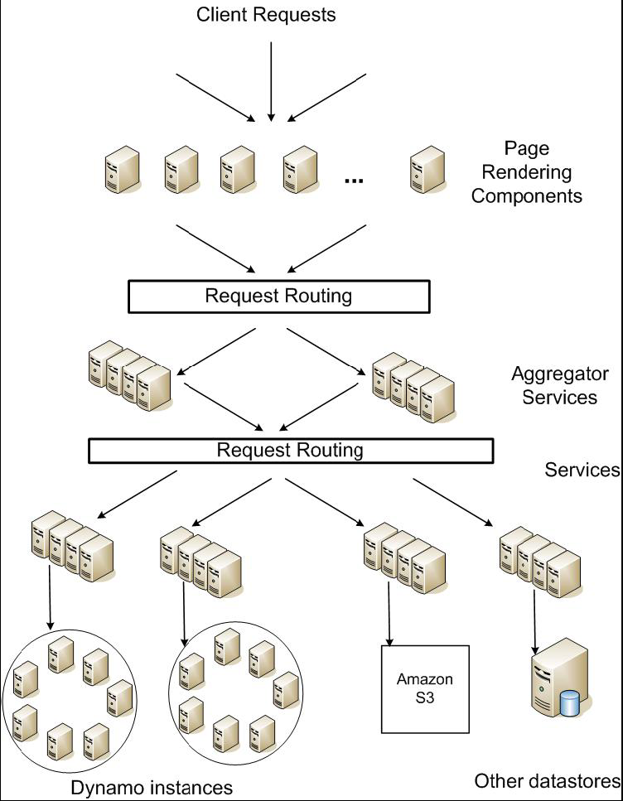
DynamoDB Example: Service Level Agreements (SLA)
Dynamo is Amazon’s storage system using “Chord” ideas
Application can deliver its functionality in a bounded time:
Every dependency in the platform needs to deliver its functionality with even tighter bounds.
Example: service guaranteeing that it will provide a response within 300ms for 99.9% of its requests for a peak client load of 500 requests per second
Contrast to services which focus on mean response time
Service-oriented architecture of
Amazon’s platform

Slide 60
Extra Slides (If time!): Security
Not to worry about for Midterm 3!

Slide 61


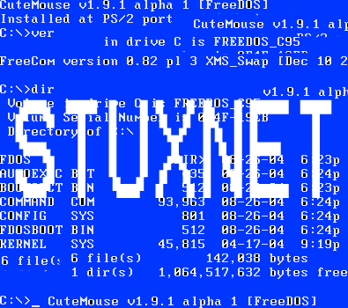




What is Computer Security Today?
Computing in the presence of an adversary!
Adversary is the security field’s defining characteristic
Reliability, robustness, and fault tolerance
Dealing with Mother Nature (random failures)
Security
Dealing with actions of a knowledgeable attacker dedicated to causing harm
Surviving malice, and not just mischance
Wherever there is an adversary, there is a computer security problem!
? ??? million
70-110 million users
.5 million
hosts
? ??? million
56 million users
BlackEnergy
SCADA malware
(Supervisory Control and Data Acquisition)
? ??? million
Mirai IoT botnet
83 million users

Slide 62
Protection vs. Security
Protection: mechanisms for controlling access of programs, processes, or users to resources
Page table mechanism
Round-robin schedule
Data encryption
Security: use of protection mechanisms to prevent misuse of resources
Misuse defined with respect to policy
E.g.: prevent exposure of certain sensitive information
E.g.: prevent unauthorized modification/deletion of data
Need to consider external operational environment
Most well-constructed system cannot protect information if user accidentally reveals password – social engineering challenge

Slide 63
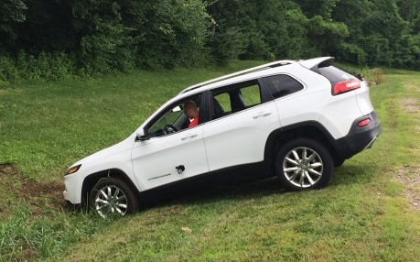
On The Importance of Data Integrity
Machine-to-Machine (M2M) communication has reached a dangerous tipping point
Cyber Physical Systems use models and behaviors that from elsewhere
Firmware, safety protocols, navigation systems, recommendations, …
IoT (whatever it is) is everywhere
Do you know where your data came from? PROVENANCE
Do you know that it is ordered properly? INTEGRITY
The rise of Fake Data!
Much worse than Fake News…
Corrupt the data, make the system behave very badly
In July (2015), a team of researchers took total control of a Jeep SUV remotely
They exploited a firmware update vulnerability and hijacked the vehicle over the Sprint cellular network
They could make it speed up, slow down and even veer off the road

Slide 64
Security Requirements
Authentication
Ensures that a user is who is claiming to be
Data integrity
Ensure that data is not changed from source to destination or after being written on a storage device
Confidentiality
Ensures that data is read only by authorized users
Non-repudiation
Sender/client can’t later claim didn’t send/write data
Receiver/server can’t claim didn’t receive/write data

Slide 65
Securing Communication: Cryptography
Cryptography: communication in the presence of adversaries
Studied for thousands of years
See the Simon Singh’s The Code Book for an excellent, highly readable history
Central goal: confidentiality
How to encode information so that an adversary can’t extract it, but a friend can
General premise: there is a key, possession of which allows decoding, but without which decoding is infeasible
Thus, key must be kept secret and not guessable

Slide 66
Basic Tool: Using Symmetric Keys
Same key for encryption and decryption
Achieves confidentiality
Vulnerable to tampering and replay attacks
Plaintext (m)
m
Internet
Encrypt with
secret key
Decrypt with
secret key
Ciphertext

Slide 67
Basic Tool: Secure Hash Function
Hash Function: Short summary of data (message)
For instance, h₁=H(M₁) is the hash of message M₁
h₁ fixed length, despite size of message M₁
Often, h₁ is called the “digest” of M₁
Hash function H is considered secure if
It is infeasible to find M₂ with h₁=H(M₂); i.e., can’t easily find other message with same digest as given message
It is infeasible to locate two messages, m₁ and m₂, which “collide”, i.e. for which H(m₁) = H(m₂)
A small change in a message changes many bits of digest/can’t tell anything about message given its hash
Fox
Hash
Function
DFCD3454BBEA788A
751A696C24D97009
CA992D17
The red fox
runs across
the ice
Hash
Function
52ED879E70F71D92
6EB6957008E03CE4
CA6945D3

Slide 68
Using Hashing for Integrity
plaintext (m)
corrupted msg
m
NO
=
digest’
Internet
Digest
HMAC(K,m)
Digest
HMAC(K,m)
Encrypted Digest
Unencrypted Message
Can encrypt m for confidentiality

Slide 69
Basic Tool: Public Key / Asymmetric Encryption
Sender uses receiver’s public key
Advertised to everyone
Receiver uses complementary private key
Must be kept secret
Plaintext
Plaintext
Internet
Encrypt with
public key
Decrypt with
private key
Ciphertext

Slide 70
Public Key Encryption Details
Idea: K_{public} can be made public, keep K_{private} private
Gives message privacy (restricted receiver):
Public keys (secure destination points) can be acquired by anyone/used by anyone
Only person with private key can decrypt message
What about authentication?
Use combination of private and public key
Alice→Bob: [(I’m Alice)^{Aprivate} Rest of message]^{Bpublic}
Provides restricted sender and receiver
But: how does Alice know that it was Bob who sent her B_{public}? And vice versa… Story for another time!
Insecure Channel
B_{public}
B_{private}
A_{private}
A_{public}
Alice
Insecure Channel
Bob

Slide 71
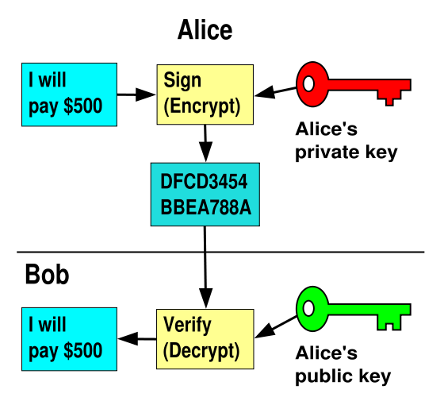
Public Key Crypto & Signatures
I will pay Bob $500
I will pay Bob $500

Slide 72
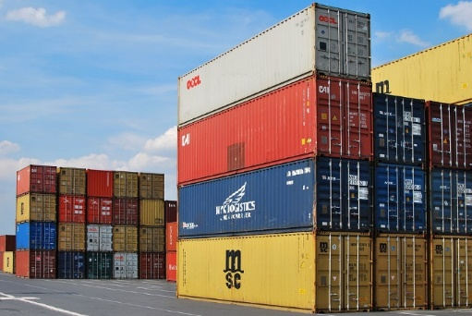
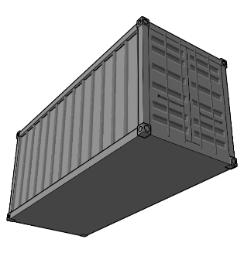
The Data-Centric Vision: Cryptographically Hardened Data Containers
Fiber
σ
0xABCD
Hole
Hash Ptr
σ
σ
Metadata Container
Signature
Inspiration: Shipping Containers
Invented in 1956. Changed everything!
Ships, trains, trucks, cranes handle standardized format containers
Each container has a unique ID
Can ship (and store) anything
Can we use this idea to help?
DataCapsule (DC):
Standardized metadata wrapped around opaque data transactions
Uniquely named and globally findable
Every transaction explicitly sequenced in a hash-chain history
Provenance enforced through signatures
Underlying infrastructure assists and improves performance
Anyone can verify validity, membership, and sequencing of transactions (like blockchain)

Slide 73
Refactoring of Applications around Security, Integrity, and Provenance of Information
Goal: A thin Standardized entity that can be easily adopted and have immediate impact
Can be embedded in edge environments
Can be exploited in the cloud
Natural adjunct to Secure Enclaves for computation
DataCapsules ⇒ bottom-half of a blockchain?
Or a GIT-style version history
Simplest mode: a secure log of information
Universal unique name ⇒ permanent reference
Applications writers think in terms of traditional storage access patterns:
File Systems, Data Bases, Key-Value stores
Called Common Access APIs (CAAPIs)
DataCapsules are always the Ground Truth
Home Control, Smart Office
Industrial Internet, …
Application
File System, Stream,
SQL, Key-value,…
Common Access
APIs (CAAPI)
Global Data Plane
DataCapsules /
Secure Routing
TCP/IP, UDP/IP, Others (non-IP), …
Network
Ethernet, WI-FI,
Bluetooth, 802.15.4, AVB,…
Physical

Slide 74
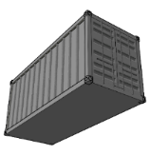
Global Data Plane (GDP) and the Secure Datagram Routing Protocol
Trust Domain #1 (EDGE)
Trust Domain #2 (EDGE)
C₁
C₃
C₇
C₂
C₄
C₅
C₆
Service Provider
Flat Address Space Routing
Route queries to DCs by names, independent of location (e.g. no IP)
DCs move, network deals with it
Short-term Channels (“μ-SSL channels”)
Black Hole Elimination
Only servers authorized by owner of DC may advertise DC service
Routing only through domains you trust!
Secure Delegated Flat Address Routing
Secure Multicast Protocol
Only clients/DC storage servers with proper (delegation) certificates may join
Queries (messages) are Fibers
Self-verifying chunks of DataCapsules
Writes include appropriate credentials
Reads include proofs of membership
Incremental deployment as an overlay
Prototype tunneling protocol (“GDPinUDP”)
Federated infrastructure w/routing certificates

Slide 75
Summary (1/2)
Distributed File System:
Transparent access to files stored on a remote disk
Caching for performance
VFS: Virtual File System layer
Provides mechanism which gives same system call interface for different types of file systems
Cache Consistency: Keeping client caches consistent with one another
If multiple clients, some reading and some writing, how do stale cached copies get updated?
NFS: check periodically for changes
AFS: clients register callbacks to be notified by server of changes

Slide 76
Summary (2/2)
Key-Value Store:
Two operations
put(key, value)
value = get(key)
Challenges
Fault Tolerance → replication
Scalability → serve get()’s in parallel; replicate/cache hot tuples
Consistency → quorum consensus to improve put() performance
Chord:
Highly scalable distributed lookup protocol
Each node needs to know about O(log(M)), where m is the total number of nodes
Guarantees that a tuple is found in O(log(M)) steps
Highly resilient: works with high probability even if half of nodes fail

Slide 77
Thank you!
File Systems
Address Space
Concurrency
Reliability, Security, Cloud
Distributed Systems
OS Concepts
intro
Thanks for all your great questions!
Good Bye!

