Slide 1
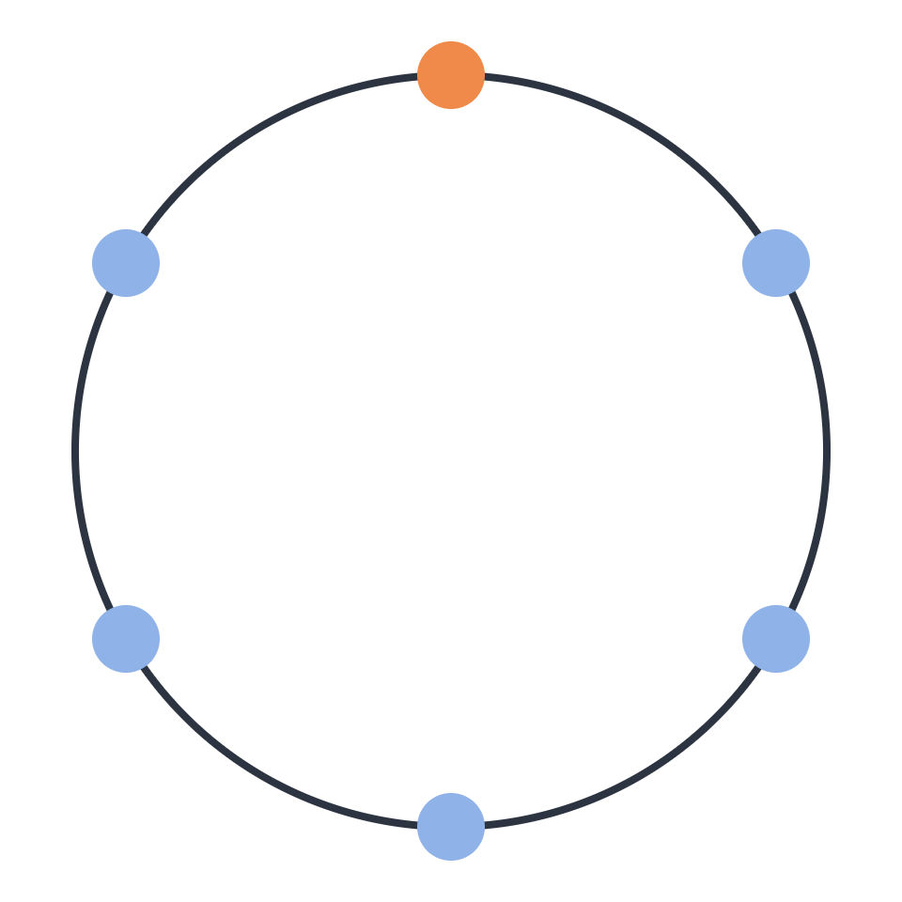
The AI-native
SDLC
How agents change every stage of the lifecycle, from plan to production. A 10-minute intro to the playbook.
Anatolii Pastushuk · October 2026
Notes:
Welcome. This is a 10-minute appetizer for Anthropic's "AI-native SDLC playbook" — a 40-minute read I'd like everyone to go through before or during the retreat. Goal today: give you the map, so the full article is easy to digest, and seed a few discussion questions for us.

Slide 2
Code is no longer the bottleneck
WHY NOW
Agents write code faster than the process around it can absorb. When build shrinks from weeks to hours, three things happen:
01
02
03
The bottleneck moves
Controls stop matching reality
Governance gets expensive
Plan, review, test and deploy still run at human speed.
Reading every line by hand can't keep up once agents write most of the diff.
Exceptions still wait for meetings and committees that meet weekly or monthly.
02 · The AI-native SDLC
Notes:
The playbook's starting point: our SDLC — gates, reviews, handoffs, sign-offs — was designed for a world where writing code was the slowest, most expensive step. PRDs and estimation rituals existed to align people before weeks of coding. Now an agent can do the build in hours, so the slow parts are everything around it. Example from the article: security teams are sized for human output. When agents multiply output, either the review queue grows or code ships under-reviewed — neither is acceptable. So the rest of the lifecycle needs the same transformation the coding step already had.

Slide 3

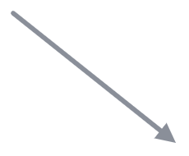
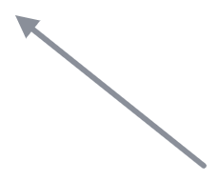
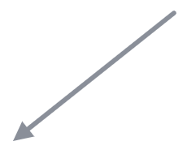
From a line to a loop
THE BIG SHIFT
Plan
Traditional: six phases, each owned by a different role, joined by documents, tickets and sign-offs.
Maintain
Design
AI-native: the same six stages with AI embedded in each. Handoffs are automated, and problems found in production restart the loop.
AI embedded at every stage
Humans stay accountable for every decision that needs judgment. Their attention moves to the gates.
Deploy
Build
Test
03 · The AI-native SDLC
Notes:
The stages are the familiar ones: plan, design, build, test, deploy, maintain. What changes is the shape. Traditionally it's a line of phases owned by different roles — PM, architect, engineer, QA, release, ops — and work moves by documents and sign-offs. In the AI-native version it's a loop: Claude is embedded in each stage, handoffs trigger automatically, and maintenance feeds new work back into planning (the orange arrow). Important: this is not "remove the humans". People stay accountable for every judgment call — but their attention shifts from doing each step to reviewing at the gates.

Slide 4
Every stage commits an artifact
THE COMMON THREAD
1 · Plan
2 · Design
3 · Build
4 · Test
5 · Deploy
6 · Maintain
intent.md
spec.md
plan.md + diff
tests + output
PR + review findings
incident → new intent.md
Humans and agents read and act on the same files. The chain of commits is the audit trail: who asked for what, what the agent produced, who approved it.
Accepting an artifact fires the next stage: an accepted intent starts design, an approved spec starts planning, a merged PR starts the pipeline, a production alarm writes the next intent.
04 · The AI-native SDLC
Notes:
This is the single most useful idea in the article. Each stage ends by writing something to version control, and the next stage starts by reading it. Early on these are markdown files — intent.md, spec.md, plan.md — because both a product owner and an agent can read and act on the same file. From Build onward it's code, tests and the PR with review findings. Two consequences: first, handoffs can be automated — accepting one artifact triggers the next step. Second, governance comes for free: git history shows who asked for what, what the agent did and who approved it. The article also has a sidebar on legacy tools like Jira: pick one system as the source of truth per artifact, or at minimum link them both ways.

Slide 5
Intent first, then a spec
STAGES 1–2 · PLAN & DESIGN
intent.md
spec.md
Capture the idea once
Requirements and design in one session
The person with the idea brainstorms it with Claude in plain words. Claude writes intent.md: problem, outcome, users, constraints, open questions. The product owner accepts it.
Claude turns the accepted intent into a spec, applying security, UX and brand standards as skills. Conflicts get flagged. A human decides if it goes to build.
The payoff: idea to committed intent in hours instead of weeks of refinement, and policy applied while the spec is written rather than in a review weeks later.
05 · The AI-native SDLC
Notes:
Now a quick walk through the six stages. Plan: instead of an idea passing through backlog entries, user stories and refinement meetings — losing meaning at every handoff — the originator brainstorms with Claude, which asks the questions an analyst would ask, and writes intent.md using an agreed template. The product owner reviews and accepts it. Design: the accepted intent goes to Claude, which produces spec.md in one session, guided by the organization's standards encoded as skills. It flags areas of concern, especially conflicting policies. A human still decides whether it proceeds. Later this can be fully triggered: merging an intent.md kicks off the spec pass automatically.

Slide 6




Plan first, then guardrails as code
STAGE 3 · BUILD
Plan mode
CLAUDE.md
Skills
Hooks
Claude reads the code and proposes files, order and tests. Nothing is edited until the engineer accepts. Saved as plan.md.
What a new joiner needs: commands, conventions, known pitfalls. Same mistake twice? It goes in the file.
Institutional knowledge as versioned instructions. Advisory: they make policy violations rare.
Deterministic checks on every action: block protected paths, run the linter, keep secrets out. Violations become near-impossible.
Then scale out: parallel sessions in separate git worktrees, plus subagents for repeated jobs. The engineer's role shifts to steering and reviewing.
06 · The AI-native SDLC
Notes:
Build is where most of us already use AI, but the playbook adds structure. One: start in plan mode. Claude can read but not edit, proposes which files change, in what order, and which tests prove it. You interrogate the plan, then commit it as plan.md — with a good plan, implementation is often a single pass. Two: CLAUDE.md — under a page, checked into the repo, the rule being "same mistake twice, it goes in". Three: skills for knowledge that must be applied consistently, like a security standard. Skills are advisory. Four: hooks are the deterministic layer behind them. Skill makes a violation rare; hook makes it close to impossible. Once that's in place, one engineer can run two or three sessions in parallel — the limit is how much you can properly review.

Slide 7



The agent checks its own work
STAGE 4 · TEST
A feedback loop
Always give Claude a way to verify its work: tests, a build, a screenshot.
One command each for build and test, a measurable target, and "done" means the checks passed.
Failing test first
It iterates until the check passes, so what reaches you has already passed it.
For bugs: reproduce it as a test, confirm it fails, then fix the code without touching the test.
Continuous evals
20–50 real tasks re-run whenever CLAUDE.md, skills or hooks change. The agent's config gets regression tests too.
07 · The AI-native SDLC
Notes:
Traditionally the signal that code works arrives late — CI minutes later, a tester days later, production weeks later. With agents producing the code, a late signal means a human has to check everything, and that human becomes the bottleneck. So: give the session a way to check itself. Wrap build and test into single commands, list them in CLAUDE.md, state a measurable target. For bug fixes, write the failing test first and forbid the agent from editing it — a hook can enforce that, because an agent fixing code must not be able to weaken the check. The second play is evals: a suite of real tasks that runs whenever the agent's configuration changes or a model is swapped, so CLAUDE.md and skills get regression-tested just like code. Every production incident becomes a new eval.

Slide 8
Agents review, humans approve
STAGE 5 · DEPLOY
AI in the PR loop
Hooks as approval gates
Every PR gets the same passes (bugs, security, match with spec.md and plan.md), ranked by severity. Tag @claude on a comment and it pushes the fix.
A hook can allow, ask or block before Claude acts. Non-negotiable gates live in managed settings that engineers can't switch off.
The agent may act up to the production gate, and never past it.
Separation of duties holds: the agent that wrote the code has no way to approve it.
08 · The AI-native SDLC
Notes:
Review capacity was planned around human output. With agents writing most of the diff, line-by-line human review doesn't scale. So Claude both gives and receives reviews: every PR gets identical review passes defined in a REVIEW.md, findings ranked by severity, and Claude addresses review comments on its own PRs. Humans move up a level: does the change do what the plan intended, and is the risk acceptable? Branch protection still requires a code owner's approval. Hooks also act as approval gates — e.g. a production deploy is blocked unless there's a release authorization. And CI/CD gets tiered autonomy: in dev the agent deploys freely; in production it prepares the release and a named person authorizes it.

Slide 9
The loop closes itself
STAGE 6 · MAINTAIN
Detection stays deterministic. A script watches a metric against its rolling baseline; no model decides when to wake up.
1σ
Log it
A record, nothing more.
Findings become a new intent.md and flow through the stages like any other idea.
2σ
Diagnose
Claude investigates with read-only tools.
Same pattern for scheduled security scans and incidents raised in team chat.
Propose
3σ
A PR into the review gate, or a pre-approved runbook such as rollback.
09 · The AI-native SDLC
Notes:
Up to now a human starts each stage. Maintain is where the loop runs on its own. A plain script — no AI — watches a metric like CI failure rate or post-deploy 5xx rate against a rolling baseline. The response tiers are in version-controlled config: at one sigma just log, at two sigma Claude diagnoses read-only, at three sigma Claude may act, but only by opening a PR into the normal review gate or running a pre-approved runbook like rollback. Whatever it finds is written as a new intent.md, so it re-enters the loop at Plan. A human triages: fix now, schedule, or dismiss. The article applies the same idea to recurring security scans and to Claude responding in incident channels.

Slide 10
Plays we could try first
GETTING STARTED
01
02
03
04
A CLAUDE.md per repo
One-command checks
Plan mode by default
One skill, one hook
Encode one convention we enforce inconsistently, and back the must-haves with a hook.
Run /init, trim it to one page, commit it. When Claude repeats a mistake, the fix goes in.
Build and test that Claude can run itself, e.g. dotnet build and dotnet test, listed in CLAUDE.md.
A reviewed plan.md before code for anything non-trivial.
None of these depends on anything else being in place first. Small, cheap, and they make every later play easier.
10 · The AI-native SDLC
Notes:
The article is explicit that the plays are modular — you don't transform everything at once. It includes a dependency graph, and several plays have no prerequisites at all. These four are the ones I think fit us best as a first step: a CLAUDE.md in each repo, one-command build and test so the agent can verify itself, plan mode as the default for non-trivial changes, and turning one inconsistently enforced convention into a skill, with a hook behind anything that must always hold. Adjust this slide to whatever we already have in place.

Slide 11
Questions to bring
FOR THE RETREAT
01
Which stage is our real bottleneck today?
02
What would go into our first CLAUDE.md?
03
Which controls must stay human, and which could become hooks?
"The loop keeps running. Human judgement stays above it." — from the playbook
Full playbook (about 40 min): claude.com/resources/articles/the-ai-native-sdlc-playbook
Notes:
That's the map. Please read the full playbook before or during the retreat — each stage has concrete steps, example files (intent.md, CLAUDE.md, REVIEW.md, hooks, settings) and how to measure whether it worked. There's also a PDF version for offline reading. Three questions I'd like us to come with: where our real bottleneck is, what our first CLAUDE.md would contain, and which of our controls need to stay human versus which could be enforced as hooks.

