Slide 1
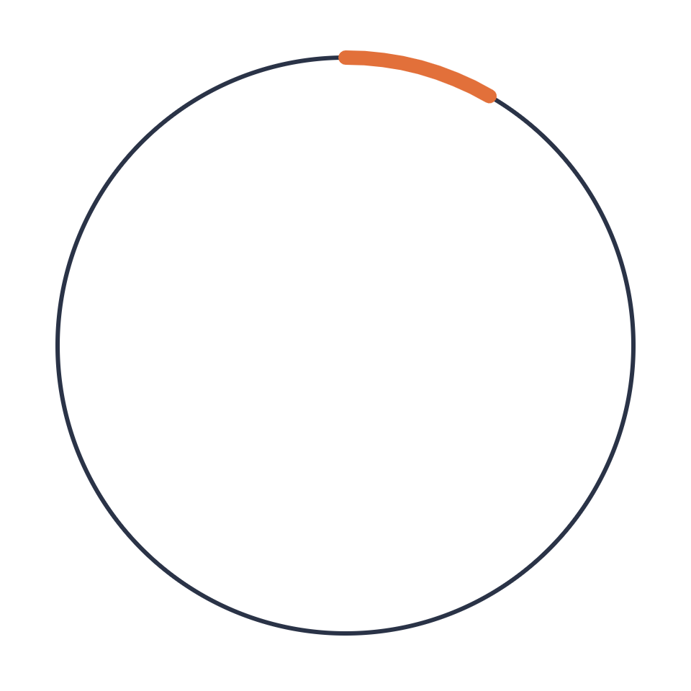
Under the Hood
Foundations of agentic development
ANATOLII PASTUSHUK OCTOBER 2026
Notes:
Welcome everyone. This is the foundations talk, the one that explains what is actually happening under the hood when we work with an AI coding agent. Why a separate talk? Because the other sessions, on the SDLC and on methodology, assume we share a mental model of how agents work. Most of the practical advice you will hear, like keeping sessions short or writing specs first, sounds like folklore until you understand the mechanics behind it. Once you see the mechanics, the advice becomes obvious. One promise for the next hour: no magic. An agent is a model, a loop, some tools and a context window. Everything else follows from those four things. Notice the orange ring. It fills a little more at the start of each part, so you always know where we are.

Slide 2
Six parts
AGENDA
01
The problem
Why “almost right” is the real risk
02
Under the hood
The loop, the harness, the context window
03
From prompts to context
What the model sees matters most
04
The context toolkit
CLAUDE.md, skills, subagents, hooks
05
Team practices
Tools, git and security
06
Back to the problem
Each tool mapped to the risk it fixes
Notes:
Here is the route. Six parts. We start with the problem: AI output that is almost right, and why that is more dangerous than output that is obviously wrong. Then we go under the hood: the agent loop, the harness around the model, and the context window, which is the single most important concept today. Part three is a short bridge from prompt engineering to context engineering. Part four is the toolkit: CLAUDE.md, skills, subagents and hooks. Each one is an answer to the same question: what should the model see, and when? Part five is team practice: one tool or many, what goes into git, and security. And we finish by going back to the problem, mapping every tool to the risk it addresses. If you only remember one slide, make it that last table.

Slide 3
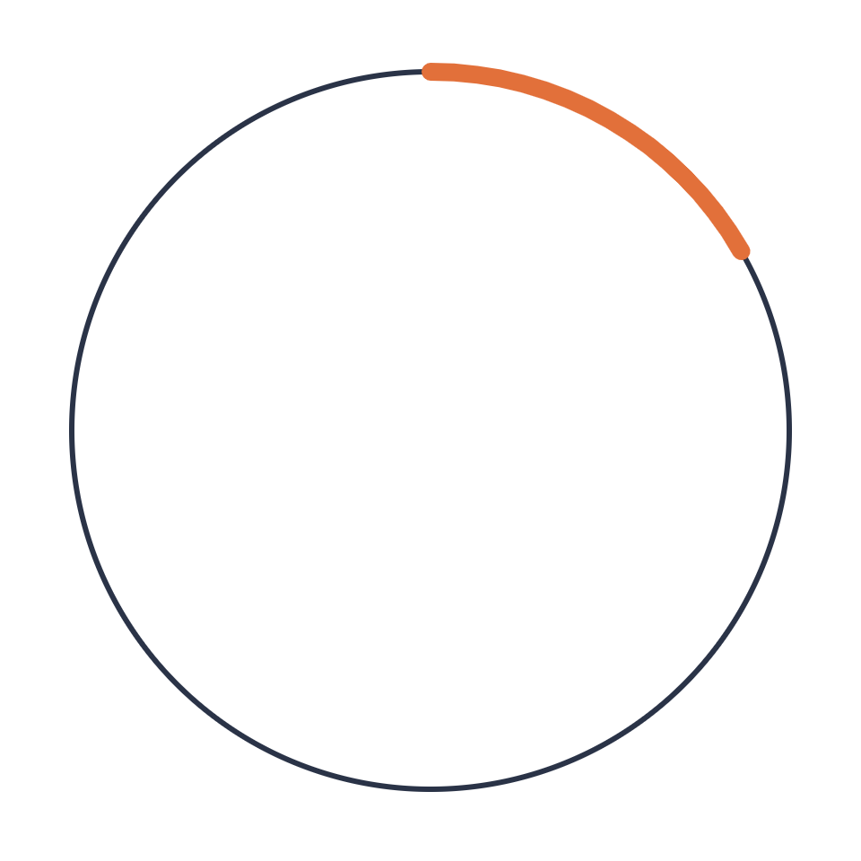
The problem
PART 01 OF 06
Why “almost right” is the real risk
Notes:
Part one. Before we talk about how agents work, let us be honest about what goes wrong with them. The failure mode that matters most is not the dramatic one.

Slide 4
The most common frustration
01 · THE PROBLEM
66%
45%
say debugging AI-generated code takes more time
of developers name “almost right, but not quite” as a problem they run into with AI solutions
46%
actively distrust AI accuracy, while 33% trust it
Source: Stack Overflow Developer Survey 2025 · 49,000+ respondents in 177 countries
Notes:
This is from the 2025 Stack Overflow Developer Survey, with more than 49,000 respondents in 177 countries, most of them with over ten years of experience. So these are not beginners. Sixty-six percent named "AI solutions that are almost right, but not quite" as a problem they run into. It was the most common frustration in the survey. Be careful with the wording if someone asks. The 66 percent is the share of developers who report this frustration. It does not mean 66 percent of AI output is almost correct. On the right: 45 percent say debugging AI-generated code takes more time, and more developers actively distrust AI accuracy, 46 percent, than trust it, 33 percent. Why does almost right happen at all? A model writes the most plausible code given what is in its context. If your invariants, your conventions, your edge cases are not in that context, it fills the gaps with generic patterns. The result compiles, looks idiomatic, and is subtly wrong for our system. Keep that sentence in mind: "given what is in its context." The whole talk hangs on it.

Slide 5
Trust now depends on verification
01 · THE PROBLEM
6.6%
26.2%
24%
would trust AI with an important decision
use automated agent workflows
say their employer has approved tools or an official AI policy
Nearly half say they trust AI output when they can verify it themselves.
Source: Stack Overflow Developer Survey 2026 (published October 6, 2026) · 30,000+ respondents in 169 countries
Notes:
A fresh data point. The 2026 survey results were published on October 6, so this is about a week old. Over 30,000 respondents in 169 countries. Only 6.6 percent would trust AI with an important decision. About a quarter, 26.2 percent, already use automated agent workflows. And only 24 percent say their employer has approved tools or an official AI policy. The line at the bottom is the key one: nearly half say they trust AI output when they can verify it themselves. Trust has become conditional on verification. That gives us two takeaways. First, verification is the thing that makes agents trustworthy, and we will come back to it in part four. Second, most companies have no guidance yet. Sessions like this retreat are exactly how a team builds that guidance. I have not confirmed whether the "almost right" question was repeated in 2026, so I am not quoting a 2026 number for it.

Slide 6

How “almost right” compounds
01 · THE PROBLEM
01
02
03
04
Plausible
Approved
Merged
Repeated
Fits generic patterns, not your invariants
Compiles, looks idiomatic, passes a quick review
Review fatigue grows with volume
The next agent copies it as precedent
The result is comprehension debt: code the team didn’t write and doesn’t fully understand. And imperfectness piles up.
Notes:
Here is why almost right is worse than obviously wrong. Broken code fails loudly. Almost right code gets merged. Walk the chain. It is plausible: it fits generic patterns, not our invariants. It gets approved: it compiles, looks idiomatic, passes a quick look. It gets merged, and as AI increases the volume of code, review attention stays the same, so review fatigue grows. And then the subtle part: the next agent reads that code as precedent. Agents learn from the codebase they are working in. A bad pattern that got merged becomes a pattern that gets repeated. That is the rot. Not one bad commit, but hundreds of small "fine for now" decisions that reinforce each other. The bottom line names the result: comprehension debt. Code the team did not write and does not fully understand. Technical debt you at least chose; comprehension debt you can accumulate without noticing. Transition: so how do we fight it? First we need to understand where the output comes from.

Slide 7
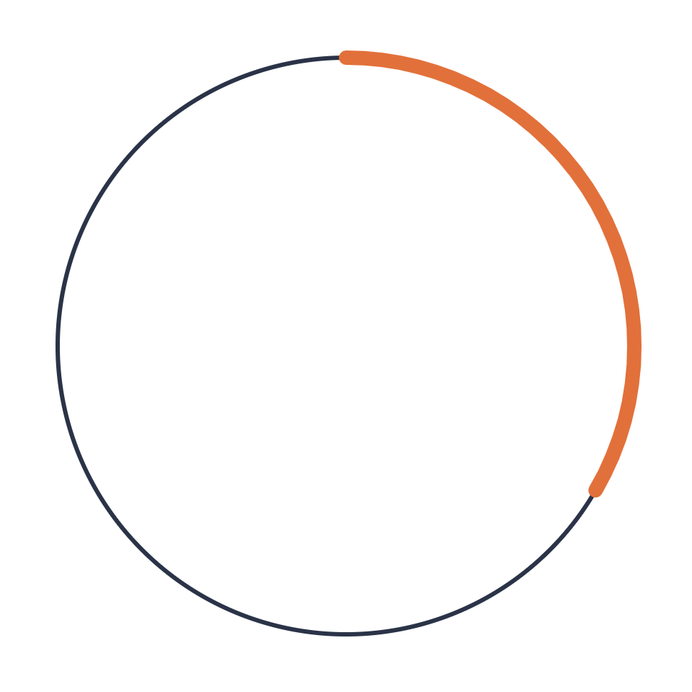
Under the hood
PART 02 OF 06
What actually happens between your prompt and the diff
Notes:
Part two, under the hood. What actually happens between the moment you press enter and the moment a diff appears.

Slide 8



The agentic loop
02 · UNDER THE HOOD
01
02
03
04
Context
Decide
Act
Observe
Everything the model can see
The model picks the next step
Edit a file, run a command
The result joins the context
repeat until the task is done, or you stop it
Every turn re-reads the whole context, and every tool result makes it bigger.
Notes:
This is the most important diagram of the talk. An agent is a model running in a loop. One: context. Everything the model can see: the instructions, your request, the files it has read, the history so far. Two: decide. The model reads all of that and picks the next step. That is all a model ever does: given this text, what comes next. Three: act. The next step is often a tool call: read a file, edit a file, run the tests, search the code. The harness executes it. The model itself cannot touch your disk; the tools do. Four: observe. The tool's result, the file contents, the test output, the error message, is appended to the context. And we go around again. It repeats until the task is done or you stop it. Two consequences to notice now, because the rest of the talk follows from them. First, every turn re-reads the whole context, so the context keeps growing. Second, the loop is what makes verification possible: if the agent can run the tests, it can observe its own mistakes and fix them before you ever see them. A chatbot cannot do that. An agent can.

Slide 9
Same model, different harness
02 · UNDER THE HOOD
Environment | System prompt by | What you add | Tools
claude.ai (web) | Anthropic | Project instructions, preferences, styles | Search, artifacts, connectors
Desktop app | Anthropic | Same as web | Plus local MCP, Cowork, Claude Code
Claude Code | Anthropic, tuned for coding | CLAUDE.md, skills, MCP servers | Files, shell, git, subagents
API | You | Everything you send | Whatever you define
The model is the same everywhere. The harness decides what it sees and what it can do.
Notes:
Same model, different harness. People often say "Claude behaved differently in the web app than in Claude Code." That is expected. The model is the same. What differs is the harness: the software around the model that writes the system prompt, defines the tools and decides what goes into context. In the web app and the desktop app, Anthropic writes the system prompt. You add layers on top: project instructions, user preferences, styles. Tools are search, artifacts and connectors. The desktop app adds local MCP servers, Cowork, and a Claude Code tab. In Claude Code, the system prompt is tuned for agentic coding. Before you type a word, it also loads tool definitions, your CLAUDE.md files, skill descriptions and MCP tool schemas. The tools are real: files, shell, git, subagents. With the API you write the whole system prompt yourself, and the model gets exactly what you send and nothing else. Think of layers: product system prompt, then project-level instructions, then your message. If you ever wonder why behavior differs, ask: which harness, and what did it put in the context? A nice demo if time allows: ask the same question in the web app and in Claude Code and compare.

Slide 10
What’s in the context window
02 · UNDER THE HOOD
FIXED COST
GROWS EVERY TURN
Loaded before you type
Added as you work
System prompt
Tool definitions
MCP tool schemas
CLAUDE.md files
Skill names and descriptions
Your messages
Files the agent reads
Tool output: tests, logs, search
The agent’s own replies
/context
shows the real breakdown for your session. The whole window is processed again on every turn.
Notes:
What is actually in the context window? Not just your chat. On the left, the fixed cost, loaded before you type anything: the system prompt, tool definitions, MCP tool schemas, every CLAUDE.md file in scope, and the names and descriptions of all available skills. Every MCP server you connect adds its tool schemas here, which is why connecting ten servers you rarely use has a cost. On the right, what grows every turn: your messages, every file the agent reads, every tool output, including test logs, stack traces and search results, and the agent's own replies. And remember from the loop: the whole window is processed again on every turn. The practical tool here is the /context command in Claude Code. It shows a breakdown of what fills your window right now. This is a great live demo: run /context in a real session that has been going for a while and let people see how much of it is tool output they never read. A context window of 200K or even a million tokens is a capacity limit. It is not a promise that the model pays equal attention to all of it. Which brings us to the next slide.

Slide 11
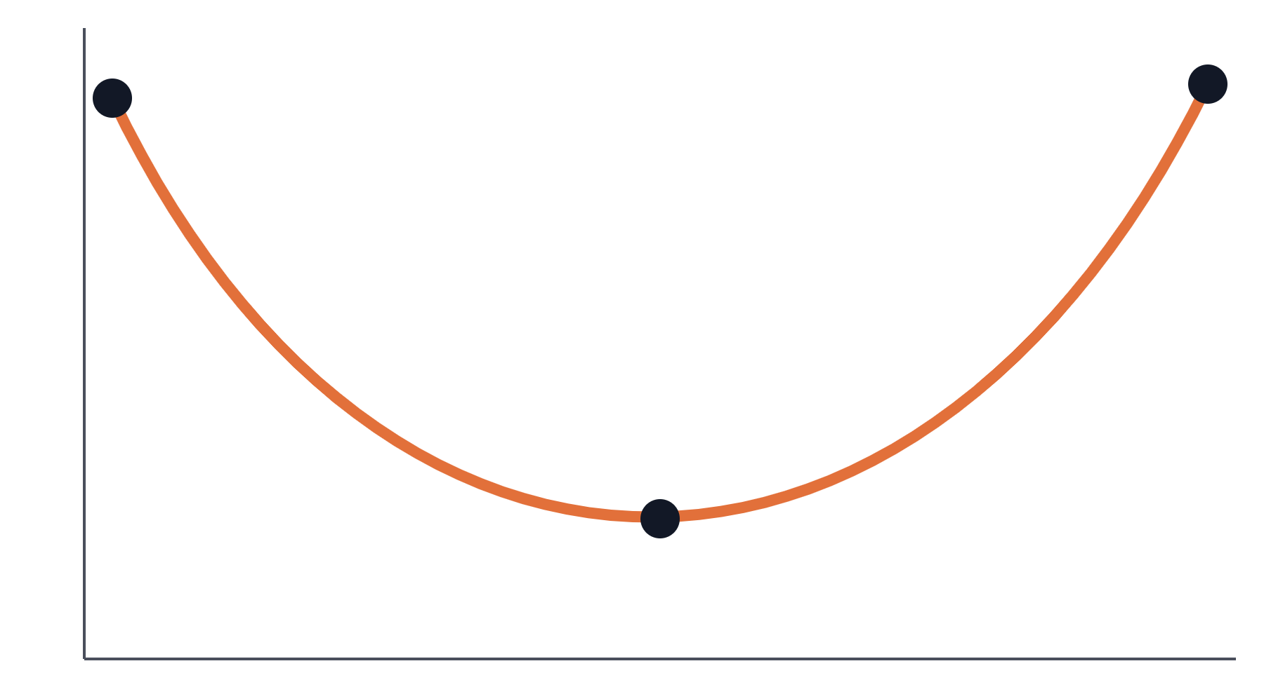
Lost in the middle
02 · UNDER THE HOOD
Accuracy
The finding. Accuracy was highest when the relevant information sat at the start or end of a long context, and dropped in the middle.
The nuance. Later benchmarks show the effect varies by model and task.
The rule. Long documents first, your question last.
Start
Middle
End
Position of the relevant information in the context
Source: Liu et al., “Lost in the Middle: How Language Models Use Long Contexts” (2023). Curve is illustrative.
Notes:
Lost in the middle. A 2023 paper by Liu and colleagues tested how well models use information depending on where it sits in a long context. They hid the relevant document among distractors and moved it around. The result was a U-shaped curve: accuracy was highest when the relevant information was at the very beginning or the very end, and dropped in the middle. It held even for models designed for long contexts. The curve on the slide is an illustration of that shape, not their exact data. Be honest about the nuance, because a sharp colleague may raise it. Later benchmarks found the effect varies by model and task, and some newer models are much flatter. So position bias is real but not universal. The practical rule survives either way: when you give a model a big chunk of material, put long documents first and your question or instructions last. Anthropic's own prompting guidance says the same. The bigger, more general problem is not where information sits but how much of it there is. That is the next slide.

Slide 12
Aim for “the smallest possible set of high-signal tokens.”
CONTEXT ENGINEERING
Every token spends attention budget. As the window fills, accuracy degrades: context rot.
Source: Anthropic, “Effective context engineering for AI agents” (September 2025)
Notes:
This is the one sentence to take home from part two. It comes from Anthropic's engineering post "Effective context engineering for AI agents," September 2025. Their framing: like humans with limited working memory, models have an attention budget. Every token you add spends some of it. As the context grows, the model's ability to relate everything to everything gets stretched thin. Anthropic calls the resulting degradation context rot. So the goal is not "give the model as much as possible." The goal is the smallest possible set of high-signal tokens that gets the result you want. Pause here for a moment. Most of us instinctively do the opposite: paste the whole log, attach every file, keep one session going all day "so it remembers." That instinct is exactly what causes the drift we see later in long sessions.

Slide 13
Context burnout: symptoms and fixes
02 · UNDER THE HOOD
SYMPTOMS
FIXES
The session is wearing out
Give it a fresh, focused window
Forgets decisions made earlier
Repeats mistakes you already fixed
Ignores constraints from the start
Gets slower and more expensive
Clear between unrelated tasks
Compact with a focus note
Delegate noisy work to subagents
Keep plans and progress in files
Fetch just in time instead of pasting
Notes:
Context burnout in practice. How do you recognize it? The agent forgets decisions you made an hour ago. It repeats a mistake you already corrected. It ignores a constraint you gave at the start. And everything gets slower and more expensive, because every turn re-processes a huge window. Very large sessions can even make the tool itself feel sluggish. The fixes all follow from the attention budget. Clear between unrelated tasks. A fresh window is not a loss; it is a reset of attention. When you must continue the same task, compact with a focus note. Compaction summarizes, and summaries are lossy, so tell it what matters. Delegate noisy work, like searching a big codebase, to subagents. We will cover them in part four. Keep plans and progress in files, not only in the conversation. A file survives a clear; the conversation does not. And fetch just in time: let the agent grep and open the one file it needs instead of pasting everything up front.

Slide 14
Five commands to know
02 · UNDER THE HOOD
COMMAND
WHAT IT DOES
REACH FOR IT WHEN
/context
Shows what fills the window
Before deciding to clear or compact
/clear
Starts with an empty context
Switching to unrelated work
/compact [focus]
Summarizes the session so far
Same task, window getting full
/rewind (Esc Esc)
Rolls back code and/or conversation
An edit went wrong
/usage
Shows cost and plan limits
Watching the budget
Command names change between versions. Check /help on the version your team runs.
Notes:
Five commands that run most of the day in Claude Code. /context shows what fills the window. Use it before you decide whether to clear or compact. /clear starts with an empty context. Use it when you switch to unrelated work. /compact, optionally with a focus, summarizes the session so far to free space. Use it when you are still on the same task but the window is filling up. The rule of thumb: compact to continue, clear to switch. /rewind, or Escape twice, rolls back code and conversation, or both, to an earlier checkpoint. This is your undo button when an edit goes wrong. Claude Code snapshots files before edits, which is what makes this possible. /usage shows cost and plan limits. Short version: /context is about the context window, /usage is about money and quotas. Other useful ones to mention verbally: /init drafts a CLAUDE.md, /memory edits your CLAUDE.md files, /agents manages subagents, /model switches models, and Shift+Tab toggles plan mode. The footer matters: command names change between versions. Check /help on the version your team actually runs.

Slide 15
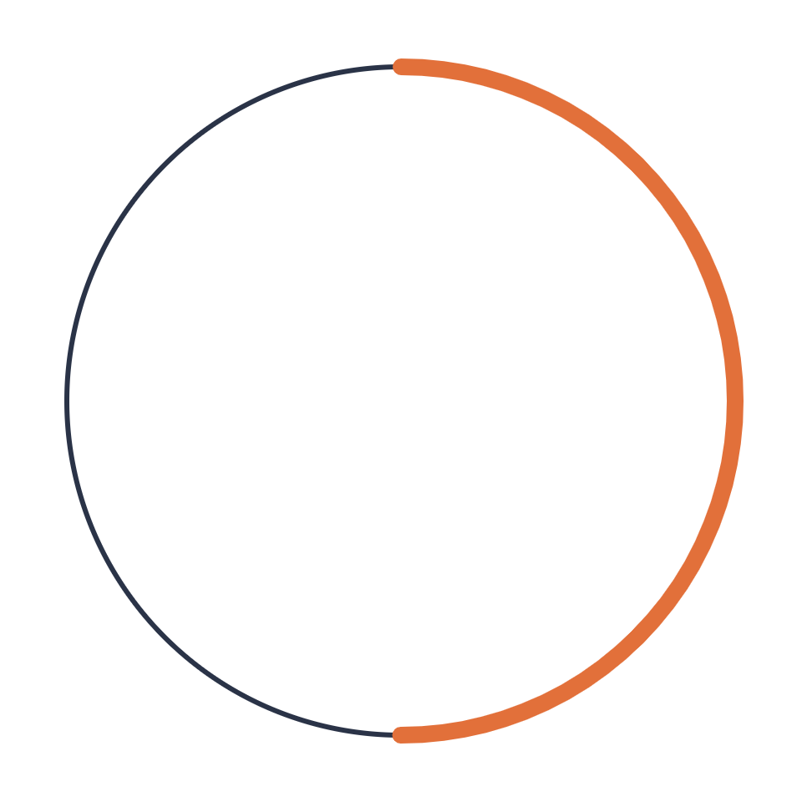
From prompts to context
PART 03 OF 06
What the model sees matters more than how you phrase it
Notes:
Part three is a short bridge. We know now that the context is what matters. So how should we think about the text we write for the model?

Slide 16
Prompt vs context engineering
03 · FROM PROMPTS TO CONTEXT
ONE MESSAGE
EVERY TURN
Prompt engineering
Context engineering
How you write the instruction: clear, structured, with examples.
What the model sees: instructions, tools, files, history and results, curated as the session runs.
Anthropic describes context engineering as the natural progression of prompt engineering.
Notes:
Prompt engineering versus context engineering. Prompt engineering is about how you write one instruction: clear, structured, with examples. It is still useful, and the next slide covers the essentials. Context engineering is broader. It is about everything the model sees across every turn: instructions, tool definitions, files, history and tool results, and curating that as the session runs. With a chatbot, the prompt was most of the context. With an agent that runs fifty tool calls, your prompt is a small fraction of what is in the window. Anthropic describes context engineering as the natural progression of prompt engineering, not a replacement. A clear prompt with the wrong material fails. All the right material with a vague instruction also fails. You need both. Part four is really a catalogue of context engineering tools.

Slide 17
Prompting essentials
03 · FROM PROMPTS TO CONTEXT
Be clear and direct
Explain why
Show examples
Brief it like a smart new hire with zero context.
The reason behind a rule helps it generalize.
One good example beats a paragraph of description.
Structure with tags
Plan before acting
Mind the order
Separate instructions, context and data, e.g. with XML tags.
Ask for a plan first. In Claude Code, use plan mode.
Long documents first, the question last.
Notes:
Six prompting essentials from Anthropic's guidance. Each one is quick. Be clear and direct. Brief the model like a brilliant new hire who has zero context about our project. If a new colleague would need to ask a follow-up question, the model needs that answer in the prompt. Explain why. "Never use ellipses" is weaker than "this text is read by a text-to-speech engine, so never use ellipses." The reason lets the model generalize to cases you did not list. Show examples. One good example of the output you want beats a paragraph describing it. Structure with tags. Separate instructions, context and data, for example with XML tags, so the model never confuses your data for an instruction. Plan before acting. Ask for a plan first, and in Claude Code use plan mode, where it explores and proposes but does not edit. Reviewing a plan is far cheaper than reviewing a wrong diff. Mind the order. Long documents first, question last, as we saw with lost in the middle. One more worth saying out loud: recent models follow instructions quite literally. If you want it to go beyond the request, ask explicitly.

Slide 18
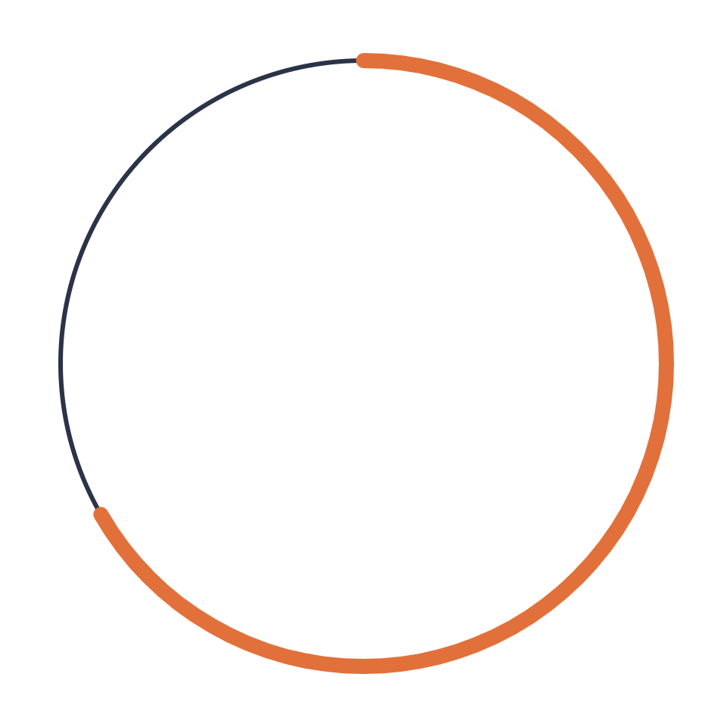
The context toolkit
PART 04 OF 06
CLAUDE.md, skills, subagents and hooks
Notes:
Part four, the context toolkit. Each tool here answers the same three questions: what goes into context, when, and in whose window.

Slide 19
Standing instructions: CLAUDE.md
04 · THE CONTEXT TOOLKIT
Loaded into every session: an onboarding doc for a colleague who forgets everything overnight.
How it loads
~/.claude/CLAUDE.md
Drafted by /init, then curated by the team
Versioned and reviewed like code
Short: every line costs attention, every session
Personal, every project
./CLAUDE.md
Team, committed to the repo
CLAUDE.local.md
Personal, this repo only
.claude/rules/*.md
Scoped rules, loaded when relevant
Notes:
CLAUDE.md, the project's standing instructions. Every Claude Code session starts with a fresh context window. CLAUDE.md is how project knowledge survives between sessions: it is loaded into every session automatically. The best mental model: an onboarding document for a brilliant colleague who forgets everything overnight. How it loads, on the right. A personal file in your home folder applies to every project. The CLAUDE.md in the repo is the team's, committed and shared. Claude Code walks up the directory tree from where you start, loading CLAUDE.md files along the way, plus CLAUDE.local.md for personal, repo-specific notes. And files in .claude/rules can be scoped so they load only when relevant. Who writes it? The /init command drafts a first version from the repo. After that, it is a team artifact: versioned and reviewed in merge requests like code, and pruned regularly. And keep it short. Anthropic's guidance suggests well under a couple of hundred lines. Remember the attention budget: every line in CLAUDE.md is paid for in every single session. A bloated CLAUDE.md is a tax on all of your work. There is also auto memory, notes Claude writes for itself from your corrections. Useful, but if it captures a real team decision, move that decision into a versioned file.

Slide 20
What belongs in CLAUDE.md
04 · THE CONTEXT TOOLKIT
BELONGS
LEAVE OUT
Keep it here
Put it elsewhere
Build and test commands
Conventions a model wouldn’t guess
Known pitfalls and gotchas
Pointers to architecture docs
Rules a linter already enforces
Long reference material: use a skill
Anything stale
@AGENTS.md
Claude Code reads CLAUDE.md, not AGENTS.md. Import it to keep one source of truth.
Context, not enforcement. Anything that must hold belongs in tests, lint, hooks or CI.
Notes:
What belongs in CLAUDE.md? Keep: build and test commands, so the agent can verify its own work. Conventions a model would not guess, the things that differ from the generic default. Known pitfalls and gotchas. And pointers to architecture docs rather than the docs themselves. Leave out: rules a linter already enforces, because the linter does it better. Long reference material, which belongs in a skill that loads on demand. And anything stale, because a stale instruction is worse than none; the agent will follow it. AGENTS.md: it is the cross-tool convention used by Codex and others. Claude Code reads CLAUDE.md, not AGENTS.md. Some online tables claim otherwise, so trust the official docs. The recommended pattern is a CLAUDE.md that imports AGENTS.md with an @ reference, so every tool reads one shared source. The most important line on this slide is the bottom one. CLAUDE.md is context, not enforcement. It is a strong suggestion the model usually follows. If something must always hold, encode it in tests, lint, hooks or CI.

Slide 21
Skills: know-how on demand
04 · THE CONTEXT TOOLKIT
LEVEL 1
LEVEL 2
LEVEL 3
Name + description
SKILL.md body
References & scripts
Always in context. It decides when the skill triggers.
Loaded when a request matches the description.
Read only when the task needs them.
.claude/skills/<name>/SKILL.md
Invoke as /name, or Claude loads it when relevant. Custom commands are skills now.
Notes:
Skills: know-how on demand. This is the answer to the bloated CLAUDE.md problem. A skill is a folder with a SKILL.md file, plus optional scripts, references and templates. The trick is progressive disclosure, in three levels. Level one: only the skill's name and description are always in context. That is tiny, and it acts as the trigger: the description is how the model decides the skill is relevant. So writing a good description is the most important part of writing a skill. Level two: when a request matches the description, the full SKILL.md body is loaded. Level three: reference files and scripts inside the skill are read only when the task actually needs them. Result: you can have dozens of skills installed and pay almost nothing for the idle ones. Compare that with CLAUDE.md, where everything is loaded every time. Practicalities: skills live in .claude/skills, one folder per skill. You can invoke one explicitly as a slash command, or Claude loads it when relevant. And custom slash commands have been merged into skills; the old .claude/commands folder still works. Rule of thumb: facts go in CLAUDE.md, procedures go in skills.

Slide 22
Subagents: separate context windows
04 · THE CONTEXT TOOLKIT
MAIN SESSION
Researcher
Reads 40 files, returns one paragraph
Delegates and stays clean
Implementer
Edits within one scoped task
Sends a task, gets back a summary.
Reviewer
Checks the diff without the implementer’s assumptions
Why: context isolation. The noise stays in the subagent’s window.
Trade-off: summaries are lossy, and a subagent never sees your conversation.
Notes:
Subagents. Each subagent runs in its own context window, with its own system prompt, its own tool access and its own permissions. You define them as markdown files in .claude/agents, and Claude Code also has built-in ones, like a read-only Explore agent. The main session delegates a task and gets back a summary. That is the whole point. A common and effective pattern is the one on the slide. A researcher reads forty files and returns one paragraph. An implementer edits within one scoped task. A reviewer checks the diff without sharing the implementer's assumptions, which is exactly why it catches things the implementer missed. Why use them? The real value is not parallelism, it is context isolation. All the noise of exploration stays in the subagent's window, and your main session stays clean and focused. The trade-off: summaries are lossy, and a subagent starts fresh. It gets its own system prompt, your delegation message, the project's CLAUDE.md and any preloaded skills, but it never sees your conversation. So the quality of the delegation message matters a lot. Write it as if briefing a colleague who just walked in.

Slide 23
Subagents vs agent teams
04 · THE CONTEXT TOOLKIT
 | Subagents | Agent teams
Talks to | The main session only | Each other, directly
Coordination | The main session delegates | Shared task list; teammates claim work
Each worker | Own window, returns a summary | A full Claude Code session
Best for | Focused, isolated tasks | Interdependent work, competing ideas
Token cost | Moderate | Grows with team size
Status | Built in | Experimental, behind a flag
Enable agent teams with CLAUDE_CODE_EXPERIMENTAL_AGENT_TEAMS=1. Teams cannot be nested.
Notes:
Subagents versus agent teams, the next step up. Subagents only report back to the main session; they never talk to each other. The main session does all the coordinating. In an agent team, teammates message each other directly and share a task list where they claim work. Each teammate is a full Claude Code session with its own window, loading CLAUDE.md, MCP servers and skills. When are teams worth it? When work is interdependent: a frontend teammate and a backend teammate negotiating an API contract, several teammates testing competing hypotheses while debugging, or adversarial review where one teammate challenges another. When are they not worth it? Simple, isolated tasks. Token cost grows with team size, because every teammate is a separate full session. Status: agent teams are experimental. They are enabled with the environment variable in the footer, and teams cannot be nested; a teammate cannot spawn its own team. Treat this as something to experiment with, not a default workflow.

Slide 24
Verification: let the agent check itself
04 · THE CONTEXT TOOLKIT
01
02
03
04
Agent edits
Hook fires
Feedback
Review
Writes the change
Format, lint, build, test
Failures go straight back to the agent
You see code that already passes
A RULE IN CLAUDE.MD
A HOOK OR CI GATE
is a request the model may miss.
runs every time, for every tool.
Notes:
Verification. This is the real answer to "almost right," and it is the payoff of the loop from part two. The flow: the agent edits. A hook fires: formatter, linter, build, tests. Failures go straight back into the agent's context. The agent fixes them. By the time you review, you see code that already passes. Hooks are commands Claude Code runs automatically on events, for example after every file edit or before a tool runs. They are deterministic: they do not depend on the model remembering anything. That is the contrast at the bottom. A rule in CLAUDE.md is a request the model may miss, especially deep into a long session with a full context. A hook or a CI gate runs every time, for every tool and every developer. The single biggest quality improvement for agentic work: give the agent a way to check its own work. Good tests, fast builds and strict analyzers used to help humans; now they make the agent dramatically better too. Investment in our test suite is investment in our agents. And CI is tool-agnostic. Whatever agent a teammate uses, the same gates apply.

Slide 25
The toolkit at a glance
04 · THE CONTEXT TOOLKIT
Mechanism | Loaded | Role
CLAUDE.md | Every session | Facts and conventions
Skill | On demand, by description | Procedures and know-how
Subagent | When work is delegated | A worker with its own context
MCP | Tool schemas up front | Connection to external systems
Hook | On events, deterministically | Enforcement
Notes:
The toolkit at a glance. This is the summary slide for part four; you may want to leave it up for a moment. CLAUDE.md: loaded every session; holds facts and conventions. Skills: loaded on demand, matched by description; hold procedures and know-how. Subagents: used when work is delegated; a worker with its own context window. MCP: tool schemas loaded up front; the connection to external systems like issue trackers, databases or docs. Hooks: run on events, deterministically; they are the enforcement layer. A quick way to choose: is it a fact everyone needs every time? CLAUDE.md. Is it a procedure for a specific kind of task? A skill. Is it noisy work that would pollute your session? A subagent. Does it need data from another system? MCP. Must it always happen? A hook.

Slide 26
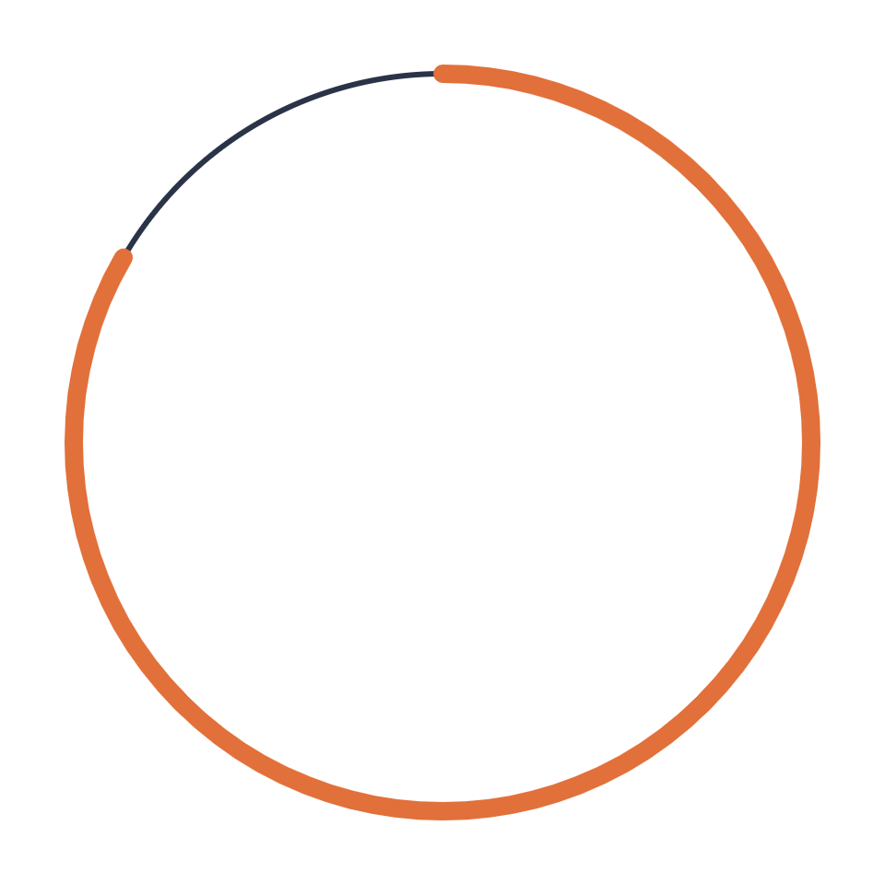
Team practices
PART 05 OF 06
Tools, git and security
Notes:
Part five, team practices. Everything so far was about one developer and one agent. Now: how do we work with this as a team?

Slide 27
One tool or many?
05 · TEAM PRACTICES
ONE TOOL
MANY TOOLS
Easier to share
Easier to adapt
Shared skills, agents and conventions
Teammates can debug each other’s setup
One security and licensing review
Less lock-in while tools leapfrog
People keep the tool they’re fastest in
Different tools for different strengths
Standardize the contract, not the client.
The real risk of mixing tools is drift: duplicated rules that slowly diverge.
Notes:
One tool or many? Some of us use Claude, some use Codex, and Antigravity is around too. Should we unify? Arguments for one tool: skills, agents and conventions get written once and benefit everyone. Teammates can help debug each other's agent setup; with three tools, "works on my agent" becomes a real problem. And security, licensing and data handling get reviewed once, which matters in a corporate environment. Arguments for many: less lock-in while models and tools overtake each other every few months. People stay in the tool they are most productive in. And tools genuinely have different strengths. My recommendation is the line at the bottom: standardize the contract, not the client. Agree on the shared layer, the instructions, the review bar, the gates, and allow some freedom in the tool itself. The real risk of mixing is drift. Rules get copied into each tool's own file, then edited separately, and slowly the agents follow different conventions. The next slide shows how to avoid that.

Slide 28
One source of truth, thin adapters
05 · TEAM PRACTICES
AGENTS.md
Shared instructions, one source of truth
Claude Code
Codex
Antigravity
CLAUDE.md imports @AGENTS.md
Reads AGENTS.md natively
Reads AGENTS.md; GEMINI.md takes precedence
SAME FOR EVERY TOOL
Review standard
CI gates
Data policy
Spec format
Notes:
One source of truth, thin adapters. AGENTS.md is the shared baseline. It holds the instructions every agent should follow. Each tool gets a thin adapter. Claude Code reads CLAUDE.md, so our CLAUDE.md simply imports AGENTS.md and adds only Claude-specific bits. Codex reads AGENTS.md natively. Antigravity reads AGENTS.md too, though if a GEMINI.md exists, it takes precedence on conflicts, so keep GEMINI.md minimal or absent. What does not port: agent definitions. Claude uses markdown files in .claude/agents, Codex uses its own format. Skills are converging on the same SKILL.md format, but tools keep them in different folders. And at the bottom, the things that must be the same for every tool, whatever we decide about tools: one review standard, where AI-written code meets the same bar as human code. One set of CI gates, which are tool-agnostic and are our real enforcement. One data and security policy. And, if we adopt spec-driven development, one spec format.

Slide 29
What goes into git
05 · TEAM PRACTICES
COMMIT
IGNORE
DISTILL, THEN DELETE
Shared, durable
Personal
Ephemeral
AGENTS.md, CLAUDE.md
.claude/settings.json
.claude/agents, skills, rules
.mcp.json, without secrets
docs/adr/ and specs/
CLAUDE.local.md
.claude/settings.local.json
.ai-work/ scratch folder
Worktrees inside the repo
Session dumps and transcripts
Grill sessions → an ADR
Branch plans → docs before merge
Research notes → MR description
Commit the conclusion, not the conversation.
Notes:
What goes into git. The organizing principle is at the bottom: commit the conclusion, not the conversation. Commit what is shared and durable: AGENTS.md and CLAUDE.md, the team settings in .claude/settings.json, our agents, skills and rules, the project MCP configuration with environment-variable references instead of secrets, and decision records and specs. Ignore what is personal: CLAUDE.local.md, settings.local.json, a scratch folder for agent working notes, and worktree folders if anyone keeps them inside the repo. Distill, then delete what is ephemeral. Session dumps and transcripts never get committed. A grill session produces decisions; those go into an ADR, and the transcript goes away. A plan file for multi-session work can live on the feature branch so the agent can resume, but before merge it becomes docs or is deleted. Research notes become the merge request description. Why so strict? Because the repo is the agent's context, which is the next slide.

Slide 30
A layout that works
05 · TEAM PRACTICES
The repo is the agent’s context
repo/
Every committed .md file may be read and believed. Stale plans become wrong instructions.
├── AGENTS.md # shared source of truth
├── CLAUDE.md # @AGENTS.md + Claude bits
├── .claude/
Worktrees are not content
│ ├── settings.json # committed
│ ├── settings.local.json # ignored
Each one is a checkout of a branch. Keep them outside the repo, or gitignore their folder.
│ └── agents/ skills/ rules/
├── .mcp.json
├── docs/adr/ # decisions
├── specs/
└── .ai-work/ # ignored scratch
Notes:
A layout that works. On the left, one possible repo structure: AGENTS.md as the shared source, CLAUDE.md importing it, the .claude folder with committed and ignored settings, the MCP config, decision records, specs, and an ignored scratch folder. The key idea on the right: the repo is the agent's context. Agents grep, open and read markdown files. Any committed .md file may be read and believed. A stale plan or an abandoned brainstorm in the repo turns into wrong instructions for the next agent. That is "almost right" again, fed by a polluted context. So treat every committed markdown file as something an agent will trust. Worktrees: they are never committed, because a worktree is not content, it is a second checkout of another branch sharing the same git database. The agent's work there is already in git as commits on that branch. Keep worktrees outside the repo folder, or gitignore their folder, and remove them with git worktree remove once the branch is merged. Worktrees are the standard way to run several agents in parallel without them editing the same working copy.

Slide 31
Security: treat agent config as code
05 · TEAM PRACTICES
Config runs code
Untrusted input
Least privilege
Hooks execute shell commands on every teammate’s machine. Review .claude/ changes and add CODEOWNERS.
Files, web pages and tool output can carry prompt injection. Content is data, not instructions.
Use permission modes and tool allowlists. Keep secrets out of .mcp.json and the repo.
Notes:
Security: treat agent config as code. Config runs code. Hooks execute shell commands on every teammate's machine. A malicious or careless change to the .claude folder in a merge request runs on everyone's computer after they pull. So review those changes like code, and consider a CODEOWNERS entry for .claude and the instruction files. It is cheap insurance. Untrusted input. Files, web pages and tool output can carry prompt injection: text written to look like instructions. An agent reading a README from a third-party package or a web page could be steered. The principle: content is data, not instructions. Be especially careful when an agent reads external content and also has write or shell access. Least privilege. Use permission modes and tool allowlists so agents only get the access a task needs. Keep secrets out of the MCP config and out of the repo; reference environment variables instead. In a corporate environment someone will ask about this, so it is good to have answers ready.

Slide 32

Back to the problem
PART 06 OF 06
Each tool, mapped to the risk it fixes
Notes:
Part six. Let us return to where we started: almost right.

Slide 33
Each tool, mapped to the risk
06 · BACK TO THE PROBLEM
Risk | What addresses it
Missing project context | CLAUDE.md, skills, specs
Context rot in long sessions | /clear, /compact, subagents, notes in files
Plausible but wrong code | Tests, hooks and CI gates: the agent checks itself
Volume outruns review | Small diffs, human ownership of every merge
Drift across tools | AGENTS.md as the single source of truth
Notes:
Each tool, mapped to the risk it addresses. This is the slide to remember. Missing project context is why output is generic. The fix is CLAUDE.md, skills and specs: put our invariants into the context. Context rot in long sessions is why agents forget and drift. The fix is clearing, compacting, delegating to subagents, and keeping notes in files. Plausible but wrong code is the core of almost right. The fix is verification: tests, hooks and CI gates, so the agent checks itself before we review. Volume outrunning review is how almost right gets merged. The fix is small diffs and a human who owns every merge. Drift across tools is how a mixed team ends up with inconsistent agents. The fix is AGENTS.md as the single source of truth. Notice that none of these is about a smarter model. Every one is about what the model sees and what checks its output. That is why this is a foundations talk.

Slide 34
The model is only as good as its context.
THANK YOU
Questions?
Notes:
One sentence to close: the model is only as good as its context. We control that context. Through what we write in CLAUDE.md and skills, through how we manage sessions, through what we commit, and through the checks we build around the agent. The other sessions at this retreat build on this foundation: the SDLC talk on how this changes our process, and the methodology talk on how to structure the work. Thank you. Questions?

