Slide 1
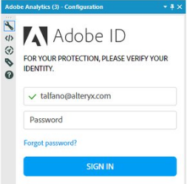
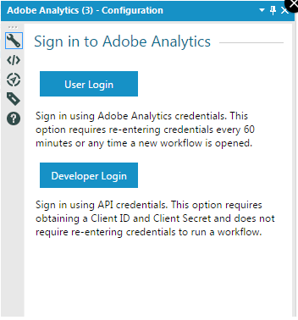
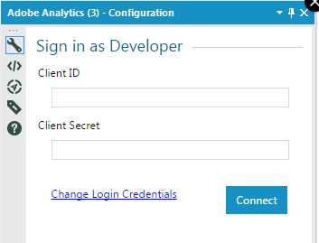
HTML FRONTEND
https://alteryx.quip.com/enwsABVZgkAb
Step 1
Bookmark.GetBookmarks
UI: listBox with reports
MACRO BACKEND
Input Data
clientId
clientSecret
Authorization
companyEndpoint
bookmark_id
Step 4
Report.Get
Batch Macro
Supporting
Online || Offline
Step 2
Bookmark.
GetReportDescription
Main
Step 3
Report.Queue
Main
Step 5
Parse JSON Response
Macro Supporting
Report
Offline
Authorization
Macro
Supporting
Raw JSON
API Response

Slide 2
Report Suite
Required:
access_token
Date Pickers
Granularity
Metrics
Required:
reportSuiteID
Elements
Required:
reportSuiteID
Segment (optional)
Required:
reportSuiteID
Summary
Validate Report

