Slide 1




An on-chain decision ledger for AI agents that trade tokenized stocks.
No trade happens unseen.
Live app covenant-eight-self.vercel.app
Repo github.com/altf4-games/Covenant
Chain BNB Smart Chain mainnet, source verified
BNB Hack:
Tokenized Stocks Edition
Notes:
A tokenized stock trades straight through the weekend, priced off a reference that may not have updated in two days. Now put an AI agent in charge of that trade. What stops it from doing something you never allowed? I built Covenant to answer that.

Slide 2




Binance's status endpoint reports bStocks as TRADING around the clock, so it can't tell an agent the NYSE is closed.
NVDAB above Thursday's NYSE close, measured on 2026-09-25 at 07:21 UTC, with the NYSE shut.
The RWA reference price is empty for all 46 bStocks, so there is no second price to compare against.
A buy at that premium is exactly what a careless agent would make.
The agent holds the funds. Nothing in the wallet limits a bad fill by market session, drift or the quote it committed to.
Notes:
Binance's market-status endpoint says bStocks are trading around the clock, and the reference price is empty for all 46 of them. So the agent has no way to know the NYSE is shut, and nothing in the wallet's own limits looks at market session or drift.

Slide 3





Owner
sets the mandate
Event log
Covenant.sol
every decision, public
Mandate, oracle and guard.
Allowed or denied, it records both on chain.
Oracle updater
price, halt, NYSE session
1 commit
3 settle or cancel
Agent
Binance router
a Binance Agentic Wallet
2 baw market-order swap, natively
the real swap
verify.ts and judge.ts read only chain state: every real transfer must match a settled decision.
Notes:
Covenant is one contract on BNB Smart Chain. The owner sets a mandate: which stocks, by exact address, how many dollars per trade and per day, a slippage limit, a position cap, and how far from Friday's close a stock may trade while the NYSE is shut. Before every trade, the agent, a Binance Agentic Wallet, commits it to the contract. The contract decides, allowed or denied, and records it either way. Then the wallet trades natively and settles the real fill back on chain.

Slide 4


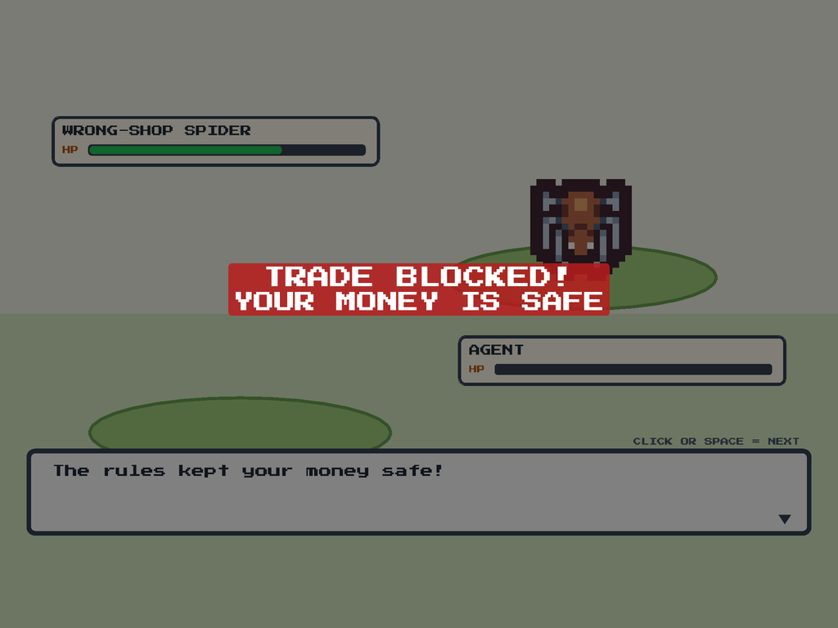


Token on the allowlist, by exact address
TokenNotAllowed
Per-trade and daily dollar caps, and the position cap
NotionalExceeded, PositionLimit
Quote and minimum output within the slippage bound
SlippageTooLoose
Oracle fresh and token not halted
OracleStale, OracleHalted
Denials don't revert. A reverted transaction discards its own event, so Covenant records the refusal and returns.
No buying at a weekend premium while the NYSE is shut
ClosedMarketDrift
Notes:
These are the checks, and each one has its own monster in the app. Each denial has its own reason, and the contract records the refusal rather than reverting, so even a denial leaves a trace.

Slide 5

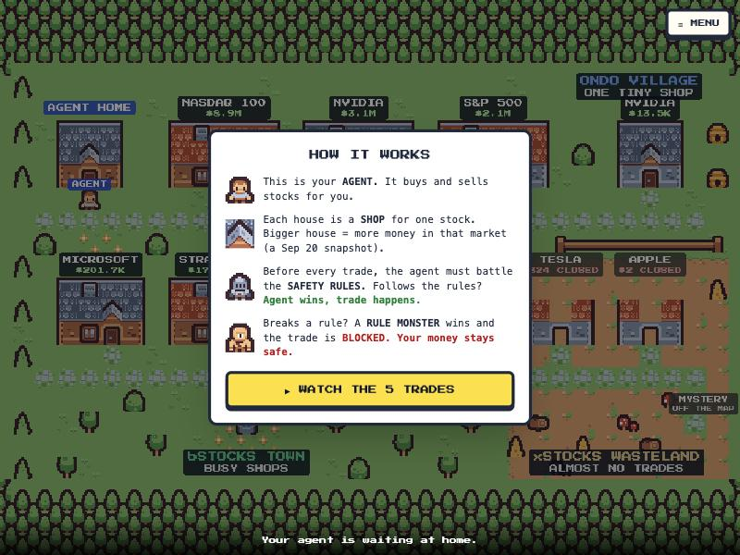
The real mainnet ledger, played back as a game.
covenant-eight-self.vercel.app
A trade that follows the rules wins its battle and goes through.
A trade that breaks a rule is blocked, and the refusal is recorded.
Every battle is a real decision read from BNB Smart Chain.
It opens on a snapshot of the real ledger. LOAD re-reads the chain live.
Notes:
DEMO. Switch to the browser here and open covenant-eight-self.vercel.app. Press WATCH THE 5 TRADES. Let one allowed battle play, then the forty-cent buy: the Spending Cap monster wins, NotionalExceeded, trade blocked. Narration: This is the real ledger from mainnet, played as a little town. Each shop is a token. Every trade is a battle against the rules. This one follows them and goes through. This one tries a buy of forty cents against a twenty-five cent cap, and the Spending Cap monster blocks it. Your money stays safe. The page ships a snapshot of the chain because free RPCs only keep a few days of logs, and the Load button re-reads it live. When the replay ends, come back to this deck at the next slide.

Slide 6



decisions on mainnet
1
Sell 0.001 NVDAB
Allowed, swapped, then cancelled by my script
2
Buy $0.20
Allowed, swapped, settled
3
Buy $0.40
Denied: NotionalExceeded
transactions re-read from chain by judge
4
Buy $0.10, loose minimum
Denied: SlippageTooLoose
5
Sell 0.001 NVDAB
Allowed, swapped, settled
trades matched, one flagged
0x90F642be72b5aD815B924AB3CFFd5f241Dc656aa
Verified on BscScan and Sourcify. The mandate is sized to a $2 budget: $0.25 per trade, 5 trades and $0.75 a day.
Notes:
It's deployed and verified on BscScan. Five decisions in total: two settled trades, two denials, and one I'll come back to. Anyone can check this without trusting me: judge re-reads each transaction from chain and decodes it, eight of eight.

Slide 7



My first script looked up a swap by the orderId Binance returned. The order list never found that id.
$ npm run verify
decisions: 5
trades: 3 (2 matched to a settled decision)
[OK] 0x43d624bc…be38 buy decision #2
[OK] 0x166d33a1…5bed sell decision #5
[UNMATCHED_TRADE] 0x1df46d49…e1be
sent 0.000999 NVDAB with no settled
decision
1 violation(s).
It assumed the swap hadn't happened and cancelled the decision. The swap had filled.
A cancelled decision can't be settled, so that trade is flagged for good.
That is the system doing its job: a trade with no approved decision shows up for anyone.
Notes:
verify is the stronger check. It reads every transfer in and out of the agent's wallet and matches each trade to an approved, settled decision. Two trades match. One doesn't. That one is my own mistake, and I left it in. My first script looked up a swap by the order id Binance returned, but the order list never found that id. It assumed the swap hadn't happened and cancelled the decision. The swap had filled. A cancelled decision can't be settled, so that trade is flagged forever. That is the system doing its job: a trade with no approved decision shows up for anyone.

Slide 8

swap's orderId is not list's orderId
No reference price for any bStock
TRADING while the NYSE is shut
Off by +222, +1 and −18 on three swaps. The list never found the id the swap returned.
It is null for all 46 bStocks. Ondo returns one. I used the hourly candle's last close instead.
The status endpoint has no session field for bStocks, so the oracle carries its own NYSE calendar.
Real gas per swap cycle was three to four times my estimate, so a $2 budget bought five decisions. Everything else is in the friction log and the developer experience report. 277 tests, and the live ones found real bugs.
Notes:
I kept a log of everything that broke on the Binance side: bStock reference prices that are empty for all 46 tokens, a market status that says trading while the NYSE is closed, and that order id. That went into my developer experience report. The code has 277 tests, and the live ones found real bugs, like a router call that compiled but reverted on the first real swap.

Slide 9

Five decisions on a $2 budget, and every kind of outcome is in them.
Live app
covenant-eight-self.vercel.app
Repo
github.com/altf4-games/Covenant
Contract
bscscan.com/address/0x90F642be…c656aa
Built for BNB Hack: Tokenized Stocks Edition
Notes:
I had two dollars, so mainnet has five decisions. Every kind of outcome is in them. Everything is in the repo and the app is live. Covenant: no trade happens unseen.

