Slide 1
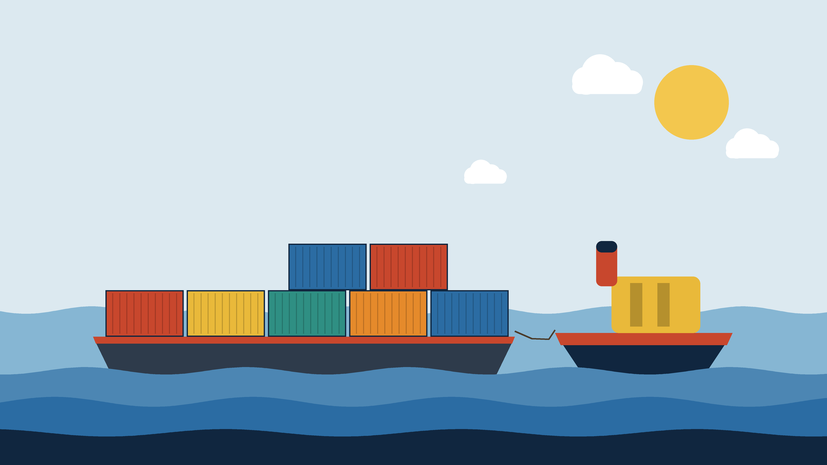
TUGBOAT
Push a branch, tugboat does the towing.
A self-hosted deploy platform in the style of Vercel and Railway.
Pradyum Mistry | DevOps mini project (Lab CA)
Notes:
Tugboat is a small self-hosted version of Vercel or Railway, and I built it for my DevOps mini project. You link a GitHub repo and every push gets built into a container, routed to a URL, and shared through a public HTTPS link. When you push to the default branch it goes to production.
I used open-source tools throughout and tested it against real Docker, Traefik and pack instead of mocks.

Slide 2
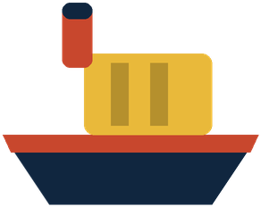
Getting code online takes too many steps
1
Write a Dockerfile.
Vercel, Railway and Render do all of this for you.
But they are hosted and metered, and you can't see how they work.
So I built my own small version from open-source tools.
It runs on one laptop.
For every app, in every language.
2
Set up a reverse proxy and TLS.
And reload it when something changes.
3
Open ports or configure DNS.
So other people can reach it.
Tugboat 2 / 12
Notes:
To put an app on the internet you normally write a Dockerfile, set up a reverse proxy with TLS, and open ports or configure DNS so other people can reach it.
Vercel, Railway and Render do all of that for you, but they are hosted and metered, and you can't see how they work. So I built my own small version from open-source tools. It runs on one laptop, and I understand every part of it.

Slide 3
What Tugboat does
1
2
3
4
Link a repo
Push, and it's built and run
Get a public link
Merge to production
Sign in with GitHub and pick a repo. Tugboat adds a webhook to it.
Buildpacks turn the code into a container, so there's no Dockerfile. Traefik routes the branch to its own URL.
A Cloudflare quick tunnel gives every deployment an HTTPS URL anyone can open.
The default branch goes live without dropping requests. One click rolls it back.
TUGB 000001 4
TUGB 000002 4
TUGB 000003 4
TUGB 000004 4
Tugboat 3 / 12
Notes:
Four steps from the user's side. You sign in with GitHub and link a repo, and Tugboat adds a webhook to it.
Every push is built with Buildpacks, so no Dockerfile is needed, and Traefik routes the branch to its own URL. A Cloudflare quick tunnel gives each deployment a public HTTPS link.
Pushing to the default branch swaps production without dropping requests, and rollback is one click.

Slide 4
How the pieces fit together
Runs on your laptop
Control plane
Docker
Node.js and Express
pack build
Cloud Native Buildpacks
GitHub
repo and webhook
push webhook
Webhook intake
checks the HMAC signature
image
Deploy pipeline
App containers
one per branch, plus production
cloudflared
quick tunnel per deployment
Public URL
*.trycloudflare.com
clone, build, run, promote
build + run
host port
HTTPS
Browser
dashboard
REST + logs
REST API and live logs
Server-Sent Events
reads labels
production
route
Traefik
routes by hostname
Local URL
*.127.0.0.1.nip.io
local hostname
SQLite
projects and deployments
The part I wrote. The colored boxes are existing tools.
Each deployment gets a local URL through Traefik and a public URL through its own tunnel.
Tugboat 4 / 12
Notes:
Read it left to right. GitHub sends a push webhook to my control plane, which is the part I wrote (the yellow box). Everything else is an existing tool.
The control plane checks the HMAC signature, clones the repo, runs pack build, and starts the container in Docker with Traefik labels. Traefik watches Docker and routes the hostname to that container.
Each deployment also gets its own cloudflared quick tunnel, which produces the public HTTPS link. The dashboard talks to the control plane over REST, and build logs stream over Server-Sent Events.
For production, the control plane writes a route file into Traefik after the new container passes its health check.

Slide 5
Where each DevOps stage shows up
Stage
What I did
Tools
Source control
Each deployment comes from a Git commit, delivered by a GitHub webhook.
Git, GitHub
Build
Buildpacks detect the language and build the image, so there's no Dockerfile.
pack, Paketo
Test
I wrote the tests first: unit tests, plus integration tests that use real Docker, Traefik and pack.
Vitest
Containerize
Every deployment runs in its own container, with environment variables and memory and CPU limits.
Docker
Deploy
Each branch gets a preview. The default branch goes to production, and you can roll back.
Traefik, Cloudflare Tunnel
Operate
Live build logs, webhook delivery history, and cleanup when a branch is deleted.
SSE, SQLite
Tugboat 5 / 12
Notes:
This maps the project to the DevOps cycle. Source control is Git and GitHub webhooks, build is Buildpacks, test is Vitest, containerize is Docker, deploy is Traefik plus the tunnel, and operate is the logs, webhook history and cleanup.
Every stage uses the real tool. The pipeline itself is the CI/CD: a push triggers the build and deploy automatically.

Slide 6
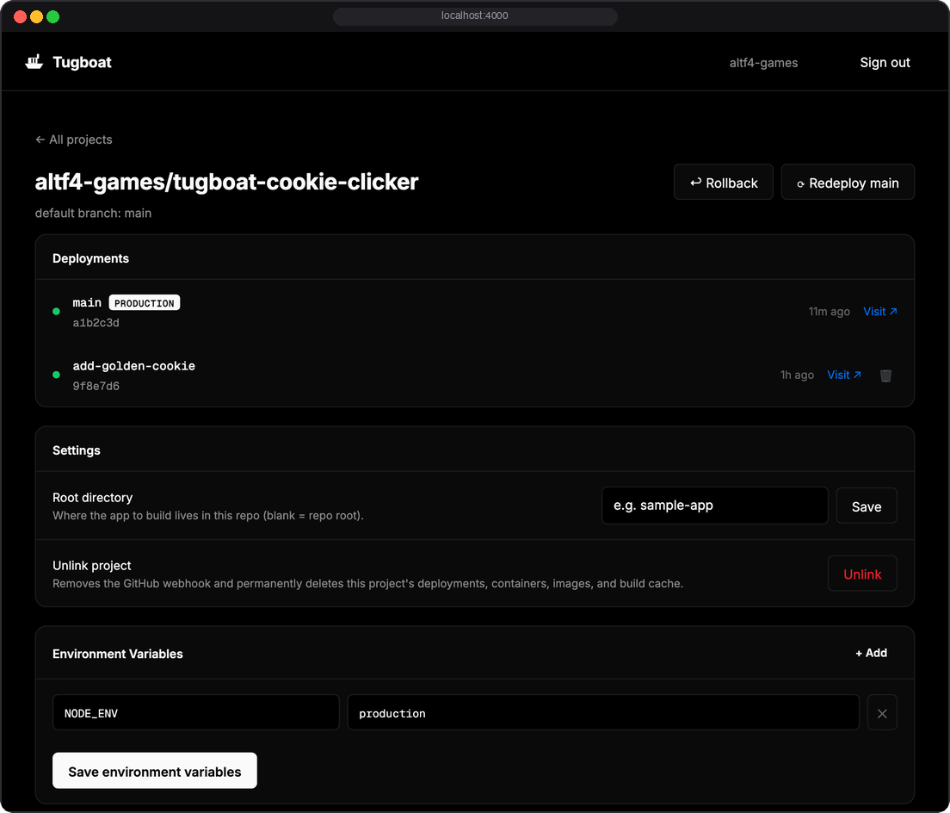
The web app
Sign in with GitHub. The session survives restarts.
Pick any of your repos to link. You can point at a subfolder if it's a monorepo.
The build log streams to the browser while pack runs.
Each project has settings for environment variables and memory and CPU limits.
A project page also shows webhook history and has Rollback and Redeploy buttons.
Unlinking removes the webhook, containers, images and build cache.
Project page, shown with sample data.
Tugboat 6 / 12
Notes:
Besides the pipeline there is a dashboard. You sign in with GitHub, pick a repo to link, and watch the build log stream in while pack runs.
Each project page has Rollback and Redeploy buttons, settings for environment variables and memory and CPU limits, and a history of the webhooks GitHub sent. Unlinking a project removes the webhook, containers, images and build cache.
The screenshot is rendered with sample data for illustration. The landing page on the first slide is the real app.

Slide 7
Swapping production without downtime
Start the new version next to the old one. Production keeps serving.
0
failed requests
1
Check that the new container answers /health. Nothing is routed to it yet.
2
Point Traefik's production route at it in one step, then confirm through Traefik's API that the route loaded.
3
In the integration test I send a request every 50 ms while production is promoted twice in a row. None of them fail.
Stop the old container.
4
Rollback runs the same steps with the previous image.
Tugboat 7 / 12
Notes:
Four steps. Start the new container next to the old one, check that it answers /health before anything is routed to it, point Traefik's production route at it in one step and confirm through Traefik's API that the route loaded, then stop the old container.
The proof is an integration test. It sends a request every 50 milliseconds while production is promoted twice in a row, and asserts that none of them fail.
Rollback runs the same steps with the previous image.

Slide 8
How I tested it
I wrote each feature test-first: a failing test, then the code to make it pass.
74
tests
Integration tests run the real tools: docker, pack, Traefik and cloudflared. Nothing is mocked.
28
test files: 15 unit, 12 integration, 1 smoke test
The webhook tests use payloads captured from real GitHub deliveries, with their signatures checked.
0
mocked services
The database only has rows from real builds and real webhooks. I never seeded it.
Tugboat 8 / 12
Notes:
I wrote each feature test-first. The integration tests run the real tools, docker, pack, Traefik and cloudflared, and nothing is mocked.
The webhook tests use payloads captured from real GitHub deliveries, with their signatures verified. The database only has rows from real builds and real webhooks, because I never seeded it.
The numbers are from the last full run: 74 tests in 28 files. 15 of those files are unit tests, 12 are integration tests, and one is a smoke test.

Slide 9
Problems I hit
What went wrong
Why
What I did
Traefik couldn't talk to Docker on OrbStack
Traefik's Docker client uses API 1.24, and OrbStack needs 1.40 or newer.
I put an nginx proxy in front of the socket that rewrites the API paths.
Requests dropped during production swaps
Traefik sent traffic to the new container before its first health check.
I moved production to Traefik's file provider and swap the route in one step after the health check.
Route changes weren't picked up on macOS
Writes through a bind mount don't trigger inotify across the VM.
I write the route file with docker cp instead.
Double-clicking Redeploy killed a live preview
Two builds for the same branch ran at once, and one stopped the other's tunnel.
I added a lock per branch, with a test that starts two deploys at once.
New preview links didn't load for a few seconds
New trycloudflare.com names take a while to resolve on the local DNS.
I wait until a public resolver (1.1.1.1) resolves the name, and give the screenshot browser the IP directly.
Tugboat 9 / 12
Notes:
These all showed up because nothing was mocked.
Traefik's Docker client speaks API 1.24 and OrbStack needs 1.40 or newer, so I put an nginx proxy in front of the socket. Label-based routing for production dropped requests during a swap, so production uses Traefik's file provider.
File writes through a bind mount didn't trigger inotify on macOS, so I write the route with docker cp. A double-clicked Redeploy raced two builds, so there is a lock per branch. And new trycloudflare.com names took a few seconds to resolve locally, so I wait on a public resolver.

Slide 10
Demo
1
Sign in with GitHub.
$ cd control-plane
$ npm start
open http://localhost:4000
2
Link tugboat-cookie-clicker. It deploys right away.
3
Open the deployment and watch the build log stream.
Open the preview URL.
Before starting
4
Docker (OrbStack) is running
5
Push a commit to main and watch production swap.
pack and cloudflared are installed
control-plane/.env is filled in
6
Click Rollback, then unlink the project to clean up.
Base images pulled (first build downloads about 5 GB)
Tugboat 10 / 12
Notes:
Before presenting: Docker (OrbStack) running, pack and cloudflared installed, control-plane/.env filled in.
Pull the base images beforehand. The first pack build downloads about 5 GB (the Paketo builder alone is about 4.8 GB), so do one throwaway build first and the live one will be quick.
Run order: open http://localhost:4000 and sign in with GitHub. Link tugboat-cookie-clicker; the first deploy starts by itself. Open the deployment to show the build log streaming. Open the preview URL and point out the screenshot. Push a commit to main and show production swap. Click Rollback, then unlink to show the cleanup.
If the network is slow, fall back to the screenshots from the earlier slides.

Slide 11
Limits and what I'd do next
Limit
Next step
All projects share one production route.
Give each project its own production route and hostname.
Rollback history only lives in memory.
Store it in SQLite so it survives a restart.
Quick tunnel URLs change on every deployment.
Use named Cloudflare tunnels with custom domains.
OAuth tokens and environment variables are stored unencrypted in SQLite.
Encrypt them, and add build-time variables.
Tugboat 11 / 12
Notes:
These are the gaps I know about. All projects share one production route. Rollback history is kept in memory, so a restart clears it. Quick tunnel URLs change on every deployment. And OAuth tokens and environment variables are stored unencrypted in the local SQLite database.
Each one has an obvious next step: per-project production routes, storing history in SQLite, named Cloudflare tunnels with custom domains, and encrypting secrets.

Slide 12
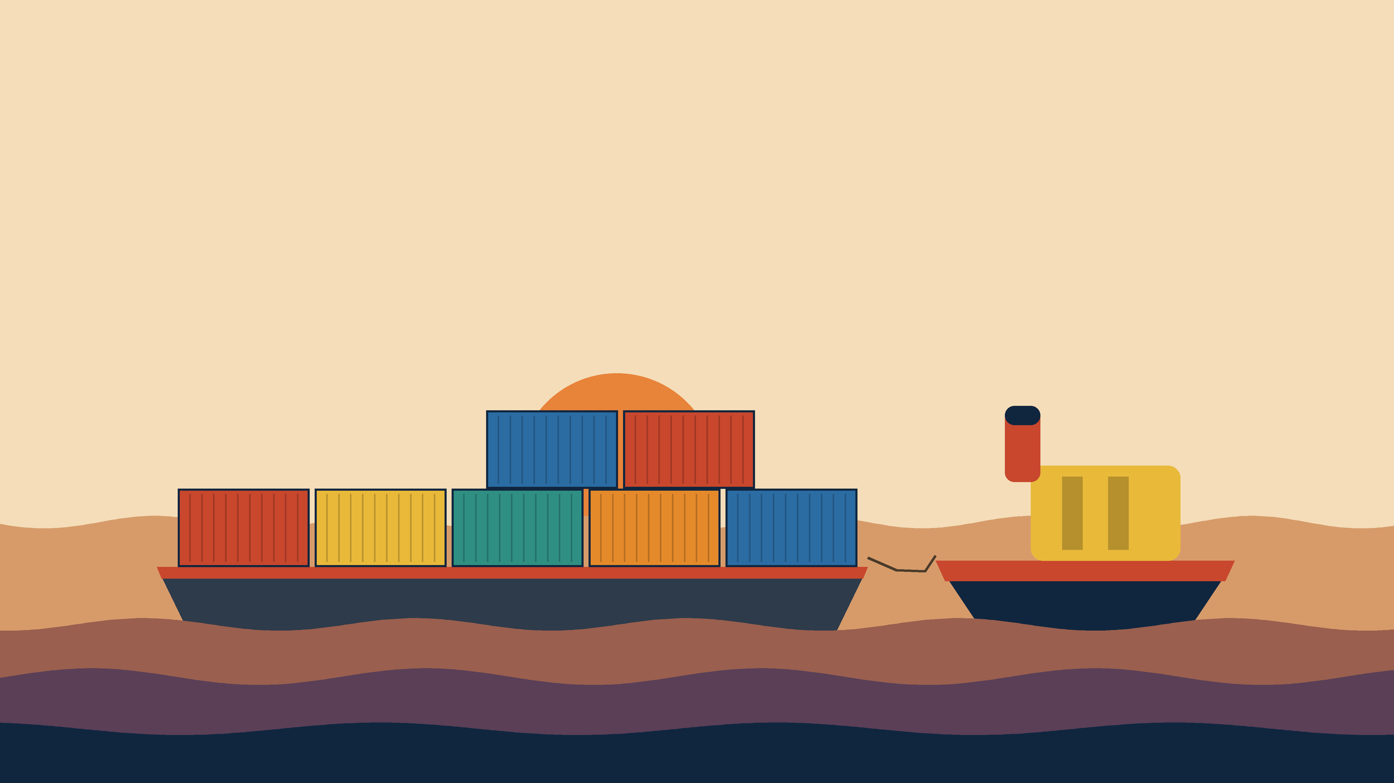
Thank you
Questions?
github.com/altf4-games/tugboat
Notes:
Thank you. Questions welcome. The repo is github.com/altf4-games/tugboat, and the README covers setup, screenshots and how to run the tests.

