Slide 1
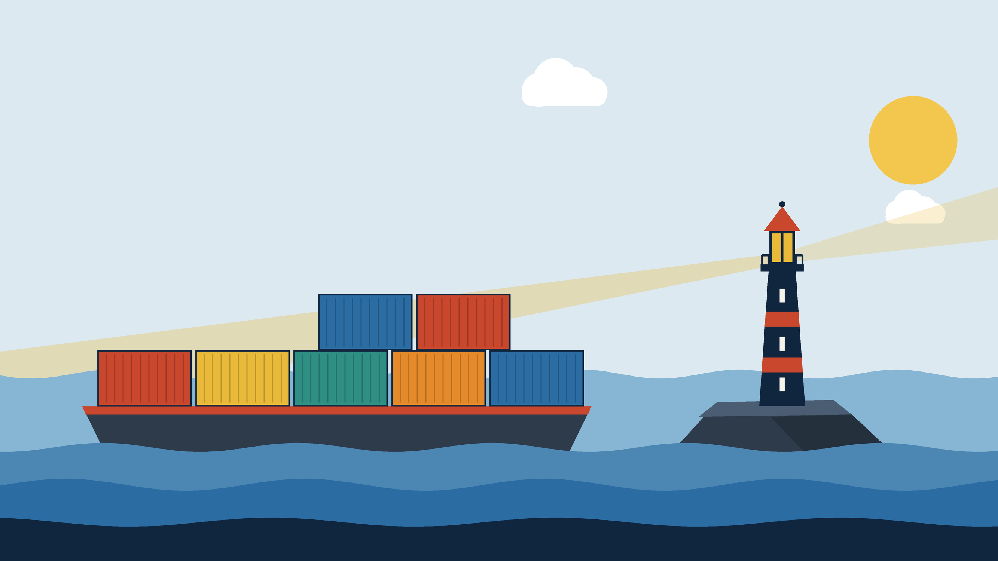


TRAEFIK
Routes that follow your containers.
Zero-config service discovery and automatic HTTPS routing for containerized deployments.
Pradyum Mistry | 16010123236 | DevOps Theory IA
Notes:
[About 0:30. On screen: Title slide. Look at the camera for the first sentence.]
Hi, I'm Pradyum Mistry. For my DevOps theory case study I picked Traefik. In the next fifteen minutes I'll explain what it is, show its two main features working on my own machine, and compare it with the alternatives.
The two features are in the title: service discovery with no configuration, and automatic HTTPS.

Slide 2
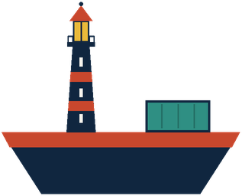
Two chores every container deployment has
1
Keep the routes in step.
With a proxy that reads a config file, someone edits the file and reloads the proxy every time a container moves.
Traefik reads what is running, and gets the certificates itself.
Containers start and stop all the time, and each gets a new address.
2
Get a certificate for every name.
Request it, install it, and renew it before it expires.
Traefik 2 / 15
Notes:
[About 1:00. On screen: Slide 2. Point at the left items first, then the card on the right.]
Think about what happens when you run containers. Each one gets a new internal address every time it starts, and they start and stop all the time. Something has to sit in front and send each request to the right one. If that something reads its backends from a file, someone has to edit the file and reload the proxy every time a container appears or moves. That's the first chore.
The second chore is HTTPS. Every hostname needs a certificate, and a certificate has to be requested, installed, and renewed before it expires. Traefik takes both chores away. It reads what is running, and it gets the certificates itself.

Slide 3
Where Traefik fits in the DevOps cycle
Plan
Code
Build
Test
Release
Deploy
Operate
Monitor
Traefik
sends live traffic to the running version
Traefik 3 / 15
Notes:
[About 0:45. On screen: Slide 3. Trace the loop with the cursor from Plan to Monitor, then rest on Deploy and Operate.]
This is the usual DevOps cycle. Traefik works near the end, in deploy and operate. Once a new version is running, Traefik is what sends live traffic to it, and while the app runs it keeps the routing right as containers come and go.
I chose it for three reasons. It was built for containers, it handles certificates in the same tool, and I already use it in my mini project, Tugboat, so I know where it works well.

Slide 4
What Traefik is
Written in
Go
Why I chose it
License
MIT
It was built for containers, so discovery from Docker is a core feature.
Maintained by
Traefik Labs
It handles certificates itself, so both halves of my title are in one tool.
First release
1.0 in 2016
I already use it in Tugboat, so I know where it works well.
Version I used
3.7.14
Ships as
one binary or a container image
Both features can be tested on a laptop.
Traefik 4 / 15
Notes:
[About 1:00. On screen: Slide 4. Read the left column, then the reasons on the right.]
Some facts. Traefik is written in Go and released under the MIT license. It started in 2015 as a side project of Emile Vauge, and version 1.0 came out in 2016. Today it's developed by Traefik Labs. It ships as one binary or as a container image, and it has a dashboard and an API built in.
I used version 3.7.14 for everything you'll see in this video. On the right are my reasons for choosing it: it's made for containers, it does certificates too, I already use it, and I can test both features on a laptop.

Slide 5
How Traefik works
Client
browser or curl
Entrypoint
:80 web, :443 websecure
Router
a rule, such as Host(...)
Middlewares
redirect, headers, limits
Service
a load balancer
dynamic configuration
containers
Providers
Docker, files, Kubernetes. They watch for changes and send routes to Traefik while it runs.
Static configuration
read once at start: entrypoints, providers, certificate resolvers
Dynamic configuration
routers, services, middlewares: changes while running
Traefik 5 / 15
Notes:
[About 1:30. On screen: Slide 5. Follow the arrows left to right with the cursor, then go to the Providers box, then the two lines at the bottom right.]
Traefik has a handful of ideas to learn. A request arrives on an entrypoint, which is just a port, like 80 or 443. Traefik checks it against its routers. A router is a rule, such as 'the host is whoami dot something'. The router can run middlewares, which change the request or the response, for example by adding a header or redirecting to HTTPS. Then the router passes the request to a service, which usually shares the load over several containers.
The last idea is the provider, at the bottom. A provider is where routes come from, and it can change them while Traefik is running. Docker is a provider, a file is a provider, Kubernetes is a provider.
That gives two kinds of configuration. The static one is read once at start: entrypoints, providers, and certificate resolvers. The dynamic one is the routers, services and middlewares, and it changes live.

Slide 6
Service discovery with the Docker provider
I start a container: docker compose up -d whoami.
1
labels:
- traefik.enable=true
- traefik.http.routers.whoami
.rule=Host(`whoami.127.0.0.1.nip.io`)
- traefik.http.routers.whoami
.entrypoints=web
Docker sends Traefik a start event.
2
Traefik reads the container's labels, IP and port.
3
That is the whole configuration for the app.
The documentation warns that Docker socket access is powerful. On a shared server, put a socket proxy in front of it.
A router and a service exist. Traefik was not restarted.
4
Traefik 6 / 15
Notes:
[About 1:00. On screen: Slide 6. Read the four steps, then move to the label box.]
Traefik connects to the Docker socket, lists the running containers, and then watches Docker's events. When a container starts, Traefik inspects it, reads the labels that start with traefik, and builds a router and a service from them.
On the right is the whole configuration for one app: a few labels. There's no proxy file to edit, and Traefik isn't restarted.
One caution from the documentation. Access to the Docker socket is powerful, so on a shared server you would put a socket proxy in front of it.

Slide 7
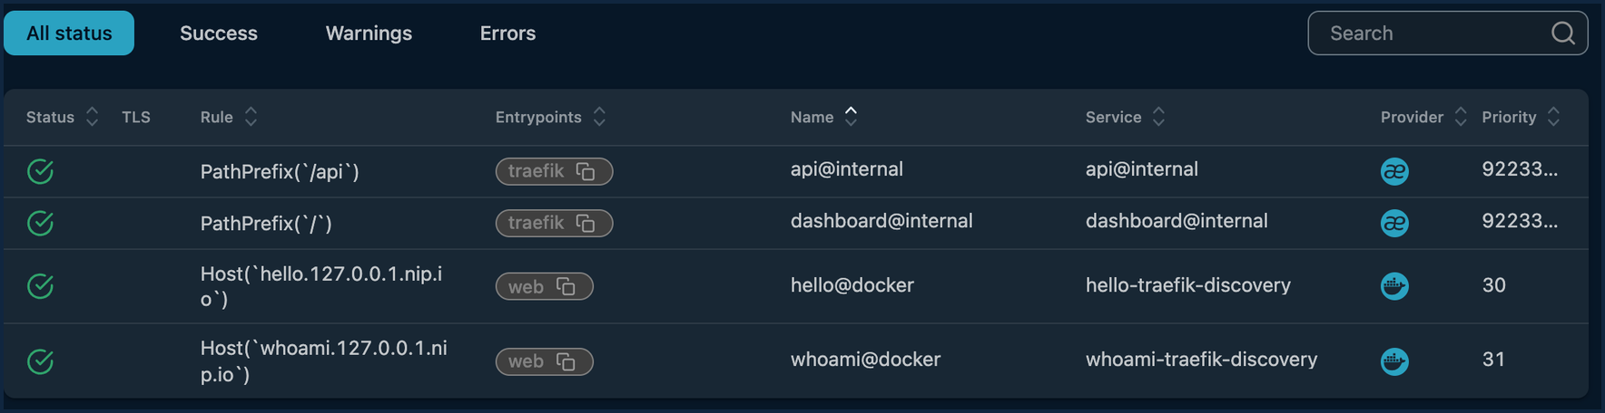
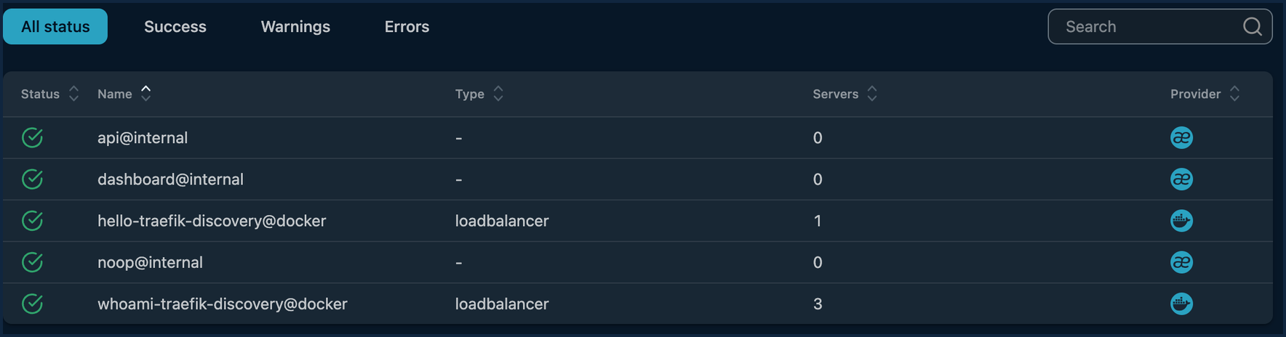
Demo 1: service discovery
Start Traefik alone. Unknown hosts return 404.
1
Start an app. The same request returns 200.
2
Dashboard: a router for each app, provider Docker.
Add a second app. No restart.
3
Scale one app to three copies. Requests rotate.
4
Dashboard: three servers behind whoami, all UP.
Stop an app. Its route disappears.
0
restarts of Traefik while apps came and went
5
Traefik 7 / 15
Notes:
[About 1:45. On screen: Slide 7 for ten seconds, then switch to the terminal and run the Demo 1 commands. Switch back to the slide at the end.]
I start Traefik with no apps. Its API lists only its own two routers, and a request for my app's hostname gets a 404.
Now I start the first app. Traefik isn't touched. The same request returns 200, and you can see the header my middleware added.
I add a second app with its own hostname, and that works too. Now I scale the first app to three copies. Six requests in a row, and they rotate across all three containers. Here they are in the dashboard.
Finally I stop the second app, and its hostname goes back to 404. Traefik started once at the beginning and was never restarted.

Slide 8
Automatic HTTPS with ACME
Register
an account
Order
a certificate for the name
Prove
control with a challenge
Sign
send a signing request
Receive
the certificate
Traefik runs the whole exchange when a router appears for a name with no certificate.
Results are saved in acme.json. Traefik starts renewing 30 days before expiry.
# static: declare a resolver once
certificatesresolvers.pebble.acme
.caserver=https://pebble:14000/dir
# per router: opt in with one label
tls.certresolver=pebble
Traefik 8 / 15
Notes:
[About 1:15. On screen: Slide 8. Walk along the five steps, then point at the label and the storage line.]
Now HTTPS. The protocol is called ACME, and Let's Encrypt is the best-known authority that speaks it. A client registers an account, asks for a certificate for a name, and proves that it controls the name by completing a challenge. Then it sends a signing request and gets the certificate back.
Traefik has this client built in. You declare a certificate resolver once, and then a router asks for a certificate with a single label. When that router appears and no certificate exists yet, Traefik runs the whole exchange itself, saves the result in a file called acme.json, and starts renewing thirty days before the certificate expires.

Slide 9
Challenge types and limits
Challenge
What the authority checks
Needs
Wildcard
HTTP-01
The authority fetches a token over plain HTTP.
Traefik reachable on port 80
No
TLS-ALPN-01
The authority makes a TLS connection and expects a special certificate.
Traefik reachable on port 443
No
DNS-01
The authority looks for a token in a DNS record.
DNS provider access
Yes
Limits
A public authority must reach you, so you need a real domain. Public authorities have rate limits, so test on a staging server. The state lives in one file, so one Traefik instance is the simple case.
Traefik 9 / 15
Notes:
[About 0:45. On screen: Slide 9. Read down the table, then the limits strip.]
The proof of control comes in three kinds. With HTTP-01, the authority fetches a token over plain HTTP, so Traefik has to be reachable on port 80. With TLS-ALPN-01 the authority connects on port 443. With DNS-01 it looks for a record in DNS, and that's the only way to get a wildcard certificate.
There are three limits to know. A public authority has to be able to reach you, so you need a real domain. Public authorities have rate limits, so you test on a staging server first. And the state lives in one file, so the simple case is one Traefik instance.

Slide 10
Demo 2: automatic HTTPS
Start Pebble, Let's Encrypt's test server, and Traefik.
1
INF Register... providerName=pebble.acme
INF Obtaining bundled SAN certificate.
domains=secure.demo.test
INF Validations succeeded;
requesting certificates.
INF Server responded with a certificate.
Start an app whose router asks for the resolver.
2
Watch Traefik's log: it gets the certificate by itself.
3
issuer=CN=Pebble Intermediate CA 225f7d
TLSv1.3, TLS_AES_128_GCM_SHA256
Verify return code: 0 (ok)
(without the Pebble root: fails)
Check the certificate from the client side.
4
A test authority, not Let's Encrypt itself.
Traefik 10 / 15
Notes:
[About 1:45. On screen: Slide 10 for ten seconds, then switch to the terminal and run the Demo 2 commands. Show the dashboard certificate page, then switch back to the slide.]
I can't use Let's Encrypt from a laptop, so I used Pebble, which is Let's Encrypt's own test server. It speaks the same protocol, so Traefik can't tell the difference. I start Pebble, its challenge server, and Traefik.
Then I start an app whose router asks for the resolver. Look at Traefik's log: it registers, obtains a certificate, the validations succeed, and the server responds with a certificate. I didn't run any certificate command.
Now I check from the client side. The certificate is issued by Pebble's intermediate CA, it works over TLS 1.3, and it verifies when I trust Pebble's root. Without that root, verification fails, as it should. The dashboard shows the router with its resolver, and the certificate.
One limit: this used a test authority, not Let's Encrypt itself.

Slide 11
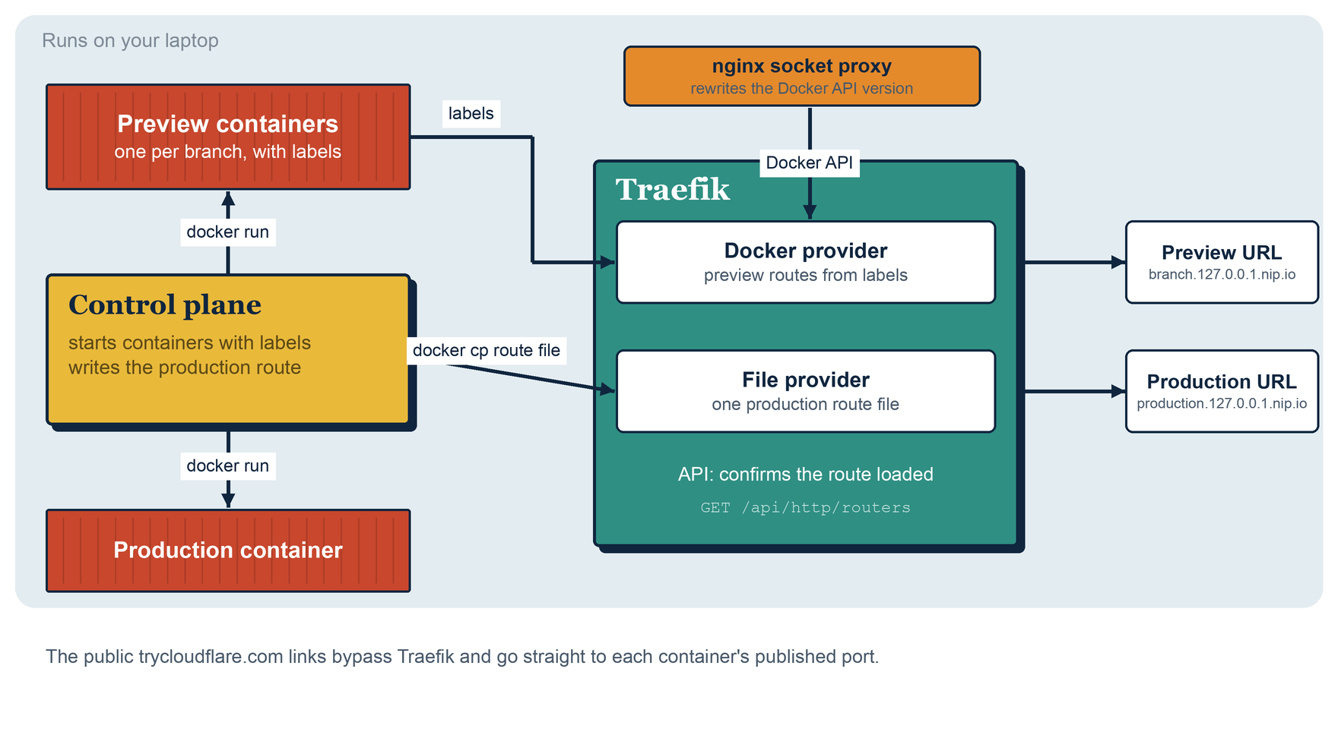
Traefik inside Tugboat
Previews use labels.
The Docker provider finds each branch container. No file, no restart.
Production uses a file.
One route file is written after a health check, then Traefik's API confirms it loaded.
No Traefik HTTPS here.
Public links come from Cloudflare tunnels.
Traefik 11 / 15
Notes:
[About 1:00. On screen: Slide 11. Point at the diagram: previews on top, production below.]
Traefik is also part of my mini project, Tugboat. For branch previews, Tugboat starts each container with labels, and Traefik discovers it through the Docker provider, exactly like the first demo.
Production is different. A swap done with labels removes and re-adds the router, and requests can be dropped in between. So for production Tugboat writes one route file for the file provider, then asks Traefik's API to confirm the route loaded before it stops the old container. A test sends a request every fifty milliseconds across two production swaps, and none fail.
Tugboat doesn't use Traefik's HTTPS, because its public links come from Cloudflare tunnels. That's why I showed HTTPS separately.

Slide 12
How Traefik compares
Tool
Configuration
Container discovery
Automatic HTTPS
Traefik
Routes come from providers while it runs
Built in: Docker, Kubernetes, files
Built in: HTTP-01, TLS-ALPN-01, DNS-01
nginx
Config files, applied with a reload
None in the core
ACME module announced in 2025 as a preview
Caddy
Caddyfile or JSON, with an admin API
Community plugin reads Docker labels
On by default for public names
HAProxy
Config file plus a runtime API
DNS-based. No Docker labels
Experimental ACME in 3.2
Envoy
A control plane through the xDS APIs
Through the control plane
Not built in
I ran only Traefik. The other rows come from their documentation and announcements.
Traefik 12 / 15
Notes:
[About 1:00. On screen: Slide 12. Read the Traefik row, then run down the other four.]
How does it compare? I ran only Traefik, so the others are from their documentation.
nginx is configured through files and reloaded, and it has no container discovery in the core. It announced an official ACME module in 2025 as a preview. Caddy has automatic HTTPS on by default, and a community plugin reads Docker labels. HAProxy uses a config file plus a runtime API, and added experimental ACME support in version 3.2. Envoy is configured by a control plane through the xDS APIs, and it leaves certificates to that system.
Only Traefik reads the container platform directly in its core, and it has certificates built in.

Slide 13
Evaluation
What worked
What was hard
Discovery behaved as documented, with no restart.
Labels are long strings with no type checking.
The certificate exchange needed no commands from me.
Docker socket access is powerful.
The dashboard made mistakes easy to see.
Traefik and Docker must agree on an API version.
HTTPS needs a public name.
I did not measure performance.
Traefik 13 / 15
Notes:
[About 0:45. On screen: Slide 13. Left column, then right column.]
What worked: discovery behaved as documented, every change showed up within seconds without a restart, the certificate exchange needed no commands from me, and the dashboard made mistakes easy to see.
What was hard: labels are long strings with no type checking, and Docker socket access is powerful. Traefik and Docker also have to agree on an API version, which I hit when version 3.1 stopped working with a newer Docker. Automatic HTTPS needs a public name. And I didn't measure performance, so I make no claim about speed.

Slide 14
Conclusion
1
2
3
Routes follow the containers
Certificates come with the router
Limits to keep in mind
Traefik builds them from what Docker says is running. No file to edit, no restart.
One label, and Traefik runs the ACME exchange, stores the result, and renews it.
A test authority in my demo, long labels, socket access, and a Docker API version to keep in step.
Next step for my own project: use Traefik's HTTPS in Tugboat, with a real domain.
Traefik 14 / 15
Notes:
[About 0:30. On screen: Slide 14. Slow down on the last sentence.]
To sum up: Traefik builds its routes from the containers that are running, and it gets certificates through ACME. I confirmed both on real software, with the limits I mentioned.
For my own project, the next step is to use its HTTPS with a real domain.

Slide 15
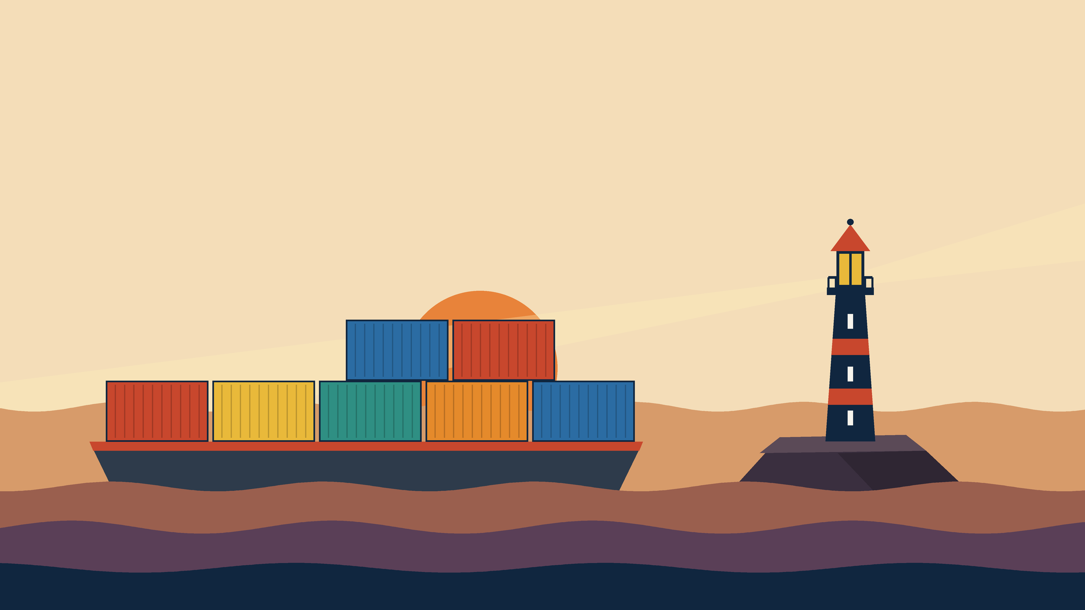
Thank you
Questions?
github.com/altf4-games/tugboat (traefik-demo)
Notes:
[About 0:10. On screen: Slide 15. Hold for a couple of seconds, then stop the recording.]
Thank you. The demo files are in the traefik-demo folder of my Tugboat repository.

