Slide 1

ReLU
GELU
Output layer
($C_{t}, R_{t}$, static inputs)
FC1
FC2
FC3
Prediction

Slide 2




$$y$$
$$tanh$$
ReLU
Output layer
$$h_{n}$$
+
Prediction
RNN
FC1
FC2
($C_{t}, R_{t}$)
Static inputs

Slide 3


$$y$$
ReLU
Output layer
Transformer
Encoder
$$h_{n}$$
+
Prediction
FC1
FC2
Positional
Encoding
Static inputs
($C_{t}, R_{t}$)

Slide 4

$$y$$
ReLU
Output layer
Self
Attention
$$h_{n}$$
+
Prediction
FC1
FC2
($C_{t}, R_{t}$)
Static inputs

Slide 5









RNN
ReLU
Output layer
$$h_{0}$$
$$h_{1}$$
$$h_{2}$$
$$h_{3}$$
$$h_{4}$$
+
FC1
FC2
Prediction
($C_{0}, R_{0}$)
($C_{1}, R_{1}$)
($C_{2}, R_{2}$)
($C_{3}, R_{3}$)
Static inputs

Slide 6



















$$y_{1}$$
$$y_{2}$$
$$y_{6}$$
FC2
ReLU
$$h_{0}$$
$$h_{1}$$
$$h_{2}$$
$$h_{3}$$
$$h_{4}$$
+
FC1
$$s_{0}$$
$$s_{1}$$
$$s_{2}$$
…
$$s_{6}$$
($C_{0}, R_{0}$)
($C_{1}, R_{1}$)
($C_{2}, R_{2}$)
($C_{3}, R_{3}$)
Static inputs
($C_{4}, R_{4}$)
($C_{5}, R_{5}$)
($C_{9}, R_{9}$)

Slide 7



















$$y_{1}$$
$$y_{2}$$
…
$$y_{6}$$
FC2
ReLU
$$h_{0}$$
$$h_{1}$$
$$h_{2}$$
$$h_{3}$$
$$h_{4}$$
+
FC1
$$s_{0}$$
$$s_{1}$$
$$s_{2}$$
…
$$s_{6}$$
($C_{0}, R_{0}$)
($C_{1}, R_{1}$)
($C_{2}, R_{2}$)
($C_{3}, R_{3}$)
Static inputs
($C_{4}, R_{4}$)
$$y_{1}$$
…
$$y_{5}$$

Slide 8

$$y$$
$$tanh$$
ReLU
Output layer
$$h_{n}$$
Prediction
RNN
FC1
FC2
($C_{t}, R_{t}$, static inputs)

Slide 9
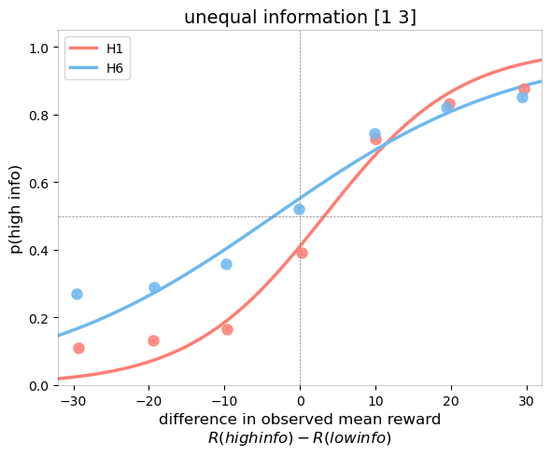
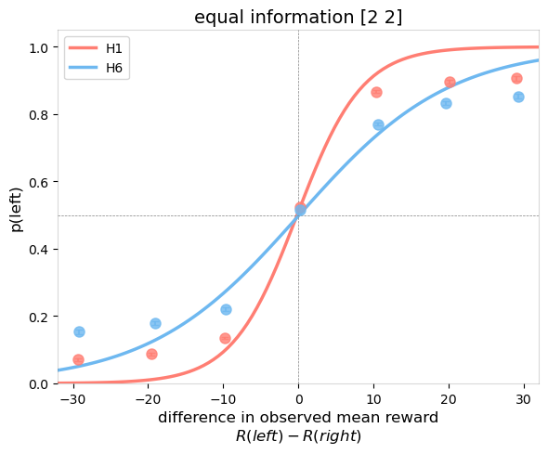
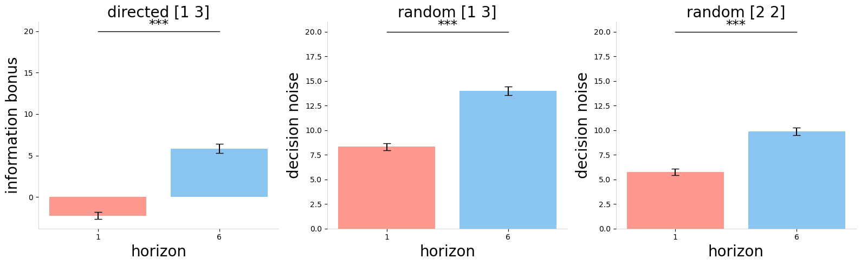
A
B
C
D
E

Slide 10
