Slide 1
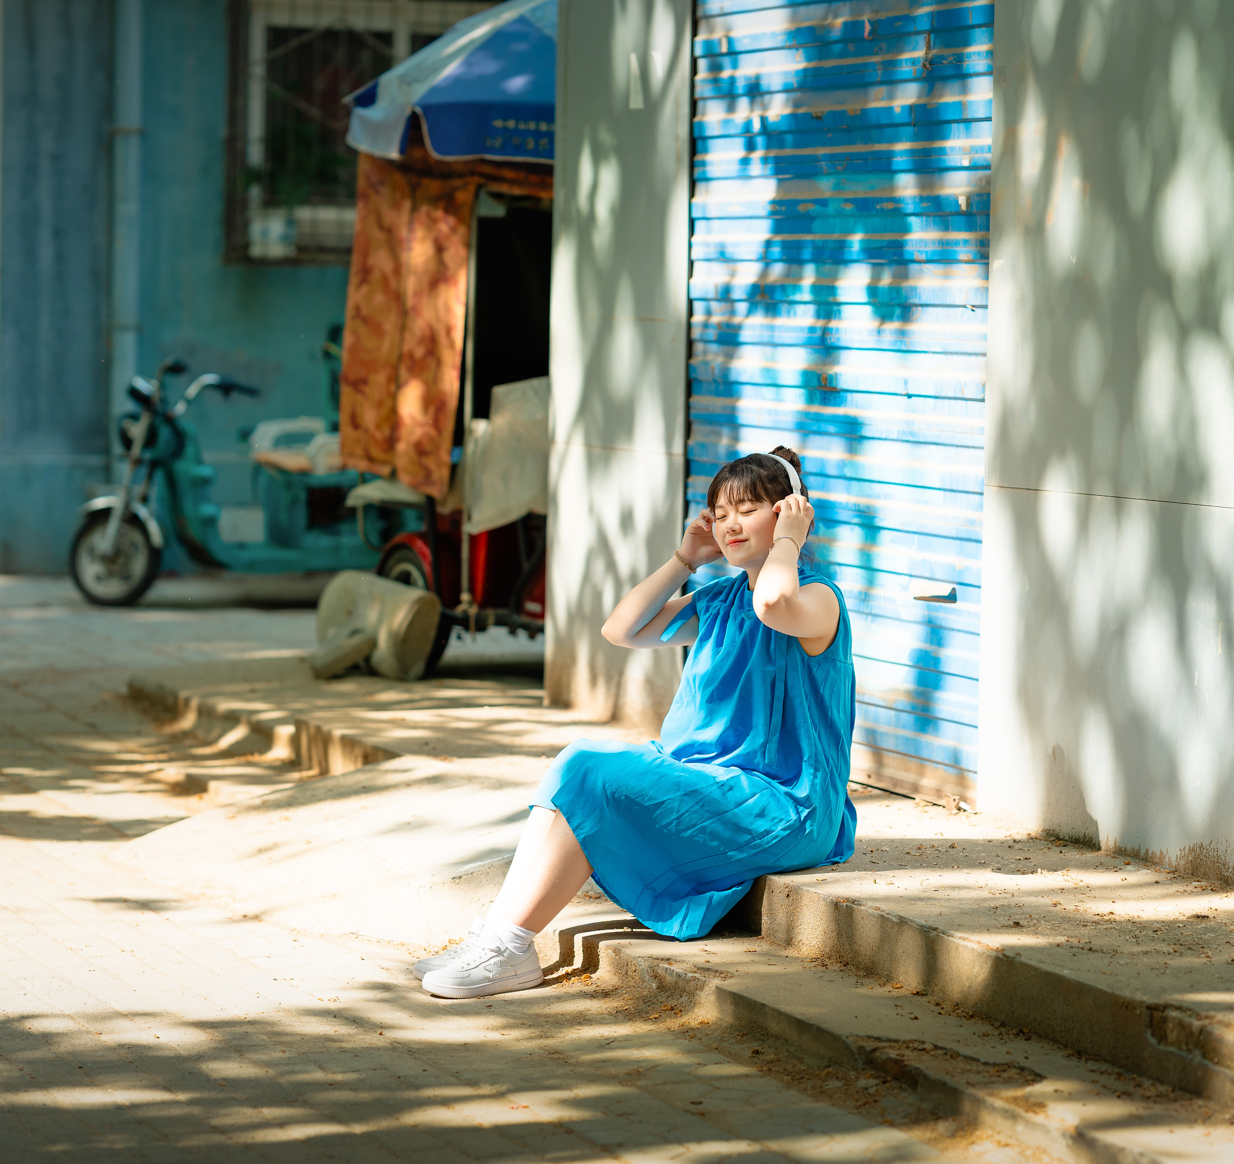
PORTRAIT PHOTOGRAPHY / CREATIVE DIRECTION
The Space
to Be
Portrait photography often begins with a simple wish: to see a beautiful version of oneself. Yet the camera can turn self-expression into self-judgment.
I begin with conversation. Before each shoot, I listen to how each subject wants to be seen, then translate those expectations into styling, setting, and visual direction. During the session, I use imagination and gentle guidance rather than fixed poses.
By building trust around the image-making process, I aim to create portraits that hold both individuality and aspiration.
A portrait begins before the camera is raised.
PROJECT 03 01/03

Slide 2
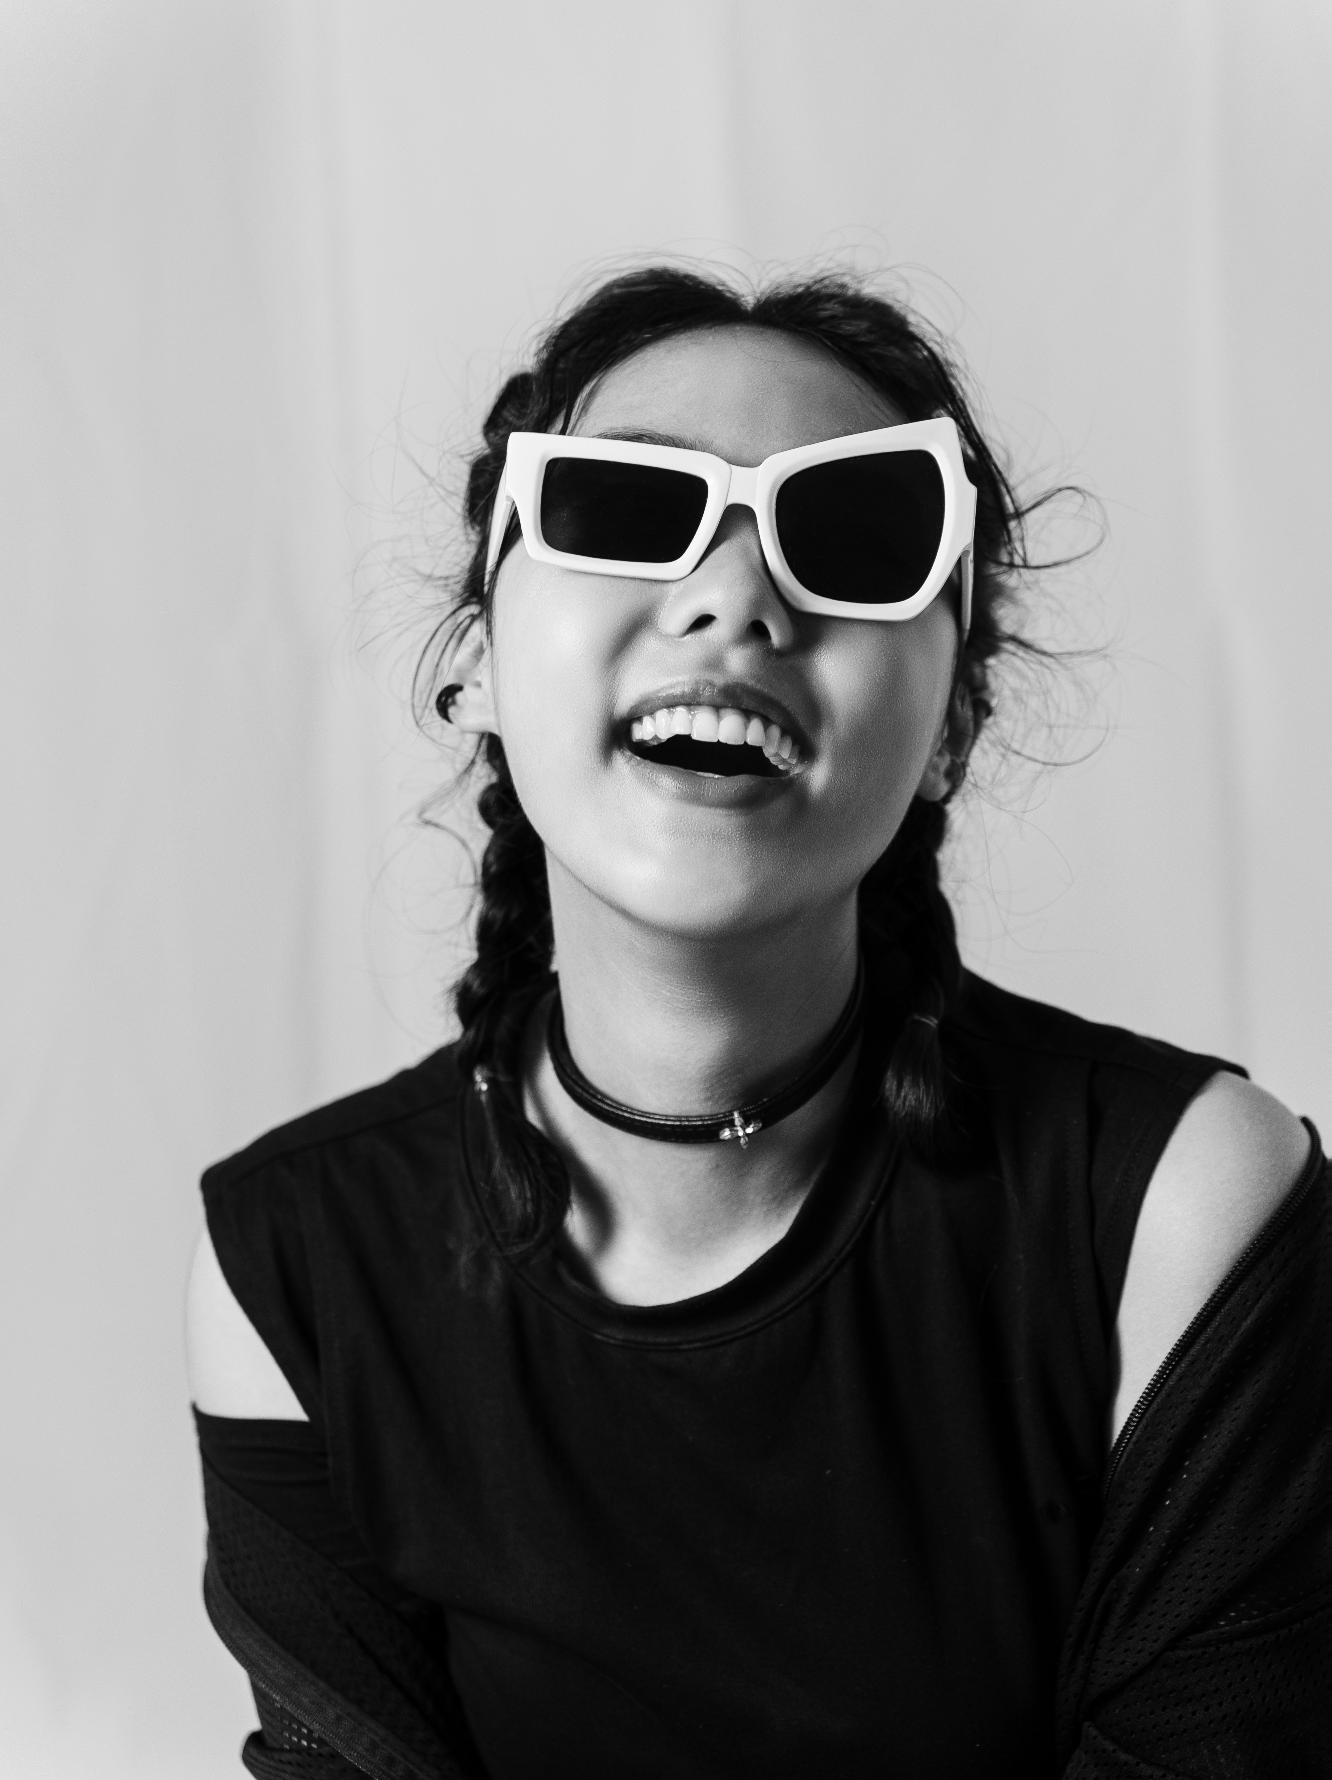
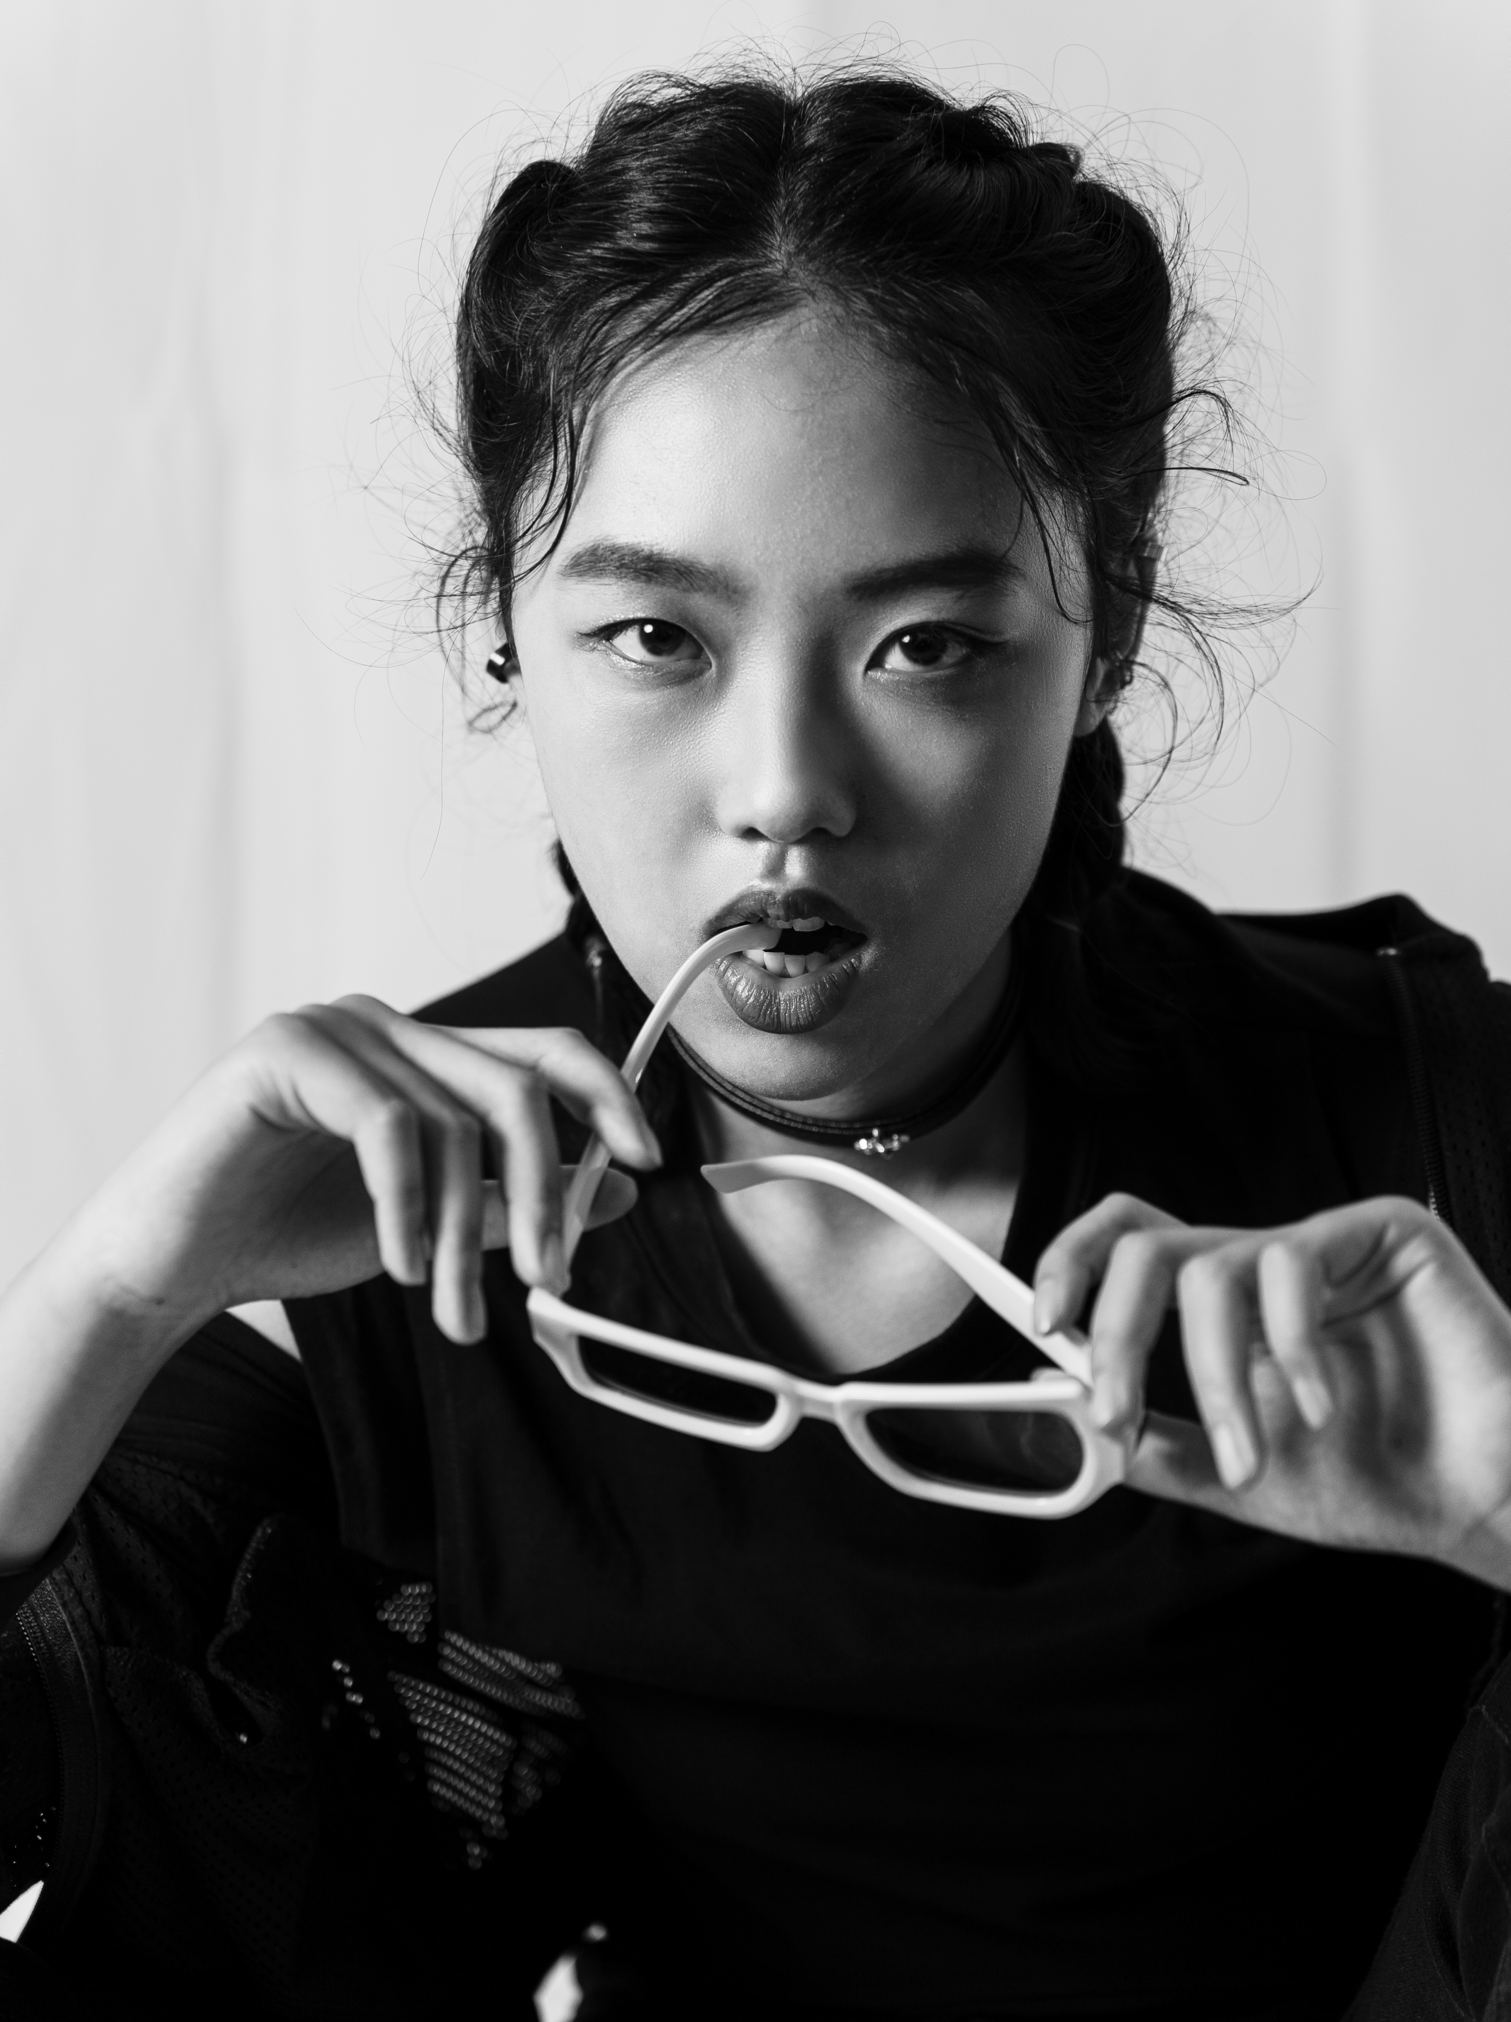
From Conversation to Character
A fashion-inspired portrait session
The subject wanted portraits that felt like a magazine editorial. I translated that aspiration into a visual direction and invited her to imagine herself as a professional model. Rather than prescribe every gesture, I guided the role and let her explore expressions and poses with greater confidence.
01
SUBJECT'S WISH
Fashion magazine-inspired portraits
02
CREATIVE DIRECTION
Editorial styling and role-based imagination
03
PHOTOGRAPHIC EXPRESSION
Gestures and expressions discovered through character
PROJECT 03 02/03

Slide 3
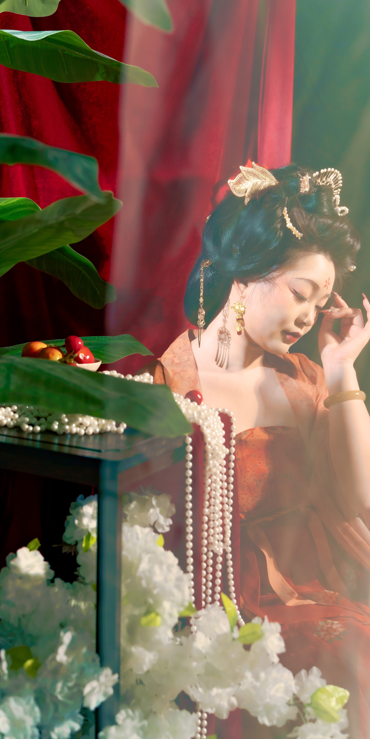
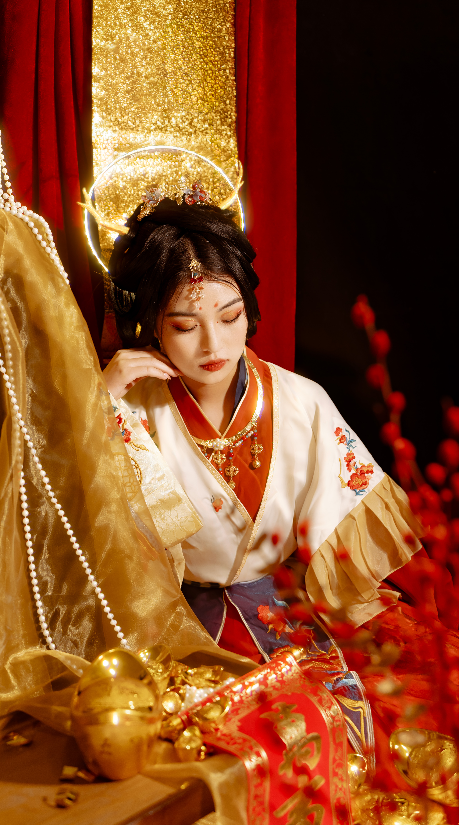
Building a Story Together
For the traditional costume portraits, I began by discussing each subject's preferences and expectations. Those conversations informed the costumes, props, and setting. During the shoot, I invited the subjects to inhabit a world inspired by the past, allowing gesture and expression to emerge through the imagined role.
COLLABORATIVE VISUAL DIRECTION
Costume, props, light, and spatial composition establish the atmosphere. The subject interprets the imagined role through her own gestures and expressions.
PROJECT 03 03/03

