Slide 1
Terrorism?
Althea Smith
Dat-nyc-43

Slide 2
Problem
Why do terrorist groups exist?

Slide 3
Data
Political agency/participation studies
List of recognized terrorist groups (State Dept., UN)

Slide 4
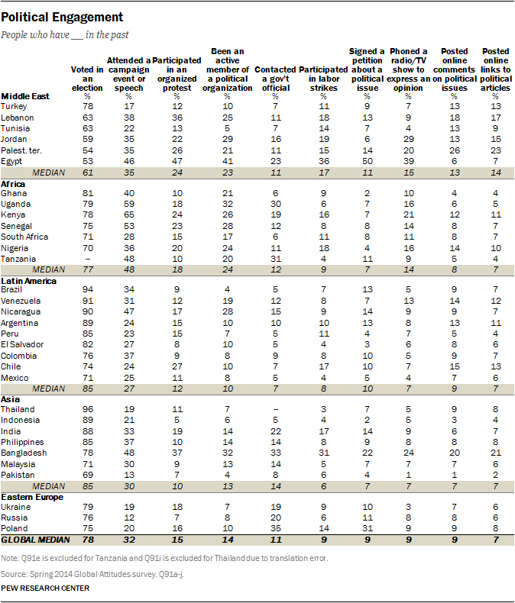
MANY IN EMERGING AND DEVELOPING NATIONS DISCONNECTED FROM POLITICS

Slide 5
https://en.wikipedia.org/wiki/List_of_designated_terrorist_groups

Slide 6
Solution
Hypothesis: negative correlation between political agency and existence of terrorist groups
Result: ???? But probably not hypothesis
Super Great Notebook

Slide 7
Uses
Restrategizing counterterrorism
> Cautionary tale for data use
Rethinking definition of ”terrorism” vs. official list of terrorist groups
> Need to classify list of groups as meeting the definition or not, and classify all other political groups globally as well
Predicting risk of political violence
> Maybe?

Slide 8
Further work
Explore colonization as a factor
Look at time series data – when groups were formed, not just when they were declared terrorist groups
Break down geographical areas from countries to regions
Look at which groups were declared terrorist groups by multiple countries, and which groups were declared by their home countries
Check list of groups against definition of terrorist group

