Slide 1
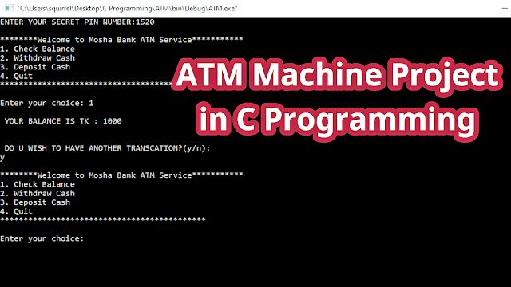
ATM MACHINE
based on
C programming
T

Slide 2
#include <stdio.h>
unsigned long amount = 1000, deposit,withdraw;
int choice, pin, k;
char transaction = 'y’;
void main() {
while (pin != 1520)
{
printf("ENTER YOUR SECRET PIN NUMBER:");
scanf("%d", & pin);
if (pin != 1520)
printf("PLEASE ENTER VALID PASSWORD! \a\n");
}
do
{
printf("\n********Welcome to SRM Bank ATM Service***********\n");
printf("1. Check Balance\n");
printf("2. Withdraw Cash\n");
printf("3. Deposit Cash\n");
printf("4. Quit\n");
printf("********************************************\n\n");
printf("Enter your choice: ");
scanf("%d", & choice);
switch (choice)
{

Slide 3
case 1:amount = amount - withdraw; printf("\n\n PLEASE COLLECT CASH"); printf("\n YOUR CURRENT BALANCE
printf("\n YOUR BALANCE IS TK : %lu ", amount);
break;
case 2:
printf("\n ENTER THE AMOUNT TO WITHDRAW: ");
scanf("%lu", & withdraw);
if (withdraw % 100 != 0) {
printf("\n PLEASE ENTER THE AMOUNT IN MULTIPLES OF 100");
} else if (withdraw > (amount - 500))
{
printf("\n INSUFFICENT BALANCE");
} else
{
amount = amount - withdraw;
printf("\n\n PLEASE COLLECT CASH");
printf("\n YOUR CURRENT BALANCE IS %lu", amount);
}
break;

Slide 4
case 3:
printf("\n ENTER THE AMOUNT TO DEPOSIT");
scanf("%lu", & deposit);
amount = amount + deposit;
printf("YOUR BALANCE IS %lu", amount);
break;
case 4:
printf("\n THANK YOU FOR USING SRM Bank ATM");
break;
default:
printf("\n INVALID CHOICE");
}
printf("\n\n\n DO U WISH TO HAVE ANOTHER TRANSCATION?(y/n): \n");
fflush(stdin);
scanf("%c", & transaction);
if (transaction == 'n' || transaction == 'N’)
k = 1;
}
while (!k);
printf("\n\n THANKS FOR USING SRM Bank ATM SERVICE");
}

Slide 5
OUTPUT:
ENTER YOUR SECRET PIN NUMBER: 1520
***Welcome to ATM Service**
1. Check Balance
2. Withdraw Cash
3. Deposit Cash
4. Quit
***
Enter your choice: 1
YOUR BALANCE IN Rs 1000
DO U WISH TO HAVE ANOTHER TRANSCATION? (y/n)
**Welcome to ATM Service*
Check Balance
Withdraw Cash
Deposit Cash
Quit
**
Enter your choice:
YOUR BALANCE IN Rs 1000
DO U WISH TO HAVE ANOTHER TRANSCATION? (y/n):
***Welcome to ATM Service
Check Balance
2. Withdraw Cash
3. Deposit Cash
4. Quit***: Enter your choice: 2
ENTER THE AMOUNT TO WITHDRAW: 200PLEASE COLLECT CASH
YOUR CURRENT BALANCE IS 800

Slide 6
Enter your choice: 1
YOUR BALANCE IN Rs 1000
DO U WISH TO HAVE ANOTHER TRANSCATION? (y/n):
***Welcome to ATM Service1***
1.Check Balance
2. Withdraw Cash
3. Deposit Cash
4. Quit
***
Enter your choice: 2
ENTER THE AMOUNT TO WITHDRAW: 200
PLEASE COLLECT CASHYOUR CURRENT BALANCE IS 800
DO U WISH TO HAVE ANOTHER TRANSCATION? (y/n):
***Welcome to ATM Service***
Check Balance
Withdraw Cash
Deposit Cash
Quit
**

Slide 7
Enter your choice: 3
ENTER THE AMOUNT TO DEPOSIT 5000
YOUR BALANCE IS 5800
DO U WISH TO HAVE ANOTHER TRANSCATION? (y/n):
***Welcome to ATM Service***
Check Balance
Withdraw Cash
Deposit Cash
Quit
***
Enter your choice: 1
YOUR BALANCE IN Rs: 5800
DO U WISH TO HAVE ANOTHER TRANSCATION? (y/n):
***Welcome to ATM Service***
Check Balance
Withdraw Cash
Deposit Cash
Quit
***

Slide 8
Enter your choice: 4
THANK U USING ATM
DO U WISH TO HAVE ANOTHER TRANSCATION? (y/n):
***Welcome to ATM Service***
Check Balance
Withdraw Cash
Deposit Cash
Quit
***
Enter your choice: 4
THANK U USING ATM
DO U WISH TO HAVE ANOTHER TRANSCATION? (y/n):
***Welcome to ATM Service***
Check Balance
Withdraw Cash
Deposit Cash
Quit
***
Enter your choice: n
THANK U USING ATM
DO U WISH TO HAVE ANOTHER TRANSCATION? (y/n):
THANKS FOR USING OUR ATM SERVICE.

