Slide 1
SI 618 Jupyter Notebooks + Pandas
Instructor: Ceren Budak

Slide 2
Jupyter Notebooks
The Jupyter Notebook is an open-source web application that allows you to create and share documents that contain live code, equations, visualizations and narrative text.
A notebook combines the functionality of
a word processor — handles formatted text
a "shell" or "kernel" — executes statements in a programming language and includes output inline
a rendering engine — renders HTML in addition to plain text

Slide 3
Notebooks
Advantages: A notebook combines explanations with executable code and its output to enable:
reproducible research results
documentation of processes instructions
tutorials and training materials of all shapes and sizes
Ways to use:
On your own computer after installing a Jupyter notebook server
With an online notebook server like cocalc.com
Save notebook with output and use a notebook viewer
Export to HTML, PDF, L^{A}T_{E}X, etc.

Slide 4
Cells & Kernels
Cells and kernels are key both to understanding Jupyter and to what makes it more than just a word processor.
A kernel is a “computational engine” that executes the code contained in a notebook document.
A cell is a container for text to be displayed in the notebook or code to be executed by the notebook’s kernel.
A code cell contains code to be executed in the kernel and displays its output below.
A Markdown cell contains text formatted using Markdown and displays its output in-place when it is run.

Slide 5
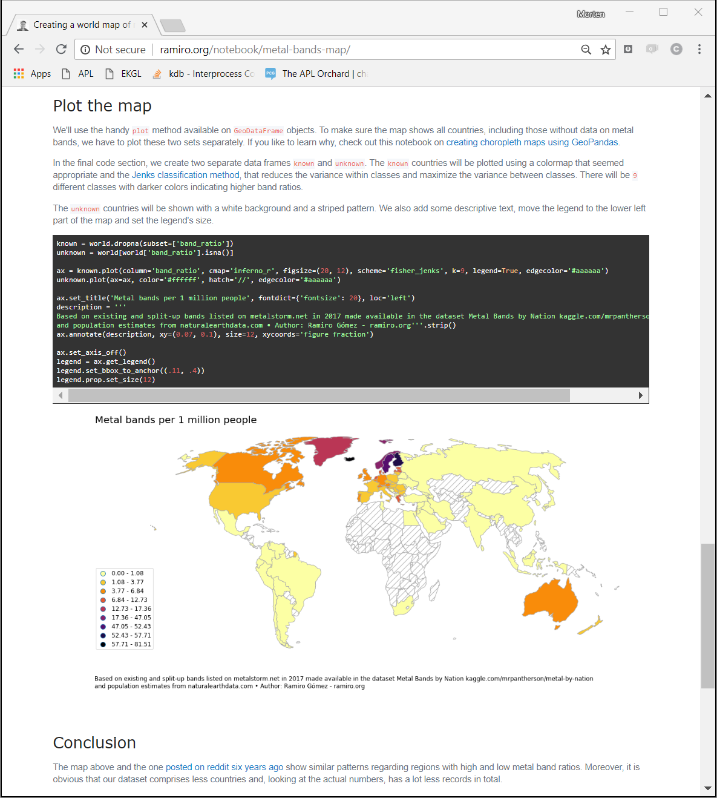
Example
Example notebook
global density of metal bands

Slide 6
What is happening there?
Anaconda Python platform
interpreter
Python
notebook server
localhost:8888
web browser
Jupyter kernel for Python

Slide 7
A few Useful Shortcuts
Control + Enter : to run a cell
Toggle between edit and command mode with Esc and Enter, respectively.
Control + Shift + P : to see the menu of options
In command mode:
Scroll up and down your cells with your Up and Down keys.
Press A or B to insert a new cell above or below the active cell.
Markdown vs Code cell:
M will transform the active cell to a Markdown cell.
Y will set the active cell to a code cell.
D + D (D twice) will delete the active cell.
Z will undo cell deletion.
Hold Shift and press Up or Down to select multiple cells at once.
With multiple cells selected, Shift + M will merge your selection.

Slide 8
Installing Jupyter Notebook
conda
You can install the classic Jupyter Notebook using the conda package manager:
conda install -c conda-forge notebook
pip
pip install notebook
Congratulations, you have installed Jupyter Notebook! To run the notebook, run the following command at the Terminal (Mac/Linux) or Command Prompt (Windows):
jupyter notebook

Slide 9
A quick demo of Jupyter Notebooks…

Slide 10
Caution
Jupyter notebooks are everywhere and useful but they do have certain disadtantages/shortcomings.
Check out the following presentation (it lists common mistakes that lead to a lot of headache): I don't like Notebooks by Joel Grus
You should learn how to use notebooks for quick analysis but the *finished* products of your research/analysis might benefit from settings that better support extensive testing—especially for large projects.

Slide 11
numpy

Slide 12
Numpy
NumPy, short for Numerical Python, is one of the most important foundational packages for numerical computing in Python.
It provides array-oriented arithmetic operations, fast mathematical operations that do not require for loops, linear algebra, random number generation etc. capabilities.
Stepping stone to another important library with array-oriented semantics—pandas (more on that later).

Slide 13
Numpy is Fast!
Fast vectorized array operations for data munging and cleaning, subsetting and filtering, transformation
In [7]: import numpy as np In [8]: my_arr = np.arange(1000000)
In [9]: my_list = list(range(1000000))
In [10]: %time for _ in range(10) : my_arr2 = my_arr * 2 CPU times: user 20 ms, sys: 10 ms , total: 30 ms
Wall time: 31.3 ms
In [11]: %time for _ in range(10) : my_list2 = [x * 2 for x in my_l ist] CPU times: user 680 ms, sys: 180 ms, total: 860 ms
Wall time: 861 ms

Slide 14
Ndarray
An ndarray is a generic multidimensional container for homogeneous data. It has a shape, a tuple indicating the size of each dimension, and a dtype, an object describing the data type.
You can create ndarrays using array function
In [12]: import numpy as np
# Generate some random data
In [13]: data = np.random.randn(2 , 3)
You can also import using “from numpy import *” but I don’t recommend this because numpy namespace is large and contains a number of functions whose names conflict with built- in Python functions
In [17]: data.shape
Out[17]: (2, 3)
In [18]: data.dtype
Out[18]: dtype('float64')
In [19]: data1 = [6, 7.5, 8, 0, 1]
In [20]: arr1 = np.array(data1)
In [21]: arr1 Out[21]: array([ 6. , 7.5, 8. , 0., 1.])

Slide 15
Ndarray
You can create ndarrays using array function
You can also create nested sequences:
You can also use functions such as zeros, ones, empty, arange to create arrays (of all zeros, ones, uninitialized, and in a sequence in order).
In [19]: data1 = [6, 7.5, 8, 0, 1]
In [20]: arr1 = np.array(data1)
In [21]: arr1 Out[21]: array([ 6. , 7.5, 8. , 0., 1.])
In [22]: data2 = [[1, 2, 3, 4], [ 5, 6, 7, 8]]
In [23]: arr2 = np.array(data2)
In [24]: arr2
Out[24]: array([[1, 2, 3, 4],
[5, 6, 7, 8]])
In [30]: np.zeros((3, 6))
Out[30]: array([[ 0., 0., 0., 0., 0., 0.], [ 0., 0., 0., 0., 0., 0.],
[ 0., 0., 0., 0., 0., 0.]])

Slide 16
Ndarray operations
Conversions
Arithmetic
Indexing and Slicing
In [44]: numeric_strings = np.array(['1.25', '-9.6', '42'], dtype=np.string_)
In [45]: numeric_strings.astype(float)
Out[45]: array([ 1.25, -9.6 , 42. ])
In [60]: arr = np.arange(10)
In [61]: arr
Out[61]: array([0, 1, 2, 3, 4, 5, 6, 7, 8, 9])
In [62]: arr[5]
Out[62]: 5
In [63]: arr[5:8]
Out[63]: array([5, 6, 7])
In [64]: arr[5:8] = 12
In [65]: arr
Out[65]: array([ 0, 1, 2, 3, 4, 12, 12, 12, 8, 9])
***Changes to the slice are reflected in the original nparray
If you want a copy of a slice of an ndarray instead of a view, you will need to explicitly copy, e.g. arr[5:8].copy().
In [67]: arr_slice = arr[5:8]
In [68]: arr_slice[1] = 12345
In [69]: arr
Out[69]: array([ 0, 1, 2, 3, 4, 12, 12345, 12, 8, 9])

Slide 17
Ndarray operations
Boolean Indexing
In [98]: names = np.array(['Bob', 'Joe', 'Will', 'Bob', 'Will', 'Joe', ' Joe’])
In [99]: data = np.random.randn(7, 4)
In [100]: names
Out[100]: array(['Bob', 'Joe', 'Will', 'Bob', 'Will', 'Joe', 'Joe'], dtype='<U4’)
In [101]: data
Out[101]: array([[ 0.0929, 0.2817, 0.769 , 1.2464], [ 1.0072, -1.2962, 0.275 , 0.2289], [ 1.3529, 0.8864, -2.0016, -0.3718], [ 1.669 , -0.4386, -0.5397, 0.477 ], [ 3.2489, -1.0212, -0.5771, 0.1241], [ 0.3026, 0.5238, 0.0009, 1.3438], [-0.7135, -0.8312, -2.3702, -1.8608]])
In [102]: names == 'Bob’
Out[102]: array([ True, False, False, True, False, False, False], dtype =bool)
In [103]: data[names == 'Bob'] Out[103]: array([[ 0.0929, 0.2817, 0.769 , 1.2464],
[ 1.669 , -0.4386, -0.5397, 0.477 ]])
Note that the boolean array must be of the same length as the array axis it’s indexing

Slide 18
Ndarray operations
Mathematical operations
Linear algebra (transpose, dot product etc.)
In [178]: arr = np.array([0, 1, 2, 3, 4, 5, 6, 7])
In [179]: arr.mean()
Out[179]: 3.5
In [180]: np.mean(arr)
Out[180]: 3.5
In [181]: arr.sum()
Out[181]: 28
In [182]: arr.cumsum()
Out[183]: array([ 0, 1, 3, 6, 10, 15, 21, 28])

Slide 19
pandas

Slide 20
Pandas
Pandas contains data structures and data manipulation tools designed to make data cleaning and analysis fast and easy in Python.
Commonly used along computing libraries like NumPy and SciPy, analytical libraries like statsmodels and scikit-learn, and data visualization libraries like matplotlib.
Unlike Numpy, pandas is designed for working with tabular or heterogeneous data
Import and use as:
Two important data structures: Series and DataFrame.
A Series is a one-dimensional array-like object containing a sequence of values and an associated array of data labels, called its index.
A DataFrame represents a rectangular table of data where each column can be a different value type (numeric, string, etc.).
In [1]: import pandas as pd

Slide 21

Series
A one-dimensional array-like object containing values and the corresponding index.
Create specifying the index
In [11]: obj = pd.Series([4, 7, -5, 3])
In [12]: obj
Out[12]: 04 17 2 -5 33
dtype: int64
In [15]: obj2 = pd.Series([4, 7, -5, 3], index=['d', 'b', 'a', 'c '])
In [16]: obj2
Out[16]:
d 4 b 7
a -5
C 3
dtype: int64
In [17]: obj2.index
Out[17]: Index(['d', 'b', 'a', 'c'], dtype='object’)
In [18]: obj2.values
Out[18]: array([4,7,-5,3])
Can access the index and values separately

Slide 22
Series
Looks like a Python dict, doesn’t it? You can create a series from a dict simply as:
Indexing
In [26]: sdata = {'Ohio': 35000, 'Texas': 71000, 'Oregon': 16000, 'Utah': 5000}
In [27]: obj3 = pd.Series(sdata)
In [28]: obj3
Out[28]:
Ohio 35000
Oregon 16000
Texas 71000
Utah 5000
dtype: int64
In [15]: obj2 = pd.Series([4, 7, -5, 3], index=['d', 'b', 'a', 'c '])
…
In [18]: obj2['a’]
Out[18]: -5
In [19]: obj2['d'] = 6
In [20]: obj2[['c', 'a', 'd’]]
Out[20]: c 3 a -5
d 6
dtype: int64

Slide 23
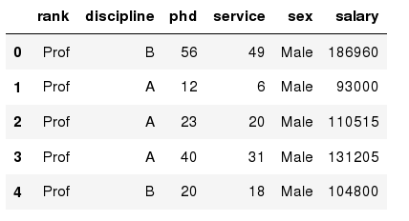
DataFrame
Rectangular table of data, has both a row and column index; it can be thought of as a dict of Series all sharing the same index
You can read a table from file
data = {'state': ['Ohio', 'Ohio', 'Ohio', 'Nevada', 'Nevada', 'Nevada'], 'year': [2000, 2001, 2002, 2001, 2002, 2003], 'pop': [1.5, 1.7, 3.6, 2.4, 2.9, 3.2]}
frame = pd.DataFrame(data)
In [45]: frame
Out[45]:
pop state year
0 1.5 Ohio 2000
1 1.7 Ohio 2001
2 3.6 Ohio 2002
3 2.4 Nevada 2001
4 2.9 Nevada 2002
5 3.2 Nevada 2003
df = pd.read_csv(“salaries.csv”)

Slide 24
Data Frames attributes
Python objects have attributes and methods.
df.attribute | description
dtypes | list the types of the columns
columns | list the column names
axes | list the row labels and column names
ndim | number of dimensions
size | number of elements
shape | return a tuple representing the dimensionality
values | numpy representation of the data

Slide 25
Data Frames methods
Unlike attributes, python methods have parenthesis.
All attributes and methods can be listed with a dir() function: dir(df)
df.method() | description
head( [n] ), tail( [n] ) | first/last n rows
describe() | generate descriptive statistics (for numeric columns only)
max(), min() | return max/min values for all numeric columns
mean(), median() | return mean/median values for all numeric columns
std() | standard deviation
sample([n]) | returns a random sample of the data frame
dropna() | drop all the records with missing values

Slide 26
Selecting a column in a Data Frame
Method 1: Subset the data frame using column name:
df['sex']
Method 2: Use the column name as an attribute:
df.sex
Note: there is an attribute rank for pandas data frames, so to select a column with a name "rank" we should use method 1.

Slide 27
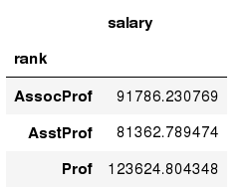
Data Frames groupby method
You can use groupby to group and summarize + calculate various statistics for each group:
In [ ]:
#Calculate mean salary for each professor rank:
df.groupby('rank')[['salary']].mean()
Note: If single brackets are used to specify the column (e.g. salary), then the output is Pandas Series object. When double brackets are used the output is a Data Frame

Slide 28
Data Frame: filtering
To subset the data we can apply Boolean indexing. For example if we want to subset the rows in which the salary value is greater than $120K:
In [ ]:
#Calculate mean salary for each professor rank:
df_sub = df[ df['salary'] > 120000 ]
Any Boolean operator can be used to subset the data:
> greater; >= greater or equal;
< less; <= less or equal;
== equal; != not equal;
In [ ]:
#Select only those rows that contain female professors:
df_f = df[ df['sex'] == 'Female' ]

Slide 29
Data Frames: Selecting columns and rows
When selecting one column, it is possible to use single set of brackets, but the resulting object will be a Series (not a DataFrame):
In [ ]:
#Select column salary:
df['salary']
When we need to select more than one column and/or make the output to be a DataFrame, we should use double brackets:
In [ ]:
#Select column salary:
df[['rank','salary']]
If we need to select a range of rows, we can specify the range using ":"
In [ ]:
#Select rows by their position:
df[10:20]

Slide 30
Numpy + Pandas example…

