Slide 1
κmachine
Martin Larralde
Biochemical Programming 2018-2019
A program machine implementation in Kappa

Slide 2
1. Counter Machines

Slide 3
Counter Machine
Primitive model of register machines, close to actual computers
Finite numbers of registers
Small number of instructions:
  clr(r); inc(r); dec(r); cpy(r1, r2); jz(r, z); je(r1, r2, z)
Program consists in a list of labelled instructions
Turing complete (with a few tricks) !

Slide 4
Program Machine
Defined by Marvin Minsky in 1967¹
Base model using the following instructions:
  inc(r); dec(r); jnz(r, z)
All the remaining instructions can be emulated
(but require more registers to do so)
1: Minsky, M. L. (1967). Computation: Finite and Infinite Machines. ISBN: 978-0-13-165563-8

Slide 5
2. Biological Model

Slide 6
Program
Polymer of instruction agents
One agent /instruction, states as arguments
Labels are treated as instructions

Slide 7
Machine
The machine is modelled as a single agent
Each register is a binding site
Register value is stored as a polymer of units
Units are agents

Slide 8
The Big Picture
INC
cm
r
r1
MACHINE
r2
INC
r1
r3
r
r1
ip
LBL
l
loop
DEC
r
r1
JNZ
r1
r
l
loop

Slide 9
The ACTUAL Big Picture
PROG
INC
r
r1
MACHINE
r2
PROG
INC
r1
r3
r
r1
ip
PROG
LBL
l
loop
PROG
DEC
r
r1
PROG
JNZ
r1
r
l
loop

Slide 10
Agents – Machine
%agent: UNIT(
prev[next.UNIT, r1.MACHINE, …,],
next[prev.UNIT],
r{none, r1, …}
)
%agent: MACHINE(
ip[cm.PROG],
state{run, move, bind},
target{none, l1, …},
r1[prev.UNIT],
…,
)
%obs: ‘r1’ |UNIT(r{r1})|
MACHINE
r2
r1
r3

Slide 11
Agents – Program
%agent: PROG(
prev[next.PROG],
next[prev.PROG],
cm[ip.MACHINE],
ins[prog.ADD, …],
)
%agent: INC(
prog[ins.PROG],
r{r1, …},
)
%agent: JNZ(
prog[ins.PROG],
r{r1, …},
l{l1, …},
)
%agent: LBL(
prog[ins.PROG],
l{l1, …},
)
PROG
INC
r
r1
PROG
LBL
l
l1

Slide 12
Initial State
%init: 1
MACHINE(
ip[0],
state{run},
target{none},
r1[.]
),
PROG (
cm[0],
ins[1],
next[2],
),
…
%init: N UNIT()
MACHINE
PROG
INC
r1
r
r1
ip
PROG
INC
r
r1
PROG
LBL
l
loop
PROG
DEC
r
r1
PROG
JNZ
r1
r
l
loop

Slide 13
3. Execution

Slide 14
Execution
Sequential execution in 2 steps:
  Execute the instruction
  Move to the next instruction
We store the current step (run or move) as a state.

Slide 15
Execution – Movement
PROG
PROG
PROG
move
run
MACHINE
state
MACHINE
MACHINE
PROG
state
PROG
PROG
‘mov’
MACHINE(state{move}, ip[1]),
PROG(cm[1], next[2]),
PROG(cm[.], prev[2])
→
MACHINE(state{run}, ip[1]),
PROG(cm[.], next[2]),
PROG(cm[1], prev[2])
@ 1

Slide 16
Execution – inc(r), ∀r
run
move
MACHINE
MACHINE
state
state
PROG
INC
PROG
INC
r
r
‘inc(rXX)’
MACHINE(state{run}, ip[1], rXX[3]),
PROG(cm[1], ins[2]),
INC(prog[2], r{rXX}),
UNIT(prev[3]),
UNIT(prev[.], next[.], r{none})
→
MACHINE(state{move}, ip[1], rXX[3]),
PROG(cm[1], ins[2]),
INC(prog[2], r{rXX}),
UNIT(prev[4]),
UNIT(prev[3], next[4], r{rXX})
@ 1

Slide 17
Execution – inc(r), ∀r ( ⟦r⟧ρ = 0)
run
move
MACHINE
MACHINE
state
state
PROG
INC
PROG
INC
r
r
‘inc(rXX)’
MACHINE(state{run}, ip[1], rXX[.]),
PROG(cm[1], ins[2]),
INC(prog[2], r{rXX}),
UNIT(prev[.], r{none})
→
MACHINE(state{move}, ip[1], rXX[3]),
PROG(cm[1], ins[2]),
INC(prog[2], r{rXX}),
UNIT(prev[3], r{rXX})
@ 1

Slide 18
Execution – jnz(r, z), ∀r, ∀z ( ⟦r⟧ρ ≠ 0)
run
bind
state
#
l
MACHINE
MACHINE
state
target
target
PROG
r
PROG
r
JNZ
JNZ
l
l
‘jnz(rXX, lXX)’
MACHINE(state{run}, ip[1], target{#}, rXX[_]),
PROG(cm[1], ins[2]),
JNZ(prog[2], r{rXX}, l{lXX}),
→
MACHINE(state{bind}, ip[.], target{lXX}, rXX[3]),
PROG(cm[.], ins[2]),
JNZ(prog[2], r{rXX}, l{lXX}),
@ 1

Slide 19
Execution – Binding
bind
run
l
l
MACHINE
state
MACHINE
state
target
target
PROG
LBL
PROG
LBL
l
l
‘bind(lXX)’
MACHINE(state{bind}, ip[.], target{lXX}),
PROG(cm[.], ins[1]),
LBL(prog[1], l{lXX}),
→
MACHINE(state{run}, ip[2], target{none}),
PROG(cm[2], ins[1]),
LBL(prog[1], l{lXX}),
@ 1

Slide 20
4. Optimisations

Slide 21
Usual emulation of clr(r)
clr can easily be implemented with dec and jnz :
clear:
dec %rax
jnz %rax, clear
clr %rax

Slide 22
Direct Kappa implementation of clr(r)
Possible implementation in Kappa without emulation:
run
run
MACHINE
MACHINE
state
state
r
r
PROG
CLR
PROG
CLR
r
r
run
move
MACHINE
MACHINE
state
state
r
r
PROG
CLR
PROG
CLR
r
r

Slide 23
Actual Kappa implementation of clr(r)
Trick: force depolymerisation of unbound UNIT polymers:
prev
prev
prev
prev
next
next
next
next
r
r
#
none
‘reset units’
UNIT(prev[.], next[_], r{#})
→
UNIT(prev[.], next[.], r{none})
@ inf

Slide 24
Actual Kappa implementation of clr(r)
clr(r) is O(1), UNITs are reset in the background
run
move
MACHINE
MACHINE
state
state
r
r
PROG
CLR
PROG
CLR
r
r
‘clr(rXX)’
MACHINE(state{run}, ip[1], rXX[3]),
PROG(cm[1], ins[2]),
CLR(prog[2], r{rXX}),
UNIT(prev[3]),
→
MACHINE(state{move}, ip[1], rXX[.]),
PROG(cm[1], ins[2]),
CLR(prog[2], r{rXX}),
UNIT(prev[.]),
@ 1

Slide 25
5. Demonstration

Slide 26

Instructions
Compiler from pseudo-ASM to Kappa code
https://github.com/althonos/kmachine
Following instructions available:
  add(r1, r2) O(1)
  clr(r) O(1)
  cpy(r1, r2) O([r1])
  inc(r) O(1)
  jmp(z) O(1)
  jnz(r, z) O(1)
  jz(z) O(1)
  mov(r1, r2) O(1)
  mul(r1, r2) O([r1])
  swp(r1, r2) O(1)

Slide 27
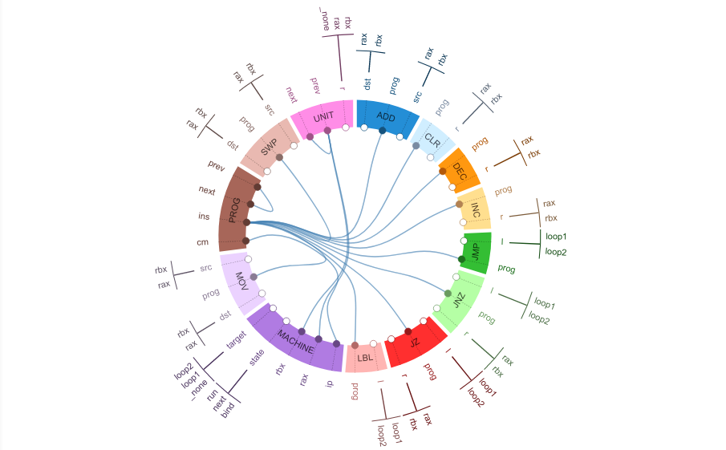
Contact Map

Slide 28
6. Questions ?

