Slide 1
Classes, inheritance and type compatibility

Slide 2
You can pass an object of a derived class to a formal parameter of the base class type

Slide 4
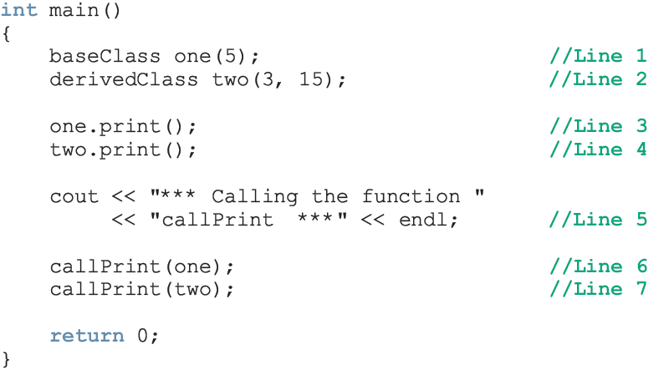
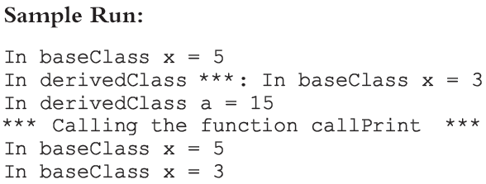

Slide 5
For both statements (Lines 6 and 7), member function print of baseClass was executed
Because the binding of print, in the body of callPrint, occurred at compile time
Compile-time binding: the necessary code to call a specific function is generated by the compiler
Also known as static binding

Slide 6
How can we avoid this problem?
Virtual functions (reserved word virtual)
Virtual function: binding occurs at program execution time, not at compile time
This kind of binding is called run-time binding
Run-time binding: compiler does not generate code to call a specific function; it generates information to enable run-time system to generate specific code for the function call
Also known as dynamic binding

Slide 7
Inheritance, Pointers, and Virtual Functions (continued)

Slide 8
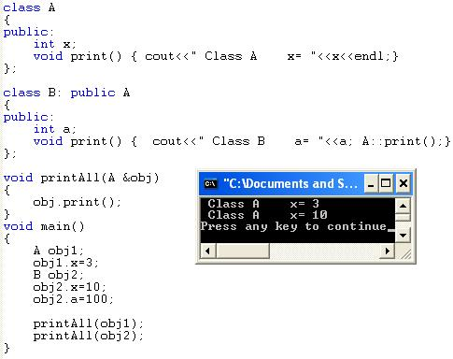
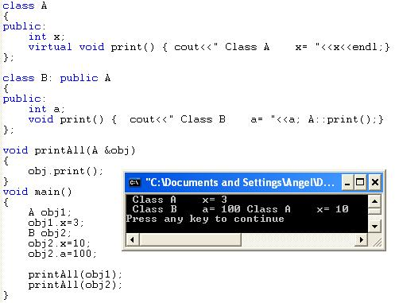

Slide 9
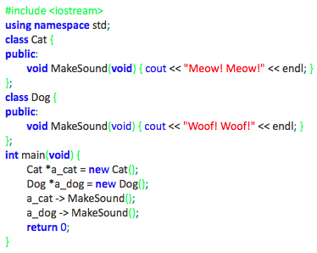
Type compatibility – the simplest case
Each new class constitutes a new type of data. Each object constructed on the basis of such a class is like a value of the new type.
This means that any two objects may (or may not) be compatible in the sense of their types.
Take a look at the very simple example on the right →

Slide 10
Type compatibility – the simplest case cont’d
The objects of the Cat class are not compatible with the objects of the Dog class, although the structure of both classes is identical. Neither of the following assignments is valid and both of them will cause a compiler error:
a_dog = a_cat;
a_cat = a_dog;
As you see, the Dog and Cat classes have nothing in common in the sense of inheritance – they’re both completely independent.
So we can say that objects derived from classes which lie in different branches of the inheritance tree are always incompatible.
The program will produce the following output:
Meow! Meow!
Woof! Woof

Slide 11
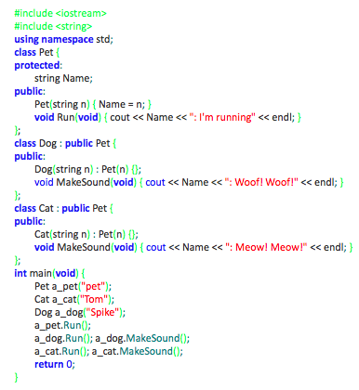
Type compatibility – more complex case (1)
We’ve rebuilt our example significantly. We still have the two previous classes Dog and Cat, but we’ve put them into the same inheritance tree. Take a look →

Slide 12
Type compatibility – more complex case (1) cont’d
objects of the superclass are compatible with objects of the subclass
objects of the subclass are not compatible with objects of the superclass
This means that:
you can do the following:
a_pet = new Dog("Huckleberry");
a_pet -> Run();

Slide 13
Type compatibility – more complex case (1) cont’d
but you cannot do anything like this:
a_pet -> MakeSound();
because Pets don’t know how to make sounds (in our world of classes, at least)
you are not allowed to do the following:
a_dog = new Pet("Strange pet");

Slide 14
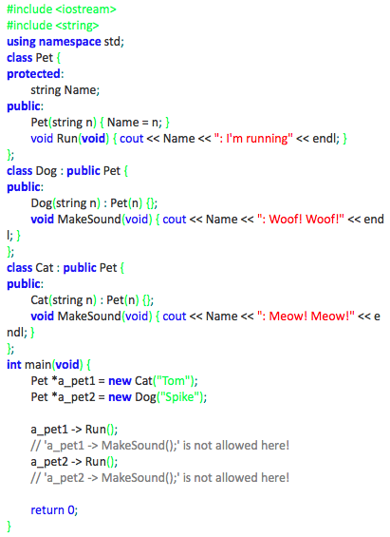
Type compatibility – more complex case (2)
The sample code here →
illustrates the rules we’ve just described.
Analyze the code and pay attention to how the pointer to the superclass objects (a pointer of type Pet *) may serve as a pointer to subclass objects.
The comments mark the statements that would be illegal in this context.
The code produces the following output:
Tom: I'm running
Spike: I'm running

Slide 15
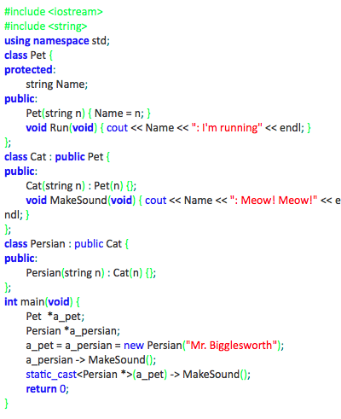
Type compatibility – final case
The rule stating that objects lying at higher levels are compatible with objects at lower levels of the class hierarchy works even when the inheritance chain is arbitrarily long.
The example here → shows a chain of three classes. The pointer to the top-most superclass works perfectly for the bottom-most objects too.
The program emits the following text:
Mr. Bigglesworth: Meow! Meow!
Mr. Bigglesworth: Meow! Meow!

