Slide 1
Capstone Project Data Classification and Summarization Breast Cancer Witconsin (diagnostic)
Student Development Initiative
Muhammad Septian Nugroho

Slide 2
Project Overview
01
02
03
Goal
Models
Metrics
Predict benign vs malignant
Logistic Regression, Random Forest
Accuracy, Precision, Recall, F1 Score, ROC AUC

Slide 3
Analysis Process
02
04
01
03
Load dataset
Target: diagnosis (0=malignant, 1=benign)
Train & evaluate models
Train/test split (stratified)
Visualize ROC + Confusion matrix; Feature Importances

Slide 4
Insight & Findings
Best model: Logistic regression (AUC=0.995)
Important features: texture, concavity, worst area/perimeter, etc.
Great separability; both linear & tree models strong

Slide 5
Conclusion & Recommendations
Use RF or tuned Logistic Regression; calibrate threshold to reduce FN
Consider calibration & hyperparameter tuning
External validation for robustness

Slide 6
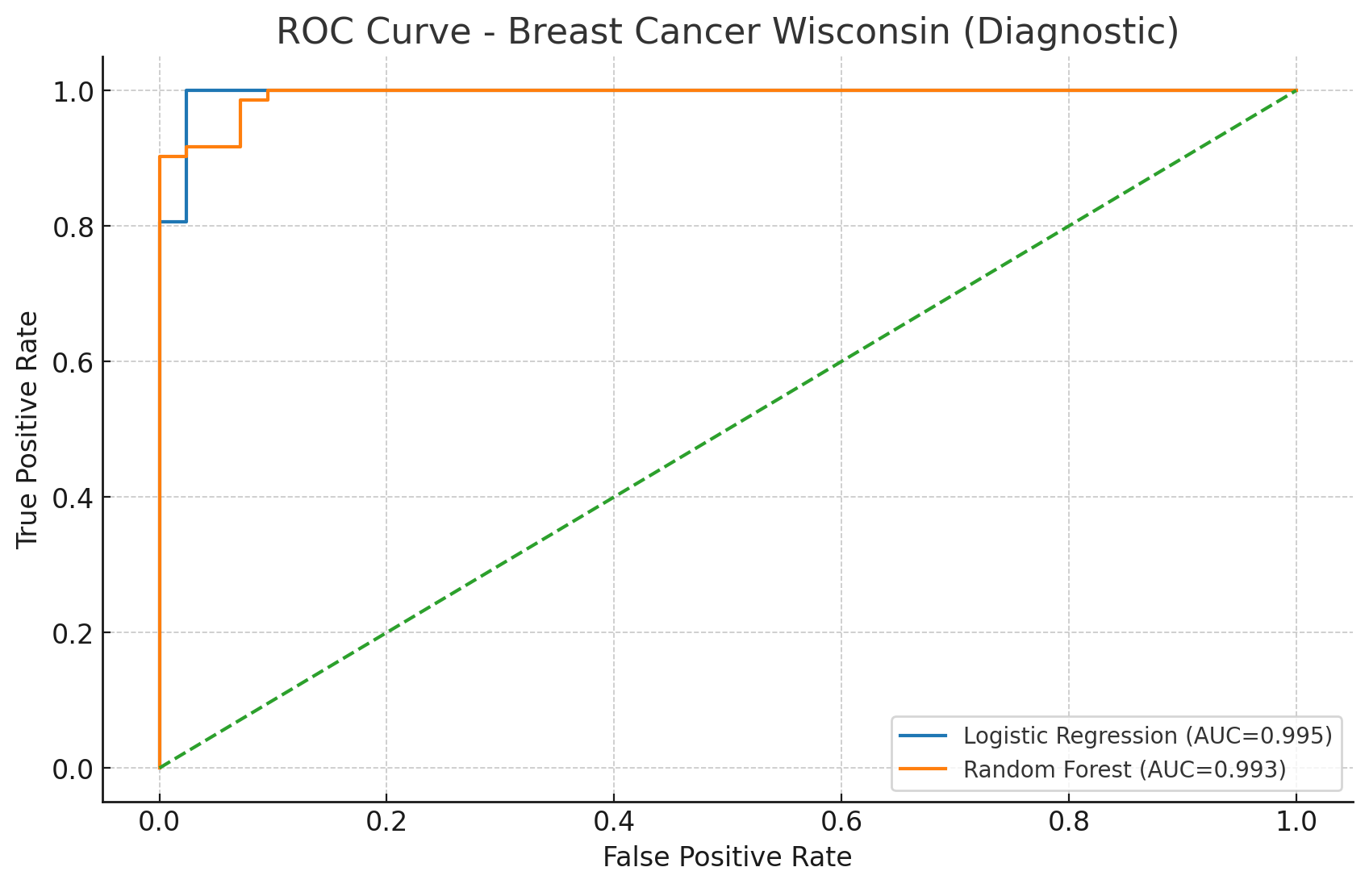
ROC Curve

Slide 7
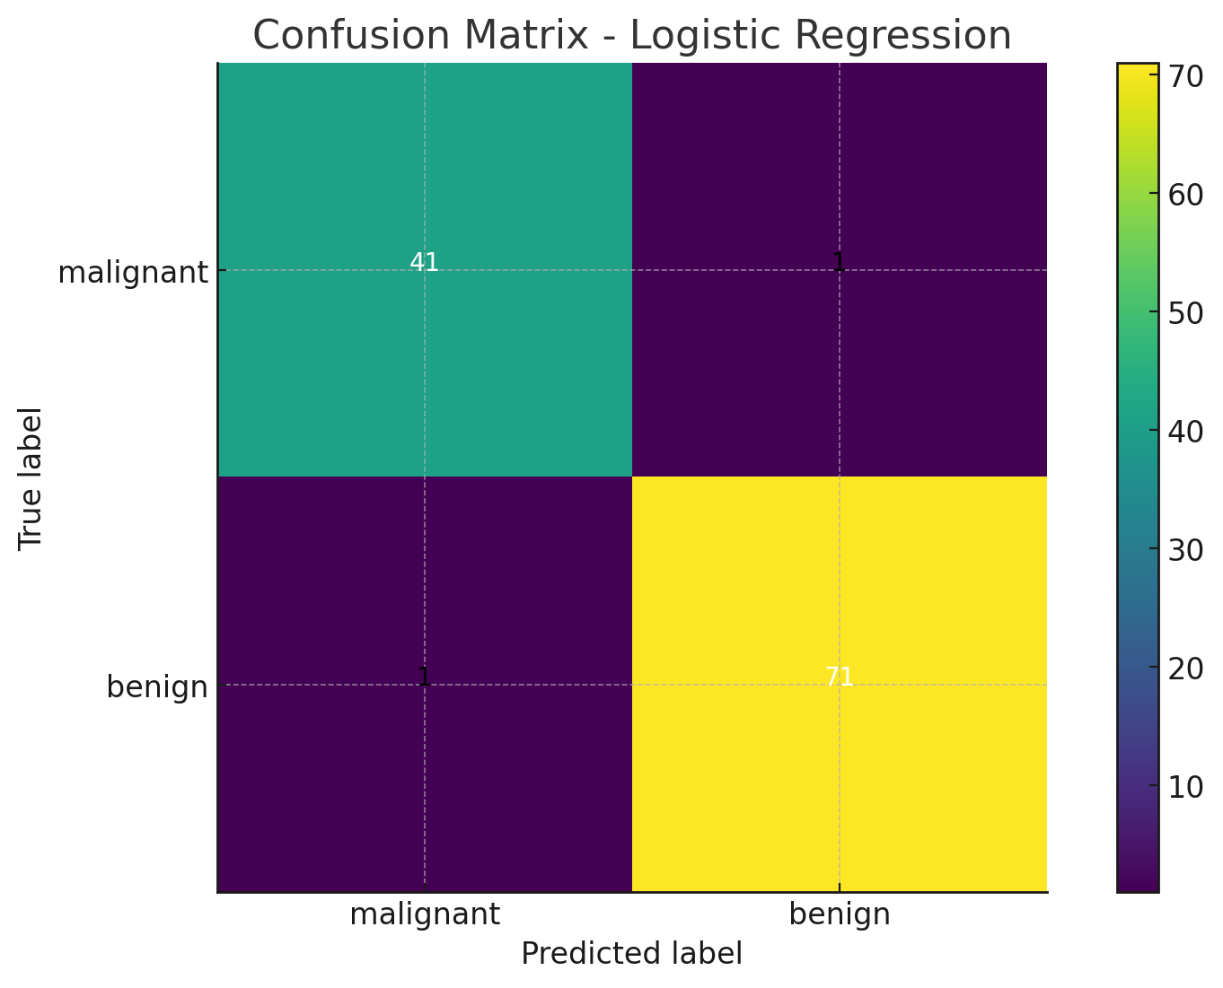
Confusion Matrix – Logistic Regression

Slide 8
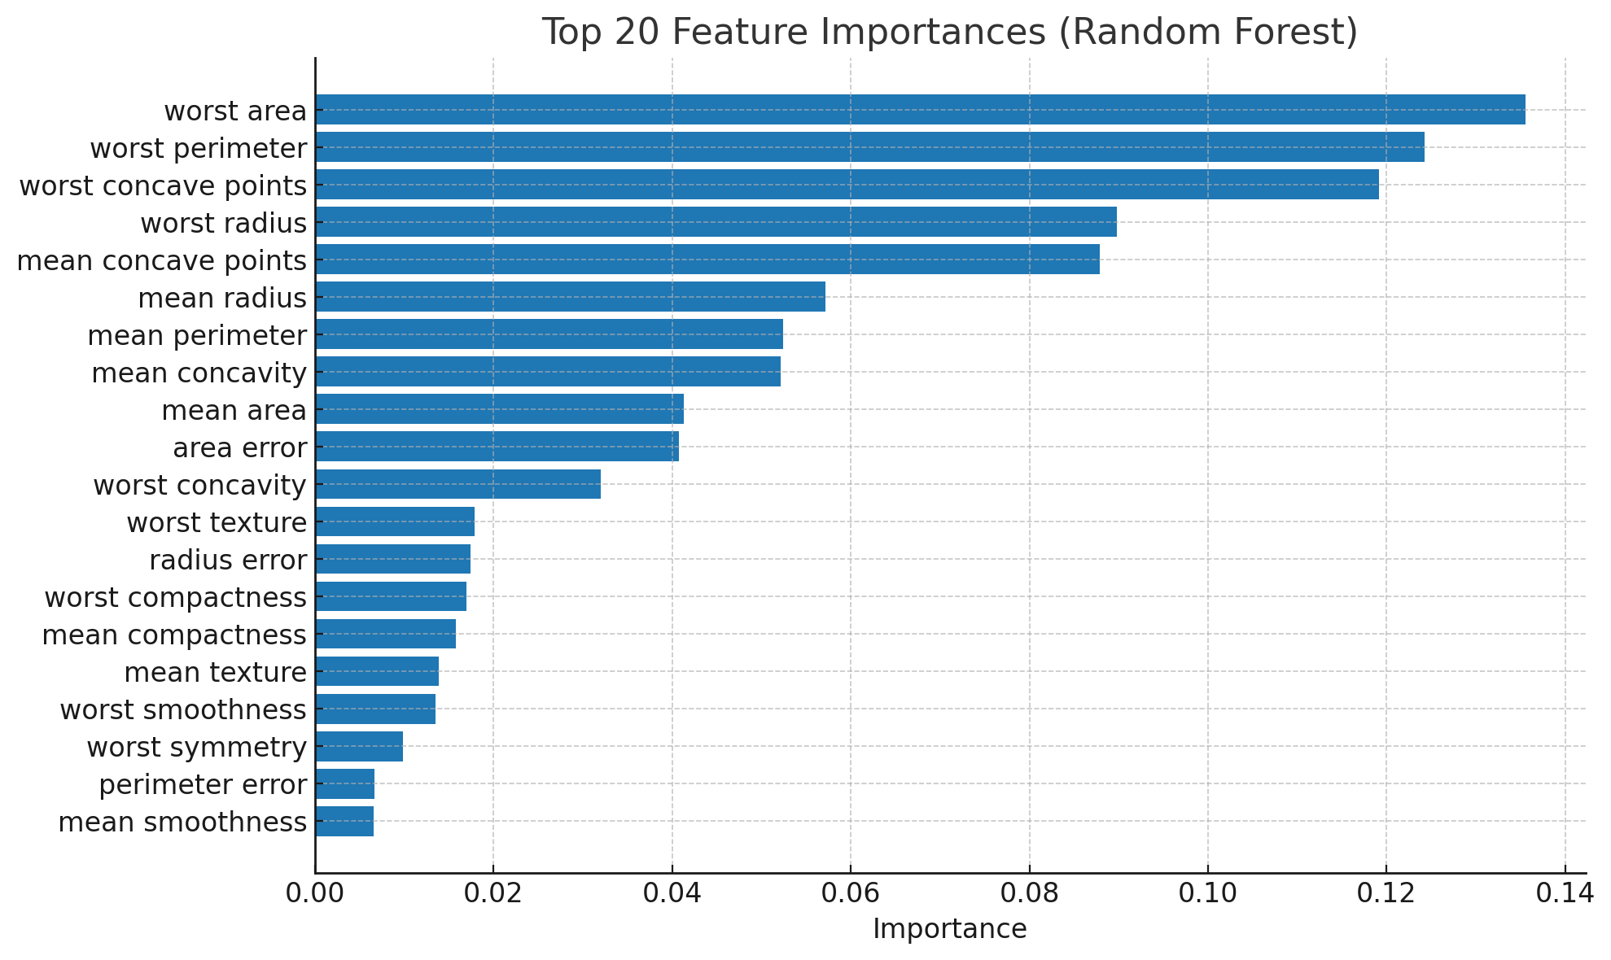
Top 20 Feature Importances (RF)

Slide 9
AI Support (IBM Granite in watsonx.ai)
- Use Granite Chat for summarization / Classification - Prompt: Summarize these metrics into 3 insights + actions - Flows engine for chaining steps

