Slide 1

The Dataset

Slide 2


Experimental setting
The code for the analysis is executed on Colab by using Pyspark
Environment: Colab
GPU: Invidia T4 CPU: 2 Intel(R) Xeon(R) CPU @ 2.00GHz
RAM:12.7GB
ROM:72.8GB

Slide 3
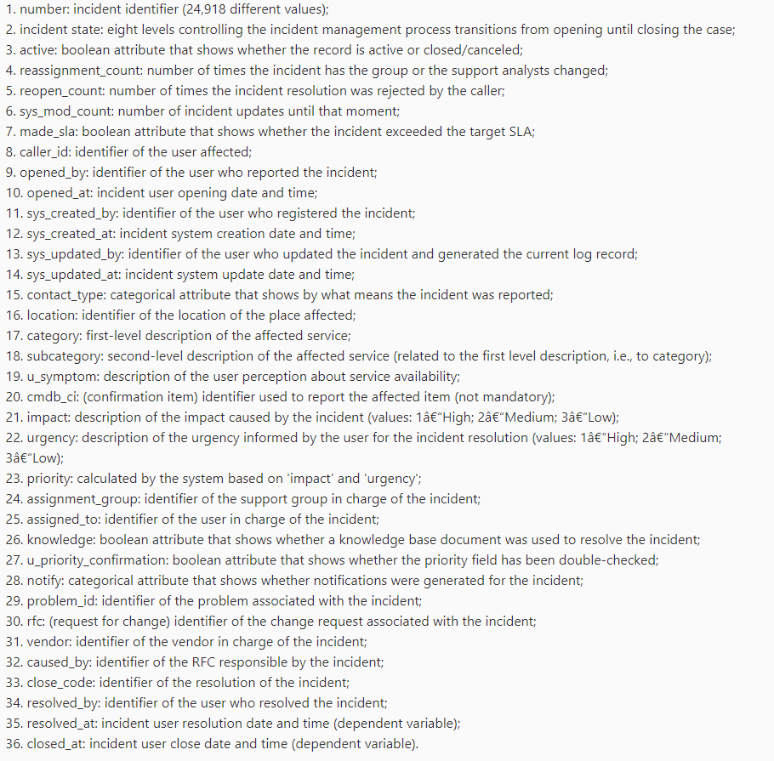
Features

Slide 4
Features manipulation
String Replacement: Removing or replacing specific substrings within the values.
Date Extraction: Extracting specific components (like the date part) from datetime columns.
String Splitting: Splitting strings based on a delimiter and keeping only certain parts.
Column Renaming: Changing column names.
Delete rows that has ‘?’ or Null values and also columns with high occurrence o these values

Slide 5
Number : will be dropped because it is not useful in terms of prediction incident_state : will be dropped because it is not useful in terms of prediction active: Only the rows False because means that the incident ends reassignment_count ,reopen_count : summarized into the sum of the 2 values takes the name of caller_satisfaction sys_mod_count: it is an integer made_sla: from true and false to integer caller_id: dropped not useful opened_by: dropped not useful opened_at: summarized with closed_at in days_op_closed sys_created_by,sys_updated_at: dropped too much ‘?’ values

Slide 6
contact_type : dropped not useful location: integer category:integer subcategory:integer u_symptom,cmdb_ci: dropped too much ‘?’ values impact: integer urgency: integer priority: integer assignment_group: dropped too much ‘?’ values knowledge: boolean u_priority_confirmation: dropped not useful notify: dropped not useful problem_id,rfc,vendor: dropped too much ‘?’ values

Slide 7

Resolved_by:dropped not useful Closed_code: integer Caused_by: dropped too much ‘?’ values Resolved_at,closed_at summarized in days_delay_to_close

Slide 8
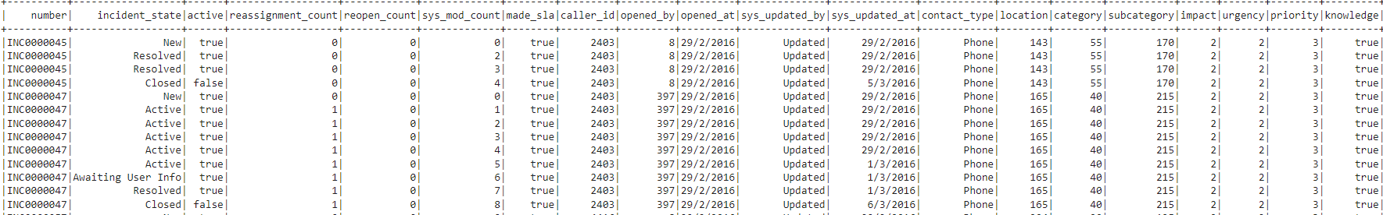
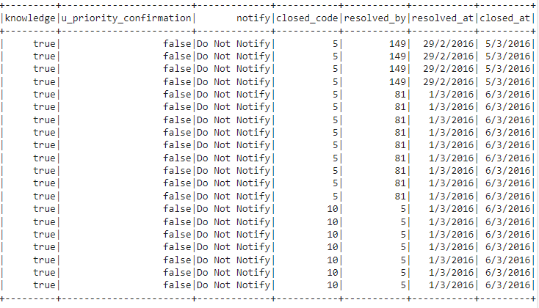
Considering only active=False due of the repetition of information

Slide 9
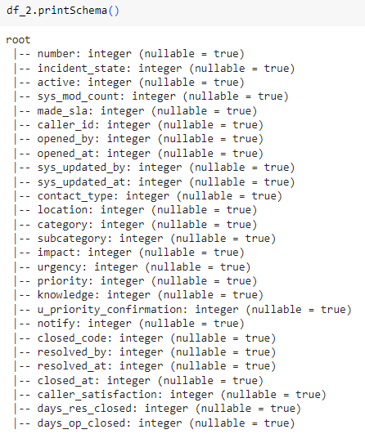
Schema

Slide 10
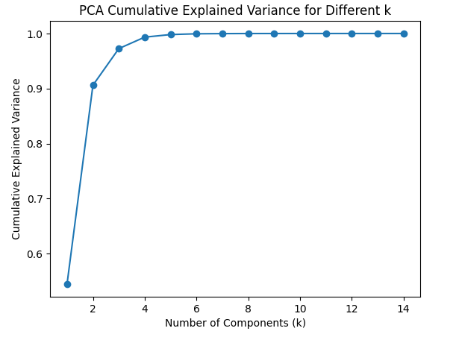
PCA
The point with k=4 is where the rate of variance retention starts to slow down. This point might be a good choice for balancing dimensionality reduction and information retention.
The cumulative explained variance for each k shows how much of the total variance is captured when including up to k principal components.
The goal is to choose a value of k that retains a sufficiently high amount of variance while reducing the dimensionality of the data.
The principal components are 4 and will be selected by using the loadings of them.

Slide 11
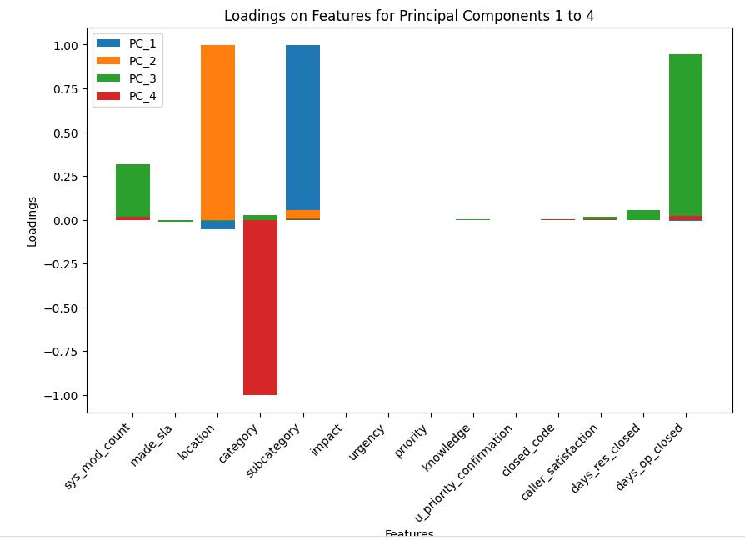
The components chosen are:
location,
category,
subcategory,
days_op_closed

Slide 12
Regression
The dataset on which the models are trained has a number of instances in the training set: 15977, instances in the test set: 6680.
The regression models to guess the days_op_closed uses as features [sys_mod_count+location+category+subcategory]:
1. Random Forest Regressor
Root Mean Squared Error (RMSE): 12.6870
Mean Absolute Error (MAE): 5.6655
R-squared (R2): 0.7117
2. GBTRegressor
Root Mean Squared Error (RMSE): 12.7734
Mean Absolute Error (MAE): 5.0046
R-squared (R2): 0.7077
3. Decision Tree Regressor
Root Mean Squared Error (RMSE): 10.7526
Mean Absolute Error (MAE): 4.9222
R-squared (R2): 0.7929
4. Linear Regressor
Root Mean Squared Error (RMSE): 10.9734
Mean Absolute Error (MAE): 5.8720
R-squared (R2): 0.7843

Slide 13
Regression
The dataset on which the models are trained has a number of instances in the training set: 15977, instances in the test set: 6680.
The regression models to guess the sys_mod_countuses as features [sys_mod_count+location+category+subcategory+ days_op_closed]:
1. Random Forest Regressor
Root Mean Squared Error (RMSE): 5.5264
Mean Absolute Error (MAE): 2.7672
R-squared (R2): 0.6083
2. Linear Regressor
Root Mean Squared Error (RMSE): 4.4409
Mean Absolute Error (MAE): 2.6223
R-squared (R2): 0.7471

Slide 14
Regression
The dataset on which the models are trained has a number of instances in the training set: 15977, instances in the test set: 6680.
The regression models to guess the days_res_closed as features [sys_mod_count+location+category+subcategory+ days_op_closed]:
1. Random Forest Regressor
Root Mean Squared Error (RMSE) on test data: 5.07
Mean Absolute Error (MAE): 1.5568
R-squared (R2): 0.2748
2. Linear Regressor
Root Mean Squared Error (RMSE): 5.5264
Mean Absolute Error (MAE): 2.7672
R-squared (R2): 0.6083

Slide 15
Classification
The dataset on which the models are trained has a number of instances in the training set: 15977, instances in the test set: 6680.
The regression models to guess the caller_satisfaction that uses as features [days_op_closed+location+category+subcategory]:
1. Random Forest Classifier
Test accuracy: 56.81%
Area under ROC curve: 0.6864
Weighted Precision: 0.4382
Weighted Recall: 0.5681
F1 Score: 0.4946
Decision Tree
Test accuracy: 57.04%
Area under ROC curve: 0.7168
Weighted Precision: 0.4708
Weighted Recall: 0.5704
F1 Score: 0.5069

Slide 16
Classification
The dataset on which the models are trained has a number of instances in the training set: 15977, instances in the test set: 6680.
The classification models to guess the made_sla that uses as features [days_op_closed+location+category+subcategory]:
1. Random Forest Classifier
Test accuracy: 95.67%
Area under ROC curve: 0.9583
Weighted Precision: 0.9576
Weighted Recall: 0.9567
F1 Score: 0.9569
Decision Tree
Test accuracy: 95.64%
Area under ROC curve: 0.9557
Weighted Precision: 0.9567
Weighted Recall: 0.9564
F1 Score: 0.9565

Slide 17
Classification
The dataset on which the models are trained has a number of instances in the training set: 15977, instances in the test set: 6680.
The classification models to guess the urgency that uses as features [days_op_closed+location+category+subcategory]:
1. Random Forest Classifier
Test accuracy: 95.42%
Area under ROC curve: 1.0000
Weighted Precision: 0.9302
Weighted Recall: 0.9542
F1 Score: 0.9320
Decision Tree
Test accuracy: 95.46%
Area under ROC curve: 1.0000
Weighted Precision: 0.9516
Weighted Recall: 0.9546
F1 Score: 0.9333

Slide 18
Classification
The dataset on which the models are trained has a number of instances in the training set: 15977, instances in the test set: 6680.
The classification models to guess the priority that uses as features [days_op_closed+location+category+subcategory]:
1. Random Forest Classifier
Test accuracy: 95.42%
Area under ROC curve: 1.0000
Weighted Precision: 0.9302
Weighted Recall: 0.9542
F1 Score: 0.9320
Decision Tree
Test accuracy: 95.46%
Area under ROC curve: 1.0000
Weighted Precision: 0.9516
Weighted Recall: 0.9546
F1 Score: 0.9333

Slide 19
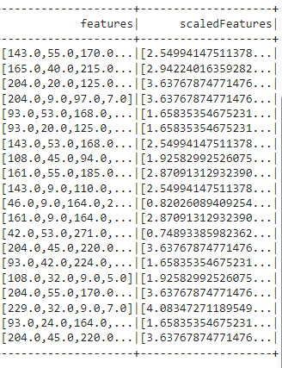
Clustering
The clustering model used is the K-means with the futures obtained by the PCA and produces the ScaledFeatures by using the Pyspark library.
Advantages of StandardScaler:
Equalizes Scale: By ensuring that all features have a mean of zero and a standard deviation of one. The StandardScaler brings features to a comparable scale.
Improved Convergence: Standardizing features can help optimizing algorithms convergence more quickly during the training of machine learning models.

Slide 20
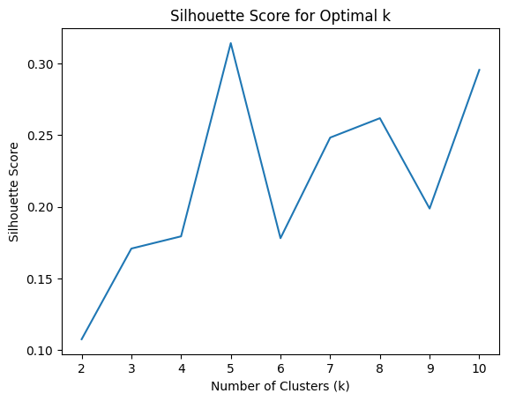
Clustering
The k that yields the highest silhouette score is often considered the optimal number of clusters. This is because it indicates that the objects within each cluster are well-matched and separated from objects in other clusters.
In this graph the better value of the silhouette score is 5, therefore 5 clusters will be obtained.

Slide 21
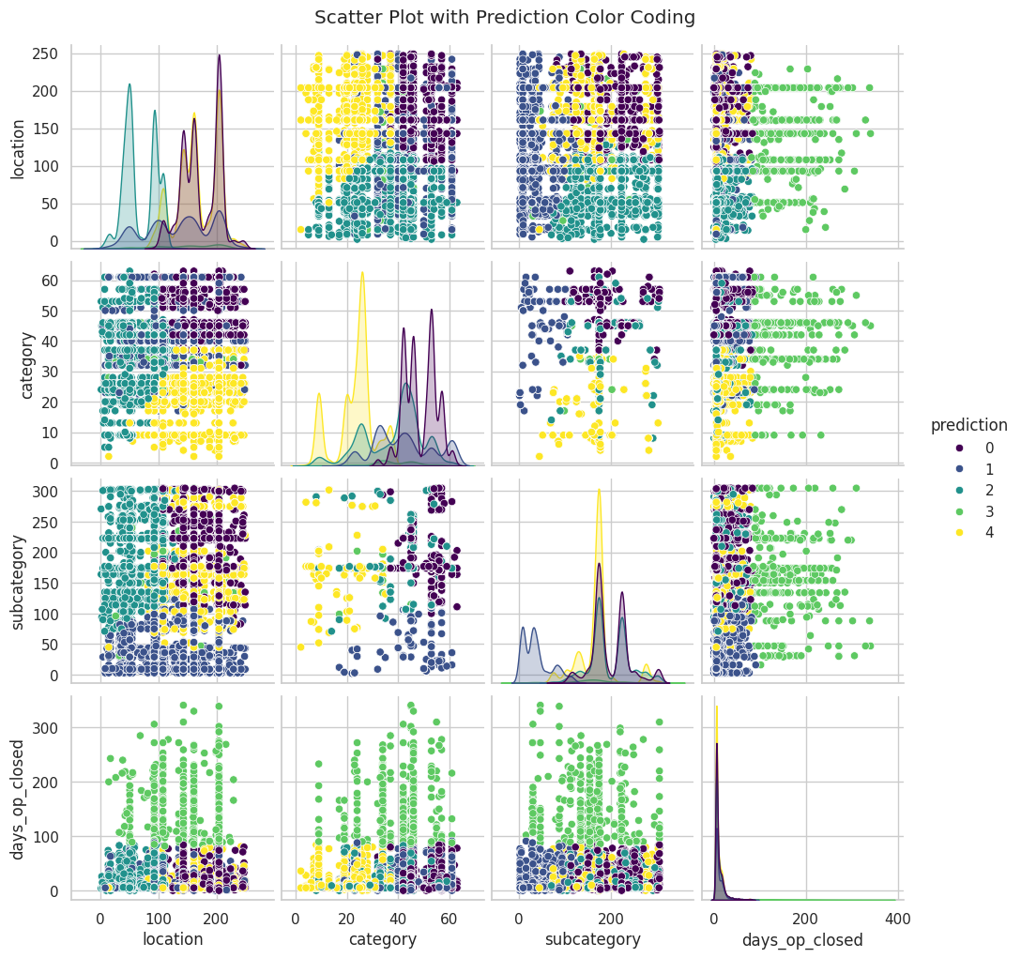
Clustering
The optimal clustering combination to achieve a better segmentation within groups is one that considers both category and subcategory distinctions.

Slide 22
Decision Tree Classifier on clusters prediction
Results obtained:
Test accuracy: 95.88%
Area under ROC curve: 0.9577
Weighted Precision: 0.9579
Weighted Recall: 0.9588
F1 Score: 0.9578

