Slide 1
Welcome to the PowerPoint UI Toolkit
The goal of this toolkit is to help designers and developers put together high-fidelity UI wireframes using standard controls and patterns.

Slide 2
What’s in this Toolkit?
ANATOMY OF THE TOOLKIT
Slide 1: Intro
Slide 2: Table of Contents
Slides 3-4: Instructions
Slides 5-7: Type & Colors
On this slide are the standard type sizes, as well as the basic colors you should use in your comps. This toolkit was designed to be used with the Light Theme.
Slide 8: Device Frame
The device frames represent the common sizes within the three device snap points (phone, tablet, desktops). These are the standard screen sizes that the design team is targeting. Within each frame, the dotted red lines indicate the standard page margins; your UI should fit within these boundaries (though it can scroll off the bottom).

Slide 3
How to use the Toolkit
Start by saving a copy of this deck. Don’t save over the original!
Make sure that you have Visual Studio 2013 Premium or Ultimate installed.
Go to the Storyboarding tab and open the Storyboard Shapes panel. Import storyboard shapes from the Storyboard Shapes directory included in this download.
Use the device frames for whichever devices the app is targeting. Most Universal Windows Platform apps will show UI across all three.
Turn on Guides in the View tab. Your UI should fall within the guides.
Drag the controls you need from Storyboard Shapes into the device frames. Use the type styles and color swatches provided, and refer to the UX guidelines documentation for more about how to put a page together.
Keep the device frame on the top of the layers so that controls do not overlap. (Labeled “KEEP ON TOP (XXXXX Frame)”)
When you’ve created your screens, you can export individual slides by selecting “Save As” (PNG format) and “Just This One” when prompted.

Slide 4
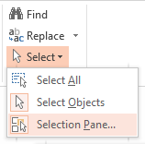
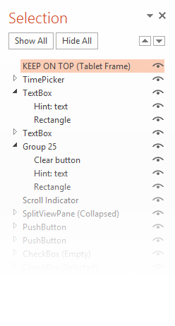
Helpful tip
PowerPoint has a layer panel—you can find it under the Editing group in the Home tab.

Slide 5
Type Styles
Copy and paste these styles into your comps to conform to the standard type styles.
Header
Subheader
Title
Subtitle
Base
Body
Caption

Slide 6
Color swatches
Use these colors for your text and UI elements.
RESPECT THEME
BaseLow
BaseMediumMid
BaseMid
BaseMediumHigh
BaseHigh
ListHover
List Press
ListSelectRest
ListSelectHover
ListSelectPress
More colors on the next slide…

Slide 7
Color swatches continued
Use these colors for your text and UI elements.
RESPECT THEME
AccentHigh
ChromeLow
ChromeMediumMid
ChromeMid
ChromeHigh
ChromeContrast
DO NOT RESPECT THEME
BaseWhite
BaseBlack

Slide 8


