Slide 1
FHE MOD2.
Alexey Titov,
Alexander Lyashevsky
Inspired by Boaz Barak and Zvika Brakerski
https://windowsontheory.org/2012/05/02/building-the-swiss-army-knife/
Jan20th 2021

Slide 2
A fully homomorphic encryption scheme
a, b ∈ {0, 1}, plaintext
c_{a}= E(a), c_{b} = E(b) – encryption
a = D(c_{a}), b = D(c_{b}) – decryption
Add(a,b) = XOR (a,b)%2 = D(add(c_{a} ,c_{b}))
Mul(a,b) = AND(a,b)%2 = D(mul(c_{a} ,c_{b}))
To achieve full homomorphism, it is sufficient to homomorphically evaluate addition and multiplication - {XOR, AND} - modulo 2.

Slide 3
Talk
Security parameters.
Homomorphic encryption interface.
KeyGen, Encrypt, Decrypt
HE Add (XOR%2)
HE Mul (AND%2)
Leveled HE
Full HE
Is it secure?

Slide 4

Security parameters
$$λ≅256, ε≅ 2^{−\sqrt{λ}}$$

Slide 5
HE Interface:
KeyGen
Encode
Encrypt
Decrypt
Decode
Add
Multiply

Slide 6
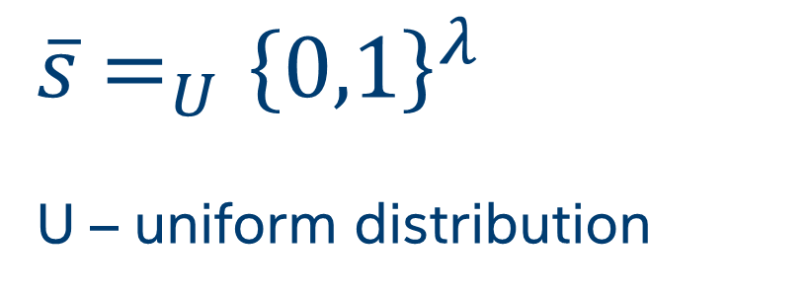
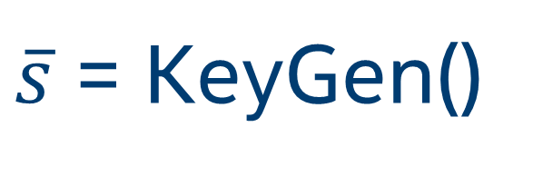
$\overline{s}$ = KeyGen()
$\overline{s}$ $=_{U}{\left\{0,1\right\}}^{λ}$
U – uniform distribution
Notes:
S is a vector

Slide 7


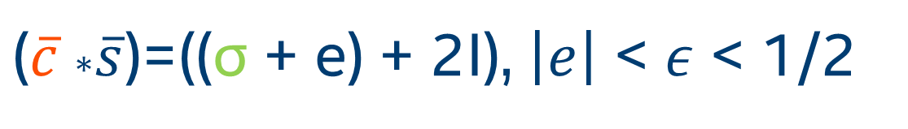
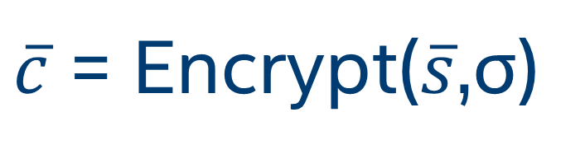


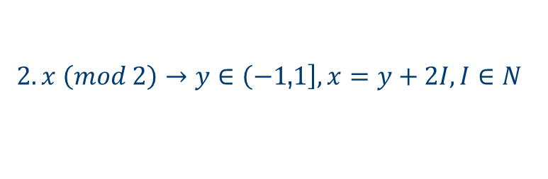

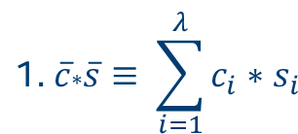
$\overline{c}$ = Encrypt($\overline{s}$,σ)
cyphertext
plaintext
$\overline{c}$ $=_{U}$ ${\left(−1,\left.1\right]\right.}^{λ}$
$$σ ε \left\{0,1\right\}$$
$$\text{1. }\overline{c}\text{∗}\overline{s}≡ \sum_{i=1}^{λ}{c_{i}∗s_{i}}$$
$\overline{c}$ $\text{∗}\overline{s}\text{(}\text{mod}\text{ 2) }=_{ε} σ$
$2. x \left(mod 2\right)→y∈\left(−1\right.$,$\left.1\right], x=y+2I, I∈N$
$3. x=_{ε}y≡$ $\left|x−y\right|≤ε$
$\text{(}\overline{c} \text{∗}\overline{s}\text{)=((}\text{σ}\text{ + }\text{e}\text{) + 2}\text{I}\text{), }\left|e\right|$ < $ε$ < 1/2

Slide 8
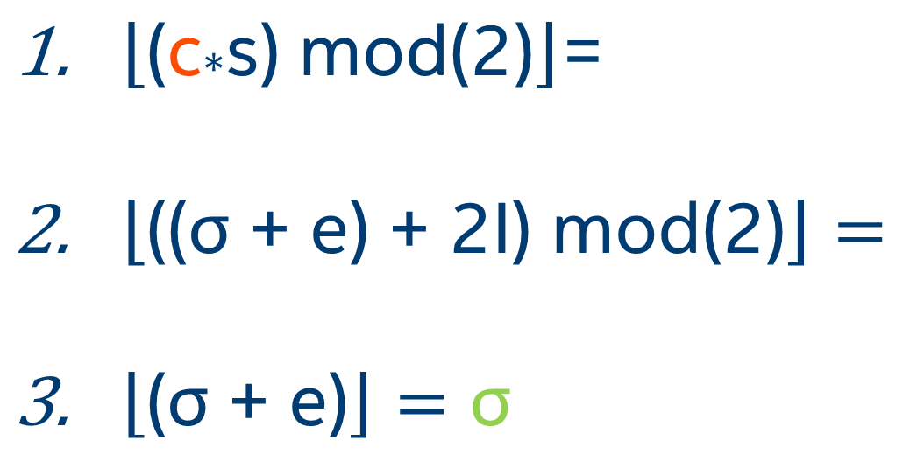
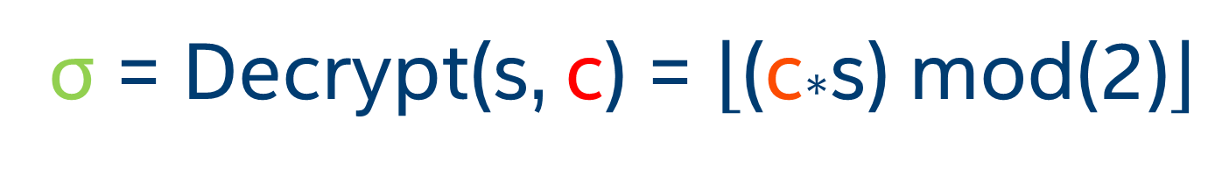

σ = Decrypt(s, c) = $\left\lfloor \text{(}\text{c}\text{∗}\text{s}\text{) }\text{mod}\text{(2)}\right\rfloor$
$\left\lfloor \text{(}\text{c}\text{∗}\text{s}\text{) }\text{mod}\text{(2)}\right\rfloor \text{= }$
$\left\lfloor \text{((}\text{σ}\text{ + }\text{e}\text{) + 2}\text{I}\text{) }\text{mod}\text{(2)}\right\rfloor =$
$\left\lfloor \text{(}\text{σ}\text{ + }\text{e}\text{)}\right\rfloor =\text{σ}$
iff $\left|e\right| \text{< }ε<1/2 \text{is} \text{called}\text{ "}\text{noise}\text{"}$

Slide 9

$$c_{add}=Add(c_{1},c_{2})$$

Slide 10


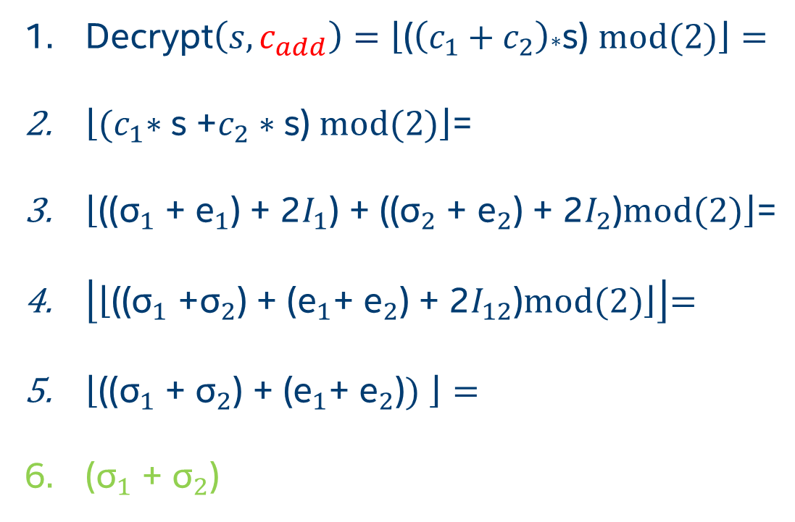
$c_{add}=(c_{1}+c_{2})$ mod(2)
Decrypt$\left(s,c_{add}\right)=\left\lfloor \text{(}\left(c_{1}+c_{2}\right)\text{∗}\text{s}\text{) }\text{mod}\text{(2)}\right\rfloor =$
$\left\lfloor {(c}_{1}∗\text{s}\text{ +}c_{2}∗\text{s}\text{)} \text{mod}\text{(2)}\right\rfloor \text{=}$
$\left\lfloor \text{((}{\text{σ}}_{1}\text{ + }{\text{e}}_{1}\text{) + 2}I_{1}\text{) + ((}{\text{σ}}_{2}\text{ + }{\text{e}}_{2}\text{) + 2}I_{2}\text{)}\text{mod}\text{(2)}\right\rfloor \text{=}$
$\left\lfloor \left\lfloor \text{((}{\text{σ}}_{1}\text{ +}{\text{σ}}_{2}\text{) + (}{\text{e}}_{1}\text{+ }{\text{e}}_{2}\text{) + 2}I_{12}\text{)}\text{mod}\text{(2)}\right\rfloor \right\rfloor \text{=}$
$\left\lfloor \text{((}{\text{σ}}_{1}\text{ + }{\text{σ}}_{2}\text{) + (}{\text{e}}_{1}\text{+ }{\text{e}}_{2}\text{)}\text{)} \right\rfloor =$
$\text{(}{\text{σ}}_{1}\text{ + }{\text{σ}}_{2}\text{)}$
iff $\left|{\text{e}}_{1}\text{+ }{\text{e}}_{2}\right| \text{<} 2ε<1/2\text{ − }\text{additive}\text{ "}\text{noise}\text{"}$
Notes:
Works due to distributivity linearity

Slide 11

$$c_{mul}=Mul(c_{1},c_{2})$$

Slide 12
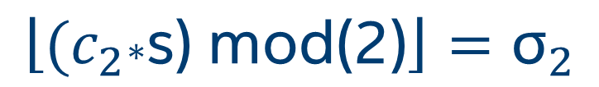

Given:
$$\left\lfloor \text{(}c_{1}\text{∗}\text{s}\text{) }\text{mod}\text{(2)}\right\rfloor ={\text{σ}}_{1}$$
$$\left\lfloor \text{(}c_{2}\text{∗}\text{s}\text{) }\text{mod}\text{(2)}\right\rfloor ={\text{σ}}_{2}$$
Wanted:
$$\left\lfloor \text{(}c_{mul}\text{(}c_{1},c_{2})\text{∗}\text{s}\text{) }\text{mod}\text{(2)}\right\rfloor ={\text{σ}}_{1}{\text{σ}}_{2}$$

Slide 13
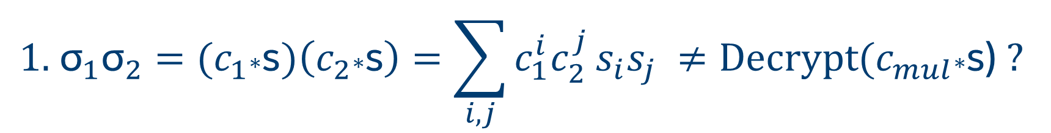
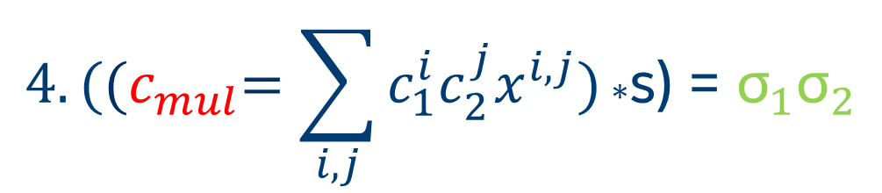
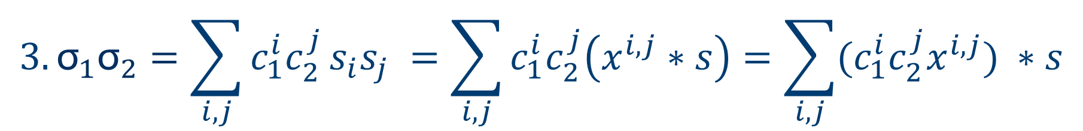
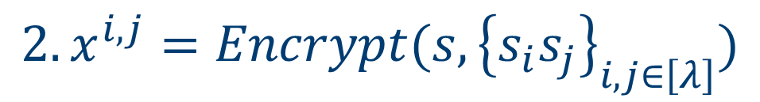
$${\text{1. }\text{σ}}_{1}{\text{σ}}_{2}={(c}_{1}\text{∗}\text{s})\left(c_{2}\text{∗}\text{s}\right)=\sum_{i,j}{c_{1}^{i}c_{2}^{j}}s_{i}s_{j} ≠\text{Decrypt}\text{(}c_{mul}\text{∗}\text{s}\text{)} ?$$
$${2. x}^{i,j}=Encrypt(s, {\left\{s_{i}s_{j}\right\}}_{i,j∈\left[λ\right]})$$
$$3. {\text{σ}}_{1}{\text{σ}}_{2}=\sum_{i,j}{c_{1}^{i}c_{2}^{j}}s_{i}s_{j} =\sum_{i,j}{c_{1}^{i}c_{2}^{j}\left(x^{i,j}∗s\right)}=\sum_{i,j}{{(c}_{1}^{i}c_{2}^{j}x^{i,j}) ∗s}$$
$$4. \text{(}{(c}_{mul}=\sum_{i,j}{c_{1}^{i}c_{2}^{j}x^{i,j})}\text{∗}\text{s}\text{) = }{\text{σ}}_{1}{\text{σ}}_{2}$$
Notes:
Got s^2, need to low the s power back to linear

Slide 14
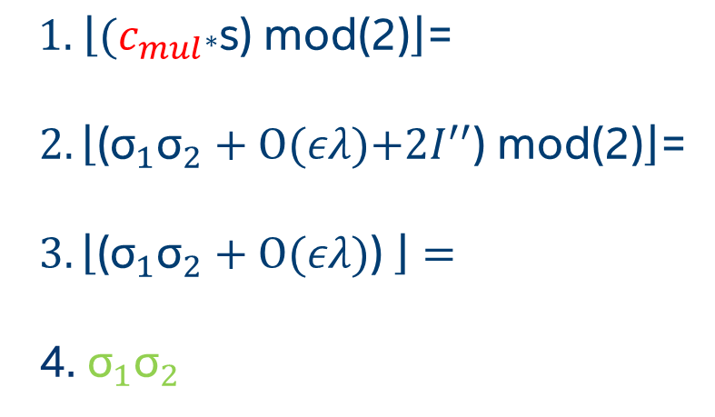
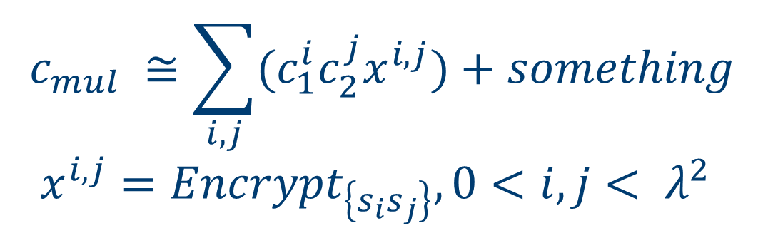
$$c_{mul} ≅\sum_{i,j}{{(c}_{1}^{i}c_{2}^{j}x^{i,j})+something}$$
$x^{i,j}={Encrypt}_{\left\{s_{i}s_{j}\right\}},0<i,j< λ^{2}$
$$\text{1. }\left\lfloor \text{(}c_{mul}\text{∗}\text{s}\text{) }\text{mod}\text{(2)}\right\rfloor \text{=}$$
$2.\left\lfloor \text{(}{\text{σ}}_{1}{\text{σ}}_{2}\text{ + }O\text{(}ελ\text{)+2}I^{′′}\text{) }\text{mod}\text{(2)}\right\rfloor$=
$3.\left\lfloor \text{(}{\text{σ}}_{1}{\text{σ}}_{2}\text{ + }O\text{(}ελ\text{)}\text{) }\right\rfloor =$
4. ${\text{σ}}_{1}{\text{σ}}_{2}$
$$iff ελ <1/2 \text{is} \text{a} \text{multiplicative}\text{ "}\text{noise}\text{"}$$

Slide 15
Leveled HE

Slide 16




$$Noise\left(Add\right)≅O\text{(}2ε\text{)}$$
$$Noise\left(Mul\right)≅O\text{(}ελ\text{)}$$
$$Noise\left(f^{\text{o}\text{(}\text{d}\text{)}}\right)≅O\text{(}ελ^{O\text{(}\text{d}\text{)}}\text{)}\text{ < 1/2}$$
homomorphic encryption scheme, called “leveled HE”, can evaluate
arithmetic circuit of depth(level) d
if d is known upfront a proper $λ$ can be selected

Slide 17
Full HE = HE+bootstrapping

Slide 18

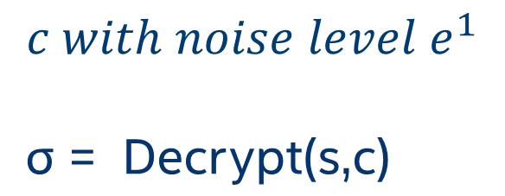

Bootstrapping
is a homomorphic evaluation of the Decryption function
$$f(x,y)=Decrypt(s,c) \text{with} \text{depth} \text{d}$$
$s_{enc}=Encrypt(s,s)$
$$c with noise level e^{1}$$
$$\text{σ}\text{ = }\text{Decrypt}\text{(}\text{s}\text{,}\text{c}\text{)}$$
${c^{′}\text{ = }\text{σ}}_{enc}=fhom\left(s_{enc},c\right) with noise level e^{2}$ << $e^{1}$
$\text{σ} =Decrypt\left(s,c^{′}\right)$

Slide 19
Is it secure? LWE

Slide 20
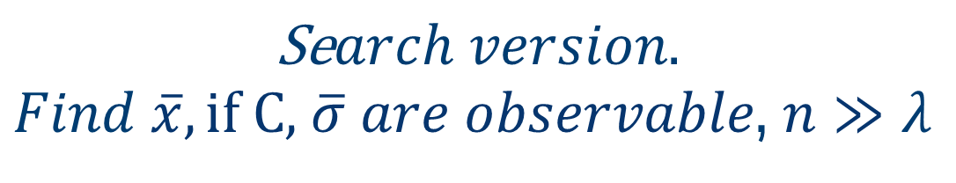

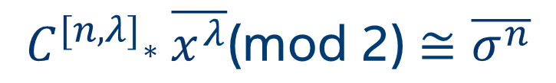

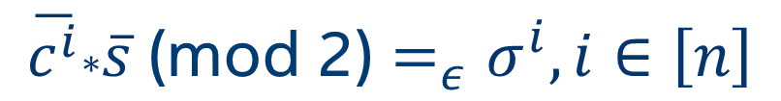
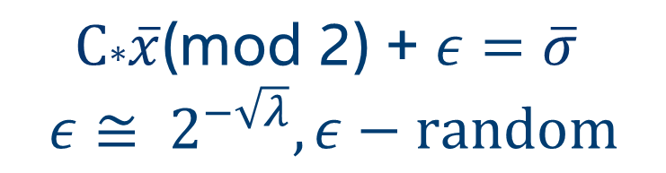


$$Learning with errors.$$
Oded Regev, 2005 (2018 Gödel Prize)
$$\overline{c^{i}}\text{∗}\overline{s} \text{(}\text{mod}\text{ 2)}=_{ε}σ^{i},i∈\left[n\right]$$
$$\text{Se}arch version.$$
$Find \overline{x}, \text{if} \text{C}\text{,}$ $\overline{σ} are observable$, $n≫λ$
$$C^{[n,λ]}\text{∗} \overline{x^{λ}}\text{(}\text{mod}\text{ 2)}≅\overline{σ^{n}}$$
$$\text{C}\text{∗}\overline{x} =\overline{σ}$$
$$\text{C}\text{∗}\overline{x}\text{(}\text{mod}\text{ 2) + }ε=\overline{σ}$$
$$ε≅ 2^{−\sqrt{λ}},ε−random$$
$$Feasible.$$
Insecure.
$\text{Infeasible}$.
Quantum safe.
Notes:
simple Gaussian elimination

