Slide 1
HE computational basics.
Alexey Titov,
Alexander Lyashevsky
Inspired by
“HEAAN Demystified: Accelerating Fully Homomorphic Encryption Through Architecture-centric Analysis and Optimization”, https://arxiv.org/, Mar, 2020
Dec 17th 2020

Slide 2
Talk content
Main thesis
Problem setting
HE MatMul complexity
CRT-RNS Ops
“Instructions” proposals
Conclusions

Slide 3
Main thesis
The first step to the HE (and PPC) acceleration is
to implement a fast native integer modulo operations
data types: 26, 32, 52 or 64 bit.
Notes:
That’s what I intent to prove at least on theoretical level
MVP: to be able to design, test and integrate into the SW stack.

Slide 4
Problem setting

Slide 5

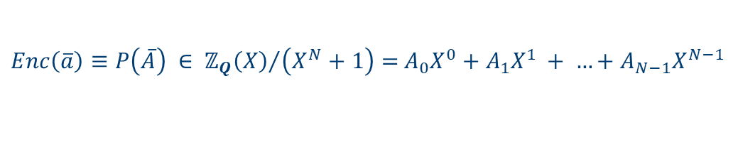





Data morphism
$$\overline{a} ≡Dec\left(P\left(\overline{A}\right)\right)$$
$Enc\left(\overline{a}\right)≡P\left(\overline{A}\right) ∈ {ℤ_{Q}\left(X\right)}/{\left(X^{N}+1\right)}=$ $A_{0}X^{0}+A_{1}X^{1 }+ …+A_{N−1}X^{N−1}$
PV-20
PP-21
$$\overline{a}$$
n
$P\left(\overline{A}\right)≡$ $\overline{A}$
N
Enc
Dec
$$μ{ }$$
$$\log{\text{Q} }$$
$N \sim 2^{16}$Q$\sim 2^{2048} μ \sim 64$n$≤N/2$
PT-23
Notes:
Parallel vector machine operates only on vectors – plaintext, message
Parallel Polynomial HE machine operates only on vectors - polynomials - crypto text
Enc/Dec bi-directional map hiding gory details of HE protocol
cyclotomic polynomial ring finite field order Q
If N fixed n is also fixed, the cost is the same

Slide 6

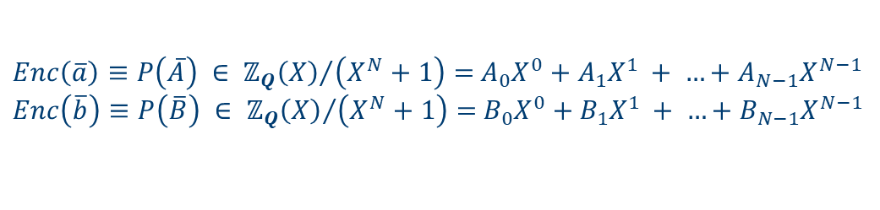

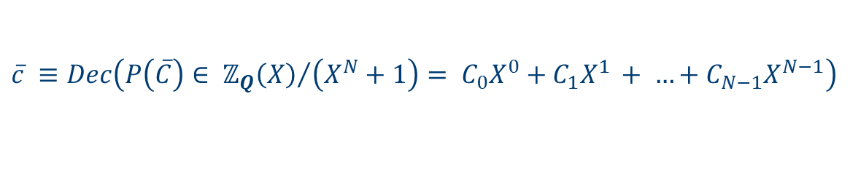





Homo morphism
$Enc\left(\overline{a}\right)≡P\left(\overline{A}\right) ∈ {ℤ_{Q}\left(X\right)}/{\left(X^{N}+1\right)}=$ $A_{0}X^{0}+A_{1}X^{1 }+ …+A_{N−1}X^{N−1}$
$Enc\left(\overline{b}\right)≡P\left(\overline{B}\right) ∈ {ℤ_{Q}\left(X\right)}/{\left(X^{N}+1\right)}=$ $B_{0}X^{0}+B_{1}X^{1 }+ …+B_{N−1}X^{N−1}$
PV-20
PP-21
$$P(\overline{C)}= Eval(+, Enc\left(\overline{a}\right),Enc\left(\overline{b})\right)$$
BigInt
add
$\overline{a}+\overline{b}=elemwise\left(a_{i}+b_{i}\right)=\overline{c}$
$P\left(\overline{A}\right)+ P\left(\overline{B}\right)=\overline{A}+\overline{B}$= $elemwise(A_{i}+B_{i})$=$\overline{C} =P\left(\overline{C}\right)$
BigInt
Mul
BigInt
add
$$P(\overline{C)}= Eval(∗, Enc\left(\overline{a}\right),Enc\left(\overline{b})\right)$$
$\overline{a}∗\overline{b}=elemwise\left(a_{i}∗b_{i}\right)=\overline{c}$
$$\overline{c}=Dec\left(P\left(\overline{C}\right)\right)$$
$P\left(\overline{A}\right) ∗P\left(\overline{B}\right){= conv(\overline{A},\overline{B})}_{}$= $\overline{C} =P\left(\overline{C}\right)$
$$\overline{c}=Dec\left(P\left(\overline{C}\right)\right)$$
$$\overline{c} ≡Dec\left(P\left(\overline{C}\right)∈ {ℤ_{Q}\left(X\right)}/{\left(X^{N}+1\right)}= C_{0}X^{0}+C_{1}X^{1 }+ …+C_{N−1}X^{N−1}\right)$$
PT-23
Notes:
Only 2 ops add , multiply
Do not care what Enc, Dec do as long as + * manipulate polynomials

Slide 7
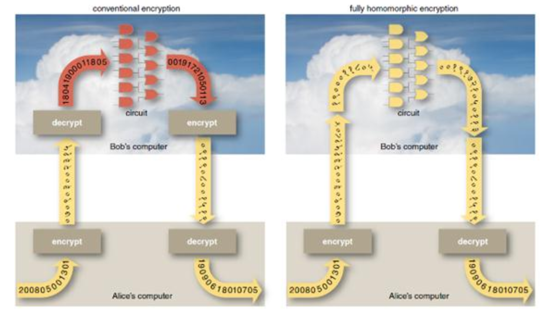
conventional encryption scheme VS fully homomorphic scheme

Slide 8
HE MatMul complexity

Slide 9
Data morphism
$$\overline{a} ≡Dec\left(P\left(\overline{A}\right)\right)$$
$Enc\left(\overline{a}\right)≡P\left(\overline{A}\right) ∈ {ℤ_{Q}\left(X\right)}/{\left(X^{N}+1\right)}=$ $A_{0}X^{0}+A_{1}X^{1 }+ …+A_{N−1}X^{N−1}$
PV-20
PP-21
$$\overline{a}$$
n
$P\left(\overline{A}\right)≡$ $\overline{A}$
N
Enc
Dec
$$μ{ }$$
$$\log{\text{Q} }$$
$N \sim 2^{16}$Q$\sim 2^{2048} μ \sim 64$n$≤N/2$
PT-23
Notes:
Parallel vector machine operates only on vectors – plaintext, message
Parallel Polynomial HE machine operates only on vectors - polynomials - crypto text
Enc/Dec bi-directional map hiding gory details of HE protocol
cyclotomic polynomial ring finite field order Q
If N fixed n is also fixed, the cost is the same

Slide 10

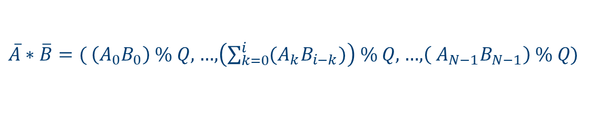
pP-21 Multiply
PP-21
$P\left(\overline{A}\right) ∗P\left(\overline{B}\right){= conv\left(\overline{A},\overline{B}\right)}_{\%Q}= {P\left(\overline{A}∗\overline{B}\right)}_{\%\left(X^{N}+1\right)}=P\left(\overline{C}\right)$
BigInt
mul
$$\overline{A}=\left(A_{0},A_{1}, …, A_{N−1}\right),\overline{B}=\left(B_{0},B_{1}, …, B_{N−1}\right)$$
$\overline{A}∗\overline{B}=($ $\left(A_{0}B_{0}\right) \% Q,$…,$\left(\sum_{k=0}^{i}{{(A}_{k}B_{i−k}})\right) \% Q,$ …,$\left({ A}_{N−1}B_{N−1}\right) \% Q$)
$P\left(\overline{C}\right)$ = $P\left(\overline{A}∗\overline{B}\right) \% \left(X^{N}+1\right)$
BigInt
add
Complexity: $≈\text{O}\left(N^{2} ∗Complexity( \text{BigInt} \text{mul})\right)$
Notes:
Let’s ignore mod X^N + 1 for a moment

Slide 11





BigInt representation
PT-23
L= qLimbs = $\log{Q}/μ$
$$μ$$
$μ$ - # of bits, native machine word
BigInt
$\log{Q}$- # of BigInt bits
$$\log{Q}$$

Slide 12

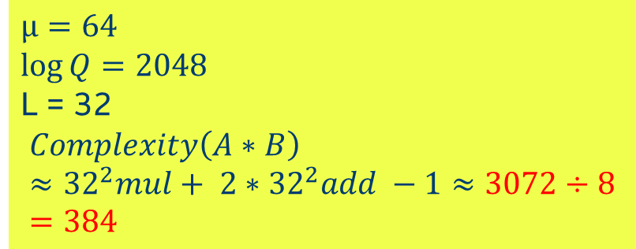

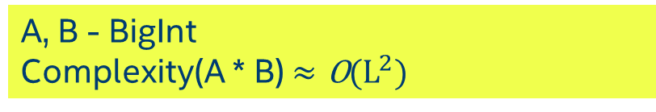



PT-23 BigInt MUL
A, B - BigInt
Complexity(A * B) ${≈\text{O}\text{(}\text{L}}^{2})$
PT-23
L =qLimbs = $\log{Q}/μ$
$$μ=64$$
$$\log{Q}=2048$$
L = 32
$$Complexity\left(A∗B\right)≈{32}^{2}mul+ {2∗32}^{2}add −1≈3072÷8=384$$
$$μ$$
$μ$ - # of bits, native machine word
x
$$μ$$
BigInt
$\log{Q}$- # of BigInt bits
$$\log{Q}$$

Slide 13

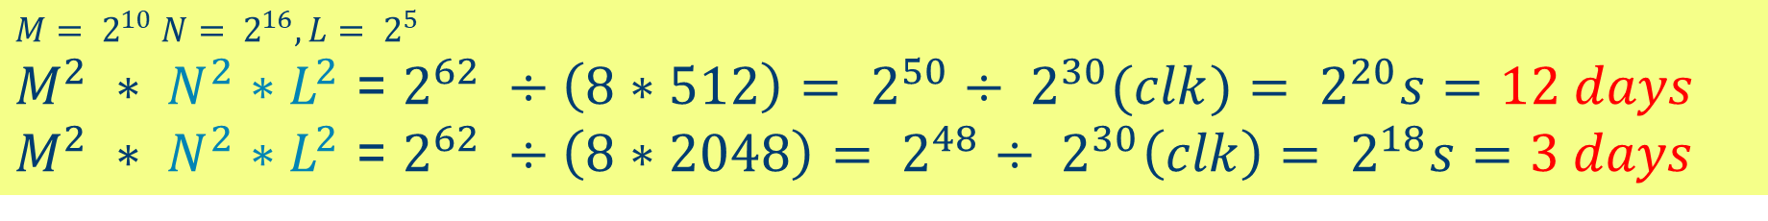
pT-23 HE matmul COMPLEXITY
Complexity of $P\left(\overline{A}\right) ∗P\left(\overline{B}\right)$: $≈\text{O}\left(N^{2} ∗Complexity(\text{BigInt} \text{mul}\text{)}\right)$
Complexity of BigInt (A * B) ${≈\text{O}\text{(}\text{L}}^{2})$
HE Mul Complexity: $≈\text{O}\left(N^{2}∗L^{2}\right)$
HE MatMul Complexity($M^{2}matrix)≈\text{O}\left(M^{2} ∗ N^{2}∗L^{2}\right)$
$$M= 2^{10} N= 2^{16}, L= 2^{5}$$
$M^{2} ∗ N^{2}∗L^{2}$ = $2^{62} ÷\left(8∗512\right)= 2^{50}÷ 2^{30}(clk)= 2^{20}s=12 days$
$M^{2} ∗ N^{2}∗L^{2}$ = $2^{62} ÷\left(8∗2048\right)= 2^{48}÷ 2^{30}\left(clk\right)= 2^{18}s=3 days$
Bandwidth: $2^{16}∗2^{11}÷2^{3}=$16MB per row $∗{2∗2}^{10}=$ 32GB / 500 = 64ms

Slide 14
pT-23. How to tackle HE MatMul Complexity?
$$≈\text{O}\left(M^{2} ∗ { N}^{2} ∗{ L}^{2}\right)$$
CRT/iCRT
NTT/iNTT
Strassen
Notes:
How to deal with the complexity?

Slide 15
CRT-RNS ops

Slide 16
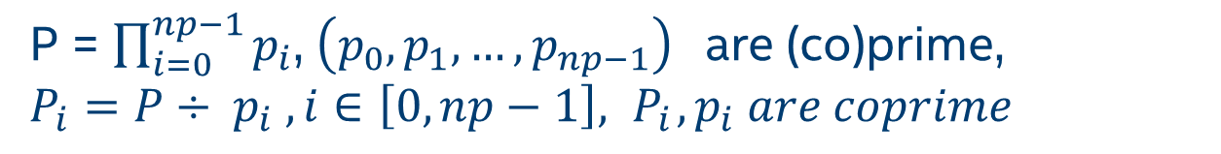
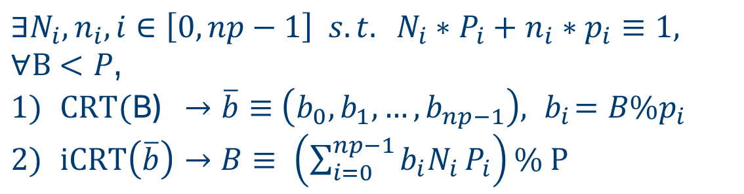
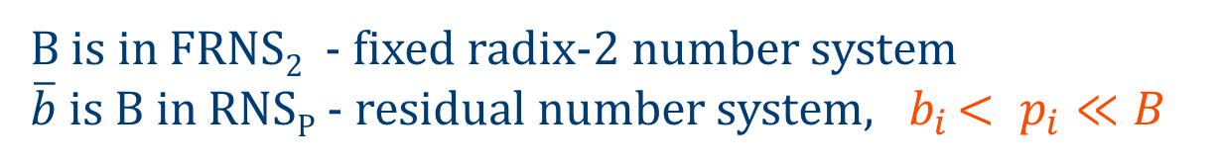
CRT transform
Chinese remainder theorem (the 3rd century AD)
P = $\prod_{i=0}^{np−1}{p_{i}}$, $\left(p_{0},p_{1},…,p_{np−1}\right) \text{are}\text{ (}\text{co}\text{)}\text{prime}\text{,}$
$$P_{i}=P÷ p_{i} , i∈\left[0,np−1\right], { P}_{i},p_{i} are coprime$$
$$∃N_{i},n_{i}, i∈\left[0,np−1\right] s.t. N_{i}∗P_{i}+n_{i}∗p_{i}≡1,$$
$∀B$ $<P$,
$CRT($B) $→\overline{b}≡$ $\left(b_{0},b_{1},…,b_{np−1}\right),{ b}_{i}=B\%p_{i}$
$iCRT\left(\overline{b}\right)→B≡ \left(\sum_{i=0}^{np−1}{b_{i}N_{i}}P_{i}\right)\% P$
B is in FRNS₂ - fixed radix-2 number system
$\overline{b}$ is B in RNS_{P} - residual number system, ${ b}_{i }< p_{i}≪B$
Notes:
P is a product of ps
Pi is a reminder P/pi
gcd - Greatest Common Divisor
Extended Euclidean algorithm

Slide 17
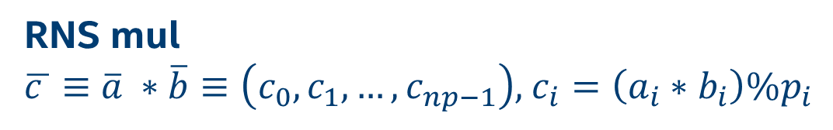

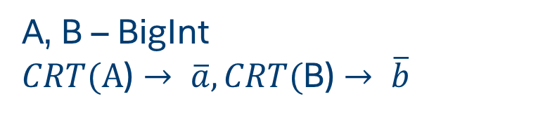

RNS mul/ADD
A, B – BigInt
$CRT(\text{A}\text{)}→ \overline{a}, CRT($B) $→ \overline{b}$
RNS mul
$\overline{c }≡$ $\overline{a} ∗\overline{b}≡\left(c_{0},c_{1},…,c_{np−1}\right)$, $c_{i}=\left({a_{i}∗b}_{i}\right)\%p_{i}$
RNS add
$\overline{c }≡$ $\overline{a}+\overline{b}≡ \left(c_{0},c_{1},…,c_{np−1}\right)$, $c_{i}=\left({a_{i}+b}_{i}\right)\%p_{i}$
$iCRT(\overline{c }$) $→$ C = (A * B)
Notes:
A,B, C in FRNS
a, b, c = a*b in RNS
Both mul and add can be done over a,b vectors in parallel

Slide 18
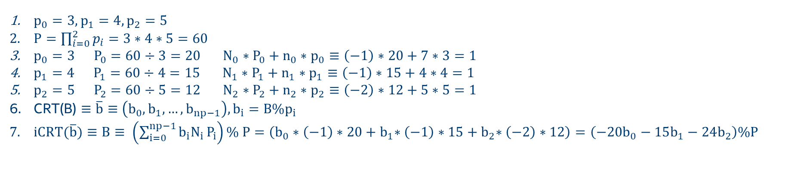
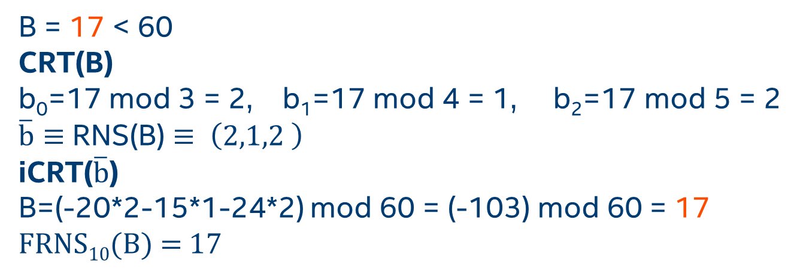
CRT transform EXAMPLE
$p_{0}=3,p_{1}=4,p_{2}=5$
$P=\prod_{i=0}^{2}{p_{i}=3∗4∗5=60}$
$p_{0}=3 P_{0}=60÷3=20 N_{0}∗P_{0}+n_{0}∗p_{0}≡\left(−1\right)∗20+7∗3=1$
$p_{1}=4 P_{1}=60÷4=15 N_{1}∗P_{1}+n_{1}∗p_{1}≡\left(−1\right)∗15+4∗4=1$
$p_{2}=5 P_{2}=60÷5=12 N_{2}∗P_{2}+n_{2}∗p_{2}≡\left(−2\right)∗12+5∗5=1$
CRT(B) $≡\overline{b}≡$ $\left(b_{0},b_{1},…,b_{np−1}\right),b_{i}=B\%p_{i}$
$iCRT(\overline{b})≡B≡ \left(\sum_{i=0}^{np−1}{b_{i}N_{i}}P_{i}\right)\% P=\left(b_{0}∗\left(−1\right)∗20{+ b}_{1}∗\left(−1\right)∗15{+ b}_{2}∗\left(−2\right)∗12\right)=\left(−20b_{0}−15b_{1}−24b_{2}\right)\%P$
B = 17 < 60
CRT(B)
b₀=17 mod 3 = 2, b₁=17 mod 4 = 1, b₂=17 mod 5 = 2
$\overline{b}≡$ RNS(B) $≡ \left(2,1,2 \right)$
iCRT($\overline{b}$)
B=(-20*2-15*1-24*2) mod 60 = (-103) mod 60 = 17
FRNS₁₀(B) = 17
Notes:
Symbolic transform

Slide 19
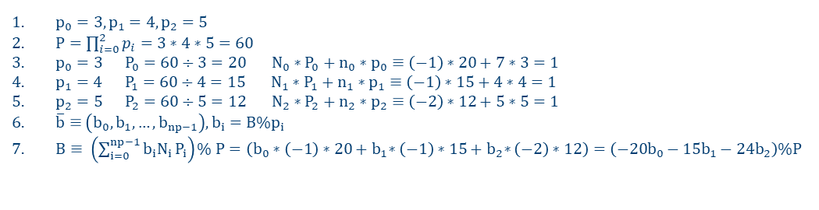
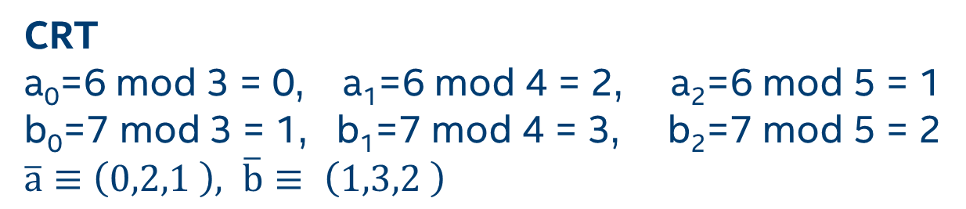
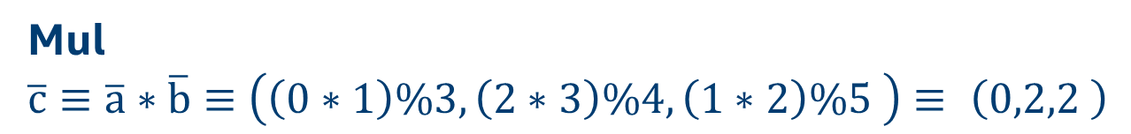
RNS MUL EXAMPLE
$p_{0}=3,p_{1}=4,p_{2}=5$
$P=\prod_{i=0}^{2}{p_{i}=3∗4∗5=60}$
$p_{0}=3 P_{0}=60÷3=20 N_{0}∗P_{0}+n_{0}∗p_{0}≡\left(−1\right)∗20+7∗3=1$
$p_{1}=4 P_{1}=60÷4=15 N_{1}∗P_{1}+n_{1}∗p_{1}≡\left(−1\right)∗15+4∗4=1$
$p_{2}=5 P_{2}=60÷5=12 N_{2}∗P_{2}+n_{2}∗p_{2}≡\left(−2\right)∗12+5∗5=1$
$\overline{b}≡$ $\left(b_{0},b_{1},…,b_{np−1}\right),b_{i}=B\%p_{i}$
$B≡ \left(\sum_{i=0}^{np−1}{b_{i}N_{i}}P_{i}\right)\% P=\left(b_{0}∗\left(−1\right)∗20{+ b}_{1}∗\left(−1\right)∗15{+ b}_{2}∗\left(−2\right)∗12\right)=\left(−20b_{0}−15b_{1}−24b_{2}\right)\%P$
A, B = 6, 7 < 60, 6*7=42
CRT
a₀=6 mod 3 = 0, a₁=6 mod 4 = 2, a₂=6 mod 5 = 1
b₀=7 mod 3 = 1, b₁=7 mod 4 = 3, b₂=7 mod 5 = 2
$\overline{a}≡$ $\left(0,2,1 \right), \overline{b}≡ \left(1,3,2 \right)$
Mul
$\overline{c}≡\overline{a}∗\overline{b}≡$ $\left(\left(0∗1\right)\%3,\left(2∗3\right)\%4, \left(1∗2\right)\%5 \right)≡ \left(0,2,2 \right)$
iCRT
C=(-20*0-15*2-24*2) mod 60 = (-78) mod 60=42
Notes:
Modulo ops are independent and parallizable

Slide 20
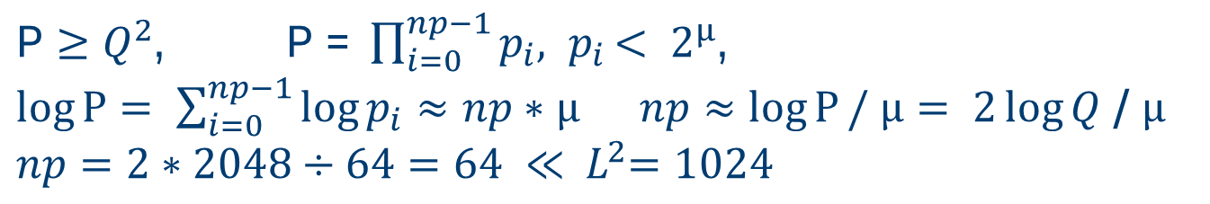
PT-23 RNS mul complexity/cost
$\text{P}≥Q^{2}$, $\text{P}\text{ = }\prod_{i=0}^{np−1}{p_{i}{, p}_{i}< 2^{μ}\text{,}}$
$\log{P}= \sum_{i=0}^{np−1}{\log{p_{i}}}≈np∗μ np≈\log{P}/ μ= 2\log{Q}$ / $μ$
$$np=2∗2048÷64=64 ≪{ L}^{2}=1024$$
A, B – BigInt
Complexity C= (A * B)$≈O\left(np\right)≈2\log{Q}$ / $μ$ = 4096/64 = 64/8 = 8
MutMul: 16X speedup, only 300min ☺
Real cost of C = A*B: (CRT(A) + CRT(B) + CRTmul + iCRT($\overline{c}$))
To avoid the transform overhead stay in RNS.
Notes:
Keep int mostly in RNS and do %p all the time

Slide 21
“instructions”

Slide 22
GENERIC NATIVE INTEGER modulo multiply, add OPS
source/destination/modulo type | bit length (?)
D26, D, Q52, Q | D26 - 26, D – 32, Q52 - 52, Q - 64
MMUL
for ( n = 0; n < exec_size; n++ ) {
if ( WrEn.chan[n] ) {
temp.chan[n] = (src1.chan[n] * src2.chan[n]) % src0.chan[n];
dst.chan[n] = temp.chan[n]
}
}
MADD
for ( n = 0; n < exec_size; n++ ) {
if ( WrEn.chan[n] ) {
temp.chan[n] = (src1.chan[n] + src2.chan[n]) % src0.chan[n];
dst.chan[n] = temp.chan[n]
}
}
Notes:
What bit length? Preferably to use both pipes

Slide 23
FAST MODULAR Arithmetic for RNS (Residual Number system)
Reduction: A mod p, where A < p^2
Barrett reduction:
1/p is approximated by 1/2^k,
2^k is a right shift.
(MS SEAL HE Lib)
Cheaper reduction with p in a special form:
Mersenne prime: 2^k-1,
Solinas prime: 2^a±2^b±1, 0<b<a,
Generalized Mersenne prime: f(2^m), f – low-degree polynomial.

Slide 24
conclusions

Slide 25

The first step to HE acceleration:
RNS significantly speedup BigInt arithmetic, the HE foundation.
HW proposals: native type modulo arithmetic.
Next steps:
NTT/iNTT algorithmic and HW acceleration: ($N^{2}→N\log{N})$, another 1000X speedup.
Back to the future: Strassen - MatMul with mul cost >> add cost.
Computational graphs to avoid transform (and other) costs.
HE scheme-dependent acceleration.

Slide 26
THANK YOU

