Slide 1
Estimating population dynamics using microsimulation
Notes:
Erdély
Hablicsek 2007
Mindenből magas-közepes-alacsony változat

Slide 2
Key Issues
Aging society (Life expectancies ▲ / Birth rates ▼)
Active workers ▼/ Pensioners ▲
Health care demand ▲
Pension system Income ▼/ Expenses ▲
Notes:
Most of the developed countries face the problems of an aging society.
This means that the life expectancies are increasing while the birth rates decrease.
In Hungary - just like in many European countries – the pension costs of an individual are covered by the currently working population.
And so, as the population ages, the ratio of active workers compared to pensioners continuously worsens, and this way the income of the pension system decreases along with the increase of its expenses.

Slide 3
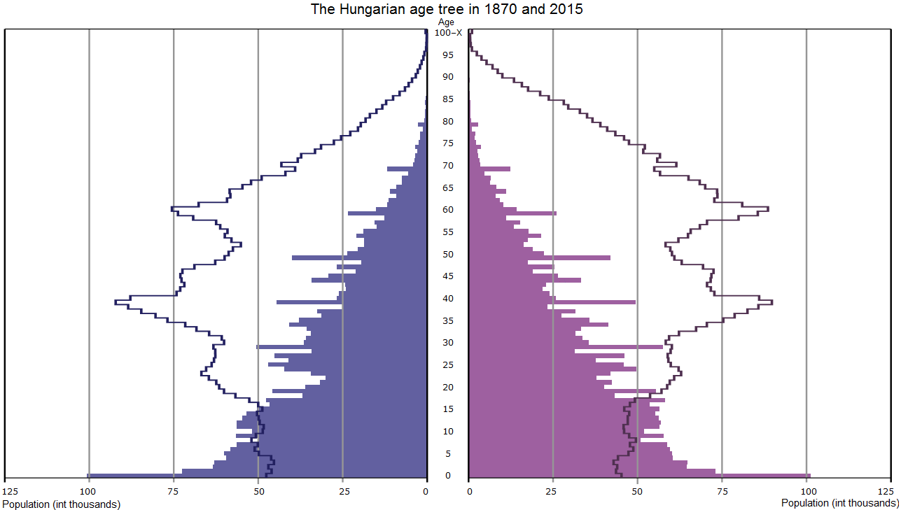
150 years of our pension system
2015
1870
Source: Hungarian Central Statistical Office
Notes:
The Hungarian pension system - even though it was slightly reformed in the past few years – is mainly based on the Pension System of Bismarck from 1870.
The pay as you go system worked perfectly at that time, but as you can see on the figure the age tree changed drastically in the last 150 years.
The triangle shape basically flipped upside down.
Currently the active population can barely sustain the pension system, and according to every single forecast, the situation worsens every year.
It is clear that the problems can not be solved by altering the parameters of the current pension processes.
It is necessary to rethink the whole system.

Slide 4
Pension and health care costs
GDP
Notes:
To underline the importance of the problem.
Let’s take a look at the following figure.
As you can see, the pension and health care costs take up a significant part of the Hungarian GDP, thus if the sustainability of these system is not secured, it could be a significant burden for the society.
That is why it is necessary to analyze the effects of changes in these systems.
It is important to note, that the pension costs are not homogeneous. They consist of different types of pensions, and more than a fourth of the costs are different from the standard age based pension. Significant changes could shift the proportions of these types, or maybe even eliminate some of them. It is for example a perfectly reasonable idea to reallocate the financing of the disability pensioners to the health care.
Some shifts in the proportions are even more justifiable in case of the health care system, where only 3 percent of the total costs is spent on prevention.
Such structural changes cause some rippling effects, that are impossible to include in macro level forecasts.

Slide 5
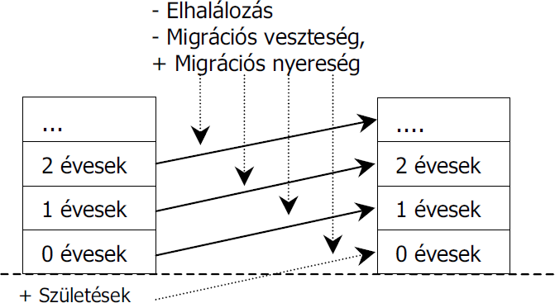
The Cohort Component Population Projection Method

Slide 6




Forecasted dataset
Year T
♂46
♀ 42
♂17
♂65
♀59
♂28
♀24
…
10.0 million
+
Year T+1
♂47
♀43
♂18
♂66
♀60
♂29
♀25
♂0
…
10.1 million
+
Year T+10
♂56
♀52
♂27
♀59
♂38
♀34
♂9
…
11.0 million
+
Year T+20
♂46
♀42
♂17
♂48
♀44
♂19
…
12.0 million

Slide 7
Forecasted dataset
Year T
♂46
♀ 42
♂17
♂65
♀59
♂28
♀24
…
10.0 million
+
Year T+1
♂47
♀43
♂18
♂66
♀60
♂29
♀25
♂0
…
10.1 million
+
Year T+10
♂56
♀52
♂27
♀59
♂38
♀34
♂9
…
11.0 million
+
Year T+20
♂46
♀42
♂17
♂48
♀44
♂19
…
12.0 million

Slide 8
Forecasted dataset
Year T
♂46
♀ 42
♂17
♂65
♀59
♂28
♀24
…
10.0 million
+
Year T+1
♂47
♀43
♂18
♂66
♀60
♂29
♀25
♂0
…
10.1 million
+
Year T+10
♂56
♀52
♂27
♀59
♂38
♀34
♂9
…
11.0 million
+
Year T+20
♂46
♀42
♂17
♂48
♀44
♂19
…
12.0 million

Slide 9
Forecasted dataset
Year T
♂46
♀ 42
♂17
♂65
♀59
♂28
♀24
…
+2.2m
+1.8m
-
3.2m
1.7m
2.4m
0m
…
Year T+1
♂47
♀43
♂18
♂66
♀60
♂29
♀25
♂0
…
2.4m
+2.2m
+1.8m
-
3.2m
1.7m
2.4m
0m
-
…
Year T+10
♂56
♀52
♂27
♀59
♂38
♀34
♂9
…
2.4m
+2.2m
+1.8m
-
3.2m
1.7m
2.4m
0m
-
Year T+20
♂46
♀42
♂17
♂48
♀44
♂19
…
+2.2m
+1.8m
-
3.2m
1.7m
2.4m
0m
-

Slide 10
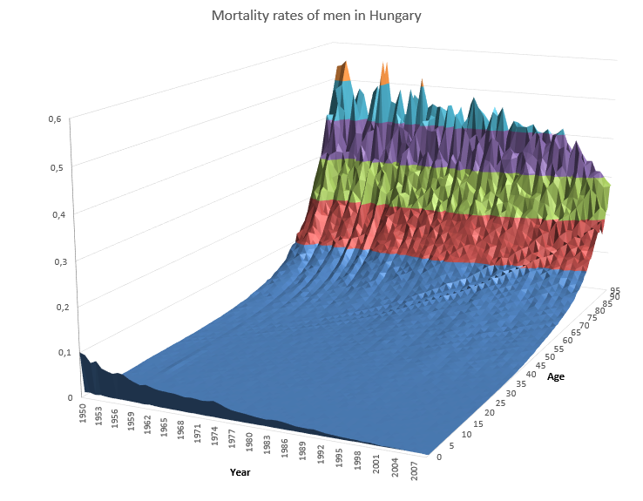
Probability
Notes:
This figure shows the mortality rates of men in Hungary from 1950.
The mortality rates are obviously influenced by the age of an individual.
Parameters usually represent events that for some reason we can not perfectly model. In this example we do not know the exact reasons of a persons death, but we can calculate the probability from statistical values.
Unfortunately - as you can see on the figure - most of the time these calculated values are time dependent, and this means that for the future iteration steps these parameters have to be estimated.

Slide 11
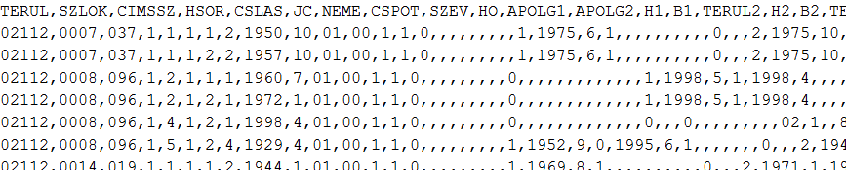

A kiinduló állomány
Statistical Matching eljárással összekapcsolva a
2004-es KSH Háztartási Költségvetés felvétel (HKF)
2005-ös Mikrocenzushoz tartozó Jövedelem felvétel
{
}
Súlyozott kutató adatállomány 25000 személy adataival
Notes:
279 változót mért a KSH

Slide 12
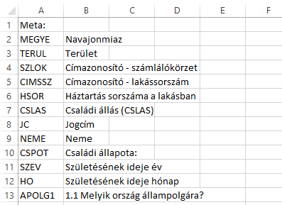
Metadata

Slide 13
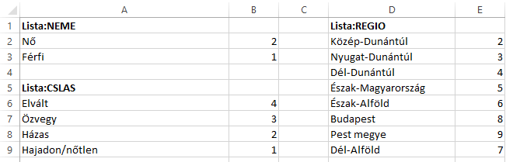
Metadata

Slide 14
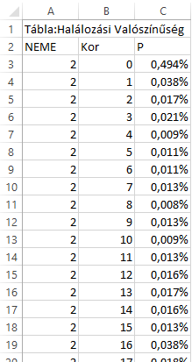
Parameter tables

Slide 15
Nómenklatúrák, metaadatok és paramétertáblák Excelben

Slide 16
Mortality tables
Probability of male mortality by age.

Slide 17
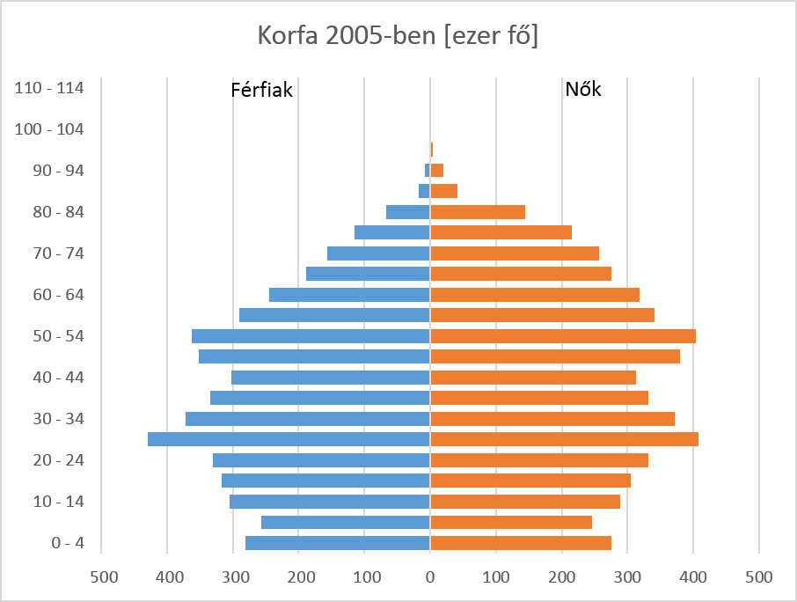
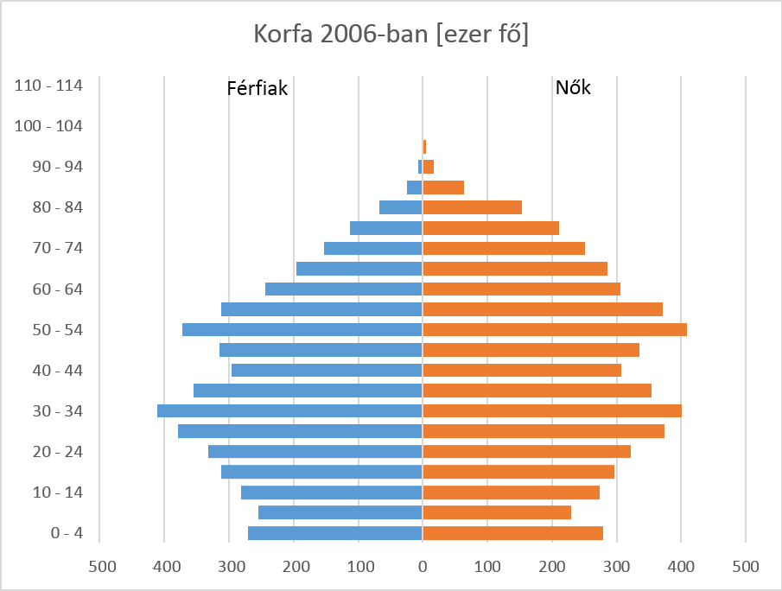
Age trees

