Slide 1
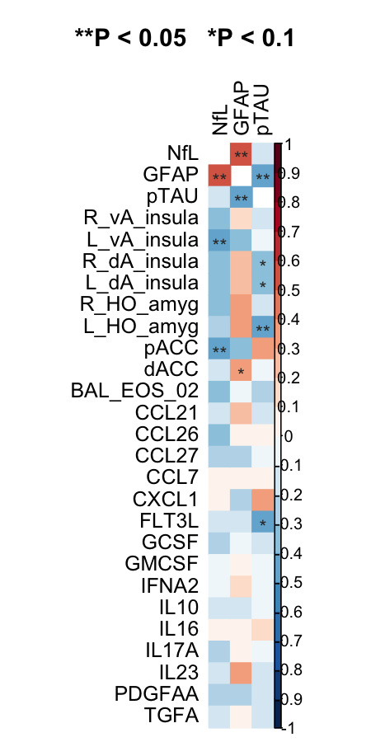
Pearson correlations of post minus pre
plasma biomarkers (NfL, GFAP, pTAU)
Against sPLS-selected gene module, protein cytokines, and fMRI measures

Slide 2
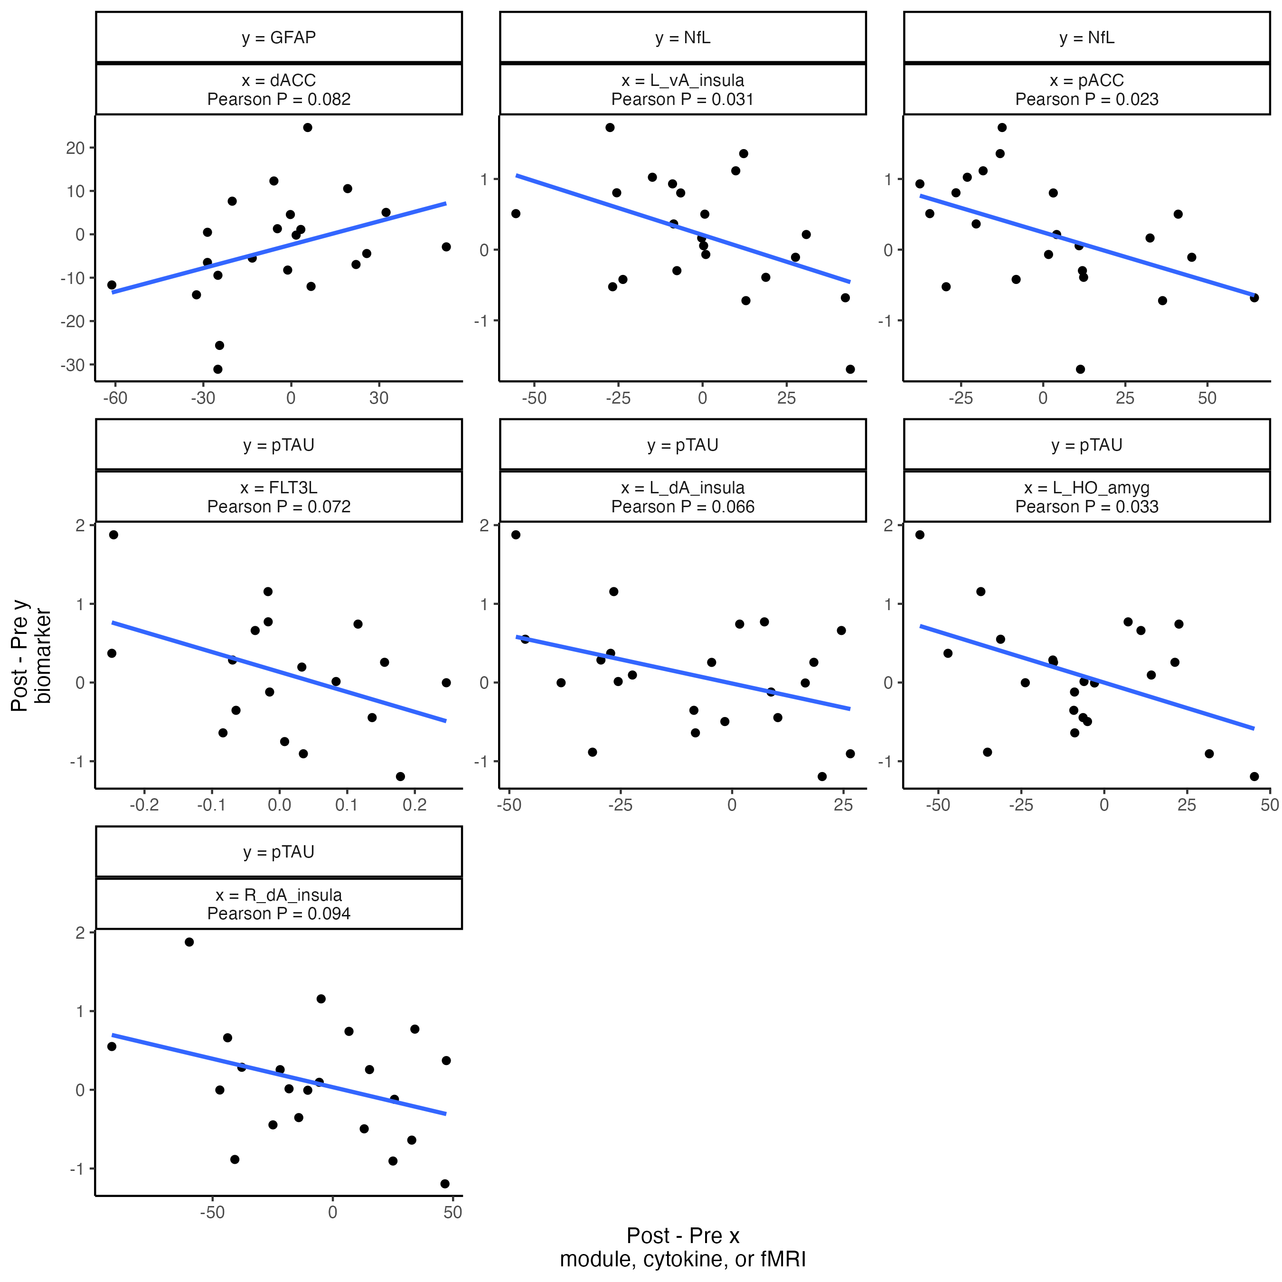
Dot plots of correlations with P < 0.1
Only pTAU is significantly correlated with a module or cytokine

Slide 3
Based on correlations, ran causal mediation for
FLT3L → pTAU → L dA insula
FLT3L → pTAU → L HO amyg
FLT3L → pTAU → R dA insula

Slide 4
53% of FLT3L’s effect is mediated through pTAU (P = 0.24)
FLT3L’s total effect P = 0.19
30% of FLT3L’s effect is mediated through pTAU (P = 0.14)
FLT3L’s total effect P = 0.02
148% of FLT3L’s effect is mediated through pTAU (P = 0.87)
FLT3L’s total effect P = 0.95
pTAU
pTAU
pTAU
Estimate = 36
P = 0.13
Estimate = 38
P = 0.13
Estimate = 73
P = 0.10
FLT3L
L dA insula
FLT3L
L HO amyg
FLT3L
R dA insula
Estimate = 32
P = 0.53
Estimate = 87
P = 0.09
Estimate = -68
P = 0.40
Maybe interesting. The total effect of FLT3L on L dA insula isn’t very significant but over 50% of that effect is mediated through pTAU.
Most interesting of the three. FLT3L’s total effect on L HO amyg is significant and roughly a third of that effect is mediated through pTAU.
Not valid because FLT3L and pTAU have different signs (+/-) for effects.

