Slide 1
PROJECT -CHÕRUS
Contributors: andrea, arthur, Nathan & Ayush

Slide 2
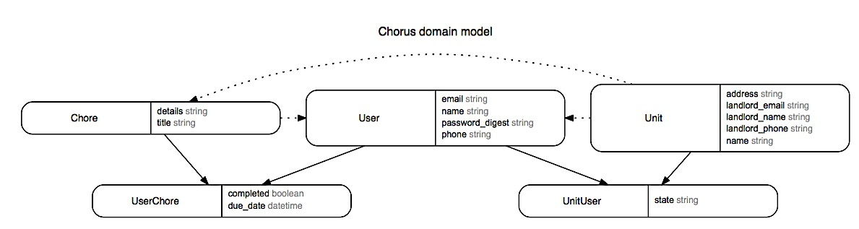
ERD MODEL

Slide 3
Technologies used
Ruby on Rails
Rails gems – (erd, friendlyID, cane, jQuery-ui, jQuery-rails)
PostgreSQL
jQuery
Turbolinks
Bootstrap & Bootswatch
Rspec
Sass
Heroku

Slide 4
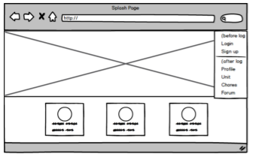
Wireframe – splash page
User is able to see the splash page with nav-bar
User is able to log-in / sign-up

Slide 5
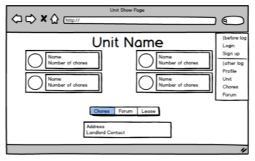
WIREFRAME – UNIT SHOW
Upon log-in/ sign-up, if user is part of a Unit, he/she is able to see the UNIT SHOW page
If a user is not a part of a unit, he/she can create or request to Join from UNITS index page.
UNIT consists of roommate info cards, link to CHORES INDEX & Unit info

Slide 6
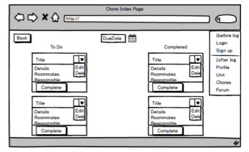
WIREFRAME – CHORES INDEX
User is able to see Completed/ Incomplete Chores & Due Date
The cards display the chore title & details and who the chore is assigned to
User is able to reassign each chore & edit the due date for all of the chores at once

Slide 7
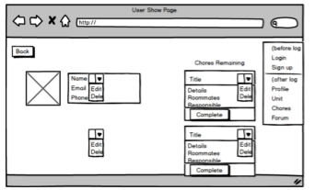
WIREFRAME – USER show page
User’s info with authorization required to Edit & Chores Show cards
Back link to User’s Unit Page

Slide 8

Thanks To…

Slide 9
Members
Heroku link: https://gentle-ocean-15832.herokuapp.com/
GitHub CHŌRUS repo: https://github.com/altonelli/chorus

