Slide 1
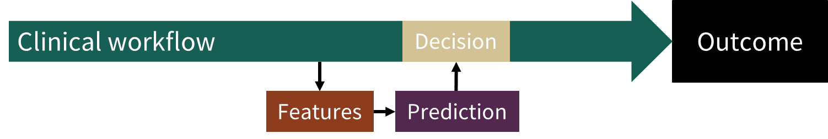
Designing supervised learning prediction models for successful clinical implementation
Alton Russell
McGill University
20 March 2023
Notes:
Talk about lessons learned from two ongoing peojects, with Vitalant Research Institute, a leading blood safety research center in San Francisco, and with Lucile Packard Children’s Hospital at Stanford

Slide 2
Case 1: Personalizing blood inter-donation interval
Background
U.S. blood donors can donate every 56 days, but some take longer to replenish iron
In 2017
> 600,000 prospective blood donors were deferred for low hemoglobin
2 – 5 million completed donations were from donors with low or absent iron stores
Donors vary in ability to replenish iron after donation due to biology, diet, and donation history
Objective
Predict individual donors’ risk of iron-related adverse outcomes at next donation attempt as a function of time since last donation
Personalize the inter-donation interval to each donor’s risk profile
Notes:
Assign each donor an inter-donation interval to MINIMIZE hemoglobin deferrals and taking blood from donors with low iron while MAXIMIZING the available blood supply.

Slide 3
Case 1: Prediction task
(1) Predict: Use a donor profile and time to next donation attempt to predict the risk of iron-related adverse outcomes at the next donation attempt.
(2) Recommend inter-donation interval: Use the prediction and a simple decision rule to assign an inter-donation interval to each donor
No adverse outcome
Minimize harms to blood donors while maximizing volume of collected blood
Whole blood donation
Next donation attempt
Hemoglobin deferral
t > 56 days
Low iron donation
Absent iron donation
Notes:
Using a research dataset from REDS-II, we trained a machine learning to use information available at the time a successful whole blood donation is completed to predict the outcome at the next attempt
We defined 4 outcomes: 1, 2, 3, 4
We then applied a simple decision rule to the predictions generated by the ML model to assign a personalized IDI, or the time that the donor’s risk of adverse outcomes has diminished enough for them to return for their next donation attempt.
This allows donors to return as soon as their risk is sufficiently diminished, maximizing protection for donors while minimizing threat to the blood supply

Slide 4
Case 2: Targeted follow-up to prevent chronic kidney disease after inpatient acute kidney injury
Background
At Lucile Packard Children’s Hospital, about 25% of ICU patients and 5% of floor patients experience acute kidney injury (AKI) during hospitalization
Some AKI survivors go on to develop chronic kidney disease (CKD)
Insufficient capacity to follow up with all AKI survivors
Objective
Predict risk of chronic kidney disease (CKD) 3-12 months after a hospitalization
Enroll highest-risk patients in new AKI survivors’ clinic for follow-up renal care
Notes:
We can’t follow up with ALL AKI survivors, but if we knew who were at greatest risk then we could follow up with SOME

Slide 5
Case 2: Prediction task
(1) Predict:
(2) Enroll: The highest-risk patients will be enrolled in a new AKI survivors’ clinic
Inpatient stay
3 – 12 months after discharge
AKI develops
CKD stage 3+ may or may not develop
At discharge, which AKI survivors will develop CKD in the next 3-12 months?
AKI = acute kidney injury; CKD = chronic kidney disease

Slide 6
Developing clinical risk prediction with supervised learning
Features
Train & validate: Learn a function mapping features to outcomes
Predicted Outcome
Labeled Outcome
Minimize difference
Features
Test: Make sure the model performs well on unseen data
Predicted Outcome
Labeled Outcome
Verify they’re close
Features
Implement: Use the model on unlabeled data to inform clinical decisions
Predicted Outcome
Inform Decision
Notes:
The basic procedure for developing an ML prediction algorithm is well known and widely accepted.
There are numerous excellent free online courses and bootcamps
Looking at disparity between # of published prediction models and # of models that have been implemented in clinical settings, it’s clear that mastering this process is not sufficient for successful implementation

Slide 7


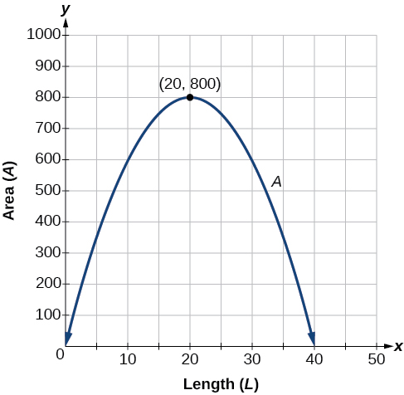
Zooming out
Features
Prediction
How do we evaluate the potential value of the prediction model?
Decision
Clinical workflow
Outcome
Decision
How does the prediction model fit into the clinical workflow?
Features
Prediction
How do we design for maximal utility (rather than just predictive ability)?
Notes:
Zooming out, 3 questions that the train/validate/test procedure does not address

Slide 8


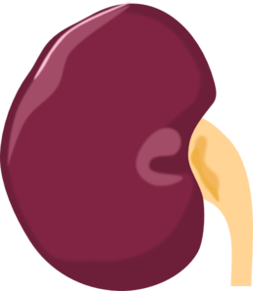
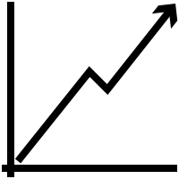
Outline
Background
Keys to successful implementation: Case studies:
Assess potential value
Design for the workflow
Maximize utility, not accuracy
Case study updates & takeaways
Managing blood donors’ risk of iron-related adverse outcomes through personalized inter-donation intervals
Identifying pediatric patients at risk of post-hospitalization chronic kidney disease for follow-up care

Slide 9
A model can add value when
Actionable intervention – intervening can change the outcome
Intervention creates value – intervening will improve health and/or save money
Expected value exceeds costs
Outcome would have happened
+ -
+
-
TP
FP
Predicted outcome would happen
Can calculate how good the model must be to add value
FN
TN
Notes:
If the patient really would experience an adverse event without intervention, correctly predicting that can have enormous value, and failing to intervene can have grave consequences
If we intervene on a patient who was never going to experience the adverse outcome, this is wasteful but often not too harmful
Correctly identifying a patient who will not experience the outcome is usually neutral or positve

Slide 10
Assessing value of CKD prediction model
Actionable intervention – enroll in AKI survivor’s clinic
Intervention adds value – Preliminary evidence of good outcomes from other centers
Expected value exceeds cost
Outcome would have happened
+ -
+
-
CKD managed or prevented
1-3 unnecessary outpatient visits
Predicted outcome would happen
CKD not prevented or detected early
No issues
Benefit of true positive >>>> harms of false positive or false negative
Suggests even modest predictive ability could add value

Slide 11
Engagement with clinicians and domain experts is key to assessing potential value!
Notes:
Nephrologist Scott Sutherland and Blood safety expert Brian Custer were essential to success of respective project.
Domain experts have knowledge needed to assess potential value
Walking through the process of assigning value to TP, FP, and so on, either rigorously or informally, is a valuable exercise

Slide 12
Outline
Background
Keys to successful implementation: Case studies:
Assess potential value
Design for the workflow
Maximize utility, not accuracy
Case study updates & takeaways
Managing blood donors’ risk of iron-related adverse outcomes through personalized inter-donation intervals
Identifying pediatric patients at risk of post-hospitalization chronic kidney disease for follow-up care

Slide 13
Designing for clinical workflow: When to run model?
Too early
Not enough data to make good prediction
Available data accumulating
Clinical workflow
Outcome
Opportunity to intervene shrinking
Too late
More costly, more difficult, or too late to modify outcome
‘Sweet spot’
Good features available
Outcome modifiable
Notes:
It’s possible that no sweet spot exists for your use case. Better to find out earlier.
Again, working with clinicians and domain experts is critical!

Slide 14
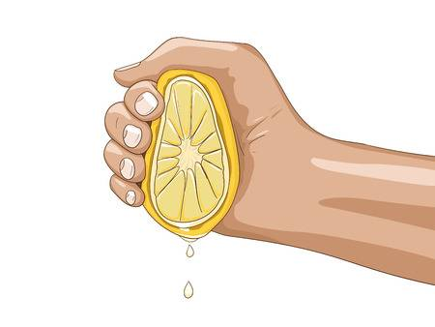
What features to use?
Available data accumulating
Clinical workflow
Outcome
Opportunity to intervene shrinking
‘Sweet spot’
Use features available for most patients at ‘sweet spot’
Be wary of collecting data just for your model
Increase cost of model
Barrier to implementation
Juice might not be worth the squeeze!

Slide 15
CKD prediction model
Available data accumulating
Inpatient stay
CKD?
Opportunity to intervene shrinking
Discharge
Predict at discharge
All inpatient data available, patient easily contacted for clinic enrollment
Serum creatinine only lab value used
Other labs not routinely collected for most patients

Slide 16
Personalized inter-donation intervals
Available data accumulating
Adverse donation outcome?
Last donation
Opportunity to intervene shrinking
Shortly after donation
Predict shortly after donation
Can communicate inter-donation interval recommendation with disease screening results
Train model without ferritin, sTfR
Excellent iron status indicators, but not routinely collected by blood centers

Slide 17
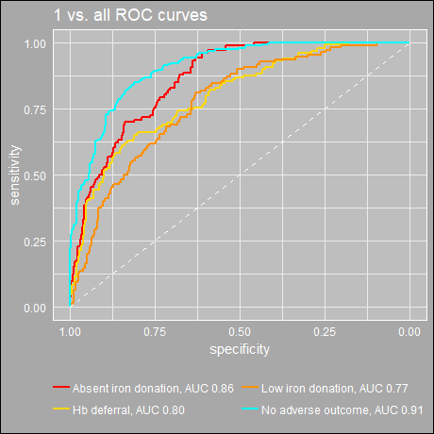
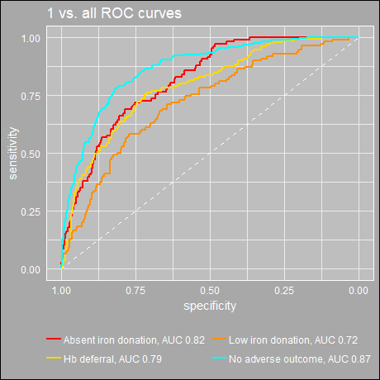
Assessing model performance without non-routine features
Does the performance boost of collecting non-routine features justify the cost?
ROC curves with ferritin and sTfR
ROC curves without ferritin and sTfR
Overall AUC (Hand 2001 method): 0.81
Overall AUC (Hand 2001 method): 0.76

Slide 18
Outline
Background
Keys to successful implementation: Case studies:
Assess potential value
Design for the workflow
Maximize utility, not accuracy
Case study updates & takeaways
Managing blood donors’ risk of iron-related adverse outcomes through personalized inter-donation intervals
Identifying pediatric patients at risk of post-hospitalization chronic kidney disease for follow-up care

Slide 19
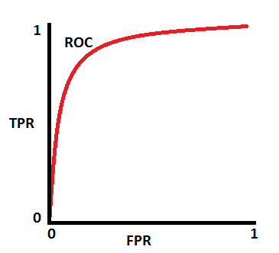
The decision threshold should maximize utility
Risk prediction scores often need to be converted into binary decisions
If risk > threshold, intervene
Typical ways to set threshold
Default to 0.5
Maximize measure of predictive ability (accuracy, F1 score, etc)
Threshold should be set in a way that maximizes utility
TP | FP
FN | TN
TP | FP
FN | TN
TP | FP
FN | TN
Points on ROC = possible decision thresholds
TP | FP
FN | TN
What threshold maximizes utility?

Slide 20
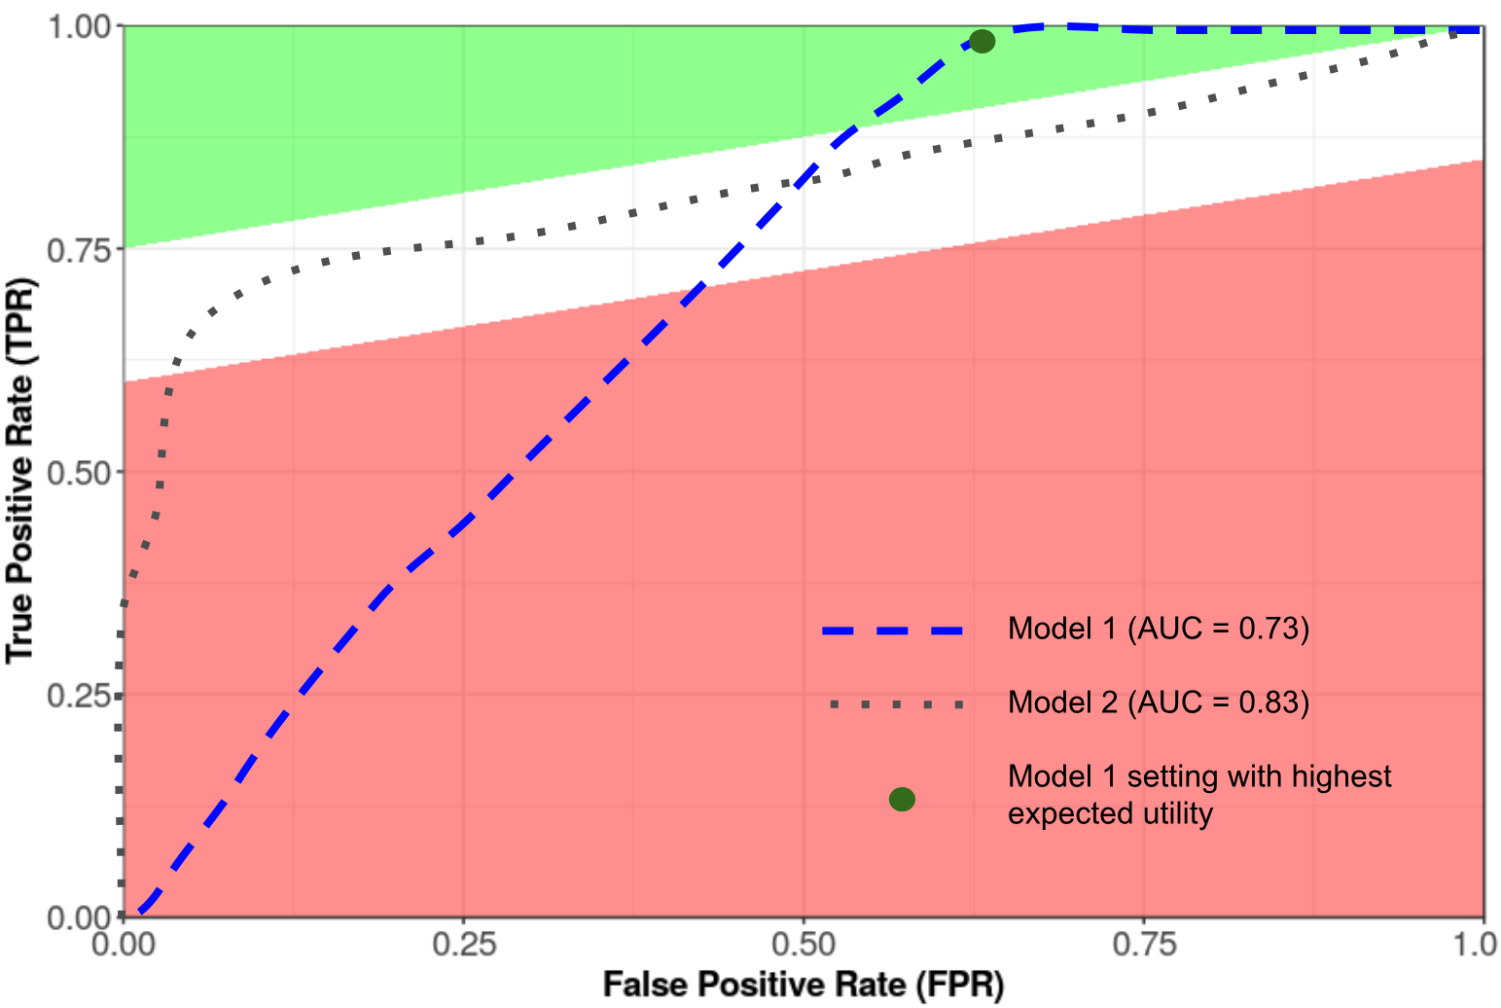
Model selection for maximal utility
Capacity constraints put lower bound on intervention threshold
Model with higher overall AUC might perform worse in the feasible region!
David Scheinker, Nigam Shah working paper
Notes:
Utility can be calculated using the 2-by-2 table shown earlier, for anywhere in the ROC space
Utility tends to increase as you get closer to a perfect prediction model (upper right corner of ROC space),
Often, net utility of testing will be negative if the prediction model is not good enough
When comparing models, its not necessarily true that point of maximum utility is on the model with the higher overall AUC

Slide 21
Maximizing utility: Case studies
Capacity limit
CKD prediction
Capacity constrained: Can only intervene in 5% riskiest patients due to limited spots in clinic
If increasing capacity is an option later, utility calculation would inform how many spots to open
Blood inter-donation intervals
Trade-off between longer intervals (collect fewer donations) and shorter intervals (adverse events more likely)
To do: work with blood center leadership to identify optimal trade-off
Utility-maximizing threshold

Slide 22
Outline
Background
Keys to successful implementation: Case studies:
Assess potential value
Design for the workflow
Maximize utility, not accuracy
Case study updates & takeaways
Managing blood donors’ risk of iron-related adverse outcomes through personalized inter-donation intervals
Identifying pediatric patients at risk of post-hospitalization chronic kidney disease for follow-up care

Slide 23
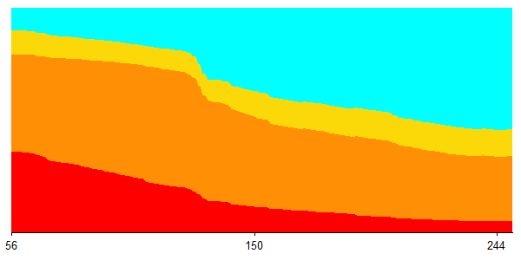
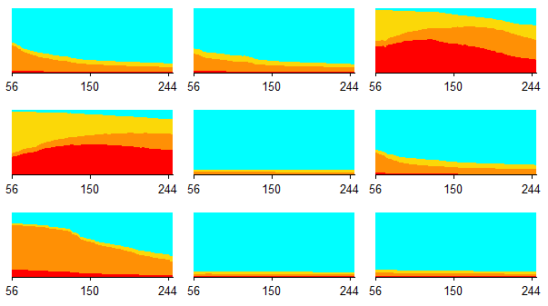
Update: Inter-donation interval
Individual donor risk over time
9 other test set donors
Tailored IDI
No adverse outcome
Probability of outcome
Low iron donation
Hemoglobin deferral
Absent iron donation
Days until next attempt
Simulated minimum IDI policy | Collections per 100 donor-years | Adverse outcomes per 100 donations
Status quo 56W-56M | 408 | 65
Canada 84W-56M | 377 (-8%) | 61 (-6%)
Tailored 0.2H-0.5L-0.4A | 379 (-7%) | 58 (-11%)
Australia 84W-84M | 335 (-18%) | 56 (-14%)
Tailored 0.2H-0.4L-0.2A | 339 (-17%) | 51 (-22%)
UK 112W-84M | 304 (-25%) | 52 (-20%)
Tailored 0.3H-0.6L-0.1A | 306 (-25%) | 45 (-31%)
Notes:
Decrease collections by 30%
Reduce ratio of Hb deferral : collected donations by 45%
Reduce ratio of low-iron donations : collected donations by 12%
Reduce ratio of absent-iron donations : collected donations by 73%
Proof of concept using research dataset that overrepresents high-risk donors
Presented in Switzerland at ISBT last month
Started convos with blood bankers in Denmark and South Africa and potential retraining and implementation there

Slide 24





Update: CKD prediction
Day 1
(admit)
SCr: 0.4 mg/dL
Day 2
SCr: 0.7 mg/dL
Day 3
SCr: 0.9 mg/dL
Day 4
SCr: 0.6 mg/dL
Day 5 (discharge)
SCr: 0.5 mg/dL
AKI stage = 0
AKI stage = 1
AKI stage = 2
AKI stage = 1
AKI stage = 0
Begin AKI treatment
End AKI treatment
Without model
AKI resolved by discharge, so no outpatient nephrology visits
With model
Risk score generated and sent to AKI survivor’s clinic
Highest-risk patients contacted and enrolled
Notes:
Epic cognitive layer

Slide 25
Takeaways
Algorithmic breakthroughs in individualized risk prediction have had limited impact on real-world clinical decisions
High predictive performance ≠ real-world utility
Assess potential value
Greater chance of successful implementation
Design for the workflow
Maximize utility
Notes:
Prediction isn’t fundamentally aimed at understanding the disease process but rather at informing individuals and assisting in decision-making.
The ultimate decision that is being informed should guide every step of the process from what you try to predict, what data you use to predict it, how you develop and validate your model, and how it is implemented in practice.

Slide 26
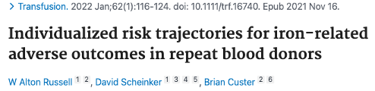
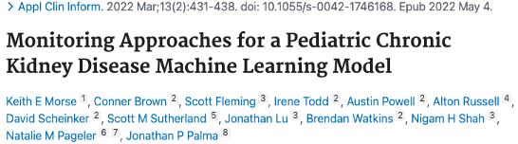
Thank you to co-authors!

