Slide 1
Net monetary benefit
(Net health benefit)
+
Cost-effective by worsens inequity
Cost-effective and improves equity
-
Net equity impact
+
Not cost-effective and worsens inequity
Not cost-effective buy improves equity
-

Slide 2
Net monetary benefit
(Net health benefit)
+
0
-

Slide 3
Net monetary benefit
(Net health benefit)
+
-
Net equity impact
+
-

Slide 4
Net monetary benefit
(Net health benefit)
+
Is the health benefit worth equity loss?
-
Net equity impact
+
Is the equity benefit worth the health loss?
-

Slide 5
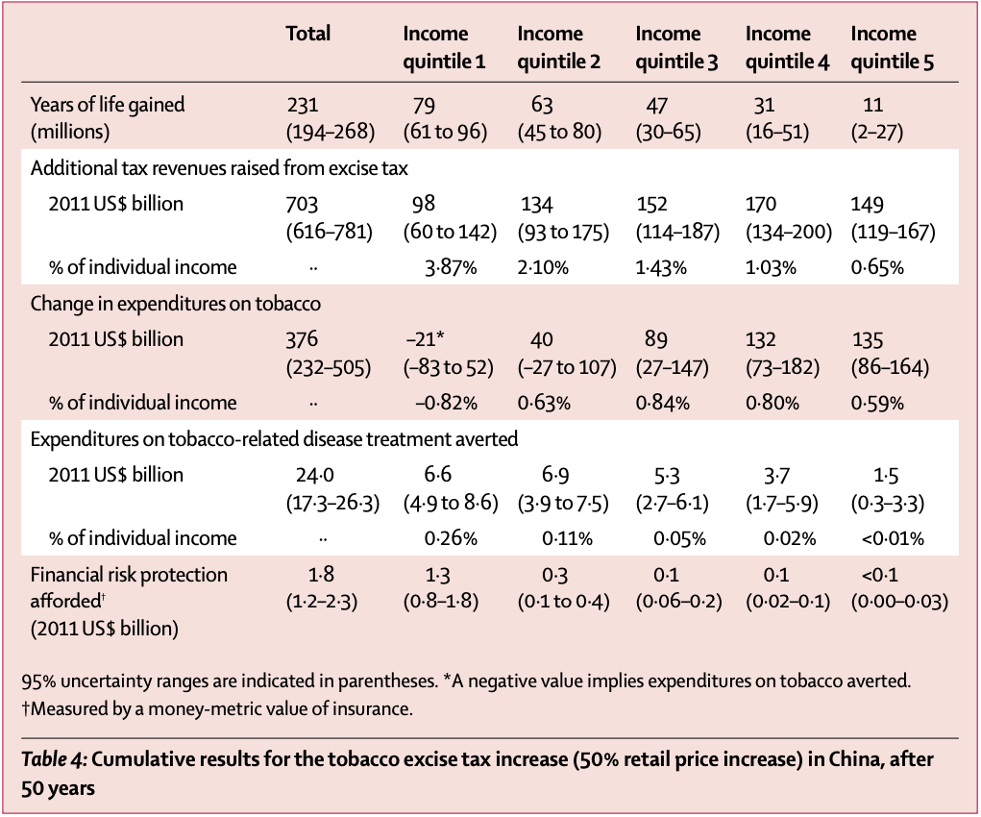
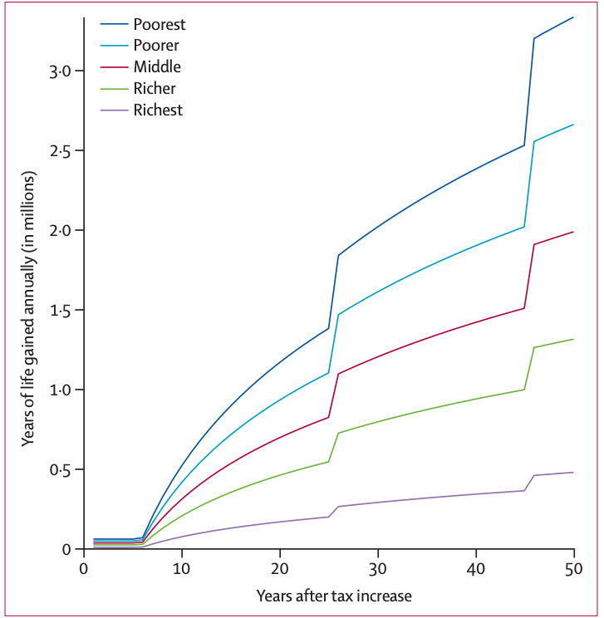

Slide 6
Net monetary benefit
(Net health benefit)
+
-
Net equity impact
+
-

Slide 7
Net monetary benefit
(Net health benefit)
+
-
Net equity impact
+
Foregone net monetary benefit
-

Slide 8
Net monetary benefit
(Net health benefit)
+
-
Net equity impact
+
-

