Slide 1
Integrating supervised machine learning and decision analysis W. Alton Russell, PhD Assistant Professor McGill School of Population and Global Health
EPIB 676, McGill University, 8 Oct 2024

Slide 2

Why does heterogeneity matter?
Traditional decision-analytic models focus on average outcomes
Increased interest in distributional outcomes across heterogeneous populations
Enable targeted intervention
Inform equity-related impact
Can also improve estimation of aggregate outcomes!
Source: pmlive.com

Slide 3
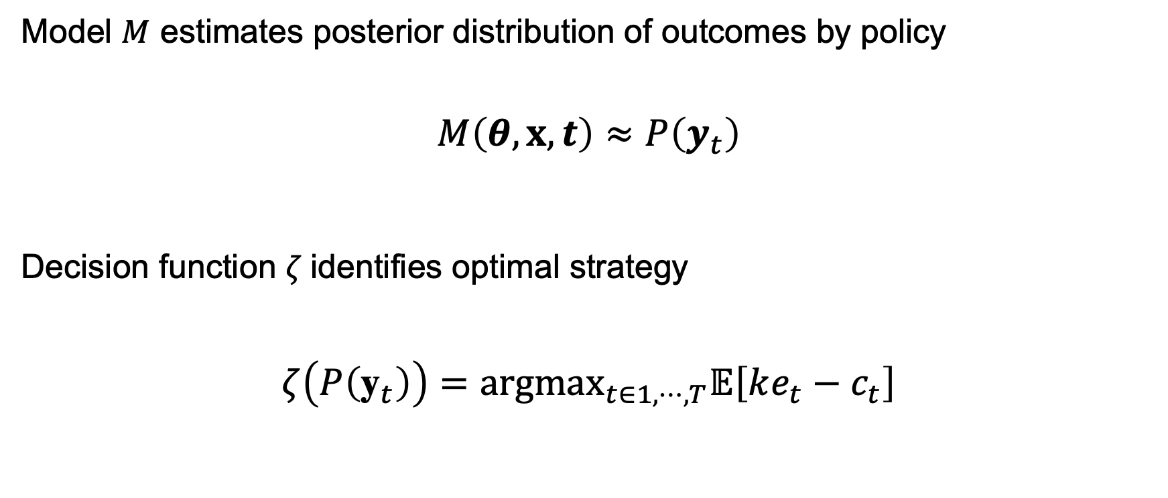
Traditional decision analysis setting
Model $M$ estimates posterior distribution of outcomes by policy
$$M\left(θ,x,t\right)≈P\left(y_{t}\right)$$
Decision function $ζ$identifies optimal strategy
$$ζ\left(P\left({\text{y}}_{t}\right)\right)={argmax}_{t∈1,⋯,T}𝔼\left[ke_{t}−c_{t}\right]$$
Parameters
Policies
Data (sometimes)
Outcomes by policy (multivariate)
Effectiveness
Cost
Maximize population net monetary benefit
Willingness to pay

Slide 4
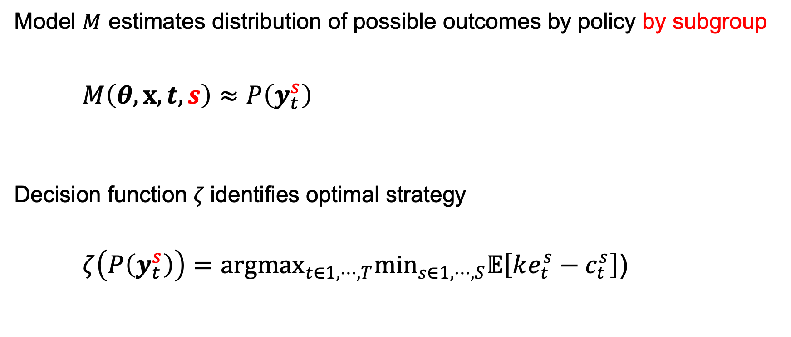
Decision analysis with subgroups
Model $M$ estimates distribution of possible outcomes by policy by subgroup
$$M\left(θ,x,t, s\right)≈P\left(y_{t}^{s}\right)$$
Decision function $ζ$identifies optimal strategy
$$ζ\left(P\left(y_{t}^{s}\right)\right)={argmax}_{t∈1,⋯,T}\min_{s∈1,⋯,S}𝔼\left[ke_{t}^{s}−c_{t}^{s}\right]\text{)}$$
Parameters
Policies
Still hard ☹️
State space explosion
Parameter estimation challenges
Data (sometimes)
Sub-groups
Outcomes by policy by subgroup
Substantial progress 🙂
Maximize net monetary benefit in worse-off subgroup

Slide 5
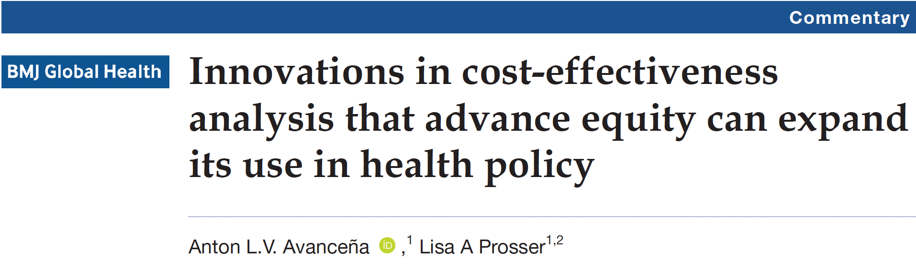
Equity-informative decision analytic frameworks
Distributional cost-effectiveness
Extended cost-effectiveness
Multi-criterion decision analysis
Ex poste equity weighting
Alternatives to quality-adjusted life year
Equal value of life years gained
Health years in total
⚠️ Presuppose subgroup heterogeneity in outcomes accurately estimated ⚠️

Slide 6
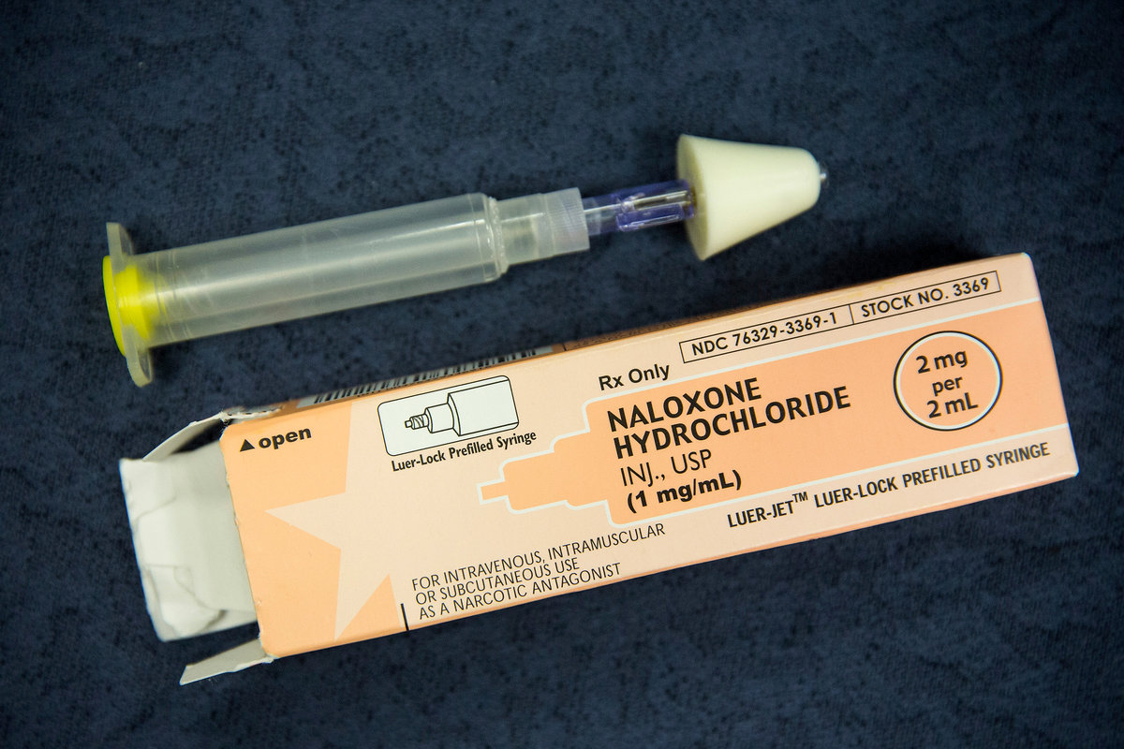
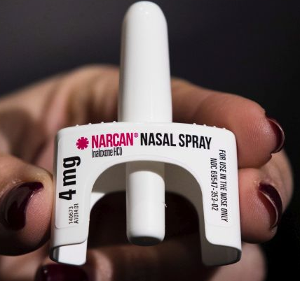
Naloxone reverses overdose (OD)
Take-home naloxone (THN) reverses witnessed and recognized opioid overdoses
Cost-saving for people using illicit opioids
Co-prescribing with prescription opioids recommended by CDC and in several US states for those at “high OD risk”
Who is high risk? Inconsistent definitions
ANDREW BURTON/GETTY IMAGES
THE CANADIAN PRESS/AP-Matt Rourke
OD: overdose, THN: take-home naloxone

Slide 7
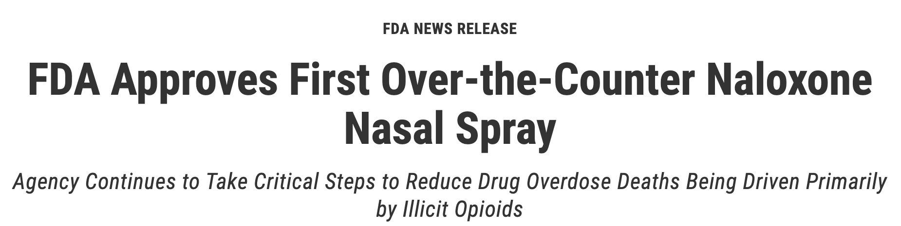
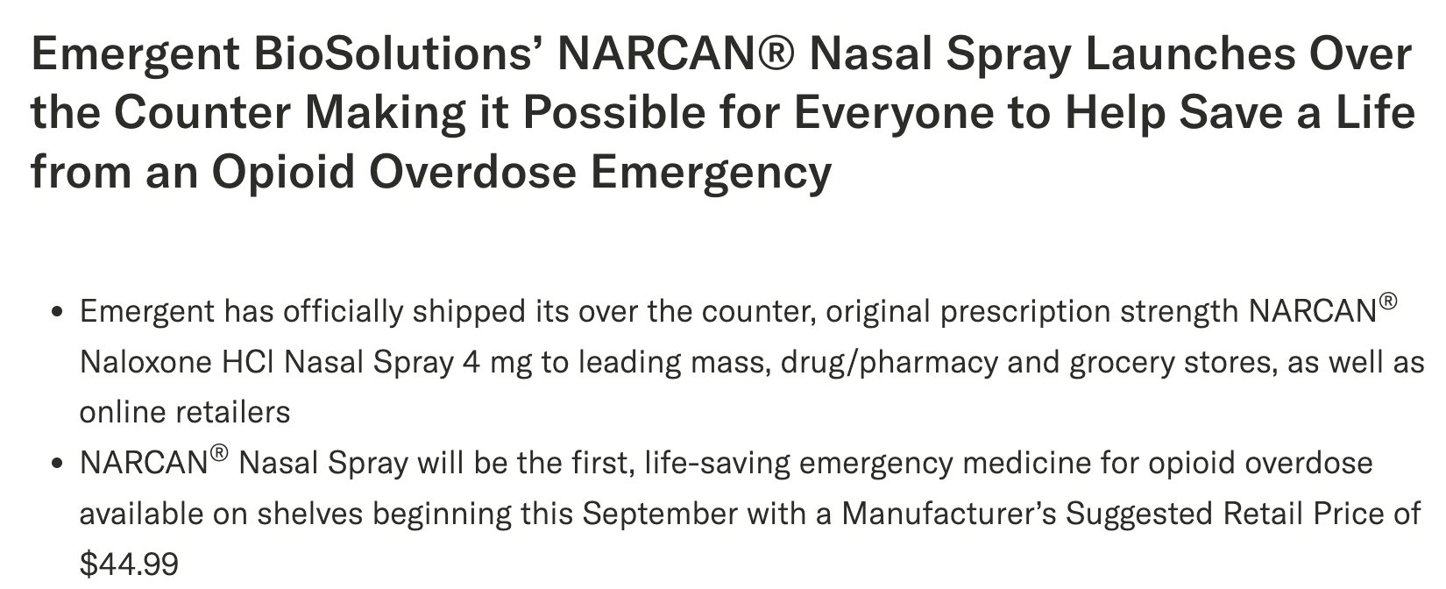

Mar 29, 2023
Aug 30, 2023
Sep 6, 2023

Slide 8

Objective
Use simulation to estimate:
Impact of THN on 2-year OD rate for patients prescribed opioids by OD risk indicator
Cost-effectiveness of THN by price
Past
$125
Present
$45
Future
$36
OD: overdose, OTC: over the counter, THN: take-home naloxone

Slide 9
Longitudinal patient-level data (IQVIA)
Drugs: all dispensed drugs for random sample of patients dispensed opioid analgesics Oct. 2018 – Sept. 2021
Construct opioid episodes, identify “risk indicator” drugs
Diagnoses: all diagnoses for linked patients
Identify diagnosed overdoses, identify “risk indicator” conditions
Demographics: age, sex, race
Strength: large, multi-payer dataset
Limitation: no data on death, including fatal overdoses

Slide 10
Method overview
Construct opioid episodes
Select cohort
Classify risk indicators
Predict diagnosed overdoses
Impute undiagnosed overdoses
OD rates by risk indicator?
Simulate outcomes with naloxone
Cost-effectiveness by price?
Cohort analysis
Policy simulation
OD: overdose

Slide 11
Construct opioid episodes
Series of opioid prescriptions with no gaps of >30 days in supply
“Carryover” accounts for overlapping days supplied
W days
Medication carryover
t
W days
Episode duration
For patients with complete data, used 1st episode Oct 2018 – Sep. 2019
3.99 million episodes; 3.98 without dispensed pharmacy naloxone

Slide 12
Definitions
2 years before episode start
Episode start
2 years after episode start
Diagnosis or drug indicating risk
Episode end
Naloxone dispensed (excluded from simulation)
Outcome: Opioid Overdose

Slide 13
Identify risk indicators
Drug-related (17)
Long term (not used in policy simulation)
High dose
Antipsychotic
Stimulant
Anti-depressant
Anxiolytic
MOUD (medication for opioid use disorder)
Mood stabilizer
Clonidine
Antiseizure
Benzodiazepine
Barbiturates
Pregabalin
Muscle relaxant
Gabapentin
Z-drug
Prazosin
Diagnosis-related (6)
Mental health
Nicotine dependence
Substance use
Severe mental health
Dementia
OD (overdose), poison, self-harm

Slide 14
Percent of patients with each risk indicator Overall and with overdose

Slide 15
Percent of patients with each risk indicator Overall and with overdose

Slide 16
Percent of patients with each risk indicator Overall and with overdose

Slide 17
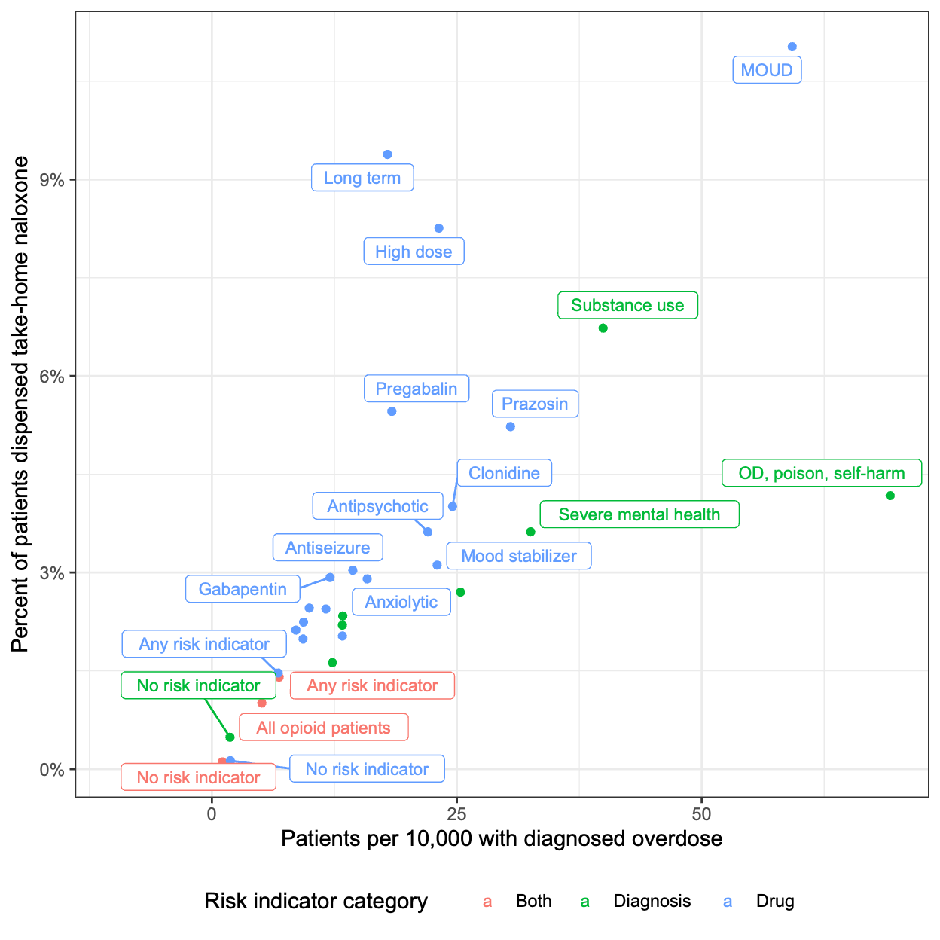
Take home naloxone vs. overdose rate
MOUD = medication for opioid use disorder
OD = overdose
Overall, 1% episodes had co-dispensed pharmacy THN

Slide 18
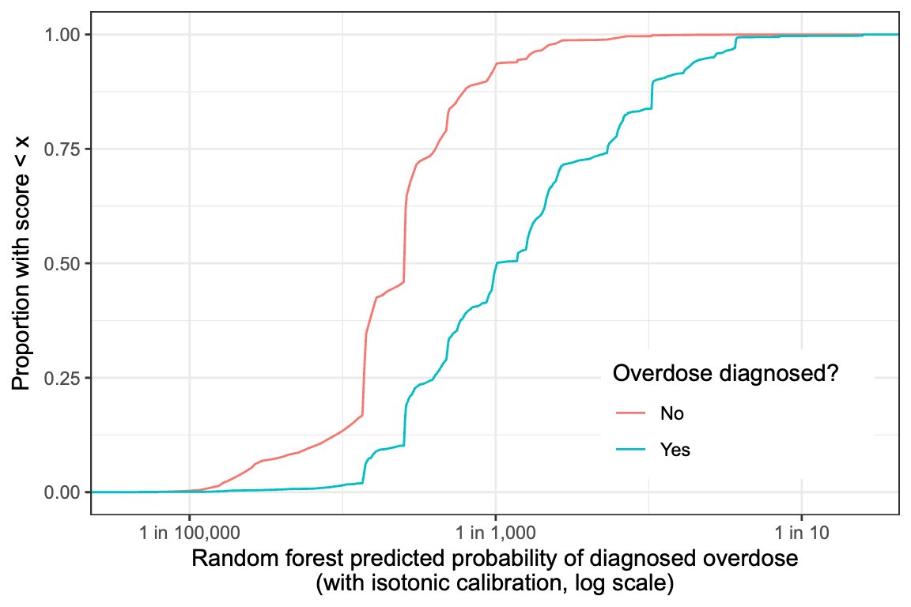
Diagnosed overdose prediction model
Used to assign risk of fatal ODs
(Assumption: risk factors for unobserved fatal OD and diagnosed OD similar)
Random forest model
Predictors: risk indicators, episode duration, age, sex, race, etc.
Out-of-sample AUC 82%
Good discrimination & probability calibration
OD: overdose

Slide 19
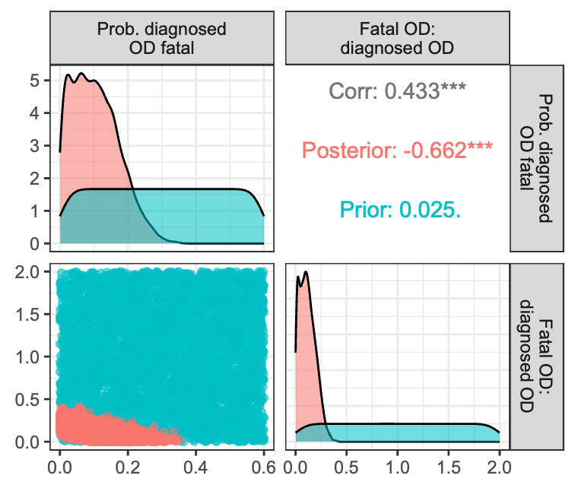
Imputing fatal ODs
Bayesian model calibration
Incremental mixture importance sampling
Used 2 calibration targets…
2-year rate of fatal OD
Ratio of fatal : non-fatal diagnosed overdose
…to generate sets of 2 parameters
Proportion of diagnosed ODs that ‘turn’ fatal
Ratio of fatal OD to diagnosed OD
OD: overdose

Slide 20
Policy simulation assumptions
THN can avert fatal overdoses within 2 years
THN used when
Overdose witnessed 40% to 80% probability
THN available 30% to 50% probability
Bystander uses it 62% to 92% probability
If used
Prevents fatal overdose 80% to 99.9% probability
THN: take-home naloxone

Slide 21
Health economic outcomes
Societal perspective (considers productivity impact)
Non-fatal overdose
Healthcare costs
Loss of quality-adjusted life year (1-5 days per OD)
Loss of productivity (0.2 to 20 days)
Fatal overdose
Loss of remaining expected QALYs (age-based)
Loss of remaining lifetime net productivity
OD: overdose, QALY: quality-adjusted life year

Slide 22
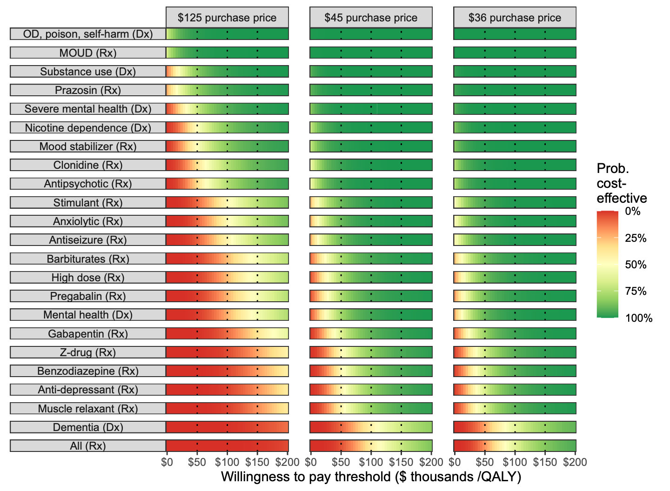
Cost-effectiveness by risk indicator
Price drop with OTC
Possible further price drop
At $100,000 per QALY:
THN now CE for most patients with OD risk indicator
Future price drop increase probability “THN for all Rx opioid patients” is CE from 40% to 62%
CE: Cost-effective, Dx: diagnosis, MOUD: medication for opioid use disorder, OD; overdose, Rx: drug, QALY: quality-adjusted life year
0.2%
40%
62%

Slide 23
As price drops, THN cost-effective for more risk indicators
Purchase price | Group for whom it’s cost-effective with probability > 50% at this price | N (%) patients
$200 | Nicotine dependence (Dx); Substance use (Dx); Severe mental health (Dx); OD, poison, self-harm (Dx); Mood stabilizer (Rx); MOUD (Rx); Prazosin (Rx) | 573 017 (14.5%)
$175 | Clonidine (Rx) | 635 217 (16.1%)
$172 | Antipsychotic (Rx) | 758 660 (19.2%)
$126 | Anxiolytic (Rx) | 947 371 (24.0%)
$125 | Stimulant (Rx) | 1 027 453 (26.0%)
$123 | Antiseizure (Rx) | 1 115 868 (28.2%)
$102 | Barbiturates (Rx) | 1 161 269 (29.4%)
$101 | High dose (Rx) | 1 233 761 (31.2%)
$100 | Mental health (Dx) Pregabalin (Rx) | 1 620 975 (41.0%)
$84 | Gabapentin (Rx) | 1 896 917 (48.0%)
$71 | Z-drug (Rx) | 1 976 756 (50.0%)
$70 | Benzodiazepine (Rx) | 2 243 645 (56.8%)
$69 | Anti-depressant (Rx) | 2 468 223 (62.5%)
$68 | Muscle relaxant (Rx) | 2 718 850 (68.8%)
$43 | Dementia (Dx) | 2 722 785 (68.9%)
$42 | All (Rx) | 3 950 701 (100.0%)
Dx: diagnosis, Rx: drug, MOUD: Medication for Opioid Use Disorder, THN: take-home naloxone

Slide 24
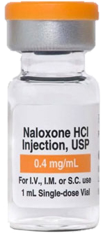
Take-aways
New over-the-counter price makes THN cost-effective for most prescription patients with OD risk indicator
At $45 we estimate:
Targeted THN cost-effective for nearly all risk indicators at $100,000/QALY
Untargeted THN may not be cost-effective
Limitations:
Does not consider access + affordability
Impact on insurance coverage? Availability through social programs?
Uncertainty could be reduced by
Better naloxone utilization data for patients prescribed opioids
Linked fatal OD data
Method take-away: combining cohort analysis, machine learning, & simulation can enable granular policy evaluation
OD: overdose, THN: take-home naloxone

